Slide 1
Module 1: Introduction
FALL PROTECTION FUNDAMENTALS

Slide 2
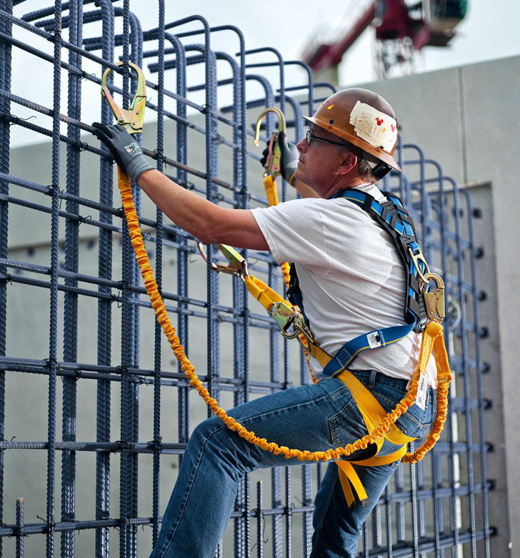
Disclaimer
Completing this course will help you understand the rules and some of the hazards related to fall protection. However, it is your employer’s responsibility to further your training where it is specific to your organization, such as permits, policies, and practices. This material should not be considered a substitute for any provisions of the Oregon Safe Employment Act, or for any standards issued by Oregon OSHA. Manufacturers, products, or services displayed in this material are for informational purposes only and do not constitute an endorsement by Oregon OSHA.
Module 1: introduction

Slide 3
Video: The Russ Youngstrom Story
Module 1: introduction

Slide 4
Fall Hazards
Fall hazards are present at almost every workplace.
Any walking/working surface can be a potential fall hazard.
Below are warning signs that can be printed off and used at your jobsite.
Fall Hazard Sign (English)
Fall Hazard Sign (Spanish)
Module 1: introduction

Slide 5
Video: Why Falls are Dangerous
Module 1: introduction

Slide 6
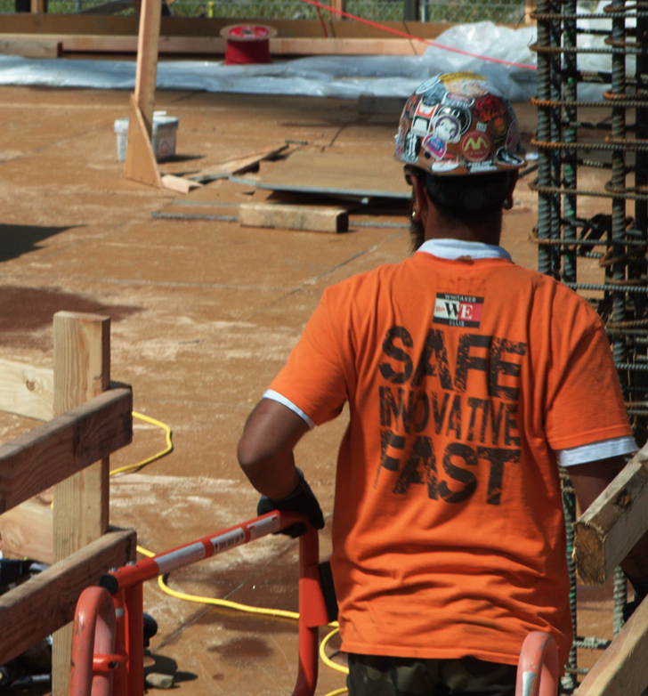
Fall Statistics
Fatal falls to a lower level in private construction increased from 255 in 2011 to 370 in 2016, a 45% increase.
In all other industries combined, the increase was 10%. Over the 6-year period, more than half the fatal falls to a lower level occurred in private construction.
U.S. Bureau of Labor Statistics
Module 1: introduction

Slide 7
Video: What is Fall Protection?
Module 1: introduction

Slide 8
Video: History of Fall Protection
Module 1: introduction

Slide 9
Video: Aftermath
Module 1: introduction

Slide 10
Accepted Claims
In 2017, there were 5,780 resolved claims in Oregon that were due to slips, trips, and falls. The average cost for these claims was $23,570.
Oregon Department of Consumer & Business Services
Module 1: introduction

Slide 11
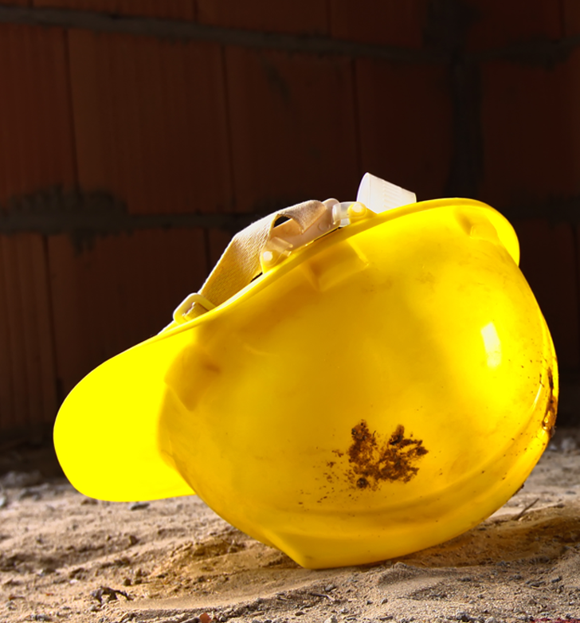
Accepted Claims
Below are a few categories of accepted disabling worker’s compensation claims from Oregon in 2018 due to falls to a lower level.
(405) From Ladders
(44) From Roofs
(38) From Scaffold
(128) Down Stairs
Oregon Department of Consumer & Business Services
Module 1: introduction

Slide 12
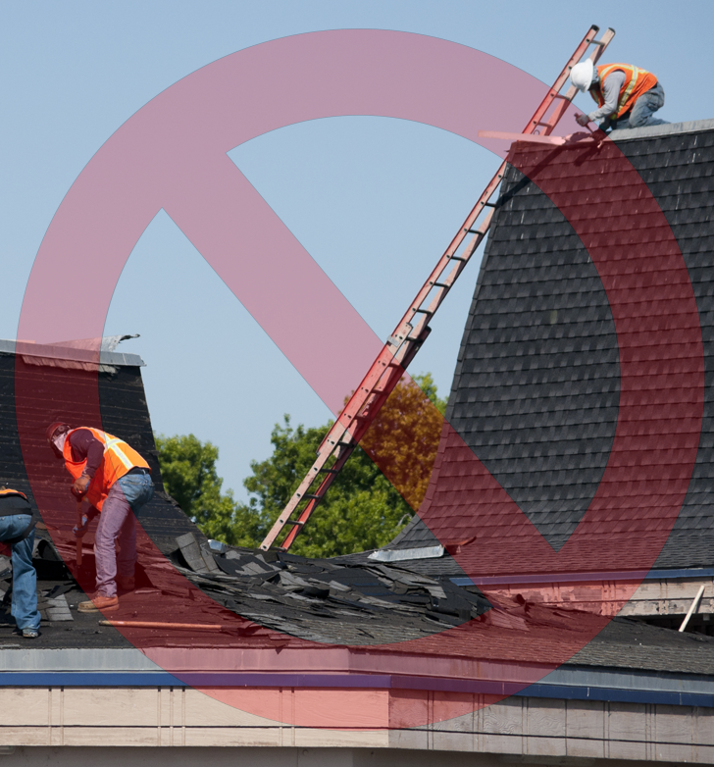
Violations
In 2018, fall protection was the most commonly cited violation for the Oregon construction industry.
Total number of violations (443)
Total initial penalties ($902,990)
Oregon Department of Consumer & Business Services
Module 1: introduction

Slide 13
Video: Who Needs Fall Protection?
Module 1: introduction

Slide 14
Video: Does Fall Protection Work?
Module 1: introduction

Slide 15
Module 2: Getting Started
FALL PROTECTION FUNDAMENTALS

Slide 16
Video: OSHA Standards
Module 2: getting started

Slide 17
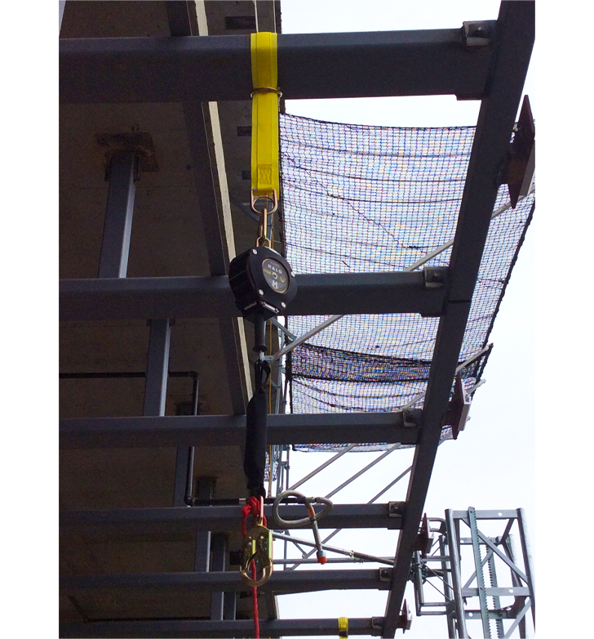
Oregon OSHA’s Fall Protection Standards
Click the links below to view the different Oregon OSHA standards that are related to fall protection.
Construction
Scaffolding, Lifts, and Aerial Platforms
Steel Erection
General Industry
Personal Fall Protection
Module 2: getting started

Slide 18
Video: Risk Assessment
Module 2: getting started

Slide 19
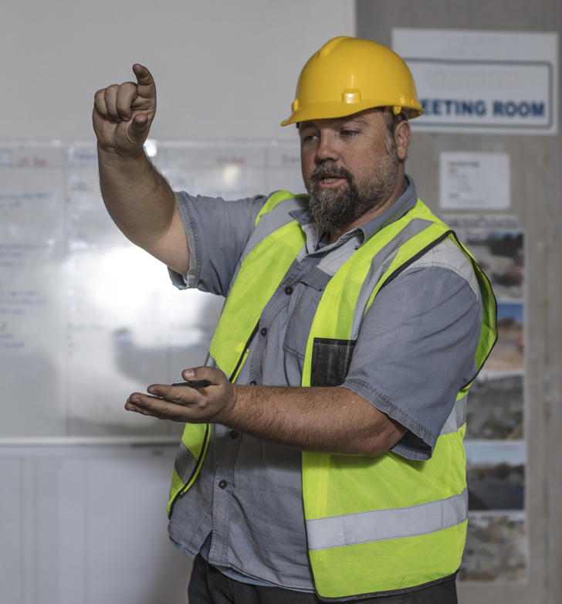
Trigger Heights
Click the links below to view the fact sheets. The fact sheets contain trigger heights for construction and general industry activities.
Trigger Heights for Construction
Trigger Heights for General Industry
Module 2: getting started

Slide 20
Video: Competent vs. Qualified
Module 2: getting started

Slide 21
Competent Persons
Click the button to view the Oregon OSHA factsheet, “Fall protection in Construction: Requirements for Competent Persons.”
Competent Person Fact Sheet
Module 2: getting started

Slide 22
Video: ABC’s of Fall Protection
Module 2: getting started

Slide 23
Video: Falling Objects
Module 2: getting started

Slide 24
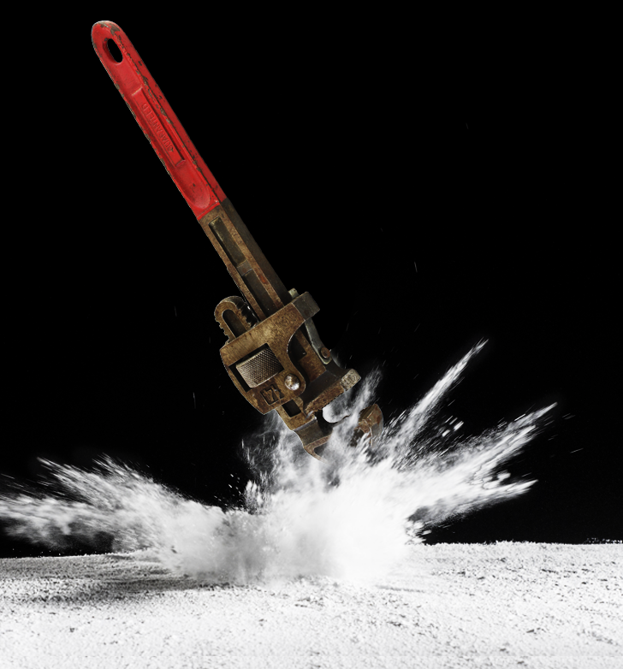
Falling Objects
Click the link below for more information on falling objects.
Falling Object Requirements in Division 3, Subdivision M, Fall Protection
Module 2: getting started

Slide 25
Module 3: Options
FALL PROTECTION FUNDAMENTALS

Slide 26
Video: Overview of Options
Module 3: options

Slide 27
Video: Eliminate
Module 3: options

Slide 28
Video: Prevent
Module 3: options

Slide 29
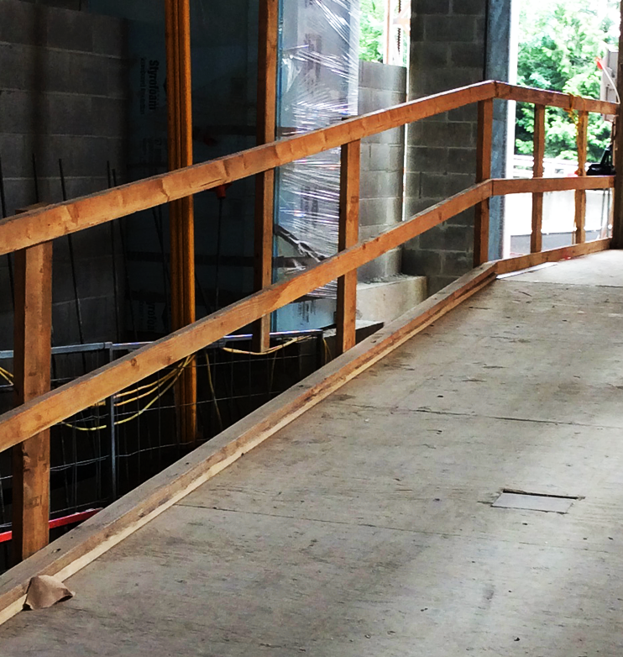
Guardrail Systems
The benefit of guardrails over control options, is that after they are installed correctly, they reduce the amount of human error.
Parts include:
Top rail
Midrail
Intermediate vertical members
Can also be combined with toeboards that prevent materials from rolling off the walking/working surface.
For more information on guardrails, click the links below:
General Industry (Fact Sheet)
Division 2, Subdivision D, Walking-Working Surfaces
Construction (Fact Sheet)
Division 3, Subdivision M, Fall Protection
Module 3: options

Slide 30
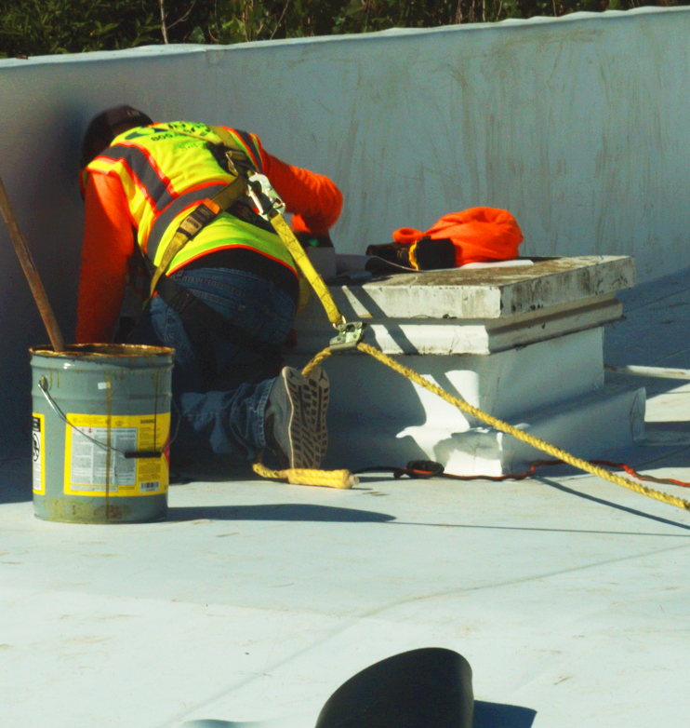
Fall-Restraint Systems
Fall restraint systems prevent workers from reaching an unprotected edge. Thus, prevents a fall from occurring.
Parts include:
Lanyard
Connectors
Body harness or body belt
The anchorage must support at least 3,000 lbs. or be designed and installed by a qualified person and have a safety factor of at least 2.
Click the link for more information.
Fall Restraint requirements in Division 3, Subdivision M, Fall Protection
Module 3: options

Slide 31
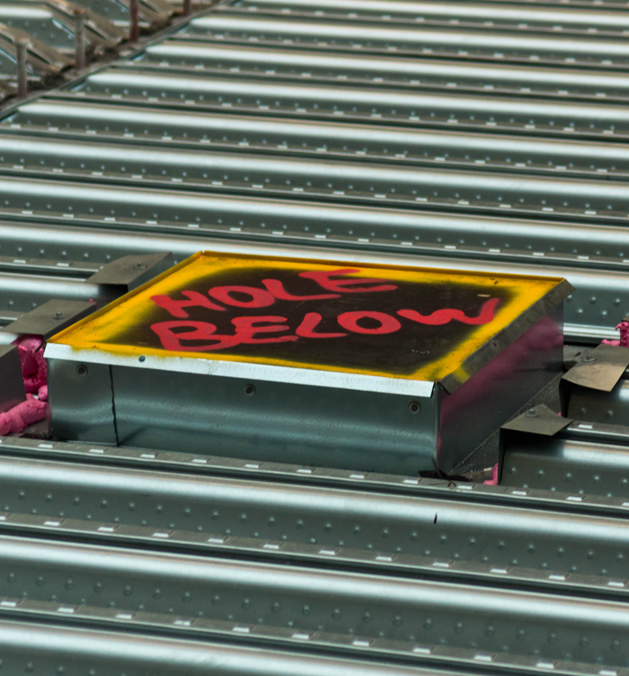
Hole Covers
Click the link for more information on hole covers.
Hole Cover Requirements in Division 3, Subdivision M, Fall Protection
Module 3: options

Slide 32
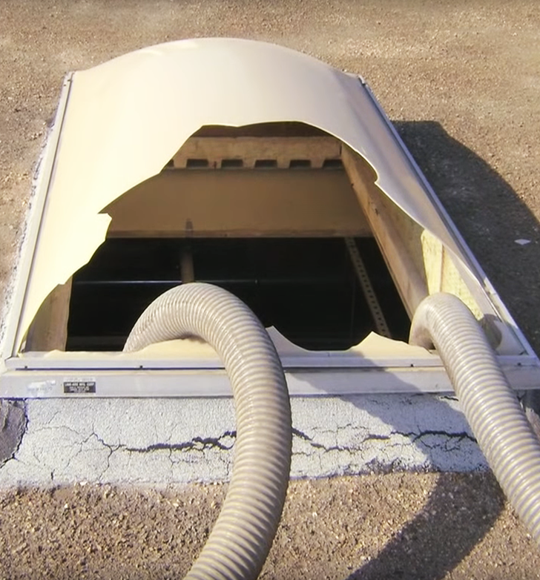
Skylights
If you are interested in watching an additional video about a true story where a man fell through a skylight, click the link below.
Preventing Falls Through Skylights
Module 3: options

Slide 33
Video: Control
Module 3: options

Slide 34
Fall-Arrest Systems
A personal fall-arrest system consists of an anchorage, connectors, and a full-body harness that work together to stop a fall and to minimize the arrest force.
Other parts may include:
Lanyard
Deceleration device
Lifeline
The fall arrest system is only effective if you know how all the components work together to stop a fall.
Fall-Arrest Requirements in Division 3, Subdivision M, Fall Protection
Module 3: options

Slide 35
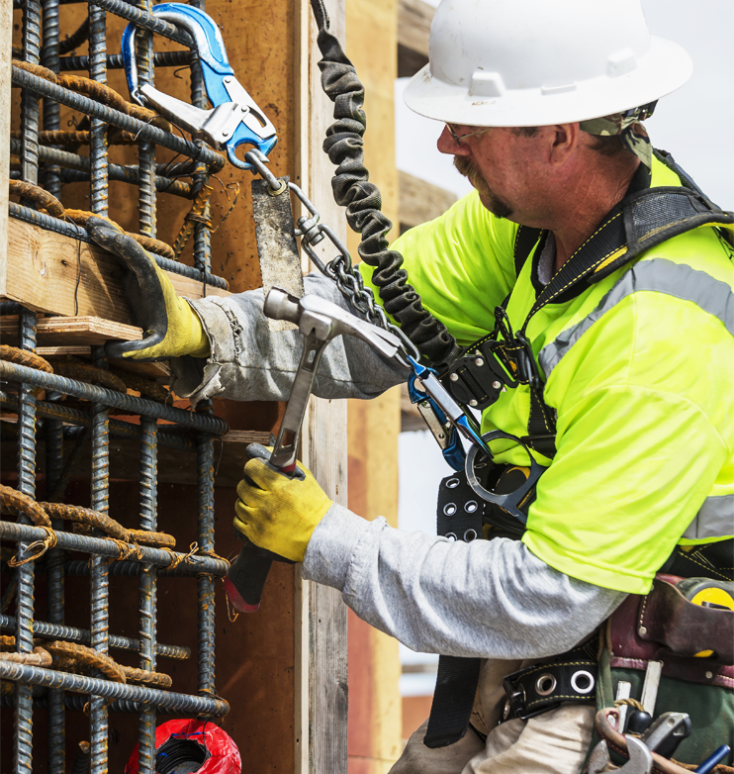
Positioning Device Systems
Positioning device systems support a person who needs to work with both hands free on surfaces such as walls or windowsills. Also used on formwork, and for placing rebar.
They provide support, and must stop a free fall within 2 feet.
Parts include:
Anchorage
Connectors
Body support
Click the link for more information.
Positioning Device Requirements in Division 3, Subdivision M, Fall Protection
Module 3: options

Slide 36
Safety Net System
Safety net systems consist of mesh nets and connecting components.
Their openings can’t be more than 6 inches on a side, center to center.
They must not be installed more than 30 feet below working surface.
They must be able to withstand a drop test consisting of a 400-pound sandbag, 30 inches in diameter, dropped from the working surface.
They must have a minimum horizontal distance to the net’s outer edge which depends on how far below the working surface the net is placed.
Click the link for more information.
Safety Net Requirements in Division 3, Subdivision M, Fall Protection
Module 3: options

Slide 37
Video: Warn
Module 3: options

Slide 38
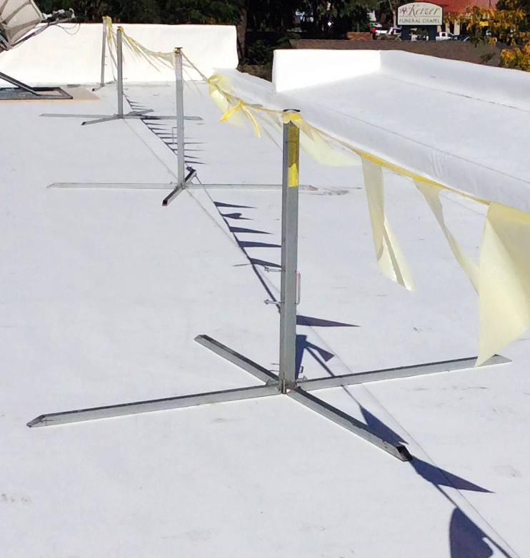
Warning Line System
A warning line system’s purpose is to warn roofers that they are near an unprotected edge.
They consist of ropes, wires, or chains, and supporting stanchions that mark off the area where work can be done without other types of fall protection.
They can only be used for roofing work on roofs that have slopes of 2:12 or less, vertical to horizontal.
Click the link for more information.
Warning Line Requirements in Division 3, Subdivision M, Fall Protection
Module 3: options

Slide 39
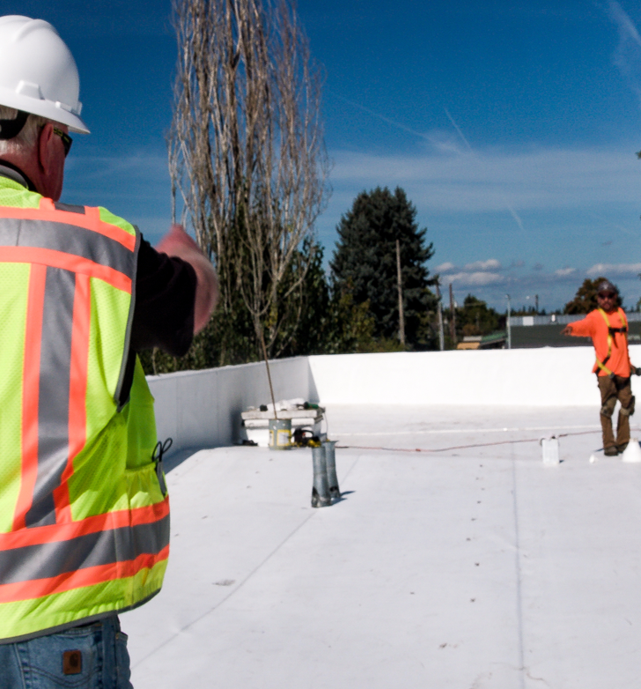
Safety Monitor
Safety-monitoring systems for roofing work can be used only to protect employees on roofs that have slopes no greater than 2:12.
They are not permitted on roofs more than 50 feet unless a warning-line system is also installed to keep employees from coming too close to an unprotected roof edge.
Click the link for more information.
Safety Monitor Requirements in Division 3, Subdivision M, Fall Protection
Module 3: options

Slide 40
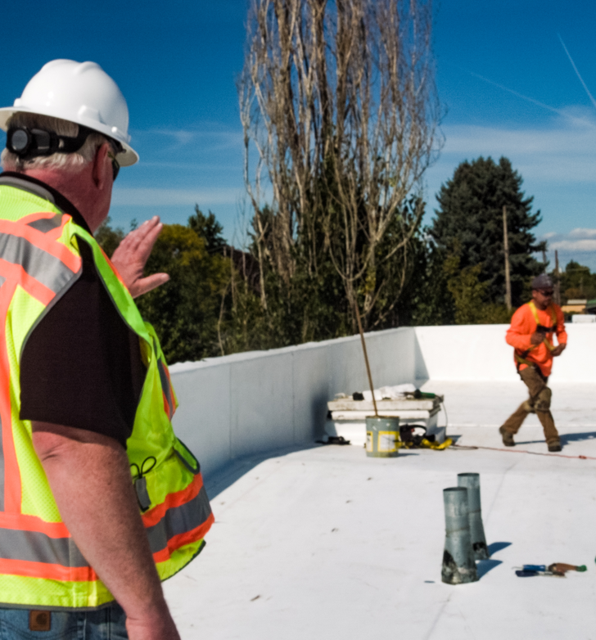
Safety Monitor/Warning Lines
Click the links to view our Safety Monitoring for Roofing Work, and Using Warning Lines Fact Sheets.
Safety Monitor
Warning Lines
Module 3: options

Slide 41
Module 4: Demonstrations
FALL PROTECTION FUNDAMENTALS

Slide 42
Video: Inspection/Maintenance
Module 4: demonstrations

Slide 43
Video: Donning a Harness
Module 4: demonstrations

Slide 44
Video: Anchors
Module 4: demonstrations

Slide 45
Module 4: demonstrations

Slide 46
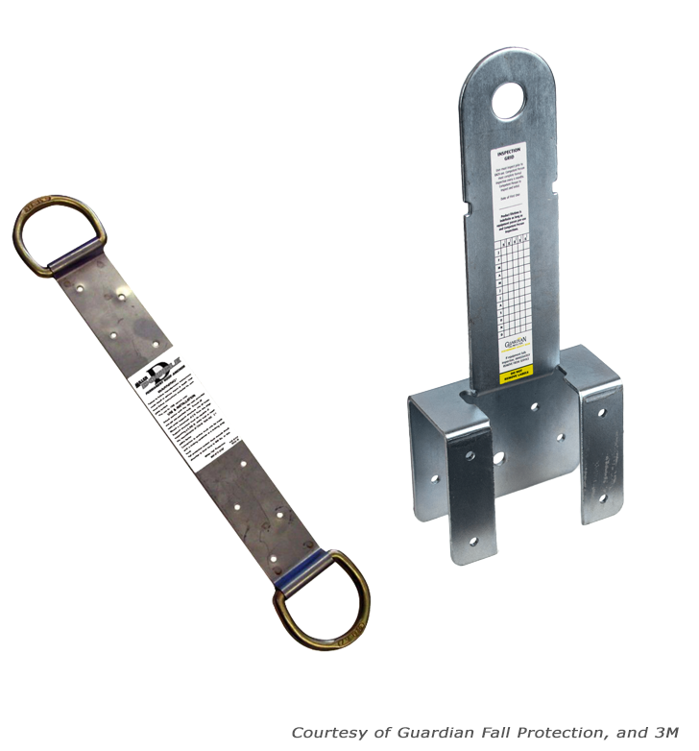
Anchor Types
Peak anchors are typically used in the roofing industry, and are usually left in place after the job is done for future jobs.
Truss anchors and spreaders are used before a structure is fully framed. Specifically, a spreader is implemented before trusses are fully sheathed.
Module 4: demonstrations

Slide 47
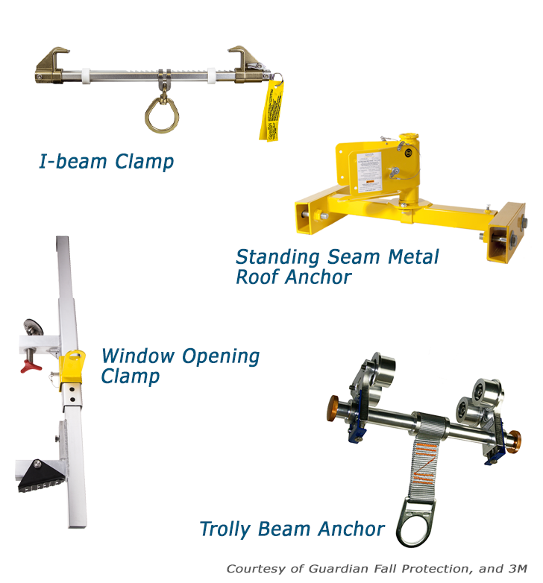
Anchor Types
Engineered Clamps are often associated with 4 different anchor types:
I-beam clamp, which adjusts to numerous steel beam sizes.
Trolley beam anchor, which allows workers greater access to greater work areas without the need for a longer lanyard.
Standing seam metal roof anchor, which clamps to parallel seams of metal roofs.
Doorway and window opening clamp, which allows for anchoring between building framing or window openings.
Module 4: demonstrations

Slide 48
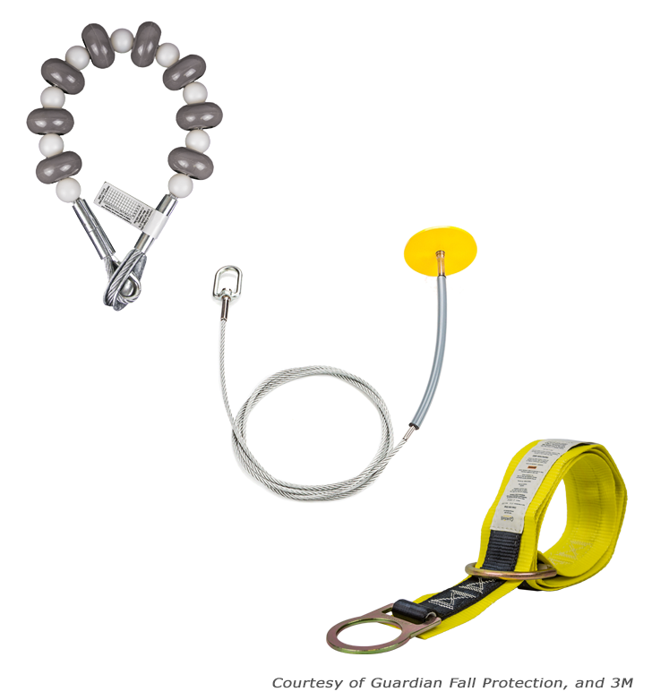
Anchor Types
Strap Anchors are associated with 3 different anchor types:
The cable anchorage sling, used around structural steel or I-beams.
Drop-through anchorage cable, suitable for concrete or steel, has an anchor point that drops through a small hole in an overhead surface.
Strap anchor, which is used for sturdy horizontal structures like beams. Keep in mind, sharp or rough edges could lead to strap damage.
Module 4: demonstrations

Slide 49
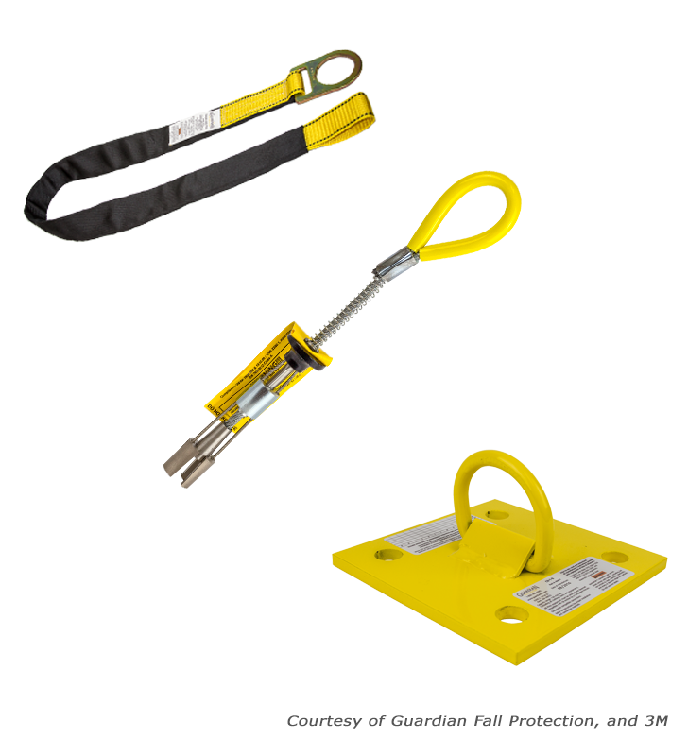
Anchor Types
Concrete Anchors are associated with 3 different anchor types:
Concrete anchor strap with d-ring, typically used by foundation and formwork employees. The strap is protected with a sleeve or wear-pad from abrasion by the concrete. It is looped around the rebar during pouring, and is cut flush with the surface when it is no longer needed.
Precast hollow core concrete anchor, which allows one worker to tie off, and is used for precast hollow concrete tasks.
Bolt-on wall anchor, which can be a temporary or permanent anchor point on a vertical concrete wall.
Module 4: demonstrations

Slide 50
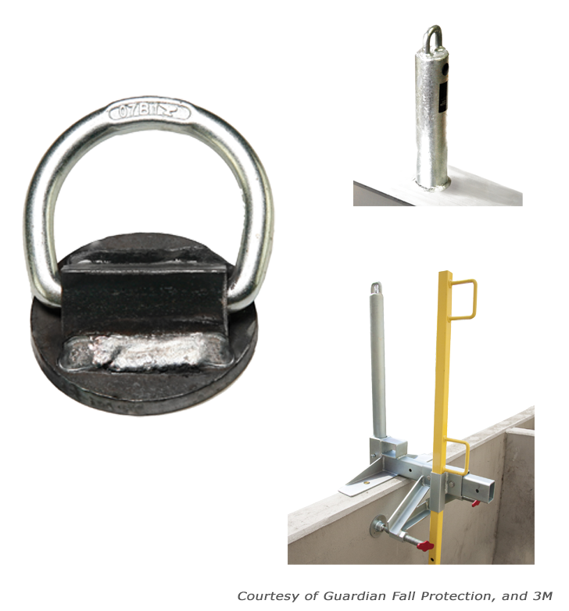
Anchor Types
The Welded Anchors consists of:
Welded d-ring anchor, which is a single d-ring anchor point that can be temporary or permanently welded onto vertical structural steel.
Weld-on anchor post, which is a permanent anchor point that is welded to an I-beam.
Trench Box Guardrail Anchor is used for performing deep excavation. It is designed with an anchor point on a post near the guardrail.
Module 4: demonstrations

Slide 51
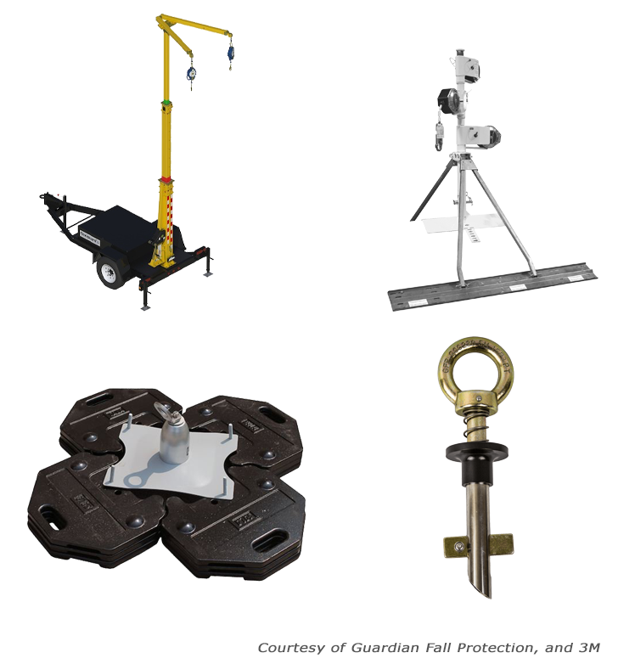
Anchor Types
Anchors not welded, or clamped in place are comprised of:
Mobile fall protection system, meant for a one employee using a fall arrest system. This anchor types allows to move quickly from location to location, and also come in versions that allow for more than one employee to anchor.
Rotating retractable anchor mast, which is most often seen used on sloped residential roofs. It allows the worker a large range of motion, and helps to elevate the anchor point above the worker.
Dead weight anchor, which is commonly used when performing roof work and you can not hammer or drill into the surface. It is made of concrete, steel, or other similar heavy materials to provide anchorage.
Bolt hole anchor, which is used in horizontal steel bolt holes.
Module 4: demonstrations

Slide 52
Video: Calculating Fall Distance
Module 4: demonstrations

Slide 53
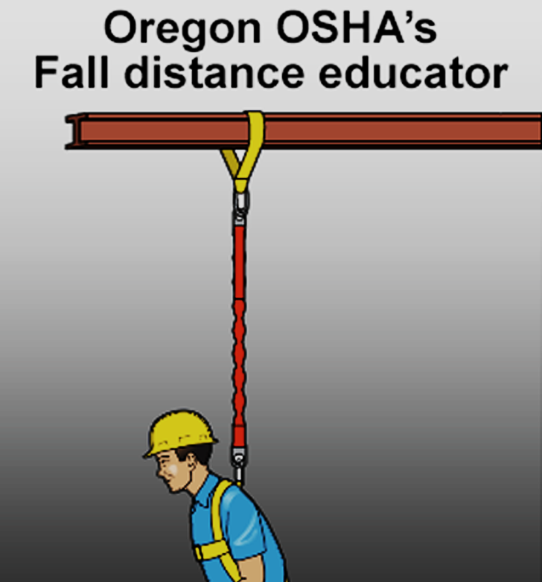
Fall Distance Educator
Click the link below to view the Oregon OSHA’s fall distance educator. The educator will provide you with 3 different scenarios.
Oregon OSHA’s Fall Distance Calculator
Module 4: demonstrations

Slide 54
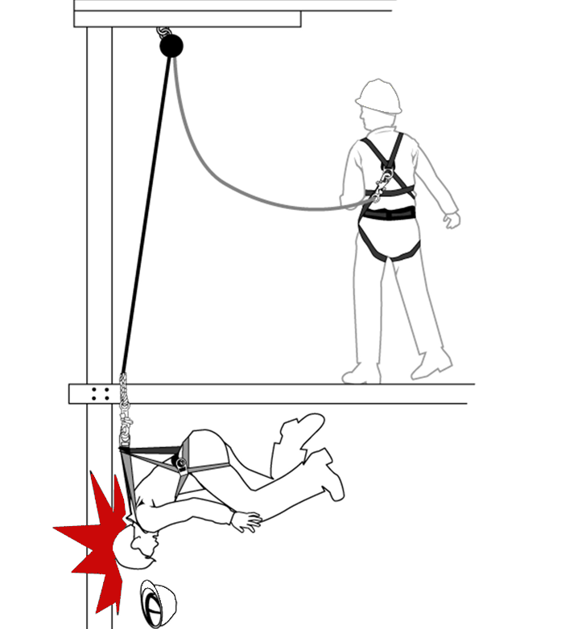
Swing Fall
For more information on swing falls click the link below.
How to Evaluate the Swing Fall Hazard
Module 4: demonstrations

Slide 55
Video: Rescue
Module 4: demonstrations

Slide 56
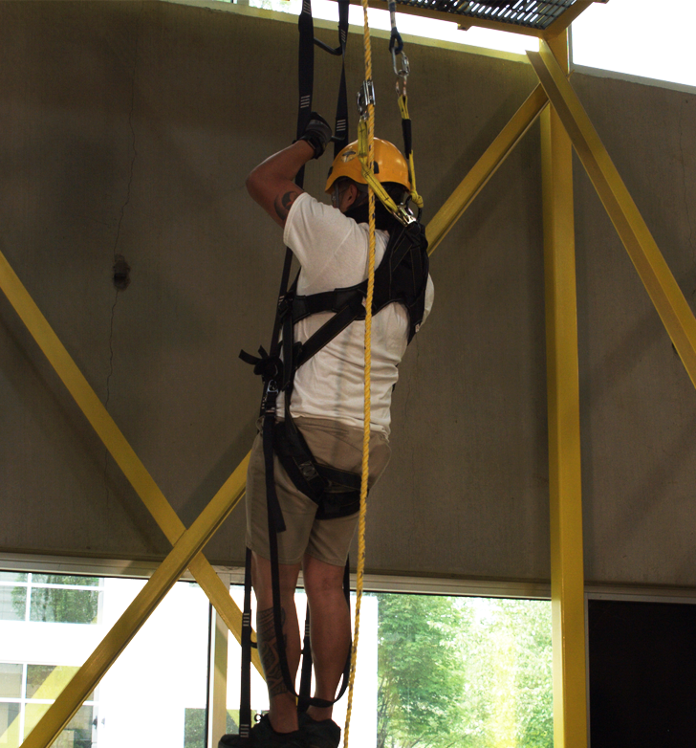
Rescue
For more information on rescue, click the link below to view the Oregon OSHA’s Safety and Health newsletter.
Newsletter (Rescue)
Module 4: demonstrations

Slide 57
Video: Inspection Example
Module 4: demonstrations

Slide 58
Module 5: Training
FALL PROTECTION FUNDAMENTALS

Slide 59
Video: Purpose of Training
Module 5: training

Slide 60
Video: Training Topics
Module 5: training

Slide 61
Video: Train Your Team
Module 5: training

Slide 62
Training Certification
When talking about certification of the training, the employer must verify that they are compliant by preparing a written certification record. This record needs to have the name or other identity of the employee trained, dates of the training, and the signature of the person who conducted the training or the employer. Once all of this is completed, you need to maintain the latest training certification.
In some instances the employee may have received training from a previous employer. If the current employer is relying on this, the record needs to indicate when the current employer determined the prior training was adequate rather than the date of the actual training.
Module 5: training

Slide 63
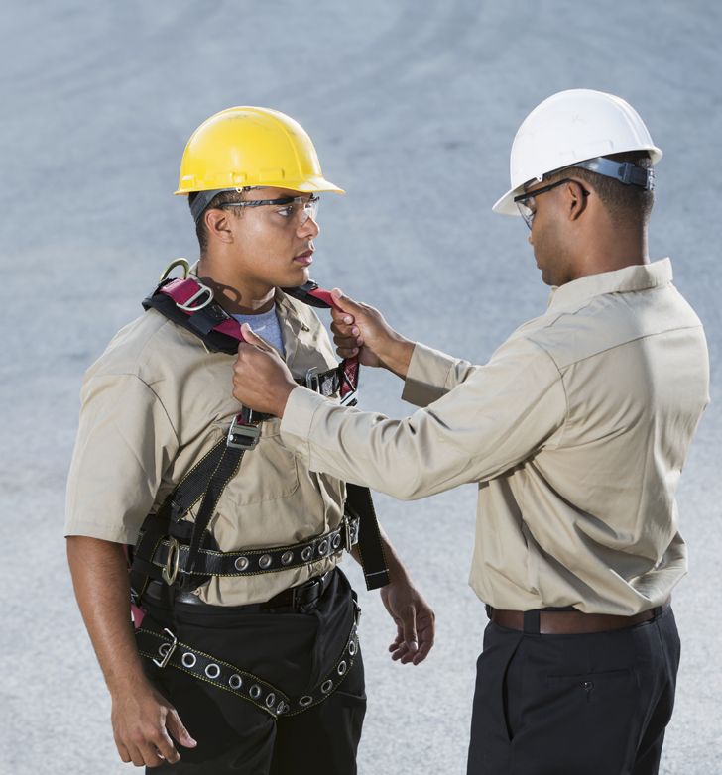
Retraining
When the employer has a reason to believe that an employee who has already been trained doesn’t have the knowledge or skills required they need to retrain the employee. Examples where retraining is required include:
Changes in the workplace or fall protection systems being used has made the previous training obsolete.
It is evident that the employee has not retained the necessary knowledge and skills from the training.
Module 5: training

Slide 64
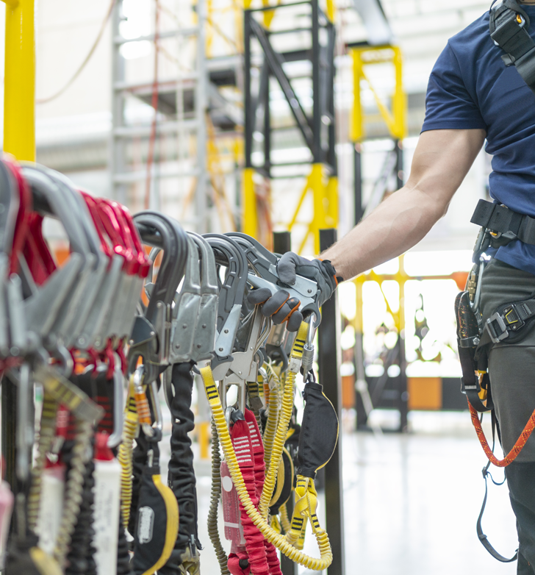
Training Requirements
Before any employee is exposed to a fall hazard, the employer must provide training for each employee who uses personal fall protection systems or who is required to be trained as specified by Oregon OSHA.
For more information on Training, click the links below:
Fall Protection for Construction Activities
Safety Monitoring for Roofing Work
Division 3, Subdivision M, Fall Protection
Walking-Working Surfaces: At a Glance
Division 2, Subdivision D, Walking-Working Surfaces
Module 5: training

Slide 65
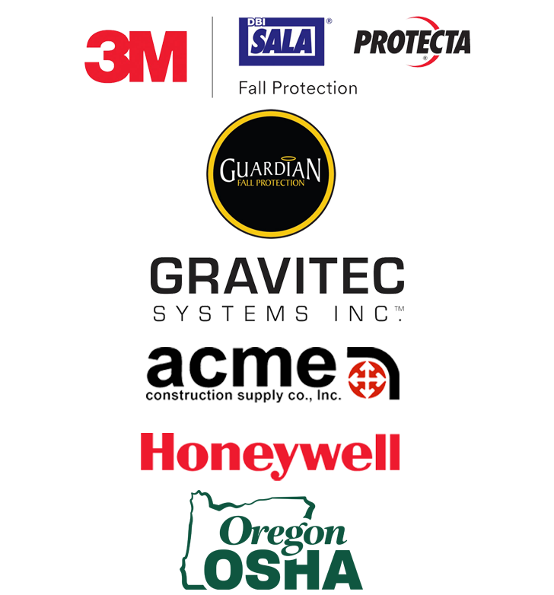
Additional Resources
There are many places to get training resources you need. We have provided a list of a few companies that provide training materials.
Just click the links to view their websites.
3M | DBI SALA | PROTECTA
Guardian Fall Protection
GRAVITEC
ACME University
Honeywell
OR OSHA Topic Index
Module 5: training

Slide 66
Module 6: Conclusion
FALL PROTECTION FUNDAMENTALS

Slide 67
Video: Safety Culture
Module 6: conclusion

Slide 68
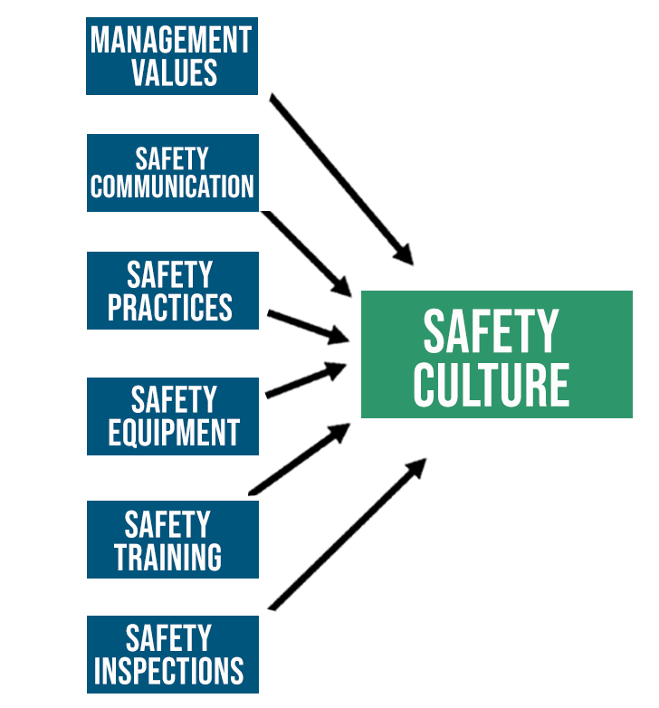
Safety Culture
While there isn’t one way to get a safety culture, here are some factors you can consider to get moving in the right direction:
Management Values – Management should lead by example. This top-down strategy shows employees that safety is very important and valued by the company.
Safety Communication – Communication should be on going with employees. If you see something wrong say something.
Safety Practices – Throughout this training we have gone over several safety practices. You should always understand your company’s safety policies, and the Oregon OSHA standards as it relates to the tasks you are doing.
Safety Training – It is crucial that employees using fall protection be trained to at least meet the standards presented by Oregon OSHA.
Safety Equipment – Use the right equipment for the job or task.
Safety Inspections – Contact Oregon OSHA’s consultation services with any questions or concerns you might have relating to your work.
Module 6: conclusion

Slide 69
Video: Getting Started
Module 6: conclusion

Slide 70
Fundamentals of Fall Protection - QUIZ
Question 1:
Guardrails are an example of what kind of fall protection?
Fall Restraint
Prevention
Control
Question 2:
You can tie off to an anchor for fall restraint when it has been approved by a qualified person, or is capable of supporting at least 3,000 lbs.
True
False
Module 6: conclusion

Slide 71
Fundamentals of Fall Protection - QUIZ
Question 3:
A fall restraint system is a method of fall prevention that when properly used, tethers a worker in a manner that will not allow a fall of any distance.
True
False
Question 4:
A personal fall arrest system includes: (Select all that apply)
Anchorage
Body Support
Connecting Devices
Deceleration Device
Module 6: conclusion

Slide 72
Fundamentals of Fall Protection - QUIZ
Question 5:
Which of the following is the last line of defense from falling objects?
Compliant toeboards
Approved head protection
Canopy structures
Question 6:
Harnesses should be inspected prior to each use.
True
False
Module 6: conclusion

Slide 73
Fundamentals of Fall Protection - QUIZ
Question 7:
Equipment that does not pass inspection should be removed from service.
True
False
Question 8:
Factors to consider with calculating fall distance include: (select all that apply)
Anchorage
Body Support
Connecting Devices
Deceleration Device
Safety Factor
Module 6: conclusion

Slide 74
Fundamentals of Fall Protection - QUIZ
Question 9:
A guardrail consists of a top rail, midrail, and shall have a vertical height of ____ inches from the upper surface of the top rail to the floor.
16 plus or minus 3 inches
42 plus or minus 3 inches
32 plus or minus 3 inches
Question 10:
Fall arrest may not work as intended if what is not performed? (Select all that apply.)
Equipment inspection
Donning and adjustment of the harness
Fall distance calculation
Training
Module 6: conclusion

Slide 75
Fundamentals of Fall Protection - QUIZ
Question 11:
A fall arrest anchorage point must support a static load of 5,000 lbs per person attached.
True
False
Question 12:
A personal fall arrest system:
Does not include a deceleration device.
Requires an anchorage point that can only support a static load of 2,000 lbs.
None of the above.
Module 6: conclusion

Slide 76
Fundamentals of Fall Protection - QUIZ
Question 13:
Warning lines are an example of what kind of fall protection.
Warn
Prevention
Control
Question 14:
Which device is not an example of the “Control” category of fall protection?
SRLs
Fall Arrest
Fall Restraint
Module 6: conclusion

Slide 77
Fundamentals of Fall Protection - QUIZ
Question 15:
A trigger height requires that you take action to protect employees from fall hazards.
True
False
Question 16:
A competent person and a qualified person are the same thing.
True
False
Module 6: conclusion

Slide 78
Fundamentals of Fall Protection - QUIZ
Question 17:
A body belt will distribute the fall arrest forces over the thighs, pelvis, waist, chest and shoulders with means for attaching it to other components of a personal fall arrest system.
True
False
Question 18:
Working above dangerous equipment has a trigger height of ___ feet.
10
6
4
0
Module 6: conclusion

Slide 79
Fundamentals of Fall Protection - QUIZ
Question 19:
The employer shall provide for prompt rescue of employees in the event of a fall or shall assure that employees are able to rescue themselves.
True
False
Question 20:
All covers shall be color coded or they shall be marked with the word “HOLE” or “COVER” to provide warning of the hazard.
True
False
Module 6: conclusion

Slide 80
Fundamentals of Fall Protection – QUIZ ANSWERS
B
A
A
A, B, C, D
B
A
A
A, B, C, D, E
B
A, B, C, D
11. A
12. C
13. A
14. C
15. A
16. B
17. B
18. D
19. A
20. A
Module 6: conclusion

Slide 81
Where To Go From Here
An excellent resource to utilize is the A-Z Topic Index on the Oregon OSHA website. It has lists of relevant publications, training materials, rules, interpretations, videos, and other miscellaneous materials.
If you want guidance in developing a safer work environment, you may consider our free and confidential consultation service. Our consultants in workplace safety, industrial hygiene, and ergonomics can help you reduce accidents, related costs, and help you develop a comprehensive program to manage safety and health.
Congratulations, you’ve completed the Fundamentals of Fall Protection course.
Module 6: conclusion

