Slide 1
Module 1: Introduction
FALL PROTECTION FOR ROOFING

Slide 2
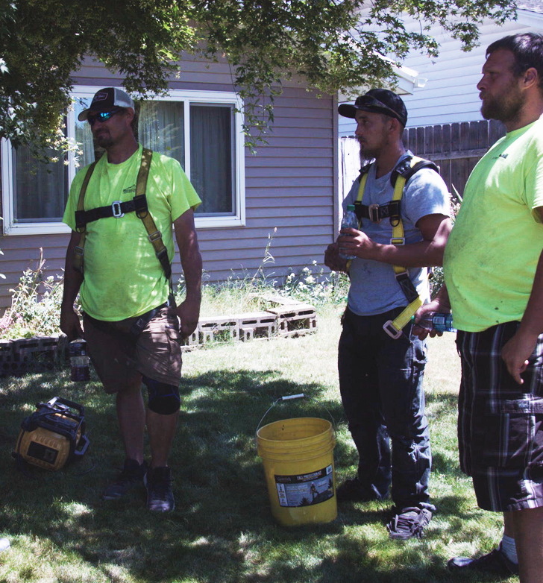
Disclaimer
Completing this course will help you understand the rules and some of the hazards related to fall protection. However, it is your employer’s responsibility to further your training where it is specific to your organization, such as permits, policies, and practices. This material should not be considered a substitute for any provisions of the Oregon Safe Employment Act, or for any standards issued by Oregon OSHA. Manufacturers, products, or services displayed in this material are for informational purposes only and do not constitute an endorsement by Oregon OSHA.
ROOFING: introduction

Slide 3
Video: Creating a Safety Policy
ROOFING: introduction
Notes:
https://vimeo.com/608740654

Slide 4
Video: Roofing Hazards
ROOFING: introduction
Notes:
https://vimeo.com/608741643

Slide 5
Fatal Work Injuries
In 2017, 91 roofers died on the job.
Of the 91 fatal work injuries, 82% were due to slips, trips, and falls.
Bureau of Labor Statistics
ROOFING: introduction

Slide 6
Accepted Claims
In 2017, there were 5,780 resolved claims in Oregon that were due to slips, trips, and falls. The average cost for these claims was $23,570.
Oregon Department of Consumer & Business Services
ROOFING: introduction

Slide 7
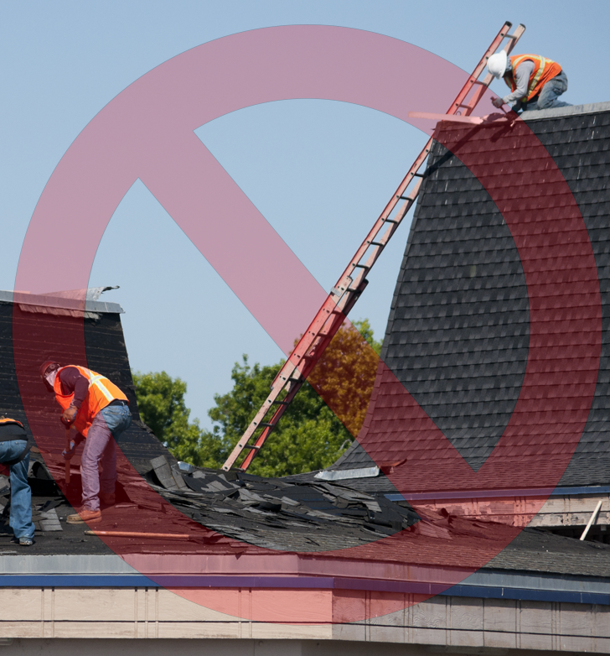
Accepted Claims
Below are a few categories of accepted disabling workers’ compensation claims from Oregon between 2013-2018, due to falls to a lower level.
(2,258) from Ladders
(329) from Roofs
Oregon Department of Consumer & Business Services
ROOFING: introduction

Slide 8
NIOSH Heat Exhaustion App
Click the link, or scan the QR Code to download the NIOSH Heat Exhaustion app.
NIOSH heat exhaustion app
ROOFING: introduction

Slide 9
Video: Choosing Fall Protection
ROOFING: introduction
Notes:
https://vimeo.com/608743992

Slide 10
Video: Commercial vs Residential Roofing
ROOFING: introduction
Notes:
https://vimeo.com/608744967

Slide 11
Module 2: Pre-job Tasks
FALL PROTECTION FOR ROOFING

Slide 12
Video: Planning
ROOFING: pre-job tasks
Notes:
https://vimeo.com/608747421

Slide 13
Competent vs. Qualified
What is the difference between competent and qualified people?
Click the link to view our video that covers the differences between the two, and how it relates to fall protection.
You hear from a leading fall protection expert detailing who these people are, what they can do, and how to become one.
Competent vs. Qualified Person Video
ROOFING: pre-job tasks

Slide 14
Video: Hazard Identification
ROOFING: pre-job tasks
Notes:
https://vimeo.com/608748432

Slide 15
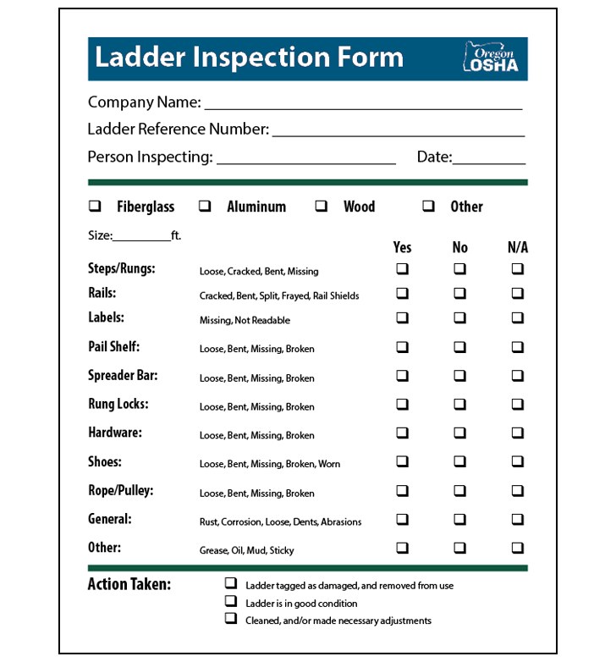
Ladder Inspection Form
A ladder inspection form is a valuable tool for identifying some of the hazards that are present when using a ladder.
The benefit is you can also see if there are trends developing, like defective parts. If any defect or damage is found during the inspection, you must do the following:
Tag the ladder “Dangerous, DO NOT USE!”
Repair the ladder immediately to original condition, or destroy the ladder.
Click the link to view the ladder inspection form:
Ladder Inspection Form
ROOFING: pre-job tasks

Slide 16
Video: Public Communication
ROOFING: pre-job tasks
Notes:
https://vimeo.com/608750758

Slide 17
Video: Skylights
ROOFING: pre-job tasks
Notes:
https://vimeo.com/608752333

Slide 18
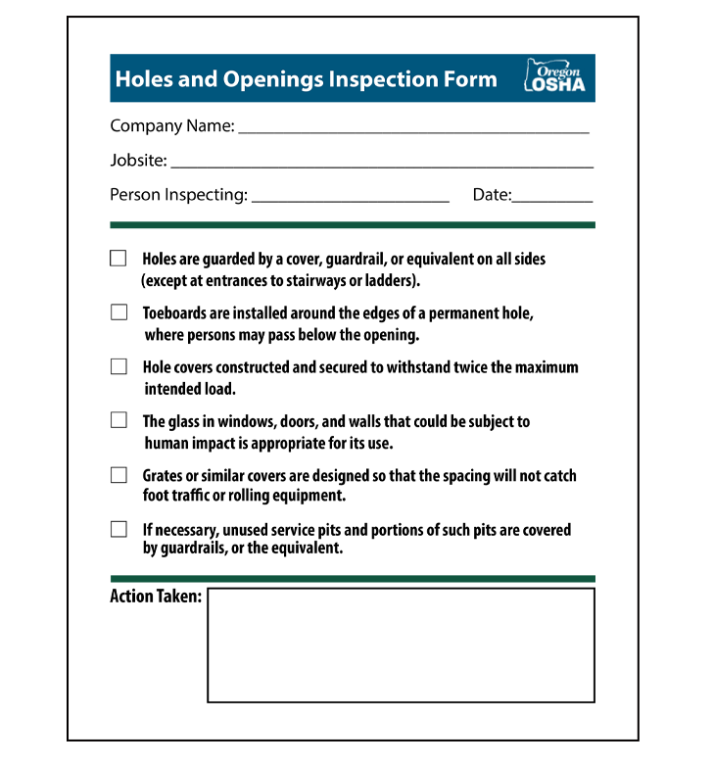
Holes and Openings Inspection Form
A holes and openings inspection form is a valuable tool for identifying and correcting some of the hazards that are present when working around holes and openings.
Click the link to view the holes and openings inspection form:
Holes and Openings Inspection Form
ROOFING: pre-job tasks

Slide 19
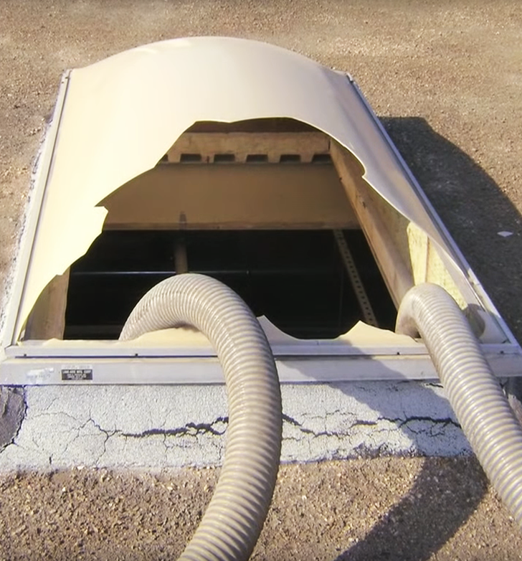
Skylights
If you are interested in watching an additional video about a true story where a man fell through a skylight, click the link below:
Prevent Falls Through Skylights
ROOFING: pre-job tasks

Slide 20
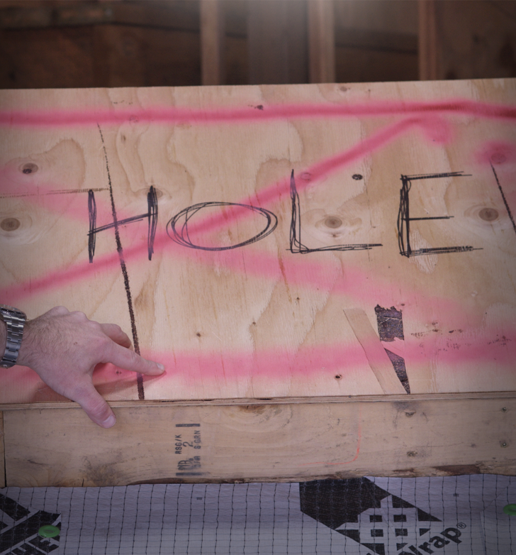
Hole Covers
For more information on hole covers, click the link.
Hole Cover Requirements
ROOFING: pre-job tasks

Slide 21
Video: Swing Falls
ROOFING: pre-job tasks
Notes:
https://vimeo.com/608754316

Slide 22
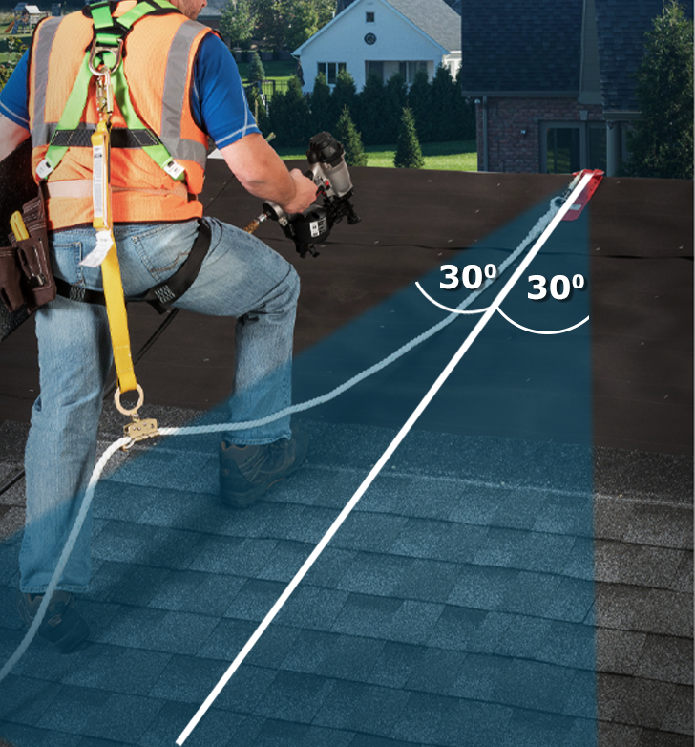
Swing Fall
In order to limit swing in the event a worker falls, workers should not go further than 30 degrees from the anchor point.
*Remember, always consult with your manufacturer’s instructions.
ROOFING: pre-job tasks

Slide 23
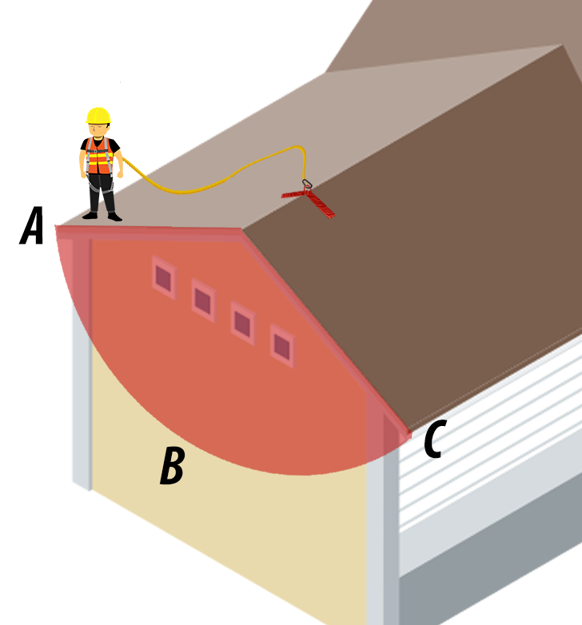
Swing Fall
For more information on swing fall click the link.
How to Evaluate the Swing Fall
ROOFING: pre-job tasks

Slide 24
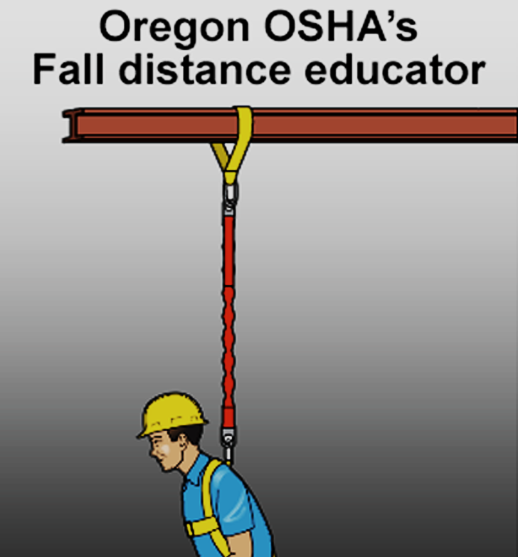
Fall Distance Educator
Click the link to view the Oregon OSHA fall distance educator. The educator will provide you with 3 different scenarios.
Fall Distance Educator
ROOFING: pre-job tasks

Slide 25
FALL PROTECTION FOR ROOFING
Module 3: Systems and Devices

Slide 26
Video: Anchors
ROOFING: systems and devices
Notes:
https://vimeo.com/608755515

Slide 27
Peak Anchors
Peak anchors are typically left in place after the job is done, so they can be used for future jobs. However, some models are meant to be temporary and reusable on other jobsites.
ROOFING: systems and devices

Slide 28
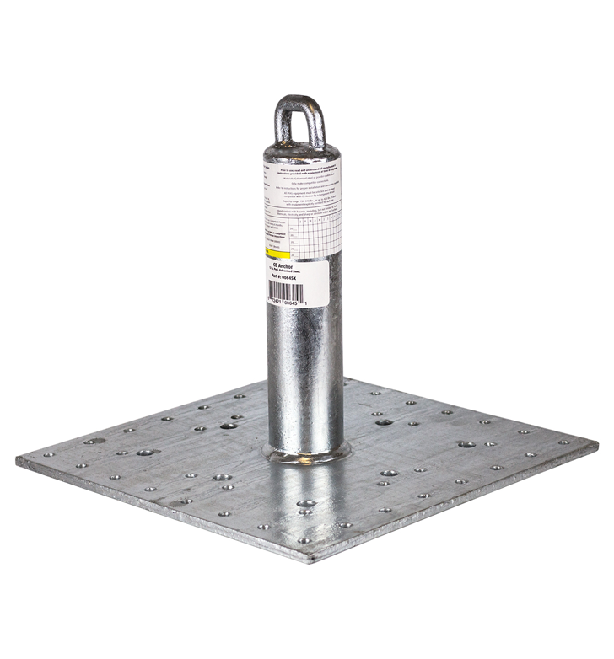
Decking Anchors
Decking anchors in the roofing industry are often used on low-slope roofs. They can work as a single anchor point, or be used in a horizontal lifeline system.
ROOFING: systems and devices

Slide 29
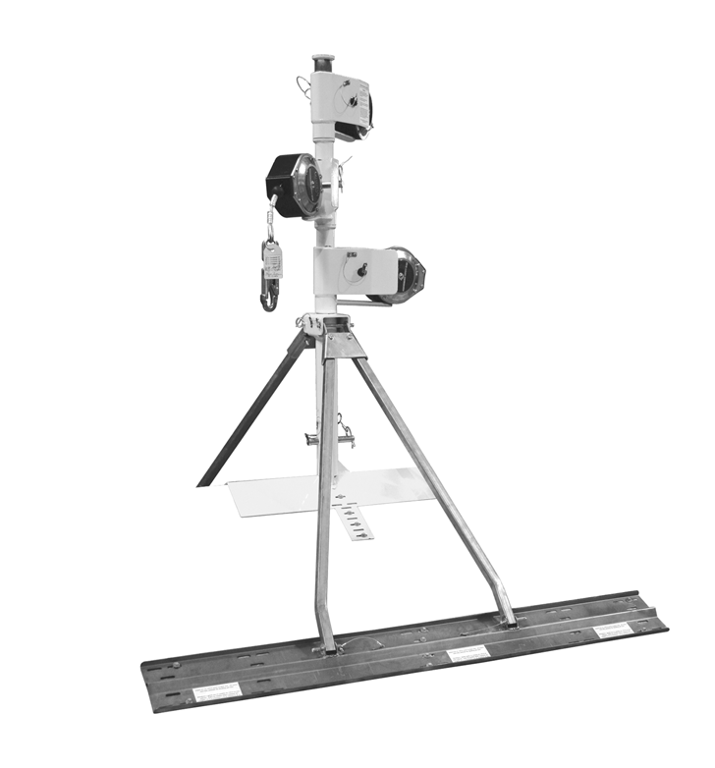
Rotating Retractable Anchor Masts
Rotating retractable anchor masts are most often used on sloped residential roofs. They allow the worker a large range of motion, and helps to elevate the anchor point above the worker.
ROOFING: systems and devices

Slide 30
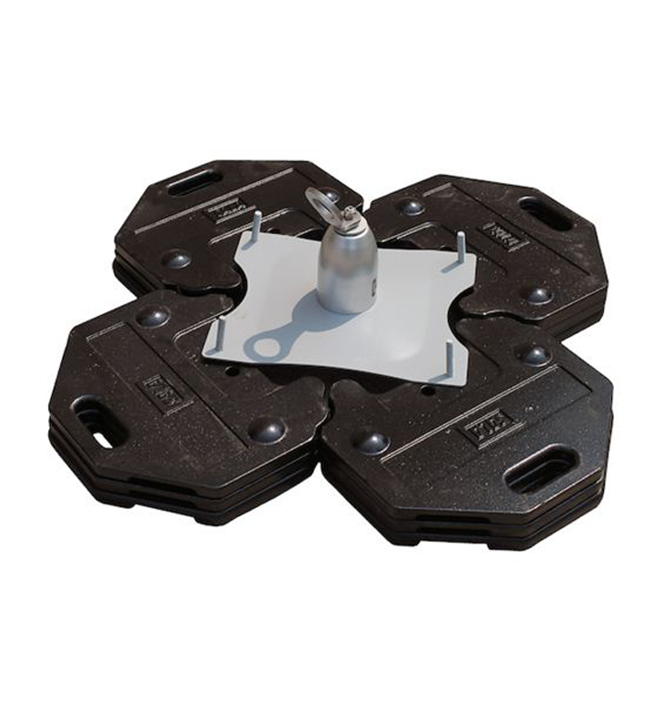
Dead Weight Anchors
Dead weight anchors are commonly used in roofing work when you cannot hammer or drill into the surface. They are made of concrete, steel, or other similar heavy materials to provide anchorage.
ROOFING: systems and devices

Slide 31
Video: Horizontal Lifelines
ROOFING: systems and devices
Notes:
https://vimeo.com/608757598

Slide 32
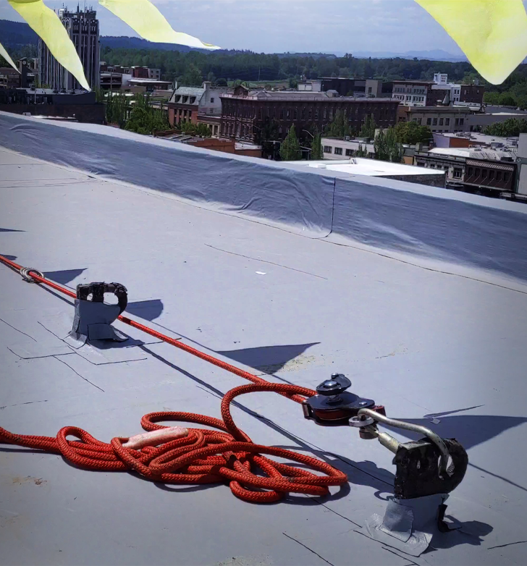
Horizontal Lifeline
The horizontal lifeline stretches between two anchorages. When you connect a lanyard or rope grab to a horizontal lifeline, you can move about freely, thus reducing the risk of a swing fall.
Horizontal lifelines can fail at the anchorage points if they’re not installed correctly. For this reason, horizontal lifelines must be designed, installed, and used under the supervision of a qualified person.
ROOFING: systems and devices

Slide 33
Video: Rope Adjustment
ROOFING: systems and devices
Notes:
https://vimeo.com/608758233

Slide 34
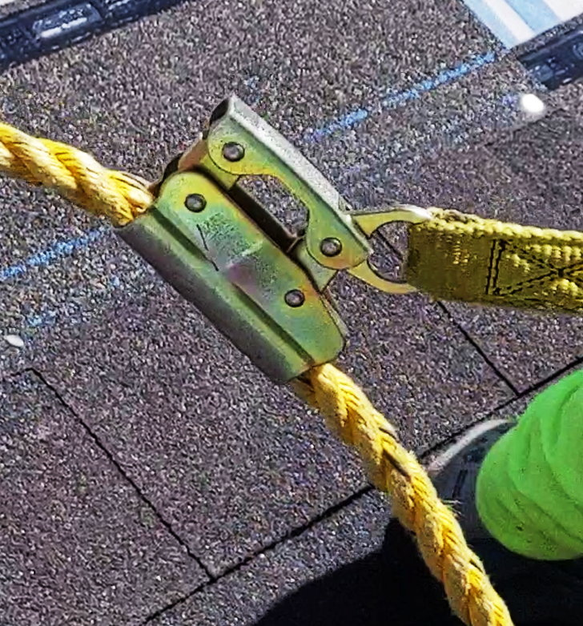
Rope Adjuster
A rope adjuster allows a worker to move along a vertical lifeline, but engages and locks on the lifeline when the worker releases the lever.
When using a rope adjuster, keep the following in mind:
The rope adjuster must be compatible with the lifeline.
The rope adjuster must be correctly attached to the lifeline (not upside down).
Keep the rope adjuster as close to the anchor as possible on the lifeline.
ROOFING: systems and devices

Slide 35
Video: Parapets
ROOFING: systems and devices
Notes:
https://vimeo.com/608759788

Slide 36
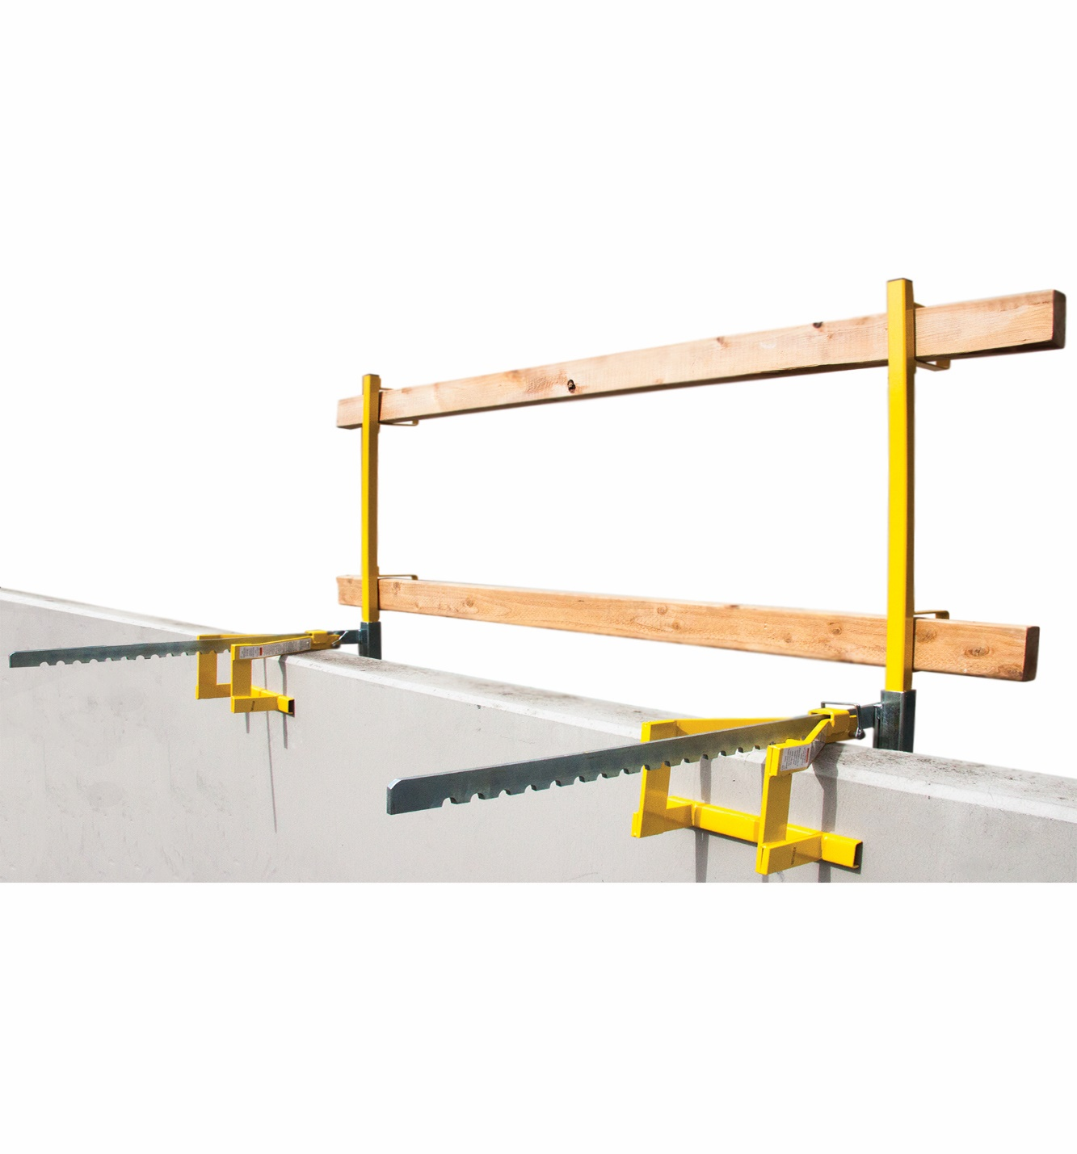
Parapet Clamp Guardrail
An often-overlooked option, the parapet clamp guardrail can provide a temporary fall prevention system.
The system is adjustable, and when set up correctly, complies with Oregon OSHA standards.
*Remember, always consult with your manufacturer’s instructions.
ROOFING: systems and devices

Slide 37
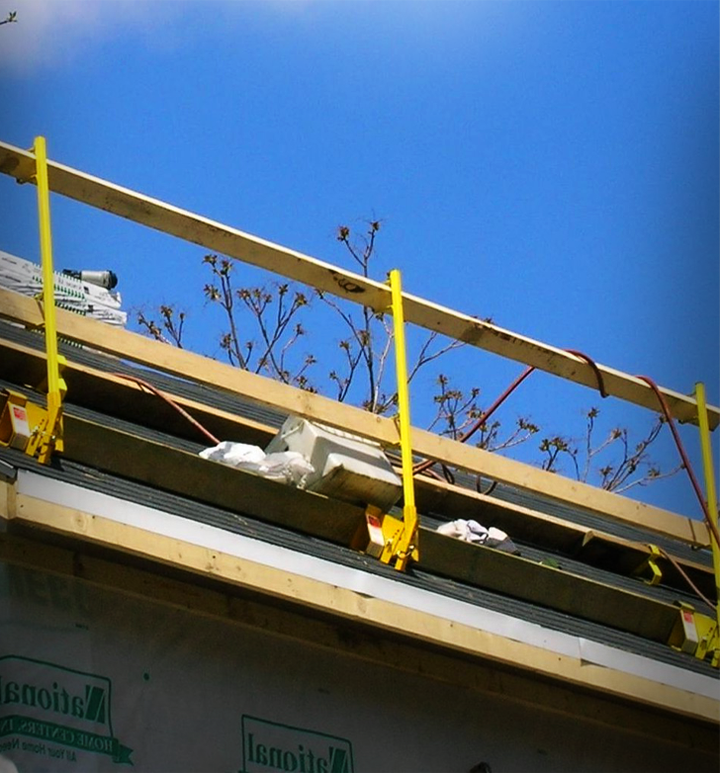
Residential Guardrail System
While not as common as other options, guardrail systems can be used as fall protection on residential roofs.
*Remember, always consult with your manufacturer’s instructions.
ROOFING: systems and devices

Slide 38
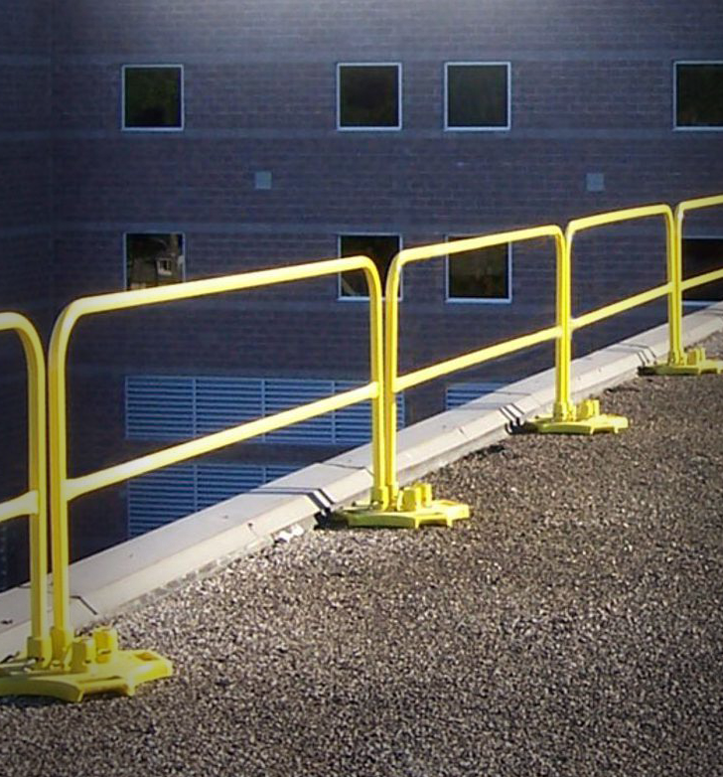
Guardrails
Guardrails over other options, when installed correctly, reduce the amount of human error, inherent with other systems. Parts include:
Top rail
Midrail, screens, mesh, intermediate vertical members, etc.
They can also be combined with toeboards for falling object protection.
Click the links for more information.
Construction (Fact Sheet)
Guardrail Requirements in Division 3, Subdivision M, Fall Protection
ROOFING: systems and devices

Slide 39
Video: Safety Monitor
ROOFING: systems and devices
Notes:
https://vimeo.com/608760720

Slide 40
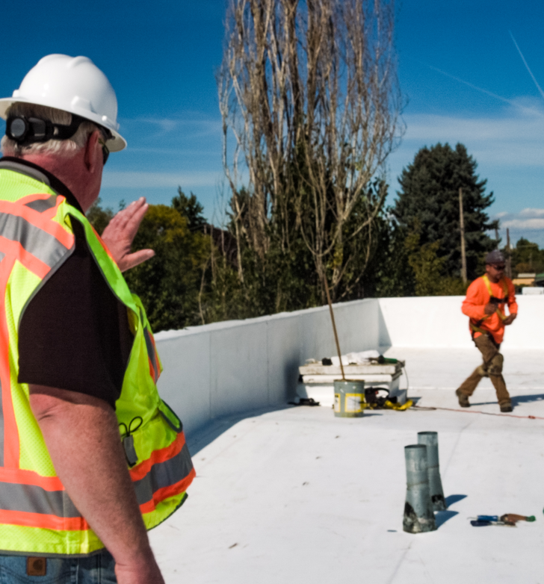
Safety Monitor
Safety monitoring systems for roofing work can only be used to protect employees on roofs that have slopes no greater than 2:12.
They are not permitted on roofs more than 50 feet in width, unless a warning-line system is also installed to keep employees from coming too close to an unprotected roof edge.
Click the link for more information:
Safety Monitor Requirements in Division 3, Subdivision M, Fall Protection
ROOFING: systems and devices

Slide 41
Video: Warning Lines
ROOFING: systems and devices
Notes:
https://vimeo.com/608762514

Slide 42
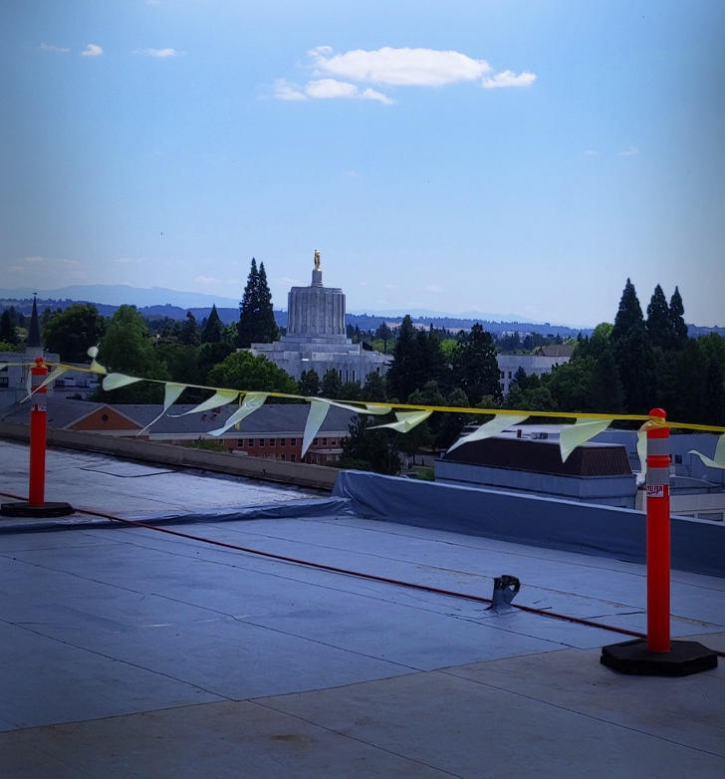
Warning Lines
A warning line system is designed to warn roofers that they are near an unprotected edge.
It consists of ropes, wires, or chains, and supporting stanchions that mark off the area where work can be done without other types of fall protection.
It can only be used for roofing work on roofs that have slopes of 2:12 or less, vertical to horizontal.
ROOFING: systems and devices

Slide 43
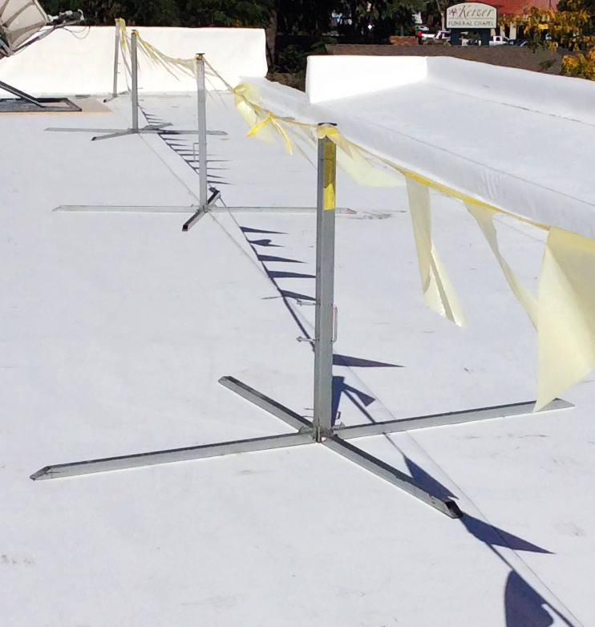
Warning Lines
Those who do roofing work between the warning line and an unprotected roof edge must be protected with personal fall-arrest systems, fall-restraint systems, guardrail systems, safety monitoring systems, or safety nets.
Warning line systems for roofing work where mobile equipment is being used, must be set up at least 10 feet from an unprotected edge.
Click the link for more information.
Warning Line Requirements
ROOFING: systems and devices

Slide 44
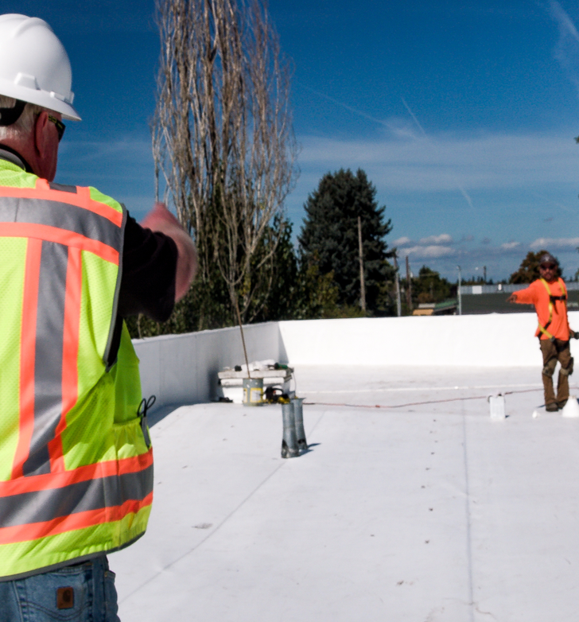
Safety Monitor / Warning Lines
Click the links to view our Safety Monitoring for Roofing Work, and Using Warning Lines Fact Sheets.
Safety Monitor
Warning Lines
ROOFING: systems and devices

Slide 45
Video: Trauma Straps
ROOFING: systems and devices
Notes:
https://vimeo.com/608762514

Slide 46
Module 4: Additional Considerations
FALL PROTECTION FOR ROOFING

Slide 47
Video: First Up, Last Down
ROOFING: additional considerations
Notes:
https://vimeo.com/608763486

Slide 48
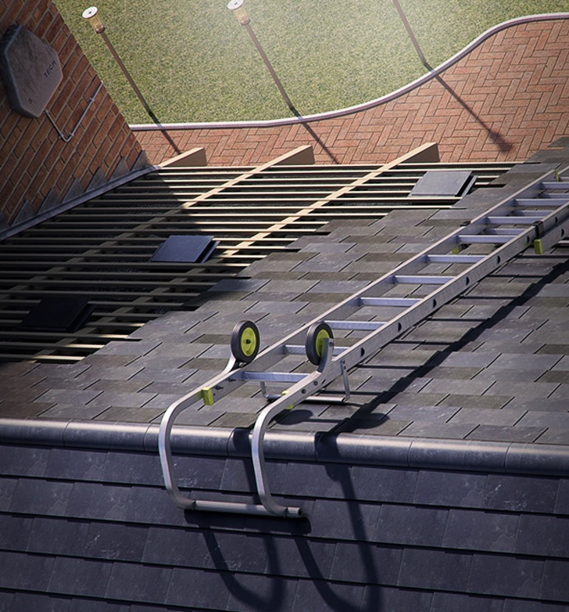
Roof Ridge Ladder Hooks
Roof ridge ladder hooks can secure almost any straight or extension ladder to a roof.
They can provide safer access when establishing your first anchor point.
*Remember, always consult with your manufacturer’s instructions.
ROOFING: additional considerations

Slide 49
Video: Safe Access
ROOFING: additional considerations
Notes:
https://vimeo.com/608764775

Slide 50
NIOSH Ladder App
Click the link, or scan the QR Code to download the NIOSH Ladder app. The app can help with:
Planning
Selection
Inspection
Set-up
Proper Use
Accessories
*The app is only available on mobile devices
(e.g. cellphones, tablets).
NIOSH Ladder Safety App
ROOFING: additional considerations

Slide 51
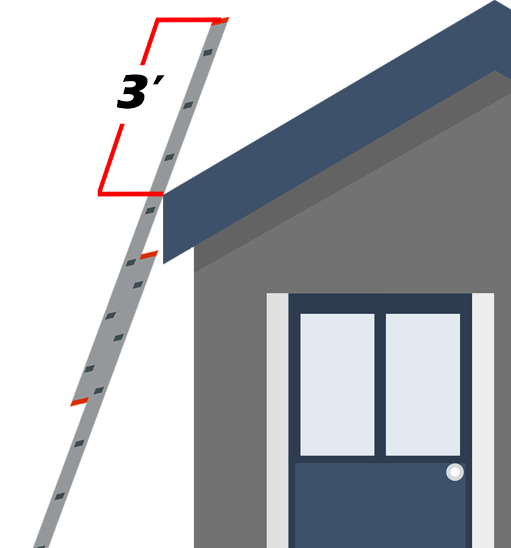
Access to Upper Landing
When portable ladders are used for access to an upper landing, they need to have the side rails extended at least 3 feet above the upper landing.
*Do not place any weight on the rungs located above the upper landing when using non-self supporting ladders to access an upper level.
ROOFING: additional considerations

Slide 52
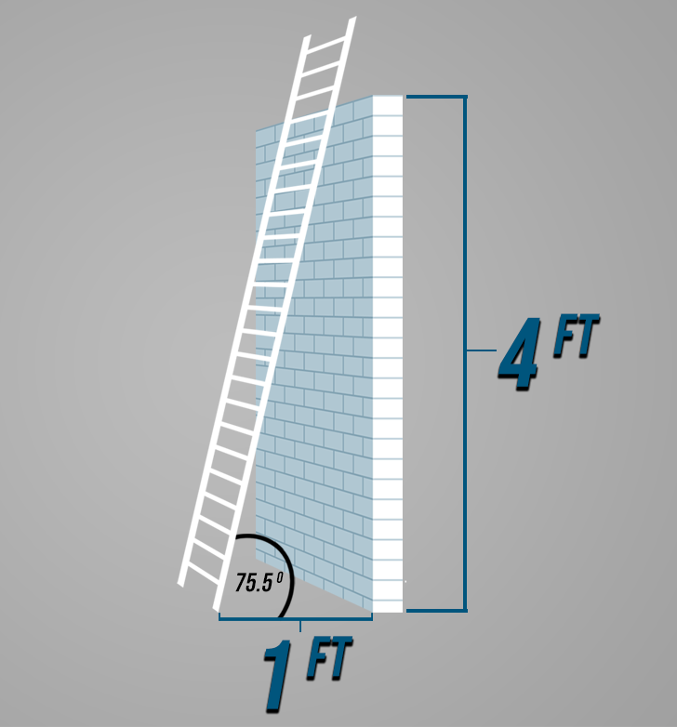
4:1 Ratio
Extension ladders need to be placed so that the working length of the ladder is four times the
horizontal distance from the ladder’s base to the structure — a 4:1 ratio.
ROOFING: additional considerations

Slide 53
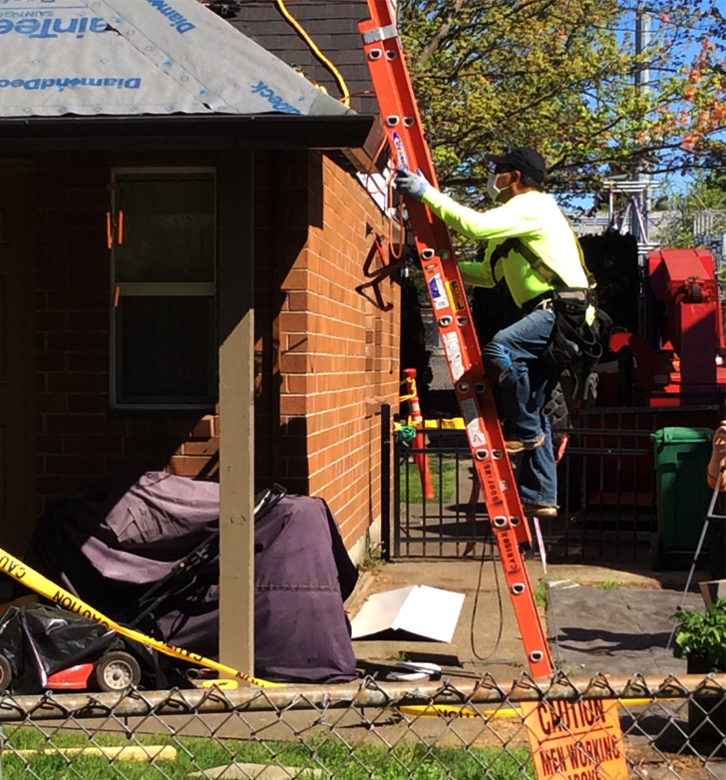
Ladder Safety Training
If you would like to learn more about ladders and how to use them safely, checkout our online ladder safety training by clicking the link.
Ladder Safety Training
ROOFING: additional considerations

Slide 54
Video: Transporting Materials
ROOFING: additional considerations
Notes:
https://vimeo.com/608766418

Slide 55
Video: Rescue
ROOFING: additional considerations
Notes:
https://vimeo.com/608767164

Slide 56
Video: Job Completion
ROOFING: additional considerations
Notes:
https://vimeo.com/608767723

Slide 57
Module 5: Conclusion
FALL PROTECTION FOR ROOFING

Slide 58
Video: Training for Roofers
ROOFING: conclusion
Notes:
https://vimeo.com/608768672

Slide 59
Video: Inspection Training
ROOFING: conclusion
Notes:
https://vimeo.com/608770778

Slide 60
Video: Ongoing Training
ROOFING: conclusion
Notes:
https://vimeo.com/608772056

Slide 61
Training Certification
In regard to certification of training, the employer must prepare a written certification record. This record needs to have the name of the employee trained, dates of the training, and the signature of the person who conducted the training or the employer. Once all of this is completed, you need to maintain the latest training certification.
In some instances the employee may have received training from a previous employer. If this is the case, the record needs to indicate when the current employer determined the prior training was adequate rather than the date of the actual training.
ROOFING: conclusion

Slide 62
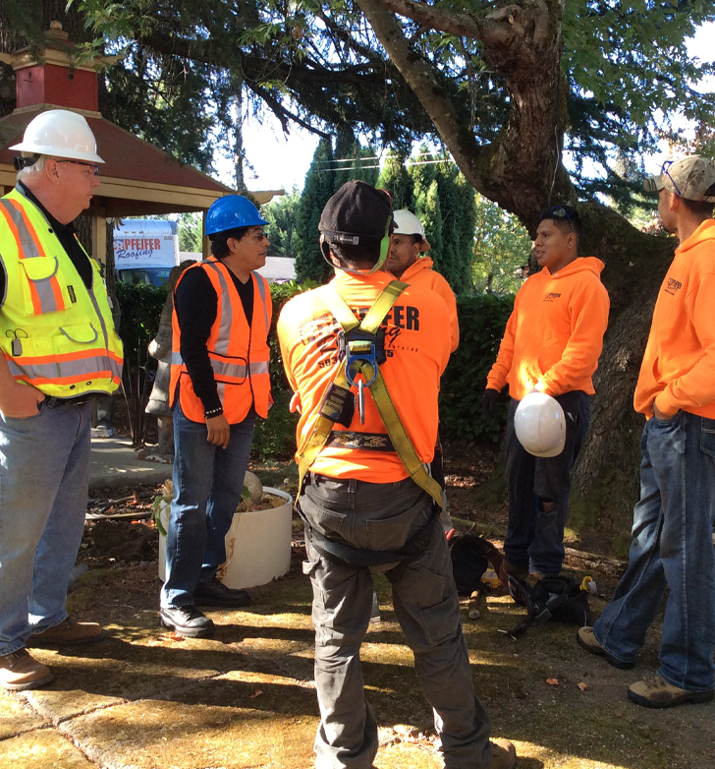
Retraining
When the employer has a reason to believe that an employee, who has already been trained, doesn’t have the required knowledge or skills, they need to retrain the employee. Examples where retraining is required include:
Changes in the workplace or fall protection systems being used has made the previous training obsolete.
It is evident that the employee has not retained the necessary knowledge and skills from the training.
ROOFING: conclusion

Slide 63
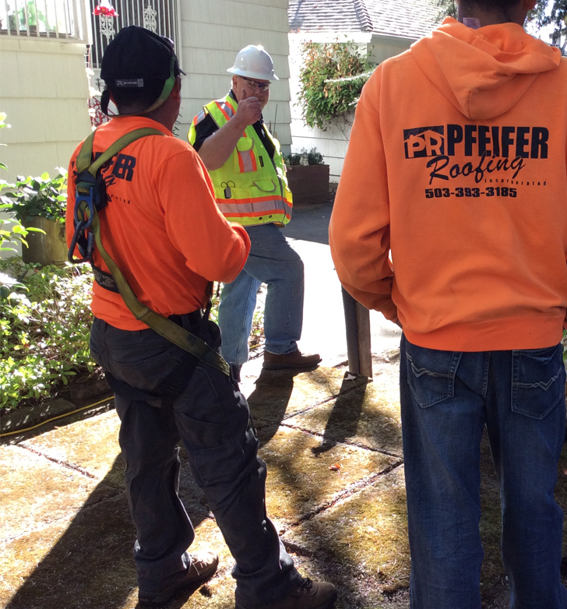
Training Requirements
Before any employee is exposed to a fall hazard, the employer must provide training for each employee who uses personal fall protection systems, or who is required to be trained as specified by Oregon OSHA.
For more information on training, click the links.
Fall protection for construction activities
Safety monitoring for roofing work
Division 3, Subdivision M, Fall Protection
Walking-working surfaces: At a glance
Division 2, Subdivision D, Walking-Working Surfaces
ROOFING: conclusion

Slide 64
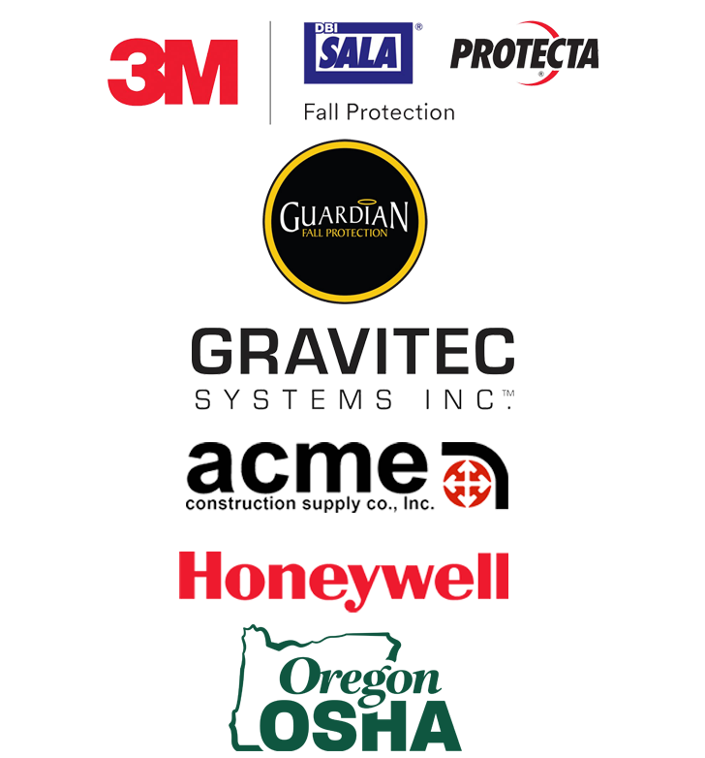
Additional Resources
There are many places to get training resources. We have provided a list of a few companies that provide training materials.
Just click the links to view their websites.
3M | DBI SALA | PROTECTA
Guardian Fall Protection
GRAVITEC
ACME University
Honeywell
OR OSHA Topic Index
ROOFING: conclusion

Slide 65
Video: Roofing Culture
ROOFING: conclusion
Notes:
https://vimeo.com/608773492

Slide 66
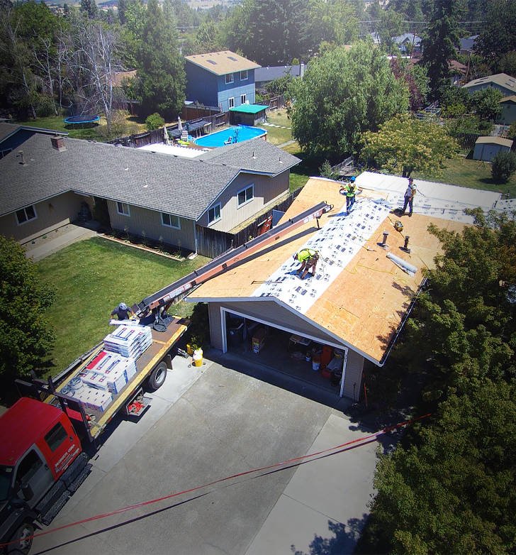
Safety and Health Program
To view more information on the fundamentals of an effective safety and health program, click the link below.
Foundation of a Safe Workplace
ROOFING: conclusion

Slide 67
Fall Protection for Roofing - Quiz
Question 1
What can help reduce the risk of swing fall?
Vertical Lifeline
Horizontal Lifeline
Fall Arrest
SRLs (Self-Retracting Lifelines)
Question 2
A rope adjuster allows a worker to move along a vertical lifeline.
True
False
ROOFING: conclusion

Slide 68
Fall Protection for Roofing - Quiz
Question 3
When does a rope adjuster engage and lock?
Automatically
When the worker releases the lever
Never
None of the above
Question 4
When using a rope adjuster, you should check the following:
It is compatible with the lifeline
It is correctly attached to the lifeline
It is as close to the anchor as possible on the lifeline
All of the above
ROOFING: conclusion

Slide 69
Fall Protection for Roofing - Quiz
Question 5
Safety monitor systems can be used as a sole fall protection option for roofing work on roofs with a slope no greater than:
2:12
4:12
6:12
8:12
Question 6
Safety monitor systems cannot be used as a sole fall protection option on roofs that are greater than 50 feet in width:
True
False
ROOFING: conclusion

Slide 70
Fall Protection for Roofing - Quiz
Question 7
Warning lines can be used as a sole fall protection option on roofs with a slope greater than 2:12.
True
False
Question 8
Generally, warning lines need to be set how many feet back from the edge?
1
2
4
6
ROOFING: conclusion

Slide 71
Fall Protection for Roofing - Quiz
Question 9
The employer must have a written certification record of training.
True
False
Question 10
Retraining is required when:
Changes in workplace has made previous training obsolete
Changes in fall protection systems made the previous training obsolete
It is evident the employee has not retained the necessary knowledge and skills
All of the above
ROOFING: conclusion

Slide 72
Fall Protection for Roofing - Quiz
Question 11
Skylights are the only kinds of holes that can be present on a roof.
True
False
Question 12
When installing your anchors you should follow the manufacturer’s instructions.
True
False
ROOFING: conclusion

Slide 73
Fall Protection for Roofing - Quiz
Question 13
A parapet can act as a form of fall protection if it is at least how tall?
30 inches
33 inches
39 inches
None of the above
Question 14
Trauma straps are used to help prevent clots from forming that occur when a worker hangs in their harness for too long after a fall.
True
False
ROOFING: conclusion

Slide 74
Fall Protection for Roofing - Quiz
Question 15
The first person up on the roof should only be installing and testing the anchor point.
True
False
Question 16
All covers shall be color coded or they shall be marked with the word “HOLE” or “HOLE COVER” to provide warning of the hazard.
True
False
ROOFING: conclusion

Slide 75
Fall Protection for Roofing - Quiz
Question 17
Which of the following can help limit swing fall?
Properly adjusting rope adjustor
Using a horizontal lifeline
Using multiple anchors
All of the above
Question 18
Employers need to train employees on how to inspect their fall protection equipment.
True
False
ROOFING: conclusion

Slide 76
Fall Protection for Roofing - Quiz
Question 19
When using a ladder to access the roof, how many feet should it extend above the edge?
1
2
3
4
ROOFING: conclusion

Slide 77
Fall Protection for Roofing – Quiz Answers
B
A.
B
D
A
A
B
D
A
D
B
A
C
A
A
A
D
A
C
ROOFING: conclusion

Slide 78
Where To Go From Here
Oregon OSHA’s online A-Z topic index is an excellent resource for you to use. It lists relevant publications, training material, rules, interpretations, videos, and other miscellaneous material.
If you want guidance in developing a safer work environment, you may consider our free and confidential consultation service. Our consultants in workplace safety, industrial hygiene, and ergonomics can help you reduce accidents, and related costs, and develop a comprehensive program to manage safety and health.
ROOFING: conclusion

Slide 79
Congratulations
You’ve completed the Fall Protection for Roofing training!
ROOFING: conclusion

