Slide 1
ACCIDENT INVESTIGATION
Module 1: Gather Information
Please note: If the online course contains videos, the video links are included in this PPT.
You will need to have an internet connection to play the videos or
you can download the videos and embed them into your copy of this PPT presentation.

Slide 2
Disclaimer
This online training program was created to help you gain the basic skills necessary to conduct an effective accident investigation and complete an accident investigation report. This course helps meet the safety committee member requirements⁽¹⁾ for training in principles of accident and incident investigations. It is your employer’s responsibility to further your training specific to your organization, such as forms, policies, and practices.
This material should not be considered a substitute for any provisions of the Oregon Safe Employment Act, or for any standards issued by Oregon OSHA.
**Please note: If taking this course on a smaller mobile device such as a smartphone, you may encounter issues. The course works best on standard-sized screens, such as a laptop or tablet.
ACCIDENT INVESTIGATION: gather information

Slide 3
Course Goals
Welcome to the Accident Investigation online training! In this course, you will learn about:
Accident-related Oregon OSHA rules,
Accidents vs. incidents,
The 3 primary tasks in an accident investigation: Gathering Information, Analyzing Event Facts, Implementing Solutions, and
The steps involved within each of the primary tasks, including making recommendations and writing the accident report.
In this first module, we will cover accidents and incidents and relevant Oregon OSHA rules that apply to them, as well as the first primary task in an accident investigation: gathering information.
Let’s get started!
ACCIDENT INVESTIGATION: gather information

Slide 4
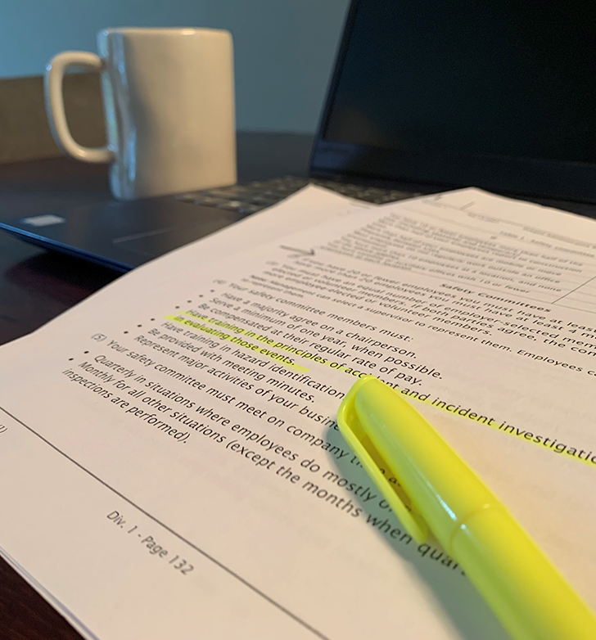
Oregon Rules
There are several rules about accident investigation that apply to this training:
The Oregon Safe Employment Act ORS 654.182 and .176⁽²⁾ requires safety committees to: (B) Establish procedures for investigating all safety incidents, accidents, illnesses and deaths.
OAR 437-001-0760 ⁽³⁾: (3) Investigations of Injuries. (a) Each employer must investigate… every lost time injury that workers suffer… to determine the means that should be taken to prevent recurrence.
OAR 437-001-0765⁽⁴⁾: (4) …safety committee members must: Have training in the principles of accident and incident investigations for use in evaluating those events. (8) Your safety committee must adopt accident investigation procedures that will identify and correct hazards; and evaluate all accident and incident investigations and make recommendations for ways to prevent similar events from occurring.
OAR 437-001-0053⁽⁵⁾: employers must preserve the physical evidence and not disturb the accident scene.
ACCIDENT INVESTIGATION: gather information

Slide 5
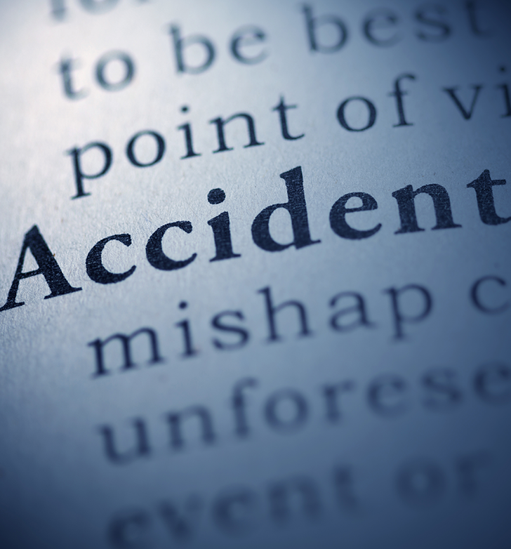
Accident vs Incident
Let’s talk about the difference between an accident and an incident.
An accident is an unexpected event or exposure that results in an injury or illness to an employee or property damage.
An incident is an event that could have resulted in personal harm or property damage.
An incident is often referred to as a near-miss or close call. An accident could be considered an incident with consequences. Proactively investigating an incident would help to prevent an accident from happening. Both accidents and incidents are preventable and should be investigated.
The object of every investigation is to prevent a repeat of the accident, and find facts in order to recommend solutions.
ACCIDENT INVESTIGATION: gather information

Slide 6
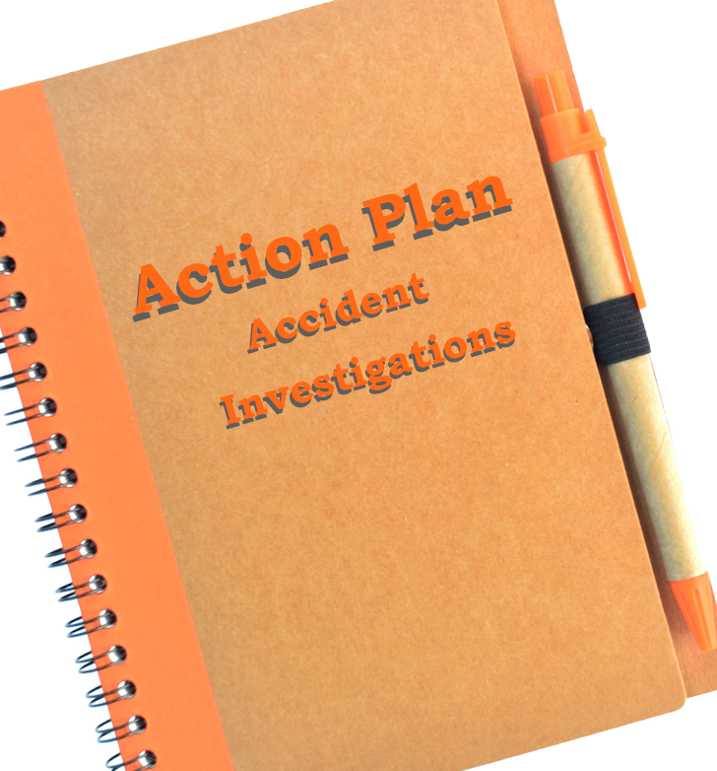
Create an Action Plan
Accidents can be a time of confusion, chaos, and high emotions. Some people will be busy dealing with the emergency at hand and others may be too shaken up to think clearly in the moment. Having a written action plan that outlines what, when, and who should do things can save valuable time. In your plan, include:
Who should be notified of an accident, and who is authorized to notify outside agencies (fire, police, Oregon OSHA, etc.),
Who is assigned to conduct investigations,
Who receives and acts on investigation reports,
A list of the typical people to interview and collect witness statements from,
Expectation of time frames for conducting the investigation and follow-up actions such as correction of the unsafe condition or action,
Where the investigator’s kit is located (more on this later), and
Who files a report with Oregon OSHA, if needed, and the relevant timeframes (see next slide).
ACCIDENT INVESTIGATION: gather information

Slide 7
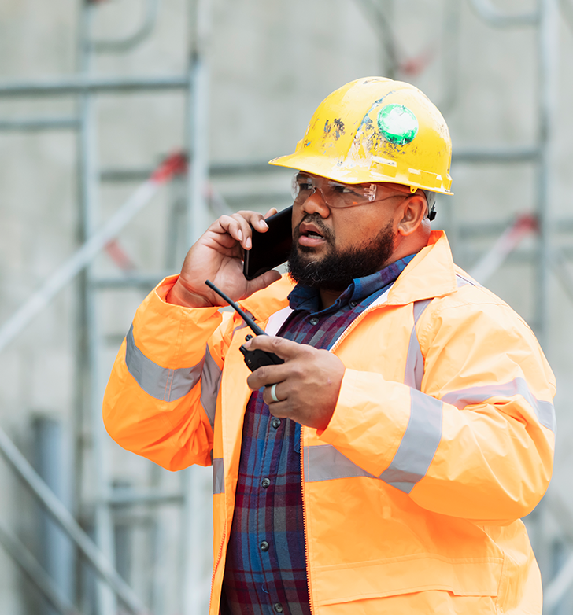
Reporting an Accident
If the accident resulted in a serious injury⁽⁶⁾ or a fatality, you are required⁽⁷⁾ to report it to Oregon OSHA. The reporting time frames start as soon as the employer representative has knowledge of the accident and are as follows:
8 Hours:
Fatality/serious injury*
Catastrophe**
24 Hours:
All in-patient hospitalizations
Amputations and avulsions that include bone or cartilage loss, and the loss of an eye
For more information, check out Oregon OSHA’s resources⁽⁸⁾ about reporting rules, including an online course⁽⁹⁾.
* Fatalities and some serious injuries are investigated by Oregon OSHA.
** A catastrophe consists of 2 or more fatalities or 3 or more employees hospitalized from the same event.
ACCIDENT INVESTIGATION: gather information

Slide 8
Primary Tasks and Steps
There are 3 primary tasks of an accident investigation, and 2 steps within each task. In this module, we will focus on the first task and steps:
1. Gather Information
a. Secure the scene
b. Collect facts about what happened
2. Analyze Event Facts
a. Develop the sequence of events
b. Determine the causes
3. Implement Solutions
a. Recommend improvements
b. Write the report
ACCIDENT INVESTIGATION: gather information

Slide 9
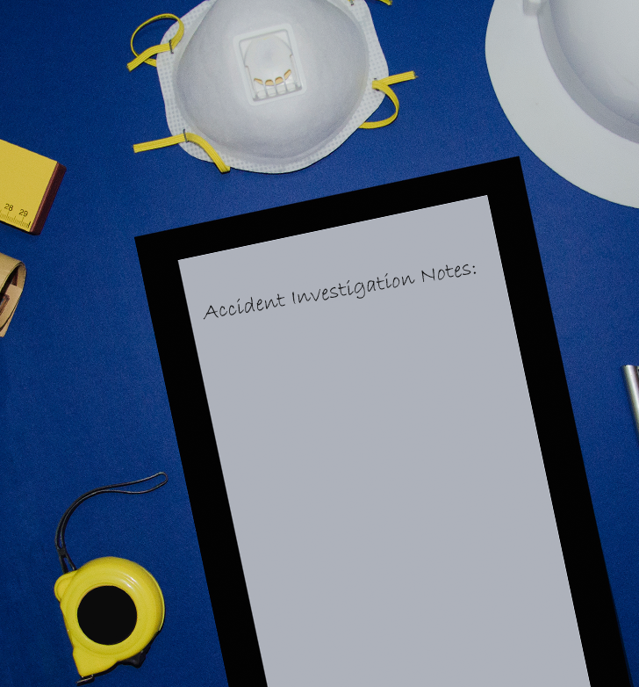
Investigator’s Kit
As mentioned earlier, things can be chaotic during an accident and time is of the essence. Don’t lose an opportunity to gather important facts because you don’t have your equipment handy! Create an “investigator’s kit” and have it packed in a backpack or duffel bag, ready to go at all times. Items in your kit might include:
Tape Measure
Clipboard, paper, pencil/pens
Interview/witness statement forms
First aid kit
Flashlight
Personal protective equipment appropriate to your business
Report forms
Paper or plastic bags with ties
Caution or barricade tape, and
Camera (or use your phone to take pictures).
ACCIDENT INVESTIGATION: gather information

Slide 10
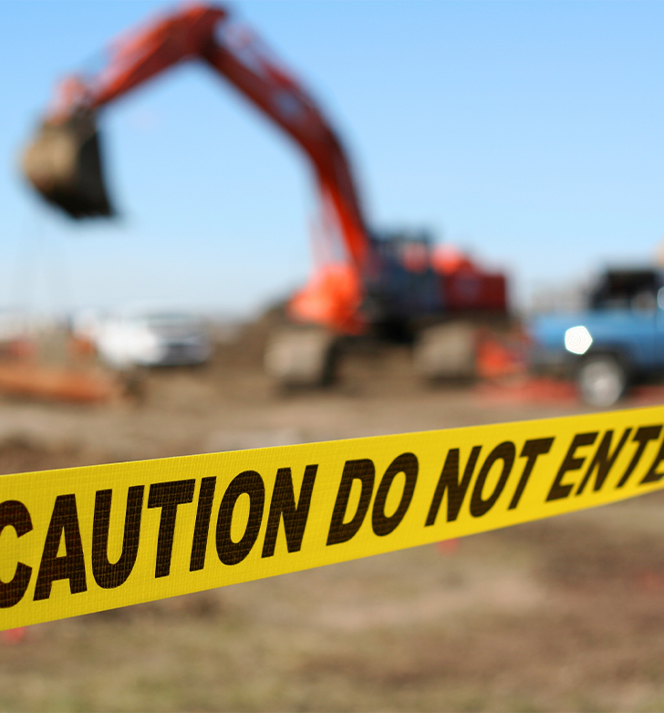
Secure the Scene
OAR 437-001-0053⁽¹⁰⁾ requires the accident scene and the physical evidence to be preserved, until instructed otherwise by the Administrator or other law enforcement agency. As the accident investigator, it is critical to secure the scene and begin initial observations as soon as possible because key evidence can become displaced by emergency responders and people’s memory of the event can change with the passing of time.
Ensure the scene is safe to enter before securing it and treat all items at the scene as important and potentially relevant to the investigation.
Sometimes you can begin this while emergency responders are helping the victim(s), other times you need to wait until they have finished. If you must wait, begin making initial observations.
Securing the scene includes isolating energy sources and blocking or cribbing any unstable equipment or loads. Make the location as inaccessible as possible to others, using cones, tape, or anything else available such as personnel, until the root cause can be determined and safety controls implemented.
ACCIDENT INVESTIGATION: gather information

Slide 11
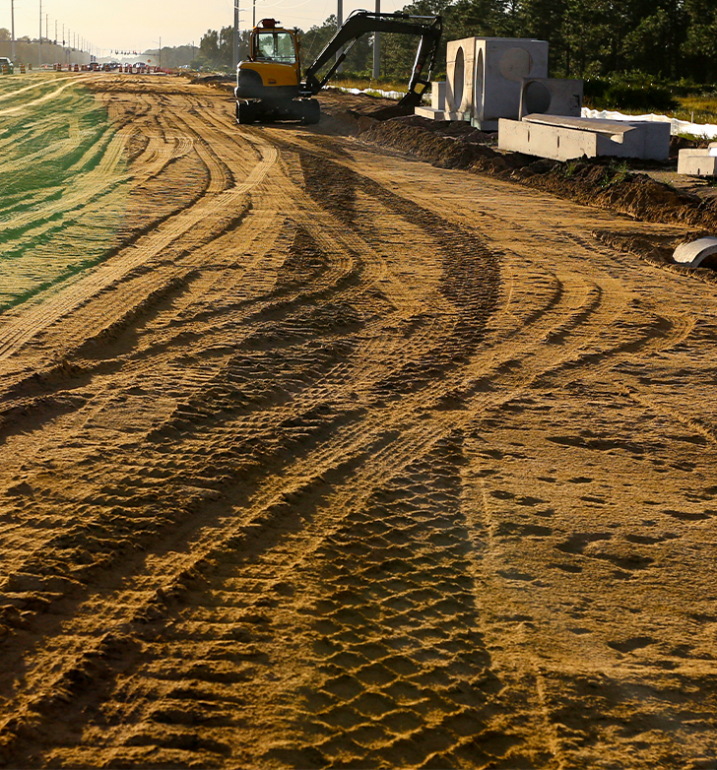
Collecting Facts: Initial Observations
Either when you are waiting to secure the scene or immediately after you have done so, some initial observations to start documenting include:
What you see, smell, hear.
Any equipment, tools, materials, and structures that are broken, damaged, or otherwise involved in the accident, and their serial or manufacturer numbers. Look for gouges, scratches, dents, etc. and note the orientation of the equipment.
If vehicles are involved, check for tracks and skid marks, any fluid spills, stains, contaminated materials, or debris.
The environmental conditions such as the terrain (flat or rough), and weather. Look for distractions or adverse conditions.
The time of day, location, lighting conditions, etc.
Distances and positions of everything in the scene.
The activity occurring around the scene.
Who is and is not at the scene. You’ll need this information for initial statements and interviews.
ACCIDENT INVESTIGATION: gather information

Slide 12
Challenge of Collecting Facts
One of the biggest challenges facing an investigator is determining which information is relevant to what, how, and why the event happened. And you must be mindful of any preconceived notions you may have about the event. If you think you already know what happened, you may subconsciously disregard important evidence.
Before you decide what is relevant, you must collect facts from as many sources as possible, and document as much as possible. Sometimes this can feel like an information overload, but
you can always discard information later on if it proves not useful to the investigation. Some people use spreadsheets as a helpful documentation tool to organize all of the information they’ve gathered. (We’ll visit this idea again in Module 2.)
ACCIDENT INVESTIGATION: gather information

Slide 13
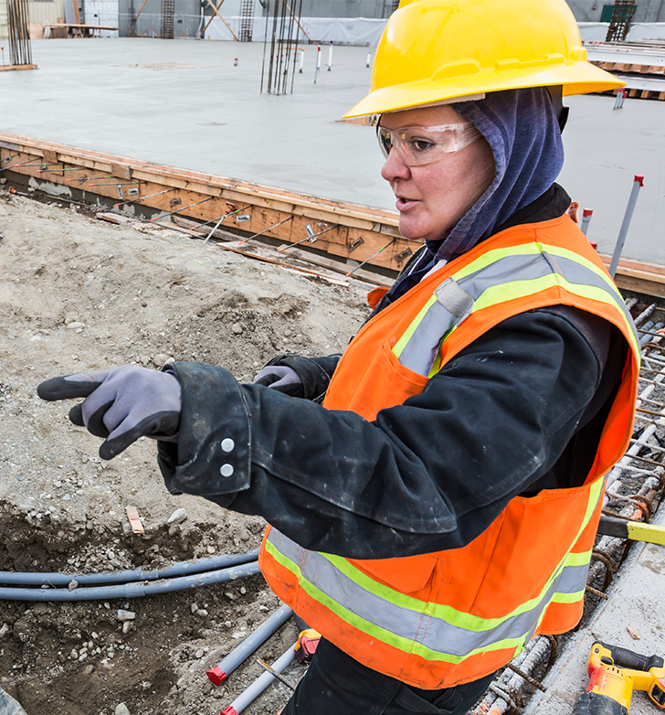
Collecting Facts: Initial Statements and Interviews
Interviews should occur as soon as possible; sometimes you can start while the emergency is being addressed, as long as it is safe to do so. You will need to determine who needs to be interviewed and then design your questions for each individual interviewee. We’ll discuss interviewees in more detail in the next few slides.
If there are witnesses to the accident, ask each of them separately to give an initial statement that describes what they saw. Although a witness is typically described as someone who saw the accident happen, for the investigation purpose, “witness” takes on a broader definition and may be someone who:
Heard the accident,
Was the first to come to the accident scene,
Was the last person to see or interact with the victim before the accident, or
Has any relevant information.
ACCIDENT INVESTIGATION: gather information

Slide 14
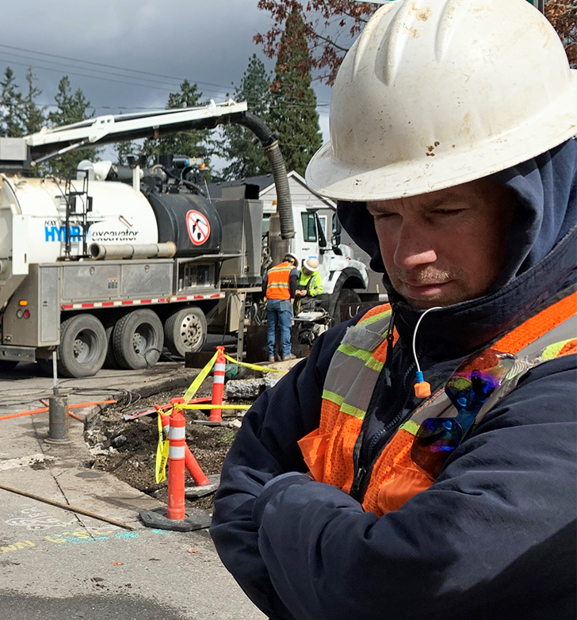
Interviewees (I)
The following are some examples of people to interview about the accident and why:
Witnesses: to gather all of the details of what occurs.
The victim: to determine specific events leading up to and including the accident.
Co-workers: to establish that the safety procedures for the task were followed.
Direct supervisor: to gather background information on the victim and information about the procedures for the task that was being performed when the accident happened.
Others who do the same job (all shifts): to establish what the normal practices are for the task the victim was performing.
Safety Committee: to determine if there is a history of this safety issue.
Training Department: to get information on quantity and quality of training the victim and others have received.
ACCIDENT INVESTIGATION: gather information

Slide 15
Interviewees (II)
Personnel department: to get information on the victim’s work history, discipline, and appraisals.
Maintenance personnel: to determine background on equipment/machinery maintenance. Maintenance personnel work with the equipment routinely and should be a knowledgeable source of information.
Emergency responders: to learn what they saw when they arrived and during the response.
Medical personnel: to get medical information (as allowed by law).
Medical examiner: to determine type/extent of fatal injuries.
The victim’s spouse or family: to see if they have insight into the victim’s state of mind or any issues that might be affecting them.
Up next, we will discuss interviewing tips.
ACCIDENT INVESTIGATION: gather information

Slide 16
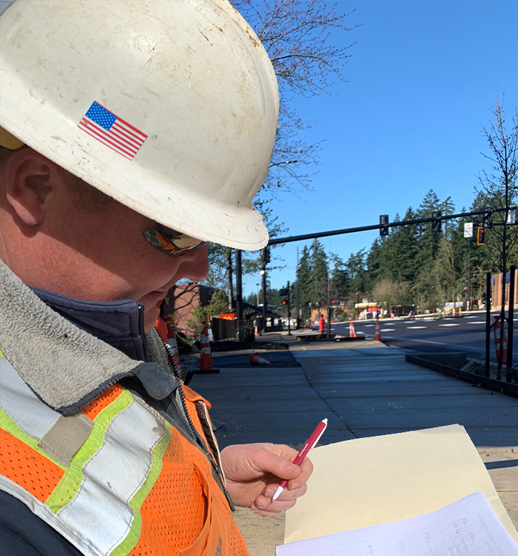
Interviewing Tips (II)
People may be nervous to be interviewed about an accident, so it is important to assure them of your goal to gather as much information to help prevent this type of accident from happening again. Some tips to keep in mind when conducting your interviews include:
Interview people one at a time so they can be candid and recall their information without being influenced by someone else’s account.
If you are recording the conversation for accuracy, ask for and obtain permission first.
Approach with an open mind and treat them as you would like to be treated.
Ask open-ended questions.
Do not promise confidentiality because it cannot be guaranteed.
ACCIDENT INVESTIGATION: gather information

Slide 17
Interviewing Tips (II)
Take careful notes, and verify responses with the interviewee.
Try to keep eye contact with the interviewee instead of only looking at your notes. Be personable and let them know they have your attention.
Ask if they have any suggestions as to how the accident could have been avoided.
Conclude the interview by thanking them for their contribution and let them know they can contact you if they remember any other important information later.
ACCIDENT INVESTIGATION: gather information

Slide 18
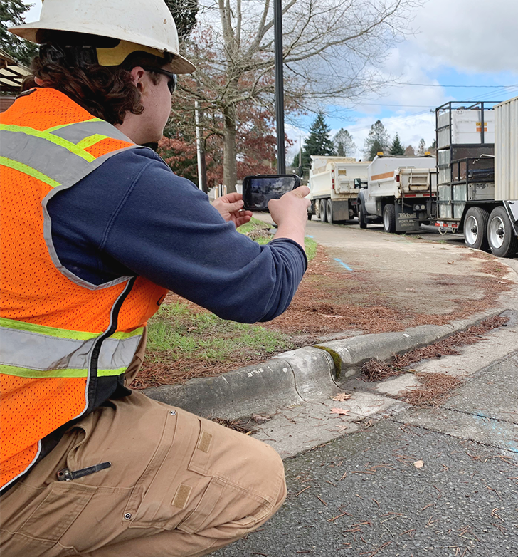
Documenting the Scene
Taking photographs and/or video of the scene can pick up details you may miss during your initial observations, and can provide valuable information to the investigation. If emergency responders are on scene with the victim, photograph/record the scene without impeding their work. Some tips for your photo/video process:
Start with distance shots, then zoom in closer.
Take pictures/video from different angles to show relationships between objects.
Take 360° video and panoramic photos to capture the maximum amount of the scene.
For close-up shots, include an object to give relative size, such as a ruler or dollar bill.
Narrate as you record, and label your photographs with details such as date, time, location, subject, weather conditions, measurements, and name of videographer/photographer.
If a vehicle was involved, video/photograph both the coming and going directions that it traveled.
Watch the video in the next slide to hear one investigator’s experience of photographing an accident scene.
ACCIDENT INVESTIGATION: gather information

Slide 19
Video: The Importance of Documenting with Images
ACCIDENT INVESTIGATION: gather information

Slide 20
Sketching the Scene
Another way to collect facts is by sketching the accident scene. Sketches can complement the scene’s photographs/video by providing distances between objects, placement of evidence, and showing where people were at the time of the accident. It also helps with memory retention, because it requires more time, focus, and attention dedicated to the task.
Some helpful aspects to include in your sketches are:
Basic scene information such as date, time, location, and identity of objects and people.
Measurements and permanent reference points such as a telephone pole or wall.
Each element of the scene, making the sketch large, clear, and as precise as possible.
Directions, and note if the drawing is not to scale.
Location of where each photo was taken in relation to the scene.
A key for any acronyms, symbols, or colors used.
ACCIDENT INVESTIGATION: gather information

Slide 21
Reviewing Documents
The last task of collecting facts is reviewing relevant documents and records. Some that you might want to review include:
Maintenance and inspection records – to determine the maintenance and inspection history of the tools, equipment, and machinery involved in the accident.
Safety Data Sheets (SDS’s) and manufacturer’s specifications – to qualify necessary safety measures.
Training records – to determine the quantity and quality of the training received by the victim and others.
Standard operating procedures (SOP) – to determine the formally established steps in the procedures.
Job hazard analysis (JHA) – to determine if any hazards have been identified.
Safety policies, plans, rules – to ensure they exist and are adequate.
Work schedules – to determine the victim’s condition at the time of the accident, such as being tired from working overtime.
Safety committee minutes – to determine the history of any discussion of related hazardous conditions, unsafe behaviors or program elements.
ACCIDENT INVESTIGATION: gather information

Slide 22
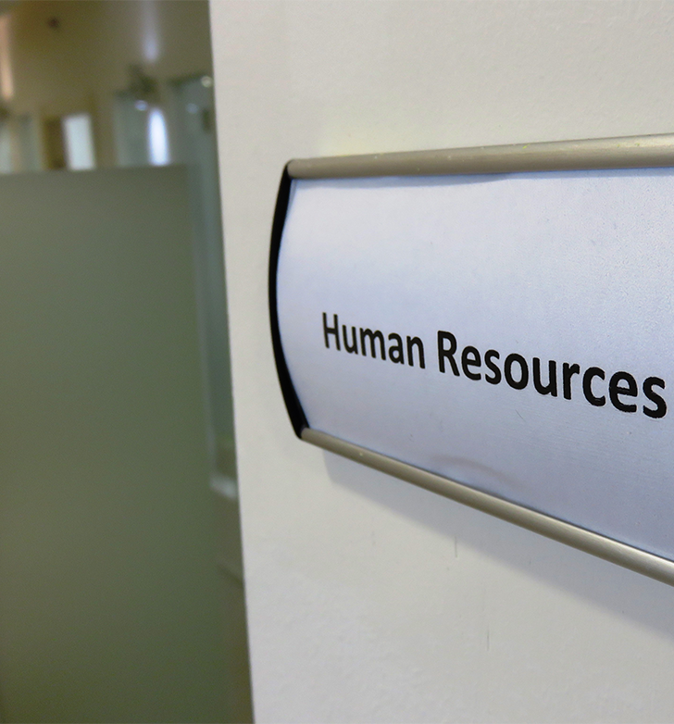
Protected Documents
Some documents that could be helpful to the investigation may also be classified as protected. If the document is considered protected, they should be reviewed by authorized human resources personnel.
Examples of documents include:
Disciplinary records to determine if disciplinary actions have occurred previously.
Injury and illness reports such as OSHA 300 Log, Form 801, SHARPS Injury Log.
Medical Examiner’s report to determine direct cause of injury causing fatality.
ACCIDENT INVESTIGATION: gather information

Slide 23
Practice!
Most likely you won’t be present when an accident or incident occurs. In that case, you will need to depend on witnesses’ memories of the event. However, in this course, you now have the opportunity to apply what you have learned thus far. The next slide contains actual footage of an accident. As you watch it, keep in mind that event investigation is about fact finding, not fault finding. Your role as an investigator, at this point, is to secure the scene and collect facts. Think about these questions for this accident:
What is the best way to secure the scene?
How can I keep the area safe for other employees during my investigation?
How do I protect the evidence?
Who should I interview?
What documents should I review?
Note: This is a silent video of an actual accident; the victim is off camera when the injuries occur, and she did make a full recovery.
ACCIDENT INVESTIGATION: gather information

Slide 24
Video: Accident Example
ACCIDENT INVESTIGATION: gather information

Slide 25
Overview
Congratulations, you’ve completed the first module!
During this module you learned about:
Accidents vs. incidents,
The Oregon OSHA rules that cover accidents and investigations,
The first primary task: Gathering Information, and
The 2 steps of securing the scene and collecting facts.
Additionally, you had the opportunity to practice your knowledge with a recorded accident scene.
Now, it’s time to learn about the second step of analyzing the facts of an accident event. Click the arrow on the right to continue to Module 2!
ACCIDENT INVESTIGATION: gather information

Slide 26
Class Discussion
Take this opportunity to ask/answer questions about the previous module and to summarize the web link addresses discussed in the module.
Module 1 Resources
1) Requirements: https://osha.oregon.gov/OSHARules/div1/437-001-0765.pdf#page=2
2) ORS 654.182: https://www.oregonlegislature.gov/bills_laws/ors/ors654.html
3) OAR 437-001-0760: https://osha.oregon.gov/OSHARules/div1/437-001-0760.pdf
4) OAR 437-001-0765: https://osha.oregon.gov/OSHARules/div1/437-001-0765.pdf
5) OAR 437-001-0053: Division 1, 437-001-0053 through 437-001-0099, Inspections (oregon.gov)
6) Serious Injury: https://osha.oregon.gov/essentials/Pages/report-fatality-or-injury.aspx
7) Required: https://osha.oregon.gov/OSHARules/div1/437-001-0704-0742.pdf
8) Resources: https://osha.oregon.gov/Pages/topics/recordkeeping-and-reporting.aspx
9) Online course: https://osha.oregon.gov/edu/courses/Pages/recordkeeping-and-reporting-online-course.aspx
10) OAR 437-001-0053: https://osha.oregon.gov/OSHARules/div1/437-001-0053-0099.pdf#page=1
ACCIDENT INVESTIGATION: gather information

Slide 27
ACCIDENT INVESTIGATION
Module 2: Analyze Event Facts

Slide 28
Welcome to Module 2
In the previous module, you learned about gathering information, the first primary task in investigating accidents. Now it is time to explore the second primary task, which is about analyzing the facts of the accident event.
1. Gather Information
a. Secure the scene
b. Collect facts about what happened
2. Analyze Event Facts
a. Develop the sequence of events
b. Determine the causes
3. Implement Solutions
a. Recommend improvements
b. Write the report
ACCIDENT INVESTIGATION: analyze event facts

Slide 29
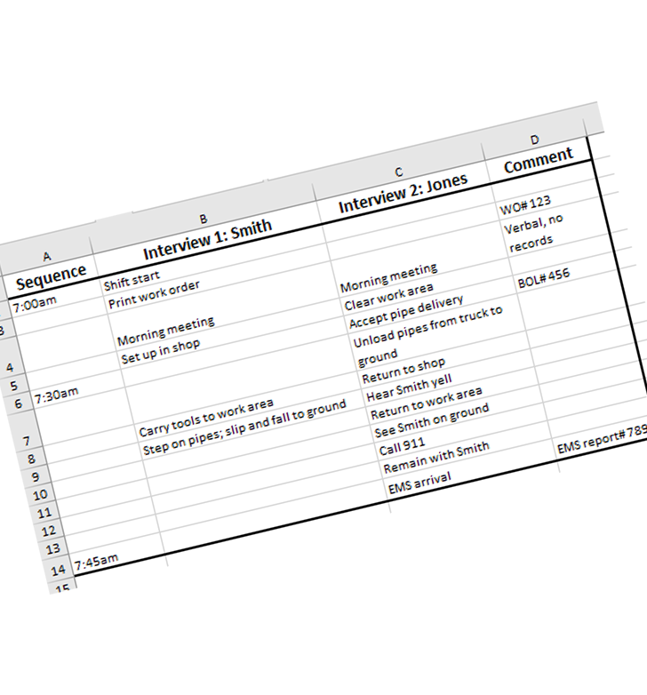
Develop the Sequence of Events
When we understand that an accident is the final event in an unplanned process, we will naturally want to know what the events and factors were preceding the accident.
The goal at this point in the investigation is to determine the sequence of events leading to the accident based on the facts you have collected. Arrange the information to accurately describe the timelines and initial conditions and actions that transformed the planned work process into an unplanned accident process. As mentioned in Module 1, some people find it helpful to use a spreadsheet to organize the information (see example to the left).
Let’s take a look at the elements of an event description in the next slide.
ACCIDENT INVESTIGATION: analyze event facts

Slide 30
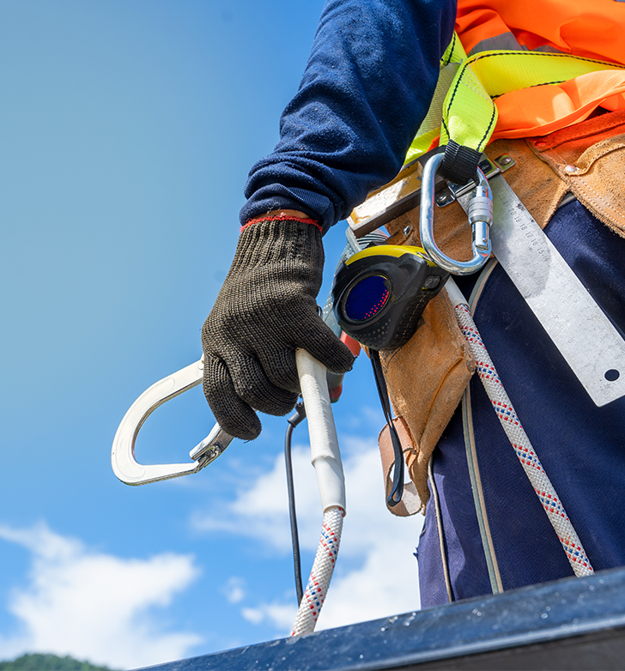
Describe an Event
A unique actor and action describe each cause or factor in the accident process. When describing events, indicate the actor and tell what the actor does. The actor is the doer, not the person or object having something done to them. In the example statement below, Bob is the actor and unhooking is the action. The lanyard and anchor are not actors because they are not performing an action. Rather, something is being done to them.
Example: Bob unhooked the lanyard from the anchor.
Actor: an individual or object that directly influenced the flow of the sequence of events. An actor may participate in the process or merely observe the process.
Action: something that is done by an actor. Actions may or may not be observable. An action may describe something that is done or not done. (Failure to act should be thought of as an action in itself.)
ACCIDENT INVESTIGATION: analyze event facts

Slide 31
Clear Picture
The sequence of events should clearly describe what occurred so that someone unfamiliar with the accident is able to visualize it as they read the accident report. If an accident includes actions by more than one person (actor), break the accident down into events and clearly state which actor did what action. If an accident is difficult to understand, the description might be too vague. Increase the detail by determining if others were involved and/or other actions took place.
To get an idea of what a sequence of events could look like, review the example in the next two slides. This was prepared for an injury investigation conducted by Oregon OSHA and breaks the sequence into 14 separate actions.
ACCIDENT INVESTIGATION: analyze event facts

Slide 32
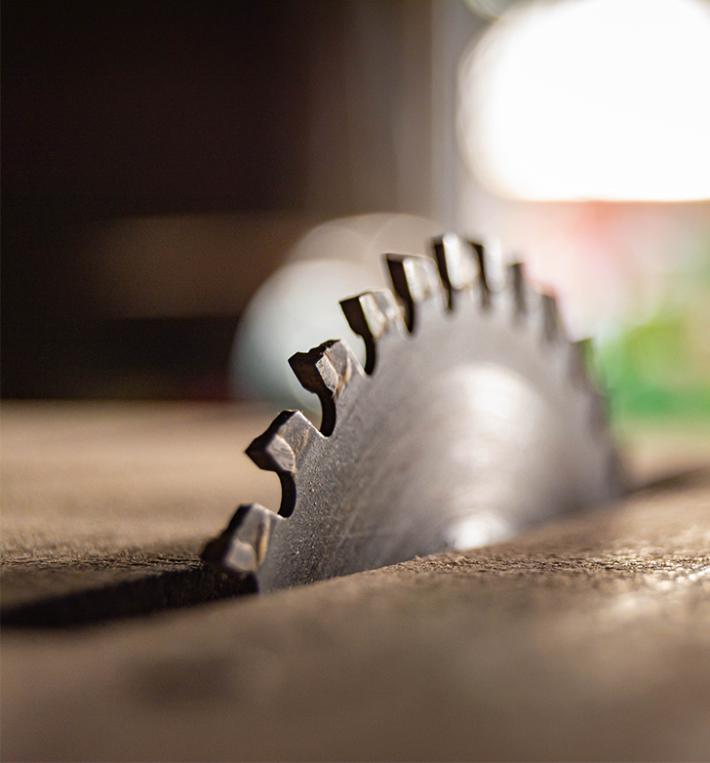
Example Investigation: Actions 1-8
At approximately 9:00 AM, Employee 1 was standing at the infeed side of the table saw.
Employee 1 was cutting a piece of wood measuring approximately ¾” x ¼” x 5’ long into three lengths.
Employee 1 had made two cuts and was making the final ¼ cut.
Employee 1 placed the board on the table saw and, with the 10-inch blade, ran the board through its entire length.
Employee 1 reached over to remove the off-cut (waste).
Employee 1 lightly touched the off cut with his hand when the piece (3/4” x 1/4” x 5’ long) hit the spinning blade.
The blade was spinning at 3500 rpm and caused the piece to shoot toward Employee 1.
The piece cut through Employee 1’s leather belt and waistband and went into his abdomen to a depth of approximately 4 ½ inches.
ACCIDENT INVESTIGATION: analyze event facts

Slide 33
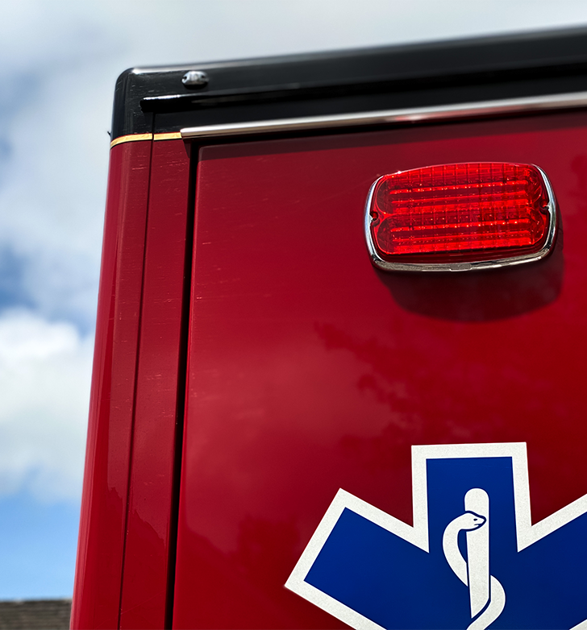
Example Investigation: Actions 9-14
9. Employee 1 fell backward and, as he was falling to the floor, pulled the piece from his abdomen.
10. Employee 2, a cabinet maker in the next room, heard the saw and the cries of Employee 1.
11. Employee #2 ran to Employee 1.
12. After assessing Employee 1’s wound, Employee 2 called the shop supervisor who was only a short distance away.
13. The supervisor, after seeing the injury, called 911, then attempted to make the victim comfortable until the ambulance arrived.
14. Paramedics stabilized the victim and transported him to Providence Hospital, where he underwent surgery for the injury.
This example is brief, and there may be other related factors/causes that indirectly contributed to the accident. However, it does give sufficient descriptive detail for a clear mental picture of the actors and actions that occurred immediately prior to, including, and after the accident.
ACCIDENT INVESTIGATION: analyze event facts

Slide 34
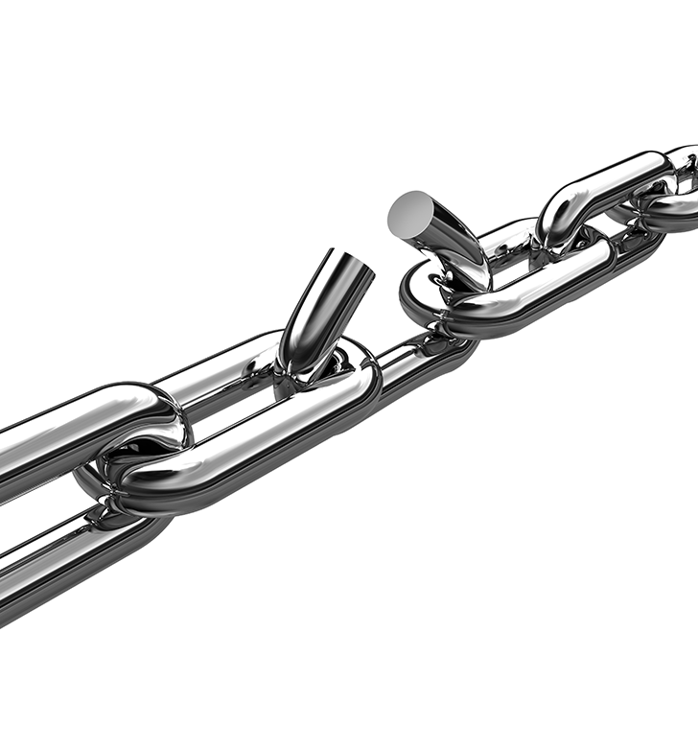
Determine Causes of an Accident
Once you have developed the sequence of events, you can then study each factor in the sequence to determine what contributed to or caused the accident:
Unsafe conditions, things, or situations,
Unsafe actions taken or not taken, and
System weaknesses, such as inadequate or missing programs, plans, policies, or procedures.
All systems have many pieces that must work together to ensure a safe working environment. Any particular safety system may include:
Safety personnel at your location,
Existence of safety policies, procedures, trainings, and
Implementation and enforcement of those policies, procedures, and training.
ACCIDENT INVESTIGATION: analyze event facts

Slide 35
Cause Analysis
At this point in the investigation you’ve gathered information and developed a sequence of events. You have a good mental picture of what happened. Now it’s time to conduct an analysis of each event to determine the surface causes and get down to the root cause(s).
While there are many different methods of analysis to choose from, we will take a quick look at 6 methods in the next slide. Whichever method you choose, you’ll use that as you conduct an:
Injury analysis
Event analysis
System analysis
We will go over injury, event, and system analysis in the next few slides.
ACCIDENT INVESTIGATION: analyze event facts

Slide 36
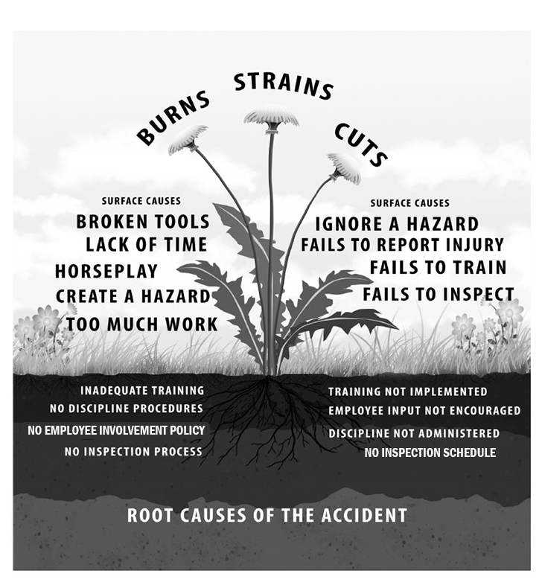
Analysis Methods
A few of the frequently used analysis methods to help you understand the causes of an event include:
The 5 Whys⁽¹⁾: Asks why to work through surface causes until the root cause is uncovered.
Domino Theory⁽²⁾: An event-based model used to explain the chain of events that occurred.
Fishbone/Ishikawa⁽³⁾: A diagram that examines a set of categories related to the problem.
HFACS/Swiss Cheese Model⁽⁴⁾: Takes a systems approach where human error is a symptom of a larger issue and not the actual cause of the accident.
MEEE⁽⁵⁾: A method to identify problems within the management, employee, equipment, and environment systems.
Accident Weed⁽⁶⁾: Identifies the direct causes, surface causes and the root cause(s). (Example pictured to the left.)
Explore the links provided in the list above to learn more about each method.
ACCIDENT INVESTIGATION: analyze event facts

Slide 37
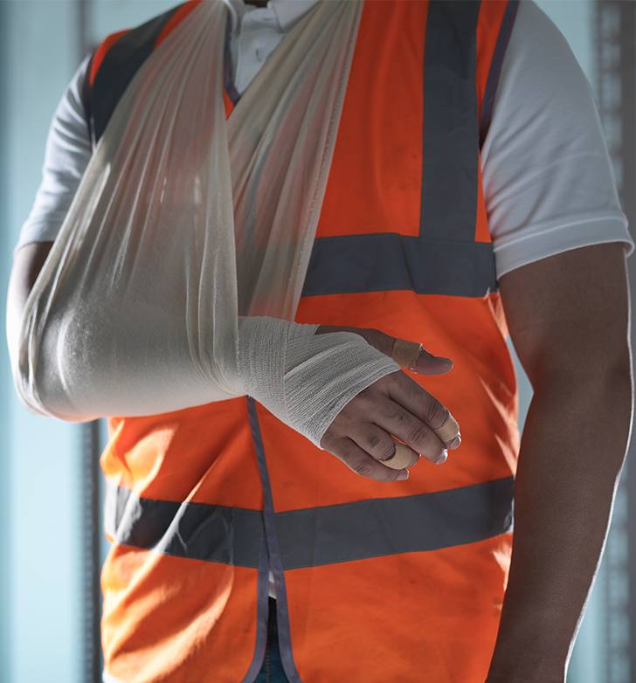
Injury Analysis
Injury analysis is simply identifying the direct cause of the injury. Essentially, that means documenting the part of the body that was injured and the object that came in contact with that body part. A couple of examples include:
Laceration to right forearm resulting from contact with a rotating saw.
Concussion to head by striking against the concrete floor.
ACCIDENT INVESTIGATION: analyze event facts

Slide 38
Event Analysis
With this analysis, you will work toward identifying the surface cause(s) of the accident by analyzing the event. Unlike injury analysis (arm coming into contact with saw), surface causes are specific unsafe conditions and/or unsafe acts that cause or contribute to the accident.
Unsafe conditions can involve materials, machinery, chemicals, and people. For example: materials not properly stored,
Machinery not regularly maintained, and
People not wearing proper protection.
An unguarded saw blade is an unsafe condition.
Unsafe acts are actions we take or don’t take that increase risk of injury or illness. These could include:
Failing to comply with rules,
Using unsafe methods,
Taking shortcuts,
Horseplay,
Insufficient training, and
Worker stress.
Using a saw with an unguarded blade is an unsafe act.
ACCIDENT INVESTIGATION: analyze event facts

Slide 39
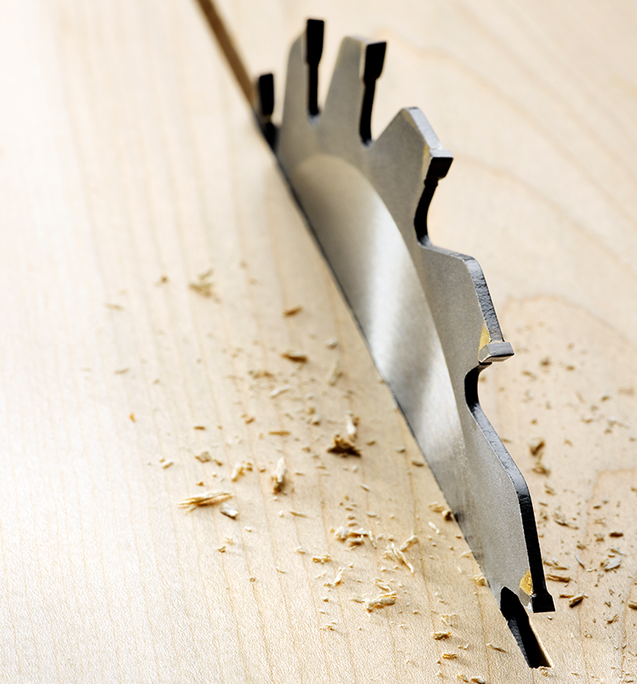
Surface Causes
Look at the surface cause(s) you identified from going through your chosen analysis method to determine if there are other contributing surface causes.
Back to our example of the saw blade, the laceration by the rotating saw blade was the direct cause of the injury; therefore, the unguarded saw blade was the initial surface cause. A contributing surface cause could be that the supervisor was not performing scheduled safety inspections or that the worker was not properly trained on how to use the saw.
From that, you may identify other causes by determining that safety inspections and equipment safety training are inconsistent.
ACCIDENT INVESTIGATION: analyze event facts

Slide 40
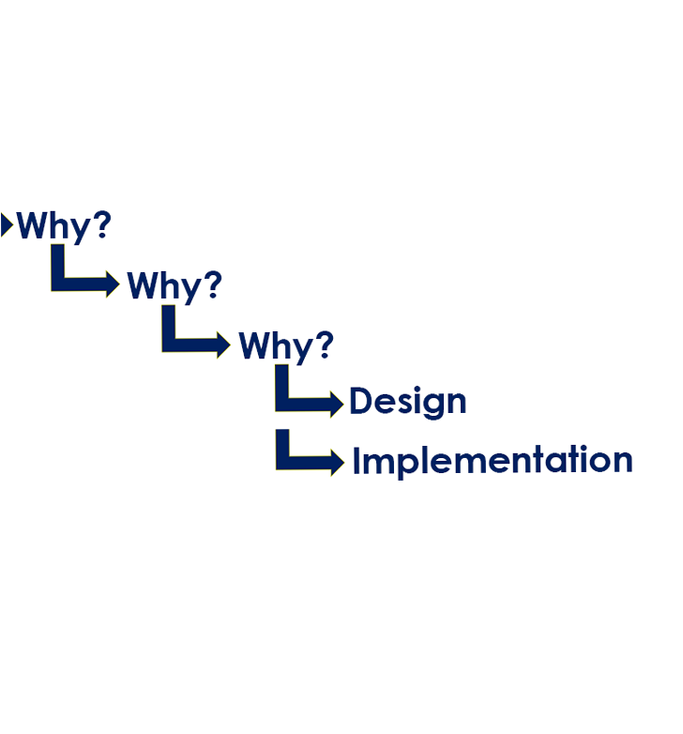
System Analysis
During the analysis, when you have identified inadequate policies, programs, plans, processes and procedures, you have arrived at the root causes of an accident. Root causes are the underlying safety system weaknesses that contribute to the existence of unsafe conditions and unsafe actions that are the surface causes of an accident.
Underlying safety system weaknesses (root causes) come in two forms:
1) Design root causes: inadequate planning and design of the safety system, such as poorly written or incomplete safety policies and procedures.
2) Implementation root causes: inadequate implementation of the safety system, such as failure to effectively carry out safety policies.
ACCIDENT INVESTIGATION: analyze event facts

Slide 41
Accident Analysis Example
Accident: a worker suffers a right-forearm cut from a rotating saw blade.
Surface causes:
1) The rotating saw blade was unguarded.
2) The supervisor was not performing scheduled safety inspections.
3) The safety inspections are inconsistent.
Root causes:
1) There are no policies requiring rotating saws to be guarded.
2) There are no safety training requirements addressing working with saws.
In this example, it is easy to place blame, but that would not ensure the accident isn’t repeated. However, fixing the safety system by implementing a policy requiring guards and adding the guards to the saws, would help prevent this accident in the future.
Furthermore, providing safety training to all workers using the saws and rewriting the inspection policy to include who should be performing safety inspections and when they should be performed will help prevent future accidents as well.
ACCIDENT INVESTIGATION: analyze event facts

Slide 42
Practice!
It is time to put your knowledge into practice! The same accident video you watched in Module 1 is shown on the next slide. Since this is just practice and you don’t get to talk to the people involved in the accident, use your imagination to fill in the missing information.
Write down a sequence of events for the accident scene.
Conduct an analysis for the injury, the event, and the system to establish surface and root causes of the accident.
ACCIDENT INVESTIGATION: analyze event facts

Slide 43
Video: Accident Example
ACCIDENT INVESTIGATION: analyze event facts
Notes:
Replace “Link video here” text with the Title of the video. Hyperlink the title to the video.
Ideal Text Font/Size: Arial, 44.
***Delete this note before uploading finished PPT to O:drive and website.***

Slide 44
Overview
Congratulations, you’ve completed Module 2! In this module, we learned about analyzing the events of an accident by first developing the sequence of events and then determining the causes. We worked through an analysis of injuries, the event, and the safety system to help identify the surface and root causes of the accident. We learned that getting to the root cause(s) of an accident will help to identify system weaknesses; and by fixing them, we can provide a better working environment for everyone by preventing accidents! And finally, you practiced applying your knowledge with the recorded accident.
Now, it’s time to learn about making recommendations and using the information we have gathered and analyzed to write a report! Please click the arrow on the right to continue to module 3.
ACCIDENT INVESTIGATION: analyze event facts

Slide 45
Class Discussion
Take this opportunity to ask/answer questions about the previous module and to summarize the web link addresses discussed in the module.
Module 2 Resources
1) 5 Whys: https://www.invensislearning.com/blog/5-whys-root-cause-analysis/
2) Domino Theory: http://andrew.mcgiffert.id.au/blog/the-domino-theory-an-incident-analysis-tool/
3) Ishikawa/Fishbone: https://www.invensislearning.com/blog/fishbone-diagram-for-root-cause-analysis/
4) HFACS/Swiss Cheese: https://hfacs.com/hfacs-framework.html
5) MEEE: https://www.saif.com/safety-and-health/topics/be-a-leader/accident-and-incident-analysis.html
6) Accident Weed: https://osha.oregon.gov/edu/Documents/workshop-materials/1-110w.pdf#page=33
ACCIDENT INVESTIGATION: analyze event facts

Slide 46
ACCIDENT INVESTIGATION
Module 3: Implement Solutions

Slide 47
Welcome to Module 3
We have reached the third and final primary task of the Accident Investigation process:
1. Gather Information
a. Secure the scene
b. Collect facts about what happened
2. Analyze Event Facts
a. Develop the sequence of events
b. Determine the causes
3. Implement Solutions
a. Recommend improvements
b. Write the report
ACCIDENT INVESTIGATION: implement solutions

Slide 48
Recommendation Tools
At this point in the accident investigation, you have gathered the necessary information, completed your analysis of the accident event, and identified the 3 types of causes for the accident:
Direct,
Surface, and
Root.
Now during the recommendation stage of the investigation, you’ll address all 3 types of causes with the tools we will be covering in this module:
Controls,
System improvements, and
Cost benefit analysis.
Later in this module, you will learn how to complete an accident report form.
ACCIDENT INVESTIGATION: implement solutions

Slide 49
Controls and System Improvements
The three levels of causes (direct, surface, and root) that contribute to an accident are eliminated or reduced by recommending controls and/or system improvements.
Controls address the direct and surface cause(s) of an accident.
System improvements address the root cause(s) of missing or inadequate safety system policies and procedures that contributed to the accident.
Let’s go over controls first.
ACCIDENT INVESTIGATION: implement solutions

Slide 50
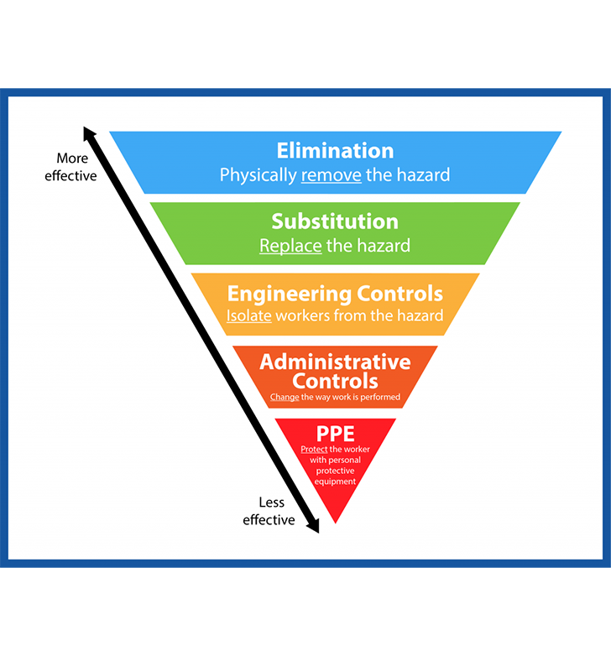
Control Strategies
Hazard controls have a hierarchy, or priority, from more effective to less effective.
Elimination Controls: Physically remove the hazard.
Substitution: Replaces the hazard.
Engineering Controls: Isolate workers from the hazard.
Administrative/Management Controls: Change the way the work is performed.
Personal Protective Equipment (PPE): Protect the worker with personal protective equipment.
Let’s take a closer look at each of these.
ACCIDENT INVESTIGATION: implement solutions

Slide 51
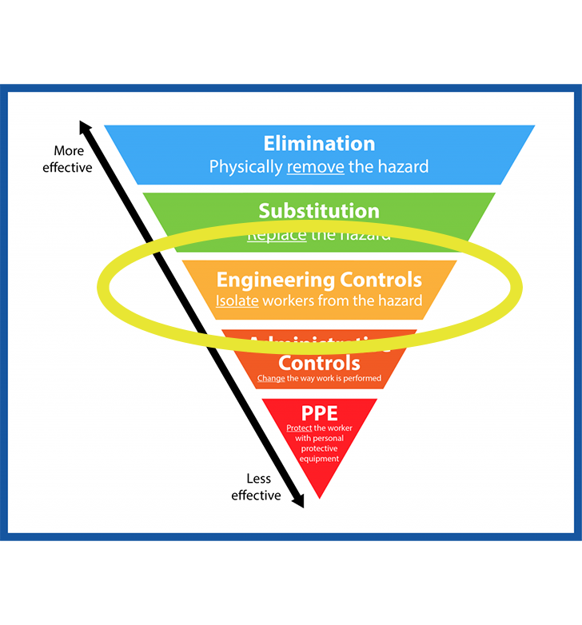
Hazard Controls
Oregon OSHA recommends that employers attempt to eliminate or substitute the unsafe conditions, if feasible, as the best way to provide a safe and healthful workplace. In some instances, however, elimination and substitution controls may not be financially feasible. In those cases, consider an engineering control.
Engineering controls are physical fixes that address the unsafe condition without relying on human behavior for effectiveness.
For an example of an engineering control to address a direct/surface cause, let’s look at imaginary “ABC Company”:
ABC Company added guards on all of their saws. This separates, or isolates, the worker from the hazard (the saw blade).
ACCIDENT INVESTIGATION: implement solutions

Slide 52
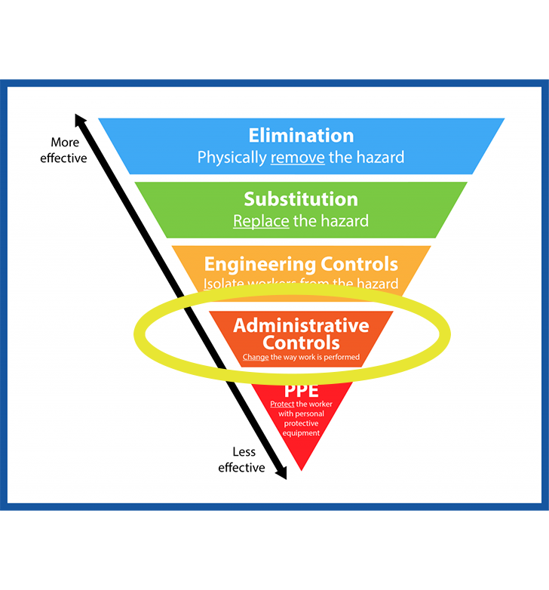
Administrative Controls
Sometimes engineering controls may not be feasible, so administrative controls would be the next level. Administrative (or management) controls can eliminate or reduce the frequency and duration of exposure to unsafe conditions by addressing worker’s actions. This can be done by:
Managing work practices: changes in work procedures and practices, as in developing and implementing job hazard analysis (JHA), and
Managing work schedules: shifts, job rotation, breaks, and locations to reduce exposure.
Since these address workers’ actions, they tend to only reduce the exposure to the unsafe conditions, but they can be used in combination with other controls.
An example of an administrative control is outlined on the next slide.
ACCIDENT INVESTIGATION: implement solutions

Slide 53
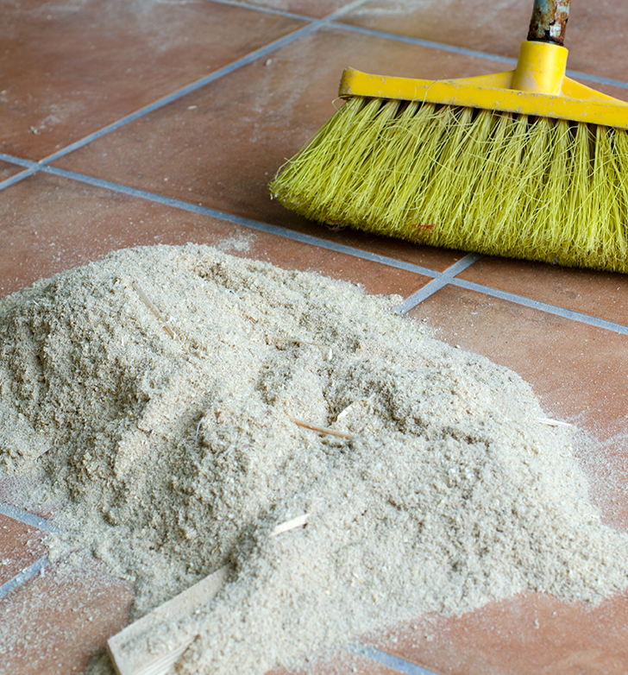
Administrative Control: Example
An administrative control that addresses a direct/surface cause in our imaginary workplace:
ABC Company adopts a new policy requiring all workstations be frequently cleaned to prevent sawdust accumulation. They have placed signs at each workstation reminding workers of the new policy. However, for the new administrative control to be effective:
workers must be trained on and understand the policy,
workers must consistently follow the policy, and
managers must diligently enforce it.
ACCIDENT INVESTIGATION: implement solutions

Slide 54
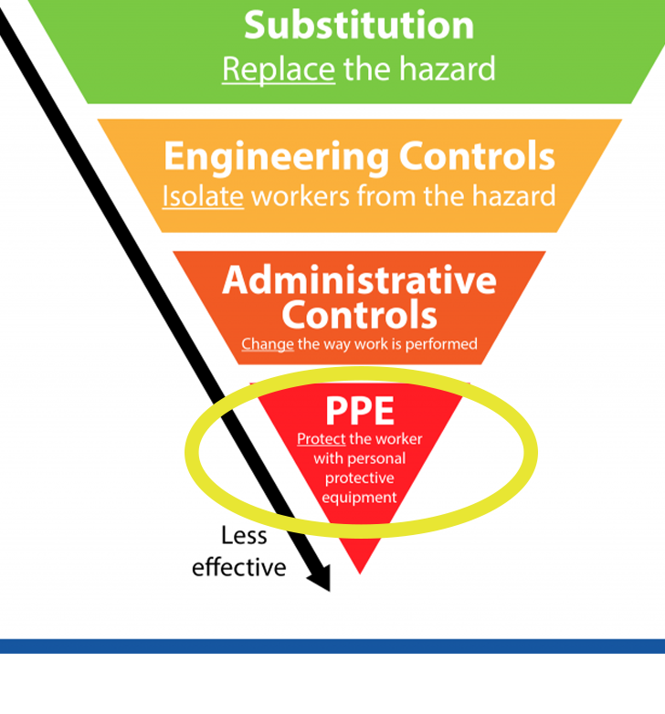
Personal Protective Equipment
The final level of the hierarchy of controls is the use of personal protective equipment (PPE). PPE simply provides a barrier between the worker and the unsafe condition, and again, depends on the worker’s actions in order to be effective. PPE should be used in conjunction with the other controls, when and if the first four levels don’t adequately reduce or eliminate the unsafe condition.
For example, ABC Company now requires the use of safety goggles and gloves for workers using saws, in addition to their other controls.
In summary, hazard controls help address the direct and surface causes of an accident. With ABC Company’s new controls, direct and surface causes are addressed by:
Engineering control: putting guards on all saws,
Administrative control: implementing a new policy requiring workstations to be kept free of sawdust and posting signs at each workstation, and
PPE: requiring the use of goggles and gloves.
Now let’s look at how to address the root cause(s)!
ACCIDENT INVESTIGATION: implement solutions

Slide 55
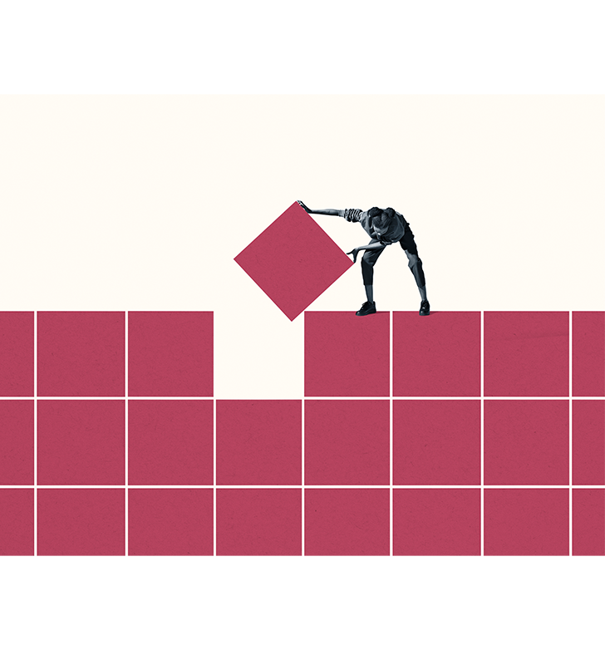
System Improvements
Missing or inadequate safety system components are always the root causes for workplace accidents. Therefore, every effort should be made to improve your safety system. Improvements could include:
Clearly establishing responsibility and accountability in the safety policy.
Changing a work process to require the use of checklists that include safety checks.
Changing the safety inspection process to include management, supervisors, and employee participation and signoff.
For example, ABC Company could write a safety policy that clearly assigns responsibility to specific supervisor positions, re-write their work process to include a checklist with all the safety checks, as well as assigning multiple positions to sign off on safety inspections at specific time intervals.
ACCIDENT INVESTIGATION: implement solutions

Slide 56
Key Questions to Ask (I)
It’s important to anticipate the questions and concerns that may arise when the safety committee and management are deciding what actions to take. To make sure you provide good information, ask yourself proactive questions such as the ones outlined below and in the next slides.
Clarify the issue
What are the specific unsafe conditions and unsafe work practices that caused the accident?
What are the missing safety system components (the inadequate or missing policies, processes, rules) that allowed the conditions and practices to exist?
Historical data
Have similar accidents occurred in the past?
What are previous direct and indirect costs for similar accidents?
How have similar accidents affected production and morale?
ACCIDENT INVESTIGATION: implement solutions

Slide 57
Key Questions to Ask (II)
Specific solutions
What are the specific engineering, administrative, and PPE controls that, when applied, will eliminate or reduce exposure to the unsafe conditions?
What are the specific system improvements needed to ensure a long-term fix?
Ultimate decision maker
Who is the person that can approve, authorize, and act on the corrective measures?
What are the possible objections that they may have?
What is the information that will be most effective in overcoming objections?
ACCIDENT INVESTIGATION: implement solutions

Slide 58
Key Questions to Ask (III)
Costs and Benefits
What are the estimated costs and benefits of taking corrective action, versus the possible costs and harm if no action is taken?
What are the employer obligations under administrative law?
For all businesses, analyzing the costs that are associated with implementing new policies, procedures, equipment, etc. is a necessary process in order to make an informed decision about what the company can afford for short-term and long-term solutions. The costs and benefits information should always be included in the recommendation. Let’s look a little closer at costs versus benefits on the next slide.
ACCIDENT INVESTIGATION: implement solutions

Slide 59
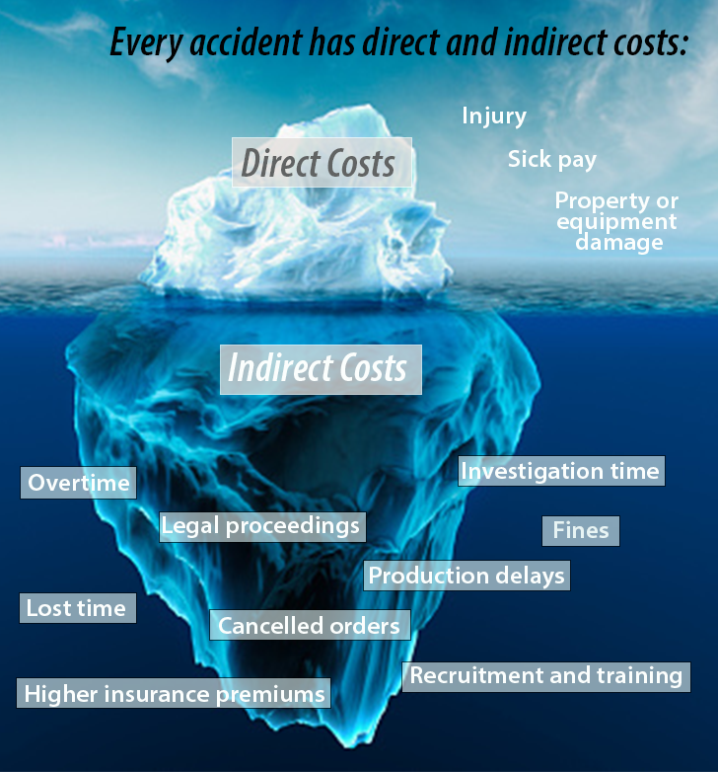
Cost-Benefit Analysis
There are many hidden or indirect costs related to an accident to consider. As the picture on the left depicts, the initial costs of the injury, sick pay, and equipment damage are just the tip of the iceberg when it comes to what the company will pay out because of the accident. When you look below the surface, you discover costs related to lost time, production delays, legal costs, fines, potential increase in insurance and workers’ compensation fees, and much more!
The objective of a cost-benefit analysis is to contrast the relatively high cost/low benefit if the unsafe condition is not eliminated, with the low cost/high benefit if the unsafe condition is eliminated. It should answer the following:
What are the potential costs to the company if the unsafe condition is not eliminated?
What are the potential costs if the unsafe condition is eliminated?
How will the corrective action pay for itself?
ACCIDENT INVESTIGATION: implement solutions

Slide 60
Costs and Benefits
Providing information about costs and benefits of your recommendation(s) is helpful for the decision makers as it helps them see the broad impact of fixing the issues. To estimate costs, federal OSHA has a Safety Pays⁽¹⁾ tool and Oregon OSHA provides resources⁽²⁾ to help assess the impact of work injuries. You can also check with your company’s Workers’ Compensation carrier for resources they offer.
A list of benefits that occur when safety improvements are made after an accident could include:
Fewer injuries,
Improved productivity,
Higher workforce morale,
Worker longevity,
Fewer workers comp claims and possibly a reduction in worker compensation insurance rates, and
Money saved by keeping employees safe by avoiding all the hidden costs of an accident.
Describe how the benefits will impact your workforce, leadership team, and overall business.
ACCIDENT INVESTIGATION: implement solutions

Slide 61
Recommendations and Alternatives
Finally, as you deliver your recommendations, it’s important to provide alternatives as well. Corrective actions are more likely to be taken when there are several options to choose from. For each recommendation, tell the decision maker why you believe it is the right fix and which unsafe condition/action it addresses.
You might present the recommendation with alternatives such as the below:
Eliminate the unsafe condition and include additional engineering and administrative controls if needed; or,
Reduce the unsafe condition using administrative controls, add engineering controls if required, and add PPE usage to reduce the hazard a little more.
ACCIDENT INVESTIGATION: implement solutions

Slide 62
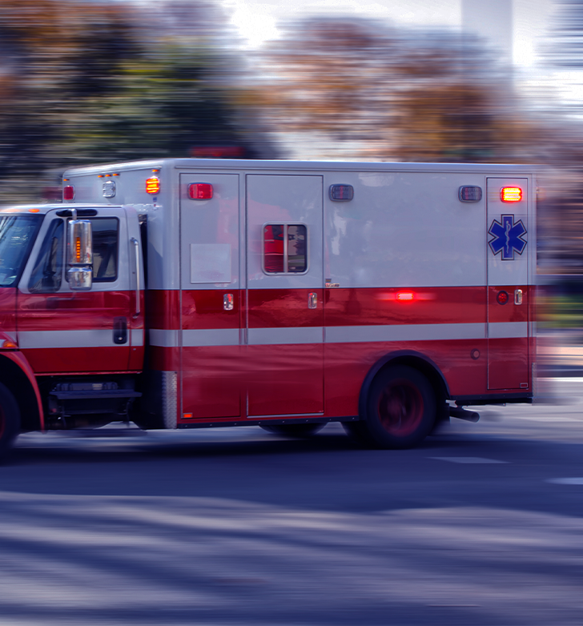
Practice: Root Cause and Recommendation
To wrap up the Recommend Improvements portion of this module, let’s take some time to look at a different accident and think about some of the concepts we have just covered.
The next slide shows a video of the true story of Russ Youngstrom, a worker who experienced an accident on the job. A direct cause of the accident is shown. As you watch the video, think about:
What a potential root cause could have been in this accident, and
A potential recommendation so this type of accident isn’t repeated.
ACCIDENT INVESTIGATION: implement solutions

Slide 63
Video: Russ Youngstrom Story
ACCIDENT INVESTIGATION: implement solutions

Slide 64
Completing the Accident Report
It’s time to get into the Accident Report section of this module. Now that we have covered the control strategies and questions you want to consider for your recommendations, we can start writing the accident report.
Remember from Module 1, that your goal as an investigator is to uncover the causes of the accident, being as objective and accurate as possible, without placing blame. Your findings, and how you present them, will shape perceptions and corrective actions by management. After completing the report you will provide it to your company’s Safety Committee and it must remain on record for 3 years as outlined in Oregon Administrative Rule 437-001-0765 (6)⁽³⁾.
ACCIDENT INVESTIGATION: implement solutions

Slide 65
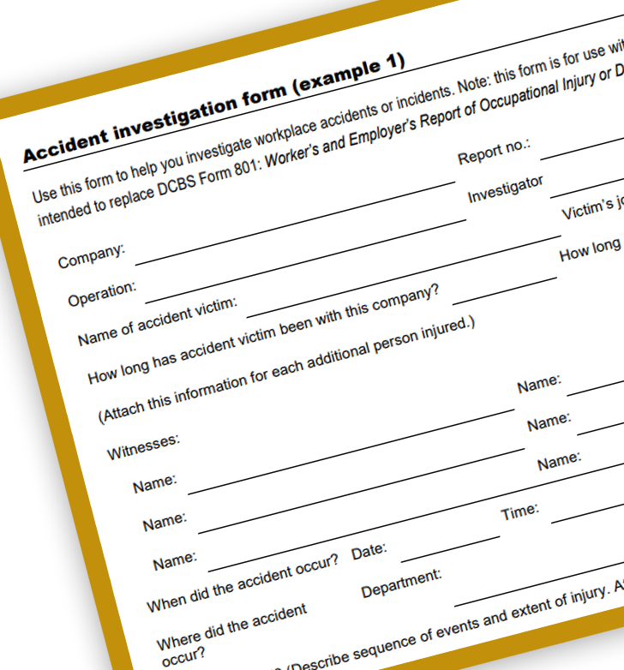
Accident Report Forms
There are many different formats of reports, but the one we will look at gives emphasis to the root causes and is similar to the one that Oregon OSHA investigators use. It includes the following sections:
Background
Description of the accident
Findings
Recommendations
Summary
Review and Follow-Up Actions
Attachments
Let’s look at each section and what it entails. You could practice with this sample Accident Report⁽⁴⁾.
ACCIDENT INVESTIGATION: implement solutions

Slide 66
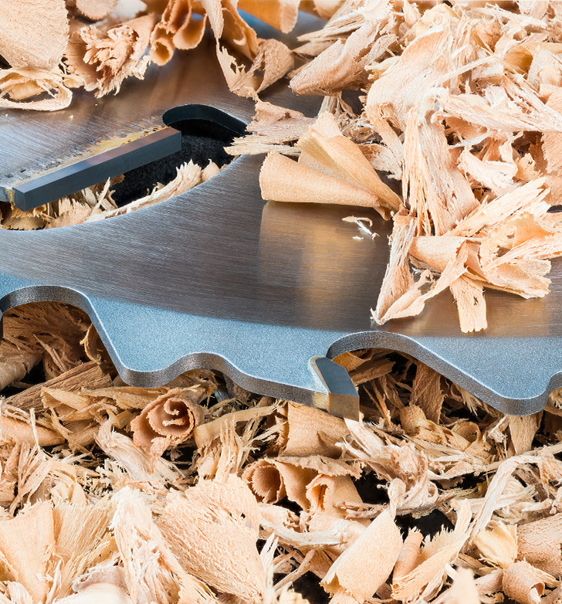
Background and Description
Background
The background section contains information that answers questions about:
The victim’s identity,
Time and date of accident, and
Location of accident.
Description of the Accident
This section tells the story of the events leading up to, including, and immediately after the accident. Remember - you already developed this narrative during the analyzing facts step of the accident investigation process. It is a clear word picture so that someone unfamiliar with the accident can “see” what happened.
ACCIDENT INVESTIGATION: implement solutions

Slide 67
Findings
The findings section describes the unsafe conditions and actions, and safety system weaknesses. Your investigation has uncovered these and identifies them as:
Direct cause(s)
Surface cause(s)
Root cause(s)
Include a reason with each finding. Explain and support your reason by including the relevant evidence. We will cover each of the 3 findings/causes in the next few slides, with examples.
ACCIDENT INVESTIGATION: implement solutions

Slide 68
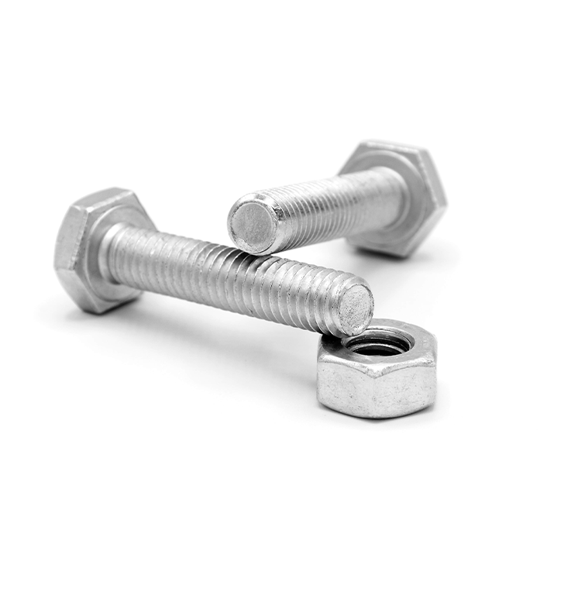
Findings: Direct Cause
Direct cause findings describe the unsafe conditions and/or actions that exist or occur immediately prior to the injury. See below for two examples.
Unsafe Condition
The bolts for the machine guard on the saw were missing and the guard was detached from the blade.
Unsafe Action
The injured employee used the saw without the guard, exposing himself to the unsafe condition.
ACCIDENT INVESTIGATION: implement solutions

Slide 69
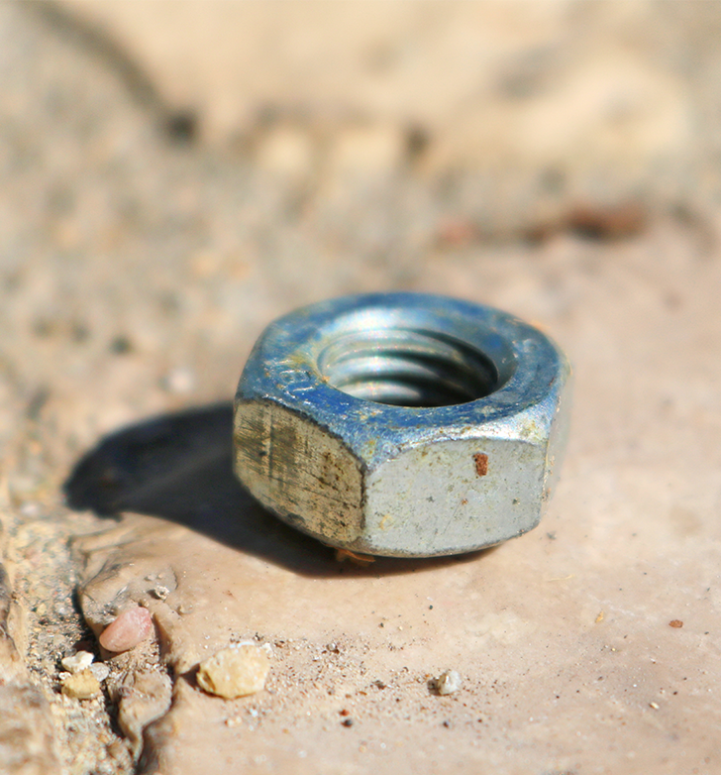
Findings: Surface Cause
Surface cause findings describe what was in place, or occurred, at some point prior to the injury accident, including:
Conditions
Activities
Practices
Actions
Examples of surface cause findings are:
Unsafe Conditions
The machine guard was damaged.
Tools to repair the machine guard were missing, broken, and unusable.
Unsafe Actions
An employee failed to replace bolts on the guard.
An employee defeated the purpose of the guard by using the saw without the guard in place.
The injured employee had not been trained in saw operation or machine guarding principles.
ACCIDENT INVESTIGATION: implement solutions

Slide 70
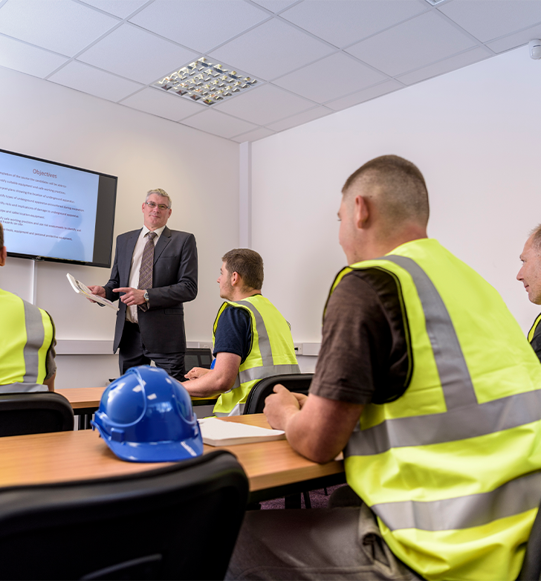
Findings: Root Cause
Implementation and design are the two types of root cause findings.
The root cause findings regarding implementation describe management’s failure to carry out the programs, processes, plans, and/or procedures described in the company’s safety management system. Root cause findings regarding design describe programs, policies, and/or processes that were inadequately designed.
Example of inadequate implementation:
Employees and supervisors do not know the safety policies and procedures for powered saws, and management has not provided training. Therefore, supervisors and management are allowing unsafe work practices associated with powered saws.
Example of inadequate design:
Safety training plans do not include policies and practices for employees working with powered saws.
ACCIDENT INVESTIGATION: implement solutions

Slide 71
Recommendations
Effective recommendations describe ways to get rid of or reduce both surface and root causes. They also include estimated expenses for carrying out corrective actions and safety system improvements.
A recommendation for a direct cause of the accident can fix the immediate issue but doesn’t have a system-wide effect. For example, a direct cause recommendation could be:
Repair the machine guard on the affected saw and train the injured employee on hazard identification and reporting procedures.
Estimated investment: $250.00
This recommendation is fine for fixing the one unsafe condition and the one injured employee’s actions; however, it does not address the surface or root causes, nor does it help other employees. Let’s explore those in the next slides.
ACCIDENT INVESTIGATION: implement solutions

Slide 72
Surface Cause Recommendations
Surface cause recommendations describe how to correct the unsafe conditions and actions that eventually produce the conditions for an injury to occur. Correcting surface causes is accomplished by improving the implementation of the safety system and will have a general positive impact throughout the work group or organization.
A surface cause recommendation example:
Ensure installation and repair tools are readily available; conduct immediate training for other affected workers, maintenance staff, and supervisors; re-establish expectations and add signs and reminders at work stations.
Estimated investment: $200
ACCIDENT INVESTIGATION: implement solutions

Slide 73
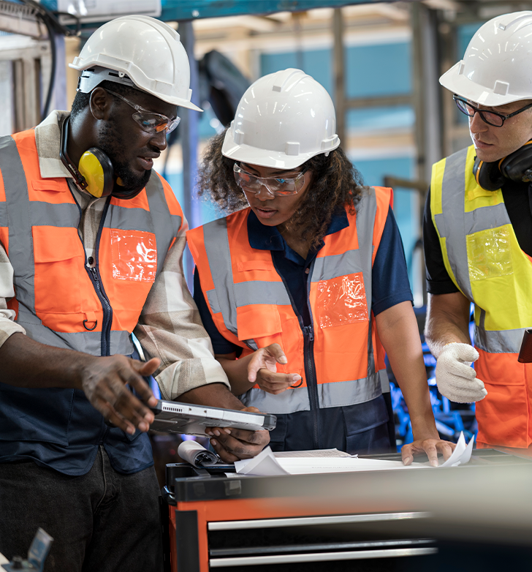
Implementation Root Cause Recommendations
An implementation root cause recommendation that could be used in addition to the previous surface cause recommendation could look like this:
Implement training schedule and weekly inspections with documentation; periodically review machine guarding principles for all maintenance staff, affected employees and managers; rotate workers so all are involved in training and inspections and hold supervisors accountable.
Estimated investment: $700
These recommendations are great, and we can also add the design aspect of root causes! Let’s go one step further…
ACCIDENT INVESTIGATION: implement solutions

Slide 74
Design Root Cause Recommendations
Solving safety system implementation weaknesses is accomplished by improving safety system design. These recommendations address improvements and/or additions to your written safety management system to fix the weak or missing policies that ultimately allowed the accident conditions to exist. The recommendation could look like this:
Review and improve the safety training plan to ensure it includes machine guarding, lockout/tagout, and hazard reporting procedures; create or revise policy to ensure managers are provided with education and resources needed to ensure enforcement is consistently administered and accountability is clearly established.
Estimated investment: $1,500.00
ACCIDENT INVESTIGATION: implement solutions

Slide 75
Summary
The summary section contains a brief review of the causes of the accident and recommendations for corrective actions. In your review, it’s important to include language that contrasts the costs of the accident with the benefits of investing in corrective actions. Including bottom-line information in this section is always helpful to management.
The review section describes the actions taken to repair:
Equipment/machinery
Work practices
Conduct training
Revise policies, procedures, etc.
It also describes the person(s) responsible for carrying out corrective actions and safety system improvements.
ACCIDENT INVESTIGATION: implement solutions

Slide 76
Attachments
The last section of the form, Attachments, is for all data collected during the investigation, including:
Photos,
Videos,
Sketches,
Interview notes, and
Other relevant documents.
You must write a description of the relevance of each item you include.
ACCIDENT INVESTIGATION: implement solutions

Slide 77
Practice
Here is one more opportunity to practice with the same accident scene shown in Modules 1 and 2. Use your findings and make recommendations for this company and their accident event.
What types of controls could be put in place?
Consider costs and benefits and the key questions as you develop recommendations.
Recommend improvements that address surface and root causes.
Again, since this is just practice, feel free to use the accident form⁽⁴⁾ and your imagination to fill in the missing information.
ACCIDENT INVESTIGATION: implement solutions

Slide 78
Video: Accident Example
ACCIDENT INVESTIGATION: implement solutions

Slide 79
Overview
As you can see, the Implementing Solutions task of the accident investigation process is a big one! We covered a lot in this module:
Types of controls: elimination, substitution, engineering, administrative, and PPE;
System improvements and cost-benefit analysis;
Key questions to consider when preparing your recommendations;
Recommending improvements to address surface and root causes; and
The sections of, and how to complete, an accident report form.
The accident report form is a “living document”, only considered complete when all issues have been addressed and all actions taken. This can take days, weeks, and/or months after the accident, depending on the recommended fixes.
Now you have a basic understanding about effective accident investigation procedures. With experience, that knowledge will transform into expertise. Click the arrow on the right to proceed to the final module of the course.
ACCIDENT INVESTIGATION: implement solutions

Slide 80
Class Discussion
Take this opportunity to ask/answer questions about the previous module and to summarize the web link addresses discussed in the module.
Module 3 Resources
1) Safety Pays: https://www.osha.gov/safetypays/
2) Resources: https://osha.oregon.gov/pubs/reports/Pages/safety-reports.aspx
3) OAR 437-001-0765(6): https://osha.oregon.gov/OSHARules/div1/437-001-0765.pdf#page=3
4) Sample Accident Form: https://osha.oregon.gov/OSHAPubs/pubform/form-investigating-an-accident-example1.docx
ACCIDENT INVESTIGATION: implement solutions

Slide 81
ACCIDENT INVESTIGATION
Module 4: Conclusion

Slide 82
Welcome to Module 4!
We have covered a lot of information in this course! You learned the goal of an accident investigation is to figure out what happened and why, in order to prevent the same type of accident from happening again. You've had several opportunities to practice and apply the concepts with an accident scenario. Now let’s take some time to do a high level review of the three primary tasks in the Accident Investigation process before we move onto the quiz.
1. Gather Information
a. Secure the scene
b. Collect facts about what happened
2. Analyze Event Facts
a. Develop the sequence of events
b. Determine the causes
3. Implement Solutions
a. Recommend improvements
b. Write the report
ACCIDENT INVESTIGATION: conclusion

Slide 83
Task 1: Gather Information
The first task of the investigation process is to gather information to understand the accident. You must secure the scene until the root cause of the accident is determined and safety measures are put in place. Document your observations such as broken equipment, spills, time of day, distractions, etc. Notice what type of activity occurs around the scene and who is there.
Next, collect facts through interviews. These interviews could be with the victim, witnesses, supervisors, co-workers, and maintenance personnel, among others. As you interview, remember to keep an open mind about the situation, make eye contact with your interviewee, and take careful notes. Continue collecting facts by documenting the scene with photographs, sketches, and video.
Conclude task 1 by reviewing any relevant documents that could give insight to the accident, such as safety policies, training records, maintenance records, and work schedules.
ACCIDENT INVESTIGATION: conclusion

Slide 84
Task 2: Analyze Event Facts
An accident is the final event in an unplanned process. For the second task, you will analyze the event facts by figuring out the sequence of events and then determine the causes of the accident.
With your sequence of events, you explain what happened clearly enough so that someone unfamiliar with the event is able to create a clear picture in their mind of it. Next, you analyze the injury, the accident event, and the safety system so that you can determine direct, surface, and root causes. We provided information on 6 different cause analysis methods.
As you conduct the event analysis, you identify unsafe conditions and unsafe acts for the surface causes. During the system analysis, you uncover root causes that apply to the design and/or implementation of the safety system.
ACCIDENT INVESTIGATION: conclusion

Slide 85
Task 3: Implement Solutions
You have gathered all the information, analyzed it to determine the causes of the accident event, and now you are ready to implement solutions by making recommendations and writing the accident report!
You look at the hazard control hierarchy to find the appropriate controls for the situation, consider key questions, analyze costs and benefits, and develop recommendations that address surface and root causes. You also write alternative recommendations which increases the likelihood that a solution will be implemented by the company.
To finish the process, complete each section in the Accident Report form that is used by your company, and provide it to your safety committee.
ACCIDENT INVESTIGATION: conclusion

Slide 86
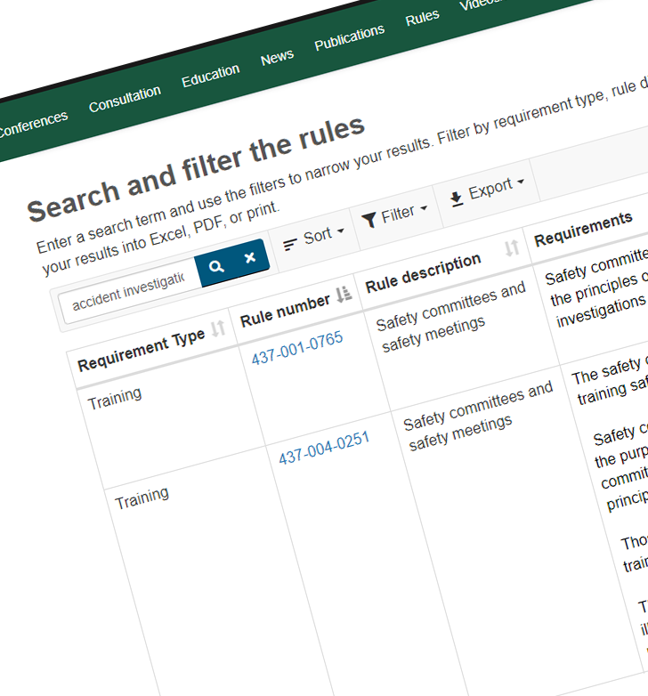
Resources
Congratulations, you made it through the whole accident investigation process! Remember, Oregon OSHA has many resources to help you understand which rules and requirements apply for your situation. Check out Oregon OSHA's Rules with Requirements⁽¹⁾ tool which provides a pre-filtered search for you, available on our website.
Now, let’s proceed to the quiz!
ACCIDENT INVESTIGATION: conclusion

Slide 87
Class Discussion
Take this opportunity to ask/answer questions about the previous module and to summarize the web link addresses discussed in the module.
Module 4 Resources
1) Rules with Requirements: https://osha.oregon.gov/pubs/Pages/Rules-With-Requirements.aspx
ACCIDENT INVESTIGATION: conclusion

Slide 88
ACCIDENT INVESTIGATION - QUIZ
Question 1: An accident is:
A near miss that could have resulted in personal harm.
An event that results in an injury or property damage.
Question 2: Safety committee members are required to have training in the principles of accident and incident investigations, and this course provides the basic training.
True
False
ACCIDENT INVESTIGATION: conclusion

Slide 89
ACCIDENT INVESTIGATION - QUIZ
Question 3: Securing the scene includes (select all that apply):
Making the scene as inaccessible as possible.
Blocking/cribbing any unstable equipment or loads.
Isolating energy sources.
Removing key evidence from the scene.
Question 4: According to this course, what are the 3 primary tasks of an accident investigation?
Gather information, Secure the scene, Make recommendations
Gather information, Analyze event facts, Develop sequence of events
Gather information, Analyze event facts, Implement Solutions
Gather information, Secure the scene, Write the report
ACCIDENT INVESTIGATION: conclusion

Slide 90
ACCIDENT INVESTIGATION - QUIZ
Question 5: An unguarded powered saw blade is an unsafe _____.
Act
Condition
Question 6: During the event analysis, you will work toward identifying the surface cause(s).
True
False
ACCIDENT INVESTIGATION: conclusion

Slide 91
ACCIDENT INVESTIGATION - QUIZ
Question 7: During the system analysis, you are trying to identify the _______.
Direct cause(s)
Surface cause(s)
Root cause(s)
Question 8: According to the hazard control hierarchy referenced in this training course, Engineering Controls are less effective than PPE.
True
False
ACCIDENT INVESTIGATION: conclusion

Slide 92
ACCIDENT INVESTIGATION - QUIZ
Question 9: A cost-benefit analysis helps to answer (select all that apply):
The potential costs to the company if the unsafe condition is not addressed.
The potential costs to the company if the unsafe condition is addressed.
How the corrective action will pay for itself.
Question 10: What are the 2 types of root cause findings?
Direct and Surface
Implementation and Design
Background and Description
Costs and Benefits
ACCIDENT INVESTIGATION: conclusion

Slide 93
ACCIDENT INVESTIGATION - QUIZ ANSWERS
B
A
A, B, C
C
B
A
C
B
9) A, B, C
10) B
ACCIDENT INVESTIGATION: conclusion
Notes:
Answers

Slide 94
Where To Go From Here
An excellent resource to utilize is the A-Z Topic Index on the Oregon OSHA website. It has lists of relevant publications, training materials, rules, interpretations, videos, and other miscellaneous materials.
If you want guidance in developing a safer work environment, you may consider our free and confidential consultation service. Our consultants in workplace health and safety can help you reduce accidents, related costs, and help you develop a comprehensive program to manage safety and health. For more information, please visit the consultation page.
File a Complaint
A-Z Topic Index
Consultation Services
Accident Investigation Resources
ACCIDENT INVESTIGATION: conclusion

Slide 95
ACCIDENT INVESTIGATION: conclusion

Slide 96
Credits
You’ve completed the Accident Investigation course!
Produced by the Public Education Team of Oregon OSHA:
Greig Lowell, Tammi Stevens, Phillip Wade, Ricardo Vázquez Rodríguez, Angelina Cox, Tim Wade, Anthony Dey, Roy Kroker, Meri Bell
Technical assistance provided as Subject Matter Experts:
Craig Hamelund, Chris Gillett
Stock Images provided by: Getty Images Inc.
ACCIDENT INVESTIGATION: conclusion

