Slide 1



ATV SAFETY
Module 1: Introduction
Please note: If the online course contains videos, the video links are included in this PPT. You will need to have an internet connection to play the videos or you can download the videos and embed them into your copy of this slide deck.

Slide 2
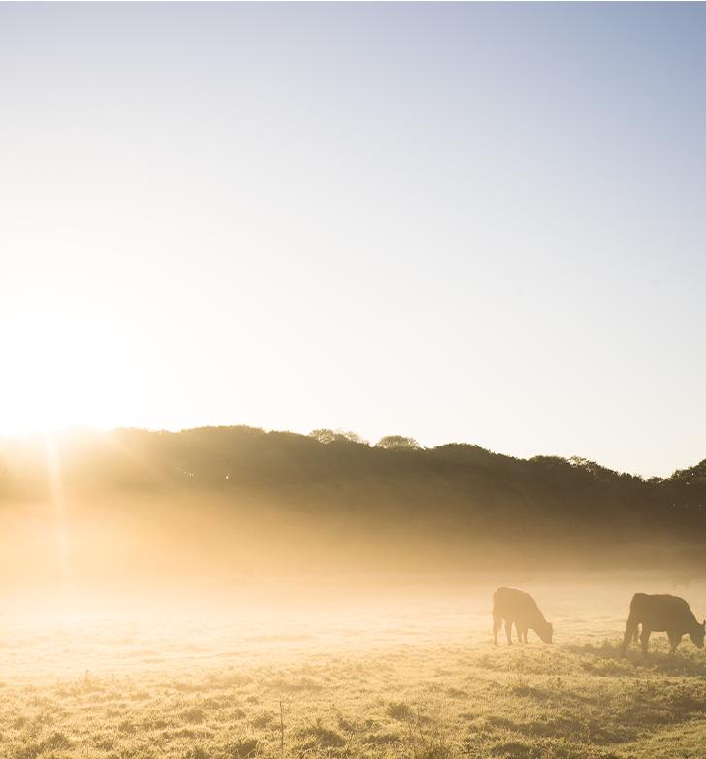

Disclaimer
Completing this course will help you learn some best practices for ATV (all-terrain vehicle) safety; however, it is your employer’s responsibility to further your training as needed. This material should not be considered a substitute for any provisions of the Oregon Safe Employment Act, or for any standards issued by Oregon OSHA. Manufacturers, products, or services displayed in this material are for informational purposes only and do not constitute an endorsement by Oregon OSHA.
ATV SAFETY:
introduction

Slide 3
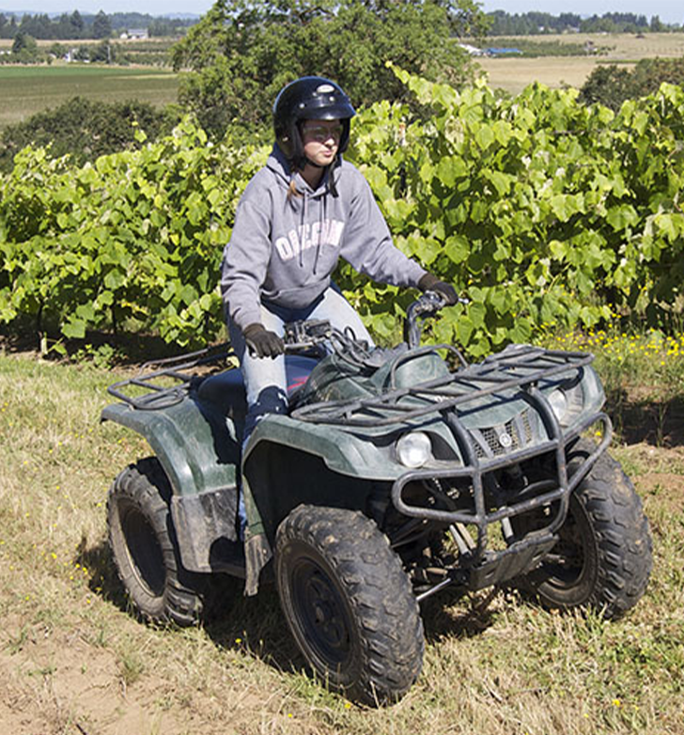
Course Goals
During the ATV Safety training course, the following learning objectives will be covered:
The importance of ATV safety and training
Inspecting the ATV
Best practices for specific situations and terrains
This course is designed to help you learn best practices while operating an ATV. It does not replace a certified training program; we recommend that you also take an ATV training course from a professional or certified trainer. In addition, we recommend that you:
Train for all conditions
Practice often and adequately
Practice under safe conditions (This means on normal terrain, away from other vehicles and people, and under supervision.)
ATV SAFETY:
introduction

Slide 4
Video: Introduction by Michael Wood
ATV SAFETY:
introduction
Notes:
Replace “Link video here” text with the Title of the video. Hyperlink the title to the video.
Text Font/Size Arial 40; modify as needed.
***Delete this note before uploading finished PPT to O:drive and website.***

Slide 5
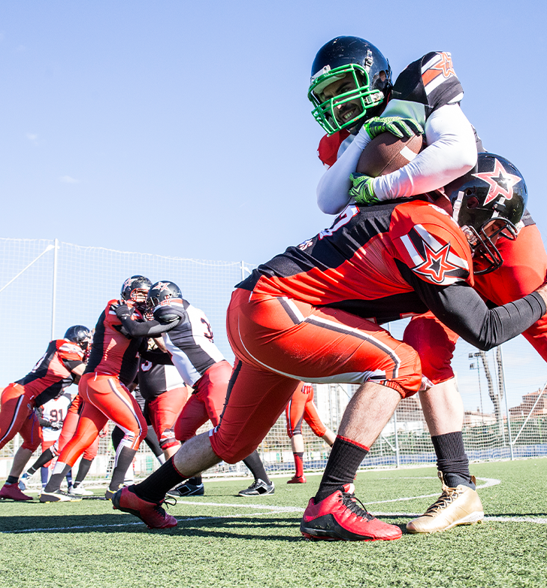
Personal Protective Equipment (PPE)
Personal protective equipment isn’t just smart, it’s often required!
In order to play any sport, you need the right equipment. Take American football - can you play with just a football? Sure, but look at the professionals. In professional football they know from experience how important it is to protect the player.
Players protect their bodies with helmets, pads, proper shoes, mouth guards, and sometimes gloves. These protections help players to have safer and longer careers even when playing in a potentially dangerous sport.
ATV SAFETY:
introduction

Slide 6
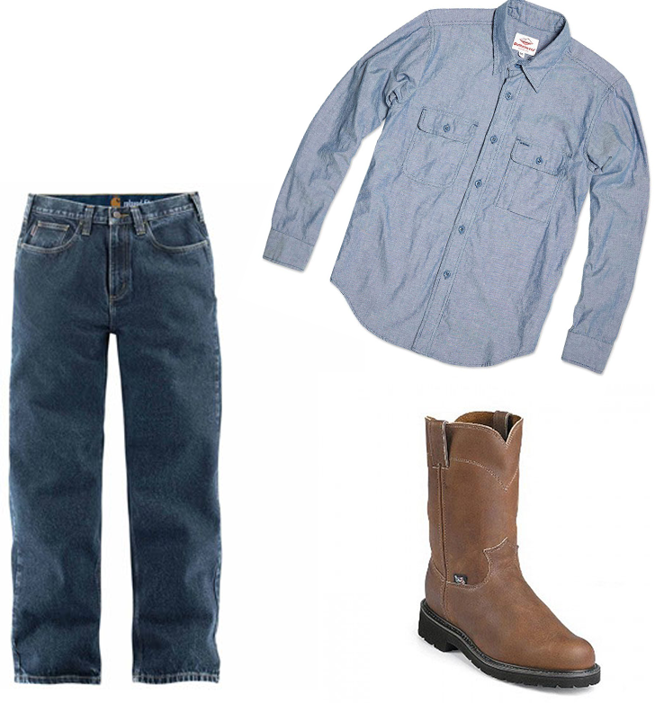
PPE (continued)
Having the right equipment keeps you safe and in the game.
While agricultural ATV use is serious business and not a sport, the same concept applies. Having the right equipment keeps you safe and keeps you in the game. PPE for ATV riders safeguards the upper body, the lower body, and the head and eyes.
ATV SAFETY:
introduction

Slide 7
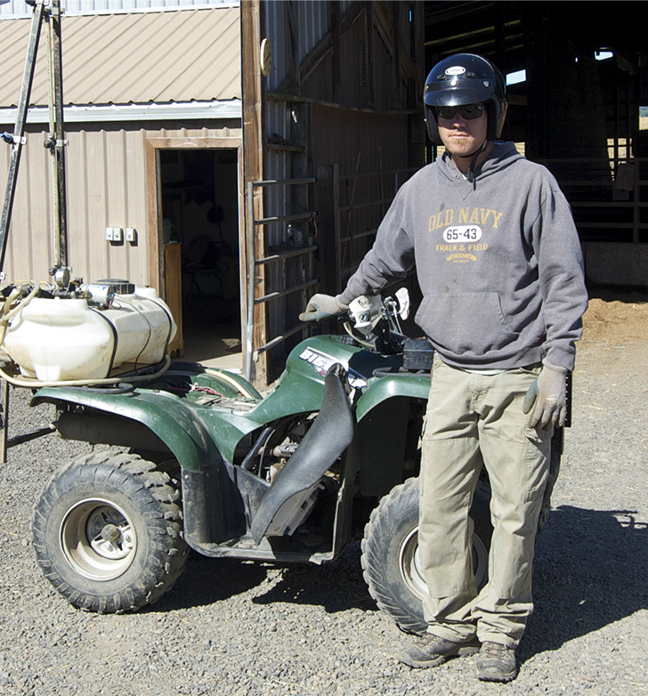
One Safe Rider
Our rider has all the right gear and clothing:
On his upper body he has on a long sleeve shirt to protect his arms from brush and branches. Long sleeves also help him become less dehydrated.
He has gloves on his hands to protect them from brush and branches as well, but also to protect them from getting too cold and losing flexibility or from sweating and losing his grip.
On his lower body, he has on heavy pants to protect his legs from brush. He also has on thick-soled boots to protect his ankles and feet.
On his head, he is wearing safety glasses to protect his eyes from bugs, dirt or debris the wind might have kicked up. And most important of all, he is wearing a helmet that is DOT-approved. His helmet is in good condition, and his chin strap is secure.
ATV SAFETY:
introduction

Slide 8
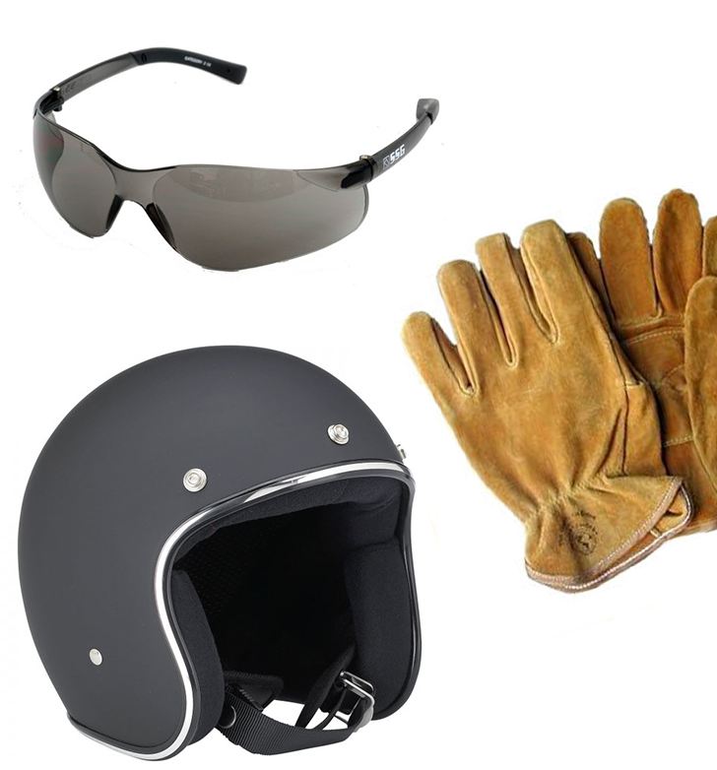
PPE Overview
While it is the employer’s responsibility to determine the hazards of each task and assign proper personal protective equipment, for best practice your PPE should include:
Long sleeves
Gloves
Heavy pants
Boots
Safety goggles or glasses
Helmet
That’s the equipment you need to stay safe and stay in the game.
ATV SAFETY:
introduction

Slide 9
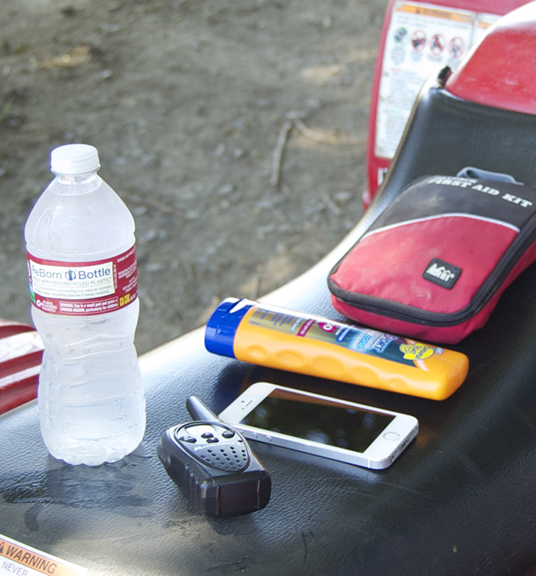
Supplies
Now let’s discuss the supplies you should always carry with you when working with an ATV.
You and your ATV may often be working in remote areas far away from co-workers and resources. Because of that, there are a few supplies that you should have with you in case of an emergency. Always carry:
Phone or radio. If you don’t have either, be sure to let someone know where you will be working and what time you should be back.
First aid kit, whether you are working remotely or close to help.
Water. Even if you think you will only be gone a short while, things happen. The ATV could break down, you could become stuck, or you could become injured and unable to ride.
Sunscreen, to protect you from the harmful effects of long exposure to the sun.
ATV SAFETY:
introduction

Slide 10
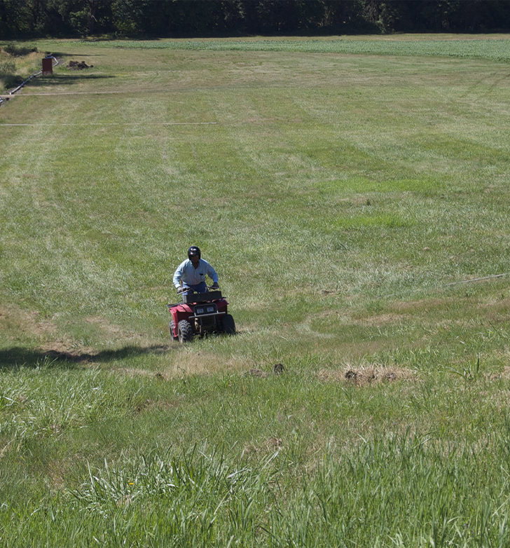
Overview
In this module we discussed PPE and supplies. Best practice for PPE for ATV riders includes:
Long sleeves
Gloves
Heavy pants
Boots
Safety goggles or glasses
Helmet
Supplies you should carry with you on your ATV for emergencies include:
Phone or radio
First aid kit
Water
Sunscreen
ATV SAFETY:
introduction

Slide 11
ATV SAFETY
Module 2: The ATV

Slide 12


Welcome to Module 2
In this module we’ll discuss:
ATV instrument panel and controls
Pre-ride inspection
Fitting the rider to the ATV
Starting the ATV
Let’s go!
ATV SAFETY:
the ATV

Slide 13
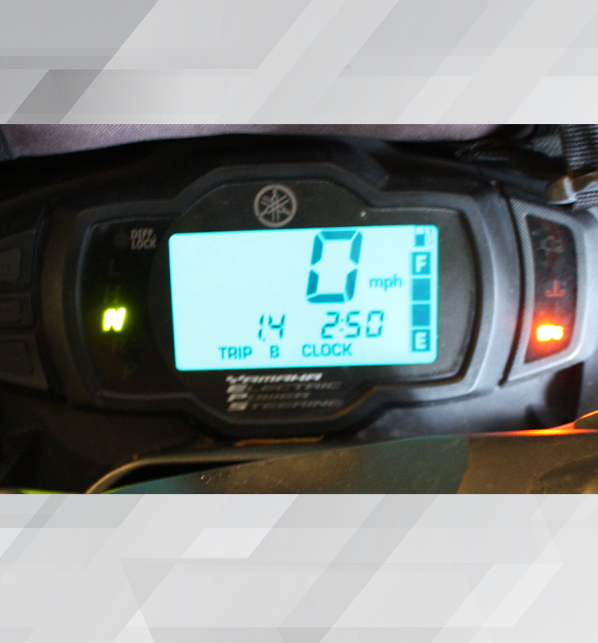
Instrument Panel
As with any vehicle you drive, you need to be familiar with the instrument panel and the controls. ATVs come in many different shapes and sizes, but they all have an instrument panel and the same basic controls. The more familiar you are with the ATV’s instrument panel and controls, the faster you can respond in dangerous situations or when riding on rough terrain.
The instrument panel on the ATV you drive may tell you your speed, what gear you are in, and how much gas is in the tank. Some ATVs also have indicator lights. Get to know where this information is on the instrument panel of the ATV you are driving.
ATV SAFETY:
the ATV

Slide 14
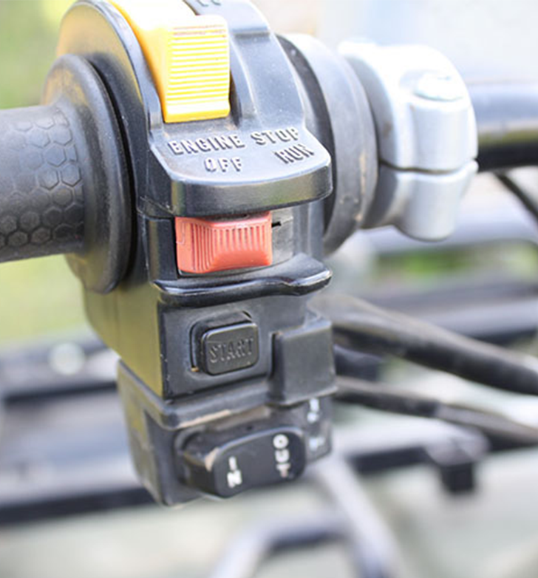
Controls
There are 10 controls on an ATV that you should be able to find and name.
1. Choke allows you to control air flow to the engine.
2. Engine cut-off switch, when pushed, turned, or flipped, depending on your ATV, kills the engine.
3. Fuel supply valve turns the fuel flow on and off to the carburetor.
4. Ignition switch sends power to the starter switch.
5. Starter switch starts the ATV.
6. Throttle lever works the same as a gas pedal in a car. Push it to go faster, reduce the pressure to slow down.
ATV SAFETY:
the ATV

Slide 15
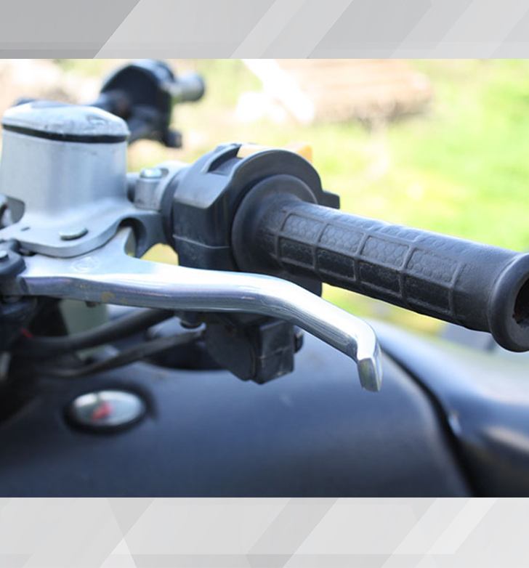
Controls (continued)
7. Front brake lever is on the right handlebar.
8. Rear brake lever or clutch lever is on the left handlebar.
9. Parking brake is also on the left handlebar. It’s a good practice to always set the parking break when the ATV is stopped.
10. Rear brake pedal is on the right footrest.
Familiarity of the ATV’s instrument panel and the 10 controls we discussed gives you one more way to guard yourself from potentially dangerous situations.
ATV SAFETY:
the ATV

Slide 16
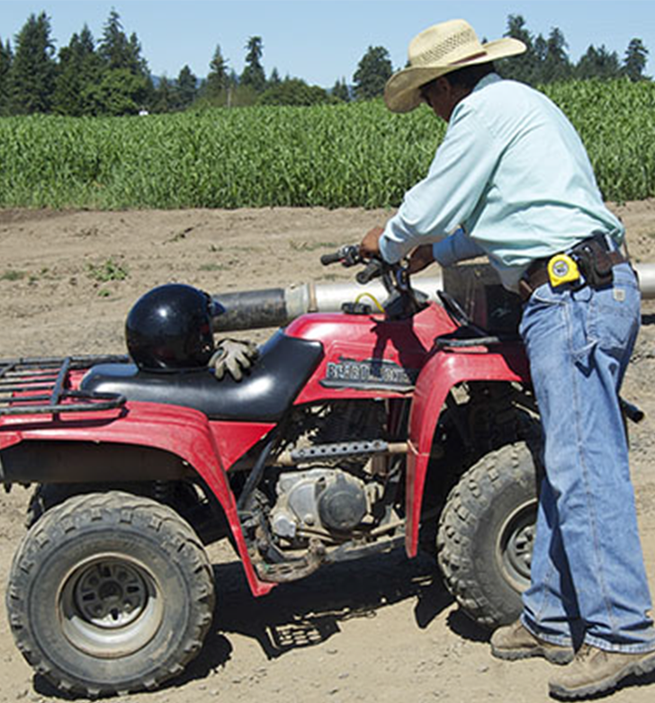
Pre-Ride Inspection
The ATV is not only the tool you will use for your task, such as spraying pesticides, it’s also your transportation there and back. The pre-ride inspection helps ensure that your tool and transportation is up to the job.
ATV SAFETY:
the ATV

Slide 17
Video: Pre-Ride Inspection
ATV SAFETY:
introduction
Notes:
Replace “Link video here” text with the Title of the video. Hyperlink the title to the video.
Text Font/Size Arial 40; modify as needed.
***Delete this note before uploading finished PPT to O:drive and website.***

Slide 18
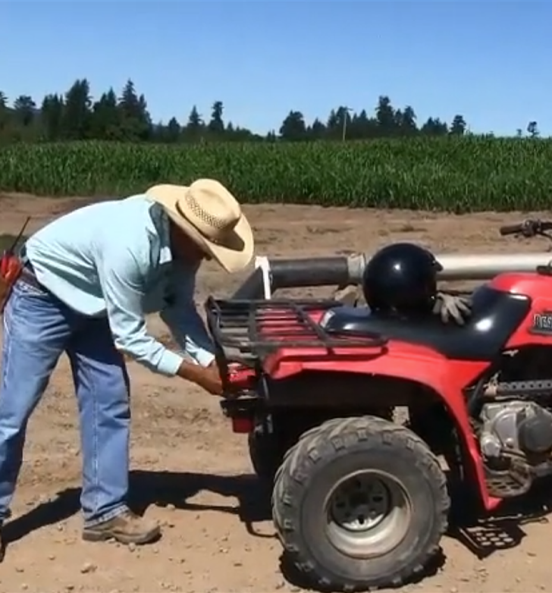
Pre-Ride Inspection Importance
The pre-ride inspection only takes a few moments of your time. Those few moments can help you avoid being stranded or, even worse, in an accident because of an ATV that’s not fully functional.
Remember, learning about ATV safety, taking a certified training course, and practicing will all help you to become a safe and responsible ATV rider.
Let’s learn about fitting the rider to the ATV next.
ATV SAFETY:
the ATV

Slide 19
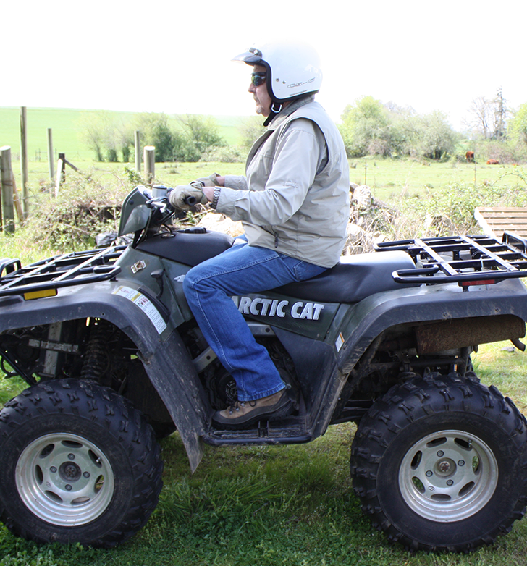
Fitting the Rider to the ATV
The ATV is ready and it is the right tool for the job, but is our rider right for the ATV? Let’s make sure. We will cover the 4 standards that need to be met:
Brake Reach
Leg Length
Grip Reach
Turning Reach
ATV SAFETY:
the ATV

Slide 20
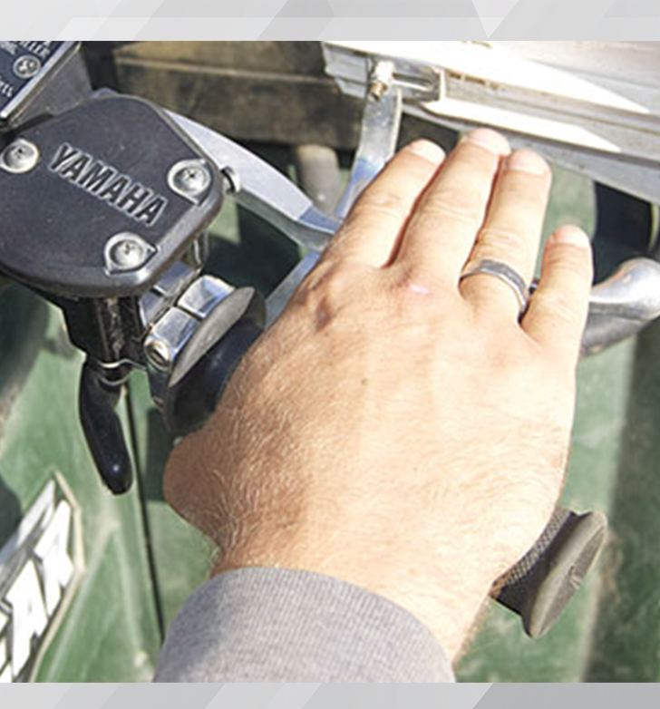
Brake Reach
First, check your brake reach. When your hand is placed in the normal driving position and your fingers are extended straight out, the first joint from the tips of your middle finger must reach beyond the brake lever.
ATV SAFETY:
the ATV

Slide 21
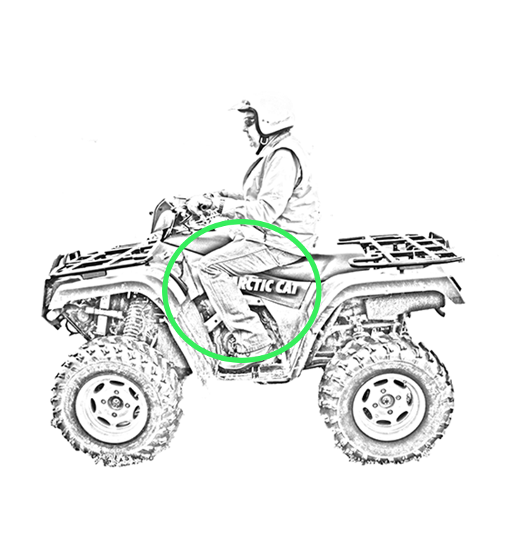
Leg Length
Second, check your leg length. While sitting with your feet on the pegs or footrest and your knees are bent at least 45 degrees, your thighs should be almost parallel to the footrests. Your knees should not be above your hips.
ATV SAFETY:
the ATV

Slide 22
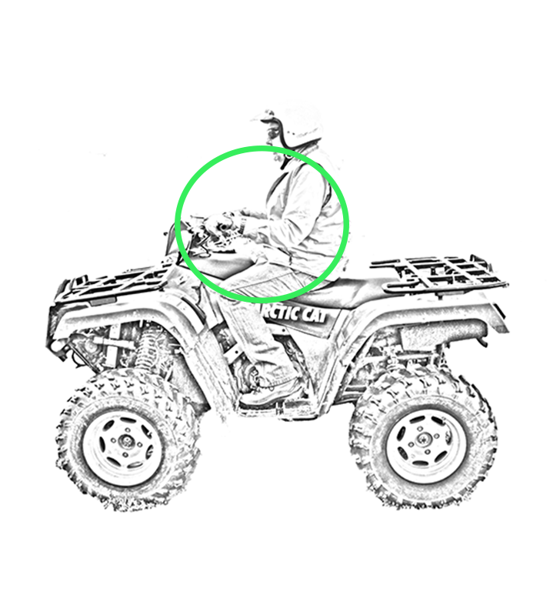
Grip Reach
Third, check your grip reach. While sitting upright on the ATV with your hands on the handlebars, and you are not leaning forward, there should be an obvious angle between your upper arm and forearm.
ATV SAFETY:
the ATV

Slide 23
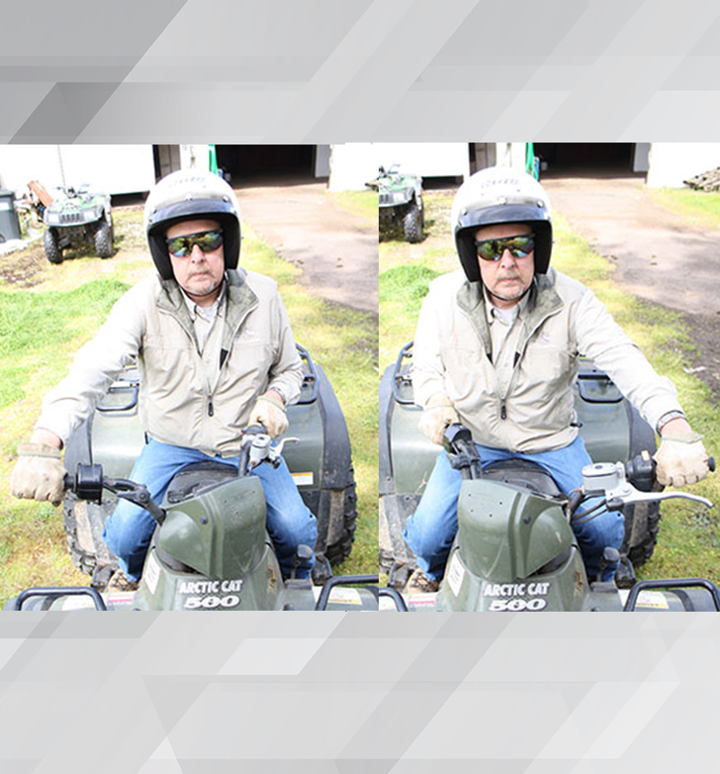
Turning Reach
Fourth, check your turning reach. Make sure that you can turn the handlebars from lock to lock while keeping a grip on the handlebars and controlling the throttle and brake.
Having the proper brake reach, leg length, grip reach, and turning reach helps you to be able to safely handle the ATV on rough terrain and during potentially dangerous situations.
ATV SAFETY:
the ATV

Slide 24
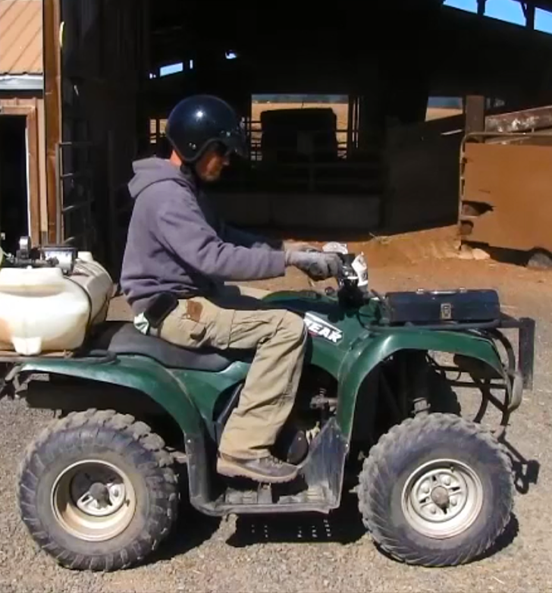
Starting the ATV
In the next video, let’s learn about the final checks you need to do after starting the ATV and how to properly sit on an ATV.
ATV SAFETY:
the ATV

Slide 25
Video: Start the ATV
ATV SAFETY:
introduction
Notes:
Replace “Link video here” text with the Title of the video. Hyperlink the title to the video.
Text Font/Size Arial 40; modify as needed.
***Delete this note before uploading finished PPT to O:drive and website.***

Slide 26
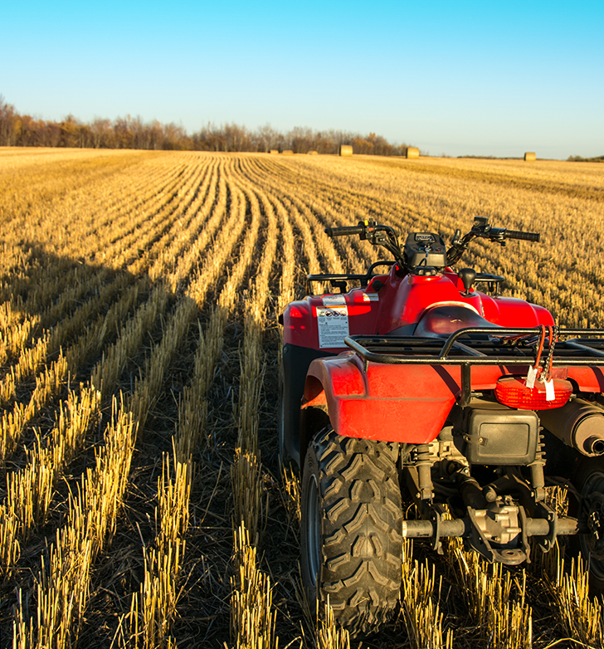
Overview
In this module, we discussed the importance of knowing and fitting to your ATV. Remember:
Get familiar with your ATV’s instrument panel and the ten controls.
Take the time to complete a pre-ride inspection.
Ensure you have the proper brake reach, leg length, grip reach, and turning reach to be able to safely handle the ATV on rough terrain and during potentially dangerous situations.
Perform the final checks after you’ve started the ATV.
During the next module, you’ll learn about an ATV’s center of gravity.
ATV SAFETY:
the ATV

Slide 27
ATV SAFETY
Module 3: Center of Gravity

Slide 28
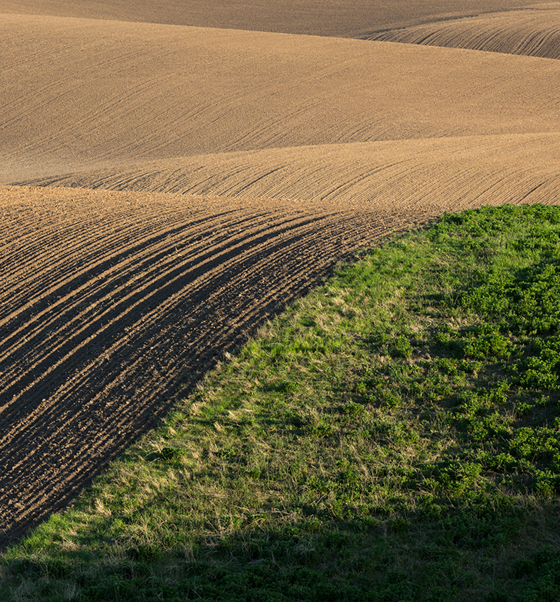

Welcome to Module 3
In this module, we will discuss an ATV’s center of gravity and how it is affected by:
Slopes and curves
Adding weight to the ATV
Riding methods
ATV SAFETY:
center of gravity

Slide 29
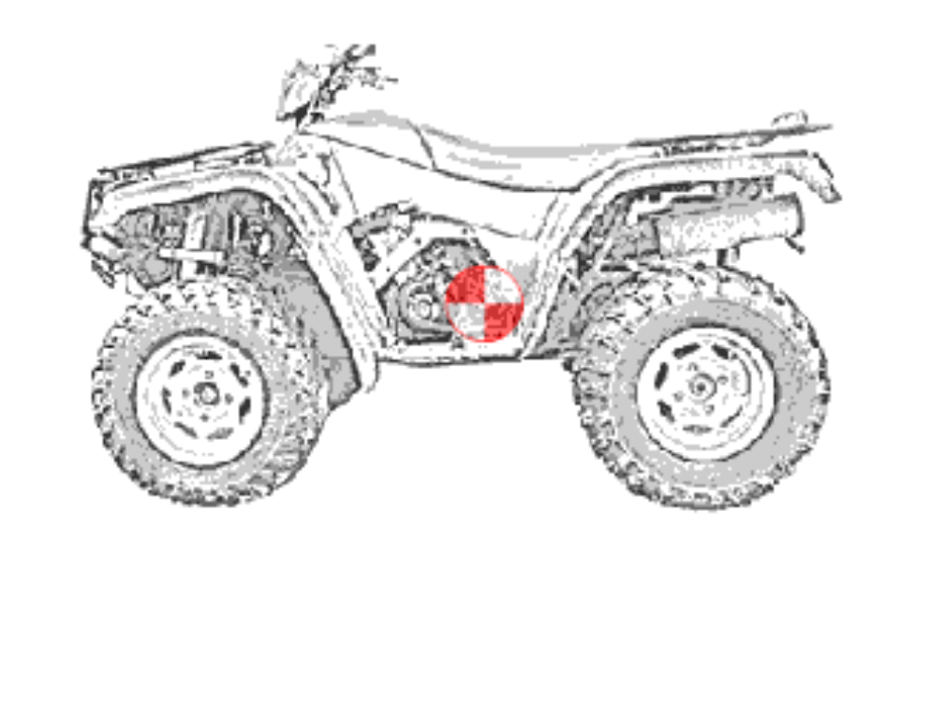
ATV’s Center of Gravity
Have you ever heard the term “center of gravity”? It’s the point in an object where it is balanced in all directions. Every object has a center of gravity. The earth’s center of gravity is at its center because it is round.
An ATV’s center of gravity is a little off-center. It’s about 6 inches above the center of the axle and about 6 inches rear of the halfway point between the axles.
It’s important to know about an ATV’s center of gravity because many things can make it shift. When an ATV’s center of gravity shifts, you need to take action to help counter that shift - this is called “active driving”. Let’s see how center of gravity shifts in an ATV in different situations.
ATV SAFETY:
center of gravity

Slide 30
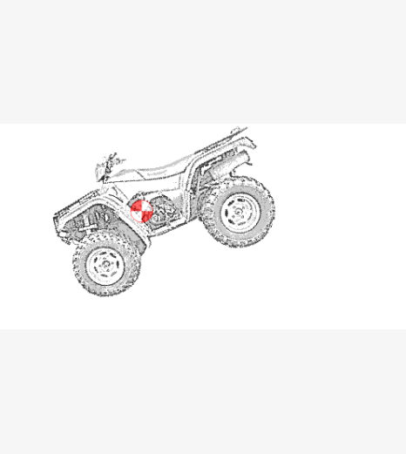
Adding Weight
As weight is added to an ATV, the center of gravity shifts.
When a rider sits on an ATV, the center of gravity shifts up.
When a load is added to an ATV, the center of gravity shifts up and toward the load.
ATV SAFETY:
center of gravity

Slide 31
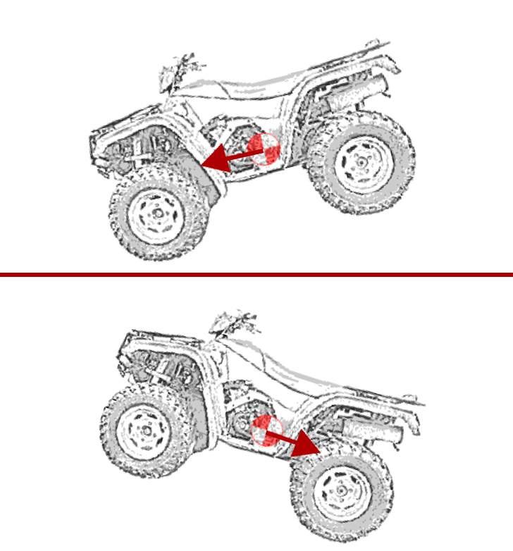
Riding on Slopes
On slopes, an ATV’s center of gravity shifts dangerously close to the tipping point.
While driving downhill, it shifts to the front of the ATV.
While driving uphill, it shifts to the back.
ATV SAFETY:
center of gravity

Slide 32
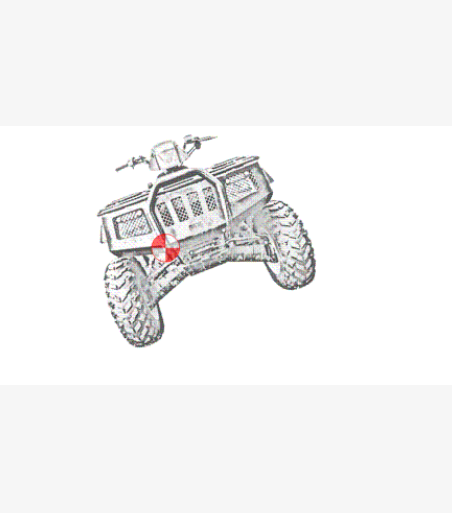
Riding on Side-hills
On side-hills, the center of gravity shifts toward the downhill side of the ATV.
ATV SAFETY:
center of gravity

Slide 33
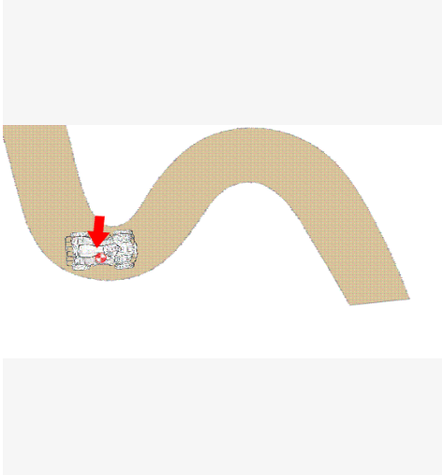
Riding around Curves
On curves, the center of gravity shifts to the outside of the curve.
Imagine you are riding on rough terrain, the ATV is constantly tilting in one direction or another, as you go uphill, downhill, across hills, and around curves. Shifts occur even as you drive across ruts, rocks, or fallen branches. That’s a lot of shifts in center of gravity.
ATV SAFETY:
center of gravity

Slide 34
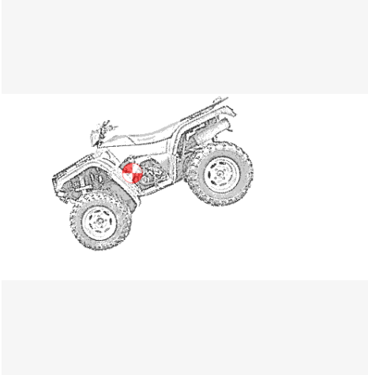
Riding Downhill
As you drive down a hill, the center of gravity on the ATV will shift forward. If you don’t take any action, you put yourself in danger of flipping forward.
View the video in the next slide to see what you can do to make driving downhill safer, including:
Slide back in the seat and sit up
Move your load to the back
Use the ATV’s low gears
ATV SAFETY:
center of gravity

Slide 35
Video: Going Downhill
ATV SAFETY:
introduction
Notes:
Replace “Link video here” text with the Title of the video. Hyperlink the title to the video.
Text Font/Size Arial 40; modify as needed.
***Delete this note before uploading finished PPT to O:drive and website.***

Slide 36
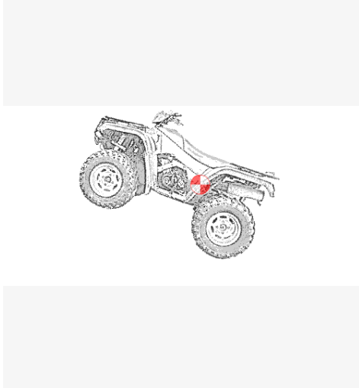
Riding Uphill
As you drive up a hill, the center of gravity on your ATV will shift backward. If you don’t take any action, you put yourself in danger of flipping backward.
Go to the next video for tips on driving uphill, including:
Lean forward and crouch low
Move your load to the front
Climb the hill in low gear and keep the throttle steady
ATV SAFETY:
center of gravity

Slide 37
Video: Going Uphill
ATV SAFETY:
introduction
Notes:
Replace “Link video here” text with the Title of the video. Hyperlink the title to the video.
Text Font/Size Arial 40; modify as needed.
***Delete this note before uploading finished PPT to O:drive and website.***

Slide 38
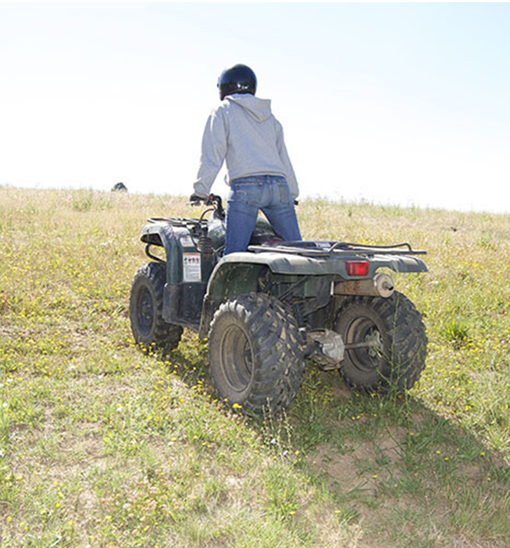
Steep Uphill Slopes
Some hills are too steep for an ATV, but you may not realize that until you’ve started up. If this happens, and your ATV begins to slide or stall, lean further forward and apply the front brake first, then the rear brake. (Applying only the rear brake may cause your ATV to flip backward.)
If the ATV continues to slide, get off and stand clear! You are more important than the ATV.
If the brakes are holding:
Step off the ATV while holding the brakes.
Stand clear of the tires, and put the parking brake on, then shut the engine off.
Finally, chock the back tires with a rock or branch and go get help. You may need a winch to get the ATV to the top of the hill.
ATV SAFETY:
center of gravity

Slide 39
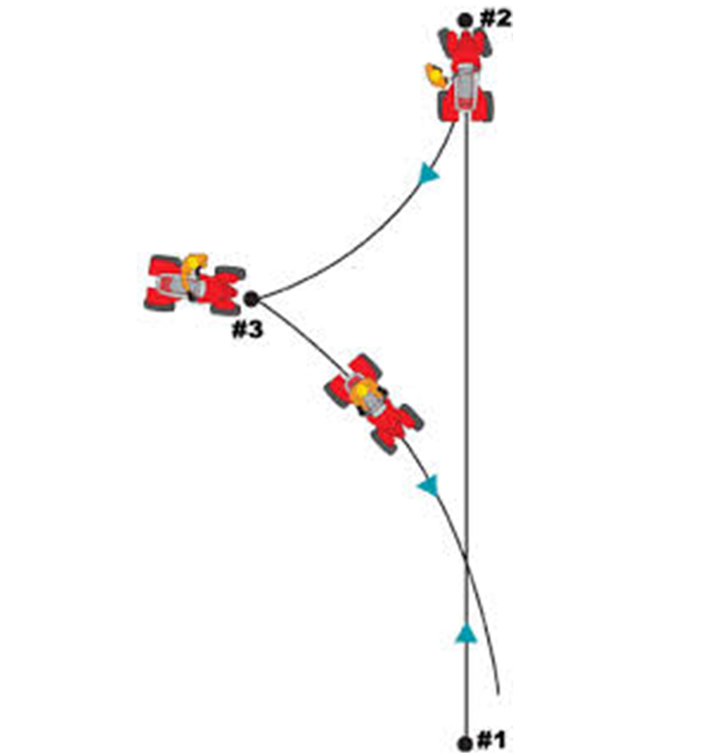
Option for Steep Slopes
If the hill is not too steep and you can do it safely, perform a K-Turn to drive back down the slope. Begin by standing next to the ATV while backing the ATV up. Then get on the ATV and drive it downhill.
ATV SAFETY:
center of gravity

Slide 40
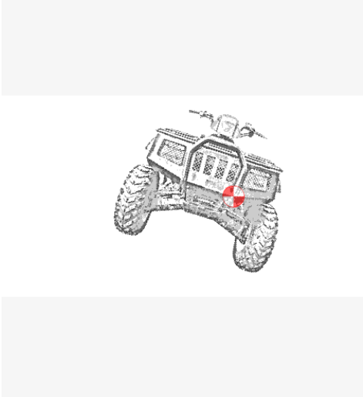
Side-hills
Riding across a hill is dangerous. Many rollovers occur while doing this. As you drive across a hill, the center of gravity shifts to the downhill side. Taking no action puts you in danger of tipping sideways and rolling down the hill.
ATV SAFETY:
center of gravity

Slide 41
Video: Side-hills
ATV SAFETY:
introduction
Notes:
Replace “Link video here” text with the Title of the video. Hyperlink the title to the video.
Text Font/Size Arial 40; modify as needed.
***Delete this note before uploading finished PPT to O:drive and website.***

Slide 42
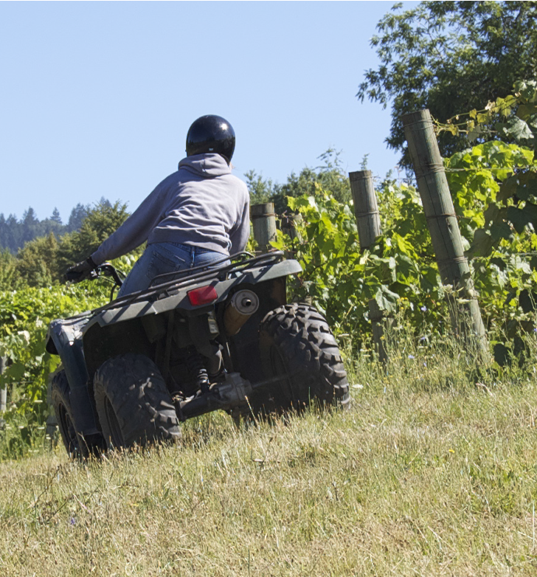
What if I Start to Tip on a Side-hill?
If you find yourself beginning to tip, try turning the wheels slightly downhill. If you can’t do that or continue to tip, carefully step off the ATV on the uphill side.
Remember, when driving on a side-hill, lean to the uphill side of the ATV then drive slowly and choose your way carefully.
ATV SAFETY:
center of gravity

Slide 43
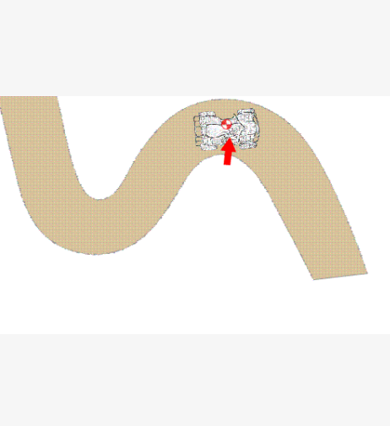
Turning Curves
When turning a curve, the center of gravity shifts to the outside of the curve. That means the ATV can tip to the outside.
ATV SAFETY:
center of gravity

Slide 44
Video: Turning Curves
ATV SAFETY:
introduction
Notes:
Replace “Link video here” text with the Title of the video. Hyperlink the title to the video.
Text Font/Size Arial 40; modify as needed.
***Delete this note before uploading finished PPT to O:drive and website.***

Slide 45
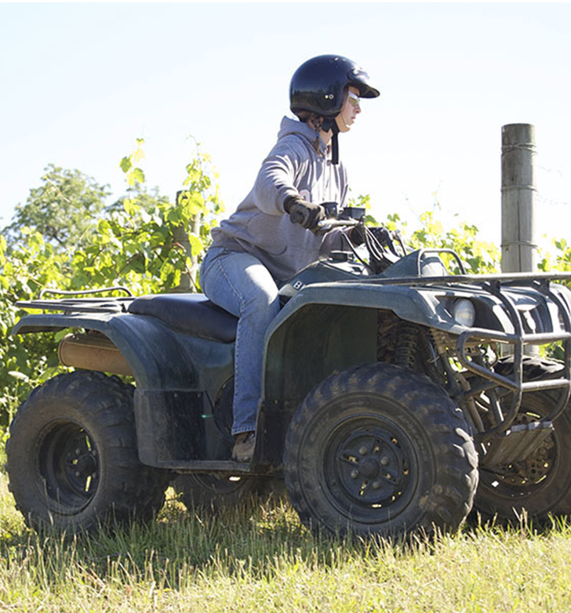
What if I Start to Tip while Turning?
If you find yourself tipping while turning a curve:
Lean further to the inside of the curve
Reduce your speed more
Try to widen your turn
Remember, when turning a curve:
Start braking before the curve
Lean to the inside of the curve
Press your foot down on the inside footrest
Go slow
ATV SAFETY:
center of gravity

Slide 46

Overview
That wraps up Module 3. We discussed:
Center of gravity of an ATV.
How the center of gravity shifts when weight is added, on slopes, or turning curves.
Active riding techniques and safety precautions to take when driving on slopes and turning curves.
ATV SAFETY:
center of gravity

Slide 47
ATV SAFETY
Module 4: Terrains

Slide 48
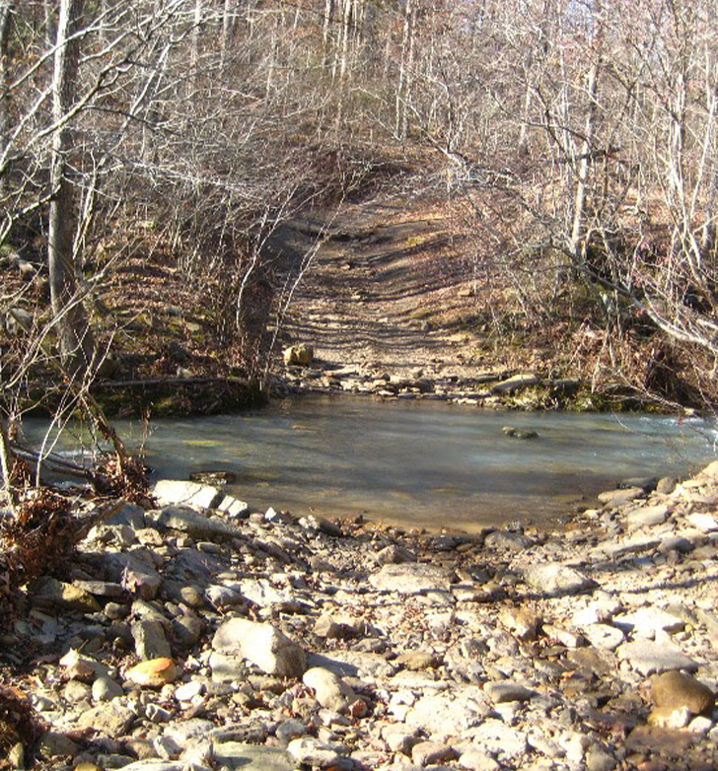

Welcome to Module 4
In this module, we will discuss ATV safety regarding:
Crossing water
Traveling on roadways
Carrying loads
Transporting liquids
Parking and reversing
ATV SAFETY:
terrains

Slide 49
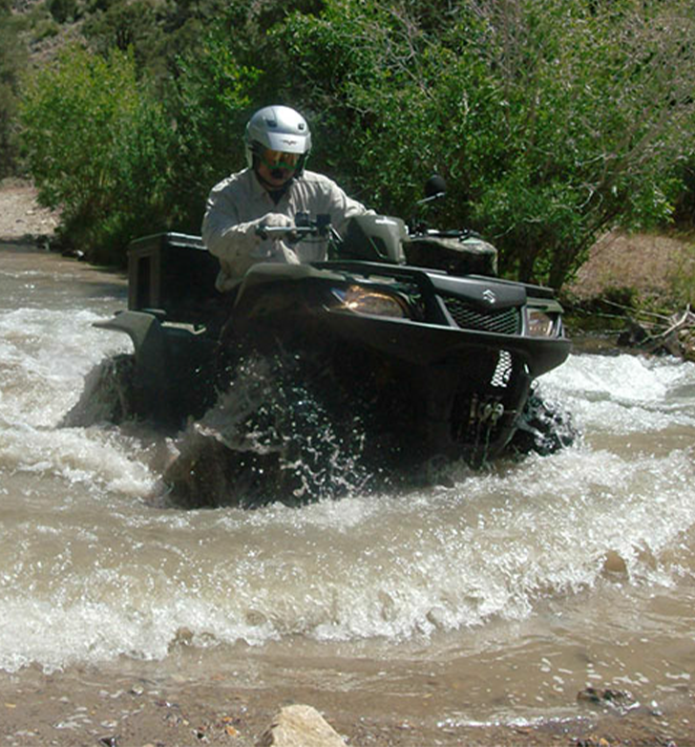
Crossing Water
If you have to cross water, there are a few things you can do to cross safely.
Never enter unfamiliar waters or fast-moving creeks or streams.
As you approach the water, stop and scout out your route. Even known water can change. Rocks could have shifted, and debris could have floated downstream.
Cross the water at a steady slow rate of speed.
When you exit the water, test and dry your brakes with a few mild stops.
ATV SAFETY:
terrains

Slide 50
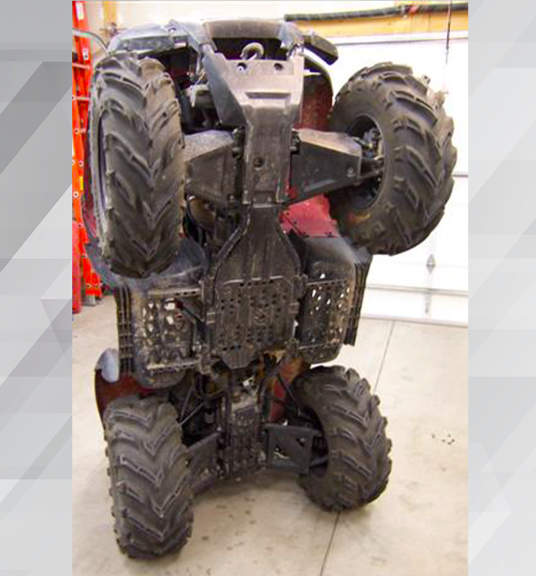
Traveling on Roads
If you have the need to cross paved roads during your work day, there are several things you need to know.
First and foremost, it is illegal to drive ATVs on public roads. Most manufacturers don’t recommend it either. That’s because ATVs have low pressure tires, a rugged suspension, and a single drive train. All designed for off-road travel over rugged terrain and all making it difficult to handle ATVs on paved roads.
ATV SAFETY:
terrains

Slide 51
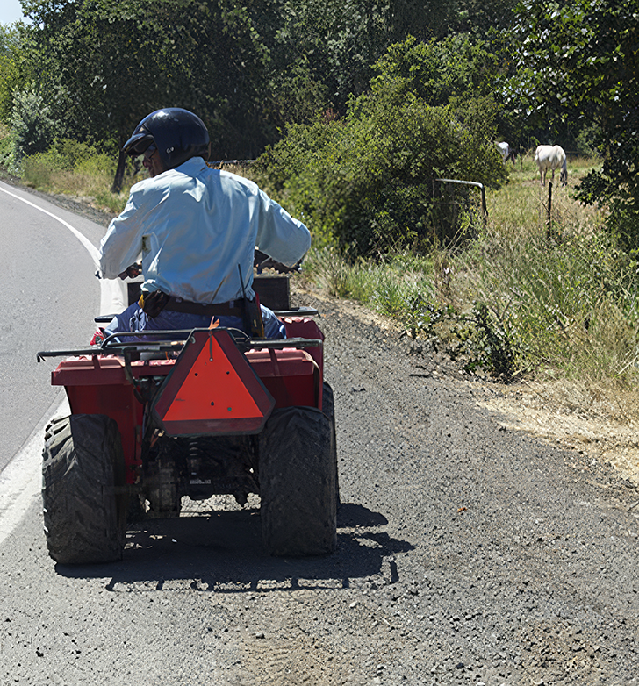
Traveling on Roads (continued)
If your work requires you to use an ATV, Oregon law allows you to cross or travel on roads with the following requirements:
You must be driving between ranching, farming, or agricultural work
You must have a valid driver’s license
You cannot go over 20 miles per hour
You must stay close to the right-hand side of the road
Headlights must be on
You must display a slow-moving vehicle sign
ATV SAFETY:
terrains

Slide 52
Video: Crossing Roads
ATV SAFETY:
introduction
Notes:
Replace “Link video here” text with the Title of the video. Hyperlink the title to the video.
Text Font/Size Arial 40; modify as needed.
***Delete this note before uploading finished PPT to O:drive and website.***

Slide 53
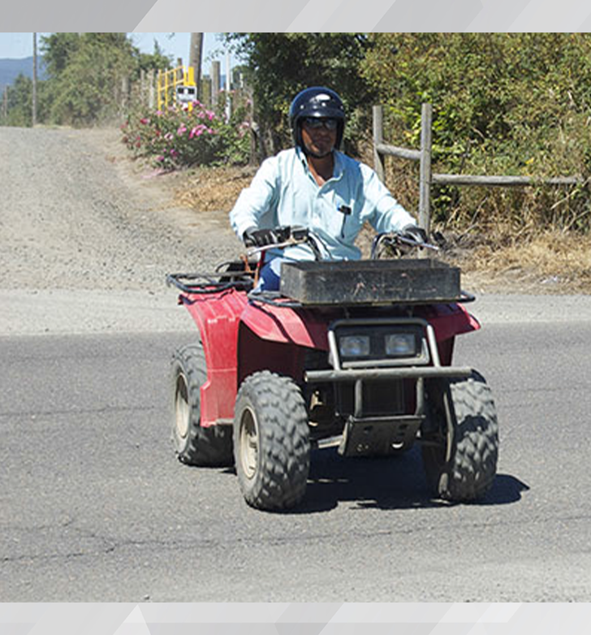
Traveling on Roads (continued)
Here are a few more things to keep in mind. If possible, think about using another type of vehicle. Always assume that other drivers do not see you. And always drive at a sensible or slow speed to maintain tire traction.
Remember, when traveling on roads:
Stop and look both ways
Allow extra time for other vehicles to pass
Cross at a 90-degree angle
Go slow
ATV SAFETY:
terrains

Slide 54
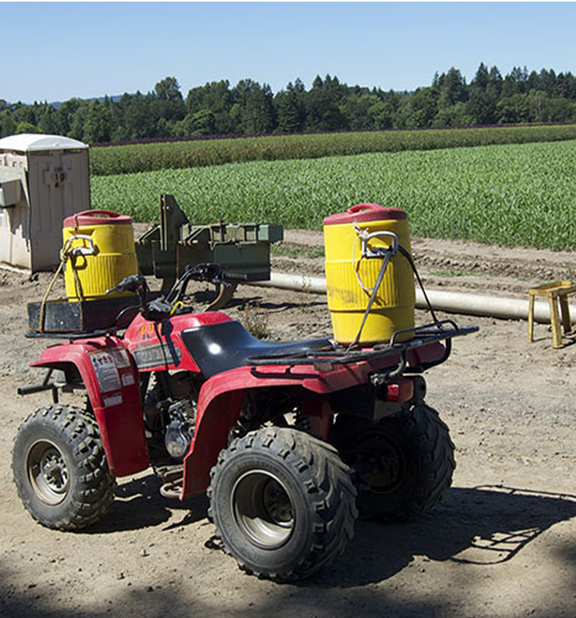
Carrying Loads
ATVs were made to carry one person and their personal gear; they weren’t made to carry heavy loads. However, when used for agriculture, you may often have to carry a heavy load. If you do, remember that extra weight shifts the ATV’s center of gravity. It also affects the handling of the ATV, making it harder to control.
Heavy loads may require you to exaggerate your active driving moves, such as leaning further into curves. And with heavy loads, it takes longer to slow down and stop.
ATV SAFETY:
terrains

Slide 55
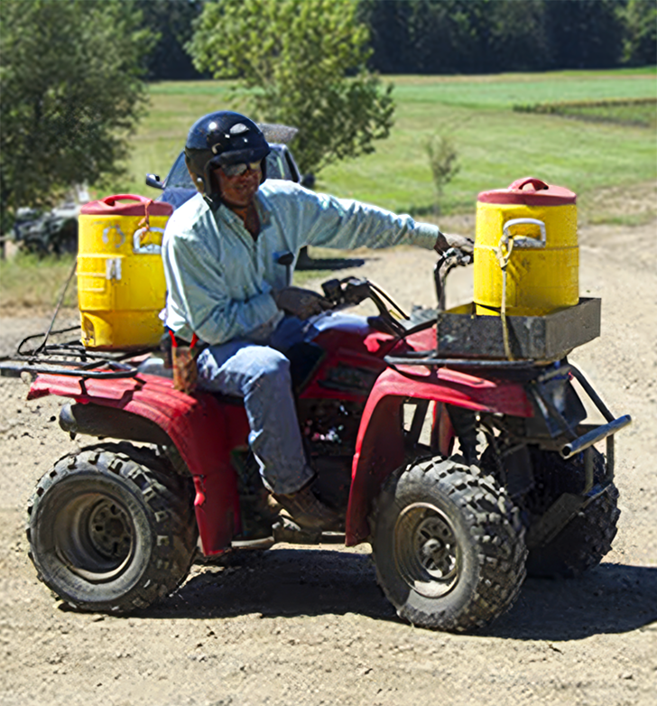
Carrying Loads (continued)
If you have to carry a heavy load,
Attach the load to the ATV’s racks in front and back to spread the weight as evenly as possible.
Be sure to secure the load properly by checking the manufacturer’s instructions for safe attachment points.
Drive slowly and cautiously.
Never carry a passenger. The longer seat of an ATV was made for active driving, giving you room to move backward and forward to offset shifts in the center of gravity.
ATV SAFETY:
terrains

Slide 56
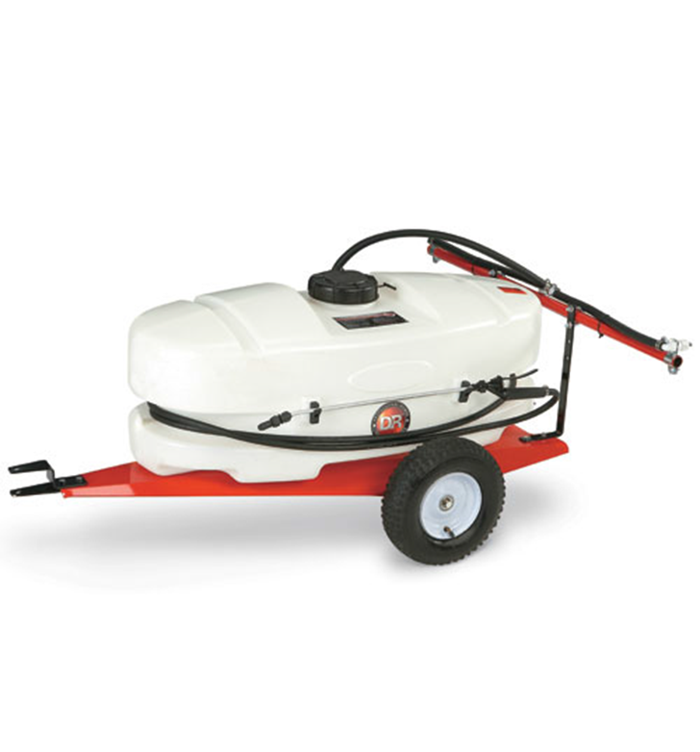
Towing
When you need to tow, always follow the manufacturer’s instructions for load limit size and correct trailer attachment.
Never use cables or ropes attached to the ATV’s carrying racks for towing. It raises the ATV’s center of gravity dangerously high and could cause the ATV to flip backward.
ATV SAFETY:
terrains

Slide 57
Video: Towing
ATV SAFETY:
introduction
Notes:
Replace “Link video here” text with the Title of the video. Hyperlink the title to the video.
Text Font/Size Arial 40; modify as needed.
***Delete this note before uploading finished PPT to O:drive and website.***

Slide 58
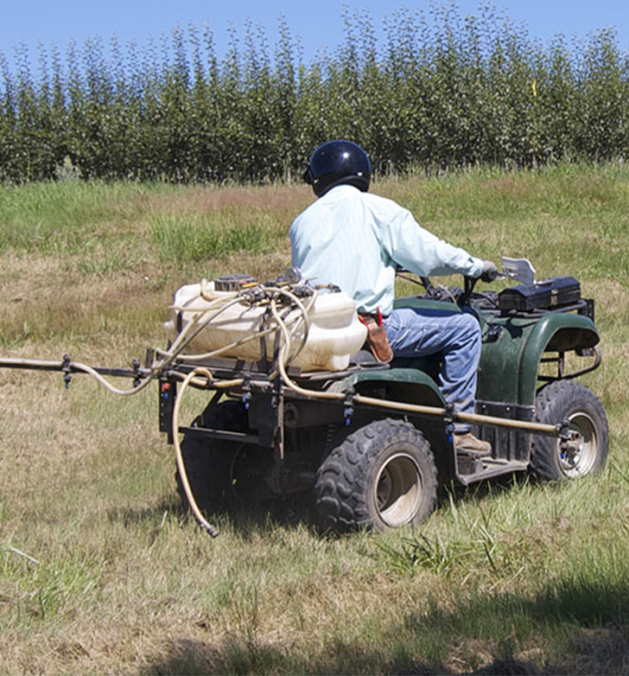
Transporting Liquids
When transporting liquids, you need to use extra caution. On rough terrain the liquid sloshes back and forth and from side to side making the ATV unstable. If possible, use a baffled container to carry liquids. This is a container with dividers inside to reduce sloshing.
For the safest solution, tow the liquid rather than carrying it and use a baffled container and a trailer designed for ATVs. (Remember, towing is safer than carrying but towing still affects the handling of the ATV.)
ATV SAFETY:
terrains

Slide 59
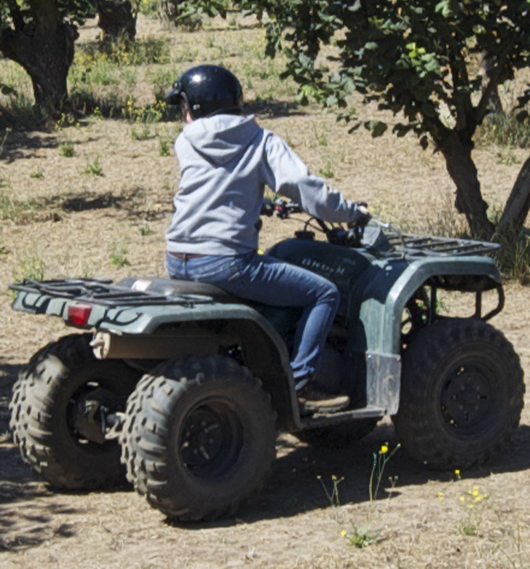
Parking and Backing Up
The safest way to park an ATV is on level ground, but that’s not always possible. If you are in an area where you cannot park on level ground, there are a few safe practices you can follow.
If you are on a slope, try to park across the slope.
If you’re parking facing downhill, put the ATV in reverse and put the parking brake on.
If you’re facing uphill, chock the tires and put the parking brake on.
In fact, it’s always a good idea to put the ATV’s parking brake on when parking.
When backing up, go slow and continue to check your path until you are stopped. Watch the next video for more about backing up.
ATV SAFETY:
terrains

Slide 60
Video: Backing Up
ATV SAFETY:
introduction
Notes:
Replace “Link video here” text with the Title of the video. Hyperlink the title to the video.
Text Font/Size Arial 40; modify as needed.
***Delete this note before uploading finished PPT to O:drive and website.***

Slide 61
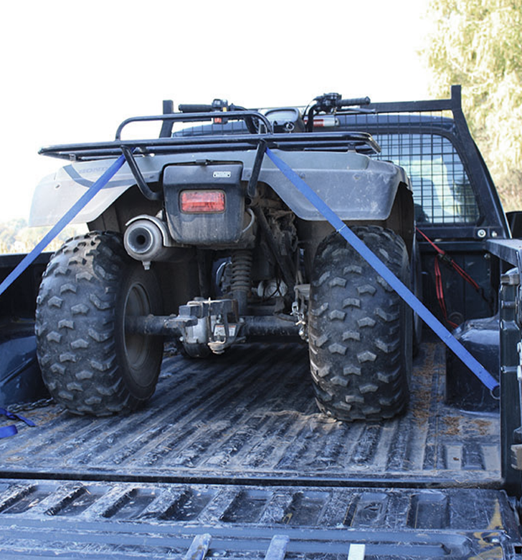
Loading and Unloading
Did you know that many accidents and injuries involving ATVs happen when loading and unloading the ATV? Not only are you working with a heavy ATV with a shifting center of gravity, but you are also working with angled ramps, different heights, and in the confined areas of a trailer or truck. However, by following safe practices, you can minimize the danger.
ATV SAFETY:
terrains

Slide 62
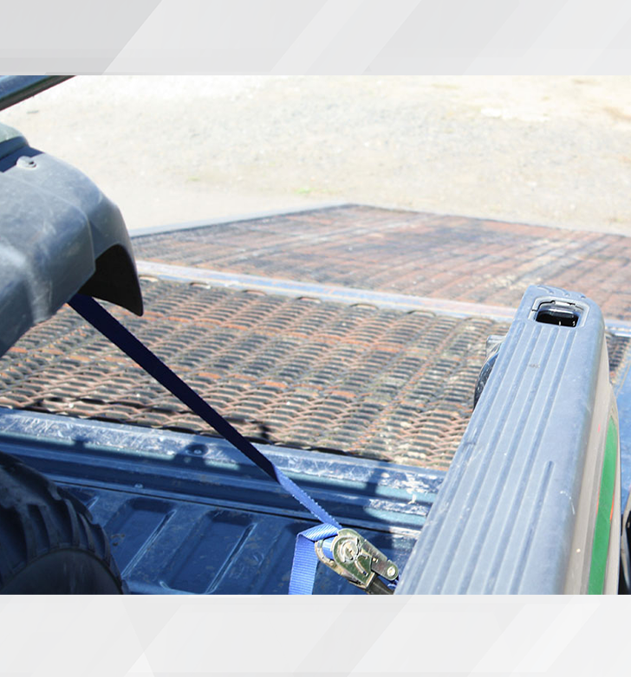
Loading and Unloading (continued)
Here are some of the steps you can take to help keep you safe:
Use the lowest truck or trailer available. This reduces the ramp angle.
Use a wide ramp for extra wheel clearance.
Be sure to secure the ramp with tie-downs. While loading an ATV, when the front tires move off the ramp and onto the pickup or trailer, the ATV’s back tires can push the ramp back if it is not secured. If the ramp moves or falls, it can cause the ATV to drop or topple back.
Stay within the ramp’s weight limits.
When the ATV is loaded, put it in gear and set the parking brake.
Be sure to tie the ATV down securely.
ATV SAFETY:
terrains

Slide 63
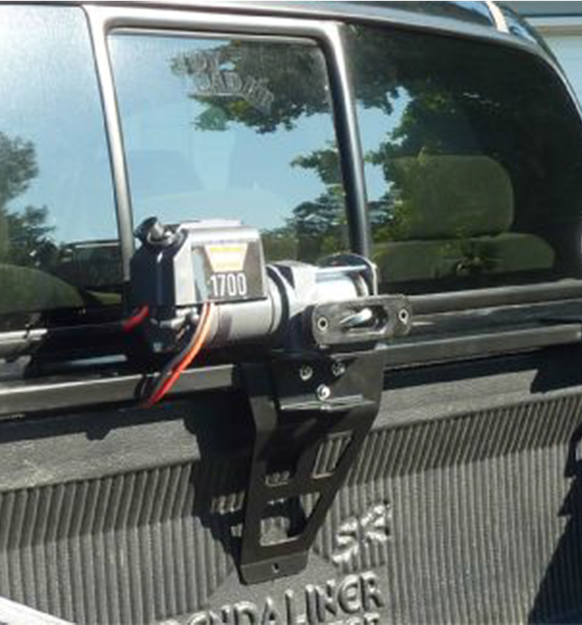
Loading/Unloading Best Practices
For best practices, here are some recommendations:
Use only experienced ATV operators to load and unload the ATV.
If possible, use a permanent structure to load and unload the ATV. This may be a berm or a structure made of earth.
Use a winch instead of driving the ATV up the ramp. Use a winch especially when loading damaged ATVs or ones carrying heavy loads.
If you don’t have access to a permanent structure, use a trailer because they are closest to the ground.
If you have to use a pick-up, use a high traction ramp.
ATV SAFETY:
terrains

Slide 64

Overview
That wraps up Module 4. We discussed best practices for crossing water, traveling on roads, carrying loads and towing, backing up and parking, and loading/unloading an ATV. A few of these best practices include:
When crossing water, stop and scout out your route first, then cross at a slow steady pace.
If you must travel on roads, remember to go under 20mph and have headlights on.
When carrying loads, try to evenly space out the weight as much as possible and never carry passengers.
Use the lowest truck or trailer available for loading an ATV and always ensure the ATV is tied down securely.
ATV SAFETY:
terrains

Slide 65
ATV SAFETY
Module 5: Riding Safe

Slide 66


Welcome to Module 5
In this module we will discuss the following topics:
Final reminders for ATV safety
Farm utility vehicles
Employee and supervisor roles
We will conclude the course with a quiz and provide you with further resources.
ATV SAFETY:
riding safe

Slide 67
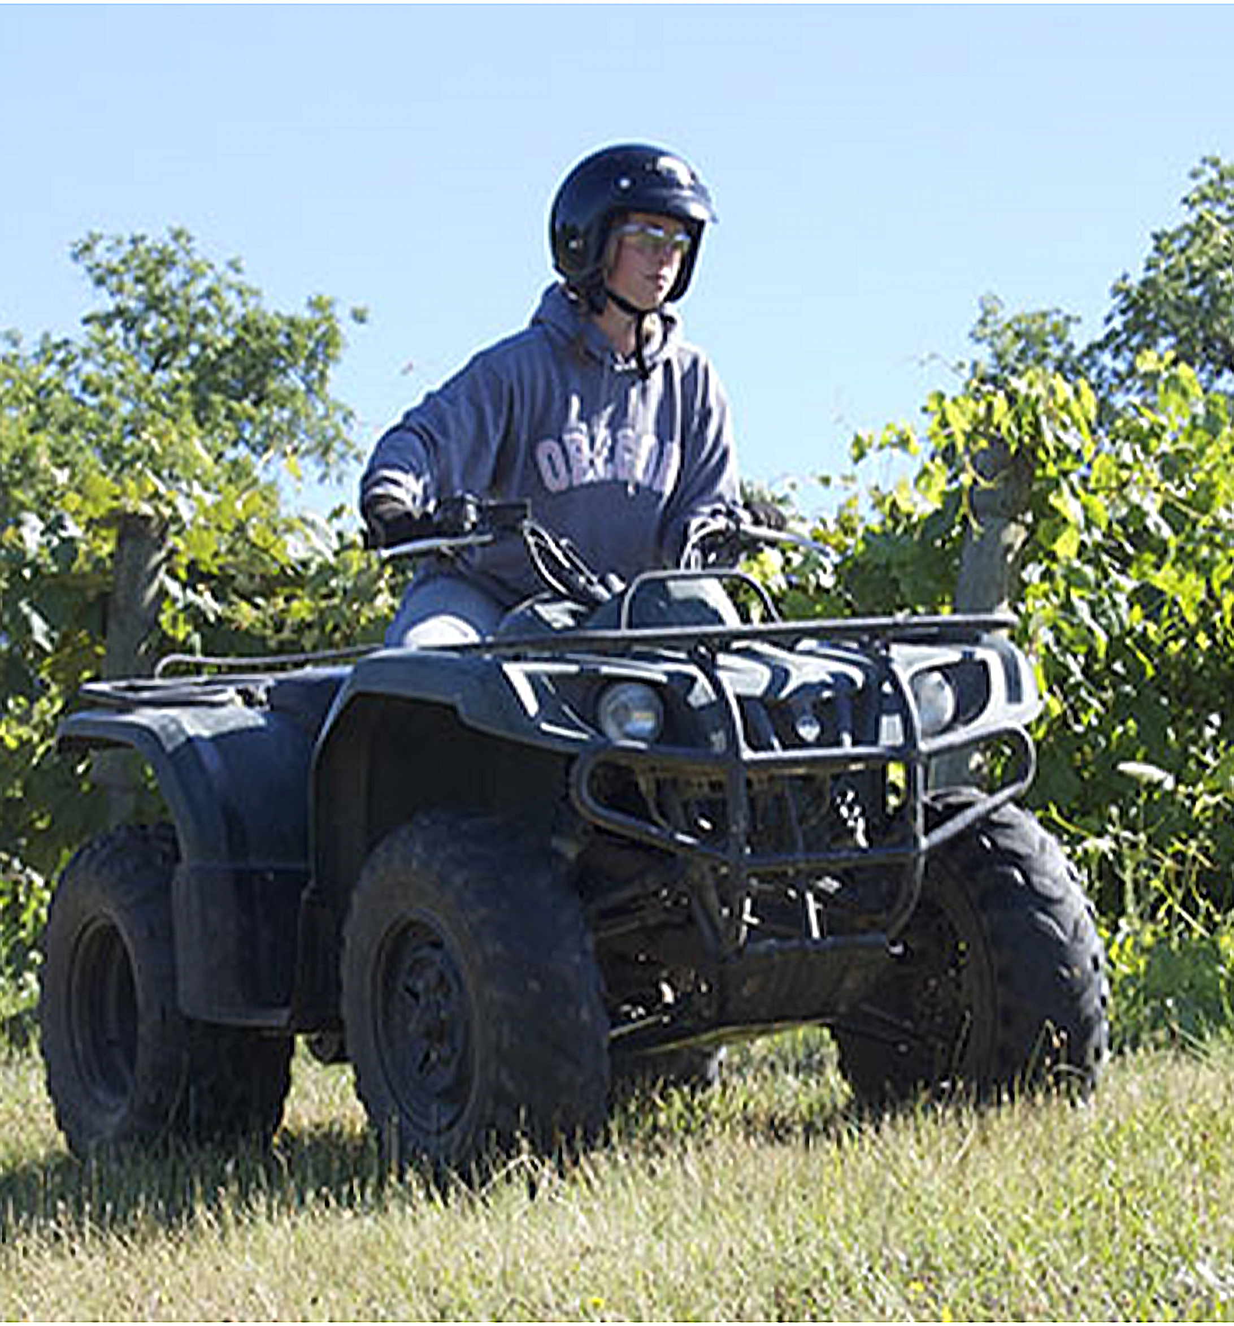
Safety Reminders
One rider for the ATV. That long seat is for active driving, not carrying passengers. When riding an ATV, keep your:
- Feet on the footrests
- Knees toward the gas tank
- Hands on the handlebars
- Attention in the direction of travel
Ride at a speed that is safe for the terrain you are traveling on, any weather conditions that are occurring, and your level of experience.
Look ahead for slopes, drop-offs, holes, ruts, and obstacles like branches, wires, and fencing. It’s always good to walk the terrain first.
(List continues on next slide)
ATV SAFETY:
riding safe

Slide 68
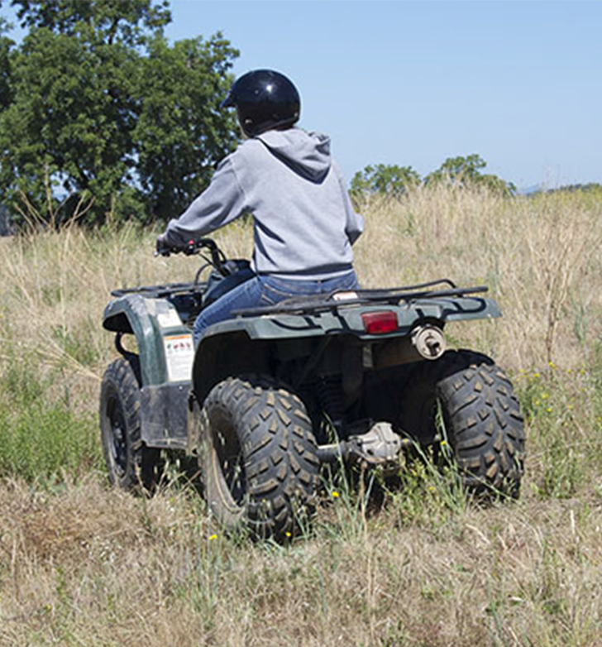
Safety Reminders (continued)
Allow plenty of time for turning and stopping.
Never pop the clutch of the ATV. It can cause the ATV to dig in and back flip. If you need to stop fast, such as in an emergency, center your weight and apply both the front and rear brakes.
Always drive at reasonable speeds.
Use extra caution during bad weather and darker hours.
Always let others know where you are working and check in regularly.
Operating an ATV safely is a choice each ATV rider has to make. Choose to ride safe - you are worth it!
ATV SAFETY:
riding safe

Slide 69
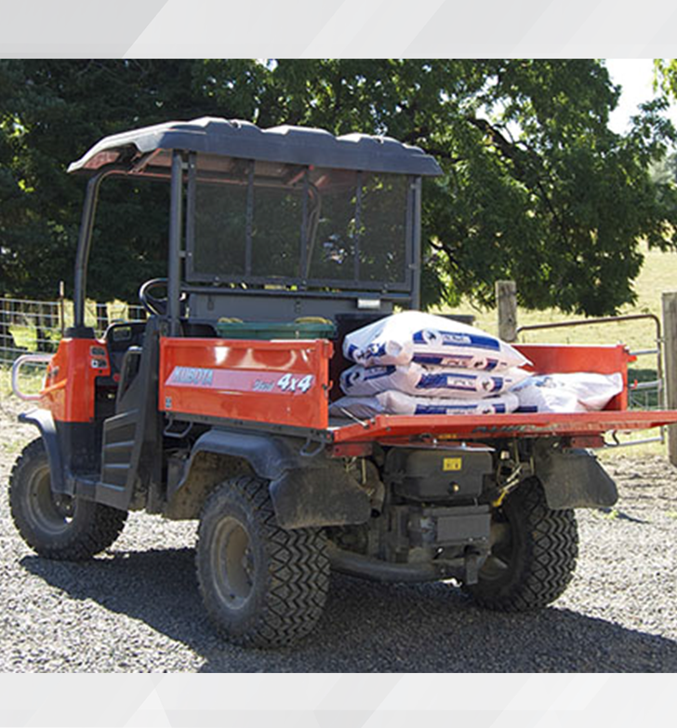
Farm Utility Vehicles
Farm utility vehicles, also known as side-by-sides, are like a cross between an ATV and a golf cart. They offer more versatility than an ATV because they can carry more than one passenger and larger, heavier loads. They also have a hitch for towing and an option to add a sunshade.
Farm utility vehicles can be used for mowing, plowing, hauling up to a ton of supplies, dumping, and towing sprayers, fertilizers, and equipment.
ATV SAFETY:
riding safe

Slide 70

Farm Utility Vehicles (continued)
But even more importantly, utility vehicles are safer than ATVs. According to Consumer Federation of America, the number of deaths from ATV use is significantly higher than utility vehicles. In a 10-year period, from 2015 to 2024, their data showed:
4,007 deaths from ATVs
347 deaths from utility vehicles
While there may be many factors influencing those numbers, utility vehicles have two important safety features that ATVs lack - seat belts and roll bars.
ATV SAFETY:
riding safe

Slide 71

Employee Role
As an employee, it is your responsibility to follow your supervisor’s rules for ATV use, including safety measures and best practices.
As an employee, you also depend on your coworkers to do the same. If you see a coworker driving an ATV unsafely, take a moment to caution them. Ask that they do the same for you.
ATV SAFETY:
riding safe

Slide 72

Supervisor Role
As a supervisor, there are several things that you can do to ensure your employees’ safety.
Require training and supervise employees’ practice sessions.
Ensure the manufacturer’s toolkit and all emergency supplies are on each ATV.
Require that your employees wear proper personal protective equipment.
Establish a maintenance program and ensure the ATVs are kept serviced and working properly.
Know, and make sure your employees also know, about the ATV’s weight limits for towing and hauling.
(List continues on next slide.)
ATV SAFETY:
riding safe

Slide 73

Supervisor Role (continued)
Establish best practices for securing and distributing loads.
Keep your employees informed of hazards such as ditches, fences, and road crossings at your site and ensure they know where ATVs are not allowed.
Require safe driving speeds.
Never allow passengers.
When it comes to ATV safety, fulfilling your role as a supervisor (or employee) is just as important as riding an ATV safely, and just as important in reducing ATV injuries and fatalities.
ATV SAFETY:
riding safe

Slide 74

Course Summary
When it comes to ATV safety, this course showed you many ways you can protect yourself from potentially dangerous situations. Some of them include:
Wearing proper personal protective gear
Completing a pre-ride inspection of the ATV
Being familiar with the ATV’s instrument panel
Understanding center of gravity and how weight, slopes, and curves can affect an ATV’s center of gravity
Learn the terrain you are riding on
Practicing active riding
Remember: Operating an ATV safely is a choice each ATV rider has to make. Choose to ride safe - you are worth it.
ATV SAFETY:
riding safe

Slide 75
ATV Safety - Quiz
Question 1: For training we recommend that you:
Seek training from a certified trainer
Train for all conditions
Practice often
All the above
Question 2: Lower body protection includes: (Select all that apply)
Heavy pants
Shorts
Thick-soled boots
ATV SAFETY:
riding safe

Slide 76
ATV Safety - Quiz
Question 3: Proper leg length means sitting with your feet on the pegs or footrest and:
Knees are bent at least 45 degrees
Thighs are almost parallel to the footrests
Knees should not be above your hips
All the above
Question 4: Head and eye protection includes: (Select all that apply)
DOT-approved helmet
Safety glasses or goggles
Baseball cap
ATV SAFETY:
riding safe

Slide 77
ATV Safety - Quiz
Question 5: What supplies should you always carry with you? (Select all that apply)
Phone or radio
First aid kit
Water
Sunscreen
Question 6: For proper turning reach you need to be able to: (Select all that apply)
Turn the handlebars from lock to lock
Keep a grip on the handlebars
Control the throttle
Control the brake
ATV SAFETY:
riding safe

Slide 78
ATV Safety - Quiz
Question 7: What are some steps you can take when driving an ATV downhill? (Select all that apply)
Stop and look ahead
Move your load to the back of the ATV
Use the low gears of the ATV
Let the engine help slow you down
Question 8: If you are carrying a load when driving uphill, where should the load be placed?
Front rack
Back rack
ATV SAFETY:
riding safe

Slide 79
ATV Safety - Quiz
Question 9: When driving uphill, what is the active driving position you should be in?
Lean forward and crouch low
Sit back and up
Question 10: When driving a side-hill, what active driving measure should you take?
Slide back in the seat and crouch low
Lean your body to the uphill side
ATV SAFETY:
riding safe

Slide 80
ATV Safety - Quiz
Question 11: If you feel yourself tipping while turning a curve, you should: (Select all that apply)
Lean further to the inside of the curve
Reduce your speed more
Widen your turn
Question 12: Large loads should be:
Attached to the front and back racks
Spread out evenly
Secured properly
All the above
ATV SAFETY:
riding safe

Slide 81
ATV Safety - Quiz
Question 13: When parking an ATV facing downhill, you should: (Select all that apply)
Put the ATV in reverse
Put the parking brake on
Put the ATV’s flashers on
Question 14: When parking an ATV facing uphill, you should: (Select all that apply)
Put the ATV in reverse
Put the parking brake on
Chock the tires
ATV SAFETY:
riding safe

Slide 82
ATV Safety - Quiz
Question 15: What are some things you can do to load an ATV safely: (Select all that apply)
Use the lowest truck or trailer
Use a wide ramp
Secure the ramp with tie downs
When loaded, put the ATV in gear
Set the ATV’s parking brake
Tie down the ATV securely
Question 16: Some ways you can ride safely include: (Select all that apply)
Never allow passengers
Always sit properly on an ATV
Drive at safe speeds
Check your route
ATV SAFETY:
riding safe

Slide 83
Hazard Identification – Quiz Answers
D
A, C
D
A, B
A, B, C, D
A, B, C, D
A, B, C, D
A
A
B
A, B, C
D
A, B
B, C
A, B, C, D, E, F
A, B, C, D
ATV SAFETY:
riding safe

Slide 84

Where to Go From Here
An excellent resource to utilize is the A-Z Topic Index on the Oregon OSHA website. It has lists of relevant publications, training materials, rules, videos, and other materials.
If you want guidance in developing a safer work environment, you may consider our free, confidential consultation service. Our consultants can help you reduce accidents, related costs, and help you develop a comprehensive program.
ATV Safety Resources
Oregon OSHA Online Courses
Consultation Services
File a Complaint
ATV SAFETY:
riding safe

Slide 85


Slide 86

Credits
Congratulations, you’ve completed ATV Safety!
Produced by the Public Education Team of Oregon OSHA
Stock media provided by: Getty Images Inc., Envato Elements
ATV SAFETY:
riding safe

