Slide 1



BLOODBORNE PATHOGENS
Module 1: Introduction
Please note: If the online course contains videos, the video links are included in this PPT.
You will need to have an internet connection to play the videos or
you can download the videos and embed them into your copy of this PPT presentation.

Slide 2


Disclaimer
Completing this course will help you understand the rules and some of the hazards related to bloodborne pathogens. However, it is your employer’s responsibility to further your training where it is specific to your organization, such as permits, policies, and practices. This material should not be considered a substitute for any provisions of the Oregon Safe Employment Act, or for any standards issued by Oregon OSHA. Manufacturers, products, or services displayed in this material are for informational purposes only and do not constitute an endorsement by Oregon OSHA.
Module 1: Introduction

Slide 3
Video: Introduction to Online Course
Module 1: Introduction

Slide 4

Who Should Take This Course
This course is designed for managers or company owners with employees that may encounter blood in their job duties. Complying with the Bloodborne Pathogens Standard can be summed up into two main tasks:
1. Develop a written exposure control plan.
2. Enforce and maintain your exposure control plan.
Module 1: Introduction

Slide 5

Background
In 1986, Federal OSHA was petitioned by various unions representing healthcare employees to develop an emergency temporary standard to protect employees from occupational exposure to bloodborne diseases. The agency concluded the risk for contracting Hepatitis B and HIV among healthcare workers required an immediate response. Interim means of compliance were put into place as compliance policies (CPLs) were adopted. On December 6, 1991 OSHA issued 26 CFR 1910.1030.
In July of 1992, Oregon OSHA adopted the standard in its entirety. In addition, Oregon OSHA adopted OAR 437-002-1030: Engineering and Work Practice Controls to enhance safety measures in Oregon.
Module 1: Introduction

Slide 6
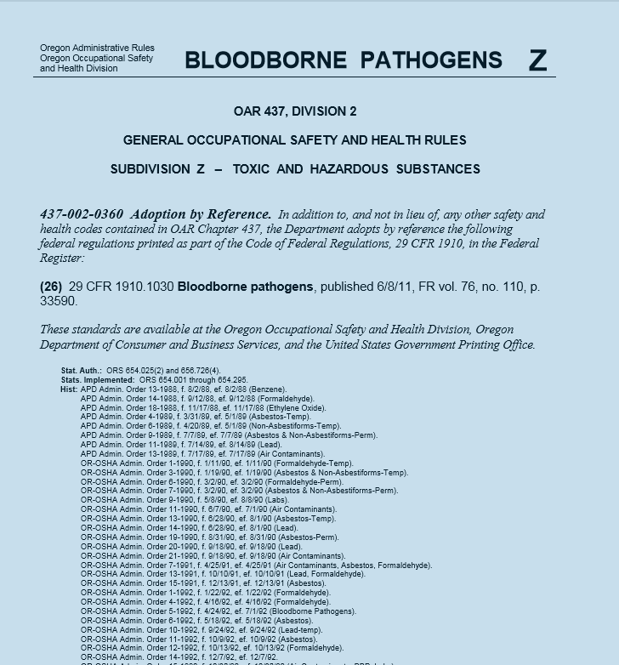
Bloodborne Pathogens Standard
Who has occupational exposure.
How to reduce workplace exposure to bloodborne pathogens.
Also included in the standard are the necessary steps to take should an exposure occur. To reference the bloodborne pathogen’s rules as you go through this course, please click on the resource button. You can also click the button:
29 CFR 1910.1030 Bloodborne Pathogens
Module 1: Introduction

Slide 7

Definitions
Occupational Exposure means reasonably anticipated skin, eye, mucus membrane, or parenteral contact with blood or other potentially infectious materials that may result from the performance of an employee’s duties.
Bloodborne Pathogens are microorganisms that are transmitted via human blood and cause disease. They can be transmitted by means of blood, tissue, and body fluids containing blood.
While there are many types of pathogens, the focus of this program is on bloodborne pathogens and what employers need to know to be in compliance with Oregon OSHA. In general, the purpose of the standard is to protect employees from the hepatitis B virus (HBV), the human immunodeficiency virus (HIV), and the hepatitis C virus (HCV).
Module 1: Introduction

Slide 8
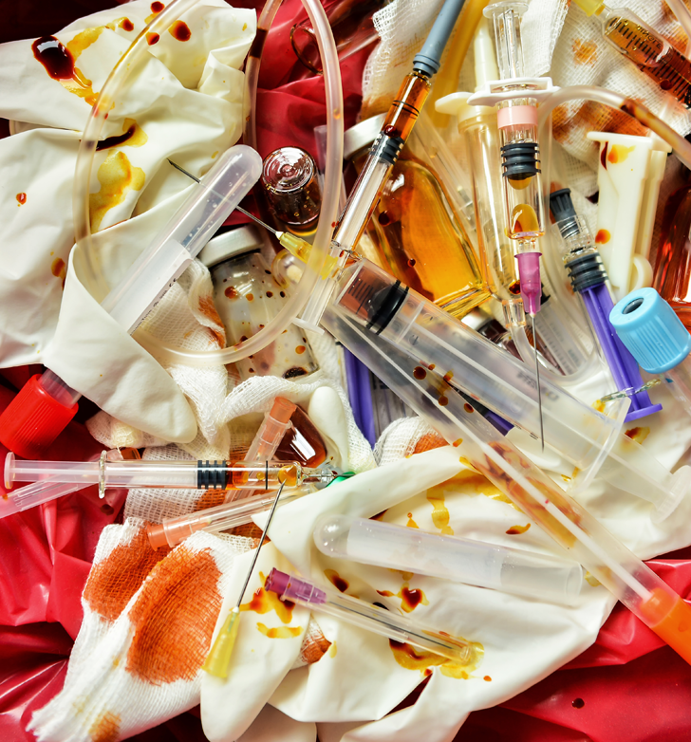
Definitions
Other Potentially Infectious Materials (OPIM) means:
(1) The following human body fluids: semen, vaginal secretions, cerebrospinal fluid, synovial fluid, pleural fluid, pericardial fluid, peritoneal fluid, amniotic fluid, saliva in dental procedures, any body fluid that is visibly contaminated with blood, and all body fluids in situations where it is difficult or impossible to differentiate between body fluids.
(2) Any unfixed tissue or organ (other than intact skin) from a human (living or dead).
(3) HIV-containing cell or tissue cultures, organ cultures, and HIV- or HBV-containing culture medium or other solutions; and blood, organs, or other tissues from experimental animals infected with HIV or HBV.
Module 1: Introduction

Slide 9
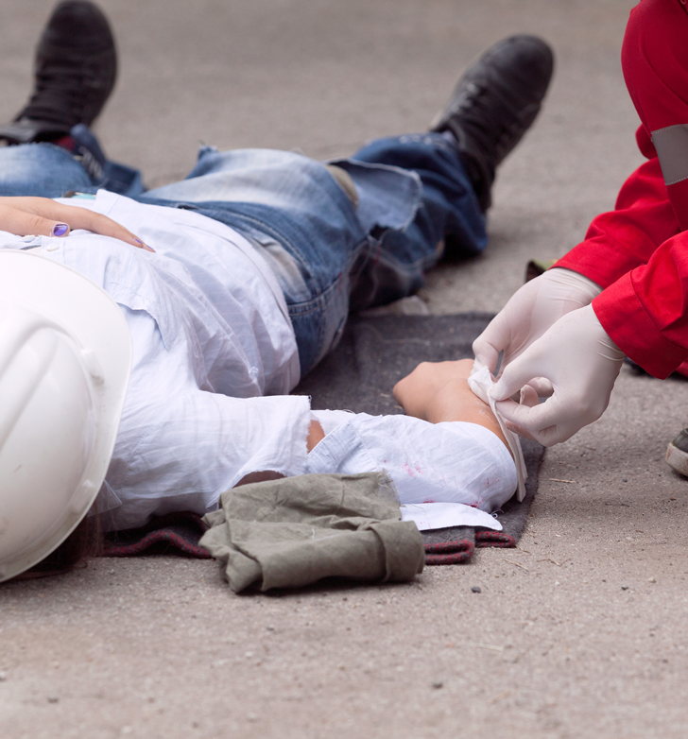
Definitions
Regulated Waste means liquid or semi-liquid blood or other potentially infectious materials(OPIM); contaminated items that would release blood or OPIM in a liquid or semi-liquid state if compressed; items that are caked with dried blood or OPIM and are capable of releasing these materials during handling; contaminated sharps; and pathological and microbiological wastes containing blood or OPIM.
Universal Precautions is an approach to infection control. According to the concept of Universal Precautions, all human blood and certain human body fluids are treated as if known to be infectious.
Parenteral means piercing mucus membranes or the skin barrier through such events as needlesticks, human bites, cuts, and abrasions.
Module 1: Introduction

Slide 10

What Are Sharps
Sharps include any device or object used to puncture or lacerate the skin. Sharps waste is classified as biohazardous waste and must be carefully handled. Common objects treated as sharps waste are:
Syringes and injection devices
Blades (i.e. scalpels, razors, scissors)
Contaminated glass and some plastics
Broken capillary tubes
Exposed ends of dental wire
In this program we’ll cover the safe handling of sharps, their disposal, and transporting.
Module 1: Introduction

Slide 11
Video: Determining Exposure in the Workplace
Module 1: Introduction

Slide 12

Types of Exposures
There are three ways that you can be exposed at work:
Needlesticks are the most obvious. The top three devices associated with bloodborne pathogen exposures are:
      -Disposable syringes
      -Suture needles
      -Winged steel needles
Splashes to mucus membranes:
-Eyes
-Mouth
Open sores (non-intact skin) from contaminated fluids
Module 1: Introduction

Slide 13

Occupations Most At-Risk
There are several occupations that put workers in danger of contracting bloodborne pathogens. The boxes below contain lists of those who are most at risk.
Hospital
Funeral Home/Assisted Living
First Responders Correctional Officers
Medical (other)
Module 1: Introduction

Slide 14

Low Risk Occupations
The following categories are those who are infrequently exposed, but still at risk:
Employees assigned to administer First Aid
Chiropractors
Janitorial staff
Housekeeping staff
Construction
Maritime
Agriculture
Next, let’s review four situations where employees were exposed to bloodborne pathogens on the job.
Module 1: Introduction

Slide 15

Conditional Occupations
Please note there are some industries that have conditions:
Construction does not have a separate rule; however, the Bloodborne Pathogens Standard applies only where a position has an expectation of exposure. The most common example is the employee assigned to give first aid.
Agriculture follows standard: OAR 437-004-9650 Bloodborne Pathogens. This standard states:
(1) The employer is responsible to determine, before work begins, if any task or activity assigned to workers will result in an occupational exposure to bloodborne pathogens.
(2) Work that exposes employees to bloodborne pathogens must comply with Division 2/Z, 1910.1030, Bloodborne Pathogens.
Module 1: Introduction

Slide 16
Video: Conclusion
Module 1: Introduction

Slide 17
Module 2: Prevention
BLOODBORNE PATHOGENS

Slide 18

Video: Introduction
Module 2: Prevention

Slide 19
Video: Overview of Exposure Control Plan for Bloodborne Pathogens
Module 2: Prevention

Slide 20

Essentials of an Exposure Control Plan
At a minimum, the exposure control plan must include the following three elements:
The exposure determination.
The procedures for evaluating the circumstances surrounding an exposure incident.
The schedule and method for implementing the provisions of the standard.
The plan must be reviewed and updated annually or whenever new tasks and procedures affect employees’ occupational exposure. In addition, the Bloodborne Pathogens Standard must be made available to employees.
Module 2: Prevention

Slide 21

Location of an Exposure Control Plan
The Exposure Control Plan doesn’t have to be a standalone document, you can incorporate it into another document, such as your facility’s health and safety manual, as long as all the components are included. However, in order for it to be accessible to your employees, it must be a cohesive entity by itself. You can also include a guiding document which states the overall policy and goals and references the elements of existing separate policies that comprise the plan.
For small facilities, the plan’s schedule and method of implementation may be an annotated copy of the Bloodborne Pathogens Standard that states how the provisions of the standard are to be implemented. Larger facilities can develop a broad facility program, and incorporate provisions of the standard that apply to their establishments.
Module 2: Prevention

Slide 22
Video: Conclusion
Module 2: Prevention

Slide 23

Industry Option
Module 3 is divided into two separate sections; healthcare and non-healthcare.
Please reference the location of these sections in the list below:
Healthcare: through slides 24-55
Non-Healthcare: through slides 56-80
Module 3: Exposure Control Plan

Slide 24
Module 3: Exposure Control Plan (Healthcare)
BLOODBORNE PATHOGENS

Slide 25
Video: Introduction
Module 3: Exposure Control Plan (Healthcare)

Slide 26
Video: Hazard Communication
Module 3: Exposure Control Plan (Healthcare)

Slide 27
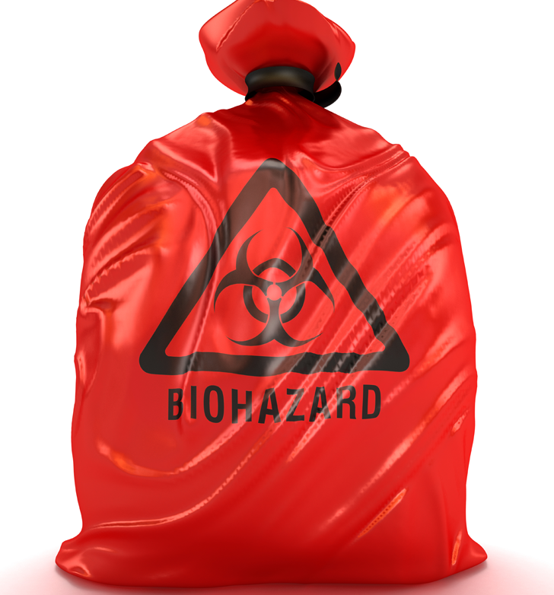
Communicating Hazards - Exemptions
Paragraph G of the standard says that labels must be placed on all containers (including refrigerators and freezers) that are used to store, dispose of, transport, and ship blood or Other Potentially Infectious Materials (OPIM). However, some exemptions apply:
- Red bags or containers may be substituted for labels.
- Containers of blood, blood components, or blood products that are labeled to their contents and have been released for transfusion or other clinical use are exempted.
- Individual containers of blood or OPIM that are placed in a labeled container during storage, transport, shipment, or disposal are exempted.
Module 3: Exposure Control Plan (Healthcare)

Slide 28

Communicating Hazards – Exemptions (continued)
Blood and blood products bearing an identifying label as specified by the Food and Drug Administration, which have been screened for HBV and HIV antibodies; and released for transfusion or other clinical uses, are exempted from the labeling requirements.
When blood is being drawn or laboratory procedures are being performed on blood samples, then the individual containers housing the blood or OPIM does not have to be labeled, provided the larger container into which they are placed for storage, transport, shipment, or disposal (e.g., test tube rack) is labeled.
Module 3: Exposure Control Plan (Healthcare)

Slide 29

Communicating Hazards – Closing Thoughts
It should be noted that HIV and HBV Research Laboratories and Production Facilities have additional requirements, which can be viewed here.
If your employees deal with toxic or hazardous substances, your company/organization may fall under the Hazard Communication Standard.
Our next topic in prevention will be Engineering Controls and Proper Work Practices.
Module 3: Exposure Control Plan (Healthcare)

Slide 30
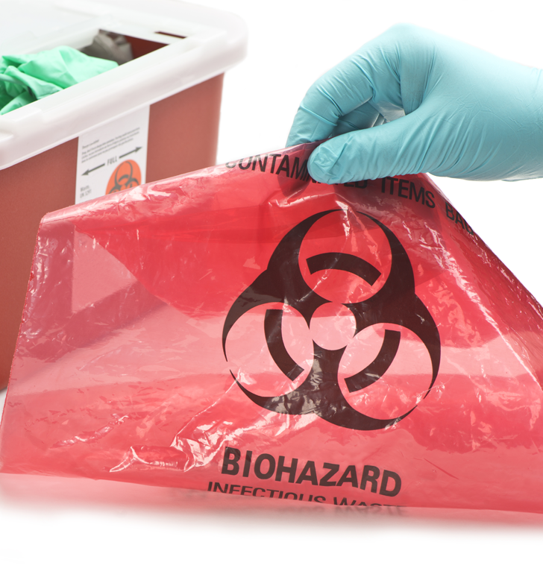
Biohazard FAQ
Question: Is it ok to reuse biohazard bags if there is no visible contamination?
Answer: The Oregon BBP standard requires specimens to be transported in a labeled and/or color-coded container that prevents leakage. The current standard does not address reusing these containers except when one or more of the specimen containers leaks blood or potentially infectious materials (OPIM), in which case it would either need to be decontaminated or disposed of properly.
We suggest you contact the appropriate licensing program or laboratory organization to ensure reusing the bag does not pose a risk of sample cross-contamination.
Module 3: Exposure Control Plan (Healthcare)

Slide 31
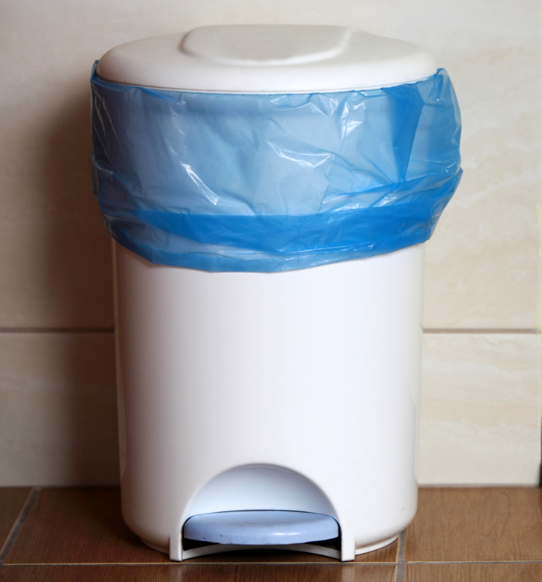
Biohazard FAQ
Question: Do biohazard bags need to be disposed of in biohazard trash or can they go in the regular trash if there is no visible contamination?
Answer: If an item is not contaminated with blood or OPIM, OSHA standards do not address how it must be disposed. However, we do suggest you contact your local DEQ solid waste office⁽⁴⁾ and your garbage handler to ensure that they have no requirements for disposal.
Module 3: Exposure Control Plan (Healthcare)

Slide 32
Video: Engineering Controls for Healthcare Facilities
Module 3: Exposure Control Plan (Healthcare)

Slide 33
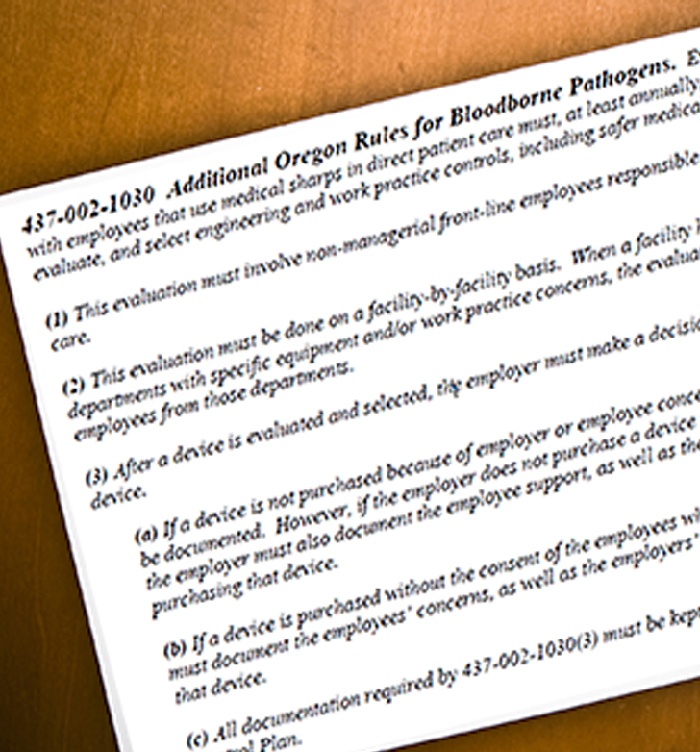
Engineering Controls – Additional Oregon Rule
The State of Oregon has additional rules regarding the Bloodborne Pathogens Standard. In summary:
“Every employer with employees that use medical sharps in direct patient care must, at least annually, identify, evaluate, and select engineering and work practice controls, including safer medical devices.”
For more information click the buttons:
Requirements
Download Handout
Download Poster
Implementation in Healthcare Facilities (NIOSH)
Module 3: Exposure Control Plan (Healthcare)

Slide 34

Engineering Controls – Proper Work Practices
Specimens of blood or OPIM must be placed in a container which prevents leakage during collection, handling, processing, storage, transport, or shipping. There are 3 points to address on this topic:
The container must be labeled or color-coded according to paragraph (g)(1)(i) and closed before being stored, transported, or shipped.
If the primary container is contaminated by an outside source, the primary container must be placed inside a secondary container. This is to prevent leakage during handling, processing, storage, transport, or shipping and is labeled or properly color-coded.
If the specimen could puncture the primary container, place it in a secondary, puncture-resistant container as mentioned above.
Module 3: Exposure Control Plan (Healthcare)

Slide 35

Engineering Controls – Proper Work Practices
Employers are required to provide handwashing facilities that are readily accessible to employees. If this is not feasible, you must provide either an appropriate antiseptic hand cleanser along with clean cloth/paper towels or antiseptic towelettes. When these materials are used, hands must be washed with soap and running water as soon as feasible.
Under the following circumstances, employers are required to ensure that employees know to wash their hands, skin, or flush mucus membranes immediately or as soon as possible:
- When gloves or PPE are removed.
- When there is bodily contact with blood or OPIM.
Module 3: Exposure Control Plan (Healthcare)

Slide 36

Engineering Controls – Proper Work Practices (cont.)
Needles or sharps that are contaminated are not to be bent, recapped, or removed. Shearing or breaking contaminated needles are also not allowed. There are two exceptions to this:
If the employer can demonstrate that no alternative is feasible or that such action is required by a specific medical or dental procedure.
Bending, recapping, or needle removal must be accomplished through the use of a mechanical device or a one-handed technique. Bending a needle by using forceps would be an acceptable example.
After use, place sharps in an appropriate sharps container as soon as possible.
Module 3: Exposure Control Plan (Healthcare)

Slide 37
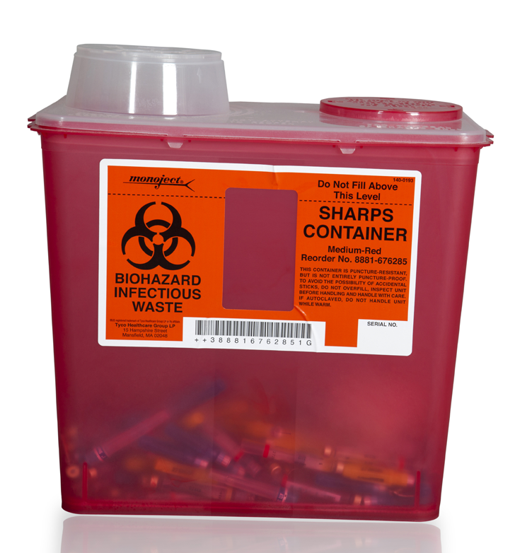
Sharps Containers
The construction of sharps containers must meet at least 4 criteria. They are to be:
Closable
Puncture resistant
Leakproof on sides and bottom.
Labeled or color-coded in accordance to the Bloodborne Pathogens labeling requirements. ⁽¹⁰⁾
Please note that many sharps injuries occur during the disposal of sharps. It’s especially important to ensure proper work practices when handling them. For more information on sharps containers, please review “Selecting, Evaluating, and Using Sharps Disposal Containers”.⁽¹¹⁾ In the next slide, we’ll look at reusable sharps.
Module 3: Exposure Control Plan (Healthcare)

Slide 38
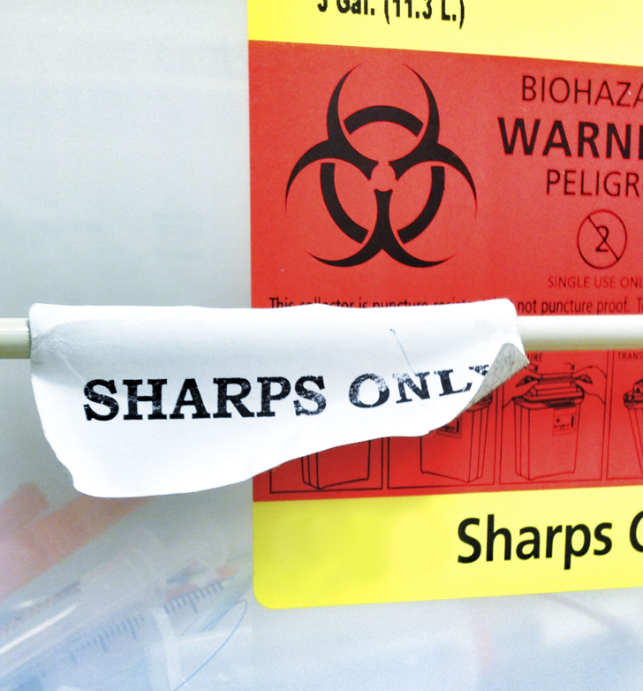
Engineering Controls – Proper Work Practices
Contaminated reusable sharps must be placed in appropriate containers until properly processed. The requirements for these containers are as follows:
Puncture resistant
Labeled or color-coded in accordance to the standard.
Leakproof on the sides and bottom.
In accordance with the reusable sharps requirements in paragraph (d)(4)(ii)(E).⁽¹²⁾
Containers for reusable sharps must meet the same requirements as containers for disposable sharps, with the exception that they are not required to be closable since it is assumed the containers will be reused.
Module 3: Exposure Control Plan (Healthcare)

Slide 39
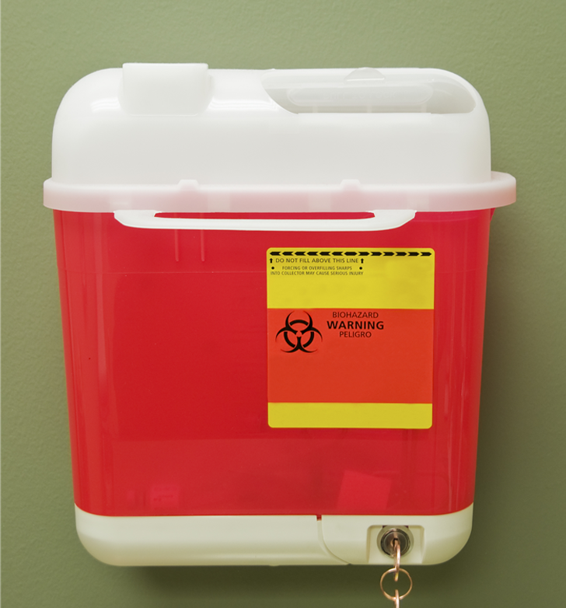
Sharps Container Usage
If an employee must travel to a remote location to discard sharps, the possibility of an accidental needlestick is dramatically increased. Because of this, Oregon OSHA requires that sharps containers are placed as close as possible to where sharps are being used or can be expected to be found. For example, laundries should have sharps containers nearby due to incidences of needles mixed with laundry.
A common problem with sharps containers is overfilling. This is often associated with containers that are too small, the inability to see how full they are, or lax procedures for container maintenance. As soon as the sharps reach the fill line, the container must be replaced. If you have reusable containers, they must be handled in a manner that does not expose employees to the risk of injury. Also, remember that sharps containers are required to be in the upright position when in use.
Module 3: Exposure Control Plan (Healthcare)

Slide 40

Engineering Controls – Proper Work Practices
In places where there is a reasonable likelihood of occupational exposure, the following activities are prohibited:
Eating/drinking
Smoking
Applying cosmetics or lip balm
Handling contact lenses
It should be noted that employees are permitted to eat and drink in an ambulance cab, for example. However, they must wash up and change contaminated clothing prior to entering the ambulance cab, and ensure that patients and contaminated material remain behind the separating partition. Also, food and drink must not be kept in refrigerators, freezers, shelves, cabinets or on counter tops or bench tops where blood or OPIM are present.
Module 3: Exposure Control Plan (Healthcare)

Slide 41
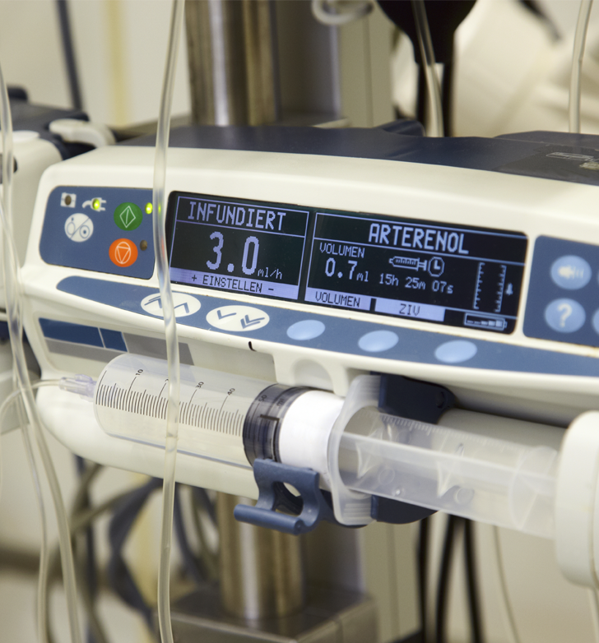
Engineering Controls – Proper Work Practices
Equipment that is expected to become contaminated with blood or OPIM must be decontaminated and examined prior to servicing or shipping, unless you can demonstrate that it’s not feasible. Please keep in mind:
A readily observable label must be attached to the equipment stating which portions remain contaminated.
The employer must ensure that this information is conveyed to all affected employees, the servicing rep, and/or the manufacturer as appropriate. This needs to be done before handling, servicing, or shipping so that necessary precautions are followed.
Module 3: Exposure Control Plan (Healthcare)

Slide 42

Engineering Controls – Proper Work Practices
All procedures involving blood or OPIM must be performed in such a manner that minimizes splashing, spraying, spattering, and generation of droplets of these substances. While uncommon, it’s important to mention that mouth pipetting/suctioning of blood or OPIM is prohibited.
That being said, Oregon OSHA allows a recognized emergency care method of clearing an infant's airways called “DeLee suctioning” in the following situation: in an emergency, when no other method is available; and a trap which prevents suctioned fluid from reaching the employee's mouth is inserted in-line between the infant and the employee.
Module 3: Exposure Control Plan (Healthcare)

Slide 43
Video: Personal Protective Equipment (PPE)
Module 3: Exposure Control Plan (Healthcare)

Slide 44
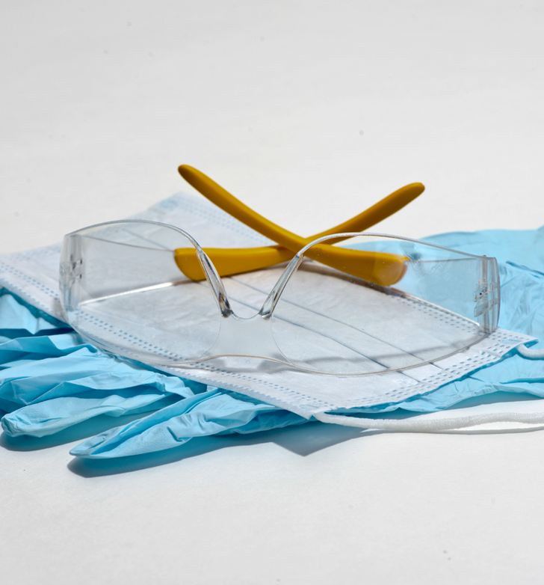
PPE – Summary
Let’s briefly summarize the key points:
Provision - The employer must provide PPE at no cost to employees.
Usage - The employer must ensure that employees are using PPE.
Accessibility - The employer must ensure that appropriate PPE is provided in correct sizes and is readily available at the worksite.
Maintenance - The employer must clean, launder, and dispose of PPE at no cost to employees.
Repair and Replacement - The employer must repair and replace PPE at no cost to employees.
Gloves - Gloves must be worn when occupational exposure is anticipated to happen.
Module 3: Exposure Control Plan (Healthcare)

Slide 45
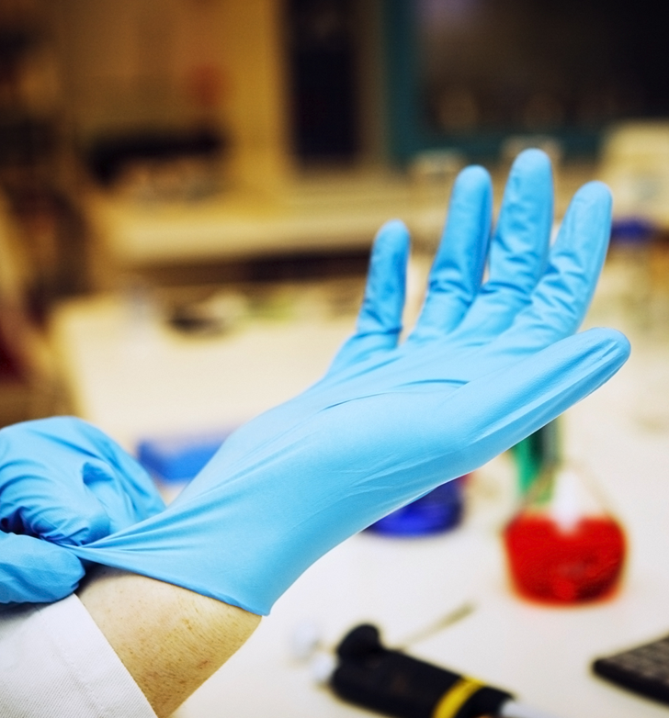
PPE – Gloves
The standard addresses a number of aspects regarding gloves and their usage. In paragraph (d)(3)(ix) ⁽¹³⁾ it states:
“Gloves shall be worn when it can be reasonably anticipated that the employee may have hand contact with blood, other potentially infectious materials, mucus membranes, and non-intact skin; when performing vascular access procedures except as specified in paragraph (d)(3)(ix)(D); and when handling or touching contaminated items or surfaces.”
The exemption mentioned above is in reference to phlebotomy procedures and applies only to employees of volunteer donor blood collection centers. It doesn’t apply to phlebotomy conducted in other settings such as plasmapheresis centers or hospitals.
Module 3: Exposure Control Plan (Healthcare)

Slide 46

PPE – Conclusion
To conclude PPE, we’ll cover two brief sections. The first is found in paragraph (d)(3)(x). ⁽¹⁴⁾ This paragraph requires protection for the mucus membranes of the face and upper respiratory tract from exposure. This is accomplished through the use of masks, eye protection, and face shields whenever splashes, spray, or droplets of blood or OPIM may happen.
Paragraphs (d)(3)(xi-xii) deal with protective body clothing such as gowns, aprons, lab coats, clinic jackets, surgical caps, and shoe covers. The employer must evaluate the task and type of exposure expected and select the appropriate PPE based on that determination. For example, lab coats with long sleeves must be used for procedures where exposure of the forearm to blood or OPIM is expected to occur.
Module 3: Exposure Control Plan (Healthcare)

Slide 47
Video: Housekeeping Practices & Procedures
Module 3: Exposure Control Plan (Healthcare)

Slide 48

Housekeeping – What is a “Worksite”
The term “worksite” is frequently mentioned in the Standard and you may want to know what meets the criteria of a “worksite”. In this section of the Standard it covers permanent fixed facilities, such as, hospitals, dental/medical offices, and clinics. Also included are temporary non-fixed workplaces, such as, ambulances, bloodmobiles, temporary blood collection centers, and any other non-fixed worksites that have a reasonable possibility of becoming contaminated with blood or OPIM.
Next, we’ll summarize cleaning and decontamination.
Module 3: Exposure Control Plan (Healthcare)

Slide 49
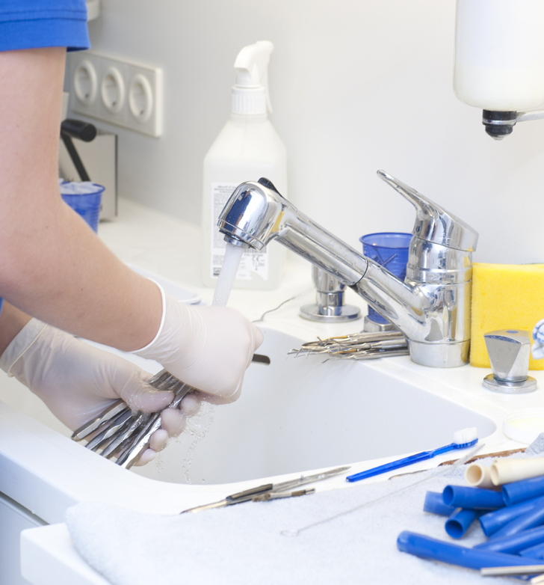
Cleaning and Decontamination
Paragraph (d)(4)(ii) ⁽¹⁵⁾ outlines the minimum requirements for cleaning and decontamination of equipment and environmental and working surfaces that come into contact with blood or OPIM:
Use an appropriate disinfectant.
Protective coverings must be removed when contaminated or at the end of a work shift.
Reusable receptacles must be inspected, cleaned, and decontaminated on a regular basis.
Broken glass must not be picked up with bare hands.
Employees are prohibited from reaching into reusable containers that are contaminated or may contain sharps.
On the next slide, let’s take a moment to cover “appropriate disinfectants”.
Module 3: Exposure Control Plan (Healthcare)

Slide 50
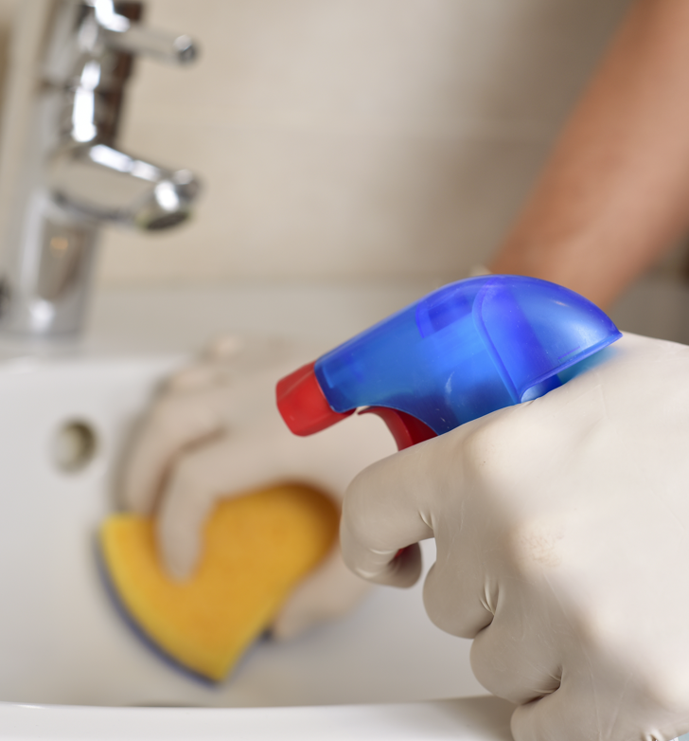
Appropriate Disinfectants
You can view a list of EPA approved disinfectants on the US Environmental Protection Agency website⁽¹⁶⁾. An example of an appropriate disinfectant is a diluted bleach solution. You must follow the label instructions regarding the amount of disinfectant and the length of time it must remain wet on the surface. Since the effectiveness of a disinfectant is determined by strictly following these instructions, Oregon OSHA compliance officers will interview employees to ensure these practices are in place.
Note that fresh solutions of diluted household bleach made up daily are also considered an appropriate disinfectant. Solutions of bleach should not be stored in glass containers, but in a material such as plastic, in which it’s originally packaged.
Module 3: Exposure Control Plan (Healthcare)

Slide 51
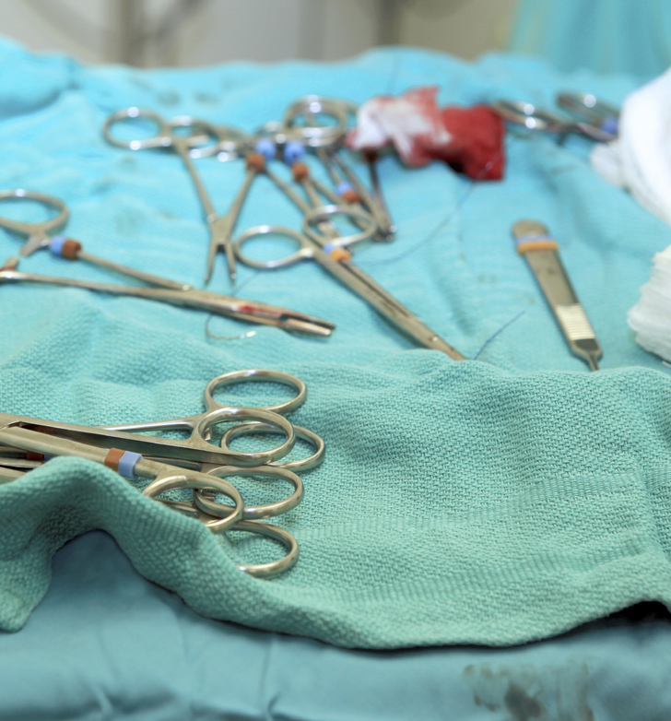
Regulated Waste
The term “Regulated Waste” refers to the following categories of waste that requires special handling:
Liquid or semi-liquid blood or OPIM.
Items contaminated with blood or OPIM that could be released if compressed.
Items caked with dried blood or OPIM that could be released during handling.
Contaminated sharps
Pathological or microbiological wastes containing blood or OPIM.
On the next slide, we’ll review the requirements for handling laundry.
Module 3: Exposure Control Plan (Healthcare)

Slide 52
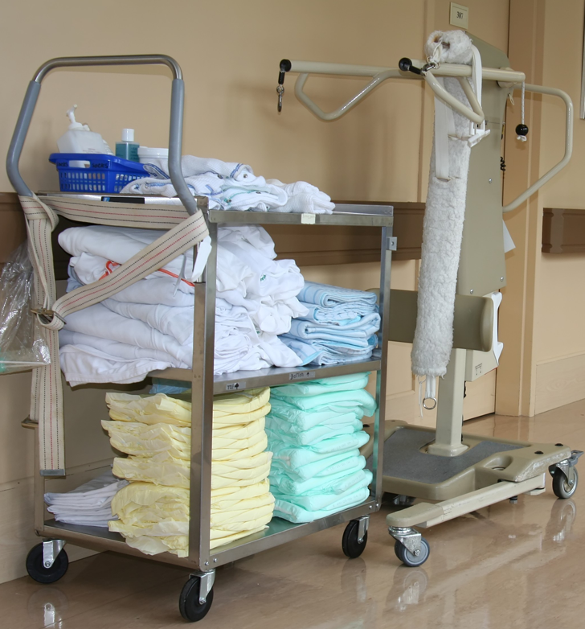
Handling Laundry
Contaminated laundry is to be handled as little as possible and all employees in contact with it must wear protective gloves and any other appropriate PPE.
When transporting contaminated laundry, employers have been given the choice to either:
Label or color-code in accordance to Bloodborne Pathogens labeling requirements. ⁽¹⁷⁾
Utilize universal precautions in the handling of all used laundry.
If the contaminated laundry is wet, the material for the bags or containers used in laundry collection must prevent soak-through or leakage of fluids.
Module 3: Exposure Control Plan (Healthcare)

Slide 53
Video: The Hepatitis Vaccine
Module 3: Exposure Control Plan (Healthcare)

Slide 54
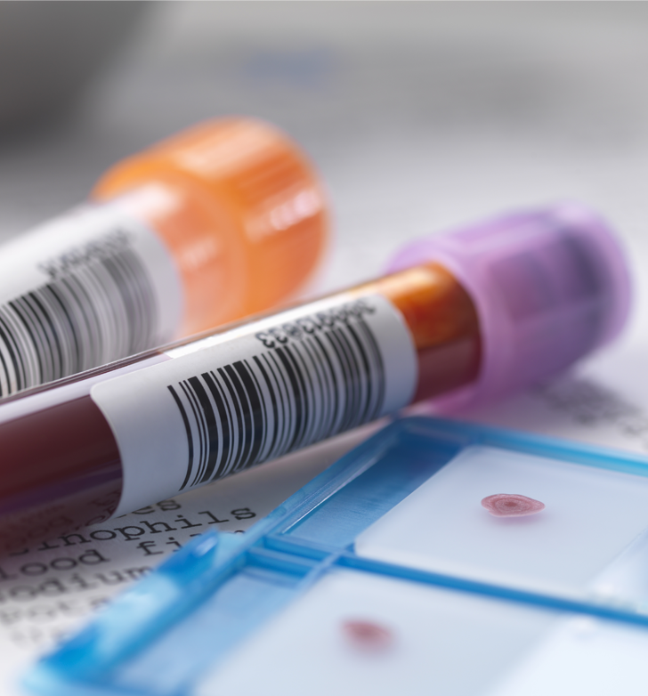
Hepatitis B Titer
Another point to consider is the Hepatitis B titer. This is a blood test performed on a person who has had either the full Hepatitis B series (3 vaccine shots delivered within the specific time-frame), a partial series, or has had a previous Hepatitis B infection.
A titer test is often scheduled 1-2 months after the final dose for those who are at high risk of exposure. This is done to ensure Hepatitis B antibodies are present. Titer testing for those at low risk for exposure is not commonly administered.
High risk exposure professions could include: Healthcare professionals with direct patient contact, those who have the risk of needlestick or sharps injury, laboratory workers who draw, and those who test or handle blood specimens.
Module 3: Exposure Control Plan (Healthcare)

Slide 55
Video: Conclusion
Module 3: Exposure Control Plan (Healthcare)

Slide 56
Module 3: Exposure Control Plan
(Non-Healthcare)
BLOODBORNE PATHOGENS

Slide 57
Video: Introduction
Module 3: Exposure Control Plan (Non-Healthcare)

Slide 58
Video: Hazard Communication
Module 3: Exposure Control Plan (Non-Healthcare)

Slide 59
Communicating Hazards - Exemptions
Paragraph G of the Standard says that labels must be placed on all containers (including refrigerators and freezers) that are used to store, dispose of, transport, or ship blood or Other Potentially Infectious Materials (OPIM). However, some exemptions apply:
Red bags or containers may be substituted for labels.
Individual containers of blood or OPIM that are placed in a labeled container during storage, transport, shipment, or disposal are exempted.
Module 3: Exposure Control Plan (Non-Healthcare)

Slide 60

Biohazards FAQ
Question: Do biohazard bags need to be disposed of in biohazard trash or can they go in the regular trash if there is no visible contamination?
Answer: If an item is not contaminated with blood or OPIM, OSHA standards do not address how it must be disposed. However, we do suggest you contact your local DEQ solid waste office⁽²⁾ and your garbage handler to ensure that they have no requirements for disposal.
Module 3: Exposure Control Plan (Non-Healthcare)

Slide 61
Video: Engineering Controls for Non-Healthcare Facilities
Module 3: Exposure Control Plan (Non-Healthcare)

Slide 62
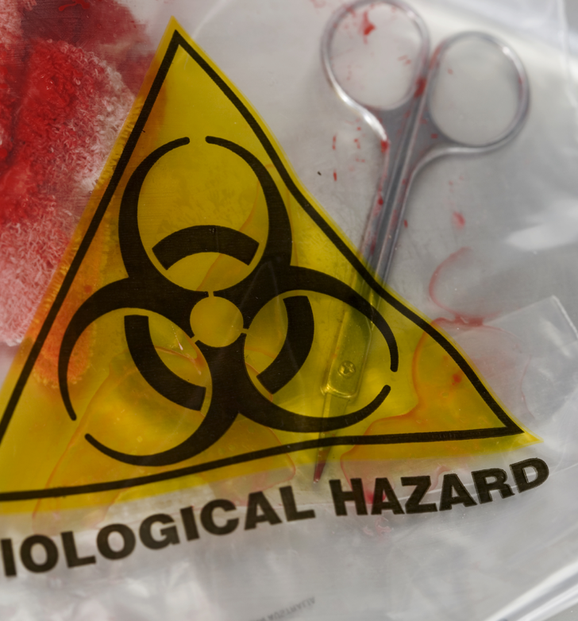
Engineering Controls / Proper Work Practices
Specimens of blood or OPIM must be placed in a container which prevents leakage during collection, handling, processing, storage, transport, or shipping. There are 3 points to address on this topic:
The container must be labeled or color-coded according to paragraph (g)(1)(i) ⁽³⁾ and closed before being stored, transported, or shipped.
If the primary container is contaminated by an outside source, the primary container must be placed inside a secondary container. This is to prevent leakage during handling, processing, storage, transport, or shipping and is labeled or properly color-coded.
If the specimen could puncture the primary container, place it in a secondary puncture resistant container, as mentioned above.
Module 3: Exposure Control Plan (Non-Healthcare)

Slide 63

Proper Work Practices: Handwashing
Employers are required to provide handwashing facilities that are readily accessible to employees. If this is not feasible, you must provide either an appropriate antiseptic hand cleanser along with clean cloth/paper towels or antiseptic towelettes. When these materials are used, hands must be washed with soap and running water as soon as feasible.
Under the following circumstances, employers are required to ensure that employees know to wash their hands, skin, or flush mucus membranes immediately or as soon as possible:
When gloves or PPE are removed.
When there is bodily contact with blood or OPIM.
Module 3: Exposure Control Plan (Non-Healthcare)

Slide 64

Proper Work Practices: Engineering Controls
Needles or sharps that are contaminated are not to be bent, recapped, or removed. Shearing or breaking contaminated needles are also not allowed. There are two exceptions to this:
If the employer can demonstrate that no alternative is feasible or that such action is required by a specific medical or dental procedure.
Bending, recapping, or needle removal must be accomplished through the use of a mechanical device or a one-handed technique. Bending a needle by using forceps would be an acceptable example.
After use, place sharps in an appropriate sharps container as soon as possible. More details on sharps containers will be covered in the next slide.
Module 3: Exposure Control Plan (Non-Healthcare)

Slide 65
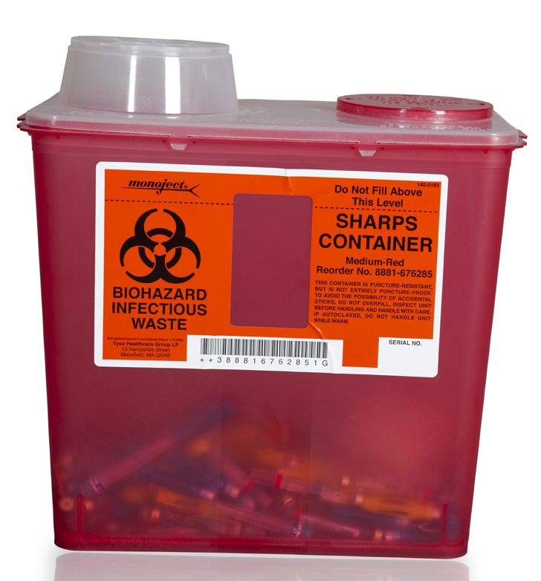
Sharps Containers
The construction of sharps containers must meet at least 4 criteria. They are to be:
Closable
Puncture resistant
Leakproof on sides and bottom.
Labeled or color-coded in accordance to the Bloodborne Pathogens labeling requirements.⁽⁴⁾
Please note that many sharps injuries occur during the disposal of sharps. It’s especially important to ensure proper work practices when handling them. For more information on sharps containers, please review “Selecting, Evaluating, and Using Sharps Disposal Containers”. ⁽⁵⁾
Module 3: Exposure Control Plan (Non-Healthcare)

Slide 66
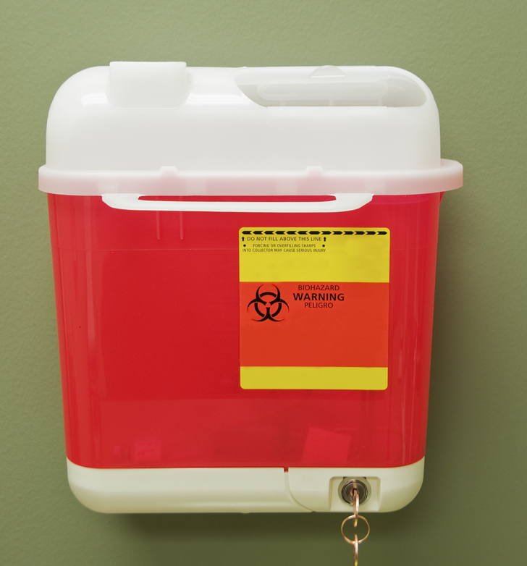
Sharps Container Usage
If an employee must travel to a remote location to discard sharps, the possibility of an accidental needlestick is dramatically increased. Because of this, Oregon OSHA requires that sharps containers are placed as close as possible to where sharps are being used or can be expected to be found. For example, laundries should have sharps containers nearby due to incidences of needles mixed with laundry.
A common problem with sharps containers is overfilling. This is often associated with containers that are too small, the inability to see how full they are, or lax procedures for container maintenance. As soon as the sharps reach the fill line, the container must be replaced. If you have reusable containers, they must be handled in a manner that does not expose employees to the risk of injury. Also remember that sharps containers are required to be in the upright position when in use.
Module 3: Exposure Control Plan (Non-Healthcare)

Slide 67

Proper Work Practices: Engineering Controls
Where there is a reasonable likelihood of occupational exposure, the following activities are prohibited:
Eating/drinking
Smoking
Applying cosmetics or lip balm
Handling contact lenses
Also, food and drink must not be kept in refrigerators, freezers, shelves, cabinets or on counter tops or bench tops where blood or OPIM are present.
Module 3: Exposure Control Plan (Non-Healthcare)

Slide 68
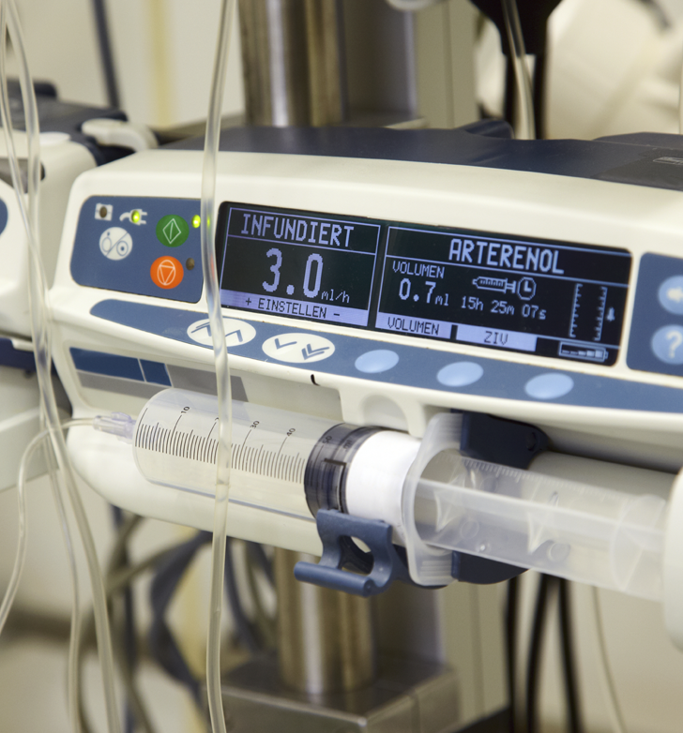
Proper Work Practices: Engineering Controls
Equipment that may become contaminated with blood or OPIM must be decontaminated and examined prior to servicing or shipping, unless you can demonstrate that it’s not feasible. Please keep in mind:
A readily observable label must be attached to the equipment stating which portions remain contaminated.
The employer must ensure that this information is conveyed to all affected employees, the servicing rep, and/or the manufacturer, as appropriate. This needs to be done before handling, servicing, or shipping so that necessary precautions are followed.
Module 3: Exposure Control Plan (Non-Healthcare)

Slide 69
Video: Personal Protective Equipment (PPE)
Module 3: Exposure Control Plan (Non-Healthcare)

Slide 70
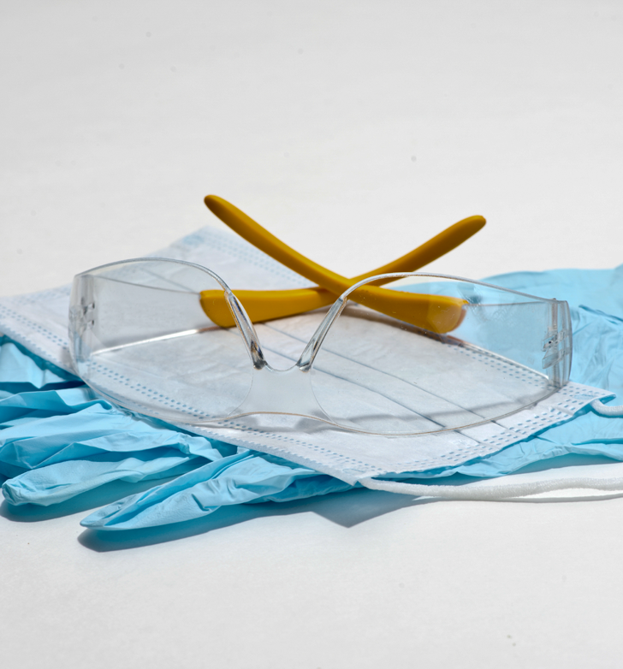
PPE – Summary
Let’s briefly summarize the key points:
Provision: The employer must provide PPE at no cost to employees.
Usage: The employer must ensure that employees are using PPE.
Accessibility: The employer must ensure that appropriate PPE is provided in correct sizes and is readily available at the worksite.
Maintenance: The employer must clean, launder, and dispose of PPE at no cost to employees.
Repair and Replacement: The employer must repair and replace PPE at no cost to employees.
Gloves: Gloves must be worn when occupational exposure are anticipated to happen.
Module 3: Exposure Control Plan (Non-Healthcare)

Slide 71
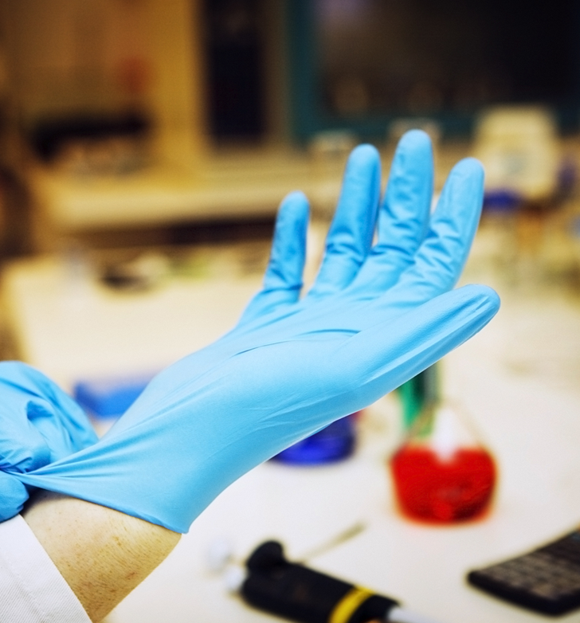
PPE – Gloves
The Standard addresses a number of aspects regarding gloves and their usage. In paragraph (d)(3)(ix) it states:
“Gloves shall be worn when it can be reasonably anticipated that the employee may have hand contact with blood, other potentially infectious materials, mucus membranes, and non-intact skin; when performing vascular access procedures except as specified in paragraph (d)(3)(ix)(D); and when handling or touching contaminated items or surfaces.”
Module 3: Exposure Control Plan (Non-Healthcare)

Slide 72
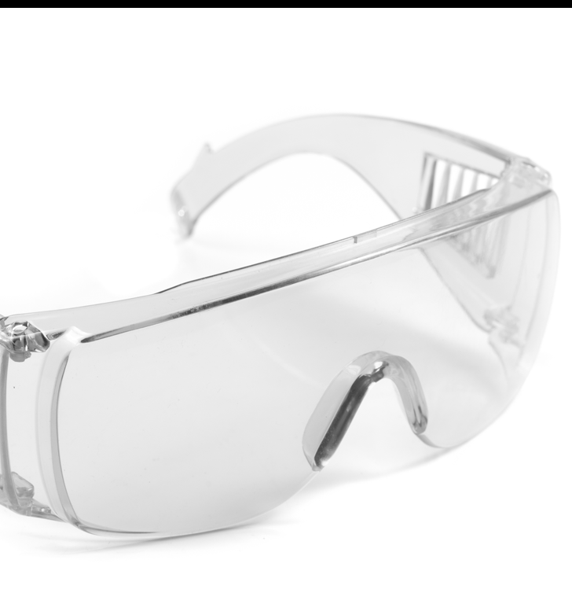
PPE - Conclusion
To conclude PPE, we’ll cover two brief sections. The first is found in paragraph (d)(3)(x). This paragraph requires protection for the mucus membranes of the face and upper respiratory tract from exposure. This is accomplished through the use of masks, eye protection, and face shields whenever splashes, spray, or droplets of blood or OPIM may happen.
Paragraphs (d)(3)(xi-xii) deal with protective body clothing such as gowns, aprons, and shoe covers. The employer must evaluate the task and type of exposure expected and select the appropriate PPE based on that determination.
Module 3: Exposure Control Plan (Non-Healthcare)

Slide 73
Video: Housekeeping Practices & Procedures
Module 3: Exposure Control Plan (Non-Healthcare)

Slide 74

Housekeeping – What is a “Worksite”
The term “worksite” is frequently mentioned in the standard and you may want to know what meets the criteria of a “worksite”. In this section of the standard it covers permanent fixed facilities such as hospitals, dental/medical offices, and clinics. Also included are temporary non-fixed workplaces, such as, ambulances, bloodmobiles, temporary blood collection centers, and any other non-fixed worksites that have a reasonable possibility of becoming contaminated with blood or OPIM.
Next, we’ll summarize cleaning and decontamination procedures.
Module 3: Exposure Control Plan (Non-Healthcare)

Slide 75

Cleaning and Decontamination
Paragraph (d)(4)(ii) outlines the minimum requirements for cleaning and decontamination of equipment and environmental and working surfaces that come into contact with blood or OPIM:
Use an appropriate disinfectant.
Protective coverings must be removed when contaminated or the end of a work shift.
Reusable receptacles must be inspected, cleaned, and decontaminated on a regular basis.
Broken glass must not be picked up with bare hands.
Employees are prohibited from reaching into reusable containers that are contaminated or may contain sharps.
On the next slide, let’s take a moment to cover what are “appropriate disinfectants”.
Module 3: Exposure Control Plan (Non-Healthcare)

Slide 76

Appropriate Disinfectants
You can view a list of EPA approved disinfectants on the US Environmental Protection Agency website. An example of an appropriate disinfectant is a diluted bleach solution. You must follow the label instructions regarding the amount of disinfectant and the length of time it must remain wet on the surface. Since the effectiveness of a disinfectant is determined by strictly following these instructions, Oregon OSHA compliance officers will interview employees to ensure these practices are in place.
Note that fresh solutions of diluted household bleach made up daily are also considered appropriate disinfection. Solutions of bleach should not be stored in glass containers, but in a material such as plastic, in which it’s originally packaged.
Module 3: Exposure Control Plan (Non-Healthcare)

Slide 77
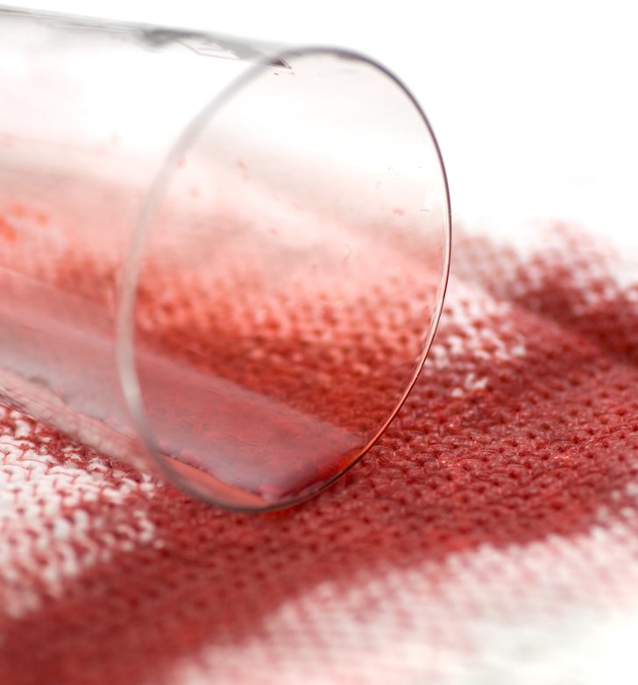
Regulated Waste
The term “Regulated Waste” refers to the following categories of waste that requires special handling, at a minimum:
Liquid or semi-liquid blood or OPIM.
Items contaminated with blood or OPIM that could be released if compressed.
Items caked with dried blood or OPIM that could be released during handling.
Contaminated sharps
Pathological or microbiological wastes containing blood or OPIM.
On the next slide, we’ll review the requirements for handling laundry.
Module 3: Exposure Control Plan (Non-Healthcare)

Slide 78
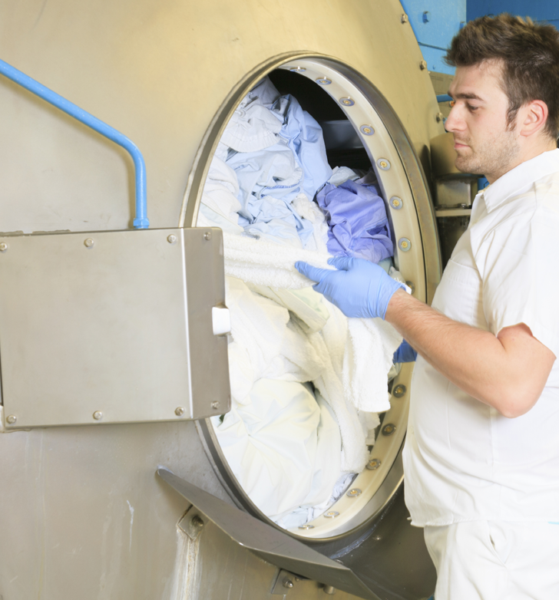
Handling Laundry
Contaminated laundry is to be handled as little as possible and all employees in contact with it must wear protective gloves and any other appropriate PPE.
When transporting contaminated laundry, employers have been given the choice to either:
Label or color-code in accordance to Bloodborne Pathogens labeling requirements.
Utilize universal precautions in the handling of all used laundry.
If the contaminated laundry is wet, the material for the bags or containers used in laundry collection must prevent soak-through or leakage of fluids.
Module 3: Exposure Control Plan (Non-Healthcare)

Slide 79
Video: The Hepatitis Vaccine
Module 3: Exposure Control Plan (Non-Healthcare)

Slide 80
Video: Conclusion
Module 3: Exposure Control Plan (Non-Healthcare)

Slide 81
Module 4: Mitigation
BLOODBORNE PATHOGENS

Slide 82

Video: Introduction
Module 4: Mitigation

Slide 83

Introducing Mitigation
If an exposure incident occurs, you are to immediately offer a confidential medical evaluation, follow-up, and counseling to the exposed employee. Please remember to provide medical care to the exposed employee first, before moving on to other steps like documentation.
Please note that employees who do not fall within the scope of the standard may still experience an exposure incident at work that is unrelated to their job duties. An example is “Good Samaritan” assistance performed voluntarily to an injured co-worker or member of the public. In such a case, Oregon OSHA strongly encourages employers in these situations to offer the same follow up as those covered under the standard.
Module 4: Mitigation

Slide 84
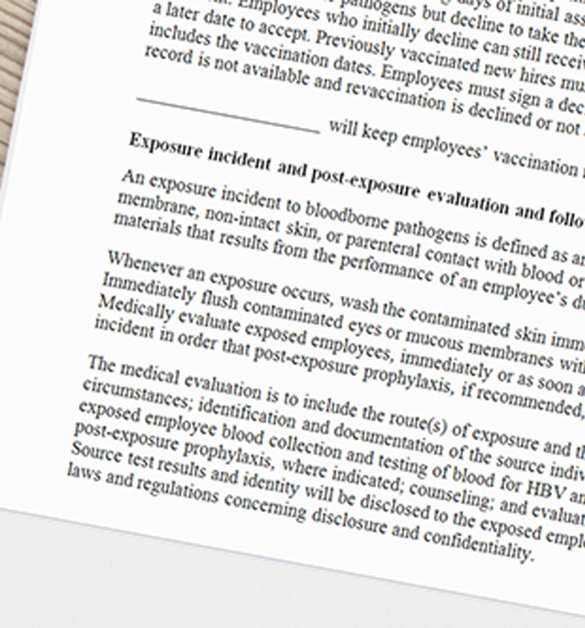
Mitigation Summary
To summarize the key points on mitigation:
Immediately offer a confidential medical evaluation, follow-up, counseling, and option for post-exposure prophylaxis.
Complete a thorough documentation of the exposure incident.
Test and document the source individual and exposed employee’s blood.
Provide appropriate information to the healthcare professional conducting the evaluation.
Provide the employee with a healthcare professional’s written opinion within 15 days of the evaluation.
It’s very important to ensure that all these steps are covered in your Exposure Control Plan. In the next module, we’ll discuss administrative duties like annual training and recordkeeping.
Module 4: Mitigation

Slide 85
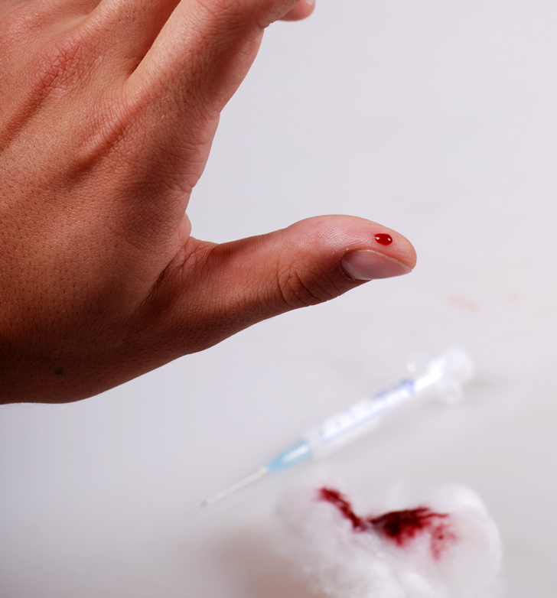
Introducing Mitigation
Does your organization have a plan to respond should an incident occur? In this module on mitigation, we’ll cover the appropriate steps you’ll need to take.
Unfortunately, many employees are nervous about reporting exposures and injuries. It’s very important you make it clear to your workers that reporting will not result in reprimands or disciplinary actions. Also emphasize how timely reporting can be very helpful in providing effective treatment.
In the next few slides, post-exposure requirements will be outlined.
Module 4: Mitigation

Slide 86
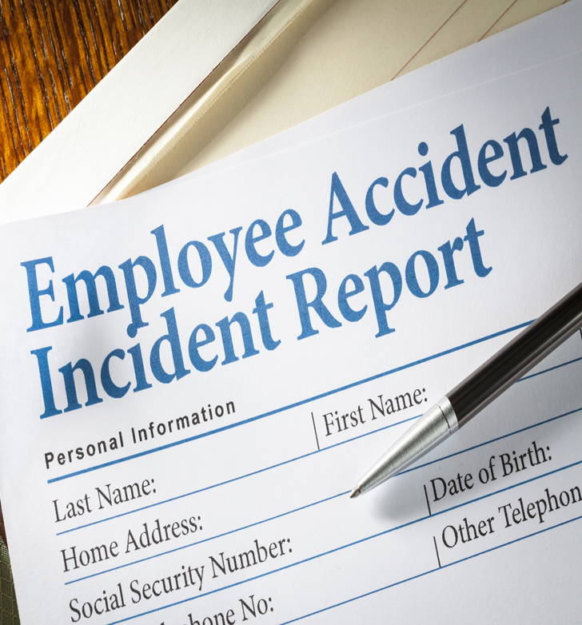
Documenting Exposure Incidents
The first step is to document, at a minimum, “the route(s) of exposure, and the circumstances under which the exposure incident occurred,” as per paragraph (f)(3)(i). To be useful, the documentation must contain sufficient details about the incident, which includes:
Engineering controls in use at the time.
Work practices followed.
Protective equipment or clothing used.
Location
Procedure being performed.
The employee’s training.
During an Oregon OSHA visit, a compliance officer will ask to review copies of your organization’s documentation on exposure incidents.
Module 4: Mitigation

Slide 87

Blood Testing – Source Individual
The next step is to identify and document the source individual’s blood. You must ask for consent from the source individual or anyone legally authorized to give consent on their behalf. If you are unable to get consent, there must be documentation in writing.
The testing must be done as soon as possible to determine if the person is infected with HBV or HIV. If it is known that the source individual was infected prior to the incident, there’s no need to test again. The test results must be made available to the exposed employee along with information on applicable laws and regulations regarding disclosure on the identity and infectious status of the source individual.
Module 4: Mitigation

Slide 88

Blood Testing – Exposed Employee
Along with testing the source individual, you must collect blood from the exposed employee as soon as possible (with their consent). It’s important to consider that employees have at least 90 days following baseline blood collection to decide if they want to have their blood tested for HIV. This 90-day time frame gives the employee the opportunity to learn about baseline serological testing after exposure incidents, and to participate in further discussion, education, or counseling.
If the blood drawn from the employee is not immediately tested for HIV, you are required to have it preserved for at least 90 days. This allows employees the chance for future testing without needing to make an immediate decision.
Module 4: Mitigation

Slide 89
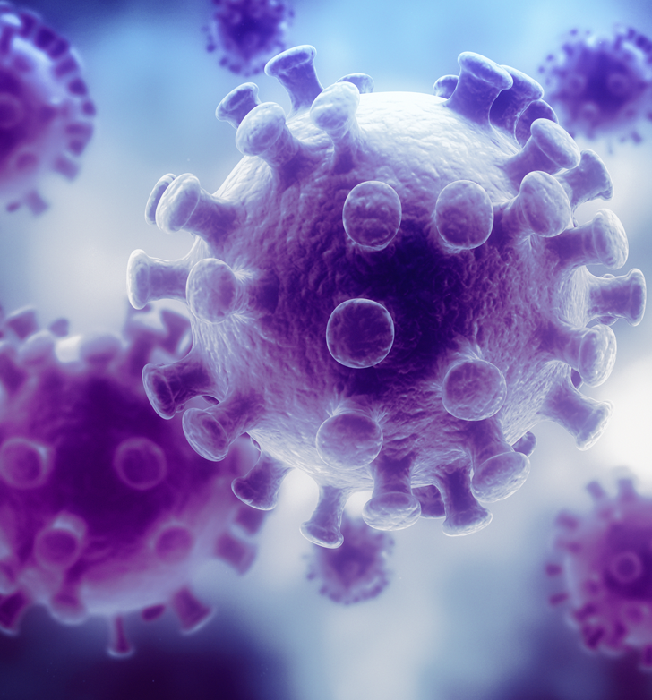
Post-Exposure Prophylaxis
You must also make Post-Exposure Prophylaxis available to the exposed employee if recommended by the U.S. Public Health Service. This is any preventative medical treatment started immediately after an exposure to counteract infection from a pathogen. In the case of an HIV exposure, this would consist of a course of antiretroviral drugs. To be most effective, treatment should be begin as soon as possible. Waiting too long will render it entirely ineffective. With new developments constantly occurring in this field, the standard requires you to follow current guidelines from the U.S. Public Health Service.
The Centers for Disease Control and Prevention website is categorized into instructions based on a number of different circumstances. In most cases, decisions about prophylaxis will be made by a healthcare professional with knowledge in that field.
Module 4: Mitigation

Slide 90

Medical Evaluation
You must provide the following information to the healthcare professional when an employee is getting a medical evaluation after an exposure incident:
A copy of the Bloodborne Pathogens Standard.
A description of the exposed employee’s duties related to the incident.
Documentation of the route(s) of exposure and circumstances under which the exposure occurred.
Results of the source individual’s blood testing (if available).
All medical records that are relevant to the treatment of the employee including vaccination status.
If the employee needs a Hepatitis B Vaccine, please provide a copy of the standard to the professional administering it.
Module 4: Mitigation

Slide 91

Medical Evaluation
Within 15 days after the medical evaluation, you are required to provide a written statement from the healthcare professional to the affected employee. However, the scope of this evaluation must be limited to the following information:
A statement showing the employee has been informed of the results of the evaluation.
Documentation that the employee was informed of any medical conditions that could result from the exposure which require further medical evaluation and treatment.
If an evaluation took place for the Hepatitis B Vaccine, the report must be limited to whether or not the vaccine is needed or if it was already administered. All other findings or diagnoses are to remain confidential and not be included in the written report.
Module 4: Mitigation

Slide 92
Module 5: Administration
BLOODBORNE PATHOGENS

Slide 93


Welcome to Module 5
In this module on administering your Exposure Control Plan, we’ll cover the following topics:
Annual Training Requirements
Keeping Medical Records
Keeping a Sharps Injury Log
Updating your Exposure Control Plan
The key point from this module is that there is more to being in compliance than creating an Exposure Control Plan. This is an area that many employers fall short on in following the standard. Next, we’ll watch a video explaining your Bloodborne Pathogens training requirements.
Module 5: Administration

Slide 94
Video: Annual Employee Training Requirements
Module 5: Administration

Slide 95

Bloodborne Pathogens Training
All employees with occupational exposure must receive initial and annual training on the hazards associated with blood and OPIM, and the protective measures to be taken to minimize the risk of exposure. This training must take place prior to being in positions where occupational exposure may happen.
Retraining should take place when there are changes in procedures or tasks that affect occupational exposure. Part-time and temporary employees and healthcare employees known as “per diem” employees are also covered and are to be trained on company time.
The instructor must be knowledgeable in the subject matter covered in the training program, as it relates to the workplace which the training addresses.
Module 5: Administration

Slide 96

Bloodborne Pathogens Training
The Standard contains a list of 14 elements that your training must include at a minimum:
1. An accessible copy of the regulatory text of the Standard and an explanation if its contents.
2. A general explanation of the epidemiology and symptoms of bloodborne diseases.
3. An explanation of the modes of transmission of bloodborne pathogens.
4. An explanation of your exposure control plan and how the employee can get a copy.
5. An explanation of the appropriate methods for recognizing tasks and other activities that may involve exposure to blood and OPIM.
(continued on next slide)
Module 5: Administration

Slide 97

Bloodborne Pathogens Training
The Standard contains a list of 14 elements that your training must include at a minimum:
6. An explanation of the use and limitations of methods that will prevent or reduce exposure including appropriate engineering controls, work practices, and personal protective equipment.
7. Information on types, proper use, location, removal, handling, decontamination, and disposal of PPE.
8. An explanation of the basis for selection of PPE.
9. Information on the Hepatitis B vaccine, including information on its efficacy, safety, method of administration, benefits, and that it will be offered free of charge.
10. Information on appropriate actions to take and the persons to contact in an emergency involving blood or OPIM.
(continued on next slide)
Module 5: Administration

Slide 98
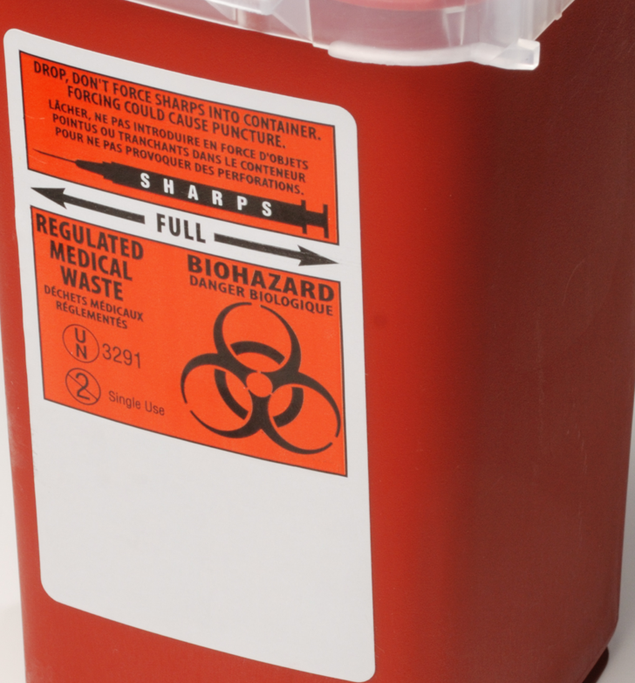
Bloodborne Pathogens Training
The Standard contains a list of 14 elements that your training must include at a minimum:
11. An explanation of the procedure to follow if an exposure incident occurs, including, the method of reporting the incident and the medical follow-up that will be made available.
12. Information on the post-exposure evaluation and follow-up that the employer is required to provide for the employee following an exposure incident.
13. An explanation of the signs and labels and/or color coding required by paragraph (g)(1).
14. An opportunity for interactive questions and answers with the person conducting the training session.
Module 5: Administration

Slide 99
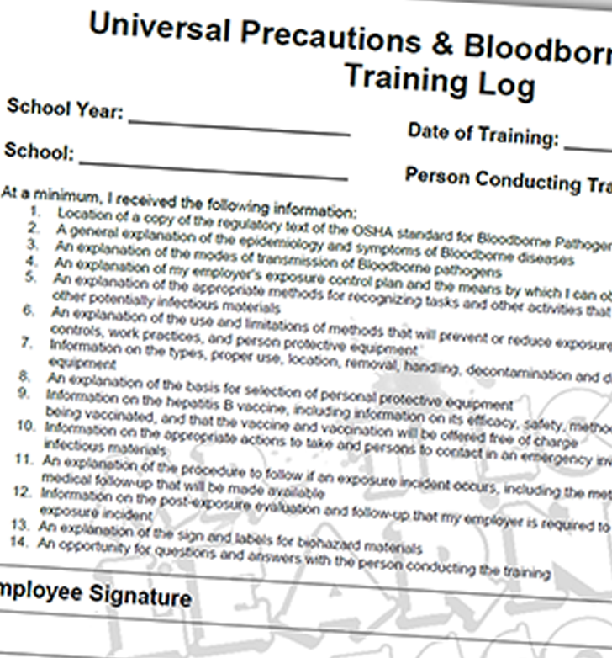
Recordkeeping Training
Paragraph (h)(2) of the standard requires accurate recordkeeping of training sessions, including titles of the employees who attended. The records are necessary to assist the employer and Oregon OSHA in determining whether the training program adequately addresses the risks involved in each job. Your records should include the following information:
Training dates
Contents or summary
Names and qualifications of trainers
Names and job titles of those attending
Training records are not to be considered confidential and may be stored in any file. They must be kept for 3 years from the training date.
Module 5: Administration

Slide 100

Keeping Medical Records
You are required to establish and maintain an accurate confidential record for each employee with occupational exposure. This report must include:
The name and social security number of the employee.
A copy of the employee’s Hepatitis B vaccination status including dates of all these vaccinations and any medical records relative to the employee’s ability to receive vaccination.
A copy of all results of examinations, medical testing, and follow-up procedures.
The employer’s copy of the healthcare professional’s written opinion as required.
A copy of the information provided to the healthcare professional.
Module 5: Administration

Slide 101

Keeping Medical Records Confidential
You are to ensure that all employee medical records are:
Kept confidential
Not disclosed or reported without the employee’s express written consent to any person within or outside the workplace, except as required by this section or as may be required by law.
You are required to maintain these records for at least the duration of employment, plus 30 years. If a worker is employed for less than a year, you are not required to keep their records past termination of their employment. You are allowed to contract the services of a healthcare professional located off-site and that company may retain the records.
Module 5: Administration

Slide 102
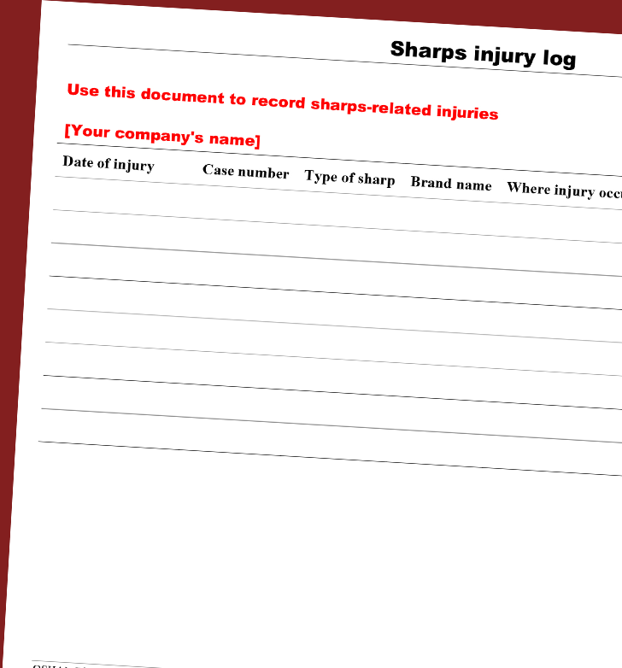
Sharps Injury Log
You must also maintain a log of sharps injuries for the recording of percutaneous injuries from contaminated sharps. This log is separate from the log of injuries and illnesses, but you can use the 300 Log⁽²⁾ as your template. The log must include the type and brand of device involved in the incident, and the department or work area where the exposure occurred. Remember to include an explanation of how the incident occurred. You can add more information, but keep in mind that the confidentiality of the injured employee must be maintained throughout the process.
The purpose of the log is to aid in the evaluation of devices being used in the workplace and to quickly identify problem areas in the facility. It should be reviewed regularly and during the review of your Exposure Control Plan. The log must be saved for at least 5 years.
Module 5: Administration

Slide 103

Updating the Exposure Control Plan
Every year you are required to review and update your Exposure Control Plan by adding or modifying tasks and procedures which affect occupational exposure.
A periodic review ensures that the Exposure Control Plan remains current with the latest information to reduce employee exposure to bloodborne pathogens.
It’s important to document your consideration and implementation of appropriate, commercially available, and effective safer medical devices designed to eliminate or minimize occupational exposure.
Module 5: Administration

Slide 104

Conclusion
When it comes to administration of your Exposure Control Plan, here are the key points to take from this module:
Conduct annual Bloodborne Pathogens trainings for your employees.
Keep records of your trainings for 3 years.
Keep confidential records of employee exposure(s) for the duration of their employment plus 30 years.
Keep a log of sharps injuries for at least 5 years.
Annually update your Exposure Control Plan.
In the next module, we’ll summarize the various aspects of being in compliance with the Bloodborne Pathogens Standard and experience a walk through of an Oregon OSHA inspection.
Module 5: Administration

Slide 105
Module 6: Conclusion
BLOODBORNE PATHOGENS

Slide 106

Video: Introduction
Module 6: Conclusion

Slide 107

Exposure Control Plan
By law you must develop a written Exposure Control Plan:
To identify workers with job-related exposure to blood and OPIM.
To specify the methods of protecting and training your employees.
For mitigation of exposures.
An Exposure Control Plan is a ‘living’ document, and needs to be reviewed and updated annually.
Remember to engage your employees in the process of developing and updating your Exposure Control Plan. To review a sample ECP, click here to watch “An Overview of the Exposure Control Plan for Bloodborne Pathogens”.
Module 6: Conclusion

Slide 108

Elements of an ECP
At a basic level, your Exposure Control Plan must include the following elements:
Exposure Determination
Level of Precautions
Engineering and Work Practice Controls
Personal Protective Equipment
Housekeeping Practices
Post-Exposure Steps
Records
Module 6: Conclusion

Slide 109
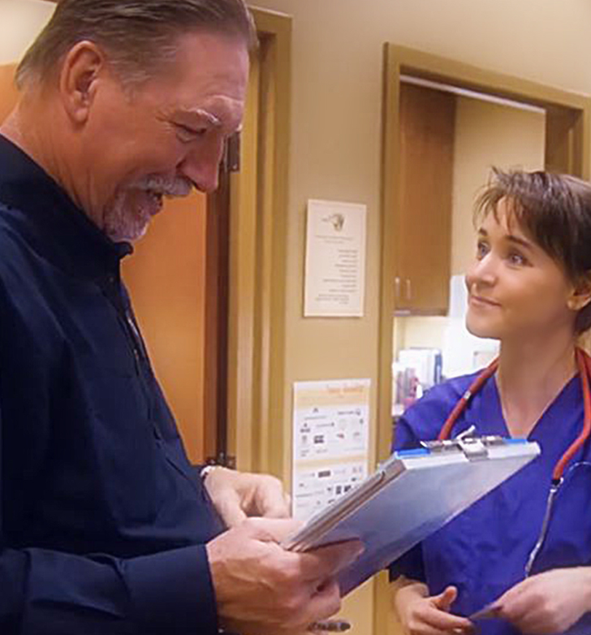
Oregon OSHA Inspections
Before closing up this module, we’d like to give you the opportunity to view a short video explaining what to expect when Oregon OSHA visits your workplace.
When a compliance officer visits your location, they will look for hazards that generally cause injuries or long-term illnesses. Since the subject of this program is bloodborne pathogens, we’re going to follow an Oregon OSHA health compliance officer as he performs an inspection at a clinic.
By the end of the video, we hope that you will feel more comfortable from the knowledge you’ve gained through this example.
Module 6: Conclusion

Slide 110
Video: What To Expect During an OSHA Inspection
Module 6: Conclusion

Slide 111

Citations and Penalties
Below are the most commonly cited violations for non-compliance with the Bloodborne Pathogens Standard. Failing to:
Have an Exposure Control Plan
Annually review the plan
Follow sharps safety procedures
Follow work practice controls
Administer the HBV vaccine
Follow training requirements
The Oregon OSHA program directive for bloodborne pathogens provides guidelines to compliance officers for inspections. It lists in detail what the inspection will entail and the guidelines for citation issuance. To review it, click the button:
OSHA Rules
Module 6: Conclusion

Slide 112
Video: Conclusion
Module 6: Conclusion

Slide 113
BLOODBORNE PATHOGENS - QUIZ
Question 1: In general, the purpose of the Bloodborne Pathogens Standard is to protect employees from:
Hazardous chemicals such as Benzene, Formaldehyde, and Mercury.
The Hepatitis B virus (HBV), the human immunodeficiency virus (HIV), and the Hepatitis C virus (HCV).
Violence in the workplace.
Question 2: Following Universal Precautions means:
Standard PPE used for all work shifts.
Covering your cough as to not spread disease.
Treating all human blood & other potentially infectious material as if they are infected and dangerous.
Bloodborne Pathogens: Quiz

Slide 114
BLOODBORNE PATHOGENS - QUIZ
Question 3: The Oregon BBP standard states that regulated waste, refrigerators or freezers used for storing blood, containers used for blood storage, and/or containers used to transport blood must be:
Labeled.
Made of synthetic materials.
Replaced annually with the new “top of the line” product.
Question 4: What color are biohazard labels required to be?
Green or bright orange.
Any fluorescent color.
Fluorescent orange or orange-red or mostly so.
Bloodborne Pathogens: Quiz

Slide 115
BLOODBORNE PATHOGENS - QUIZ
Question 5: Placing a needle in a sharps container is an example of:
An unsafe work practice.
An engineering control for your workplace.
An administrative control for your workplace.
Question 6: The primary methods used to prevent occupational transmission of bloodborne pathogens are:
Administrative controls and labeling standards.
Proper work practices and engineering controls.
Personal protective equipment and annual training.
All of the above.
Bloodborne Pathogens: Quiz

Slide 116
BLOODBORNE PATHOGENS - QUIZ
Question 7: Personal Protective Equipment must be:
Provided in appropriate sizes.
Be readily accessible.
Provided to employees at no cost.
All of the above.
Question 8: When removing Personal Protective Equipment (PPE):
Always assume it is contaminated on the outside.
Placed in an appropriately designated area or container for storage, washing, decontamination, or disposal.
All of the above.
Bloodborne Pathogens: Quiz

Slide 117
BLOODBORNE PATHOGENS - QUIZ
Question 9: Contaminated laundry must be:
Handled as little as possible, bagged at the location where it was used, and handled with appropriate PPE.
There is no difference in how laundry is treated.
Washed with extra bleach, but otherwise handled the same as other laundry.
Question 10: Employees should be allowed to take gowns, lab coats, or PPE home to be laundered.
TRUE
FALSE
Bloodborne Pathogens: Quiz

Slide 118
BLOODBORNE PATHOGENS - QUIZ
Question 11: Employers are required to provide the Hepatitis B vaccine to employees:
Within 10 working days of newly assigned tasks where exposure is possible.
Made available at a reasonable time and place.
Performed by or under the supervision of a healthcare professional.
All of the above.
Question 12: Of the following three options, which is a qualified trainer to educate employees on bloodborne pathogens?
Registered Nurse with work experience related to bloodborne pathogens.
Company president.
An employee who has previously taken a bloodborne pathogens course.
Bloodborne Pathogens: Quiz

Slide 119
BLOODBORNE PATHOGENS - QUIZ
Question 13: A training program can entirely consist of a video series on Bloodborne Pathogens.
TRUE
FALSE
Question 14: If an exposure incident occurs, you are to offer a confidential medical evaluation, follow-up, and counseling to the exposed employee. What is the time frame for this to begin?
As soon as possible
24 Hours
12 Hours
Bloodborne Pathogens: Quiz

Slide 120
BLOODBORNE PATHOGENS - QUIZ ANSWERS
B
C
A
C
B
D
D
C
9) A
10) B
11) D
12) A
13) B
14) A
Quiz Answer Sheet
Notes:
Answers

Slide 121

Where To Go From Here
An excellent resource to utilize is the A-Z Topic Index on the Oregon OSHA website. It has lists of relevant publications, training materials, rules, interpretations, videos, and other miscellaneous materials.
If you want guidance in developing a safer work environment, you may consider our free and confidential consultation service. Our consultants in workplace health and safety can help you reduce accidents, related costs, and help you develop a comprehensive program to manage safety and health. For more information, please visit the consultation page.
File a Complaint
A-Z Topic Index
Consultation Services
Bloodborne Pathogens Resources
Resource Links

Slide 122

Resource Links

Slide 123

Credits
You’ve completed the Bloodborne Pathogens course!
Produced by the Public Education Team of Oregon OSHA:
Roy Kroker, Phillip Wade, Ricardo Rodríguez, Angelina Cox, Tammi Stevens, Tim Wade, Anthony Dey, Meri Lull, Jennifer Hlad
Technical assistance provided as Subject Matter Experts:
Deborah Fell-Carlson, Lisa Rodriguez, Kathleen Kincade, Leilani Monson, Ken Langley, Chris Ottoson
Stock Images provided by: Getty Images Inc.
Credits List

