Slide 1
Module 1: Introduction & Evaluation
CONFINED SPACE SAFETY
Please note: If the online course contains videos, the video links are included in this PPT.
You will need to have an internet connection to play the videos or
you can download the videos and embed them into your copy of this PPT presentation.

Slide 2
Disclaimer
Completing this course will help you understand the rules and some of the hazards related to working in confined spaces. However, it is your employer’s responsibility to further your training where it is specific to your organization, such as permits, policies, and practices. This material should not be considered a substitute for any provisions of the Oregon Safe Employment Act, or for any standards issued by Oregon OSHA. Manufacturers, products, or services displayed in this material are for informational purposes only and do not constitute an endorsement by Oregon OSHA.
CONFINED SPACE SAFETY:
introduction & evaluation

Slide 3
Welcome
Welcome to the Confined Space Safety course! We will discuss the Confined Spaces rule that applies to Divisions:
2 (General Industry)
3 (Construction)
7 (Forest Activities)
We will also go through the Confined and Hazardous Spaces rule for Division 4 (Agriculture) during the last module of this course.
CONFINED SPACE SAFETY:
introduction & evaluation
Notes:
https://osha.oregon.gov/OSHARules/div2/div2J.pdf#page=25
https://osha.oregon.gov/OSHARules/div4/div4J.pdf#page=49

Slide 4
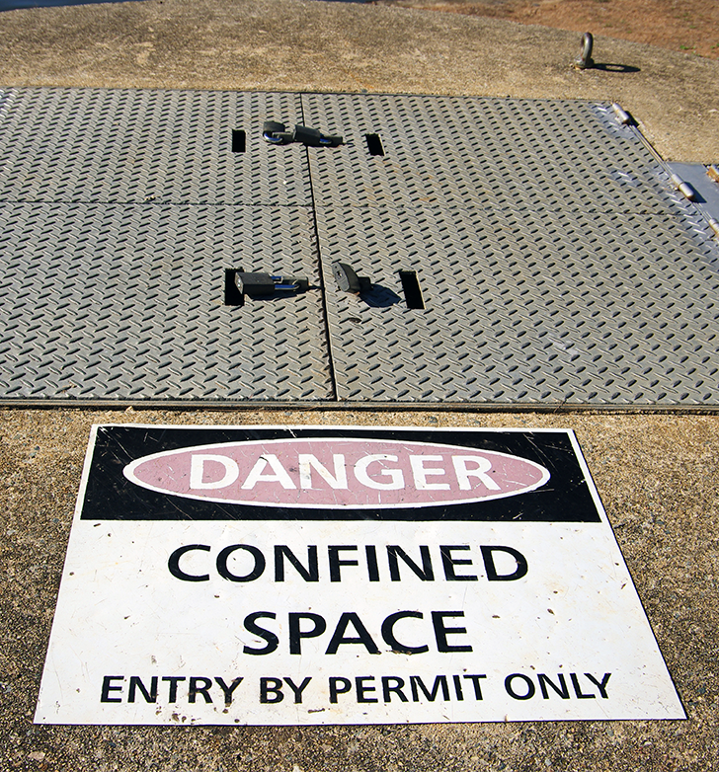
Course Objectives
The overall course objectives of Confined Space Safety are to explain:
The potential hazards involved with working in confined spaces.
The confined spaces rule requirements.
How to work safer in confined spaces.
This first module will discuss:
The purpose of and history behind the Confined Spaces rule.
Definitions in the rule.
The initial evaluation of confined spaces and identification of hazards.
Let’s get started.
CONFINED SPACE SAFETY:
introduction & evaluation

Slide 5
Purpose of the Rule
The purpose of the Confined Spaces rule is to: “...protect employees from the hazards of entering and working in confined spaces.”
Employee lives are worth protecting and the dangers of working in confined spaces are real and very unforgiving - regardless of which industry, division, or rule your work falls under.
In the next few slides, you will learn about some accidents that occurred in Oregon workplaces. This will give you an idea of the seriousness of working in confined spaces, how quickly a situation can go wrong, and that every accident affects so many more lives than just the person who was injured.
Warning: True stories are featured throughout the course; please proceed with sensitivity as some of the outcomes are tragic.
CONFINED SPACE SAFETY:
introduction & evaluation

Slide 6
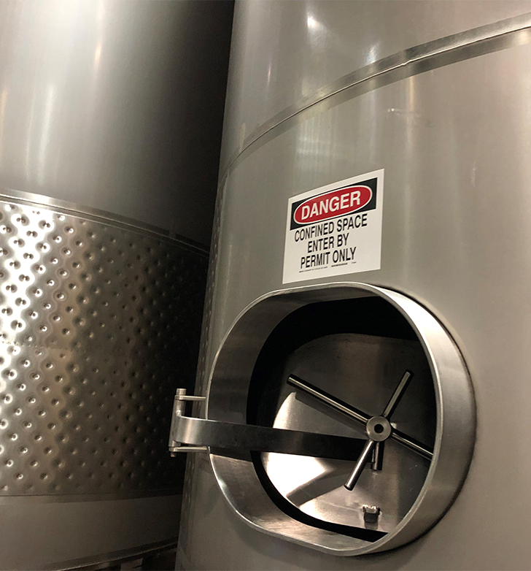
Example 1 - Winery
It was a cold February morning in Yamhill County and employees had arrived at the winery to start their work day around 8:00 am. The task assigned to Employee 1 was to pump out wine remnants from a 30,000 gallon tank to a secondary tank for additional processing. The employee entered the tank so he could move the remnants closer to the pump. Because the remnants needed to be preserved, nitrogen gas was being pumped into the tank, displacing the oxygen.
At 10:30 am, coworkers found Employee 1 unresponsive at the bottom of the wine tank he had been assigned just 2 hours prior. They called the rescue team, pulled him out of the tank, and tried to resuscitate him. When local emergency services arrived on the scene, they tried to bring him back as well, but it was too late. This employee, only 39 years old, lost his life that morning.
There had been no atmospheric testing before entry into the permit-required confined space, no attendant or entry supervisor, and the employer did not ensure all employees were proficient in their assigned duties, trained to recognize confined spaces, or trained when their assigned duties changed.
CONFINED SPACE SAFETY:
introduction & evaluation

Slide 7
Example 2 – Storm Drains
An accident occurred when employees were cleaning a storm drain in Multnomah County. Employee 1 entered the maintenance hole to pressure wash the sides of the storm drain. Employee 2 started the vacuum truck and placed the connected hose into the manhole to extract the sludge material. After finishing his task, Employee 1 exited the space, and Employee 2 shut off the vacuum truck and removed the hose from the hole. Employee 3 then entered the space for his work task, but lost consciousness within minutes of being in the space. Employee 2 immediately entered the space to retrieve Employee 3, but he also quickly lost consciousness!
Rescue services were called and, fortunately, were able to respond quickly and were prepared to work with the hazardous atmosphere conditions. Both workers were rescued, treated, and survived.
There were many requirements of entering confined spaces that were not adhered to, including evaluating the space before entry and testing the atmosphere to check for the presence of hazardous gases and adequate oxygen levels.
CONFINED SPACE SAFETY:
introduction & evaluation

Slide 8
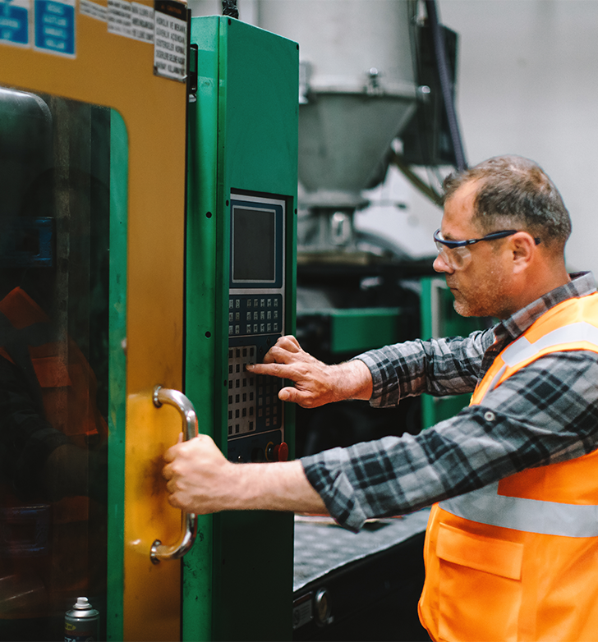
Example 3 – Equipment Maintenance
It was just another routine service and inspection day for two employees working on a piece of large manufacturing equipment for a company in Washington County. Employee 1 was inside the equipment’s confined space, cleaning and servicing the internal parts. Employee 2 was on the outside of the machine, entering commands onto the control panel to maneuver Employee 1’s location within the space so he could inspect different areas of the machine.
Due to a machine malfunction, the command that Employee 2 entered did not work properly. The panel that Employee 1 was laying on started rising towards the top of the machine. Employee 2 frantically pushed any and all commands, but he could not get the machine to stop. As the panel continued rising, Employee 1 was crushed to death between the panel and the machine’s ceiling.
Of the many factors that contributed to this tragic work accident, the company did not have a plan for evaluating the hazards of the space, the work to be performed, or safe entry conditions. And they did not ensure employees were properly trained for entry into permit-required confined spaces.
CONFINED SPACE SAFETY:
introduction & evaluation

Slide 9
Example 4 – Water Tank
An empty 20,000-gallon water tank needed maintenance in Yamhill County, so two employees went onsite to repair it. As Employee 1 climbed down the ladder into the tank, the ladder failed. Employee 1 landed on the bottom of the tank, breaking his leg on impact.
Employee 2 was not equipped, nor prepared, to rescue his co-worker. He called upon the county emergency services to help, but Employee 1 was stuck at the bottom of the tank suffering the pain of a broken leg for almost 3 hours until help arrived. Employee 1 was eventually rescued and received treatment for his injuries.
No confined space training had been provided to the employees, no confined space program was in place, no rescue plan developed, and no fall protection provided.
Thinking about the victims in all four stories, you can imagine the impact the accidents also had on their families, friends, and co-workers. Regulations, such as the confined spaces rules, ultimately help keep workers safe so they are able to return home to loved ones at the end of the workday.
CONFINED SPACE SAFETY:
introduction & evaluation

Slide 10
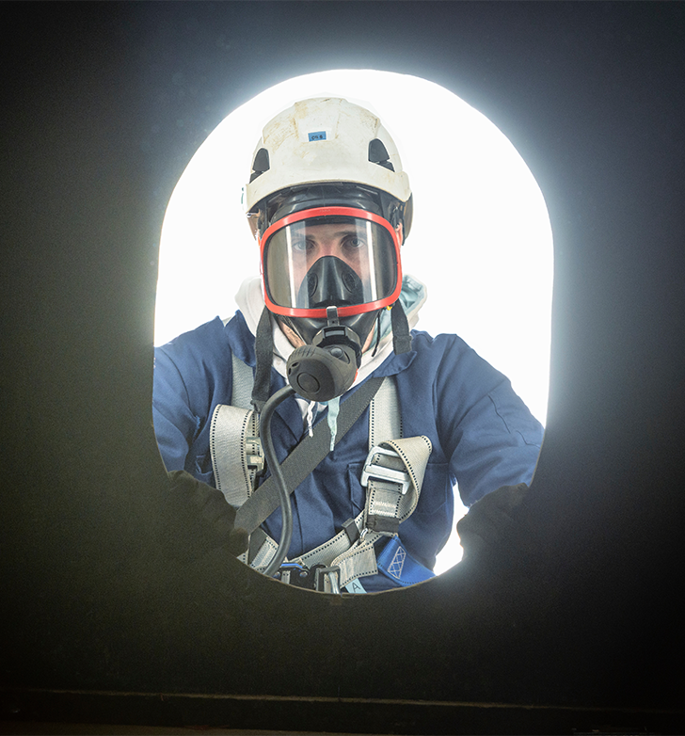
History of the Rule
Prior to 2007, federal OSHA had a confined spaces rule that only applied to general industry, not construction. As more and more fatalities were occurring across the country due to confined space work within the construction industry, federal OSHA proposed another confined space rule specifically for construction. As an approved OSHA State Plan, Oregon OSHA is required to have standards that meet or exceed the federal rules. As such, Oregon OSHA met with stakeholder groups from construction and general industries to discuss the best way to proceed with a new rule for the construction industry.
It was determined that since many work activities over the course of one job can fall under Division 2 one day and Division 3 the next day, Oregon OSHA would have just one Confined Spaces rule to cover both general industry and construction. The goal was to reduce confusion about the requirements and increase ability for employers and employees to meet the intent of the rule.
(Continued on next slide.)
CONFINED SPACE SAFETY:
introduction & evaluation

Slide 11
History of the Rule (continued)
The same Confined Spaces rule that covers construction and general industries also applies to Division 7, Forest activities.
However, it does not apply to Division 4, Agriculture. Division 4 already had an existing confined spaces rule prior to the 2007 rule-making procedures. We will discuss the details of the Division 4 rule, OAR 437-004-1250, during the final module of this course.
Note: There are some spaces and work that are not covered by this rule because they fall under a different rule, such as excavation work regulated by Division 3/P or welding work under Division 2/Q. Read the full list of exceptions here.
CONFINED SPACE SAFETY:
introduction & evaluation
Notes:
(3) Forest activities: https://osha.oregon.gov/OSHARules/div7/div7A.pdf#page=3
(4) Exceptions list: https://osha.oregon.gov/OSHARules/div2/div2J.pdf#page=25

Slide 12
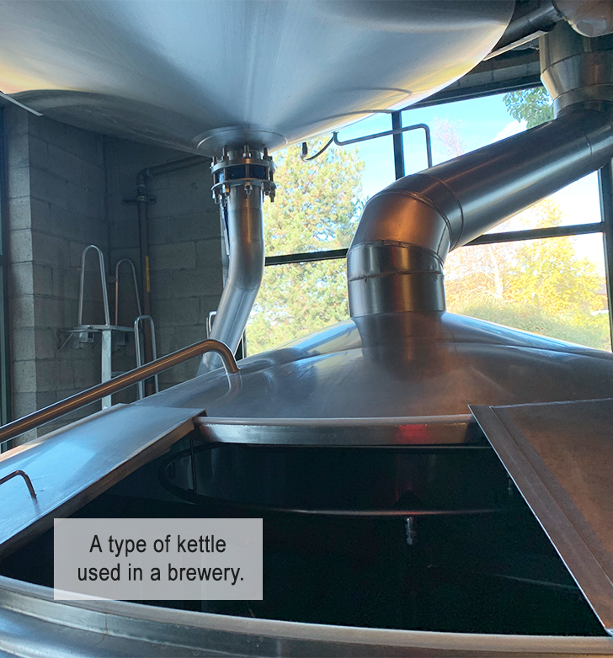
Definitions
Let’s define some important terms from the rule that we will use frequently throughout the course.
Confined Space - A space that meets all of the following criteria is considered a confined space:
Large enough and shaped in a manner that an employee can fully enter the space and perform work.
Has limited or restricted means for entry and/or exit.
Is not designed for continuous human occupancy.
If the space does not meet all three criteria, it is not considered a confined space and is not covered under this rule.
CONFINED SPACE SAFETY:
introduction & evaluation

Slide 13
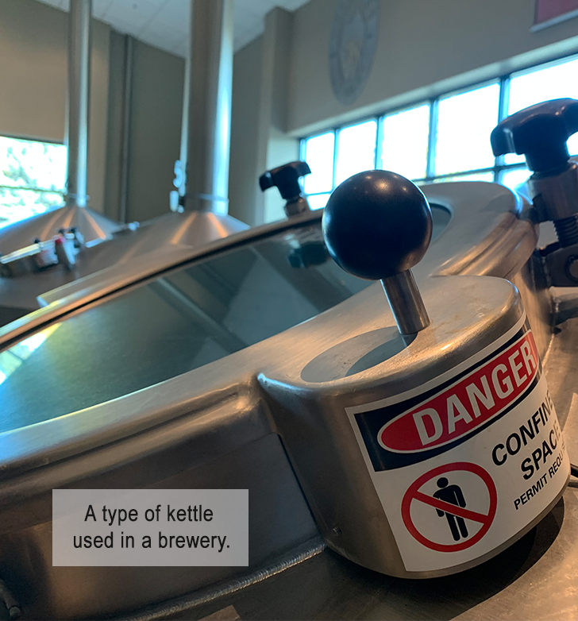
Definitions (continued)
Permit-Required Confined Space, or PRCS, or permit space – A confined space that has one or more of the following characteristics:
Contains, or has a potential to contain, a hazardous atmosphere.
Contains a material that has the potential to engulf an entrant.
Has an internal configuration such that an entrant could become trapped or asphyxiated by inwardly converging walls or by a floor which slopes downward and tapers to a smaller cross-section.
Contains any other recognized serious safety or health hazard that can inhibit an entrant’s ability to escape unaided.
Note: Division 4 Agriculture rule OAR 437-004-1250 does not differentiate permit-required confined spaces, only OAR 437-002-0146 does. We will discuss PRCS in more depth in Module 2.
CONFINED SPACE SAFETY:
introduction & evaluation

Slide 14
Definitions (continued)
Immediately dangerous to life or health (IDLH) – any condition that poses an immediate or delayed threat to life or that would cause irreversible adverse health effects or that would interfere with an individual’s ability to escape unaided from a permit space.
See additional note in the rule for example of a “delayed” threat.
CONFINED SPACE SAFETY:
introduction & evaluation
Notes:
(5) Note in the rule: https://osha.oregon.gov/OSHARules/div2/div2J.pdf#page=28

Slide 15
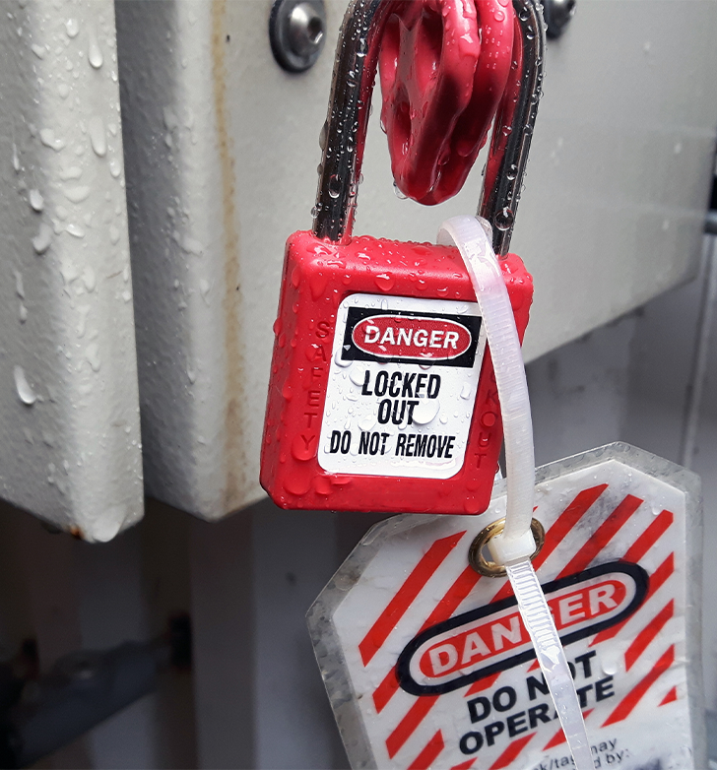
Definitions (continued)
Hazard – For the purpose of this rule, hazard means a physical hazard or hazardous atmosphere.
Physical hazard – An existing or potential hazard that can cause death or serious physical harm in or near a confined space, or a hazard that has a reasonable probability of occurring in or near a confined space, and includes, but is not limited to:
Explosives; mechanical, electrical, hydraulic, and pneumatic energy; radiation; temperature extremes; engulfment; noise; and inwardly converging surfaces.
Chemicals that can cause death or serious physical harm through skin or eye contact (rather than through inhalation).
Physical hazards can come in many different forms. The hazard could be related to the configuration of a space, equipment inside the space, or materials which can flow into a space and entrap an entrant.
CONFINED SPACE SAFETY:
introduction & evaluation

Slide 16
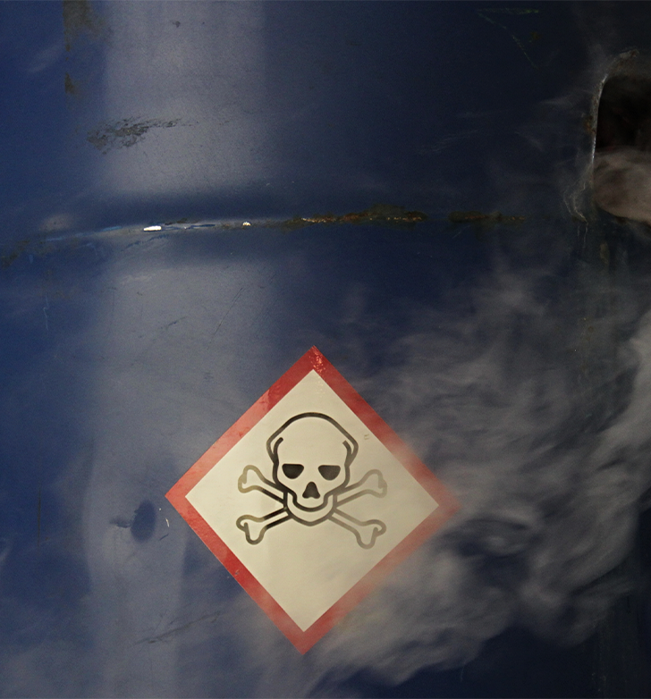
Definitions (continued)
Hazardous atmosphere – An existing or potential atmosphere that may expose employees to the risk of death, incapacitation, impairment of ability to escape unaided from a permit space, injury, or acute illness from one or more of the following:
A flammable gas, vapor, or mist in excess of 10% of its lower flammable limit.
An airborne combustible dust at a concentration that meets or exceeds its lower explosive limit.
An atmospheric oxygen concentration below 19.5% (oxygen deficient) or above 23.5% (oxygen enriched).
An airborne concentration of a substance that exceeds the dose or exposure limit specified by an Oregon OSHA requirement.
An atmosphere that presents an IDLH (immediate danger to life or health).
That wraps up the definitions for now. There are more terms defined in the rule, and we will explain more throughout the course as the need arises. Now let’s look at an example of a physical hazard and an atmospheric hazard.
CONFINED SPACE SAFETY:
introduction & evaluation

Slide 17
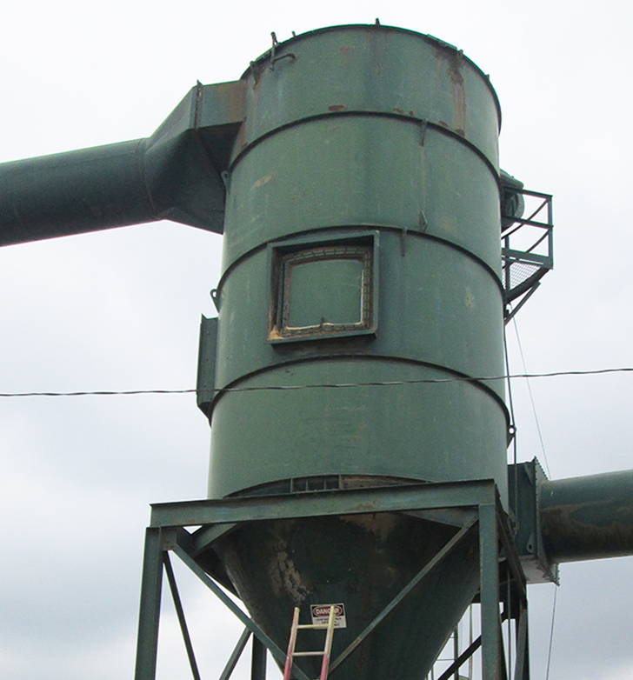
Example – Physical Hazard
This example is from an actual accident that occurred in Lane County.
Employees working at a lumber company noticed that an accumulation of sawdust was clogging up the hopper. While the machinery was running, two employees entered the confined space of the bag house silo to unclog it. Employee 1 reached into the hopper to remove the sawdust and his hand inadvertently came into contact with a rotating part. It immediately amputated 3 of his fingers!
This particular example contained multiple physical hazards:
Mechanical
Inwardly converging surfaces
Falls from height
Engulfment
Flammable (due to the combustible nature of the material)
CONFINED SPACE SAFETY:
introduction & evaluation

Slide 18
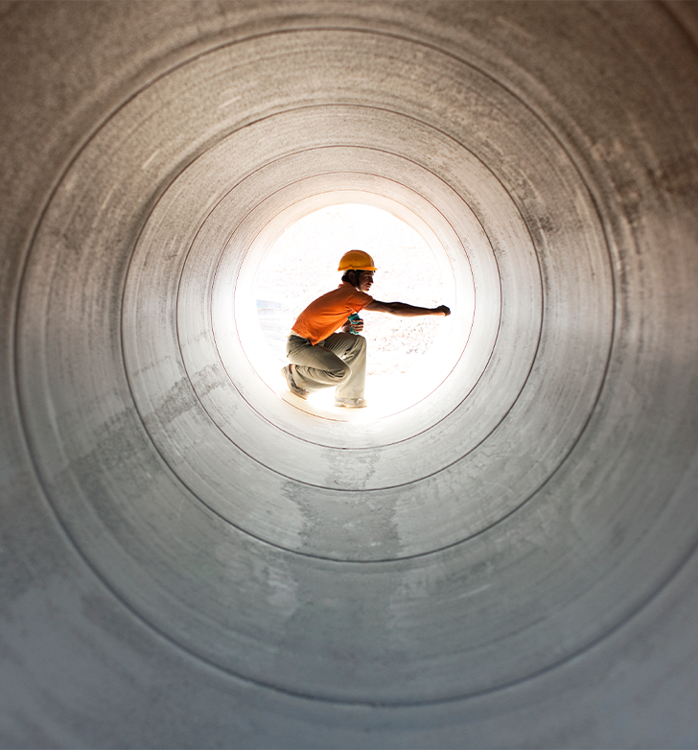
Example – Atmospheric Hazard
When evaluating the atmospheric hazards, it is important to include conditions within the space, systems connected to the space, conditions outside of the space, and anything that is brought into the space in order to perform assigned tasks.
For example, Employee 1 may need to enter one part of a tunnel where there are no obvious sources of atmospheric hazards, but Employee 2 is welding in another part of the tunnel creating an atmospheric hazard that can travel to other parts of the system and affect Employee 1.
Another example of a potential atmospheric hazard can be a small confined space with several workers inside. Although the air is tested before entry and there is no vapor or gas of concern, the simple act of all those workers breathing in that small space can create an oxygen-deficient atmosphere.
CONFINED SPACE SAFETY:
introduction & evaluation

Slide 19
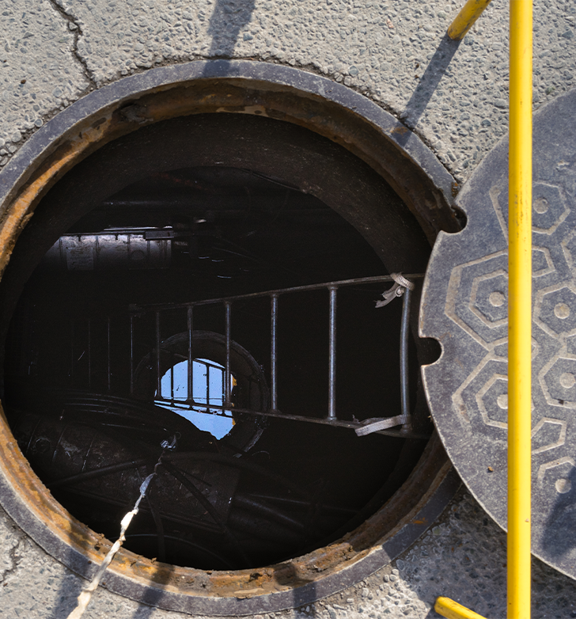
Confined Space Work
Now let’s learn about what must be completed before entering a confined space.
You’ve already determined that your workspace meets all three criteria of a confined space:
Large enough and so configured that an employee can fully enter the space and perform work.
Has limited or restricted means for entry and/or exit.
Is not designed for continuous human occupancy.
Go to the next slide to find out what the first step is!
CONFINED SPACE SAFETY:
introduction & evaluation

Slide 20
Evaluation
Before any work can be done in a confined space, a full evaluation of the space must be done. While employees must be allowed to observe the evaluation, make sure no employees enter any confined space until it has been fully evaluated.
The evaluation needs to include:
Any known or anticipated atmospheric or physical hazard.
Any previous evaluation of that space.
Any precautions and procedures that were previously implemented for entering the space.
There are several components to the evaluation that will help to determine if the space should be classified as a “permit-required confined space” (PRCS).
CONFINED SPACE SAFETY:
introduction & evaluation

Slide 21
Evaluation (continued)
After you have completed the evaluation there are a few options for your next steps:
If there are no atmospheric or physical hazards present or anticipated, then you do not have a permit space. Go about your work! However, if conditions change, make sure you re-evaluate for hazards.
If there are known or anticipated atmospheric, configuration, engulfment, and/or other recognized hazards identified during the evaluation, then the space is a permit-required confined space (PRCS). This classification comes with additional safety precautions and requirements which we will cover in the next module. If it is a permit space, identify it as such. This could be done with signs, labels, or tags on or near the space.
If you can eliminate all physical hazards and control all atmospheric hazards, you may choose to follow the “alternate entry” process. We will discuss alternate entry in Module 4.
CONFINED SPACE SAFETY:
introduction & evaluation

Slide 22
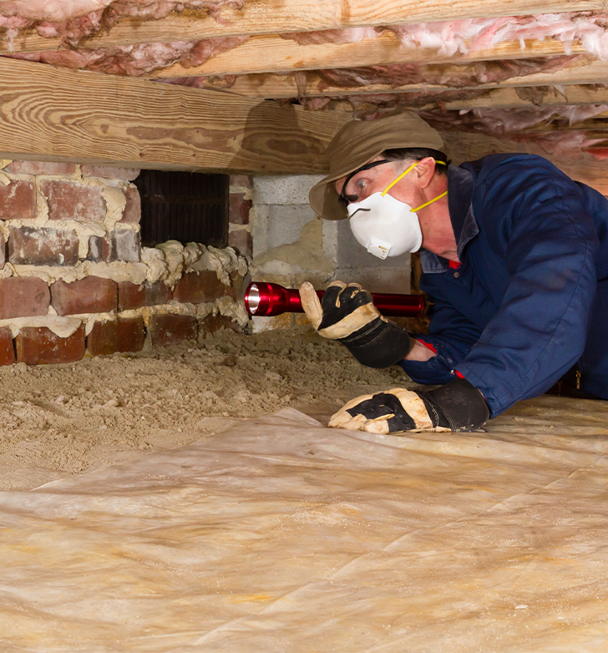
Examples
To give you an idea of what some known or anticipated hazards could be within various confined spaces, take a look at the examples below. You can click on the links for more information.
HVAC chambers/Crawlspaces: There could be mechanical hazards due to HVAC equipment components, such as fan blades or chain and belt drives. If a sewer line needs to be opened up for work within a crawlspace, this presents potential atmospheric hazard of hydrogen sulfide gasses accumulating within the space, as well as an explosive hazard if any hot work were to take place.
Brewery/Winery: Cleaning a brew kettle or tank has potential atmospheric hazards of gasses, such as carbon dioxide, carbon monoxide, and nitrogen, which displaces oxygen.
Garbage Trucks: Climbing into the back of a garbage truck exposes a worker to a crushing hazard.
CONFINED SPACE SAFETY:
introduction & evaluation
Notes:
(6) HVAC: https://osha.oregon.gov/OSHAPubs/factsheets/fs65.pdf#page=1
(7) Winery: https://osha.oregon.gov/OSHAPubs/hazard/2993-06.pdf
(8) Garbage Trucks: https://osha.oregon.gov/OSHAPubs/hazard/2993-25.pdf

Slide 23
Mobile and Other Employees
If you have mobile workers, you must determine if they will be exposed to any permit-required confined spaces at their assigned work locations. If so, the same evaluation process must be done for the spaces to gather the same information previously mentioned.
Before employees of another employer enter a confined space at your workplace that is under your control, you must provide all information related to the evaluation of the space to their employer and employees.
See section (4)(b) to read about exceptions to the evaluation process.
CONFINED SPACE SAFETY:
introduction & evaluation
Notes:
(9): Mobile Workers: https://osha.oregon.gov/OSHARules/div2/div2J.pdf#page=29
(10): Evaluation process: https://osha.oregon.gov/OSHARules/div2/div2J.pdf#page=33
(11): Section (4)(b): https://osha.oregon.gov/OSHARules/div2/div2J.pdf#page=32

Slide 24
Module 1 Overview
That completes the first module! You have learned about:
Some of the workplace accidents that have occurred within confined spaces in Oregon.
The history of the Confined Spaces rule.
Some of the rule’s key terms and definitions.
Physical and atmospheric hazards, with examples.
The evaluation requirements of the rule.
Next up in Module 2, we will learn about permit-required spaces and the necessary entry programs and permits.
CONFINED SPACE SAFETY:
introduction & evaluation

Slide 25
CONFINED SPACE SAFETY
Module 2: Permit-Required

Slide 26
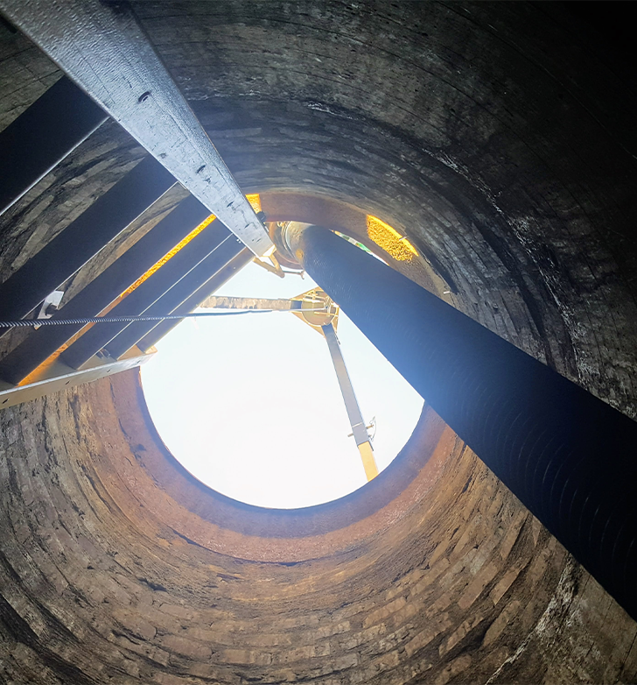
Welcome to Module 2
In the previous module, we discussed what a confined space is and the required evaluation before any employees are allowed to enter it.
In this module, we will discuss:
Permit-required confined spaces (PRCS)
Written program and permits
Entry roles for permit spaces
If there are any hazards associated with the confined space, you must take steps to eliminate or control those hazards. If you’re working within OAR 437-002-0146, you will need to follow the guidelines for a permit-required confined space entry or use the alternate entry process. (We will discuss the alternate entry process in Module 4.)
CONFINED SPACE SAFETY:
permit-required

Slide 27
Permit-Required Confined Spaces
As a reminder for what constitutes a confined space, all three of the following criteria must be present:
Large enough to fully enter and perform work
Not designed for continuous human occupancy
Limited access and egress
When one or more of the following hazards are present, it becomes a permit-required confined space (PRCS):
Atmospheric
Configuration
Engulfment
Other recognized hazard
The rule requires a written program to be created and used whenever employees need to enter a permit-required confined space, also referred to as simply a “permit space”. This written program must describe everything involved to safely identify and enter the space.
Let’s discuss the required components of the written program and permit in the next few slides.
CONFINED SPACE SAFETY:
permit-required
Notes:
1) Written program and permit: https://osha.oregon.gov/OSHARules/div2/div2J.pdf#page=33

Slide 28
PRCS Written Program
The written program must address all permit-required confined spaces that will be entered and must have:
Documented entry permit procedures, and how unauthorized persons will be prevented from entering the permit spaces.
Designated employee roles, what the duties are for each role, and training for each.
Training on the written program and entry permits.
A way to identify and evaluate hazards and how the hazards are eliminated or controlled.
Instructions on equipment use and maintenance.
A method to conclude the entry and cancel the permit once the entry operations are completed.
The location of all permit spaces on fixed sites, and the reason they are classified as such.
CONFINED SPACE SAFETY:
permit-required

Slide 29
PRCS Written Program (continued)
In addition to the components outlined on the previous slide:
All employees must have access to the written program for permit-required confined spaces. This is similar to safety meeting notes or hazard communication – make sure the information is somewhere where all employees have access.
The designated entrants must have access to the completed permit before entry so they can confirm that pre-entry preparations have been completed.
Review the permit program if a near-miss or injury occurred, or any other situation where employees weren’t protected, and revise the program as necessary.
All permits must be kept for at least one year of the completed permit, and reviewed within that year to evaluate the program and protection to employees.
If coordination with another employer is necessary for entry, that process must be included in the program as well.
CONFINED SPACE SAFETY:
permit-required

Slide 30
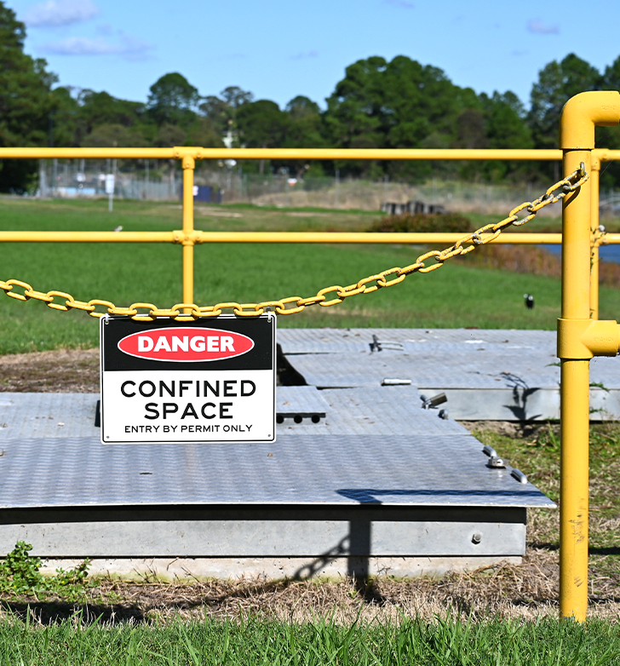
Permit Information
One of the first requirements in the written program section is to document the permit entry procedures. Those procedures must explain:
How to evaluate the hazards of the space.
The work to be performed.
Conditions for a safe entry.
There should be only one permit per monitored entry. If work will be occurring over several days, there should be a new permit for each day’s entry into the confined space.
Go to the next slide for a list of information to be included in the entry permit.
CONFINED SPACE SAFETY:
permit-required

Slide 31
Permit Information (continued)
In addition to the information listed in the previous slide, entry permits must also include the following information:
Confined space to be entered and the purpose of entry.
Date, start and end times of permit.
Hazards of the space (actual and potential).
Measures used before entry to isolate the space and eliminate/control hazards.
Communication procedures for maintaining contact during the entry.
Equipment provided for safe entry, such as for testing, monitoring, communications, and rescue.
(List continues on next slide.)
CONFINED SPACE SAFETY:
permit-required

Slide 32
Permit Information (continued)
Names of entrants and attendants. (We’ll define those terms soon.)
Signature of supervisor authorizing entry.
Results of the initial atmosphere tests, results of the periodic or continuous monitoring period, and names or initials of the testers and time of tests. (See next slide for more information.)
The rescue team and how to contact them.
Other relevant information for safety, such as additional permits for work in the space.
Any problems encountered during the entry. (Add these to the permit afterwards for purposes of evaluation and review.)
An example of a PRCS entry permit can be found in Appendix C of the rule; you can use it as a guide in developing a permit that is specific to your workspaces.
CONFINED SPACE SAFETY:
permit-required
Notes:
2) Appendix C: https://osha.oregon.gov/OSHARules/div2/div2J.pdf#page=59

Slide 33
Initial Atmosphere Tests
Initial testing for atmospheric hazards must be completed (where necessary) and the testing results must be provided to the entrants before they ever enter the space. Safe entry conditions must be maintained for the duration of the entry. If a space is too large to isolate, or is part of a continuous system such as a sewer, continuous monitoring is required where the entrants are working.
If conditions change and the space needs to be evacuated, no one should enter again until the space and hazards are re-assessed and hazards are eliminated or controlled. The entrants must be allowed to observe all re-assessments and activities to control the hazards.
CONFINED SPACE SAFETY:
permit-required

Slide 34
Multi-Employer Worksites
There are requirements outlined in the rule for when employees of another employer enter permit spaces that are under your company’s control. You are required to inform the other employer and their employees about the permit spaces, including:
The identified hazards of the space.
Any experiences with the space.
Any precautions and procedures required to protect employees working in or near the permit space.
Entry into the permit spaces is only allowed when all of the rule requirements are met. Once the entry is complete, discuss the entry program that was followed and any hazards that were created or confronted within the space.
To read the full requirements related to multi-employer worksites, see paragraph (12) in the rule.
CONFINED SPACE SAFETY:
permit-required
Notes:
3) Paragraph 12: https://osha.oregon.gov/OSHARules/div2/div2J.pdf#page=47

Slide 35
Designated Roles for Entry
Before a permit confined space is entered, the rule requires the roles of entrants, attendants, and entry supervisors to be designated and listed on the permit. Due to the inherent danger of working in permit-required confined spaces, it is important that each person knows their role, what it requires, and is competent in carrying out the duties. Lives depend on it!
Each role is defined in the rule and has specific requirements and duties. Let’s learn about the following three entry roles:
Entrant (Authorized Entrant)
Attendant
Entry Supervisor
CONFINED SPACE SAFETY:
permit-required
Notes:
4) Role is defined in rule: https://osha.oregon.gov/OSHARules/div2/div2J.pdf#page=26
5) Specific requirements: https://osha.oregon.gov/OSHARules/div2/div2J.pdf#page=38

Slide 36
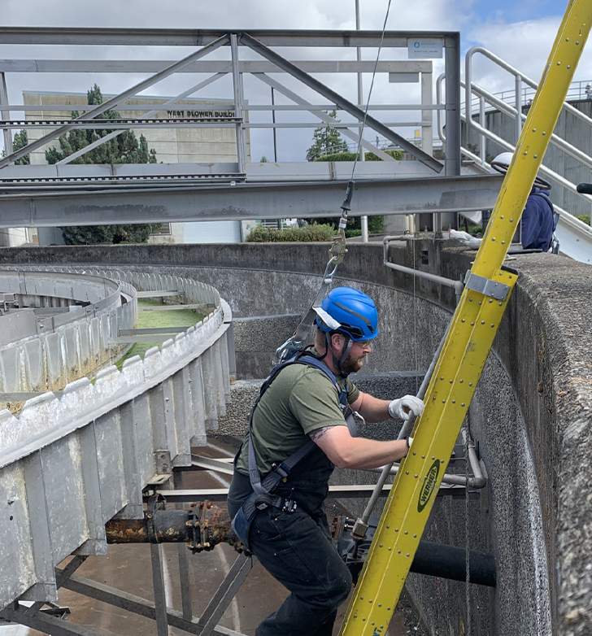
Entrant Role
Entrant/Authorized Entrant: an employee who is authorized by the employer to enter a permit space. Entrants must know about the hazards they may face during entry. This includes information about:
Types of hazards
Signs and symptoms of exposure to the hazards
Consequences of exposure
They also must communicate with the attendant, so that the attendant can monitor the entrant’s status and alert the entrant if they need to evacuate the space. If the entrant detects any dangerous or hazardous condition or warning sign of exposure, they must alert the attendant.
CONFINED SPACE SAFETY:
permit-required

Slide 37
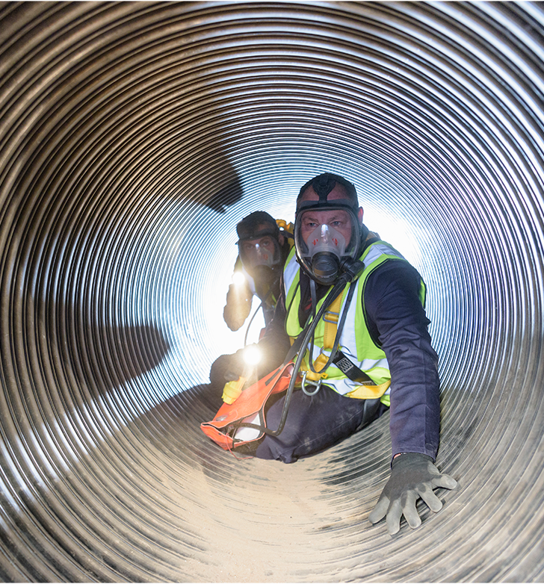
Entrant Role (continued)
The final requirement of the entrant’s role is to exit from the permit space as quickly as possible whenever any of the following occur:
An order to evacuate is given by the attendant or entry supervisor.
The entrant recognizes a warning sign or symptom of exposure to a dangerous situation.
The entrant detects a dangerous or hazardous condition.
An evacuation alarm is activated.
CONFINED SPACE SAFETY:
permit-required

Slide 38
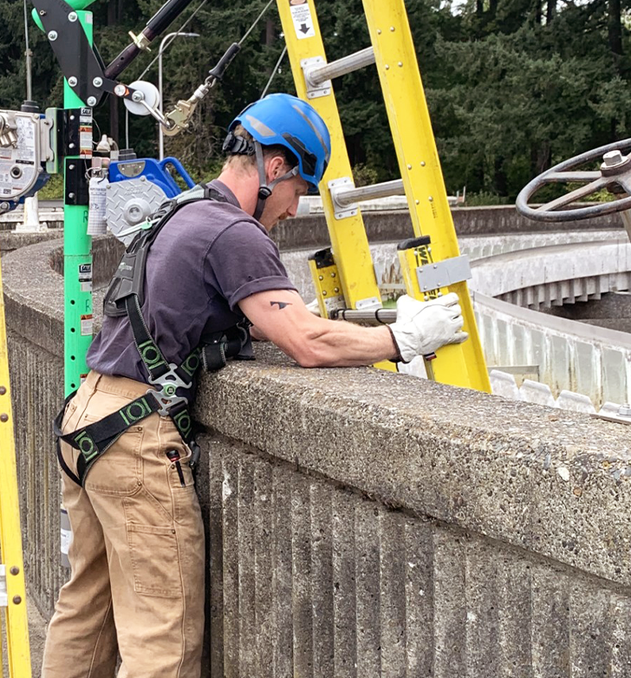
Attendant Role
Attendant: an individual stationed outside one or more permit spaces to monitor the authorized entrants and who performs all attendants’ duties assigned in the employer’s permit space program.
Depending on the type of job and work tasks, an attendant may only have one entrant in one space to attend to; or they may have multiple entrants in multiple spaces. No matter what, their primary duty is to monitor and protect the authorized entrants. They should not perform any other tasks that would interfere with that primary duty. If one of the spaces or entrants start interfering with the attendant’s ability to monitor the other spaces/entrants, either those other spaces need to be evacuated or another attendant must take over.
Let’s learn a bit more about their role in the next few slides.
CONFINED SPACE SAFETY:
permit-required

Slide 39
Attendant Role (continued)
Just as with the entrant’s role, the attendant is also required to know all the hazards that may be faced during entry, such as the signs, symptoms, and consequences of exposure to those hazards. They must also know the possible behavioral effects of hazard exposure.
For example, an entrant exposed to hydrogen sulfide could become irritable, nauseous, delirious, or even have convulsions. As an attendant, you must be aware of the possible effects so you can evacuate the space immediately (even if the entrant is unable to recognize their symptoms as being the result of exposure to the hazard).
CONFINED SPACE SAFETY:
permit-required

Slide 40
Attendant Role (continued)
The attendant must stay outside of the permit space and keep count of who the authorized entrants are in the permit space. They must monitor the activities inside and outside of the space for safety and evacuate the space if any dangerous or hazardous conditions are detected.
Additionally, the attendant has a few more important responsibilities:
Call for rescue and/or emergency services as soon as they are needed.
Perform non-entry rescues when needed as specified by the employer’s rescue procedure.
Warn unauthorized persons who enter the permit space area while entry operations are taking place, advise them to exit, and inform the authorized entrants and supervisor of an unauthorized person’s entrance into the space.
CONFINED SPACE SAFETY:
permit-required

Slide 41
Entry Supervisor Role
Entry Supervisor: The person (such as the employer, foreman, crew chief, or any other designated employee) responsible for:
Determining if acceptable entry conditions are present at a permit space where entry is planned.
Authorizing entry and overseeing entry operations.
Terminating entry when work is complete or if issues arise requiring the cancellation of the permit.
Again, just like with the entrant and attendant roles, the entry supervisor must also know the hazards of the entry as well as signs, symptoms, and consequences of exposure to those hazards.
They must understand how the hazards are being controlled and/or eliminated and inform the entrants and attendants of the methods.
(Continued next slide.)
CONFINED SPACE SAFETY:
permit-required

Slide 42
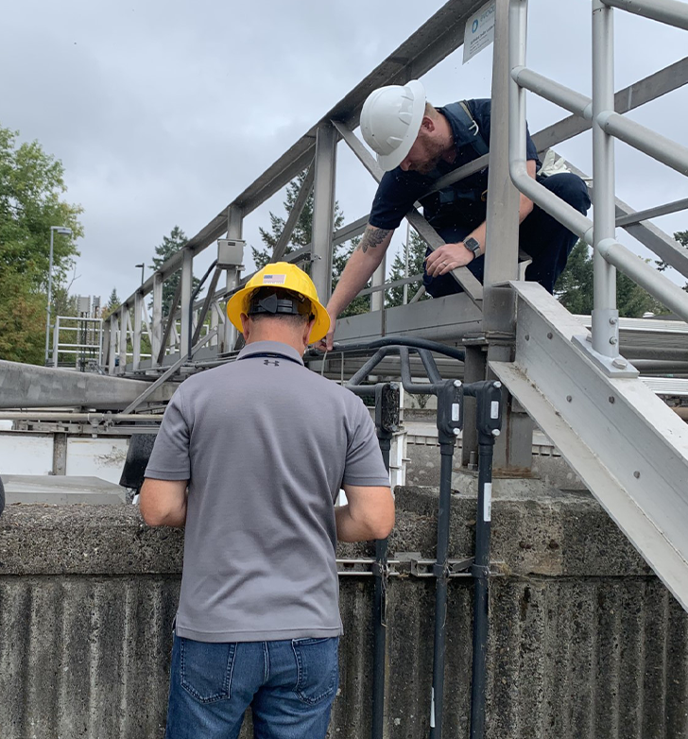
Entry Supervisor Role (continued)
The entry supervisor is also responsible for:
Verifying rescue services are available and the process to call them is working correctly.
Removing any unauthorized person who tries to enter the permit space during entry operations.
Ensuring all the correct information is on the permit, the necessary tests have been conducted, and all procedures and equipment are in place before they allow any entries.
Reevaluating the PRCS conditions whenever necessary based on the hazards and work performed in the space.
CONFINED SPACE SAFETY:
permit-required

Slide 43
Entrant Roles Example
Working in a confined space in summer, the entrant’s specific task exposes him to extreme heat and flammable vapors causing it to become classified as permit-required. The entry supervisor has informed both the entrant and attendant about the specific signs, symptoms, and consequences of exposure to the hazards.
During the course of the entry, the summer heat increases considerably, raising the temperature inside the confined space. The entrant and attendant are in communication with each other, and the entrant mentions the increase of heat in his confined work area. The entry supervisor requests a temperature reading of the space. It shows the temperature is approaching the limit of what the entry supervisor has control measures for, so she terminates the entry and cancels the permit while the attendant ensures the entrant evacuates immediately.
CONFINED SPACE SAFETY:
permit-required

Slide 44
Additional Roles
There may be additional roles that your specific work task and permit space requires. For example, sometimes companies have an additional person on duty whose only role is to continuously monitor the air for the entire duration of the entry operations. And some companies have a protocol of having two attendants on duty for each permit space.
CONFINED SPACE SAFETY:
permit-required

Slide 45
Module 2 Overview
That wraps up Module 2! We discussed:
How a confined space gets classified into a permit-required confined space (PRCS) based on the atmospheric, configuration, engulfment, or other recognized hazards that may be present.
The written program must include everything about how to enter and work in the permit space safely.
Information each entry permit must contain, including the results of atmospheric tests and what equipment is provided for safe entry and work.
Roles and responsibilities of entrants, attendants, and entry supervisors and that each of them must know the hazards of the space, and the signs and symptoms of exposure to those hazards.
Continue to Module 3 to learn about equipment and rescue operations!
CONFINED SPACE SAFETY:
permit-required

Slide 46
CONFINED SPACE SAFETY
Module 3: Equipment & Rescue

Slide 47
Welcome to Module 3
In the previous module, we covered permit-required confined spaces and some of the potential hazards that workers could be exposed to within those spaces. In this module, we will discuss:
Equipment to be provided by employers for safe entry operations into permit spaces
Rescue options
Rescue requirements
Let’s get started.
CONFINED SPACE SAFETY:
equipment & rescue

Slide 48
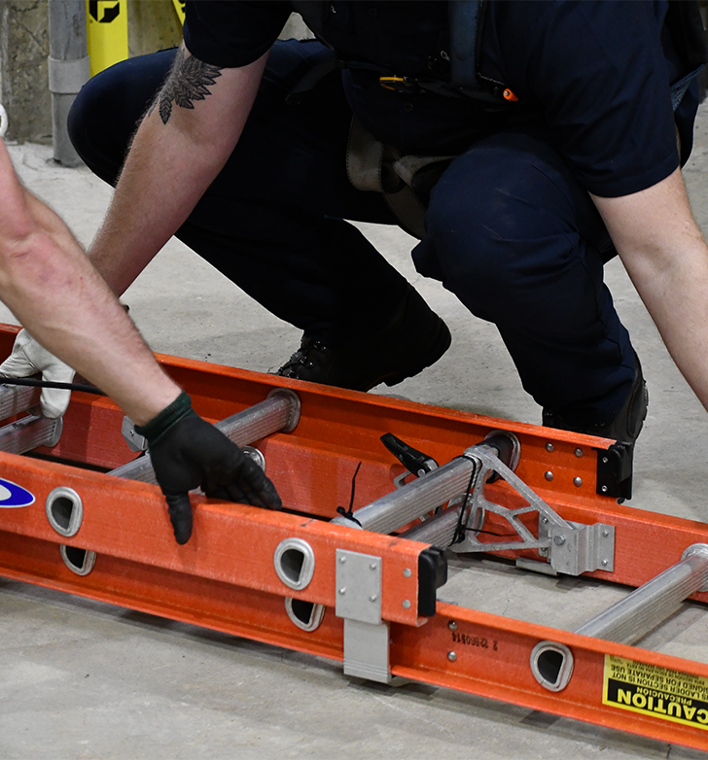
Equipment
When equipment is needed for entering and/or working in permit-required confined spaces, the rule requires employers to:
Provide all necessary equipment at no cost to employees.
Train employees on how to use the equipment.
Ensure all equipment is maintained and used in accordance with the manufacturer’s instructions.
Equipment needs will differ from space to space, depending on variables such as location, orientation (vertical or horizontal), work task(s), and the hazards associated with each. However, the rule outlines some of the specific equipment that must be provided (when necessary) by the employer to ensure employees can safely enter and work within a permit-required space.
We will go through the list of equipment (including examples) in the next few slides.
CONFINED SPACE SAFETY:
equipment & rescue
Notes:
1) List of equipment: https://osha.oregon.gov/OSHARules/div2/div2J.pdf#page=37

Slide 49
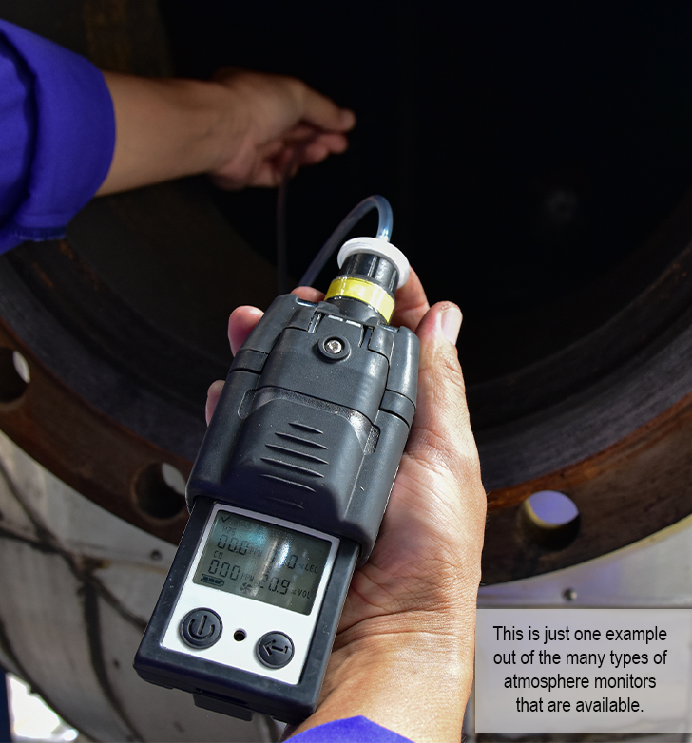
Testing and Monitoring
Testing/monitoring equipment is required to identify the gases present in the confined space’s atmosphere. An example of atmospheric testing equipment is a multi-gas meter which identifies the levels of oxygen, and hazardous gases such as hydrogen sulfide and methane.
A multi-gas meter is commonly used when workers access storm drains or sewer spaces because hydrogen sulfide occurs naturally in these types of areas, and is highly flammable and toxic. It is heavier than air so it accumulates in lower spaces such as a manhole, causing a hazardous atmosphere for workers. The multi-gas meter can be used to initially test the air, and then be worn by the entrant for the duration of the work while inside the confined space. An alarm is activated when the meter detects any gas reaching a preset warning level, prompting the entrant to evacuate the space immediately.
CONFINED SPACE SAFETY:
equipment & rescue

Slide 50
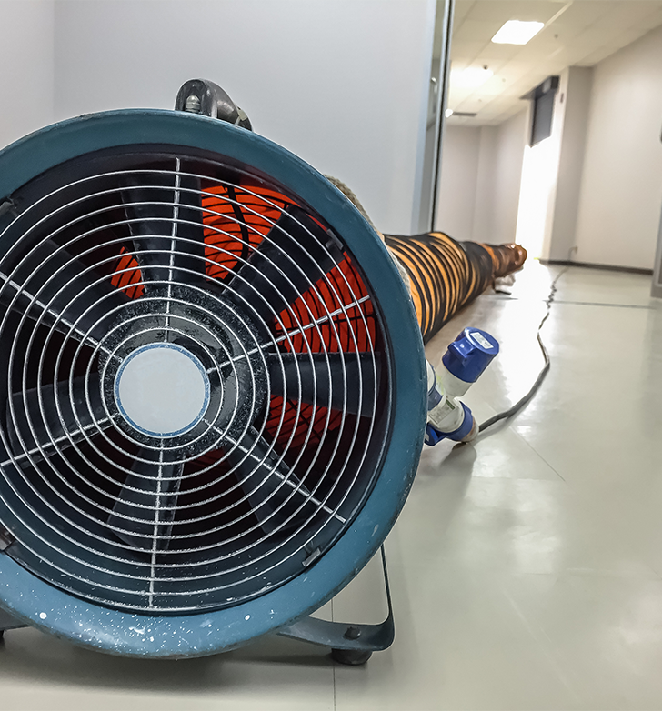
Ventilation
Ventilating equipment is used to obtain and maintain acceptable entry conditions.
An example of ventilation equipment is a vent fan and duct hose. This is commonly used in a confined space to exchange the toxic air out of the space with clean air. Sometimes one fan and duct is enough to exchange the air; other situations require more.
Keep in mind that it is necessary to keep the area clean and clear, while pumping air in. If a vehicle is idling next to the intake fan, carbon monoxide could be pumped into the confined space, creating yet another hazard.
CONFINED SPACE SAFETY:
equipment & rescue

Slide 51
Communication and Lighting
Effective communication between the attendant and all entrants is vital to initiating a rescue when necessary. Using two-way radios to connect the entrant and attendant can be an excellent solution. Some companies utilize earmuffs that have built-in radios, which also provide hearing protection.
Lighting equipment is needed to ensure employees can see well enough to work safely and exit the space quickly if there is an emergency. In some scenarios, a headlamp is enough to ensure safe working and exit conditions. In other scenarios, lighting equipment such as a light tower must be brought into the space to provide adequate visibility.
CONFINED SPACE SAFETY:
equipment & rescue

Slide 52
Barriers
Barriers or shields should be used to protect entrants from external hazards, such as pedestrians and vehicles.
Traffic barricades, cones, and tape are often used on the street around the outside of a manhole during entry operations to block people and vehicles from getting too close to the space.
Some breweries utilize safety railings and signs around brewing equipment to keep the area clear so unauthorized employees do not enter the permit space area.
CONFINED SPACE SAFETY:
equipment & rescue
Notes:
2) Traffic barricades: https://osha.oregon.gov/OSHARules/div3/div3G.pdf#page=8

Slide 53
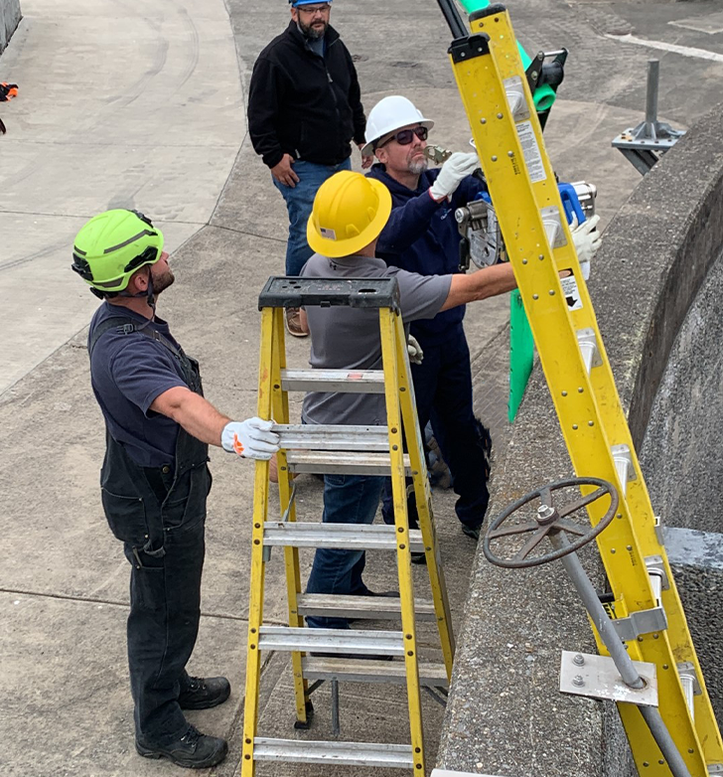
Ladders, Rescue, and Other
Ladders or other equipment to safely enter and exit the space are required. Some spaces may have fixed ladders, such as manholes, while other spaces require ladders to be brought in.
Rescue and emergency equipment which are necessary to safely and effectively rescue entrants must be provided. The equipment needed may vary with each scenario and each space.
Depending on the specific situation, there may be additional equipment necessary. In those cases, employers must make sure to provide any other equipment that is required to keep employees safe as they enter and exit the confined space. This would be identified during the evaluation and outlined in the entry permit.
CONFINED SPACE SAFETY:
equipment & rescue

Slide 54
Personal Protective Equipment
Personal protective equipment (PPE) as mandated by any applicable Oregon OSHA standard or as otherwise required by the employer’s assessment of the hazards must be provided to the employees.
For example, an airline respirator may be required in addition with the ventilation equipment that is already in use, or maybe it’s a hard hat and fall protection harness. Any necessary PPE should be identified during the evaluation, listed on the entry permit, and provided by the employer.
CONFINED SPACE SAFETY:
equipment & rescue

Slide 55
Equipment Summary
This concludes the requirements that are outlined in OAR 437-002-0146(7) for the equipment that employers are required to provide for their employees to safely work in confined spaces.
Many different types of equipment exist, for many different types of scenarios. It is important to ensure:
The right equipment is used for the job.
All equipment is in working order and is maintained according to the manufacturer’s guidelines.
Employees understand how to use the equipment.
Now let’s go over the rescue requirements outlined in the rule!
CONFINED SPACE SAFETY:
equipment & rescue

Slide 56
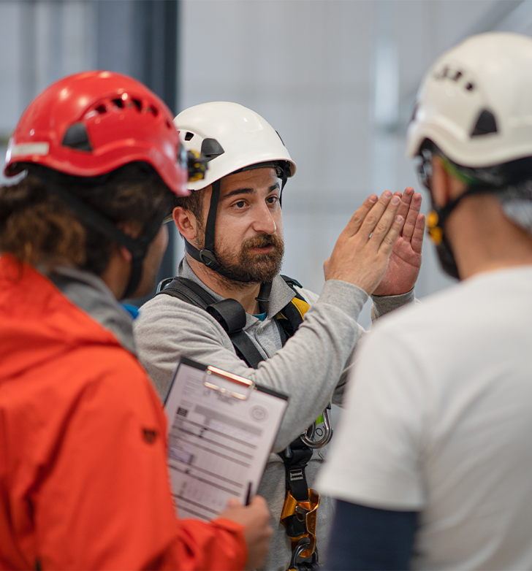
Rescue
The ultimate goal when working in a confined space is that rescue will not be necessary. Oregon OSHA requires a comprehensive evaluation, permit program, and proper equipment to eliminate the need for rescue as much as possible. However, conditions can change unexpectedly, and unforeseen circumstances can occur; therefore, we must also plan and prepare for rescuing entrants when working with permit spaces.
There are two options for rescue:
Non-entry
Entry
We’ll discuss more about each of these options, but first let’s look at the general rule requirements for rescue.
CONFINED SPACE SAFETY:
equipment & rescue
Notes:
3) Rule Requirements: https://osha.oregon.gov/OSHARules/div2/div2J.pdf#page=40

Slide 57
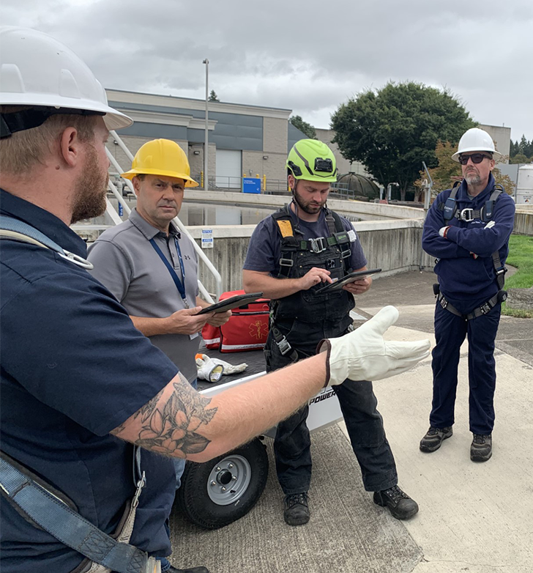
Rescue Requirements
Before employees enter a permit space, procedures must be developed to remove entrants in the event of an emergency, or if they cannot evacuate the space without outside assistance. The procedures must include:
The process for summoning rescue services.
The process for summoning emergency medical services or transporting injured entrants to a medical facility.
Providing the onsite safety data sheets to medical personnel for any substances the entrant was exposed to during their entry.
When planning for rescue services to arrive, make sure they can respond to a call in a timely manner. The rescuers must be able to reach the victims within an appropriate time frame based on the identified hazards of the permit space. This might change with each entry depending on what type of work is being done, which space is being entered, etc.
CONFINED SPACE SAFETY:
equipment & rescue

Slide 58
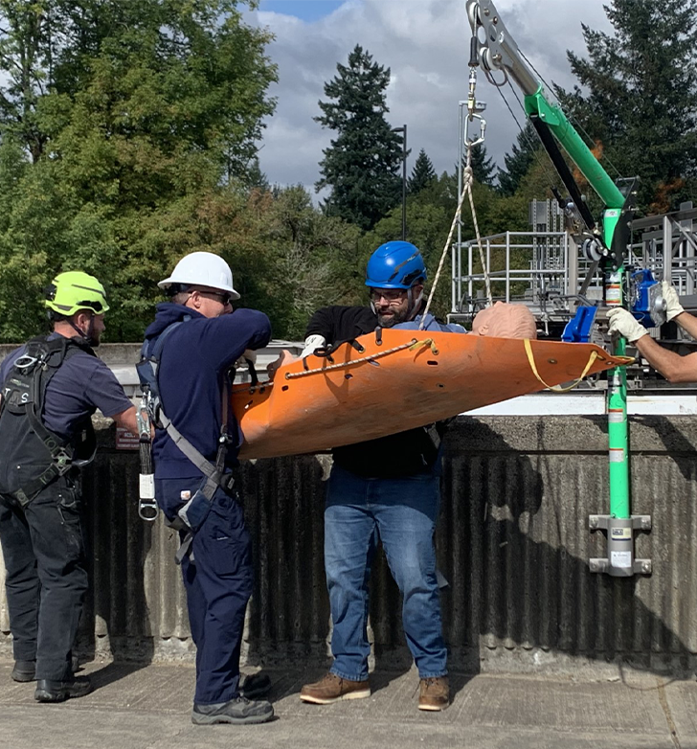
Rescue Requirements (continued)
Practicing the rescue procedures is imperative so the rescue team can react quickly and efficiently if an emergency occurs. During practice, the team learns how the equipment works, how and where to set up the equipment, and who is responsible for each piece in the rescue process. Practicing the procedures can increase efficiency and reduce the amount of time in an actual rescue, which can make all the difference in saving lives.
Rescue practice is required in the rule. At minimum, rescuers must practice performing a permit space rescue within 12 months prior to an entry into a permit space. They also must practice:
From every type of space the rescue team may perform rescues.
Removing people (or mannequins) from the actual permit space or a simulated one that has similar opening size, configuration, and accessibility issues as the permit space.
All rescuers, regardless of entry/non-entry rescue option used, must be knowledgeable in basic first aid and CPR, and at least one member of the rescue team must be certified in first aid and CPR.
Now let’s learn about these rescue options.
CONFINED SPACE SAFETY:
equipment & rescue

Slide 59
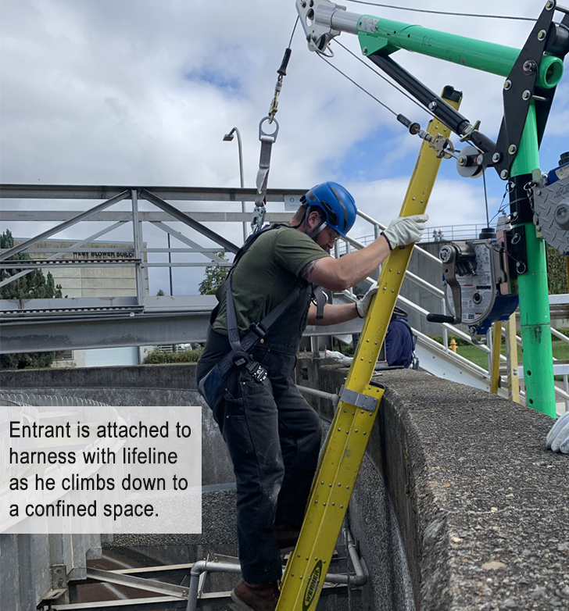
Non-Entry Rescue
Non-entry rescue option is defined as the retrieval of entrants from a permit space without entering the permit space.
If the entrant can be rescued without anyone else entering the permit space and without increasing risk to the entrant, go with the non-entry rescue option when possible.
If this is the method chosen, then the entrant must use a chest harness or full body harness before entering the space. The harness must have a retrieval line attached and the other end of the line should be attached to a mechanical device or fixed anchor point outside the permit space. This allows rescue to begin as soon as the attendant becomes aware that rescue is necessary. If it is a vertical type permit space more than 5 feet deep, ensure a mechanical device is available for retrieving the entrant(s).
CONFINED SPACE SAFETY:
equipment & rescue

Slide 60
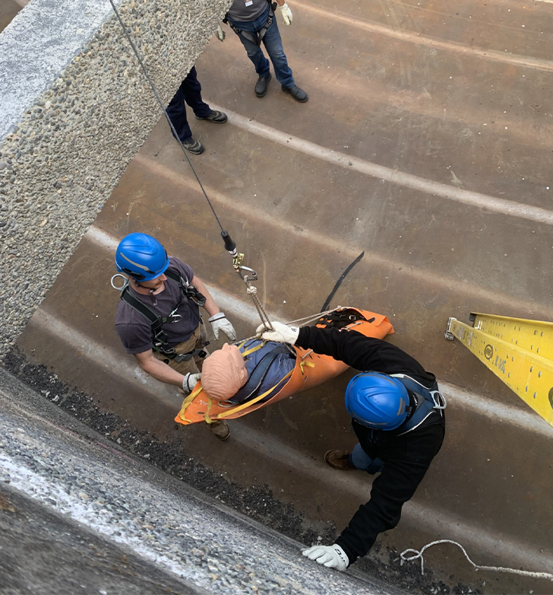
Entry Rescue
When non-entry rescue isn’t feasible, or would increase risk to the entrant, ensure a rescue team is designated, has practiced, and are efficient in their rescue processes before any employees enter the permit space.
The rescue team members must have:
Access to all permit spaces.
All the appropriate equipment to rescue employees from the permit spaces, including any PPE that is needed.
The same training as the entrant, attendant, and/or entry supervisor.
Information of all the permit space hazards they may confront during rescue.
If a third-party rescue service is used, make sure they are:
Aware of their designation as such and agreed to it. (Getting their agreement in writing is recommended!)
Capable of performing the rescue operations.
Knowledgeable in CPR and first aid, with at least one member certified in both.
CONFINED SPACE SAFETY:
equipment & rescue

Slide 61
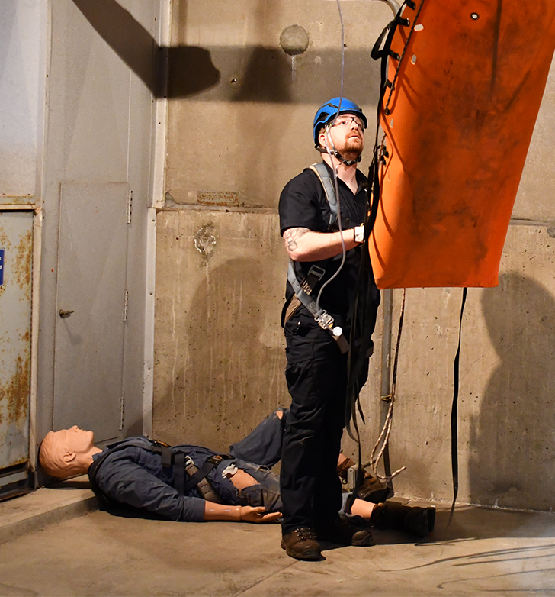
Example – Practice Rescue
The next slide is a video of a confined space practice rescue by employees of a wastewater management company in northwest Oregon. This company has many permit-required confined spaces and they practice various rescue scenarios multiple times a year. Watch the video to learn about their process and the value gained from practicing confined space rescues.
CONFINED SPACE SAFETY:
equipment & rescue

Slide 62
Video: Practicing Confined Space Rescues
CONFINED SPACE SAFETY:
equipment & rescue
Notes:
Practicing Confined Space Rescues: https://vimeo.com/926078102

Slide 63
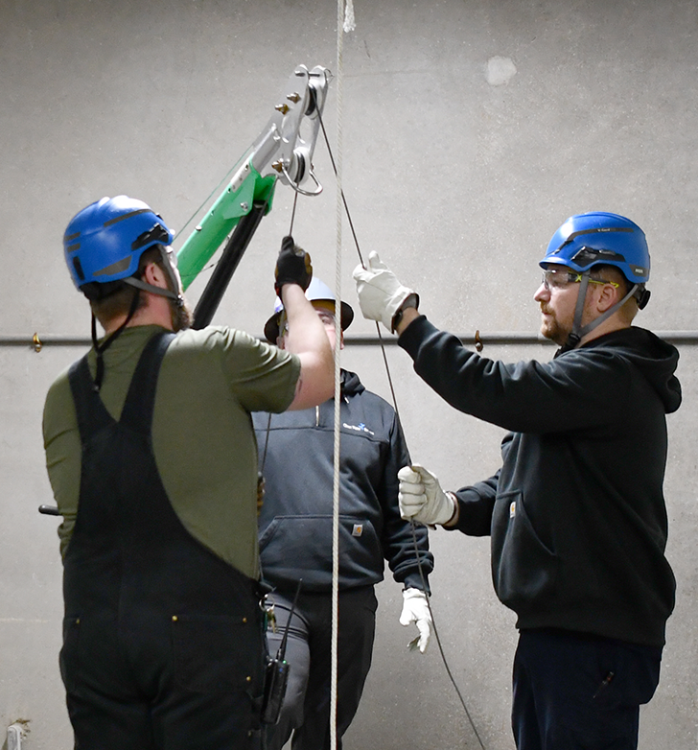
Video Summary
As seen in the practice rescue video interviews, employees involved in the company’s Confined Space Rescue (CSR) team joined because they understand the importance of:
Knowing the hazards of the various confined spaces of their work environment.
Being prepared to work safely with those hazards and spaces.
Quickly responding to an emergency situation.
The CSR team embraces the idea that the more they practice, the better prepared they will be to respond in an emergency situation. As they stated, even with practicing often, they continue to gain more knowledge with each and every practice. Gathering together as a team after the practice session helps to solidify their learning and provides an opportunity to discuss questions and share ideas to keep improving.
CONFINED SPACE SAFETY:
equipment & rescue

Slide 64
Module 3 Overview
This wraps up our discussion on equipment and rescue. In this module, we covered:
Types of equipment employers are required to provide to ensure safe working conditions in permit spaces.
Entry and non-entry rescue options.
How a practice rescue can be conducted and the importance of being prepared for rescuing entrants whether it is by entry or non-entry methods.
Go to the next module to learn about training requirements and alternate entry.
CONFINED SPACE SAFETY:
equipment & rescue

Slide 65
CONFINED SPACE SAFETY
Module 4: Training & Alternate Entry

Slide 66
Welcome to Module 4
So far in the course, we have discussed:
The initial evaluation of a confined space (Module 1).
Permits and program requirements for permit-required confined spaces and entry roles (Module 2).
Types of equipment that employers must provide, rescue requirements, and practicing rescues (Module 3).
Now, in Module 4 we will go over:
Training requirements
Alternate entry process
Examples of alternate entry scenarios in several Oregon workplaces
CONFINED SPACE SAFETY:
training & alternate entry

Slide 67
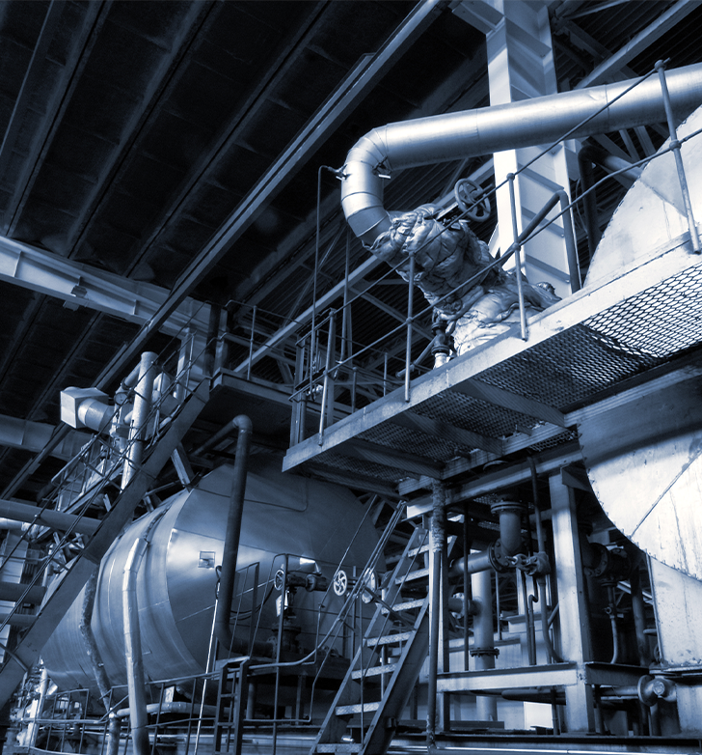
Training
Working in permit-required confined spaces (PRCS) is dangerous, and there are many different scenarios and unique hazards associated with each. As such, there are precautions that must be taken to keep workers safe within each specific space and work situation. The rule requires training for all employees who are involved in permit space activities to ensure they have the understanding and skills necessary to safely perform their duties.
Let’s go through the training requirements next.
CONFINED SPACE SAFETY:
training & alternate entry
Notes:
1) Training requirements: https://osha.oregon.gov/OSHARules/div2/div2J.pdf#page=45

Slide 68
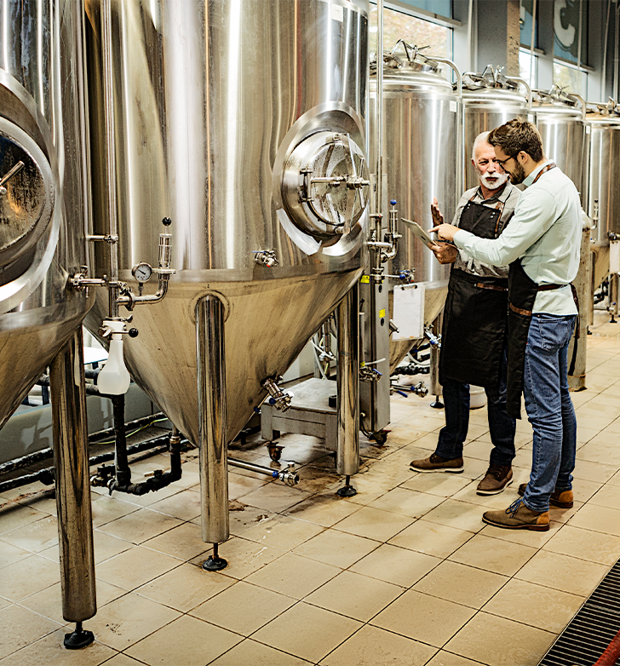
Training Requirements
How the training is conducted is up to the employer, but they must ensure that each employee is proficient in their assigned duties. The training must be documented with:
Employee’s name
Trainer’s name and signature
Date of the training
Which responsibilities were trained, such as entrant or attendant duties
(Continued on the next slide.)
CONFINED SPACE SAFETY:
training & alternate entry

Slide 69
Training Requirements (continued)
The training must be provided for all new employees, plus:
Before an employee is assigned permit space duties.
Before there is a change in an employee’s assigned duties.
When there is a hazard that the employee hasn’t yet received training for or when there’s a change in the hazards of an existing confined space.
When there are changes to the permit program.
When an employee doesn’t have adequate knowledge of the procedures.
When it is deemed necessary during the evaluation of the permit.*
*Keep in mind that permits must be evaluated within a year of completion. This evaluation helps to note any deficiencies of the program or issues that came up during the entry so that they can be fixed and employees stay safe!
CONFINED SPACE SAFETY:
training & alternate entry

Slide 70
Awareness Training
The goal of awareness training is to provide a basic overview of the permit space program and entry permit system (or the alternate entry procedures if applicable). Awareness training is required for all employees whose work operations are, or might be, in an area where permit spaces are present.
For example, a brewery with a restaurant has many PRCS at its location with brewing equipment of kettles, tanks, boilers, etc. There are specific teams that work inside the permit spaces and have been fully trained to do so, such as the brewmaster and maintenance staff. They follow the written permit program and permit entry processes.
However, there are additional staff, such as the restaurant servers and cleaning crew, whose daily duties bring them around the permit spaces. Although these employees don’t perform any work inside the spaces, they could be exposed to the hazards associated with the PRCS so they are required to receive awareness training. In the awareness training, they learn about specific entry programs and processes and that only personnel with full training and authorization may conduct. (Continued on the next slide.)
CONFINED SPACE SAFETY:
training & alternate entry

Slide 71
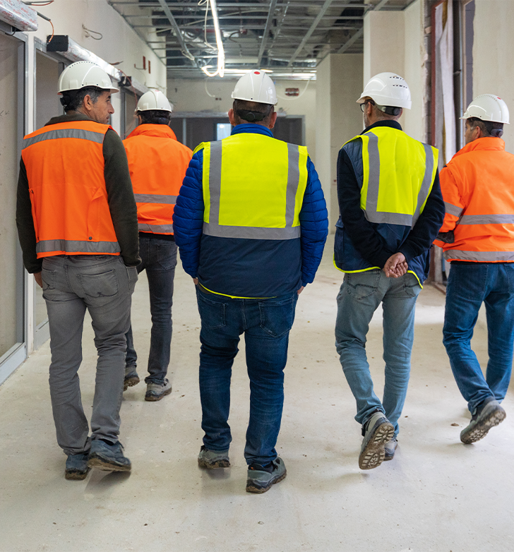
Awareness Training (continued)
The awareness training must be provided:
For all new employees who are affected.
For all employees whose duties change to include work in areas with permit spaces.
When an employee lacks knowledge or understanding of the required information.
When there is a change in the permit program.
When there are new or previously unidentified permit spaces.
Ensure that all employees understand how to recognize permit spaces in their work area. As discussed earlier in the course, the rule requires a method in place so employees can identify permit spaces, such as using labels or signs.
CONFINED SPACE SAFETY:
training & alternate entry
Notes:
2) Identify permit spaces: https://osha.oregon.gov/OSHARules/div2/div2J.pdf#page=32

Slide 72
Training Overview
That wraps up the training requirements for employees working in permit spaces, and the awareness training for employees who are not directly involved with confined space work but might be exposed to the hazards. At this point, we have covered the requirements of the Confined Spaces rule for working in a permit-required confined space.
However, there is another option! Let’s explore the alternate entry requirements next.
CONFINED SPACE SAFETY:
training & alternate entry

Slide 73
Alternate Entry
“Alternate entry” is an alternative process for entering a permit space without a permit under very specific conditions. The space remains a permit space and there are important prerequisites that must be met before the space can be entered with the alternate entry option.
First and foremost, to enter a permit space without a permit, you must ensure:
All hazards are eliminated, or
All physical hazards are eliminated and all atmospheric hazards are controlled with continuous ventilation.
CONFINED SPACE SAFETY:
training & alternate entry
Notes:
3) pd-062.pdf (oregon.gov)

Slide 74
Alternate Entry Procedures
Specific alternate entry procedures must be developed and implemented for each space to show how the hazards will be eliminated/controlled. The alternate entry procedures must address:
Who is responsible for ensuring safe entry conditions and authorizing alternate entry procedures.
Hazards of the space.
Methods used to eliminate the hazards and methods used to ensure those hazards have been eliminated.
Methods used to test the atmosphere of the space, where applicable.
How to determine if unsafe conditions arise before or during entry.
Criteria and conditions for evacuating the space during entry.
Methods for training employees in the procedures.
How to ensure employees follow the procedures.
Go to the next slide for an example of an alternate entry at an Oregon workplace.
CONFINED SPACE SAFETY:
training & alternate entry

Slide 75
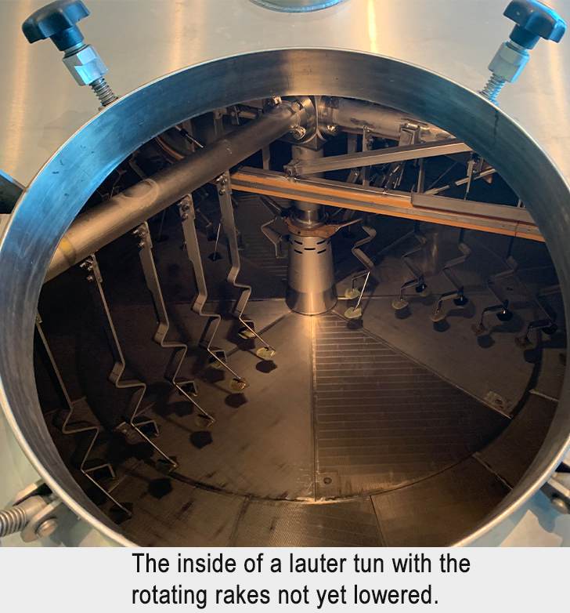
Example – Alternate Entry
A brewery in Deschutes County has a vessel that requires work on a weekly basis and the space meets the criteria for a permit-required confined space. However, the brewery has documented the following procedures to eliminate all hazards so it can be an alternate entry:
Rotating rakes in the vessel (lauter tun) are lowered to the lowest position and locked out, eliminating mechanical and gravity hazards.
Steam jackets are locked out and temperature verified to eliminate thermal hazard.
Process piping is double blocked and bled to prevent any chemical or hot water from spraying into the space, eliminating the chemical/hot water hazard.
Atmosphere is tested and monitored, but there are no atmospheric hazards anticipated as there are no gases plumbed to the brewhouse and no fermentation occurring, so no byproduct gases produced. Since there is no atmospheric hazard, continuous ventilation is not required.
(Continued on next slide.)
CONFINED SPACE SAFETY:
training & alternate entry
Notes:
4) Double blocked and bled: https://osha.oregon.gov/OSHARules/div2/div2J.pdf#page=27

Slide 76
Example – Alternate Entry (continued)
Each time the employees enter this space, they fill out their company’s alternate entry form and follow all procedures. The forms are reviewed by the safety manager on a weekly basis to ensure the information is correctly entered and employees understand the protocols.
CONFINED SPACE SAFETY:
training & alternate entry

Slide 77
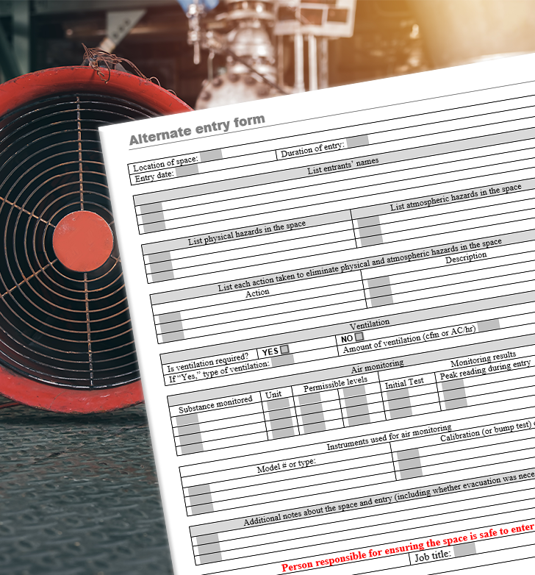
Alternate Entry Documentation
Similar to the permit entry, each alternate entry must be documented and maintained at the location of the entry. (Click here for a sample template.) However, for alternate entry, the document is only required to be kept for the duration of the entry. It must include:
Location of the space.
Hazards of the space.
Measures taken to eliminate hazards (or eliminate physical hazards and control atmospheric hazards).
The atmosphere monitoring instruments and testing results.
Date and duration of entry.
Any and all conditions that required evacuation of the space.
Name, title, and signature of the person responsible for ensuring safe entry conditions.
Some companies choose to keep the document longer and include it with their evaluation of confined space entry permits. Read an example of this on the next slide.
CONFINED SPACE SAFETY:
training & alternate entry

Slide 78
Example – Alternate Entry Documentation
Employees working for a water treatment company in Washington County frequently work in permit-required confined spaces. For some scenarios they follow the permit process, and for other situations they are able to utilize alternate entry.
They keep the permits and documents for both types of entry operations. The lead safety analyst reviews the entry documents quarterly to evaluate the effectiveness of the processes for both permit entry and alternate entry. She identifies and implements any training necessary. The document review is not required for the alternate entry process, but it certainly is a good practice to evaluate programs on a continual basis to improve safety.
CONFINED SPACE SAFETY:
training & alternate entry

Slide 79
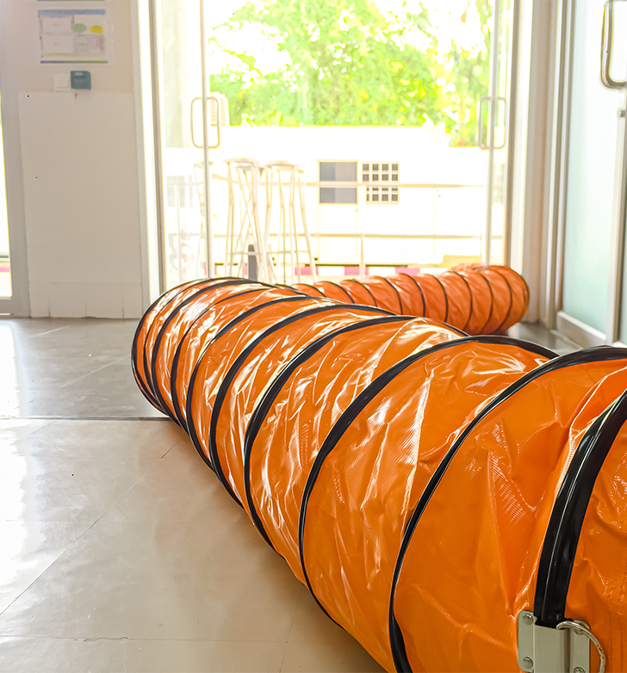
Ventilation for Alternate Entry
If there are atmospheric hazards in the permit space which cannot be eliminated, you must use continuous ventilation to control it. When doing so:
Use only properly calibrated direct-reading meters to test the atmosphere.
Test for all identified atmospheric hazards before entering the space.
Do not allow employees to enter until testing verifies that all identified atmospheric hazards are adequately controlled by the ventilation.
Perform continuous monitoring for all atmospheric hazards during the entry.
You must immediately evacuate the space when:
The monitoring indicates the return of atmospheric hazards.
A new hazard is introduced or conditions change.
The atmospheric testing equipment fails.
There is any failure with the ventilation.
CONFINED SPACE SAFETY:
training & alternate entry

Slide 80
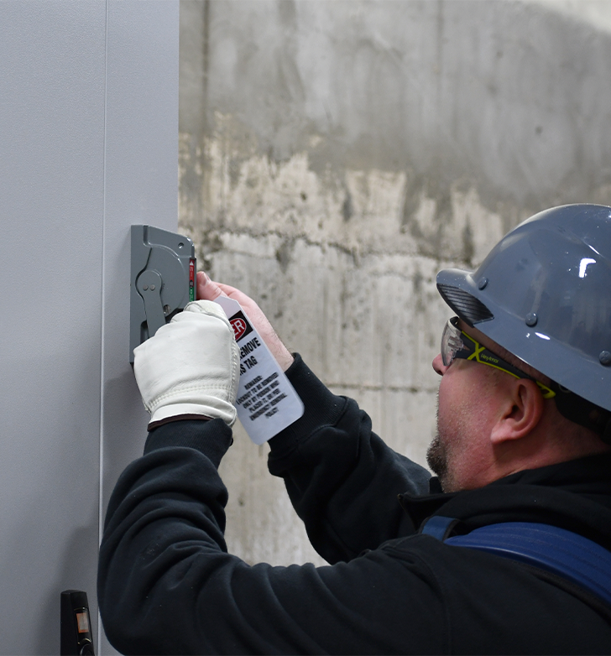
Observe and Communicate
Just as it is with the permit program, all employees (or their representatives) who will be entering the spaces under alternate entry must be allowed the opportunity to observe all activities. For example, they could:
Attend the discussions on how the hazards will be eliminated and mitigated.
Watch the atmospheric monitoring equipment being calibrated.
Observe the atmosphere being tested.
Participate in the elimination of physical hazards, such as performing a lockout or double blocking/bleeding of a pipe. (Note: The entrant’s lock or a group lock for the entire team would be required. Learn more about lockout/tagout here.)
Just as in the permit program, all employees who are entering the space under alternate entry must be provided with an effective means of communication. This is anything that would be effective in summoning help if the need should arise. Continue to the next slide to see how one company handles these requirements.
CONFINED SPACE SAFETY:
training & alternate entry
Notes:
5) Lockout/Tagout: https://osha.oregon.gov/Pages/topics/control-of-hazardous-energy.aspx

Slide 81
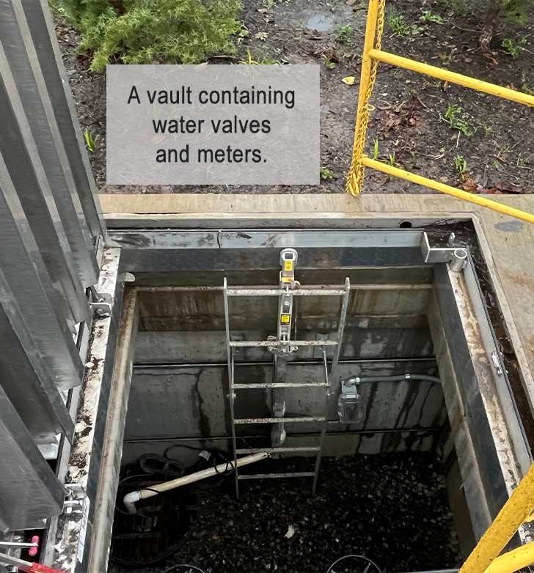
Example – Observe and Communicate
A company that works on the public’s drinking water supply pipes in Washington County occasionally performs maintenance on meters and valves located in vaults. The vaults meet the criteria for a PRCS, but following the company’s documented procedures, they are able to use alternate entry for their work.
The team, including the entrants themselves, double block and bleed the pipes, perform lockout/tagout, and test the atmosphere in the vault. Since the entrants participate in eliminating the hazards of the space, they have firsthand knowledge when it qualifies for alternate entry, exceeding the observation requirement.
The rule does not require an attendant present for alternate entry; however, this company’s protocol includes having an attendant present when vault work is in progress. The entrant and attendant are close enough in proximity to communicate without the need for extra equipment, although each employee is also required to have their company-issued mobile phone with them. This concerted safety effort more than fulfills the “effective means of communication” requirement.
CONFINED SPACE SAFETY:
training & alternate entry

Slide 82
Evacuation
When a space is evacuated, it cannot be entered again as an alternate entry unless:
All the conditions that made the evacuation necessary are corrected and
The re-entry is treated and documented as a new entry.
This means ensuring all physical hazards have been eliminated and atmospheric hazards have been eliminated or controlled with continuous ventilation. The atmosphere must be tested again, the test results documented, and continuous air monitoring is in place during the new entry (when applicable).
CONFINED SPACE SAFETY:
training & alternate entry

Slide 83
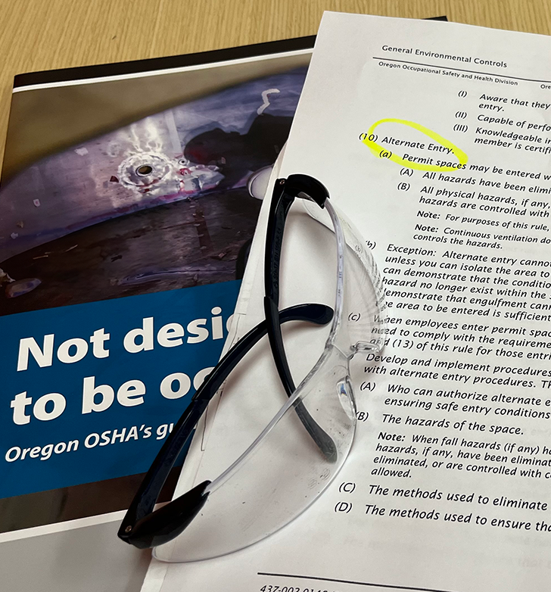
Alternate Entry Rule Requirements
As we have discussed, alternate entry work in a permit space has its specific requirements. Therefore, some of the components we have covered in the Confined Spaces rule are not applicable when using alternate entry. For example, since all the physical hazards must be eliminated and all atmospheric hazards must be eliminated and/or controlled in order to use alternate entry, there should be no reason a rescue would be needed. As such, the rescue section is not applicable for alternate entry.
When using alternate entry to enter a permit space, the paragraphs in the rule that still apply are:
(1-3) Purpose, Exceptions, Definitions
(4) Evaluation
(7) Equipment
(10) Alternate Entry
(11) Training
Click here to read through exceptions for the alternate entry option.
CONFINED SPACE SAFETY:
training & alternate entry
Notes:
6) Alt Entry exceptions: https://osha.oregon.gov/OSHARules/div2/div2J.pdf#page=43

Slide 84
Module 4 Overview
We have completed our coverage of the Confined Spaces rule that applies to general industry, construction, and forest activities. In this module, we discussed:
Training requirements.
Specific requirements to temporarily enter a permit-required confined space following alternate entry procedures.
Examples of alternate entry in a variety of Oregon workplaces.
There is only one module left in the course! Continue to Module 5 to learn about the Confined Spaces rule for agriculture, and then take the quiz at the end.
CONFINED SPACE SAFETY:
training & alternate entry

Slide 85
Module 5: Agriculture & Conclusion
CONFINED SPACE SAFETY

Slide 86
Welcome to Module 5
Now that we have covered the requirements in OAR 437-002-0146, it is time to discuss requirements for work that falls under Division 4 (Agriculture) OAR 437-004-1250, Confined and Hazardous Spaces.
This rule does not have classifications for “permit-required” or alternate entry. So what does it have? Let’s find out! We will go over the Division 4:
Definitions
Entry requirements
IDLH (immediately dangerous to life or health) atmospheres and examples
Training and rescue requirements
Note: At the end of this module, there is a short quiz to earn a certificate of completion for Confined Space Safety.
CONFINED SPACE SAFETY:
agriculture & conclusion
Notes:
Confined and hazardous spaces: https://osha.oregon.gov/OSHARules/div4/div4J.pdf#page=54

Slide 87
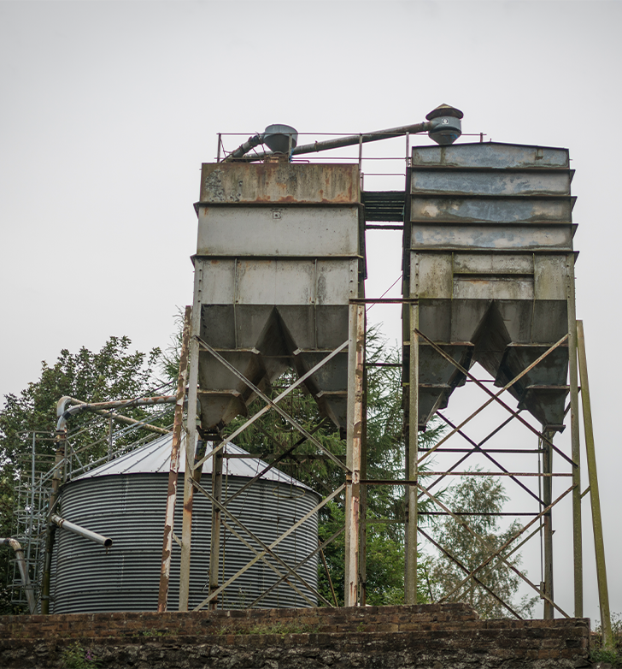
Definitions
Let us start with some definitions. The three criteria that define a confined space in the other rule still hold true in the Division 4 rule. A confined space is a space that:
Is large enough and so configured that an employee can bodily enter and work; and
Has limited or restricted entry or exit (for example, tanks, vessels, silos, storage bins, hoppers, vaults, and pits may have limited entry); and
Is not designed for continuous employee occupancy.
There is only one personnel role that is defined in this rule.
Competent person: identifies existing and predictable hazards and takes measures to eliminate them.
CONFINED SPACE SAFETY:
agriculture & conclusion

Slide 88
Definitions (continued)
The final terms to cover are engulfment and entrapment which are often used interchangeably.
Engulfment: The covering of a person by a liquid or finely divided (flowable) solid substance that when inhaled causes death or that can exert enough force on the body to cause death by strangulation, constriction, or crushing.
Entrapment: This is not defined in the rule, but it is similar to the above definition which is why both terms are used interchangeably. A person can become trapped by any solid or liquid material (does not have to be ‘flowable’, and does not necessarily cover the person’s head) and the force of materials can cause death or injury by constriction or crushing.
In agriculture, these hazards can be found where there are large bins used for storing livestock feed or hoppers of production crops such as hazelnuts, corn, or even onions. The next slide has a story about an accident that happened in eastern Oregon involving an employee and a close call with entrapment by onions.
CONFINED SPACE SAFETY:
agriculture & conclusion

Slide 89
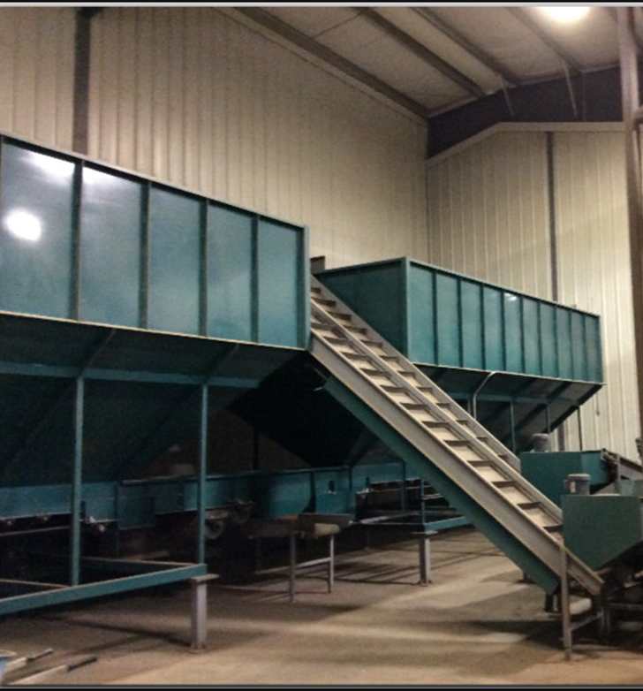
Example – Entrapment
It was a sunny July morning in Umatilla County. Employees at the receiving area of an onion facility were getting the product ready to go to a processing center. The hopper bin was so full of onions that the bottom opening became plugged. Employee 1 climbed a ladder to the top of the hopper bin, and started walking on top of the onions to try to force them down.
At the same time, another worker on the outside of the bin started manually pulling onions from the opening at the bottom. The clog freed, and the onions started flowing. The sudden flow pulled Employee 1 further into the bin, trapping him within the onions and he could not pull himself out. There was a 12-inch opening at the bottom of the bin where the onions were flowing out of and Employee 1 was stuck there with one foot on either side of the opening. He was unable to call for help as he was completely trapped, with the weight of the onions putting more and more pressure on his body.
(Continued on next slide.)
CONFINED SPACE SAFETY:
agriculture & conclusion

Slide 90
Example – Entrapment (continued)
The employees outside of the hopper had no idea their co-worker was in trouble until they saw his shoes near that lower opening!
Fortunately, Employee 1 survived this ordeal. He was rescued, taken to a medical facility, and, remarkably, was able to return to work the next day. This could have been a deadly situation; thankfully it was not for this employee.
CONFINED SPACE SAFETY:
agriculture & conclusion

Slide 91
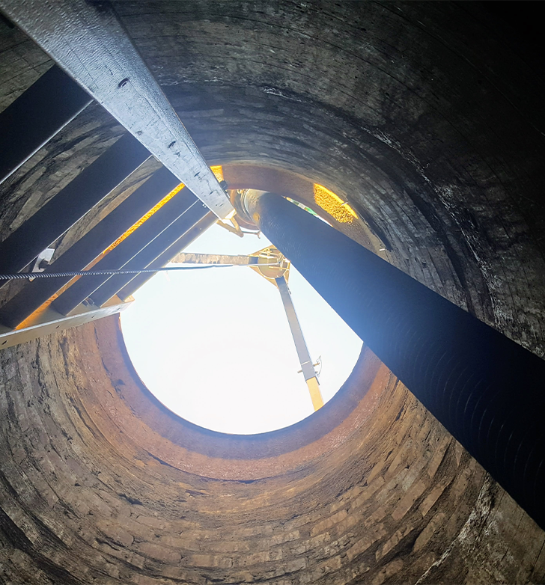
Before Entry
As the previous example and others in the course have shown, it is imperative to know and mitigate the hazards before entering a confined space. Now, let’s discuss the details in the Division 4 rule. There is an order of events lined out in this rule when you need to enter a confined space. The first step is:
Always test the atmosphere in a confined space before an employee places any part of their body into it.
This includes testing first for oxygen, then flammable atmosphere, then toxic atmosphere.
Lack of oxygen can impair a person very quickly, before they can escape. We will take some time to learn about the different types of atmospheres in the next few slides, but first let’s go over the requirements of entering a space with any type of atmosphere that is immediately dangerous to life or health (IDLH).
CONFINED SPACE SAFETY:
agriculture & conclusion
Notes:
2)First step: https://osha.oregon.gov/OSHARules/div4/div4J.pdf#page=50

Slide 92
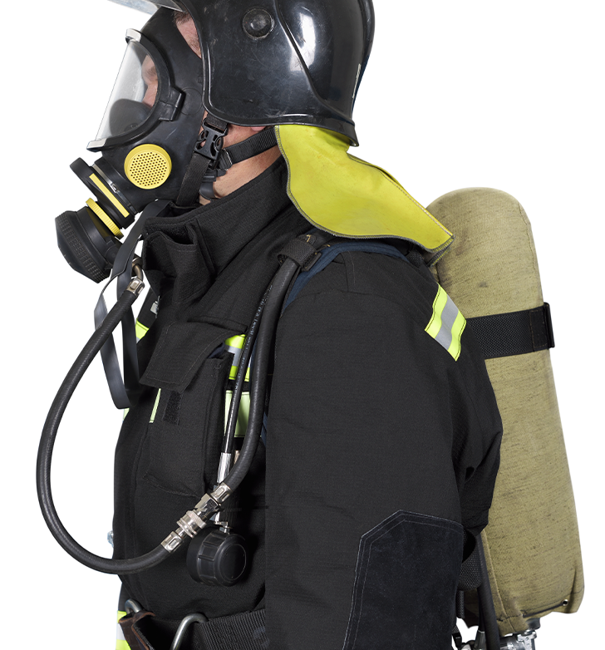
Entry into IDLH Atmospheres
Paragraph (3)(b) states that no person may enter or work in any confined space with an IDLH atmosphere, except under the following (summarized) conditions:
They must wear a supplied air or self-contained air breathing apparatus.
They must wear a safety belt with a lifeline attached, where practical. Another person with supplied air, safety belt, and lifeline attached, must be at the opening with adequate help available to remove the person if necessary.
If the person who entered the space does not respond to agreed upon signals, immediate rescue action must be taken.
The air supplied to equipment must be free from any harmful dusts, fumes, gases, etc.
Supplied air equipment must have an automatic pressure relief valve and connect through a pressure reduction valve.
Ensure at least the minimum volume of air is delivered to the user when using respiratory equipment.
Click here to see the full details of the rule.
CONFINED SPACE SAFETY:
agriculture & conclusion

Slide 93
Oxygen Deficient Atmospheres
If an atmosphere is oxygen deficient, that means there is less than 19.5% oxygen in the space. When the confined space is sealed or unventilated, it is considered IDLH and no one may enter the space unless:
All the safety equipment and procedure requirements listed in Paragraph (3)(b) from the previous slide are met, or
A competent person tests the atmosphere immediately before entry to ensure that the space contains enough oxygen to sustain life inside the space.
CONFINED SPACE SAFETY:
agriculture & conclusion

Slide 94
Flammable or Explosive Atmosphere
Another atmosphere that is considered IDLH is in any sealed or unventilated tank or other confined space that contains, or did contain, combustible or flammable materials or gases. Again, no one may enter such a space unless all the safety procedures are followed from paragraph (3)(b) or atmosphere tests by a competent person show no flammable or explosive atmosphere is present.
If the atmosphere does contain flammable or explosive vapors at or above 20% of the lower explosive limit (LEL), the space must be ventilated enough to bring the level below 20% of the LEL. People who are doing emergency work or are setting up the equipment to get rid of the gas may enter the space after they meet all the requirements listed in Paragraph (3)(e) of the rule.
CONFINED SPACE SAFETY:
agriculture & conclusion
Notes:
Paragraph 3e: https://osha.oregon.gov/OSHARules/div4/div4J.pdf#page=56

Slide 95
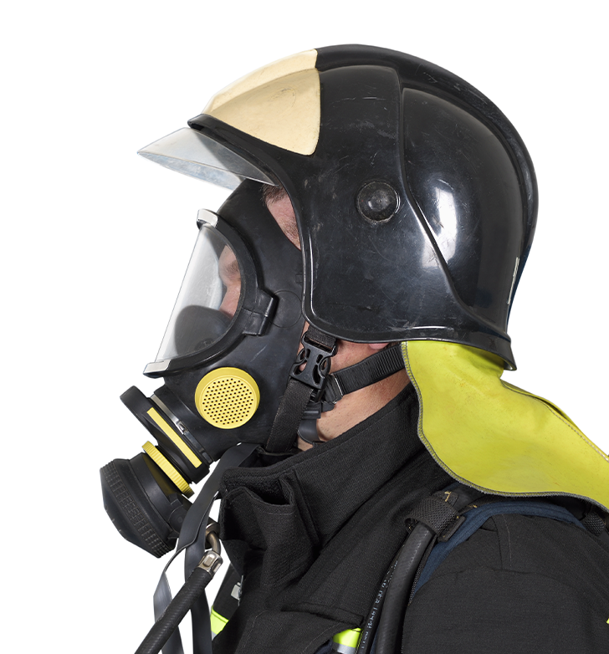
Toxic Atmosphere
If a space is sealed or unventilated that contains, or did contain, toxic materials or gases, no one may enter unless:
All requirements for safety equipment and procedures are met (paragraph (3)(b)), or a competent person tests the atmosphere and finds the contaminants are below the threshold limit values for those particular materials or gases.
If the atmosphere levels of hazardous contaminants are not IDLH but are above the threshold limits, the entrant must wear NIOSH-approved respiratory protective equipment.
Next, let’s look at two examples of IDLH atmospheres.
CONFINED SPACE SAFETY:
agriculture & conclusion

Slide 96
Example – Oxygen-Deficient Atmosphere
An accident that occurred in Hood River County, involved an oxygen-deficient atmosphere in a climate-controlled fruit storage room. The refrigerated rooms have atmospheres with purposely low oxygen levels which help preserve the fruit. An employee entered the space without the air being tested and no entry procedures in place. His co-workers found him hours later, deceased in the refrigerated storage room, unable to resuscitate him. The cause of death was asphyxiation due to low oxygen.
Sadly, death is a common outcome of many confined space accidents, which is why it is so important to know about the hazards and test the atmosphere before entering into a confined or hazardous space.
CONFINED SPACE SAFETY:
agriculture & conclusion

Slide 97
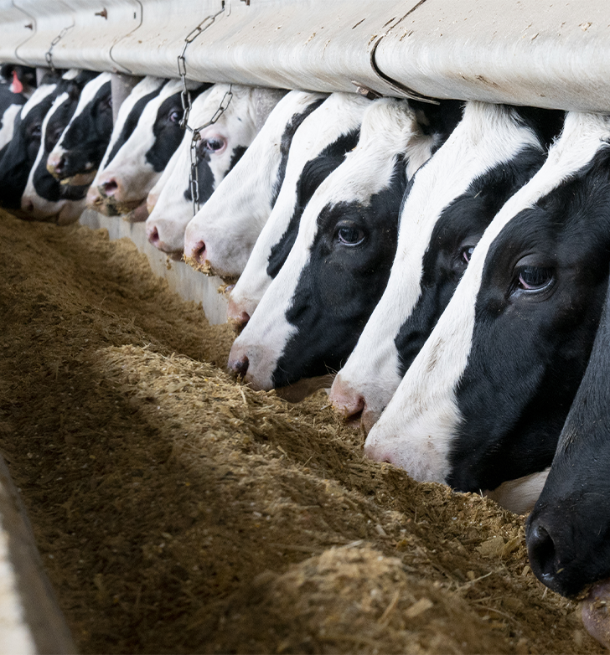
Example – Toxic Atmosphere
Manure storage facilities, many of which are classified as both confined and hazardous spaces, can be above or below ground. The storage tanks or pits are used to store liquid or solid animal waste and farm workers may need to enter the facilities to repair or maintain equipment, such as pumps and intake hoses.
These confined spaces are often oxygen-deficient atmospheres and can contain toxic and/or explosive gases such as hydrogen sulfide, methane, ammonia, and carbon dioxide.
Click here to read about an accident that occurred in a manure storage pit due to a toxic atmosphere.
CONFINED SPACE SAFETY:
agriculture & conclusion

Slide 98
Entry into Confined Spaces
The previous accident examples show the importance of testing the atmosphere before entering a confined space. There are just a few more requirements for entry into confined spaces, which are summarized below. You can read the full details here.
Natural or mechanical ventilation must be used to keep the atmosphere within the permissible limits of explosive or toxic materials and gases while employees are in the space.
Additional testing must be done when there could be explosive or toxic materials released into the confined space.
Lockout/Tagout procedures must be followed before any employees enter a space with physical hazards or intake pipelines.
Safety belts with lifelines and attendants (safety watchers) are required when an employee enters a confined space that has loose material (such as chips, sand, gravel, etc.).
If engulfment by collapsing material is a possible hazard in a confined space, no employees are allowed to enter.
That completes the entry requirements for confined or hazardous spaces in Division 4. Now let’s go through the remaining sections of this rule.
CONFINED SPACE SAFETY:
agriculture & conclusion

Slide 99
Training
The rule requires all workers to be trained before they do any activities that fall under this rule. They also need to be trained any time there are changes in the employee’s duties or changes in the confined/hazardous spaces. The training must:
Cover all hazards associated with the employer’s confined and hazardous spaces.
Cover this rule (OAR 437-004-1250) and all the duties associated with it.
Be documented and kept on record, until a new training is provided and then the documentation of the new training must be kept.
CONFINED SPACE SAFETY:
agriculture & conclusion

Slide 100
Rescue
For employers who have workers who enter confined spaces to rescue people, they must:
Provide each rescuer the personal protective equipment (PPE) and rescue equipment necessary to make rescues from hazardous spaces, as well as training on proper use of the equipment.
Train each rescuer in basic first aid and CPR. At least one rescuer with current first aid/CPR certification must be available.
If the employer uses a third-party rescue service, the employer must inform them of the hazards they may confront and provide access to all confined spaces so the service can develop appropriate rescue plans and practice rescue operations.
If the rescue is a non-entry rescue, there must be a retrieval line attached to a mechanical device or fixed point outside the hazardous space in a manner that allows the rescue to start as soon as the rescuer notices that it is necessary.
CONFINED SPACE SAFETY:
agriculture & conclusion

Slide 101
Overview of Division 4 Rule
That concludes the requirements that are outlined in the agriculture division’s rule, OAR 437-004-1250, Confined and Hazardous Spaces. In summary, we covered:
The definition of a confined space remains the same between the divisions, but there is no permit-required designation nor alternate entry in the Division 4 rule.
Air testing is required for all confined and hazardous spaces. Test first for oxygen, then flammable atmosphere, then toxic.
There are specific safety requirements for entry into different hazardous atmospheres including ventilation, respiratory equipment, and safety belts with lifelines.
Lockout/Tagout procedures must be followed for physical hazards and intake pipelines.
All employees must be trained in this rule, specific hazards, and the safety procedures before they do anything related to confined or hazardous spaces.
Rescuers must be provided the necessary equipment, with training on how to use the equipment, as well as CPR and first aid training.
CONFINED SPACE SAFETY:
agriculture & conclusion

Slide 102
Overview of Confined Space Safety
That wraps up the learning content of this course! We have covered the Oregon OSHA rules regarding confined spaces that apply to general industry and construction (OAR 437-002-0146) and agriculture (OAR 437-004-1250). You learned about:
A variety of confined space accidents.
The history of the rule.
The criteria that make up a confined or hazardous space.
Atmospheric and physical hazards, with examples of each.
Requirements for permit-required confined spaces, including permit entries and programs.
Alternate entry specifications.
Documentation requirements.
Training and rescue requirements.
After the next slide is the quiz.
CONFINED SPACE SAFETY:
agriculture & conclusion

Slide 103
CONFINED SPACE SAFETY - QUIZ
Question 1: To be considered a “confined space”, the space must meet the following criteria (select all that apply):
Large enough and shaped in a manner that an employee can fully enter the space and perform work.
Has limited or restricted means for entry and/or exit.
Is not designed for continuous human occupancy.
Has a fixed ladder or stairs for entry/exit.
Question 2: In Divisions 2, 3, and 7, before working in a confined space you must perform a full evaluation of the space which includes identifying any known or anticipated physical and atmospheric hazards.
True
False
CONFINED SPACE SAFETY:
agriculture & conclusion

Slide 104
CONFINED SPACE SAFETY - QUIZ
Question 3: Under OAR 437-002-0146, when one or more of the following hazards are present in a confined space, it becomes a permit-required confined space (PRCS). Select the hazard(s) that apply:
Atmospheric
Configuration
Engulfment
Other recognized hazard
Question 4: In Divisions 2, 3, and 7, an entrant is an employee who is authorized by the employer to enter a permit space. Before they enter, they must know about (select all that apply):
The hazards they may face during entry.
Information on the types of hazards.
Signs, symptoms, and consequences of exposure to the hazards.
The year the confined spaces rule went into effect in Oregon.
CONFINED SPACE SAFETY:
agriculture & conclusion

Slide 105
CONFINED SPACE SAFETY - QUIZ
Question 5: If ventilation equipment is necessary to make a confined space safe for entry, the employees are responsible for buying their own equipment.
True; the employees are responsible for buying their own equipment.
False; the employer is required to provide the equipment at no cost to the employee.
Question 6: At a minimum, under OAR 437-002-0146, the rescue team is required to practice rescues within __ months of a confined space entry.
3
6
12
16
CONFINED SPACE SAFETY:
agriculture & conclusion

Slide 106
CONFINED SPACE SAFETY - QUIZ
Question 7: To use “Alternate Entry” means that all hazards must be eliminated OR all physical hazards are eliminated and atmospheric hazards must be controlled with continuous ventilation.
True
False
Question 8: Both Confined Spaces rules discussed in this course require training for employees about the hazards of confined spaces and employees’ duties associated with them.
True
False
CONFINED SPACE SAFETY:
agriculture & conclusion

Slide 107
CONFINED SPACE SAFETY - QUIZ
Question 9: In the Confined and Hazardous Spaces rule in Division 4 (Agriculture), there are classifications of permit-required and alternate entries.
True
False
Question 10: In the Division 4 rule, 437-004-1250, the first step for entry into a confined or hazardous space is:
Enter the space to see what it looks like.
Complete an entry permit for the space.
Test the atmosphere before an employee places any part of their body into it.
CONFINED SPACE SAFETY:
agriculture & conclusion

Slide 108
CONFINED SPACE SAFETY – QUIZ ANSWERS
A, B, C
A
A, B, C, D
A, B, C
B
6) C
7) A
8) A
9) B
10) C
CONFINED SPACE SAFETY:
agriculture & conclusion
Notes:
Answers

Slide 109
Where To Go From Here
An excellent resource to utilize is the A-Z Topic Index on the Oregon OSHA website. It has lists of relevant publications, training materials, rules, interpretations, videos, and other miscellaneous materials.
If you want guidance in developing a safer work environment, you may consider our free and confidential consultation service. Our consultants in workplace health and safety can help you reduce accidents, related costs, and help you develop a comprehensive program to manage safety and health.
Confined Spaces Resources
Oregon OSHA Online Courses
Consultation Services
File a Complaint
CONFINED SPACE SAFETY:
agriculture & conclusion

Slide 110
CONFINED SPACE SAFETY:
agriculture & conclusion

Slide 111
Credits
You’ve completed the Confined Space Safety course!
Produced by the Public Education Team of Oregon OSHA:
Tammi Stevens, Ricardo Vázquez Rodríguez, Phillip Wade, Angelina Cox, Tim Wade
Special Thanks to: Clean Water Services, Tualatin Valley Water District, David McClung
Stock media provided by: Getty Images Inc., Envato Elements
CONFINED SPACE SAFETY:
agriculture & conclusion

