Slide 1



EVERYDAY ERGONOMICS
Module 1: Introduction
Please note: If the online course contains videos, the video links are included in this PPT.
You will need to have an internet connection to play the videos or
you can download the videos and embed them into your copy of this PPT presentation.

Slide 2


Disclaimer
This training course is designed to help you understand the purpose of workplace ergonomics. It should not be considered a substitute for any provisions of the Oregon Safe Employment Act or for any standards issued by Oregon OSHA. This course does not fulfill employee safety training requirements found in Oregon OSHA rules. Manufacturers, products, or services displayed in this material are for informational purposes only and do not constitute an endorsement by Oregon OSHA.
EVERYDAY ERGONOMICS:
introduction

Slide 3

Course Goals
By the end of this course, you will have a better understanding of the:
Concept and purpose of ergonomics
Ergonomic risk factors
Proper workstation design
How to establish an ergonomics program
Let’s get started!
EVERYDAY ERGONOMICS:
introduction

Slide 4

Ergonomics Purpose and MSDs
Ergonomics is the study of interactions between humans and other elements of a system to design an optimal overall performance. It includes designing and evaluating tasks, jobs, products, environments and systems in order to make them compatible with the needs, abilities and limitations of people. A primary goal of ergonomics is to eliminate injuries associated with the overuse of muscles and tendons, generally known as musculoskeletal disorders or MSDs. You may have also heard MSDs referred to as overexertion injuries, cumulative traumas, repetitive motion injuries, or repetitive strain injuries.
Examples of MSDs may include:
pinched nerves,
carpal or tarsal tunnel syndrome,
“tennis elbow” (lateral epicondylitis),
“carpenter’s knee” (prepatellar bursitis),
low back pain, and
other connective tissue disorders, resulting from overexertion.
EVERYDAY ERGONOMICS:
introduction

Slide 5
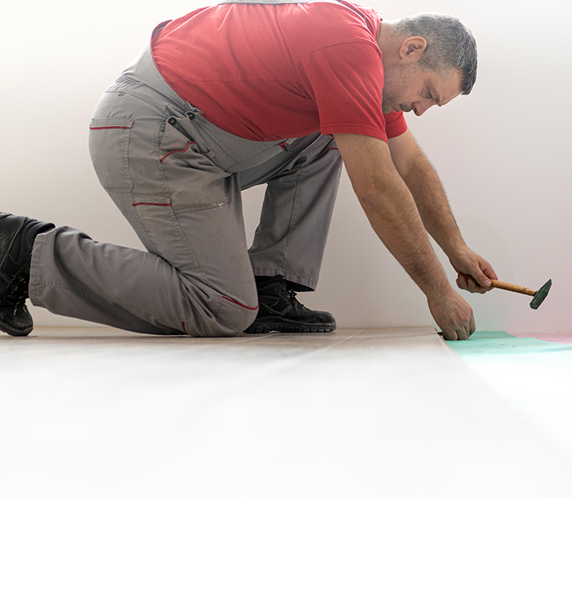
Ergonomics is for Everyone
Ergonomics is applicable for all job industries and can be practiced at all job sites for all work activities. It isn’t about what type of work you do, it’s about how you do it. Paying attention to ergonomics will help everyone complete their job tasks more efficiently and with less pain, regardless of gender, age, industry, or location.
There are MSDs that show up more frequently in specific types of jobs. For example:
Many back and shoulder injuries are reported in healthcare and long-term care environments from workers who lift patients or residents.
Knee injuries are a high risk for workers in construction and remodeling jobs who tear out and install flooring and carpets.
MSDs affecting the wrists and hands are frequent at packaging and processing locations that require small repetitive movements.
Lower back and wrist issues are often reported by workers seated or standing at a computer station for long periods.
EVERYDAY ERGONOMICS:
introduction

Slide 6

Prevention is Key!
As we discuss ergonomics, it is important to understand that preventing MSDs is the best course of action, instead of trying to push through the pain and receiving treatment after developing them. Keep in mind that every job has multiple ergonomic risk factors, and ergonomics should be considered as a way to prevent work-related MSDs. This includes just sitting or standing at a desk performing work on a computer!
A computer workstation will be the focus of the subsequent modules in this training course. If you sit or stand at a workstation for more than 2 hours for your job, the information in this course will be beneficial to you. However, even if you don’t work at a computer, the sitting and standing postural alignments that will be discussed are relevant to other jobs outside of computer work.
To access Oregon OSHA’s resources about ergonomics in job types not associated with a computer workstation, please visit our webpage.
EVERYDAY ERGONOMICS:
introduction

Slide 7

Persistent Symptoms of MSDs
If there are persistent symptoms, recovery is difficult or impossible to achieve because the continual presence of symptoms and pain does not allow the body to rest and recover.
Just like in our definition of ergonomics, the goal is to have the best fit between job and worker, ideally right from the start. However, if you notice discomfort or pain in tasks that you are doing or positions you are holding - stop. Try to fix the issue immediately by implementing proper ergonomics. If you continue to “push through” or ignore the pain or discomfort, it can lead to injury. If the issue is not corrected, the symptoms can turn into persistent, chronic, long-term pain and/or a serious injury.
EVERYDAY ERGONOMICS:
introduction

Slide 8

Effects of MSDs in the Workplace
If work is performed in awkward postures or with excessive effort, the worker may experience fatigue and discomfort. Under these conditions, muscles, tendons, ligaments, nerves, and blood vessels can be damaged.
Injuries can also increase the cost of doing business both directly and indirectly:
Direct costs may include medical services and higher workers’ compensation premiums.
Indirect costs may occur from increased employee turnover, absenteeism, and retraining. Productivity, product quality, and employee morale may also suffer.
Estimates indicate that the indirect costs associated with MSDs may be 4 to 10 times higher than the direct costs!
EVERYDAY ERGONOMICS:
introduction

Slide 9

Ergonomics Just Makes Sense
In 2018 alone, there were over 272,000 cases of MSDs reported in the U.S. private sector, resulting in an average of 12 days away from work in each case!
Taking into consideration the additional costs, lost days of work, and all the pain associated with work-related MSDs, it makes sense to spend time learning about ergonomics. If you put proper ergonomics into practice, you will prevent MSDs and avoid the extra costs and missed work!
EVERYDAY ERGONOMICS:
introduction

Slide 10

Module 1 Overview
You’ve completed Module 1! It’s important to remember that work-related musculoskeletal disorders (MSDs) can be prevented, and considering proper ergonomics is the key! Ergonomics can help lessen muscle fatigue, increase work productivity and reduce the number and severity of work-related MSDs.
In the next module, we’ll look at some ergonomic risk factors and how to address them.
EVERYDAY ERGONOMICS:
introduction

Slide 11

EVERYDAY ERGONOMICS
Module 2: Risk Factors

Slide 12


Welcome to Module 2
There are many ergonomic risk factors that can put your body at a higher risk for injury and musculoskeletal disorders (MSDs), such as strains and sprains. There are two categories we will discuss throughout this module to help you create the best working environment regardless of your location:
Individual Risk Factors
Ergonomic Risk Factors
EVERYDAY ERGONOMICS:
risk factors

Slide 13

Individual Factors
The risk factors associated in this category are connected to the individual worker. Risk factors can be affected by physical characteristics such as physical fitness, health, and age, as well as psychological characteristics like motivation, and physical and mental capabilities. The likelihood of a worker experiencing an injury is much higher if they are mismatched with a job that does not take their individual factors into account.
Consider a job description which outlines a requirement to lift 50 pounds during the workday. If a worker struggles to lift 10 pounds, they would be mismatched for this job task as their limited lifting abilities may increase the risk of injury.
EVERYDAY ERGONOMICS:
risk factors

Slide 14

Psychosocial Factors
As working-from-home became a more frequently used option for many workers, feelings of isolation and disconnection increased. Studies have shown that psychosocial factors can contribute to generalized risk factors for work-related musculoskeletal disorders. Unfortunately, they are difficult to measure since they are based on individual perceptions, and each person has many factors influencing those perceptions.
Examples of psychosocial factors include:
• how demanding the work is perceived,
• size of the workload,
• job content,
• the amount of social support available from co-workers and managers, and
• job control.
Now that we’ve covered individual risk factors, let’s discuss ergonomic risk factors.
EVERYDAY ERGONOMICS:
risk factors

Slide 15

Ergonomic Risk Factors
Ergonomic risk factors are workplace situations that cause wear and tear on the body and can cause injury. Consider if the work task requires:
awkward or prolonged positions,
repetitive activities,
contact stress, and
excessive use of force required for lifting, pushing, pulling, carrying, or gripping.
All of these factors could lead to long-term injuries or medical conditions, which is why it is important to reduce and eliminate the potential harmful impacts for the worker. We will discuss this in more depth in the following slides.
EVERYDAY ERGONOMICS:
risk factors

Slide 16

Awkward or Prolonged Positions
Sometimes as we work, we don’t notice the little accommodations we do with our body to get the job done, such as leaning forward to see smaller items on the computer screen instead of increasing the image or text size. Or bending our neck to look down at our mobile device instead of raising the device to eye-level. Perhaps the desk is too high and we raise our shoulders and tense up as we work. Let’s not forget that a keyboard is on the desk as well; now our wrists are bent in an unnatural angle. In addition, our forearms are resting on the edge of the desk causing “contact stress.”
These types of accommodations might seem minor at first glance, but they can cause discomfort and could lead to injuries. Let’s explore this further in the next slide.
EVERYDAY ERGONOMICS:
risk factors

Slide 17

Awkward Positions
Let’s look at some of the things that happen within your body with the example position of leaning forward. As you lean forward:
Your shoulders and upper/mid back round forward. This position pulls the muscles in your upper/mid back taut, stressing them as you hold that position. As your back is rounded, your chest muscles are shortened, causing tightness or stiffness in the front of your body.
Your shoulders may also lift up, causing muscles in your neck and shoulders to remain in a contracted, tightened position.
Your chin may jut forward, putting stress on neck muscles
Your neck will extend back, straining muscles and joints.
Your abdominal muscles are most likely not actively engaged, putting stress on the low back.
Let’s take a look at body alignments in the video in the next slide.
EVERYDAY ERGONOMICS:
risk factors

Slide 18
Video: The Neutral Posture
EVERYDAY ERGONOMICS:
Risk factors
Notes:
Replace “Link video here” text with the Title of the video. Hyperlink the title to the video.
Ideal Text Font/Size: Arial, 44.
***Delete this note before uploading finished PPT to O:drive and website.***

Slide 19
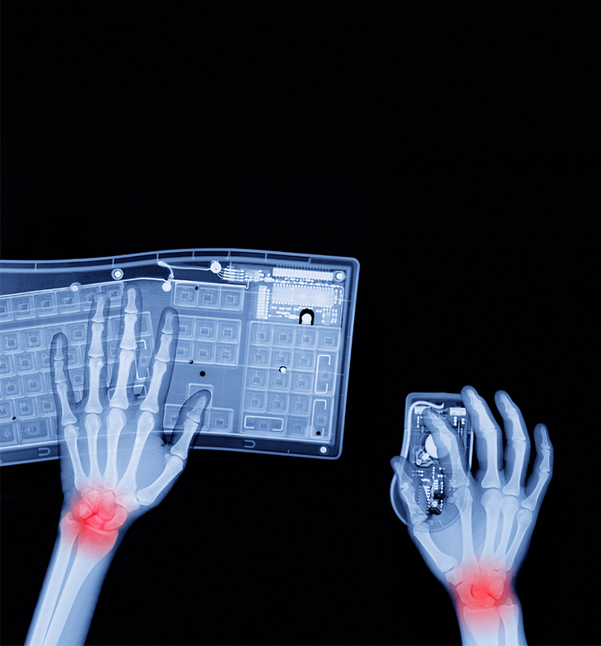
Contact Stress
Contact stress can occur externally or internally in the body.
External contact stress is when your body is in contact with a component of your workspace. For example, as you use your keyboard, your wrists or forearms rest against the hard edge of a desk or table. Or as you are sitting, your legs press against the edge of a chair. Short-term contact might only result in some discomfort, but accumulation over time can lead to injury.
Internal stress occurs when a tendon, nerve, or blood vessel is stretched or bent around a bone or tendon. Carpal tunnel syndrome, a common hand-wrist injury, is a common example of this type of stress. It is often associated with sustained computer use with the worksurface edge pressing against the bottom of the wrist. This can compress and injure the medial nerve and in time, can lead to symptoms of numbness, tingling, and weakness in that hand or arm.
EVERYDAY ERGONOMICS:
risk factors

Slide 20
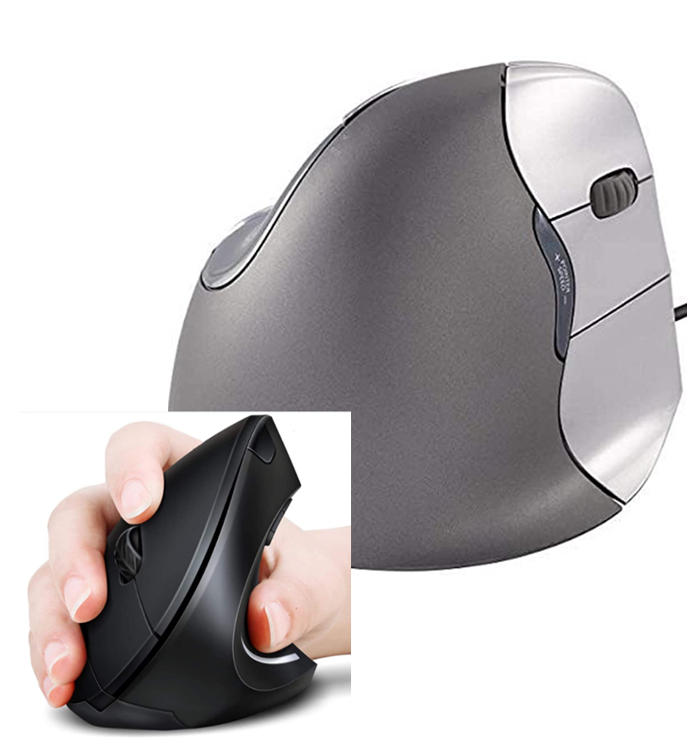
Repetitive Motions
Performing a movement repetitively can eventually cause discomfort and injury, especially if that movement is not performed with the best working posture, work surface layout, and working conditions. For example, your data entry job requires long periods of using a 10-key number pad and mouse with your right hand. This repetitive finger and hand movement, coupled with improper wrist alignment, can lead to discomfort and even injury.
In this example, to decrease the repetitiveness and avoid overuse, you could use your left hand to control the mouse and your right hand on the keyboard. Alternating the workload on each hand can help avoid repetitive motion injuries. You could also change the type of mouse to a more ergonomically friendly version such as a “handshake” or vertical one which will help your wrist remain straight.
EVERYDAY ERGONOMICS:
risk factors

Slide 21
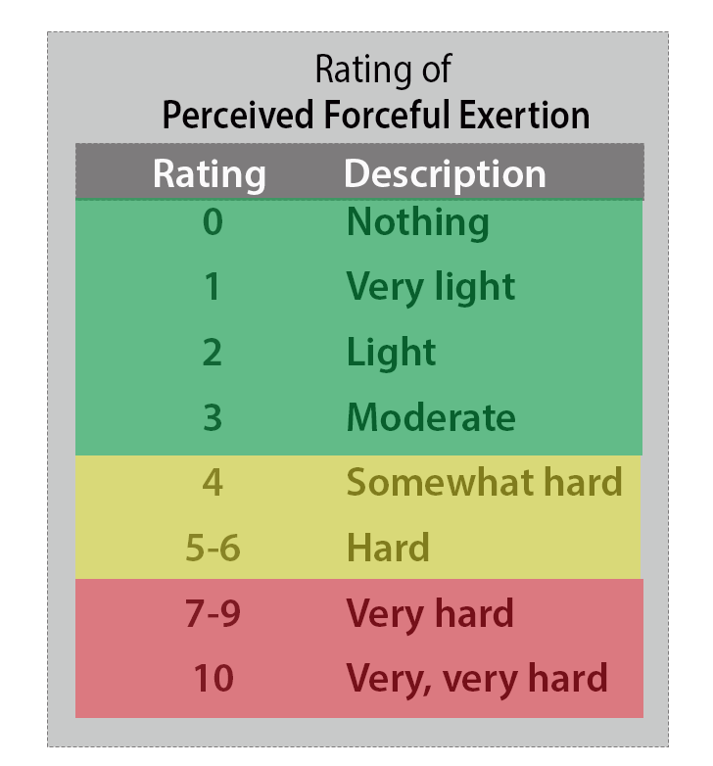
Excessive Use of Force
A physical movement that requires muscular effort is considered an exertion. The more muscular effort required, the more forceful the exertion. A common method of rating the perceived forceful exertion levels is shown to the left. Consistently performing exertions in the “Hard” category and above (in the 5-10 range) increases the worker’s risk of injury if they are not implementing proper techniques and devices to assist with the tasks that require such exertions.
EVERYDAY ERGONOMICS:
risk factors

Slide 22

Temperature
Working in extreme temperatures can pose a multitude of hazards. Prolonged work in cold temperatures can result in decreased muscle strength, endurance, and sense of touch. Workers in cold environments for prolonged periods of time will notice difficulty using their fingers to operate keyboards and touch screens. Our bodies are designed to keep heat in our core to protect the organs, so the outer extremities lose heat first.
In contrast, prolonged work in hot temperatures can result in fatigue, sweating, reduced grip strength, and a variety of heat-related illnesses. This can decrease a worker’s ability to perform their job correctly and could lead to injuries if not addressed properly.
EVERYDAY ERGONOMICS:
risk factors

Slide 23

Overview
You’ve completed Module 2! We discussed two risk factor categories, individual and ergonomic. We addressed awkward and prolonged positions and contact stress. We learned that further discomfort and injury can occur when muscles are consistently tightened and we examined the differences between correct and incorrect body alignment. And we learned that even psychosocial aspects and temperature extremes could contribute to musculoskeletal disorders (MSDs).
In the next module, you’ll learn about setting up your workstation!
EVERYDAY ERGONOMICS:
risk factors

Slide 24
EVERYDAY ERGONOMICS
Module 3: Workstation Ergonomics

Slide 25


Welcome to Module 3!
In this module, we’ll discuss workstation ergonomics. An ergonomically optimized workspace helps you to work efficiently and safely. By protecting your body from injury (or recurring pain), you’re better able to focus on your tasks, which in turn, makes you a more efficient and productive worker. These principles and techniques apply to both home workspaces and traditional offices. We’ll begin by describing a neutral working posture and how it’s beneficial to your health. From there, we’ll jump into types of workstations, chairs, computer monitors, laptops, and mobile devices. Let’s get started!
EVERYDAY ERGONOMICS:
workstation ergonomics

Slide 26
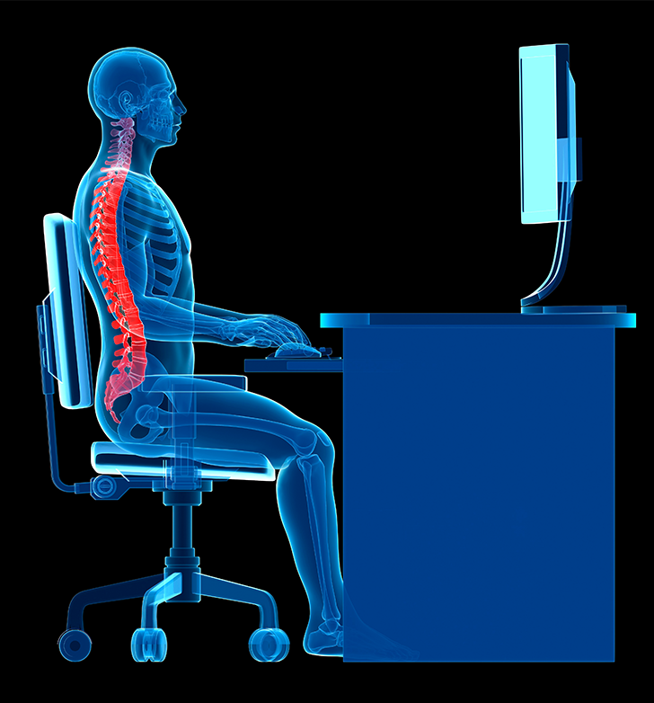
Neutral Spine Posture
Setting up an ergonomically correct workspace will take a little bit of effort on your part. As we mentioned in the previous module, start by focusing on maintaining a neutral spine whether you’re sitting or standing. Contrary to what you may think, a neutral spine isn’t one that is perfectly straight. A neutral spine is one that stays in its natural curved shape.
A neutral spine resembles an S-shape. That means at the top of your spine, near your neck, your spine curves in (toward your front). In the middle of your spine it curves out, and at your lower back it curves back in. Whether you stand or sit for long periods of time, a relaxed neutral spine position is the best position for your spine as it is not as hard on your joints and muscles. To achieve a neutral spine posture, you’ll need to set up your workspace correctly. Over the next few slides, we’ll watch a series of videos explaining how to properly do this.
EVERYDAY ERGONOMICS:
workstation ergonomics

Slide 27
Video: How to Setup Your Home Office
EVERYDAY ERGONOMICS:
workstation ergonomics

Slide 28
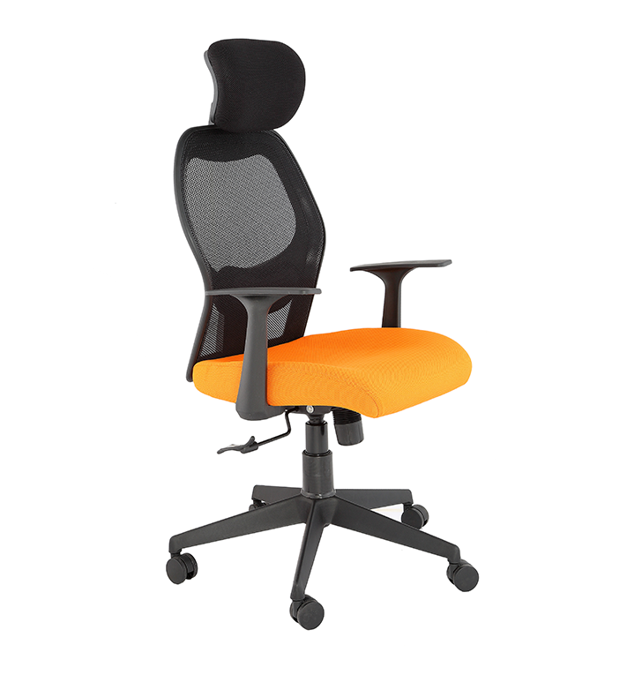
Selecting Your Chair
Your chair must be comfortable and appropriate for the work that you do. The four key components of a chair that affect its comfort are:
The base. Stability is critical, so be sure to select a chair that has a five-point base.
The seat pan. Ideal seat pans are soft, deeply padded and will allow two to three fingers’ width from the front edge of the seat pan to the back of your lower leg at the knee when your back touches the backrest.
The backrest. The backrest should be large enough and adjustable to support your entire back.
The armrests. Armrests should be adjustable and should not interfere with your work surface. Your forearms should rest comfortably on the armrests, with your shoulders relaxed when using the keyboard and mouse.
EVERYDAY ERGONOMICS:
workstation ergonomics

Slide 29
Video: Adjust Your Chair
EVERYDAY ERGONOMICS:
workstation ergonomics

Slide 30
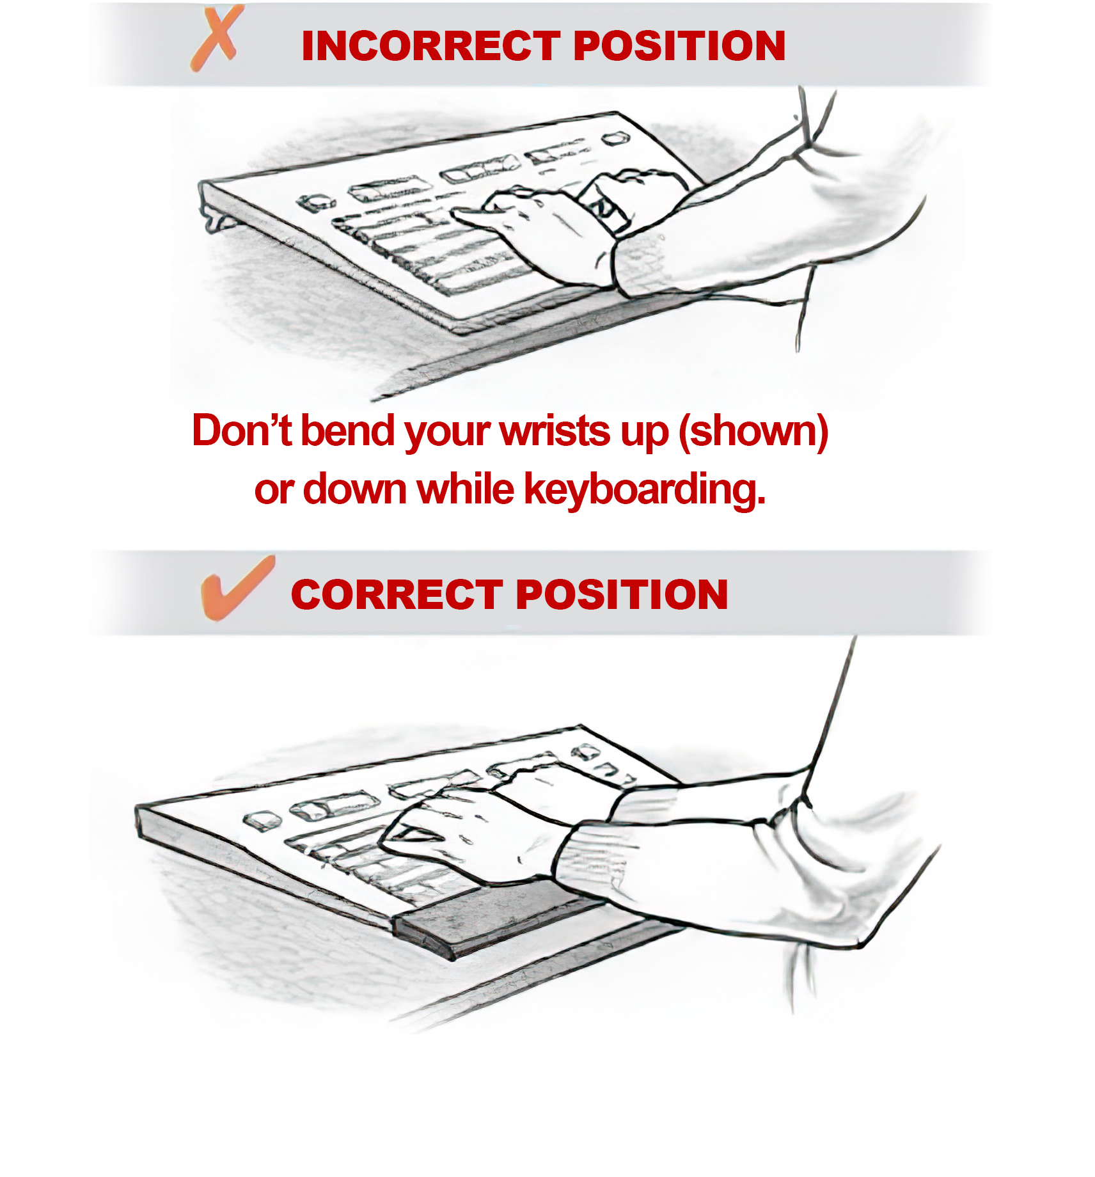
Selecting Your Chair
When you are using a keyboard, your wrists and forearms should be relatively straight, parallel to the keyboard and with fingertips just touching the keys, and your hands should be at or just below elbow height. Your shoulders should be relaxed and your elbows close to your body.
Your keyboard should be thin to help keep your wrists straight and the keyboard platform should be adjustable.
Keyboards can be fitted with palm rests that support your hands, minimize contact with table edges, and help keep your wrists straight. Make sure the palm rest supports your palms – not your wrists.
EVERYDAY ERGONOMICS:
workstation ergonomics

Slide 31
Video: Adjusting Your Keyboard and Mouse
EVERYDAY ERGONOMICS:
workstation ergonomics

Slide 32
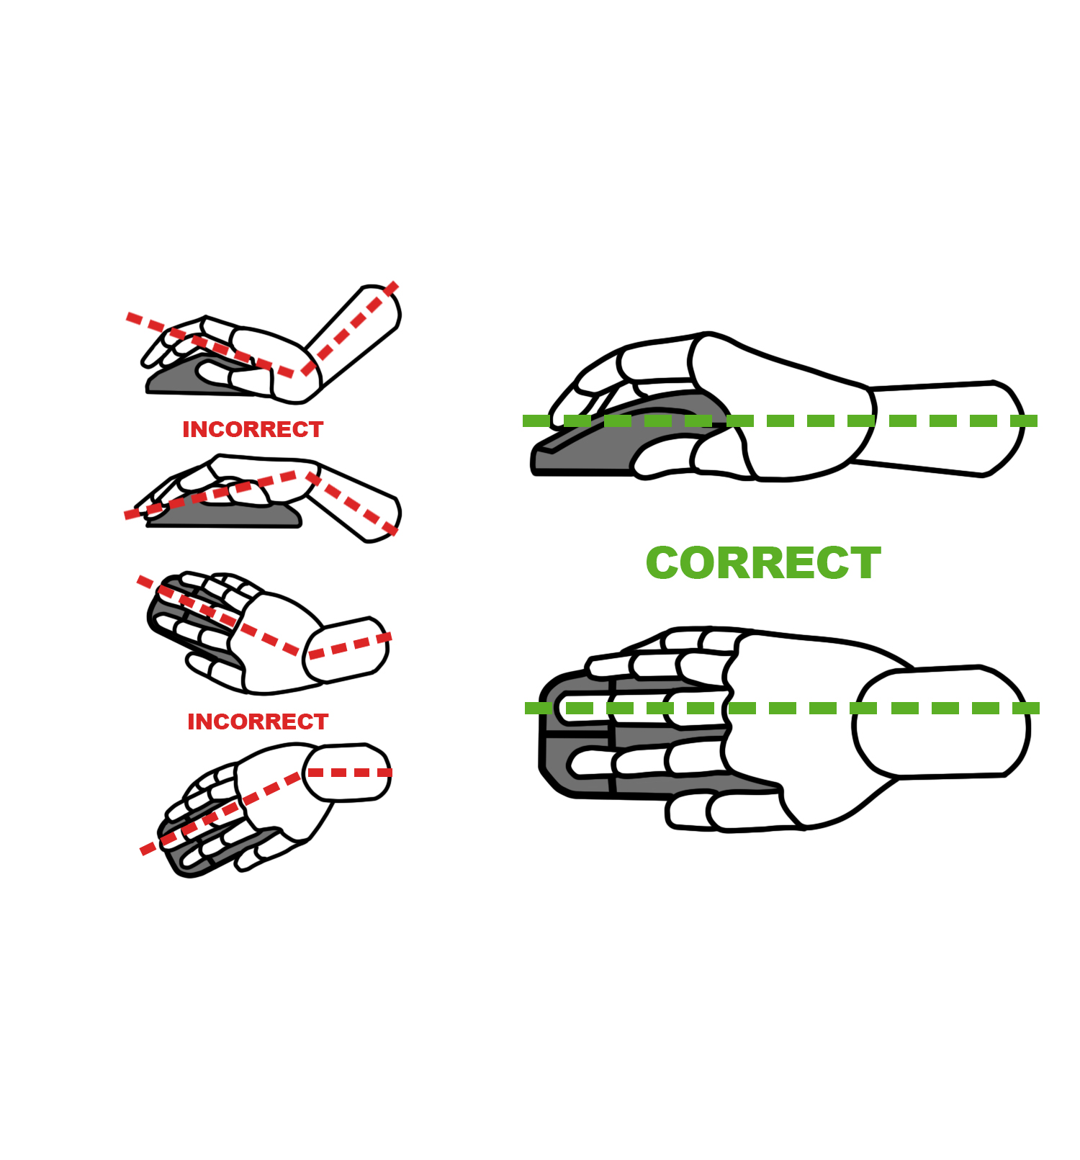
Using Your Mouse
Your mouse – or a pointing device such as a touchpad, trackball, or vertical (“handshake”) mouse – should be at the same height as the keyboard and adjacent to either side of it. Your arm should be close to your body for support. Your hand, wrist, and forearm should be relatively straight and slightly above the mouse.
Keep your wrist straight when using your mouse. Don’t bend your wrist from side to side. Instead, try to move your whole arm.
EVERYDAY ERGONOMICS:
workstation ergonomics

Slide 33
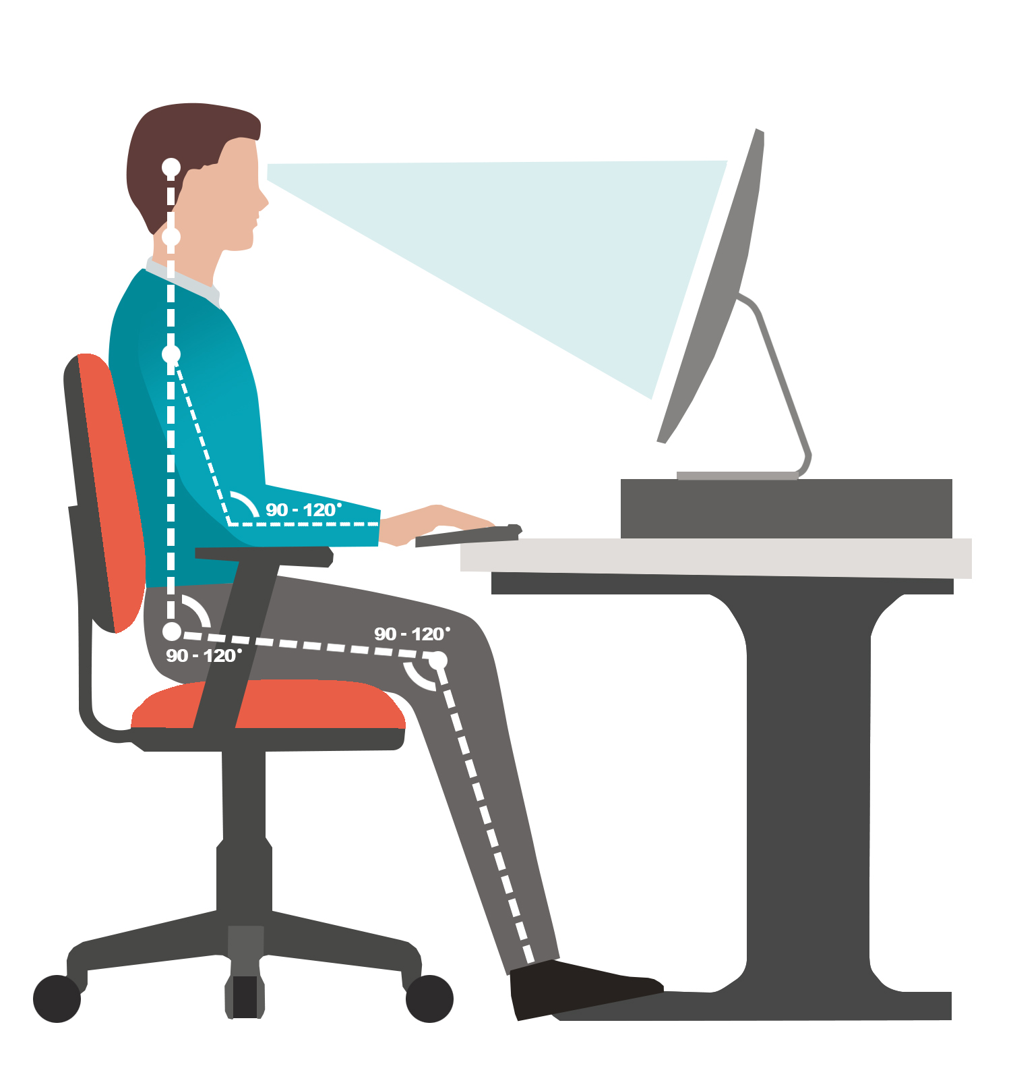
Monitor Placement
A few key points about monitor placement:
The top of the monitor should be at, or slightly below, your eye level. When you look at the middle of the screen, your eyes should look slightly down. You should be able to hold your neck straight and easily see the top third of the screen. If you find yourself bending your neck up or down, adjust the screen again.
The monitor should be at least arm’s length from you. This allows you to view the entire screen at once—meaning you won’t have to move your head from left to right.
You may also need to adjust the tilt on your screen to reduce glare and achieve proper head positioning.
Try to avoid direct light on the monitor to avoid eye strain. Try to keep the lighting to the side of the screen for indirect lighting.
Lastly, you do not want to be looking into strong light sources behind the monitor. That means no windows, lights, or shiny surfaces in the area behind the monitor.
EVERYDAY ERGONOMICS:
workstation ergonomics

Slide 34
Video: Adjusting Your Monitor
EVERYDAY ERGONOMICS:
workstation ergonomics

Slide 35
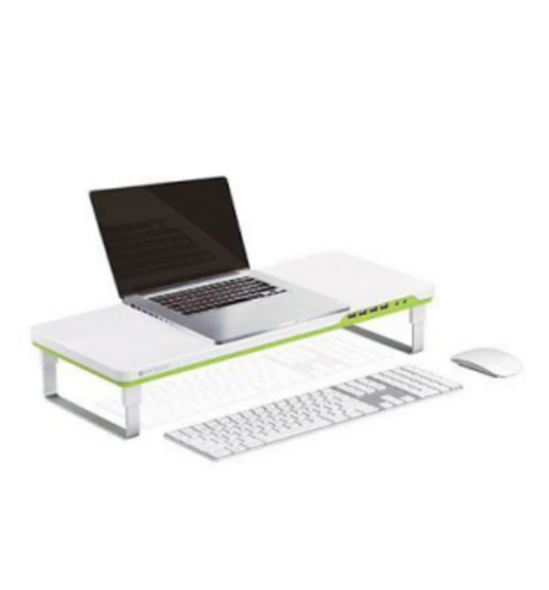
Laptops
If you use a laptop for prolonged periods:
Use a docking station, wireless mouse and keyboard, and an independent monitor (if possible).
Place the keyboard and mouse at a comfortable height on the work surface. (Your hands should be at or just below elbow height; wrists and forearms should be relatively straight, slightly above the keyboard.)
Place the laptop on a platform or riser so that the display is at a comfortable height (when looking at the middle of the screen, your eyes should look slightly down).
EVERYDAY ERGONOMICS:
workstation ergonomics

Slide 36
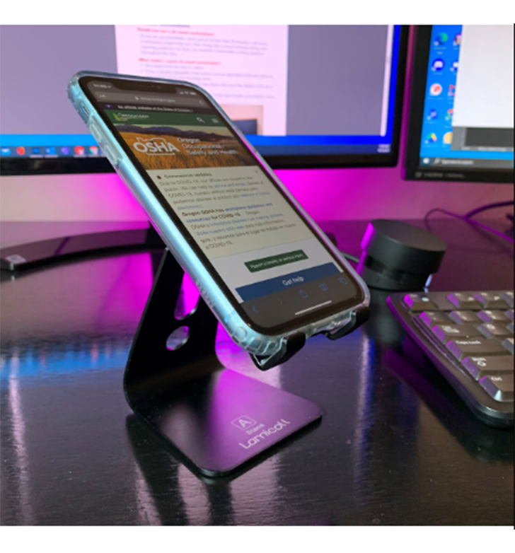
Mobile Devices
Tablets and iPads:
Use a cover that lets you adjust the device to a 45-degree angle.
Use a Bluetooth keyboard if you need to type for prolonged periods.
Cellphones:
Use earphones or a bluetooth headset so that you don’t have to hold your phone up to your ear for prolonged periods.
Avoid typing long blocks of text on your phone. Use a laptop or a desktop computer instead; they are more efficient and put less stress on your thumbs.
Consider using the word prediction and voice recognition tools on mobile devices to compose short blocks of text.
EVERYDAY ERGONOMICS:
workstation ergonomics

Slide 37
Video: Ergonomics on the Go
EVERYDAY ERGONOMICS:
workstation ergonomics
Notes:
Replace “Link video here” text with the Title of the video. Hyperlink the title to the video.
Ideal Text Font/Size: Arial, 44.
***Delete this note before uploading finished PPT to O:drive and website.***

Slide 38
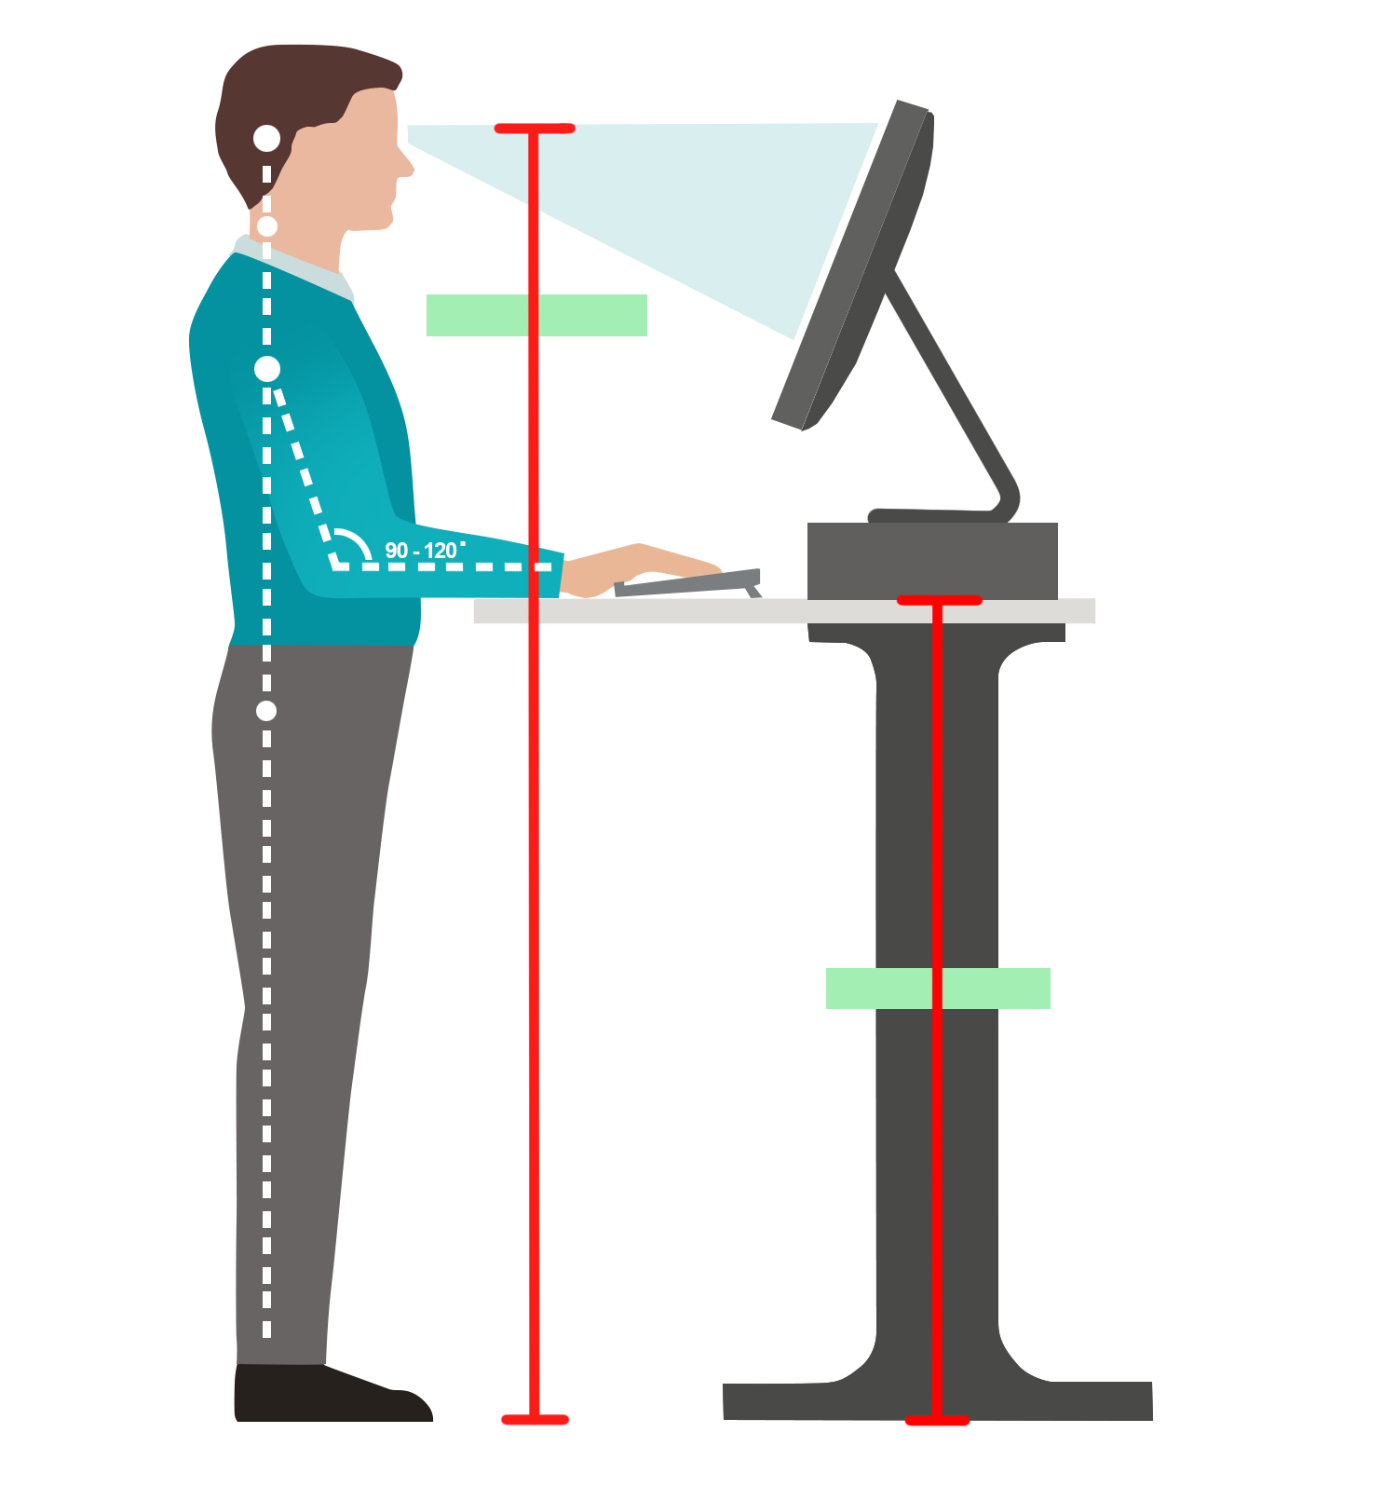
Sit-Stand Workstations
If your chair and workstation are properly adjusted, but you are uncomfortable when you sit for less than 30 minutes, you may want to consider using a sit-stand workstation. Having the ability to move between sitting and standing positions can help you maintain comfortable working postures throughout the day.
What makes a good sit-stand workstation?
Its components are easy to adjust.
It has a height-adjustable work surface and an adjustable keyboard platform that will fit sitting and standing users.
It has a display platform or arm that allows the top of the display to be set at the same height as the user’s eyes.
It permits a keyboard and mouse to be at the same height, at or slightly below the elbows.
For extended standing periods, it has a footrest or floor cushioning.
EVERYDAY ERGONOMICS:
workstation ergonomics

Slide 39

Illumination
Computer workspaces should have lower light levels than other office spaces. Illumination should be 20-50 lumens per square foot for screen viewing and 50-70 lumens per square foot for reading printed documents. (Lighting brightness is commonly measured in lumens.) The best way to measure illumination is with a light meter.
Your workspace should be located away from and at right angles to windows; windows should have adjustable blinds or drapes to reduce glare and eye fatigue. (Vertical blinds reduce glare more effectively than horizontal blinds.) Walls, furniture, and equipment near a display or display screen should have nonreflective, subdued colors to minimize glare.
Light fixtures near computers should have diffusers, cube louvers, or parabolic louvers to reduce glare. Workspaces should be spread out between rows of overhead lights to reduce glare and reflection.
EVERYDAY ERGONOMICS:
workstation ergonomics

Slide 40

Overview
You’ve completed Module 3! Whether you are working at a traditional office workspace or home-office, please take the time to carefully consider workstation ergonomics. Your neck, back, arms, wrists, eyes, and every other part of your body will thank you. Remember to take a break at least every hour to reduce eyestrain and headaches. Everyone’s body is different, which is why you need to be as conscientious as possible with your workstation ergonomics. If you feel pain, take that as a signal that you need to stop and reassess your workstation setup.
You’re almost done!
EVERYDAY ERGONOMICS:
workstation ergonomics

Slide 41
EVERYDAY ERGONOMICS
Module 4: Conclusion

Slide 42


Welcome to Module 4!
You are almost finished with this course! So far, we have discussed musculoskeletal disorders (MSDs), ergonomic risk factors that can lead to MSDs, and how to set up your workstation so that you can sit or stand in postures that will help prevent MSDs from developing.
Now, we will discuss how to develop your own ergonomics program.
EVERYDAY ERGONOMICS:
conclusion

Slide 43

Developing an Ergonomics Program
Some companies have designated ergonomists and processes to develop and maintain an ergonomics program. They are able to provide employees with ergonomic evaluations and solutions to problems. If there is no designated ergonomist, you can practice evaluating your setup and document what works well during the process (more about this in the next slide). Studies have shown that when workers are involved with their workstation design, productivity increases while health and safety risks decrease.
After you have ensured the best setup for yourself, you can then work to expand the process to your company’s workplace. We will share a few resources over the next few slides which can help with the process.
EVERYDAY ERGONOMICS:
conclusion

Slide 44
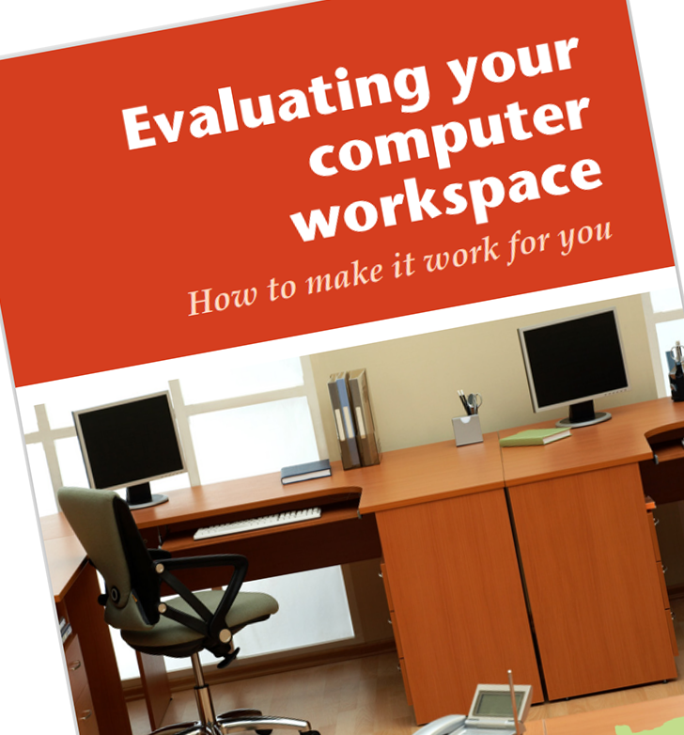
Evaluating Your Space
Start by describing and explaining your specific work processes, job tasks, equipment, and workplace layout(s). Include all risk factors involved with each of these components. If you are unsure of all the processes or risk factors, you could discuss these with coworkers who can help you identify them. You can also utilize resources from Oregon OSHA such as:
Self-Inspection checklist
Ergonomics Risk Factor Identification Tool
Evaluating your computer workspace
Review the above mentioned documents to see if they provide good evaluations of your own workspace. Make note of any additional questions that should be included for your specific situation.
EVERYDAY ERGONOMICS:
conclusion

Slide 45

NIOSH 7-Step Process
Now that you have reviewed your own work setup, you can review the 7-step process recommended by the National Institute for Occupational Safety and Health (NIOSH). This process will help you develop a company-wide ergonomics program.
The 7-steps of the NIOSH process are:
Identifying risk factors
Involving and training management and workers on the importance of ergonomics
Collecting health and medical evidence to show that an ergonomics program would benefit the company
Implementing your ergonomics program
Continual evaluation to measure the effectiveness of the program
Promoting worker recovery if/when employees develop MSDs
Maintaining management commitment and employee involvement
EVERYDAY ERGONOMICS:
conclusion

Slide 46

Ergonomics Program Resources
Oregon OSHA Consultation has ergonomics consultants available to assist you when developing an ergonomics program. Contact a consultation field office nearest you to get started!
In addition to consultants, Oregon OSHA has a variety of resources online for different job industries to help you start your own ergonomics program, all at no cost to you.
EVERYDAY ERGONOMICS:
conclusion

Slide 47

Ergonomics Program Resources
In this course, you learned about the first steps to evaluating your own workspace and identified several tools available to help you develop an ergonomics program at your workplace, including Oregon OSHA consultants, NIOSH step-by-step guides, as well as checklists.
You have also learned that ergonomics applies to all workers in all industries, and that it is about correctly matching the worker to the job. This course focused on computer workstations and some of the risk factors involved, such as:
awkward postures,
repetitive motions, and
contact stress.
One of the most important aspects we have covered is that musculoskeletal disorders are largely preventable!
A short quiz is next.
EVERYDAY ERGONOMICS:
conclusion

Slide 48
EVERYDAY ERGONOMICS - QUIZ
Question 1: Stated in this course, the primary goal of ergonomics is to __________ injuries associated with the overuse of muscles and tendons.
Maintain or develop
Reduce or eliminate
Increase or prolong
Encourage or support
Question 2: Ergonomics is only applicable for some jobs in specific industries.
True
False
EVERYDAY ERGONOMICS:
conclusion

Slide 49
EVERYDAY ERGONOMICS - QUIZ
Question 3: Musculoskeletal disorders (MSDs) may include: (select all that apply)
Pinched nerves
Carpal Tunnel Syndrome
“Tennis elbow”
Low back pain
Question 4: Contact stress can occur internally in the body and externally.
True
False
EVERYDAY ERGONOMICS:
conclusion

Slide 50
EVERYDAY ERGONOMICS - QUIZ
Question 5: A “neutral spine” resembles which shape?
C
Backwards C
S
L
Question 6: A “____” mouse can be a good option to use to decrease the contact stress of the wrist during computer work?
Flat
Handshake
Horizontal
Laptop touchpad
EVERYDAY ERGONOMICS:
conclusion

Slide 51
EVERYDAY ERGONOMICS - QUIZ
Question 7: When using a chair, what distance should the edge of the seat pan be away from the back of the person’s legs?
1 finger’s width
2-3 finger’s width
1 hand’s width
2 hands’ width
Question 8: The placement of your computer monitor should be at or slightly _____ eye level.
Below
Above
EVERYDAY ERGONOMICS:
conclusion

Slide 52
EVERYDAY ERGONOMICS - QUIZ
Question 9: To reduce glare if your computer workstation is near a window, the best angle to set your computer to the window is:
45°
90°
145°
180°
Question 10: Even if you do not have a designated ergonomics expert within your company, Oregon OSHA provides free resources to help you evaluate your work setup.
True
False
EVERYDAY ERGONOMICS:
conclusion

Slide 53
EVERYDAY ERGONOMICS - QUIZ ANSWERS
B
B
A, B, C, D
True
C
B
B
A
9) B
10) A
EVERYDAY ERGONOMICS:
conclusion
Notes:
Answers

Slide 54

Where To Go From Here
An excellent resource to utilize is the A-Z Topic Index on the Oregon OSHA website. It has lists of relevant publications, training materials, rules, interpretations, videos, and other miscellaneous materials.
If you want guidance in developing a safer work environment, you may consider our free and confidential consultation service. Our consultants in workplace health and safety can help you reduce accidents, related costs, and help you develop a comprehensive program.
Ergonomics Resources
Oregon OSHA Online Courses
Consultation Services
File a Complaint
EVERYDAY ERGONOMICS:
conclusion

Slide 55

EVERYDAY ERGONOMICS:
conclusion

Slide 56

Credits
You’ve completed the Everyday Ergonomics course!
Produced by the Public Education Team of Oregon OSHA:
Phillip Wade, Tammi Stevens, Tim Wade, Ricardo Rodríguez, Angelina Cox, Roy Kroker, Anthony Dey
Special thanks: SAIF Corporation
Stock media provided by:
Getty Images Inc., Envato Elements
EVERYDAY ERGONOMICS:
conclusion

