Slide 1



Module 1: Introduction
FALL PROTECTION IN CONSTRUCTION

Slide 2
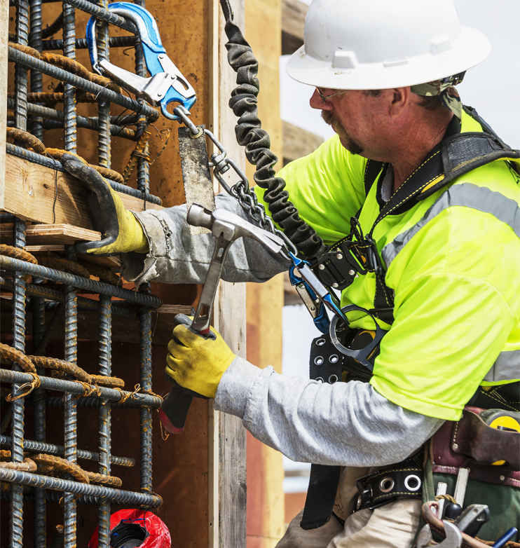

Disclaimer
Completing this course will help you understand the rules and some of the hazards related to fall protection. However, it is your employer’s responsibility to further your training where it is specific to your organization, such as permits, policies, and practices. This material should not be considered a substitute for any provisions of the Oregon Safe Employment Act, or for any standards issued by Oregon OSHA. Manufacturers, products, or services displayed in this material are for informational purposes only and do not constitute an endorsement by Oregon OSHA.
Module 1: introduction

Slide 3
Video: Fall Protection is Important
Module 1: introduction
Notes:
https://vimeo.com/609927261

Slide 4
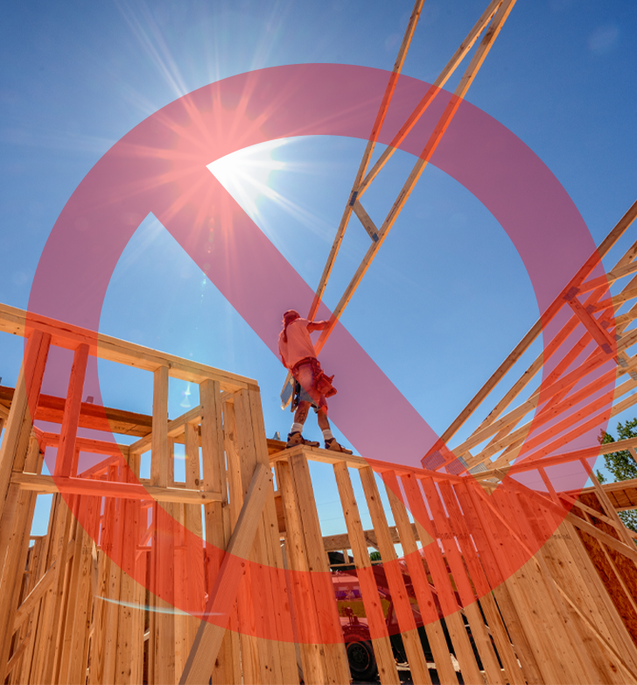
Fatal Work Injuries
In 2017, 971 construction workers died on the job.
Of the 971 fatal work injuries, 386 were due to slips, trips, and falls.
Bureau of Labor Statistics
Module 1: introduction

Slide 5

Accepted Claims
In 2017, there were 5,780 resolved claims in Oregon that were due to slips, trips, and falls. The average cost for these claims was $23,570.
Oregon Department of Consumer & Business Services
Module 1: introduction

Slide 6
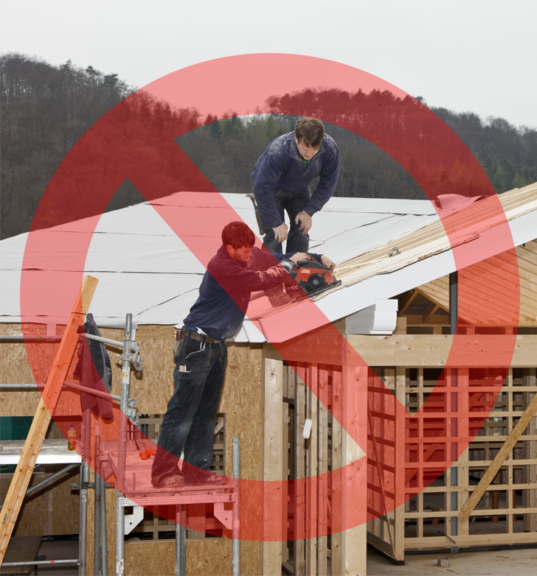
Accepted Claims
In Oregon between the years 2014 - 2018, there were 6,187 accepted disabling claims in construction due to falls to a lower level.
From Ladders: 1,980
From Vehicles/Machinery: 1,530
From Stairs: 853
From Roofs: 282
Scaffolds: 212
Floors/Walkways: 80
Other: 1,250
Oregon Department of Consumer & Business Services
Module 1: introduction

Slide 7
Video: Planning
Module 1: introduction
Notes:
https://vimeo.com/609928787

Slide 8
Video: Using Fall Protection
Module 1: introduction
Notes:
https://vimeo.com/609931075

Slide 9

Ladder Safety
Ladders are the leading cause of death and injuries in workplace slips, trips, and falls. As we close out this module, let’s take a few moments to review key points for using ladders safely at your jobsite.
Module 1: introduction

Slide 10
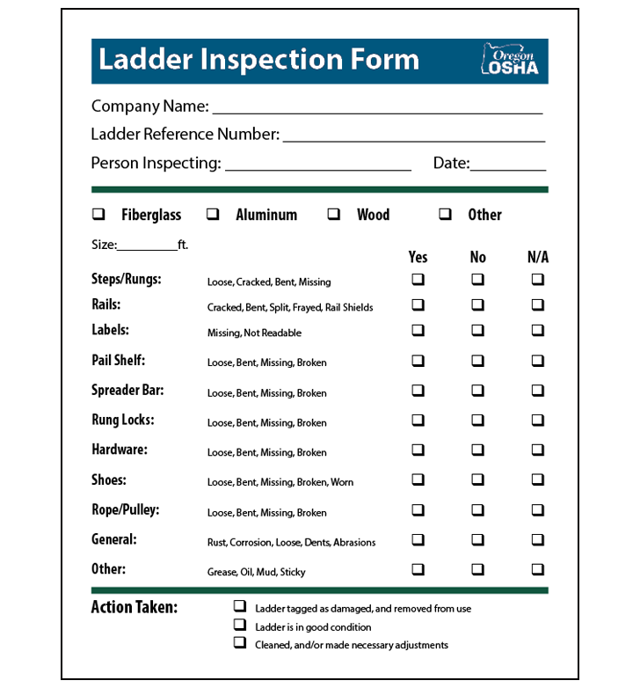
Ladder Inspection Form
A ladder inspection form is a valuable tool for identifying some of the hazards that are present when using a ladder.
The benefit is you can also see if there are trends developing, like defective parts.
If any defect or damage is found during the inspection, you must do the following:
1. Tag the ladder “Dangerous, DO NOT USE!”
2. Repair the ladder immediately to original condition or destroy the ladder.
Click this link to view the ladder inspection form.
Module 1: introduction

Slide 11

NIOSH Ladder App
Click this link, or scan the QR Code to download the NIOSH Ladder app.
The app can help with:
Planning
Selection
Inspection
Set-up
Proper Use
Accessories
*The app is only available on mobile devices
(e.g. cellphones, tablets).
Module 1: introduction

Slide 12
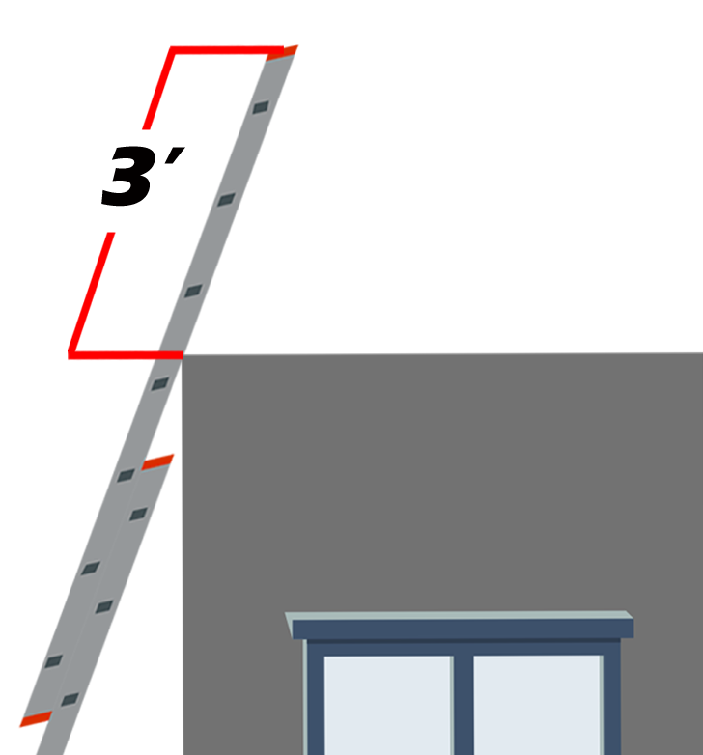
Access to Upper Landing
When portable ladders are used for access to an upper landing, they need to have the side rails extended at least 3 feet above the upper landing and must be secured to the structure.
*Do not place any weight on the rungs located above the upper landing when using non-self-supporting ladders to access an upper level.
Module 1: introduction

Slide 13
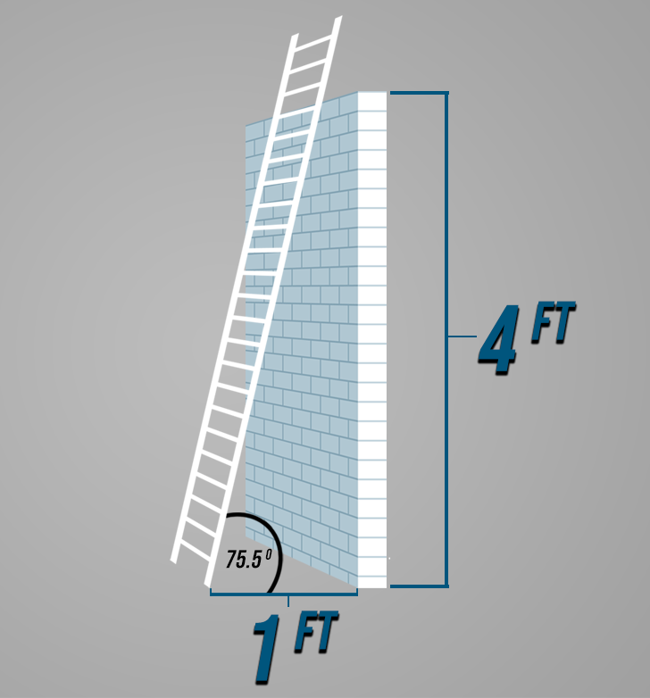
4:1 Ratio
Extension ladders need to be placed so that the working length of the ladder is four times the horizontal distance from the ladder’s base to the structure — a 4:1 ratio.
Module 1: introduction

Slide 14
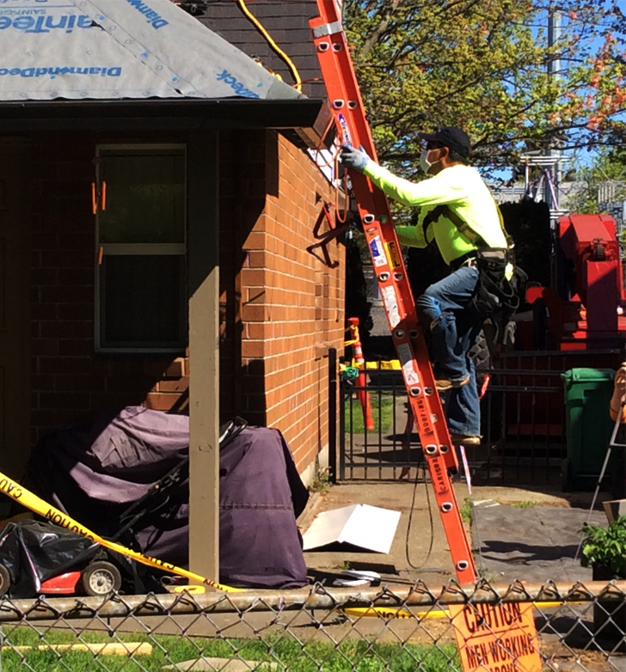
Ladder Safety Training
If you would like to learn more about ladders and how to use them safely, check out our online ladder safety training by clicking the button.
Ladder Safety Training
Module 1: introduction

Slide 15
Module 2: Equipment/Systems
FALL PROTECTION IN CONSTRUCTION

Slide 16

Video: Guardrails
Module 2: equipment/systems
Notes:
https://vimeo.com/609933293

Slide 17
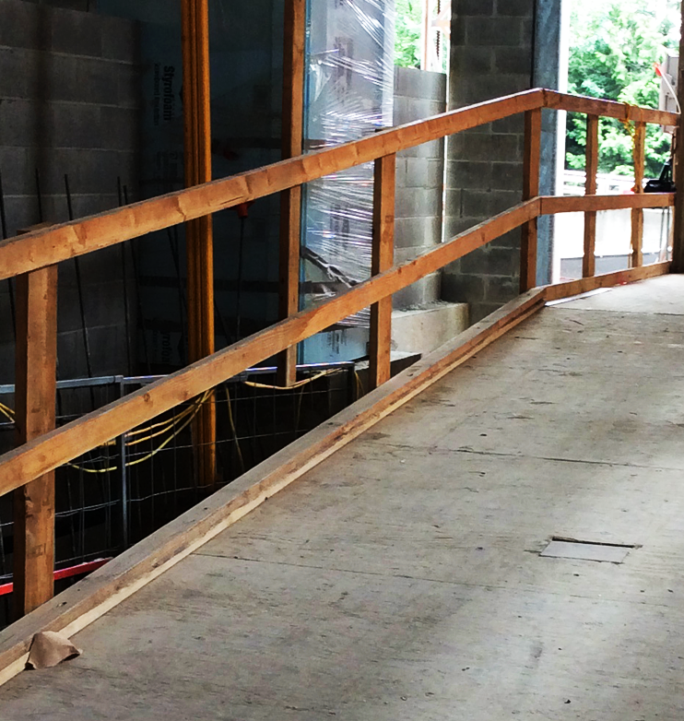
Guardrail Systems
The benefit of guardrails is that after they are installed correctly, they reduce the amount of human error.
Parts include: top rail, midrail, and intermediate vertical members.
They can also be combined with toeboards that prevent materials from being kicked or rolled off the walking/working surface.
Click the links for more information.
General Industry (Factsheet)
Construction Booklet
Division 3, Subdivision M, Fall Protection
Module 2: equipment/systems

Slide 18
Video: Positioning Devices
Module 2: equipment/systems
Notes:
https://vimeo.com/609935015

Slide 19
Guardrail Systems
Positioning device systems support a person who needs to work with both hands free on surfaces. They are commonly used on formwork and for tying rebar. They provide support and must stop a free fall within 2 feet.
Parts include:
Anchorage
Connectors
Body support
Positioning devices must be secured to an anchorage capable of supporting at least twice the potential impact load of an employee’s fall or 3,000 pounds (13.3 kN), whichever is greater.
Positioning Device Requirements, 3M
Module 2: equipment/systems

Slide 20
Video: Fall Restraint vs Fall Arrest
Module 2: equipment/systems
Notes:
https://vimeo.com/609936637

Slide 21
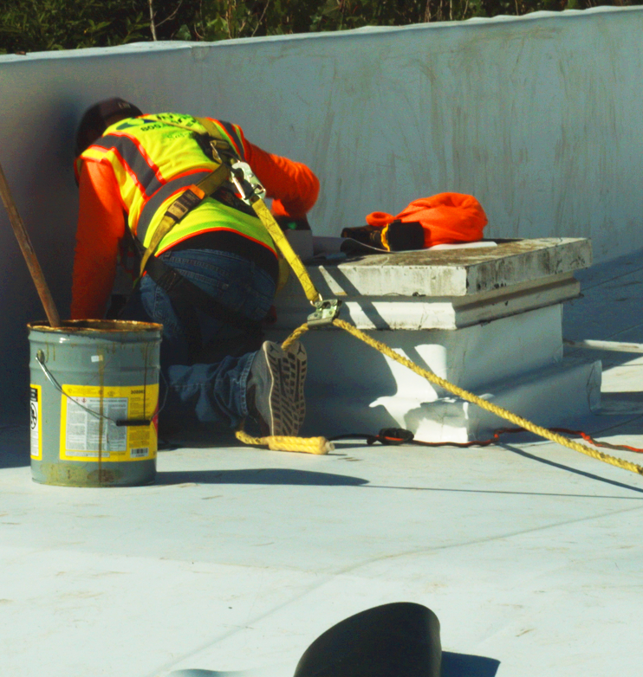
Fall-Restraint Systems
Fall restraint systems prevent workers from reaching an unprotected edge. Thus, prevents a fall from occurring.
Parts include:
Lanyard
Connectors
Body harness or body belt
The anchorage must support at least 3,000 lbs. or be designed and installed by a qualified person and have a safety factor of at least 2. This means the system is capable of supporting at least twice the potential impact load of an employees fall.
Click the button for more information.
Fall Restraint Requirements, 3M
Module 2: equipment/systems

Slide 22
Fall-Arrest Systems
A personal fall-arrest system consists of an anchorage, connectors, and a full-body harness that work together to stop a fall after it has already occurred, and to minimize the arresting forces of the fall.
Other parts include:
Lanyard
Deceleration device
Lifeline
Click the button for more information.
Fall Arrest Requirements, 3M
Module 2: equipment/systems

Slide 23
Video: Calculating Fall Distance
Module 2: equipment/systems
Notes:
https://vimeo.com/609938641

Slide 24
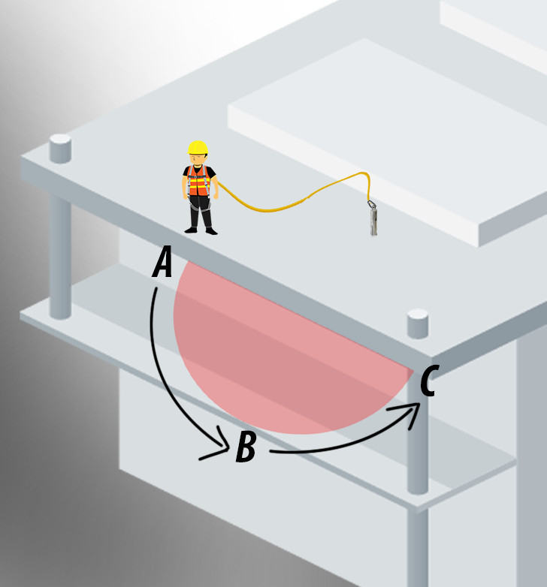
Swing Fall
Swing fall is created by the pendulum effect, which can swing a fallen worker into a nearby surface, such as a wall or protruding beam.
It is important to evaluate the swing fall hazard at any edges where a worker might fall.
A worker who falls while connected to an anchor (unless it is directly overhead) will swing back and forth like a pendulum.
Workers can be seriously injured if they strike objects during a swing fall.
Installing the anchorage point directly above the work area (i.e., connected to an overhead attachment point with sufficient strength) will help prevent swing fall injuries.
Module 2: equipment/systems

Slide 25
Fall Distance Educator
Click the button to view the Oregon OSHA fall distance educator. The educator will provide you with 3 different scenarios.
Fall Distance Educator
Module 2: equipment/systems

Slide 26
Video: Trauma Straps
Module 2: equipment/systems
Notes:
https://vimeo.com/608762514?share=copy

Slide 27
Video: Self Retracting Lifelines
Module 2: equipment/systems

Slide 28
Self-Retracting Lifelines (SRLs)
Self-Retracting Lifelines (SRLs) and Personal Self-Retracting Devices (SRL-Ps) have been around for more than a decade and they offer many advantages over shock-absorbing lanyards.
These devices are less likely to interfere with work tasks, and depending on how they are used, they can severely limit the distance a worker can free fall before they are arrested.
These devices should be mounted directly overhead to an anchorage that can support 5,000 pounds, and with no slack in the lifeline to minimize the potential for a swing fall.
Always check with the manufacturer, read the instruction manual, and follow the manufacturer’s safety warnings before using these devices.
Module 2: equipment/systems

Slide 29
Module 3: Anchors
FALL PROTECTION IN CONSTRUCTION

Slide 30

Video: Overview of Anchors
Module 3: anchors
Notes:
https://vimeo.com/609944993

Slide 31
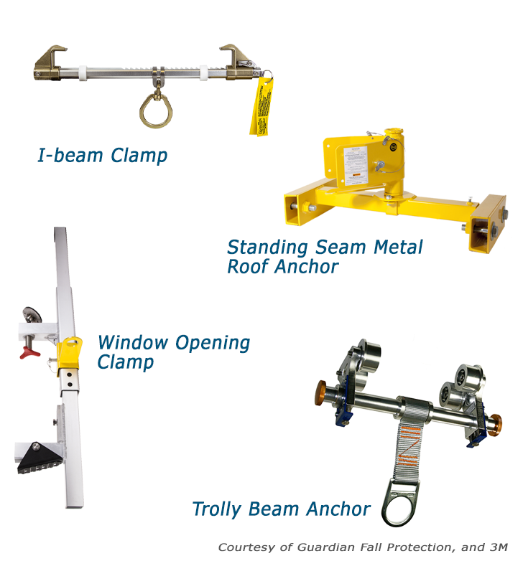
Anchor Types
Engineered Clamps are often associated with 4 different anchor types:
I-beam clamp, which adjusts to numerous steel beam sizes.
Trolley beam anchor, which allows workers greater access to greater work areas without the need for a longer lanyard.
Standing seam metal roof anchor, which clamps to parallel seams of metal roofs.
Doorway and window opening clamp, which allows for anchoring between building framing or window openings.
Module 3: anchors

Slide 32
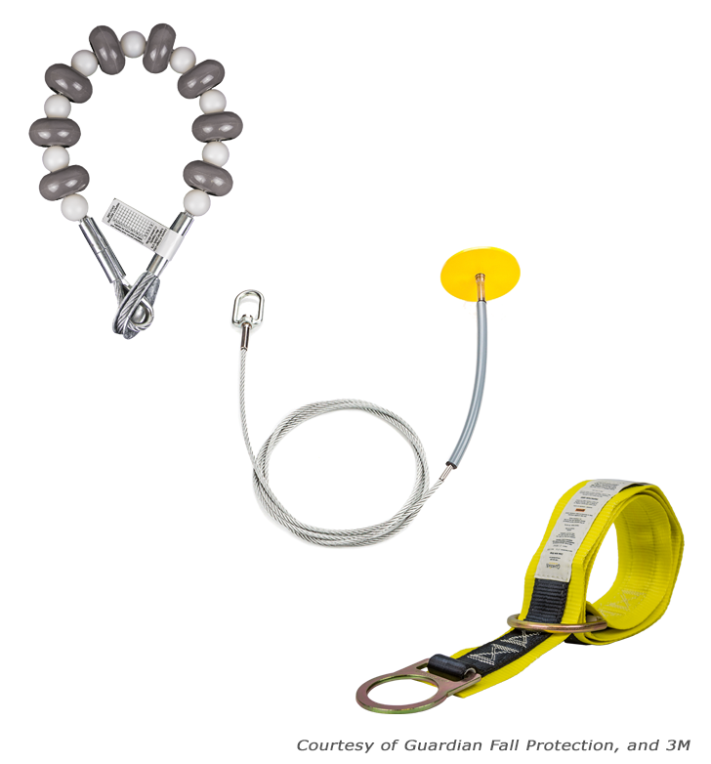
Anchor Types
Strap Anchors are associated with 3 different anchor types:
The cable anchorage sling, used around structural steel or I-beams.
Drop-through anchorage cable, suitable for concrete or steel, has an anchor point that drops through a small hole in an overhead surface.
Strap anchor, which is used for sturdy horizontal structures like beams. Keep in mind, sharp or rough edges could lead to strap damage.
Module 3: anchors

Slide 33
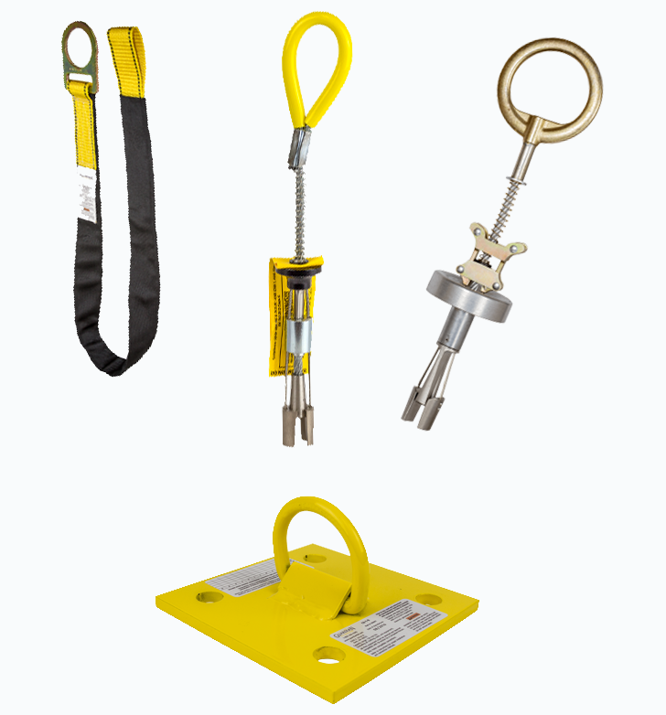
Anchor Types
Concrete Anchors are associated with 3 different anchor types:
Concrete anchor strap with D-ring, typically used by foundation and formwork employees. The strap is protected from abrasion by the concrete with a sleeve or wear-pad. It is looped around the rebar during pouring and is cut flush with the surface when it is no longer needed.
Precast hollow core/expanding concrete anchor, which allows one worker to tie off, and is used for precast hollow concrete tasks.
Bolt-on wall anchor, which can be a temporary or permanent anchor point on a vertical concrete wall.
Courtesy of Guardian Fall Protection, 3M and FallTech
Module 3: anchors

Slide 34
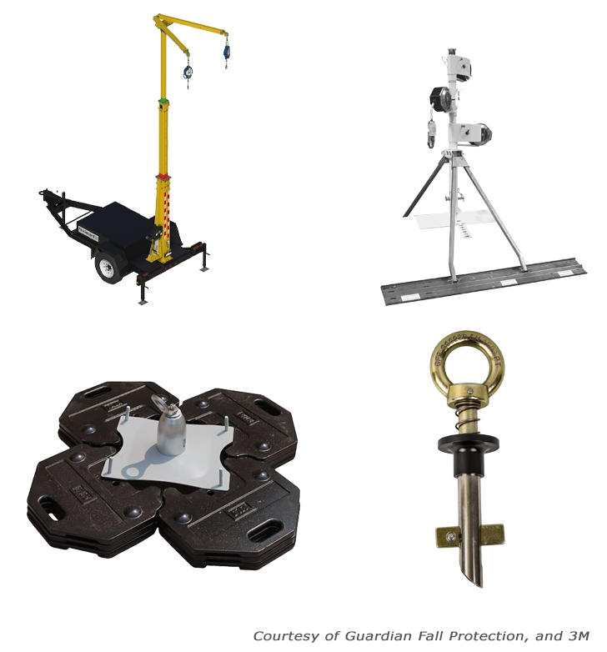
Anchor Types
Anchors not welded, or clamped in place are comprised of:
Mobile fall protection system types that can be quickly moved from location to location, and come in versions that allow for more than one employee to anchor.
Rotating retractable anchor mast, which is most often seen used on sloped residential roofs. It allows the worker a large range of motion, and helps to elevate the anchor point above the worker.
Dead weight anchor, which is commonly used when performing roof work and you can not hammer or drill into the surface. It is made of concrete, steel, or other similar heavy materials to provide anchorage.
Bolt hole anchor, which is used in horizontal steel bolt holes.
Module 3: anchors

Slide 35
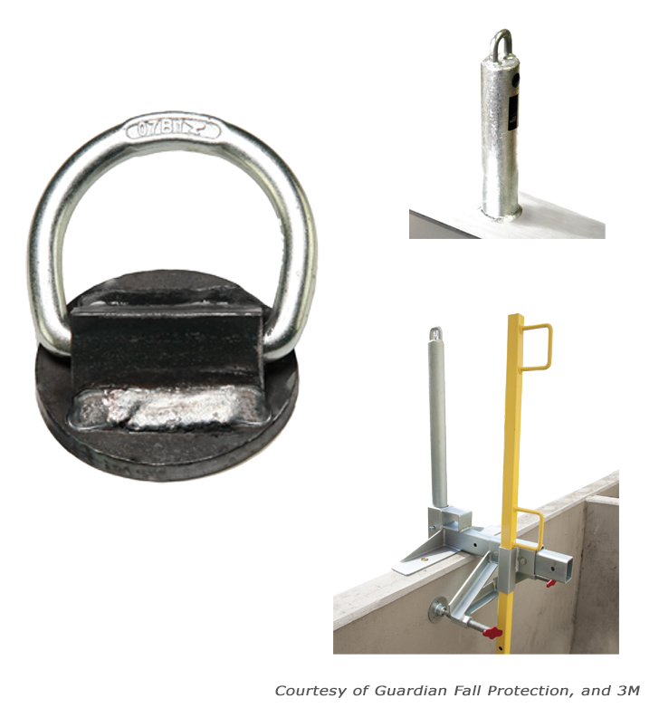
Anchor Types
Additional anchors include:
Welded D-ring anchor, which is a single d-ring anchor point that can be temporary or permanently welded onto vertical structural steel.
Weld-on anchor post, which is a permanent anchor point that is welded to an I-beam.
Trench Box Guardrail Anchor is used for performing deep excavation. It is designed with an anchor point on a post near the guardrail.
Module 3: anchors

Slide 36
Module 4: Scaffolding
FALL PROTECTION IN CONSTRUCTION

Slide 37

Video: Overview of Scaffolding
Module 4: scaffolding
Notes:
https://vimeo.com/609952313

Slide 38
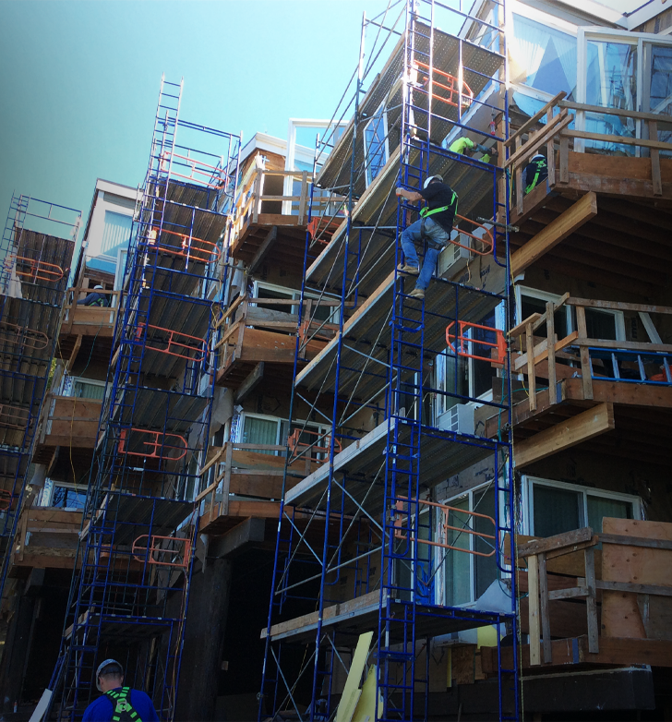
Scaffold A-Z Topic Index
You can use a scaffold to work on just about anything – silos, tanks, chimneys, bridges, stairways, roofs, ramps, and ceilings are just a few examples. In its most basic form, a supported scaffold is just a platform and a set of uprights so many people think that anyone can set one up.
That is why too many workers are injured or killed when they use a scaffold – components fail, planks break, handrails give way, or the entire structure collapses in a heap. Most scaffold accidents happen because scaffold users are untrained or improperly trained.
We highly recommend you take a moment to explore the resources in our scaffolding topic page (see below):
Scaffold A-Z Topic Index
Module 4: scaffolding

Slide 39
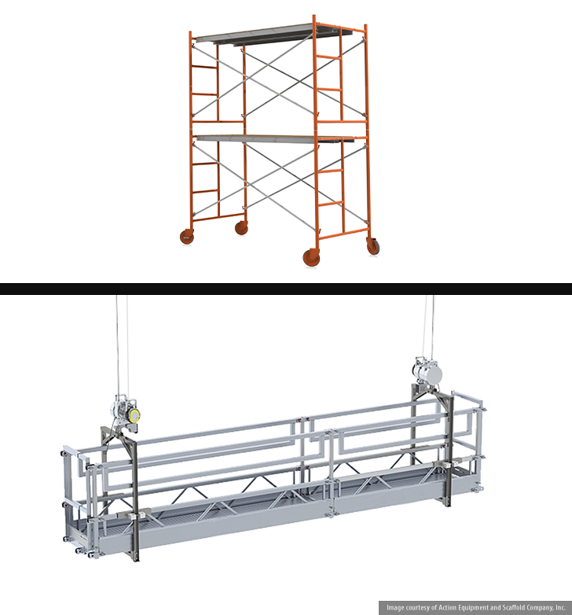
Scaffold Types
There are two basic types of scaffolds
Supported scaffolds. These are one or more platforms supported by outrigger beams, brackets, poles, legs, uprights, posts, frames, or similar rigid support.
Suspension scaffolds. These are one or more platforms suspended by ropes or other non-rigid means from an overhead structure(s).
Module 4: scaffolding

Slide 40
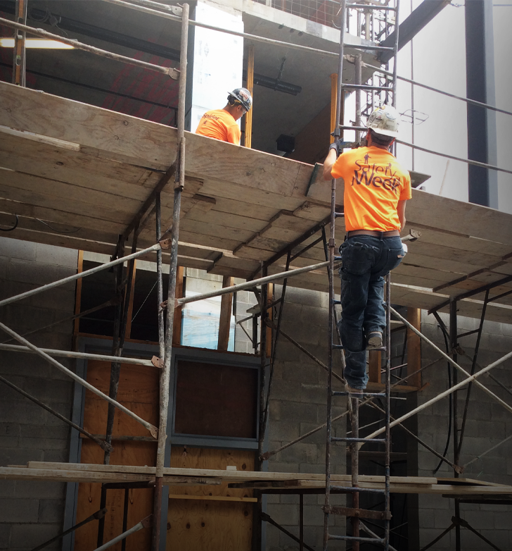
Competent Persons in Scaffolding
A competent person for scaffolding is someone who can identify existing and predictable scaffold hazards in
the workplace and has the authority to take prompt measures to eliminate them.
Scaffolds and scaffold components must be inspected for visible defects by a competent person before each work shift and after any event that could affect a scaffold’s structural integrity.
Below is a link to a factsheet outlining the requirements found in Division 3, Subdivision L. It explains how these rules apply to competent persons.
Scaffolding in Construction
Module 4: scaffolding

Slide 41

Scaffold Training
Employees who erect, disassemble, move, operate, repair, maintain, or inspect scaffolds must be trained by a competent person to recognize the hazards associated with the task. At a minimum, the training must include:
The nature of scaffold hazards;
The correct procedures for erecting, disassembling, moving, operating, repairing, inspecting, and maintaining the type of scaffold in question;
The design criteria, maximum intended load-carrying capacity and intended use of the scaffold.
Module 4: scaffolding

Slide 42
Video: Scaffolding
Module 4: scaffolding
Notes:
https://vimeo.com/609954424

Slide 43
Module 5: Job Tasks
FALL PROTECTION FUNDAMENTALS

Slide 44

Video: Framing
Module 5: job tasks

Slide 45
Video: Trusses
Module 5: job tasks

Slide 46

Carpenter’s Bracket Scaffolding
You can use scaffolding as a work platform to roll out, set, and brace the trusses. A carpenter’s bracket or top plate bracket scaffolding can be attached to the inside or outside of the exterior walls. Two 2" x 6" planks or a 12-inch-wide fabricated scaffold plank can be used for the platform.
Guardrails are required when the scaffold platform is more than 10 feet above the floor or ground. When the scaffold brackets are set so that the platform is at least 38 inches below the top plate, the top plate becomes a guardrail. To learn more the requirements for this option, click the link below:
Setting Wood Trusses and Rafters
Module 5: job tasks

Slide 47
Video: Decking Example
Module 5: job tasks

Slide 48
Video: Unprotected/Sharp Edges
Module 5: job tasks
Notes:
https://vimeo.com/609960314

Slide 49
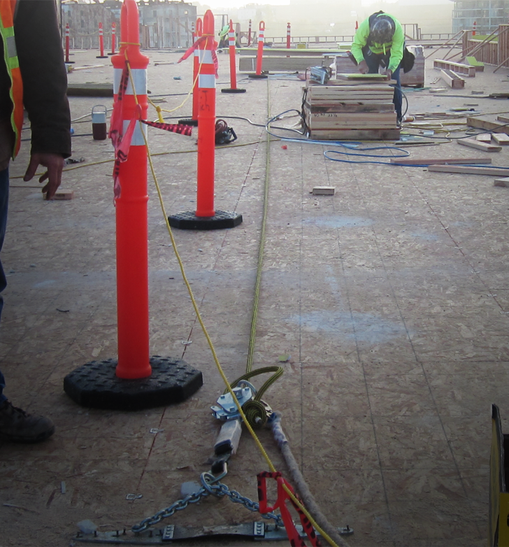
Horizontal Lifeline
One effective fall protection option for protecting workers in leading edge work is a fall-restraint system attached to a horizontal lifeline that is anchored directly to the walking/working surface.
The fall-restraint system prevents the worker from reaching an unprotected edge and the horizontal lifeline gives the worker mobility that would not be possible with a restraint system attached to a single anchor point.
Horizontal Lifelines Information
Module 5: job tasks

Slide 50
Video: Holes and Openings
Module 5: job tasks
Notes:
https://vimeo.com/609968796

Slide 51
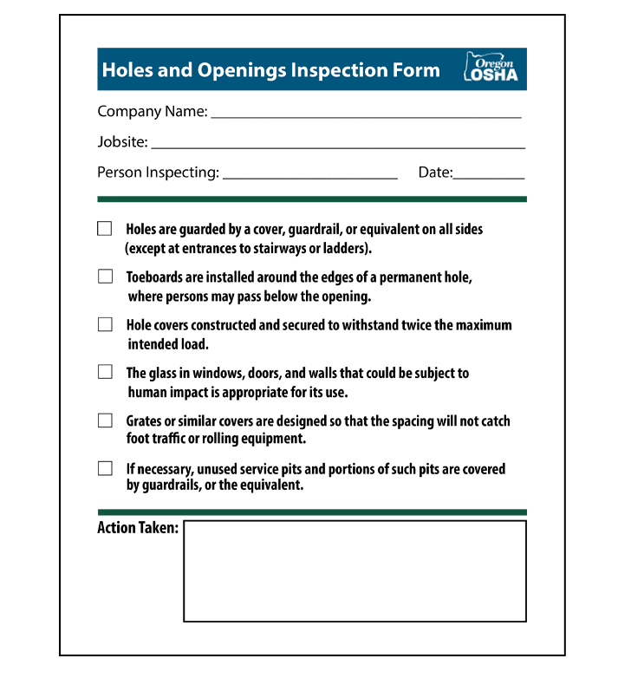
Holes and Openings Inspection Form
A holes and openings inspection form is a valuable tool for identifying and correcting some of the hazards that are present when working around holes and openings.
Click the button to view the holes and openings inspection form.
Holes and Openings Inspection Form
Module 5: job tasks

Slide 52
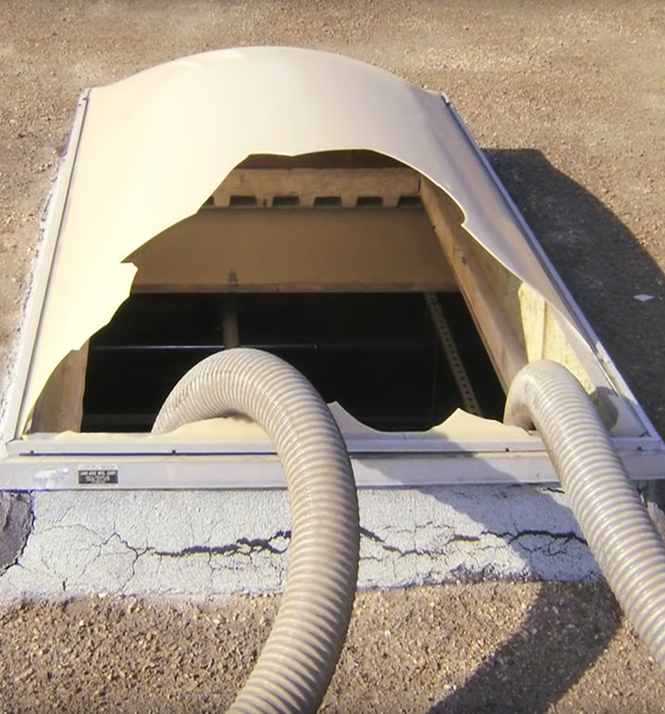
Skylights
If you are interested in watching an additional video about a true story where a man fell through a skylight, click the button.
Preventing Falls Through Skylights
Module 5: job tasks

Slide 53
Module 6: Conclusion
FALL PROTECTION FUNDAMENTALS

Slide 54

Video: Importance of Training
Module 6: conclusion
Notes:
https://vimeo.com/609974392

Slide 55
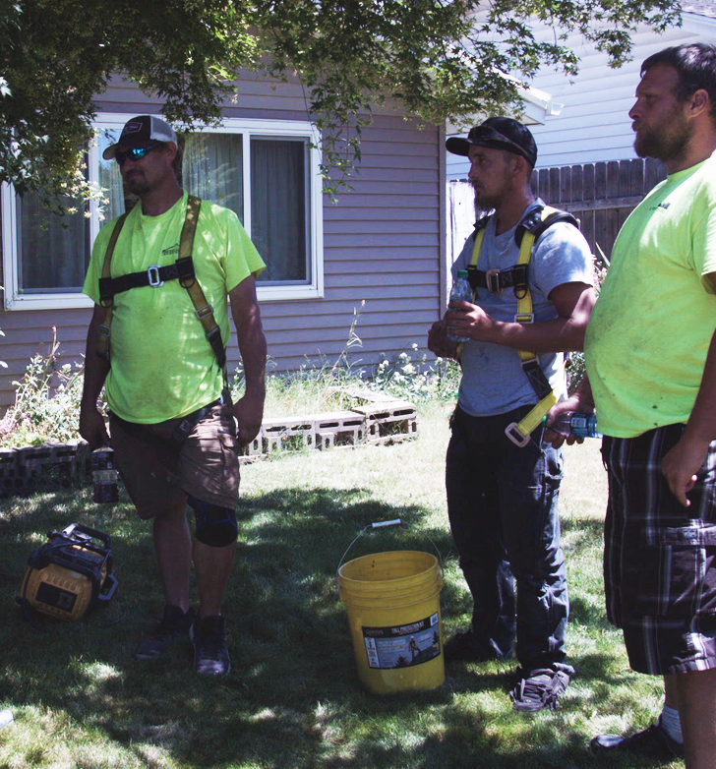
Training Certification
In regards to certification of training, the employer must verify that they are compliant by preparing a written certification record. This record needs to have the name or other identity of the employee trained, dates of the training, and the signature of the person who conducted the training or the employer. Once all of this is completed, you need to maintain the latest training certification.
In some instances the employee may have received training from a previous employer. If the current employer is relying on this, the record needs to indicate when the current employer determined the prior training was adequate rather than the date of the actual training.
Module 6: conclusion

Slide 56
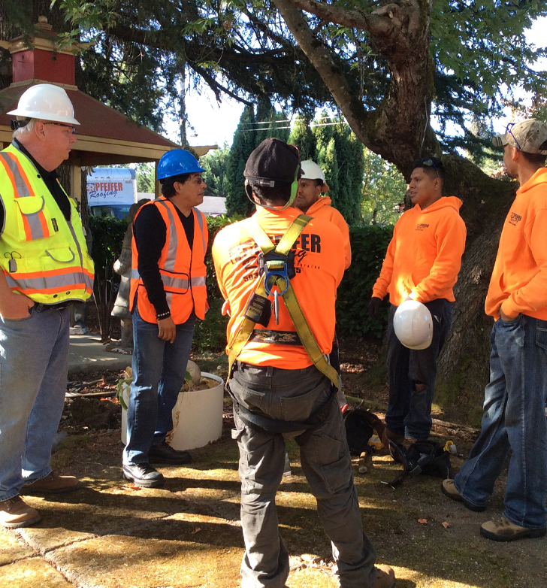
Retraining
When the employer has a reason to believe that an employee who has already been trained doesn’t have the knowledge or skills required, they need to retrain the employee. Examples where retraining is required include:
Changes in the workplace or fall protection systems being used has made the previous training obsolete.
It is evident that the employee has not retained the necessary knowledge and skills from the training.
Module 6: conclusion

Slide 57
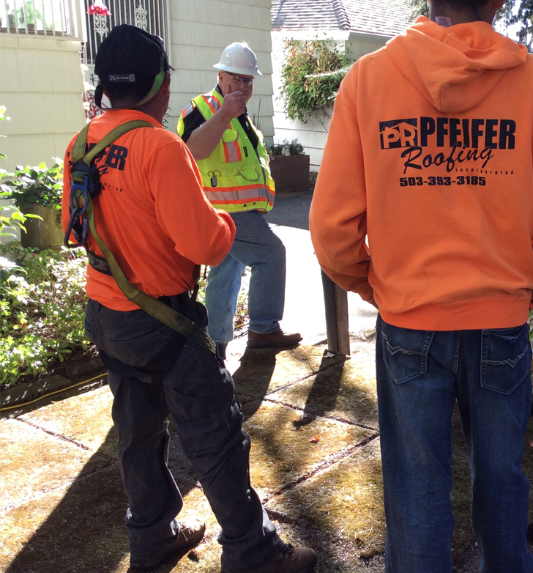
Training Requirements
Before any employee is exposed to a fall hazard, the employer must provide training for each employee who uses personal fall protection systems, or who is required to be trained as specified by Oregon OSHA.
For more information on training, click the buttons.
Fall Protection for Construction Activities
Division 3, Subdivision M, Fall Protection
Module 6: conclusion

Slide 58
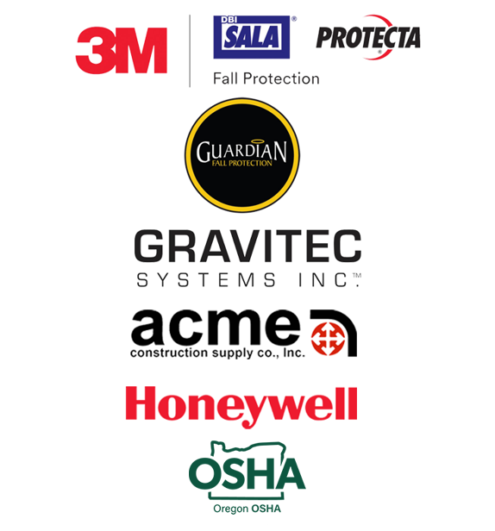
Training Requirements
Before any employee is exposed to a fall hazard, the employer must provide training for each employee who uses personal fall protection systems, or who is required to be trained as specified by Oregon OSHA. For more information on training, click the buttons.
3M | DBI SALA | PROTECTA
Guardian Fall Protection
GRAVITEC
ACME University
Honeywell
Oregon OSHA Topic Index
Module 6: conclusion

Slide 59
Video: Advice for Contractors
Module 6: conclusion
Notes:
https://vimeo.com/609977523

Slide 60
Fall Protection for Construction - QUIZ
Question 1
The employer must have a written record of training.
True
False
Question 2
Retraining is required when:
Changes in workplace has made previous training obsolete.
Changes in fall protection systems made the previous training obsolete.
It is evident the employee has not retained the necessary knowledge and skills.
All of the above.
Module 6: conclusion

Slide 61
Fall Protection for Construction - QUIZ
Question 3
When installing your anchors, you should follow the manufacturer’s instructions.
True
False
Question 4
Trauma straps are used to help prevent clots from forming that occur when a worker sits in their harness for too long after a fall.
True
False
Module 6: conclusion

Slide 62
Fall Protection for Construction - QUIZ
Question 5
The first person up on a job should only be installing the anchor point.
True
False
Question 6
In the event a worker falls:
The employer needs to provided for prompt rescue.
The employer needs to assure employees are able to rescue themselves.
All of the above.
Module 6: conclusion

Slide 63
Fall Protection for Construction - QUIZ
Question 7
All covers shall be color coded or they shall be marked with the word “HOLE” or “COVER” to provide warning of the hazard.
True
False
Question 8
Which of the following can help limit swing fall?
Using a horizontal lifeline.
Using multiple anchors.
All of the above.
Module 6: conclusion

Slide 64
Fall Protection for Construction - QUIZ
Question 9
You need to train your employees on how to inspect their fall protection equipment.
True
False
Question 10
When using a ladder to access an upper level, how many feet should it extend above the edge?
1
2
3
4
Module 6: conclusion

Slide 65
Fall Protection for Construction - QUIZ
Question 11
As an employee, what should you do if you find a broken guardrail?
Nothing.
Destroy it.
Report it.
Question 12
Fall restraint stops a worker from reaching an unprotected edge.
True
False
Module 6: conclusion

Slide 66
Fall Protection for Construction – Quiz ANSWERS
A
D
A
A
A
C
7. A
8. C
9. A
10. C
11. C
12. A
Module 6: conclusion

Slide 67
Congratulations
You’ve completed the Fall Protection for Construction training.
Module 6: conclusion

