Slide 1



HAZARD COMMUNICATION
Module 1: Introduction
Please note: If the online course contains videos, the video links are included in this PPT.
You will need to have an internet connection to play the videos or
you can download the videos and embed them into your copy of this PPT presentation.

Slide 2


This material is intended to inform employers of compliance requirements of Oregon OSHA standards and should not be considered a substitute for any provisions of the Oregon Safe Employment Act or any standards issued by Oregon OSHA. It remains the employer’s responsibility to ensure all training requirements are met, including any site-specific information. Manufacturers, products, or services displayed in this material are for informational purposes only and do not constitute an endorsement by Oregon OSHA.
Specific questions concerning chemicals or procedures at your workplace may require contacting an Oregon OSHA consultant or technical representative.
Disclaimer
HAZARD COMMUNICATION: introduction

Slide 3

Module Objectives
During this module, the following questions will be answered:
Why should you be concerned about the hazard communication rule (HazCom)?
What are Hazard Communication and Globally Harmonized System of Classification and Labeling of Chemicals (GHS)?
Who does Hazard Communication apply to?
When do you have to comply?
How do you comply?
This module should take about 10 minutes for you to complete.
HAZARD COMMUNICATION: introduction

Slide 4

Hazard Communication (HazCom) Introduction
Chances are, no matter what industry you work in, hazardous chemicals are being used at your workplace.
Using hazardous chemicals without following a safety program can result in serious injuries to you and your coworkers. Nobody wants that!
But what can we do to prevent people from getting injured or sick?
HAZARD COMMUNICATION: introduction

Slide 5

Hazard Communication (HazCom) Introduction
As with many things that can hurt us, we have rules to help prevent that from happening. In this case, we have the Hazard Communication Rule, known as HazCom for short.
The HazCom rule is based on the concept that every worker has the right to know about chemical hazards related to their jobs, and how to protect themselves from those hazards.
HAZARD COMMUNICATION: introduction

Slide 6

Hazard Communication (HazCom) Introduction
HazCom works something like this:
Under HazCom, chemical manufacturers and importers evaluate their products for the hazard classifications and categories and then pass that information on to employers.
Employers use the information to train their employees to recognize the hazards, and in ways to protect themselves.
HAZARD COMMUNICATION: introduction

Slide 7

Hazardous Chemicals
Hazardous chemicals are defined as any chemical that is classified as a physical hazard or a health hazard, simple asphyxiant, combustible dust, pyrophoric gas, or hazard not otherwise classified.
More information is listed in the next few slides about the hazard classifications listed below.
Physical Hazards
Health Hazards
Simple Asphyxiant
Combustible Dust
Pyrophoric Gas
Hazards Not Otherwise Classified
HAZARD COMMUNICATION: introduction

Slide 8
Physical Hazards
Chemicals are physical hazards when they are classified as posing one of these hazardous effects:
Corrosive to metals
Explosive
Flammable (aerosols, gases, liquids, solids)
Pressurized gases
Organic peroxides
Oxidizers (gases, liquids, solids)
Pyrophoric (liquids, solids)
Self-heating substances
Self-reactive substances
Substances that emit flammable gases in contact with water
Appendix B to 1910.1200 provides information about the classification of physical hazards.
HAZARD COMMUNICATION: introduction

Slide 9
Health Hazards
Chemicals are health hazards when they are classified as posing one of these hazardous effects:
Acute toxicity (any route of exposure)
Aspiration toxicity
Carcinogenicity
Germ cell mutagenicity
Reproductive toxicity
Respiratory or skin sensitization
Serious eye damage or eye irritation
Skin corrosion and irritation specific target organ toxicity (single or repeated exposure)
Health effects can be acute (appearing immediately after an exposure or with symptoms of short duration) or chronic (appearing after long-term exposure or with persistent symptoms).
See Appendix A to 1910.1200 for more information about classification of health hazards.
HAZARD COMMUNICATION: introduction

Slide 10
Simple Asphyxiant
A simple asphyxiant is a substance or mixture that displaces oxygen in the ambient atmosphere and can cause oxygen deprivation in those who are exposed, leading to unconsciousness and death.
HAZARD COMMUNICATION: introduction

Slide 11
Simple Asphyxiant
A simple asphyxiant is a substance or mixture that displaces oxygen in the ambient atmosphere and can cause oxygen deprivation in those who are exposed, leading to unconsciousness and death.
Combustible Dust
Combustible dust, a term not formally defined in the rule, is a particulate solid that becomes a fire or explosion hazard when suspended in air or in another oxidizing medium over a range of concentrations, regardless of the particle size or shape.
Pyrophoric Gas
A pyrophoric gas is a chemical in a gaseous state that will ignite spontaneously in air at or below a temperature of 130 degrees Fahrenheit.
HAZARD COMMUNICATION: introduction

Slide 12
Hazards Not Otherwise Classified
Hazards not otherwise classified (HNOC) describes adverse physical or health effects based on scientific evidence, that does not currently meet Federal OSHA’s specified criteria for a physical or health hazard class. This does not extend coverage to adverse physical and health effects for which there is a hazard class, but the effect either falls below the cut-off value/concentration limit of the hazard class or is under a GHS hazard category that has not been adopted by OSHA (e.g. acute toxicity Category 5). The hazards do not have to be disclosed on a label but must be disclosed in Section 2, Hazard Identification, of its safety data sheet.
HAZARD COMMUNICATION: introduction

Slide 13

What is HazCom and GHS?
HazCom is an Oregon OSHA rule intended to reduce injuries and illnesses in the workplace caused by hazardous chemicals. It is based on the US Federal OSHA rule.
Employers are required to train their employees to recognize chemical hazards and to take necessary precautions to protect themselves. The employer is required to prepare and implement a Written HazCom Program.
There are 5 main parts to the HazCom rule:
Employers must have a written HazCom Program
Labels must follow a consistent format and be on all containers
Safety data sheets must be readily available for all hazardous chemicals in the workplace
Employers must have a current chemical list
Employers must provide information and training about hazardous chemicals
These are all covered in more detail in other modules.
HAZARD COMMUNICATION: introduction

Slide 14

What is HazCom and GHS?
GHS stands for the Globally Harmonized System of Classification and Labeling of Chemicals. It was developed by the United Nations.
GHS is intended to create a uniform system to provide information about chemical hazards.
Federal OSHA was the first agency in the United States to adopt GHS.
Oregon OSHA has incorporated GHS into HazCom, as has Federal OSHA.
HAZARD COMMUNICATION: introduction

Slide 15

Who does HazCom apply to?
HazCom applies to:
Chemical manufacturers
Chemical importers
Distributors
Employers
HAZARD COMMUNICATION: introduction

Slide 16

Who does HazCom apply to?
Oregon OSHA’s HazCom rules affect employers in:
General industry
Construction
Agriculture
Forest activities
More information and specific rules for the divisions are listed in the following slides.
HAZARD COMMUNICATION: introduction

Slide 17
General Industry
General industry-Division 2Z 1910.1200. Other rules that refer to 1910.1200:
1910.119 Process Safety Management of Highly Hazardous Chemicals
1910.120 Hazardous Waste Operations and Emergency Response
1910.1001 Asbestos
1910.1020 Access to Employee Exposure and Medical Records
1910.1026 Chromium VI
1910.1027 Cadmium
1910.1028 Benzene
1910.1047 Ethylene Oxide
1910.1048 Formaldehyde
1910.1050 Methylenedianiline
1910.1051 1-3-Butadiene
1910.1052 Methylene chloride
1910.1201 Retention of DOT Markings Placards and Labels
1910.1450 Occupational Exposure to Hazardous Chemicals in Laboratories.
437-002-0170 Worker Protection Standard
437-002-0377 Additional Oregon Rules for Hazard Communication
HAZARD COMMUNICATION: introduction

Slide 18
Construction
Construction - Division 3/D, 1926.59
The requirements for construction work are identical to the general industry standard.
Other construction rules that refer to 1910.1200:
1926.1101 Asbestos
1926.1126 Chromium VI
1926.1127 Cadmium
1926.65 Hazardous Waste Operations
1926.62 Lead
437-003-1000 Oregon Rules for Air Contaminants
HAZARD COMMUNICATION: introduction

Slide 19
Agriculture
Agriculture - Division 4/Z, 437-004-9800
The rule for agricultural employers has been scaled down to eliminate those parts of 1910.1200 that relate only
manufacturers
importers and distributors
and to emphasize the parts pertaining to the employer’s responsibilities.
Other agriculture rules that refer to 437-004-9800 or 1910.1200 Division 4/W
437-004-6000 (40 CFR 170) Worker Protection Standard
437-004-9830 Retention of DOT Markings, Placards and Labels
437-004-9860 Hazardous Chemicals in Laboratories.
HAZARD COMMUNICATION: introduction

Slide 20
Forest Activities
Forest activities - Division 7.
The Division 7 rules refer to Division 2/Z - Division 7/N, 437-007-1305(2) requires employers to develop, implement and maintain a written hazard communication program meeting the requirements of 1910.1200, Hazard Communication when employees are required to handle, mix or apply hazardous chemicals.
Division 7/F, 437-007-0580(2) requires that containers of flammable and combustible liquids be marked in accordance with 1910.1200 Hazard Communication.
HAZARD COMMUNICATION: introduction

Slide 21

Who does HazCom apply to?
In the state of Oregon, HazCom applies to...
any workplace where employees are exposed to a hazardous chemical under normal conditions of use or in a foreseeable emergency...
...in any of the industries mentioned in the previous slide.
HAZARD COMMUNICATION: introduction

Slide 22

Who does HazCom apply to?
There are some special cases.
If your employees only handle chemicals in unopened containers under normal conditions of use in a place like a warehouse or retail store, or if your employees handle chemicals in a laboratory, then see the following slides for the requirements for each.
HAZARD COMMUNICATION: introduction

Slide 23
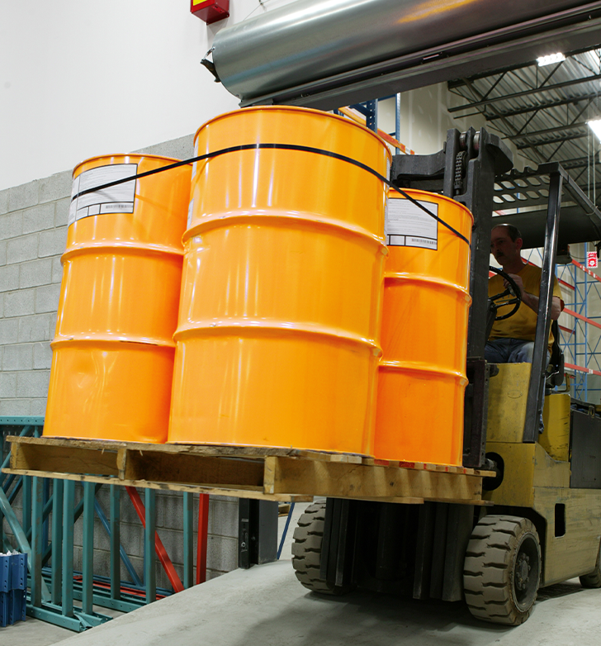
Warehouse/Retail
Ensure that labels on incoming containers of hazardous chemicals are not removed or defaced.
Maintain copies of any safety data sheets that are received with incoming shipments of the sealed containers of hazardous chemicals.
Obtain a safety data sheet as soon as possible for sealed containers of hazardous chemicals received without a safety data sheet if an employee requests the safety data sheet.
Ensure that the safety data sheets are readily accessible during each work shift to your employees when they are in their work areas.
Ensure that employees are provided with information and training to the extent necessary to protect them in the event of a spill or leak of a hazardous chemical from a sealed container.
HAZARD COMMUNICATION: introduction

Slide 24

Laboratory
Ensure labels on incoming containers of hazardous chemicals are not removed or defaced.
Maintain safety data sheets received with incoming shipments of hazardous chemicals, and make sure they are readily accessible to laboratory employees during their shift when they are in their work areas.
Ensure employees are provided required information and training, except for the location and availability of the written HazCom program.
Ensure any containers of hazardous chemicals leaving the laboratory are properly labeled and a safety data sheet is provided in accordance with the Hazard Communication Rule.
HAZARD COMMUNICATION: introduction

Slide 25

Who does HazCom apply to?
There are also some exclusions to the rule.
Certain types of chemicals are not covered by HazCom because other regulatory agencies have rules that apply to them; either, because they are not the product of a manufacturing process, or because they are not considered chemicals.
For example, hazardous waste as defined under the Resource Conservation and Recovery Act (RCRA) when subject to the Environmental Protection Agency (EPA), is not covered by HazCom.
For a more complete list, click the link below:
HazCom exclusions to the rule
HAZARD COMMUNICATION: introduction

Slide 26
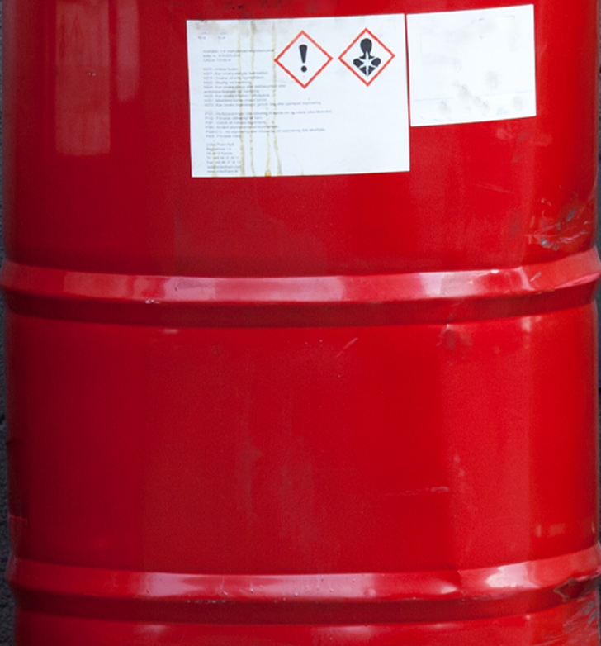
How Do You Comply?
That depends on who you are:
Chemical manufacturers and importers are required to classify and categorize the hazards of their chemical products and provide the information in the form of labels and safety data sheets.
Manufacturers, importers and distributors must ensure each shipped container of a hazardous chemical must have a label and an SDS.
Employers must provide information and training about hazardous chemicals to employees using labels and SDSs. They must have a chemical list. They must also prepare a written hazard communication plan, assign responsibility for all of the elements of the plan, and ensure the program is maintained and updated as needed.
HAZARD COMMUNICATION: introduction

Slide 27
HAZARD COMMUNICATION
Module 2: Classifying and Categorizing Chemicals

Slide 28

Module 2 Intro
During this module, you’ll learn about:
The process of classification and categorization that results in the assignment of labels and signal words and the development of safety data sheets.
This module should take about 10 minutes for you to complete.
HAZARD COMMUNICATION: classifying and categorizing chemicals

Slide 29

Overview
In the prior module, you learned that manufacturers and importers are required to evaluate chemicals. This evaluation has two steps:
Classification
Categorization
This process produces the information needed to:
Create labels
Select the appropriate pictograms
Select the appropriate signal word
Develop safety data sheets (SDSs)
HAZARD COMMUNICATION: classifying and categorizing chemicals

Slide 30
Overview
Manufacturers and importers use these four appendices of the Hazard Communication rule to complete the evaluation process and to develop the labels and safety data sheets:
Appendix A covers in detail the classes and categories of health hazards.
Appendix B covers in detail the classes and categories of physical hazards.
Appendix C covers requirements for labels.
Appendix D covers requirements for safety data sheets.
HAZARD COMMUNICATION: classifying and categorizing chemicals

Slide 31

Overview
As we move through the steps of classifying and categorizing chemicals in order to develop labels and the SDSs, we’ll use Oatey PVC cement as the example to show how the four appendices are used.
HAZARD COMMUNICATION: classifying and categorizing chemicals

Slide 32

Health Hazards
Chemicals are health hazards when they are classified as posing one of these hazardous effects:
Acute toxicity (any route of exposure)
Aspiration toxicity
Carcinogenicity
Germ cell mutagenicity
Reproductive toxicity
Respiratory or skin sensitization
Serious eye damage or eye irritation
Skin corrosion and irritation specific target organ toxicity (single or repeated exposure)
HAZARD COMMUNICATION: classifying and categorizing chemicals

Slide 33
Health Hazards
You might be interested to know that Appendix A further categorizes carcinogens as:
Potential, Presumed and Suspected.
1A means it is potential human carcinogen.
1B means it is a presumed human carcinogen.
2 means it is a suspected human carcinogen.
GHS assigns the signal word “Danger” for category 1A and 1B and the signal word “Warning” for category 2.
The pictogram for all three categories is the Health pictogram.
HAZARD COMMUNICATION: classifying and categorizing chemicals

Slide 34
Health Hazards
Oatey PVC cement has the following hazardous chemicals:
Tetrahydrofuran
Methyl ethyl ketone
Cyclohexanone
Acetone
PVC (Chloroethylene, polymer)
Manufacturers and importers must consider the full range of available scientific literature and other evidence about the potential health hazards when classifying these chemicals.
HAZARD COMMUNICATION: classifying and categorizing chemicals

Slide 35
Health Hazards
After identifying the hazardous chemicals in Oatey PVC cement, the manufacturer or importer classifies the health effects by using Appendix A of the Hazard Communication Rule.
These are the classified health hazards for Oatey PVC cement:
Acute Toxicity Oral
Acute Toxicity Dermal
Acute Toxicity Inhalation
Eye Damage / Irritation
Carcinogenicity
Specific Target Organ Toxicity Single Exposure
You can see that this product may be toxic through the mouth, skin, and nose. It could also harm the eyes and specific organs.
Also, notice that cancer may be an issue.
HAZARD COMMUNICATION: classifying and categorizing chemicals

Slide 36
Health Hazards
After the chemical has been classified, the manufacturer categorizes the hazards. Categorization identifies the degree, or severity, of hazard.
Here are the classes and categories of Oatey PVC cement:
Class | Category
Acute Toxicity Oral | 4
Acute Toxicity Dermal | 4
Acute Toxicity Inhalation | 4
Eye Damage / Irritation | 2A
Carcinogenicity | 2
Specific Target Organ Toxicity Single Exposure | 3
HAZARD COMMUNICATION: classifying and categorizing chemicals

Slide 37

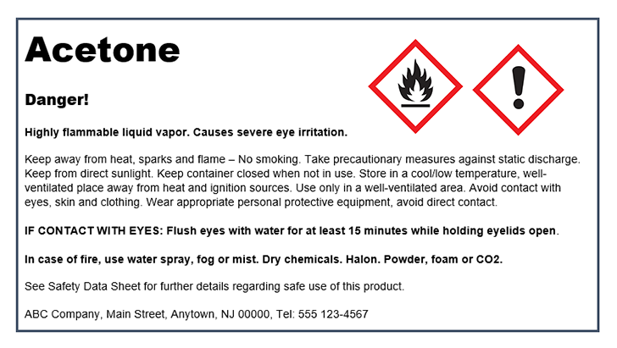
Health Hazards
The GHS categories are 1 (highest) to 4 (lowest).
The step of categorizing is important because it also determines which pictogram(s) and signal word (Danger or Warning) will be on the label and safety data sheet.
HAZARD COMMUNICATION: classifying and categorizing chemicals

Slide 38

Physical Hazards
Chemicals are physical hazards when they are classified as posing one of these hazardous effects:
Explosive
Flammable (aerosols, gases, liquids, solids)
Pressurized gases
Organic peroxides
Oxiders (gases, liquids, solids)
Pyrophoric (liquids, solids)
Self-heating substances
Self-reactive substances
Substances that emit flammable gases in contact with water
Corrosive to metals
Injuries from physical hazards include chemical burns, thermal (heat) burns, and bodily injuries from explosions.
HAZARD COMMUNICATION: classifying and categorizing chemicals

Slide 39
Physical Hazards
Here again are the hazardous chemicals in Oatey PVC cement:
Tetrahydrofuran
Methyl ethyl ketone
Cyclohexanone
Acetone
PVC (Chloroethylene, polymer)
As with health hazards, the manufacturer or importer must consider the full range of available scientific literature and other evidence concerning the potential physical hazards.
HAZARD COMMUNICATION: classifying and categorizing chemicals

Slide 40
Physical Hazards
After identifying the hazardous chemicals, the manufacturer or importer classifies the physical effects by using Appendix B of the Hazard Communication Rule.
Flammable Liquids is the classified physical hazard for Oatey PVC cement:
Flammable liquids are liquids that have a flash point at or below 93°C (199.4°F).
Flashpoint is the minimum temperature at which a liquid gives off vapor in sufficient concentration to form an ignitable mixture with air near the surface of the liquid.
HAZARD COMMUNICATION: classifying and categorizing chemicals

Slide 41
Physical Hazards
After the chemical has been classified, the manufacturer categorizes the hazards. Categorization identifies the degree, or severity, of hazard. In the case of flammable liquids, the flash point and boiling point determine the category.
This information has a practical application. For instance, acetone is a category 2 flammable because acetone will produce vapors at 73.4°F. A warm day could easily get to that temperature. Knowing this helps you to take actions to avoid flames or sparks around this product and also provide respiratory protection if necessary.
Category | Criteria
1 | Flash point < 23°C (73.4°F) and initial boiling point ≤ 35°C (95°F)
2 | Flash point < 23°C (73.4°F) and initial boiling point > 35°C (95°F)
3 | Flash point ≥ 23°C (73.4°F) and ≤ 60°C (140°F)
4 | Flash point > 60°C (140°F) and ≤ 93°C (199.4°F)
HAZARD COMMUNICATION: classifying and categorizing chemicals

Slide 42
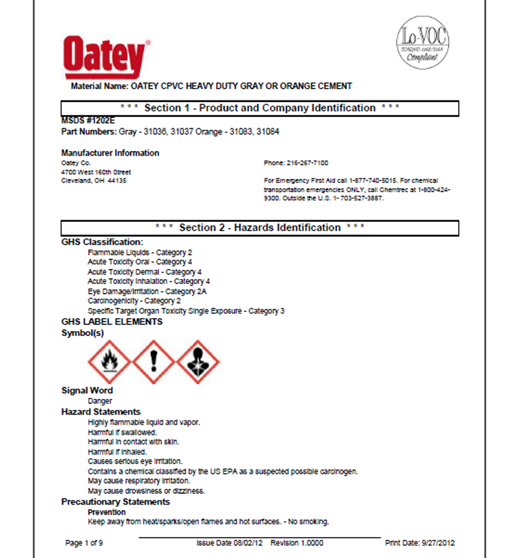
Label Elements and Safety Data Sheets
As you’ve just learned, Appendix A and B are used to classify and categorize the health and physical effects of chemicals.
Next, labels and safety data sheets are developed using the assigned classes and categories.
HAZARD COMMUNICATION: classifying and categorizing chemicals

Slide 43
Label Elements and Safety Data Sheets
The label elements are found in Appendix C and they guide the manufacturer and importer to the signal word and pictogram(s) to use.
There are two signal words under GHS:
Warning
Danger
Only one signal word may be used on a label. If at least one of the ingredients is categorized as Danger, the label must have the signal word Danger.
HAZARD COMMUNICATION: classifying and categorizing chemicals

Slide 44
Label Elements and Safety Data Sheets
The information from the process of classifying and categorizing chemicals also makes its way to the safety data sheet.
The elements of the safety data sheet can be found in Appendix D.
HAZARD COMMUNICATION: classifying and categorizing chemicals

Slide 45
Label Elements and Safety Data Sheets
Classifying and categorizing is the basis of GHS, which is a mechanism to meet the basic requirement of any hazard communication system.
Its ultimate purpose is to make information more accessible to employers and workers.
If you would like to learn more about Appendices A, B, C, and D, click the link below:
Hazard Communication Rule Division 2/Z 1910.1200
In the other modules you’ll learn about the different parts of labels and safety data sheets.
HAZARD COMMUNICATION: classifying and categorizing chemicals

Slide 46
HAZARD COMMUNICATION
Module 3: Pictograms

Slide 47

Welcome to Module 3!
During this module, we’ll answer the following questions:
What is a pictogram?
What are the parts of a pictogram?
What are the health hazard pictograms?
What are the physical hazard pictograms?
This module should take about 10 minutes to complete.
HAZARD COMMUNICATION: pictograms

Slide 48

What is a Pictogram?
Pictograms convey specific information by use of an image. This means that, without the use of words, workers from any country can understand a hazard is present.
Pictograms are found on container labels and on safety data sheets. Their intent is to give you, in a simple picture, a quick understanding of the hazards they represent.
Remember, the classification and categorization of substances and mixtures of hazardous chemicals by manufacturers and importers is the basis for the pictograms.
HAZARD COMMUNICATION: pictograms

Slide 49

What are the parts of a Pictogram?
GHS-related pictograms must have these three parts:
Red Border
White Background
Black Symbol
HAZARD COMMUNICATION: pictograms

Slide 50

What are the Health Hazard Pictograms?
There are two groups of pictograms. Appendix A of the Hazard Communication Rule talks about the health hazard categories and their related pictograms and classes.
Click the link to read Oregon OSHA’s fact sheet for more information.
HAZARD COMMUNICATION: pictograms

Slide 51

Health Hazard
Carcinogens
Respiratory Sensitizer
Reproductive Toxicity
Target Organ Toxicity
Mutagenicity
Aspiration Toxicity
HAZARD COMMUNICATION: pictograms

Slide 52

Skull and Crossbones
Acute Toxicity (severe)
HAZARD COMMUNICATION: pictograms

Slide 53

Exclamation Mark
Irritant
Dermal Sensitizer
Acute Toxicity (harmful)
Narcotic Effects
Respiratory Tract Irritants
HAZARD COMMUNICATION: pictograms

Slide 54

Corrosion
Corrosives
HAZARD COMMUNICATION: pictograms

Slide 55

What are the Physical Hazard Pictograms?
What are the Physical Hazard Pictograms?
Appendix B of the Hazard Communication Rule talks about the physical hazard categories and their related pictograms.
HAZARD COMMUNICATION: pictograms

Slide 56

Flame
Flammables
Self Reactives
Pyrophorics
Self-heating
Organic Peroxides
Emits Flammable Gas
HAZARD COMMUNICATION: pictograms

Slide 57

Flame Over Circle
Oxidizers
HAZARD COMMUNICATION: pictograms

Slide 58

Exploding Bomb
Explosives
Self Reactives
Organic Peroxides
HAZARD COMMUNICATION: pictograms

Slide 59

Gas Cylinder
Gas Under Pressure
HAZARD COMMUNICATION: pictograms

Slide 60

Environmental Pollutant
The Environmental Pollutant pictogram is part of GHS, but OSHA doesn’t regulate it.
HAZARD COMMUNICATION: pictograms

Slide 61
HAZARD COMMUNICATION
Module 4: Labels

Slide 62

Welcome to Module 4
During this module, you’ll learn about:
The elements of labels
Labeling containers
Labeling pipes
HazCom and NFPA 704
HazCom and HMIS
This module should take about 10 minutes for you to complete.
HAZARD COMMUNICATION: labels

Slide 63
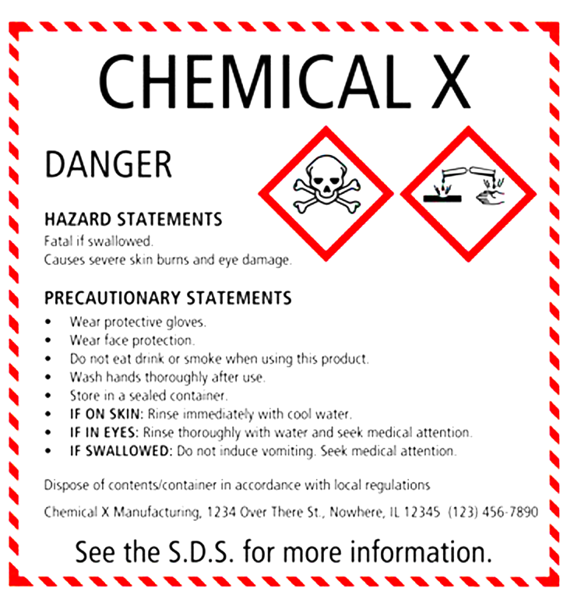
What is a Label?
If you use hazardous chemicals at your workplace, employers must ensure that each container has a legible label in English that identifies the chemical and its hazards and is easily cross-referenced with the product’s SDS.
You must not remove or deface the label.
Example Situation: In March of 2011, a worker manually performed caustic stripping and splashed chemicals on his pants, although he was wearing an apron. He attempted to wash the splashed chemicals off his pants. Later, during the second trip to the hospital, he received topical treatment. He then was unable to walk, and was transported to a burn unit. He was hospitalized for nearly a week. The company was cited under several standards, including:
The employer shall ensure that each container of hazardous chemicals in the workplace is labeled, tagged or marked.
The label may have warned the worker about the hazards and compelled him to use personal protective equipment, which may have saved him from injury.
HAZARD COMMUNICATION: labels

Slide 64
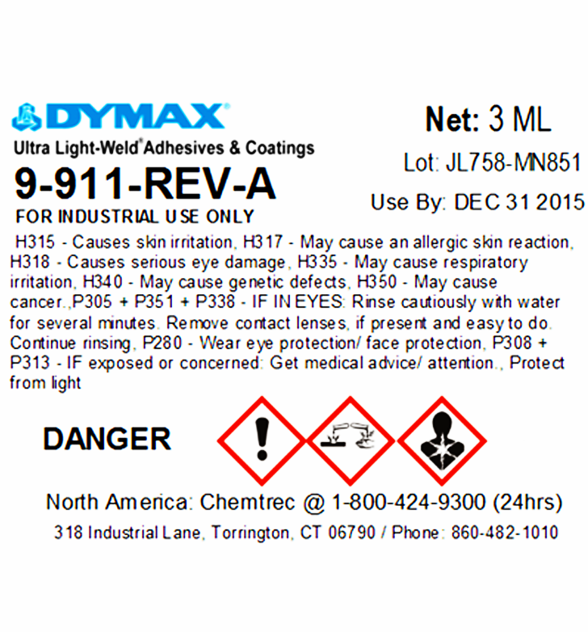
What is a Label?
Labels are attached to containers and/or pipes that hold hazardous chemicals.
Labels include information on the hazards of the chemical, plus instructions and information on the safe storage, handling, use and disposal of the chemical.
The employer shall ensure that workplace labels or other forms of warning are legible, in English, and prominently displayed on the container, or readily available in the work area throughout each work shift.
Employers having employees who speak other languages may add the information in their language to the material presented, as long as the information is presented in English as well.
HAZARD COMMUNICATION: labels

Slide 65
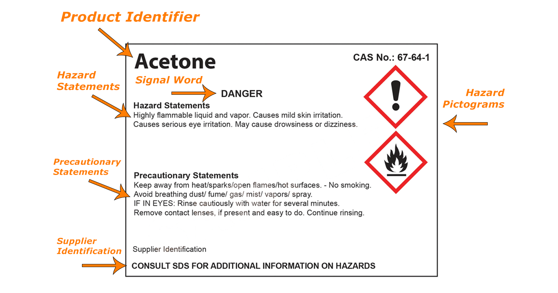
HAZARD COMMUNICATION: labels

Slide 66
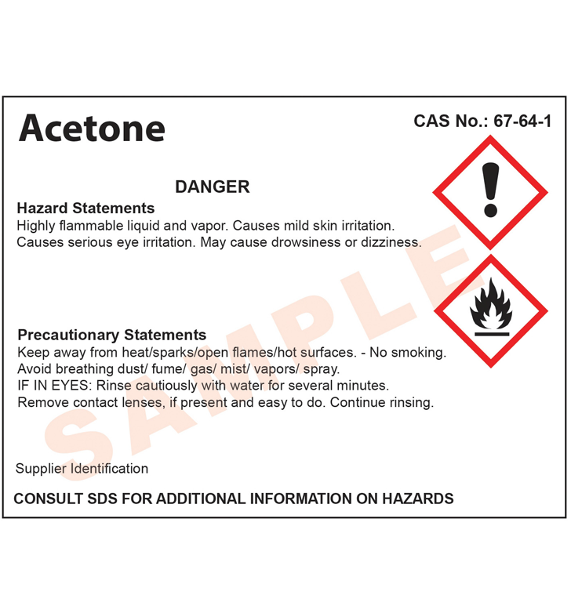
What is a Label?
Here’s what each part means:
Product identifier: the unique name or numbers of the product as given by the manufacturer or importer.
Signal word: either the word Danger or Warning to signal the level of severity of the chemical.
Hazard statements: a statement that describes the nature of the chemical and, where applicable, the degree of the hazard.
Supplier identification: the contact information for the manufacturer or importer.
Hazard pictograms: the GHS symbol assigned to the chemical based on the classification and categorization of the chemical by the manufacturer or importer.
Precautionary statements: a phrase that describes the measures that should be taken to reduce or prevent the adverse effects that may result from exposure to the chemical.
HAZARD COMMUNICATION: labels

Slide 67
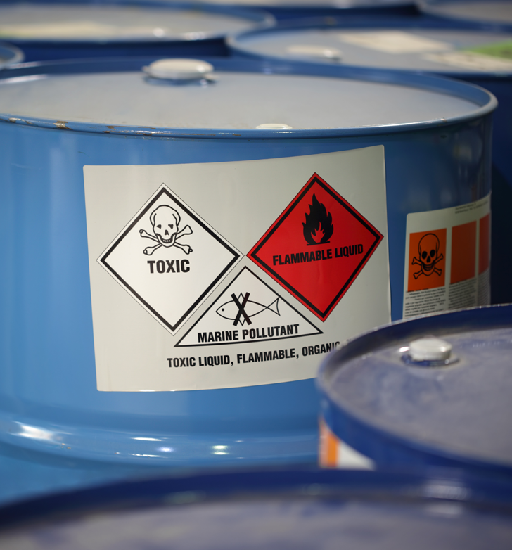
Labeling Containers
Now, let’s talk about containers and how labels need to be displayed.
There are three types of containers:
Primary
Secondary
Stationary
HAZARD COMMUNICATION: labels

Slide 68
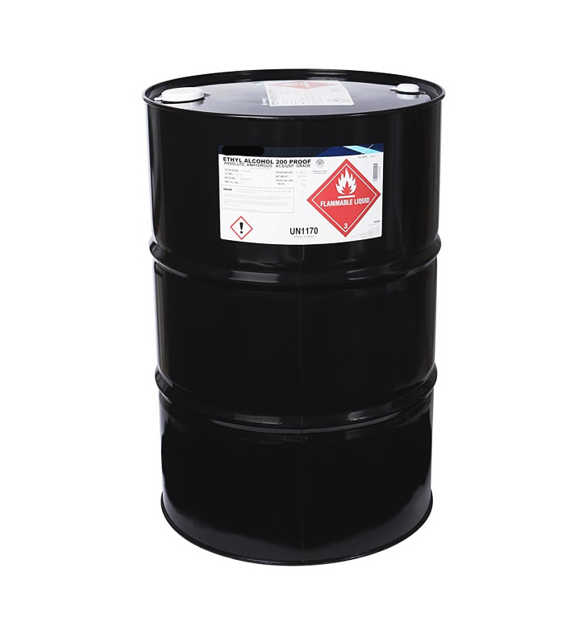
Labeling Containers
Primary containers are those containers that the chemical was shipped in from the manufacturer.
HAZARD COMMUNICATION: labels

Slide 69

Labeling Containers
Secondary containers are used to hold hazardous chemicals transferred from primary containers.
Secondary containers need to be labeled, tagged, or marked with either:
All the information specified for the labels on shipped containers,
or
The product identifier and words, pictures, symbols, or a combination that provides at least general information about the hazards of the chemical(s).
HAZARD COMMUNICATION: labels

Slide 70

Labeling Containers
Secondary containers do not have to be labeled if the following requirements are met:
The container, and the hazardous chemical inside, needs to be under the control of, and used only by, the person who transfers it from a labeled container; and it can only be used during the work shift in which it is transferred.
If these bottles are not under the direct control of a worker, they must be labeled.
HAZARD COMMUNICATION: labels

Slide 71

Labeling Containers
Stationary containers are pretty much what they sound like. They can’t be moved and are part of a work process.
Instead of putting labels on individual stationary containers, employees can use signs, placards, process sheets, batch tickets, operating procedures, or other written materials as long as this alternative method:
Identifies the specific containers it references,
and
Provides all the information required on a label.
Employers still need to ensure this alternative method of labeling is accessible to the employees in their work area throughout each work shift.
HAZARD COMMUNICATION: labels

Slide 72

Labeling Pipes
Pipes are not considered containers and have their own rule: OAR 437-002-0378.
If your workplace has pipes that contain hazardous substances, compressed air, or that are insulated with asbestos-containing material, warning labels need to be placed on the pipes.
Asbestos labels need to be placed every 75 feet, as well as at the beginning and end of the pipe and any place there may be confusion.
HAZARD COMMUNICATION: labels

Slide 73
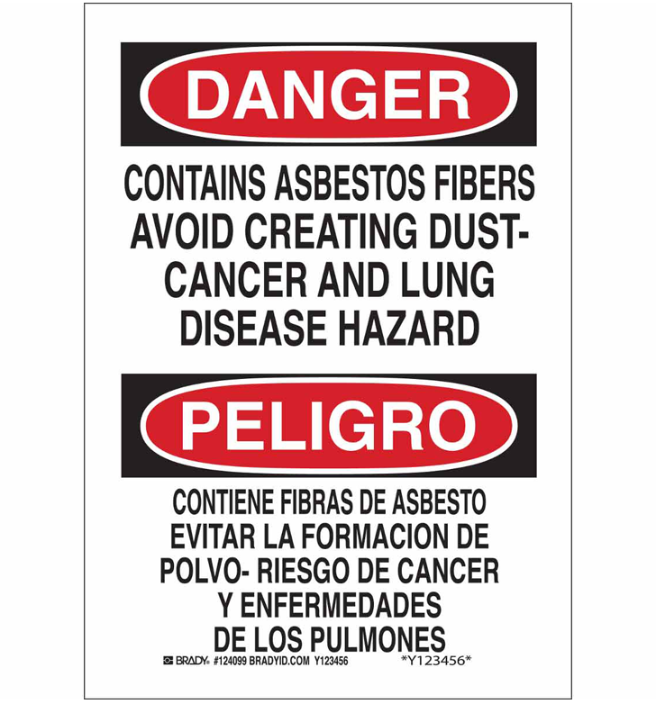
Labeling Pipes
If you use warning labels, apply them at the beginning and at the end of continuous pipe runs.
If a pipe is above or below the normal line of vision, apply the label above or below the horizontal centerline of the pipe so that employees can see it.
HAZARD COMMUNICATION: labels

Slide 74

Labeling Pipes
You can also use process sheets or written operating procedures.
If you use process sheets or written operating procedures you must:
Clearly identify the location of the pipes and the substances in the pipes.
Make them readily available to employees in their work areas.
HAZARD COMMUNICATION: labels

Slide 75

Hazard Communication and NFPA 704
Remember, HazCom is a chemical information system created to provide information and safe practices about the use and handling of chemicals in work places.
Well, NFPA 704 was developed by the National Fire Protection Association and was created to help those responding to an emergency, such as a fire or spill. It’s sometimes called the ‘fire diamond’.
NFPA 704 was never intended as a classification system for individual chemicals. It was meant for buildings.
Be careful not to confuse it with the GHS hazard classification from a product’s safety data sheet.
HAZARD COMMUNICATION: labels

Slide 76
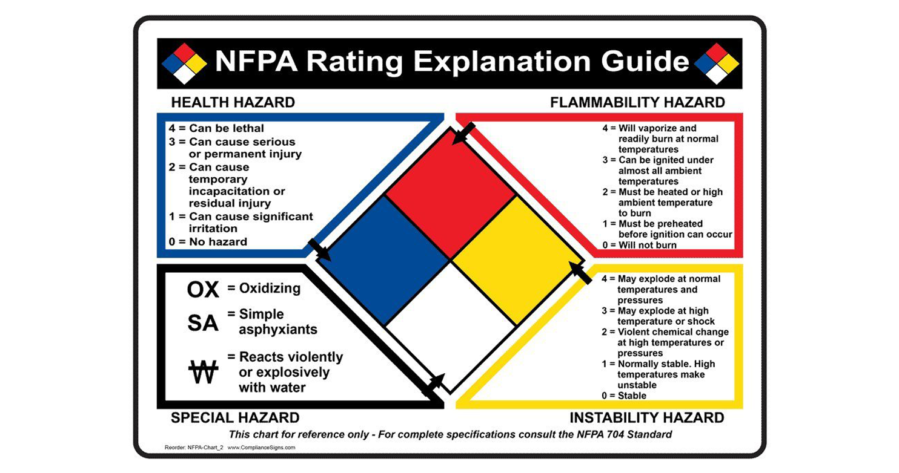
HAZARD COMMUNICATION: labels

Slide 77
Hazard Communication and NFPA 704
Here’s one difference:
HazCom uses the GHS classification system.
GHS uses 1-4, and 4 is the least hazardous.
NFPA 704 uses 0-4, and 4 is the most hazardous.
What’s most important is that employees understand the hazards.
HAZARD COMMUNICATION: labels

Slide 78
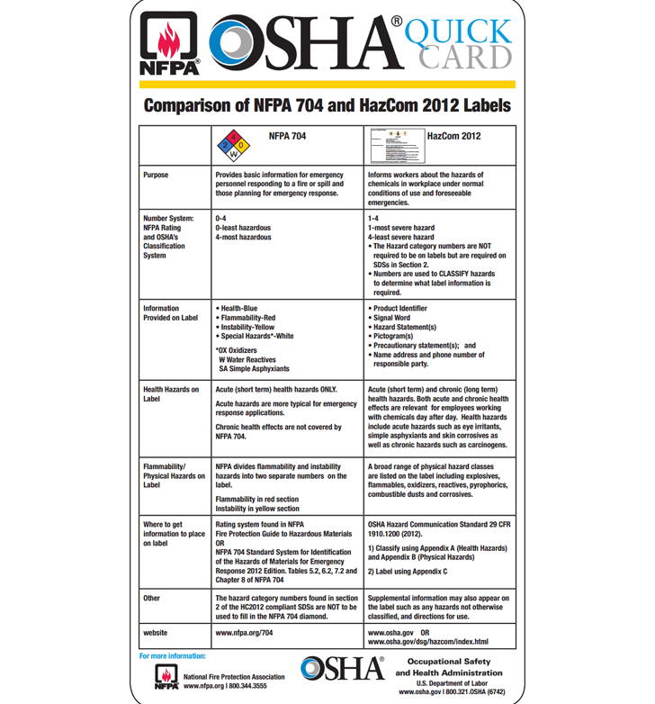
Hazard Communication and NFPA 704
So, to address this important difference:
NFPA and OSHA developed a Quick Card showing the differences between the two systems.
The Quick Card can be found on the NFPA website at www.nfpa.org/704 at the bottom of the page under ‘additional information’.
HAZARD COMMUNICATION: labels

Slide 79
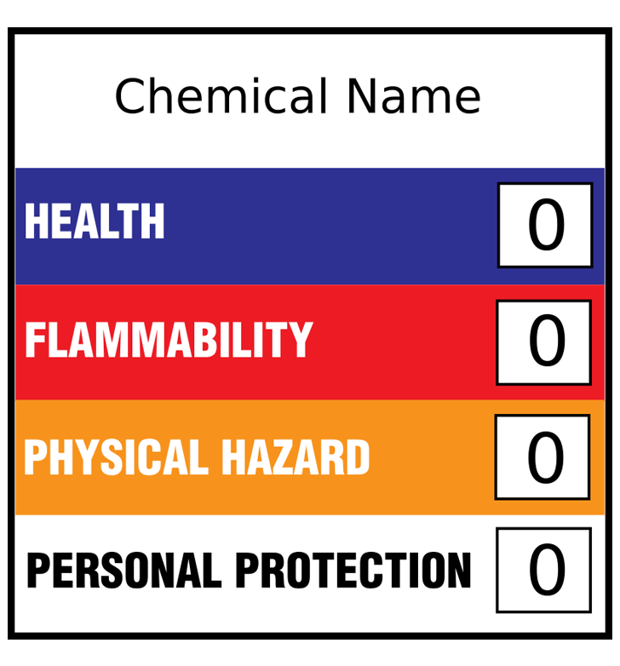
Hazard Communication and HMIS®
Remember, HazCom, aligned with the GHS classification system, is a chemical information system created to provide information and safe work practices about the degree of hazard of chemicals.
The Hazardous Materials Identification System (HMIS) was created by the American Coatings Association (ACA) as a compliance aid for the OSHA Hazard Communication Standard for use on secondary containers.
HAZARD COMMUNICATION: labels

Slide 80
HAZARD COMMUNICATION
Module 5: Safety Data Sheets

Slide 81

Welcome to Module 5
During this module, you’ll learn about:
What a safety data sheet is (SDS).
How to obtain safety data sheets.
What you need to do with your safety data sheets.
The required format and information of a safety data sheet.
This module should take about 10 minutes for you to complete.
HAZARD COMMUNICATION: safety data sheets

Slide 82
What is a Safety Data Sheet?
A safety data sheet contains detailed information about a hazardous chemical. Information includes:
The chemical’s health effects.
Its physical and chemical characteristics.
How to use the chemical safely.
What to do in an emergency.
You are required to have a current safety data sheet for every hazardous product covered by the Hazard Communication Rule that your employees use or may be exposed to as part of their work.
HAZARD COMMUNICATION: safety data sheets

Slide 83
What is a Safety Data Sheet?
Safety data sheets also include:
What to do in an emergency.
How the chemical enters the body.
The physical and health effects of the chemical.
Which personal protective equipment to use.
Pictogram(s) and signal word.
One important use for safety data sheets is to provide information in an emergency for:
First Aid Responders
Medical Personnel
Hazardous Materials Responders
HAZARD COMMUNICATION: safety data sheets

Slide 84

Where do Safety Data Sheets come from?
Chemical manufacturers and importers are required to prepare or provide a safety data sheet for each hazardous chemical product they supply.
Wholesale distributors are responsible for ensuring that you have a safety data sheet for each hazardous chemical product they sell to you.
If retail distributors sell hazardous chemicals to employers with a commercial account, they must provide safety data sheets to employers upon request.
They must also post a sign or otherwise inform employers that a safety data sheet is available.
If an employer without a commercial account purchases a hazardous chemical from a retail distributor, the retail distributor must provide the employer, upon request, with the name, address, and telephone number of the chemical manufacturer, importer, or distributor where they can obtain a safety data sheet.
HAZARD COMMUNICATION: safety data sheets

Slide 85

What Do I Do With My Safety Data Sheets?
You must ensure that safety data sheets are readily accessible to employees in their work areas.
Whether you keep safety data sheets in a notebook or on a computer, employees must be able to access the information immediately in an emergency.
If you keep safety data sheets electronically or access them on the Internet, you must have a backup system in place.
If your primary system becomes inoperable, such as from loss of power, network outage, or computer crash, you must still have a way for employees to access the information.
HAZARD COMMUNICATION: safety data sheets

Slide 86

What Do I Do With My Safety Data Sheets?
Your written HazCom program should identify who (a person, a work unit, or a job title) is responsible for managing all the safety data sheets at your workplace.
Their responsibility includes ensuring that:
The list of hazardous chemicals in the workplace is current.
The unique product identifier of each chemical on the list can be easily cross-referenced with the product identifier on its label and with its safety data sheet.
All hazardous chemical containers received have legible labels and safety data sheets.
Another purpose for safety data sheets is as a planning tool for employers. For example, when receiving a safety data sheet, management could also decide:
Who can and cannot have access to the chemical.
The level of supervision and training required by the workers handling the chemical.
What is the appropriate emergency response in the event of a spill or other situation.
HAZARD COMMUNICATION: safety data sheets

Slide 87
What Are The Parts of a Safety Data Sheet?
There are 16 parts to a safety data sheet.
As of June 1, 2015, the Hazard Communication Rule has required all safety data sheets to be in a uniform format and include the section numbers, the headings, and associated information.
See the following slides for descriptions of the sections.
HAZARD COMMUNICATION: safety data sheets

Slide 88
What Are The Parts of a Safety Data Sheet?
Identification: includes product identifier; manufacturer or distributor name, address, phone number; emergency phone number; recommended use; restrictions on use.
Hazard(s) Identification: includes all hazards regarding the chemical and required label elements.
Composition/Information on Ingredients: includes information on chemical ingredients and trade secret claims.
First-Aid Measures: includes important symptoms or effects (acute or delayed) and required treatment.
Fire-Fighting Measures: lists suitable extinguishing techniques, equipment, and chemical hazards from fire.
Accidental Release Measures: lists emergency procedures, protective equipment, and proper methods of containment and cleanup.
HAZARD COMMUNICATION: safety data sheets

Slide 89
What Are The Parts of a Safety Data Sheet?
Handling and Storage: lists precautions for safe handling and storage, including incompatibilities.
Exposure Controls/Personal Protection: lists OSHA’s permissible exposure limits (PELs), the ACGIH’s threshold limit values (TLVs), appropriate engineering controls, and personal protective equipment (PPE).
Physical and Chemical Properties: lists the chemical’s characteristics.
Stability and Reactivity: lists chemical stability and possibility of hazardous reactions.
HAZARD COMMUNICATION: safety data sheets

Slide 90
What Are The Parts of a Safety Data Sheet?
OSHA will not enforce sections Ecological Information, Disposal Considerations, Transport Information, and Regulatory Information, because this information is regulated by other agencies.
Toxicological Information: includes routes of exposure, related symptoms, acute and chronic effects, and numerical measures of toxicity.
Other Information: includes preparation and revision dates of the SDS.
HAZARD COMMUNICATION: safety data sheets

Slide 91
Do I Have to Keep Safety Data Sheets if I no Longer Use the Chemical?
The Hazard Communication Rule only requires you to keep safety data sheets for the chemicals that are present in your facility.
However, rule 1910.1020 requires employers to keep a record of employee exposures to hazardous chemicals for at least 30 years.
You can either keep the safety data sheets for these hazardous products that you no longer use; or you can keep another record that includes the chemical’s identity and where and when it was used in your workplace.
For more information about these record-keeping requirements, see: Division 2/Z, 1910.1020, Access to employee exposure and medical records
HAZARD COMMUNICATION: safety data sheets

Slide 92
HAZARD COMMUNICATION
Module 6: Training

Slide 93

Welcome to Module 6
During this module, you’ll learn about:
The requirements for training employees about chemical hazards.
The topics the training must cover.
Who can deliver the training.
This module should take about 10 minutes for you to complete.
HAZARD COMMUNICATION: training

Slide 94

When is Training Required?
The Hazardous Communication rule requires that, if you have employees who may be exposed to hazardous chemicals, you must:
inform them
and
train them
before they start their jobs or are exposed to new hazardous chemicals..
HAZARD COMMUNICATION: training

Slide 95

What Must Employees be Informed of?
There are 3 things employees need to be informed about:
An overview of Oregon OSHA’s hazard communication rules. To open a PDF of the rule, click the link below:
1910.1200 Hazard Communication (AO 4-2013)
Any operations in their work areas where hazardous chemicals are present.
The location and availability of the employer’s written hazard communication program, which includes the list of hazardous chemicals and the location of safety data sheets.
HAZARD COMMUNICATION: training

Slide 96

What are the Required Training Topics?
Required training must cover:
The methods employers use to detect the presence or release of a hazardous chemical in employees’ work areas, such as exposure monitoring and the appearance or odor of the chemicals.
The physical and health hazards of the chemicals in their work areas, including simple asphyxiation, combustible dust, pyrophoric gases, and hazards not otherwise classified.
HAZARD COMMUNICATION: training

Slide 97
What are the Required Training Topics?
Example Situation:
In March of 2010, two employees were mixing an adhesive compound. A chemical reaction caused the release of steam. Both suffered serious burns to their face, arms, and back and were hospitalized.
The company received several citations, including:
Employers shall provide employees with effective information and training on hazardous chemicals in their work area at the time of their initial assignment, and whenever a new chemical hazard the employees have not previously been trained about is introduced into their work area.
If proper training had been provided, the employees could have recognized the hazards and taken steps to avoid injury.
HAZARD COMMUNICATION: training

Slide 98

What are the Required Training Topics?
Required training must cover:
The measures employees can take to protect themselves from these hazards, including those the employer has implemented, such as appropriate work practices, emergency procedures, and required personal protective equipment.
Information and training may be designed to cover categories of hazards (e.g., flammability, carcinogenicity) or specific chemicals. Chemical-specific information must always be available through labels and material safety data sheets.
HAZARD COMMUNICATION: training

Slide 99
What are the Required Training Topics?
Example Situation:
In November of 2009, a sanitation worker was cleaning a vegetable tank. The worker experienced a burning sensation. He was hospitalized in a burn unit for chemical burns from the cleaning solution.
The company was cited for:
Employee training shall include at least:
The measures employees can take to protect themselves from these hazards, including specific procedures the employer has implemented to protect employees from exposure to hazardous chemicals, such as appropriate work practices, emergency procedures, and personal protective equipment to be used.
If the worker had been properly trained to protect himself, he could have avoided injury.
HAZARD COMMUNICATION: training

Slide 100

What are the Required Training Topics?
Required training must cover the details of the employer’s hazard communication program, including:
      An explanation of the labels on shipped containers that are received.
The labeling system used on in-house containers.
The labeling system used on pipes in employees’ work areas that contain hazardous substances.
The information presented on safety data sheets, including the order of the information.
How employees can obtain and use the information on safety data sheets.
HAZARD COMMUNICATION: training

Slide 101

Who Can Train Employees?
Choose a person who understands the required training topics and who has the skills to conduct the training in a way that employees can understand.
HAZARD COMMUNICATION: training

Slide 102

Training Form Samples
Click the links below to open samples of employee training record forms:
English version
Spanish version
Although the Hazard Communication rule does not require written training records, some employers find these forms helpful.
HAZARD COMMUNICATION: training

Slide 103
HAZARD COMMUNICATION
Module 7: Written Program

Slide 104

Welcome to Module 7
During this module, you’ll learn about:
Who needs a written hazard communication program.
The seven parts of the written hazard communication program.
This module should take about 10 minutes for you to complete.
At the end, you’ll be given a short quiz.
HAZARD COMMUNICATION: written program

Slide 105
Who Needs a Written Program?
Employers must prepare a written hazard communication program if employees at the workplace use or may be exposed to hazardous chemicals. The program must be specific to your workplace.
It’s best to complete the written program as soon as possible as it‘s one of the most cited violations by Oregon OSHA.
But more importantly, the written program is for worker safety.
HAZARD COMMUNICATION: written program

Slide 106
Who Needs a Written Program?
Example Situation: In June of 2008, a machinist was cleaning two machines with solvent. During the cleaning of the second machine, the worker experienced severe symptoms including shortness of breath, light headedness, and loss of feeling in his hands. He was taken to the hospital, where he stayed for two nights. The doctors reported that he had suffered from chemical pneumonia.
The company was cited for several violations, including:
Employers shall develop, implement, and maintain at each workplace, a written hazard communication program.
Developing a written program would have given the employer an opportunity to evaluate this type of hazard and to prevent this type of injury.
HAZARD COMMUNICATION: written program

Slide 107
Who Needs a Written Program?
Citations: Of the 4,366 citations issued in Oregon in the last 5 years under HazCom, 1,907 of them involved the written program. Most of those citations were for not having a written hazard communication program.
The written program is also an employer’s opportunity to think things through.
In other words, creating your written program helps to ensure a safe environment when it comes to hazardous chemicals.
The written program doesn’t have to be given to each employee, but employees do need to know where it is located and they need to be able to access it if necessary.
HAZARD COMMUNICATION: written program

Slide 108

What are the Parts of a Written Program?
There are seven parts to a written program and it must include:
a list of all the hazardous chemicals used at the workplace
In addition, it must describe how the employer will:
label containers of hazardous chemicals
make safety data sheets available
train employees about chemical hazards
inform employees about the chemical hazards of non-routine tasks
inform employees about the labeling system for pipes
inform contractors and other employers about the hazardous chemicals at the workplace
Let’s take a quick look at the 7 parts of a written program.
HAZARD COMMUNICATION: written program

Slide 109
What are the Parts of a Written Program?
Delegation: Can employers delegate these duties?
Yes! Delegating is okay and gets workers involved. If a worker likes to train or organize SDSs, the employer can delegate that responsibility to that person.
However, the written program must identify who is responsible for the different parts of the program, whether a job title or an individual, and the program must be updated if the responsibility changes.
Employee Rights: Employees have the right to:
Review the written program.
Be informed about hazardous chemicals in the workplace.
Have their physician or union rep receive information on their behalf.
HAZARD COMMUNICATION: written program

Slide 110

Listing the Hazardous Chemicals
If your employees could be exposed to hazardous chemicals in the workplace, make a list of the chemicals, using the product identifier from the label.
Update your list when you receive new chemicals.
Make sure there is a safety data sheet for each chemical on the list. The product identifier must allow employees to cross reference the listed name with the product label and the SDS.
HAZARD COMMUNICATION: written program

Slide 111
Listing the Hazardous Chemicals
Chemical List: Do all hazardous chemicals have to be on the chemical list?
No. If you remember from the Hazard Communication Introduction module, there are chemicals in the workplace that are excluded from HazCom.
Product Identifier:
The product identifier is the unique name used by a manufacturer or importer for a hazardous chemical included in the employer’s written HazCom program that allows users to cross-reference all the specific hazard information found on the label and in its SDS.
HAZARD COMMUNICATION: written program

Slide 112
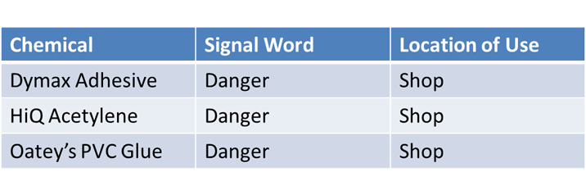
Listing the Hazardous Chemicals
Here’s an example of a chemical list.
The only requirement for your written program chemical list is the chemical’s product identifier.
We recommend adding the two additional columns. Both signal word and location of use help you to quickly identify the more dangerous chemicals in your workplace.
HAZARD COMMUNICATION: written program

Slide 113
Labeling the Containers of Hazardous Chemicals
Ensure that containers of hazardous chemicals have labels.
In your written program, describe how you will make sure that each container at your workplace has a label that identifies the chemical and provides the required information about its hazards, whether it is a manufacturer’s label or a secondary label.
HAZARD COMMUNICATION: written program

Slide 114
Making the Safety Data Sheets Available
The written program must describe where you will keep your safety data sheets.
If you store them in a paper file, identify the location where employees can access them.
If you store them electronically, describe how employees will access them, especially in an emergency.
Indicate who to contact if one is missing or incomplete.
HAZARD COMMUNICATION: written program

Slide 115
Making the Safety Data Sheets Available
You must ensure that safety data sheets are always available to employees in their work areas. Whether you keep safety data sheets in a notebook or on a computer or if they are provided by a service, employees must be able to obtain the information immediately, especially in an emergency.
If you keep safety data sheets electronically or access them on the Internet, you must have a backup system in place. If your primary system becomes inoperable, such as from loss of power, network outage, or computer crash, you must still have a way for employees to access the information.
HAZARD COMMUNICATION: written program

Slide 116
Training Employees about Chemical Hazards
Describe how you will train your employees about the chemical hazards, whether they are a new employee or are exposed to a new chemical hazard.
In your written program, include:
How employees will be trained to protect themselves from hazards.
How employees will be trained to read and understand product labels and safety data sheets.
Who is responsible for providing training.
Training requirements were covered in more detail in the Hazard Communication Training module. Refer to that module for more detailed information.
HAZARD COMMUNICATION: written program

Slide 117

Informing Employees who Perform Non-routine Tasks about Chemical Hazards
Describe how you will inform employees who do non-routine tasks about the hazardous chemicals they may be exposed to.
Identify the non-routine tasks, such as annual maintenance activities or leaks from sealed containers, and determine what employees must do to minimize exposure to these chemical hazards.
HAZARD COMMUNICATION: written program

Slide 118
HAZARD COMMUNICATION: written program
Hazardous Non-Routine Task: What is a hazardous non-routine task? Welding on metal can be a hazardous and non-routine task for an assembly plant that welds 3 to 4 times per year. But, it would not be a non-routine task for an auto-repair shop whose workers weld continuously through the day, week, month, and year.
Example Situation: In August of 2011, two maintenance workers were assigned to clear a clogged pipe. After trying a plumber’s snake, they poured liquid drain opener into the pipe. The drain opener reacted violently with something in the pipe, and caustic liquid sprayed in their faces. Both had serious burns to their eyes and faces. Both employees were hospitalized and remained out of work for more than one week. The company was cited for:
The methods the employer will use to inform employees of the hazards of non-routine tasks, and the hazards associated with chemicals contained in unlabeled pipes in their work areas.
If this type of non-routine task had been addressed in the written program these workers may have been able to avoid injury.

Slide 119
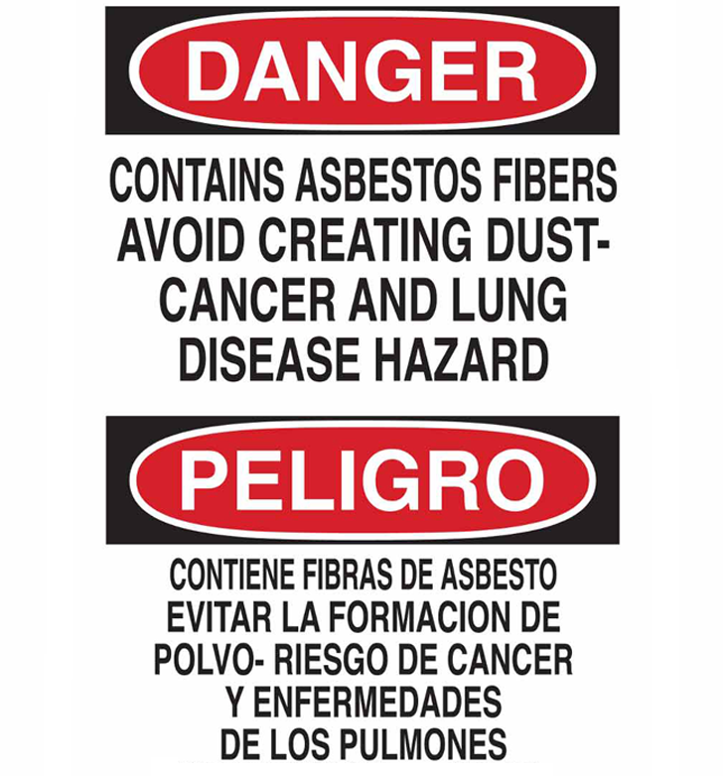
Informing Employees about Hazardous Chemicals in Pipes and Asbestos-insulated Pipes
Describe how you will inform employees about your labeling system for pipes that contain hazardous chemicals and pipes insulated with asbestos-containing material.
In Oregon, these pipes must be labeled.
For the full rule, see:
Division 2/Z, 437-002-0378 Oregon Rules for Pipe Labeling
HAZARD COMMUNICATION: written program

Slide 120

Contractors and Hazardous Chemicals
Employers must describe how they will inform contractors about the hazardous chemicals the contractor’s employees may be exposed to at the workplace.
You’ll need to describe:
How and where you will make your safety data sheets available.
How you will inform them about any precautions necessary for their employees.
The labeling system used in your workplace.
Employers must also describe how they will obtain safety data sheets from contractors.
You’ll need to identify who in your company is responsible for obtaining the safety data sheets from the contractor.
HAZARD COMMUNICATION: written program

Slide 121
Written Program Samples
Click the links below to open samples of a written program:
English version
Spanish version
For a fillable version of these samples, visit our website:
https://osha.oregon.gov/pubs/Pages/index.aspx
HAZARD COMMUNICATION: written program

Slide 122
HAZARD COMMUNICATION - QUIZ
Question 1: All chemicals fall under the Hazard Communication Rule.
True
False
Question 2: The purpose of HazCom is to reduce injuries and illnesses caused by hazardous chemicals.
True
False
HAZARD COMMUNICATION: written program

Slide 123
HAZARD COMMUNICATION - QUIZ
Question 3: One of the key elements of GHS is:
Oversight of chemical manufacturing
Consistency of labels and safety data sheets
Management of hazardous waste
Question 4: Classifying and categorizing chemicals is the basis for labels and SDS’s.
True
False
HAZARD COMMUNICATION: written program

Slide 124
HAZARD COMMUNICATION - QUIZ
Question 5: Classifying chemicals determines:
The color of a substance
If the chemical is hazardous
If the chemical is imported from another country
Question 6: Which of the below are parts of a label? (Select all that apply)
Product identifier
Signal word
Hazard statements
Supplier information
Hazard pictograms
Precautionary statements
HAZARD COMMUNICATION: written program

Slide 125
HAZARD COMMUNICATION - QUIZ
Question 7: Safety data sheets include:
What to do in an emergency
How the chemical enters the body
The physical and health effects of the chemical
Which personal protective equipment to use
Pictogram(s) and signal word
All of the above
Question 8: A current safety data sheet is required for every hazardous chemical covered by the Hazard Communication Rule that employees use or may be exposed to as part of their work.
True
False
HAZARD COMMUNICATION: written program

Slide 126
HAZARD COMMUNICATION - QUIZ
Question 9: Safety data sheets must be readily available to employees in their work areas.
True
False
Question 10: If employees may be exposed to hazardous chemicals, they must be trained regarding the hazards: (Select all that apply)
Before they start their job.
Before they are exposed to a new chemical
Never; it is not required.
HAZARD COMMUNICATION: written program

Slide 127
HAZARD COMMUNICATION - QUIZ
Question 11: Employers must train employees about:
The methods used to detect the presence or release of hazardous chemicals in work areas.
The physical and health hazards of the chemical in their work areas.
The measures employees can take to protect themselves from the hazards.
The details of the hazard communication program
All of the above
Question 12: Employers must prepare a written hazard communication program if employees at the workplace use or may be exposed to hazardous chemicals.
True
False
HAZARD COMMUNICATION: written program

Slide 128
HAZARD COMMUNICATION - QUIZ
Question 13: Employees need to be able to access the company’s HazCom written program.
True
False
HAZARD COMMUNICATION: written program

Slide 129
HAZARD COMMUNICATION - QUIZ ANSWERS
B
A
B
A
B
A, B, C, D, E, F
7) F
8) A
A
A, B
E
A
A
HAZARD COMMUNICATION: written program
Notes:
Answers

Slide 130

Where To Go From Here
An excellent resource to utilize is the A-Z Topic Index on the Oregon OSHA website. It has lists of relevant publications, training materials, rules, interpretations, videos, and other miscellaneous materials.
If you want guidance in developing a safer work environment, you may consider our free and confidential consultation service. Our consultants in workplace health and safety can help you reduce accidents, related costs, and help you develop a comprehensive program.
HAZCOM Resources
Oregon OSHA Online Courses
Consultation Services
File a Complaint
HAZARD COMMUNICATION: written program

Slide 131

HAZARD COMMUNICATION: written program

Slide 132

Credits
You’ve completed the Hazard Communication course!
Produced by the Public Education Team of Oregon OSHA:
Phillip Wade, Ricardo Vázquez Rodríguez, Tammi Stevens, Angelina Cox, Tim Wade
Stock media provided by:
Getty Images Inc. and Envato Elements
HAZARD COMMUNICATION: written program

