Slide 1



HAZARD IDENTIFICATION
Module 1: Identifying Hazards
Please note: If the online course contains videos, the video links are included in this PPT.
You will need to have an internet connection to play the videos or
you can download the videos and embed them into your copy of this PPT presentation.

Slide 2


This is not to substitute for, or an addition to, the Oregon Safe Employment Act or any rules issued by Oregon OSHA. This training course is provided as a public service, intended to assist employers to comply with Oregon occupational safety and health rules. Manufacturers, products, or services displayed in this material are for informational purposes only and do not constitute an endorsement by Oregon OSHA.
This class helps meet the safety committees training requirements.
Disclaimer
Module 1: identifying hazards

Slide 3
Video: An Introduction to Hazard Identification
Module 1: identifying hazards

Slide 4

Course Objectives
This online course will help employees, safety committee members, and management to understand their role in:
Identifying workplace hazards
Conducting safety and health inspections
Analyzing hazards
Incident and accident analysis
Controlling hazards
We’ll discuss the many types of hazards that may exist in the workplace, the various elements of an effective hazard control program, and the nature of hazards in the workplace.
Module 1: identifying hazards

Slide 5

Course Objectives
In the next few slides, we’re going to briefly examine the rules that apply to hazard identification. Understanding these rules form the basis of this course and empower you to implement them in your workplace.
What are the benefits of applying the lessons in this course?
A safer workplace
A better understanding of how to avoid or repeat injuries
A strong culture of safety
Addressing employees safety and health concerns
Module 1: identifying hazards

Slide 6

Rules Requiring Hazard Identification
Oregon Revised Statute 654.010 requires employers to furnish a safe place of employment. As described in the statute, every employer shall:
Furnish employment and a place of employment which are safe and healthful for employees therein, and
Do every other thing reasonably necessary to protect the life, safety, and health of such employees.
To read the full statute, click on this link.
Module 1: identifying hazards

Slide 7
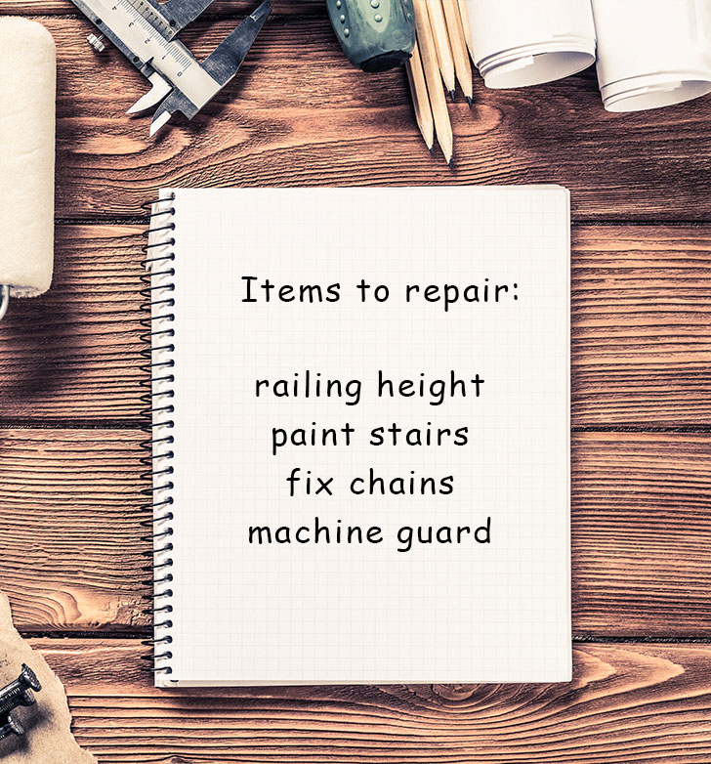
Rules Requiring Hazard Identification
Additionally, Oregon Administrative Rule 437-001-0760(7)(a)-(b) states:
“(a) All places of employment must be inspected by a qualified person or persons as often as the type of operation or the character of the equipment requires. Defective equipment or unsafe conditions found by these inspections must be replaced or repaired or remedied promptly.
(b) Wherever required in this safety code, a written and dated report, signed by the person or persons making the inspection must be kept.”
You may view the full rule here. Inspections are further clarified in the safety committee rules here.
Module 1: identifying hazards

Slide 8

Safety Committees Role in the Workplace
To best understand how to provide a safe and healthy workplace, it’s important to understand the role of the Safety Committee. In the next few slides we’ll explore:
The expectations of Safety Committees
A review of the rules and requirements, and
Selecting Safety Committee members.
To learn more about Safety Committee and Meetings requirements take the Oregon OSHA full online course.
Click Here to begin the Safety Committees and Meetings Online Course
Module 1: identifying hazards

Slide 9
Video: Safety Committees
Module 1: identifying hazards

Slide 10

Rules Requiring Hazard Identification
According to Oregon Administrative Rule 437-001-0765(7), your safety committee must establish procedures for conducting workplace safety and health inspections. Persons trained in hazard identification must conduct inspections as follows:
Inspections of primary fixed locations conducted quarterly.
Inspections of office environments, by safety committee members, or designated person, conducted quarterly.
Inspections of auxiliary and satellite locations conducted quarterly.
Inspections of mobile locations, infrequently visited sites, and sites that do not lend themselves to quarterly inspections as determined necessary.
To read the full rule, click on this link.
Module 1: identifying hazards

Slide 11

Rules Requiring Hazard Identification (continued)
As directed in Oregon Administrative Rule 437-001-0765(8) your safety committee must also:
Work with management to establish, amend, or adopt accident investigation procedures that will identify and correct hazards.
Have a system that allows employees an opportunity to report hazards and safety and health related suggestions.
Establish procedures for reviewing inspection reports and for making recommendations to management.
Evaluate all accident and incident investigations and make recommendations for ways to prevent similar events from occurring.
Make safety committee meeting minutes available for all employees to review.
To read the full rule click on this link.
Module 1: identifying hazards

Slide 12
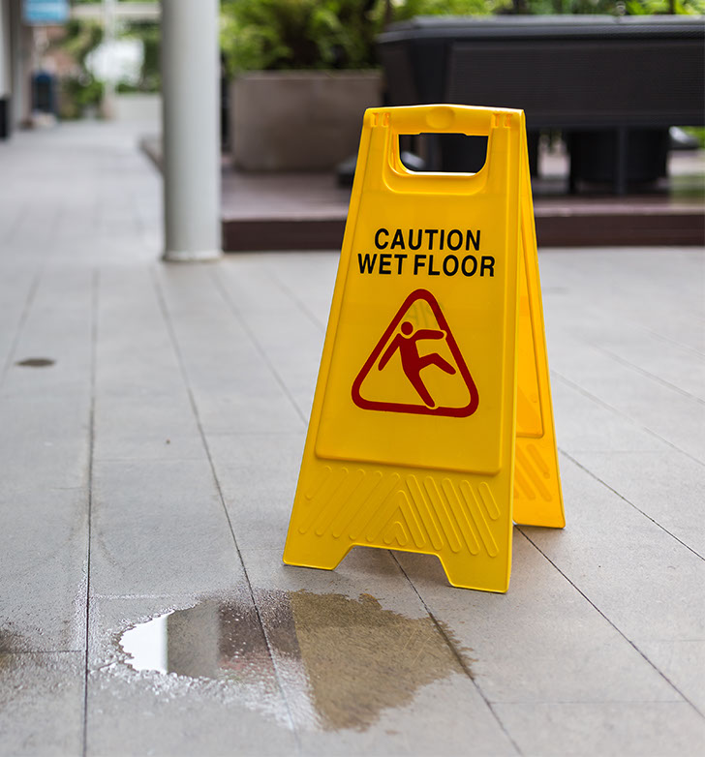
Understanding Workplace Hazards
Now we’ll look more closely at workplace hazards, looking into the types of risks present in the workplace.
Falls: Falls are the most common types of accidents, specifically falls to the same surface, and falls to below. The severity of injury from a fall depends on three factors:
Velocity of initial impact,
Magnitude of deceleration - due to hardness of the surface, and
Orientation of the body on impact.
Module 1: identifying hazards

Slide 13
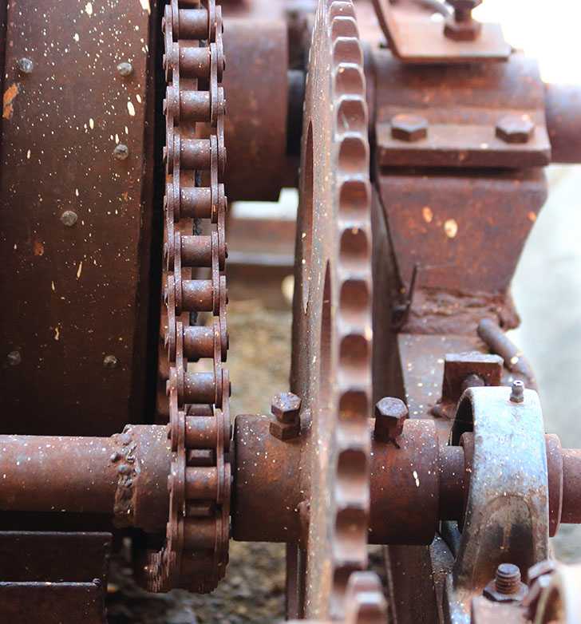
Impacts and Mechanical
Impact: Impacts resulting in struck by and struck against may cause serious accidents. The severity of injury from impacting objects depends on three factors:
Velocity of the impact,
Characteristics of the object (size, hardness, shape, etc.) and
Body part(s) impacted.
Mechanical: There are as many hazards created by moving machine parts as there are types of machines. Mechanical hazards cause caught-in, caught-on, and crush accidents that can cut, crush, amputate, break bones, strain muscles, and even asphyxiation. Mechanical hazards motions include:
Rotating
Reciprocation
Transverse
Module 1: identifying hazards

Slide 14
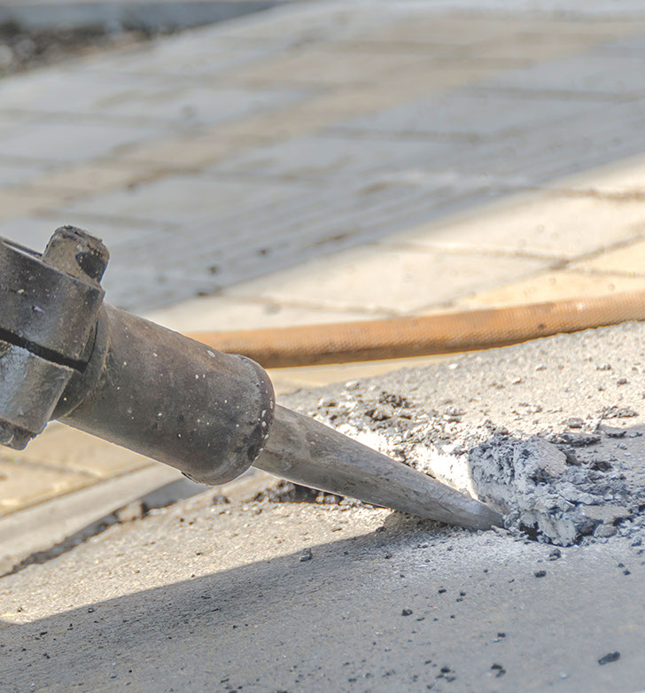
Vibration and Noise
Vibration and noise: Tools, equipment, and surfaces that vibrate, can create noise, and potentially expose a worker to vibration-related hazards.
These include:
Segmental vibration: This is when the hands or some other body part is exposed to a vibrating tool or work-surface. Segmental vibration is a known source for injuries to the hands, wrists, forearms, and upper body.
Whole-body vibrations: This is most commonly experienced in moving vehicles and impacts the spine. The lower back is particularly susceptible to fatigue and injury from exposures.
Module 1: identifying hazards

Slide 15

Toxics
Toxics: A material is toxic if a small quantity can cause an injurious effect, such as tissue damage, cancer, and/or mutations. It’s important to consider the routes of entry of toxic materials into the human body.
There are four possible routes of entry:
Inhalation: Breathing in toxics is the most common and dangerous route.
Ingestion: Toxics enter through the gastrointestinal tract.
Absorption: Toxics pass through the skin into the bloodstream.
Injection: Toxics can be injected into the body (needles, etc.) the least common, yet most direct, route of entry.
Module 1: identifying hazards

Slide 16

Heat and Temperature
Heat and temperature: Overexposure to heat and temperature extremes may result in a range of injuries from burns to frostbite. Temperature indicates the level of heat present. Heat is produced as a result of: chemical reaction, combustion, electrical current, mechanical motion, and metabolism.
Heat is transferred by:
Convection: Heat is transferred by molecules moving through a fluid, gas, or liquid.
Radiation: Occurs when a body’s temperature is above absolute zero.
Conduction: Heat is transferred through a substance or between substances without physical movement of the substance itself.
Module 1: identifying hazards

Slide 17
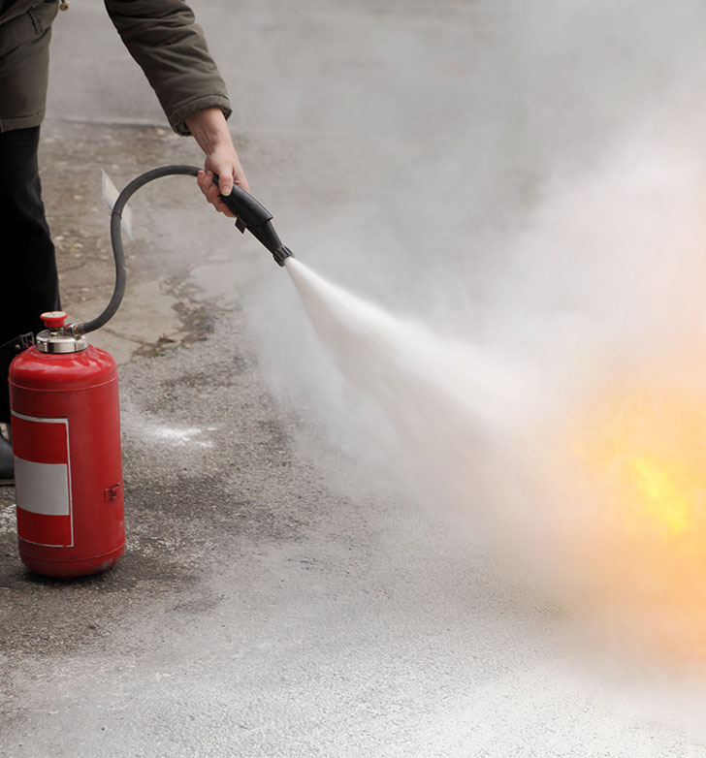
Fire and Explosives
Flammability/fire: Fire may cause burn injuries. In order for combustion to take place, the fuel and oxidizer (oxygen) must be present in gaseous form. Flammable materials include fuel, solvents, cleaning agents, lubricants, coatings, chemicals, refrigerants, insecticides, plastics, hydraulic fluid, vegetation, wood/paper, fabrics, metals, and rubber products.
Explosives: The results of an explosion may range from minor injury to major catastrophe. Many types of explosions may occur due to chemicals, dusts, solids, vapors, gases, and equipment.
Module 1: identifying hazards

Slide 18
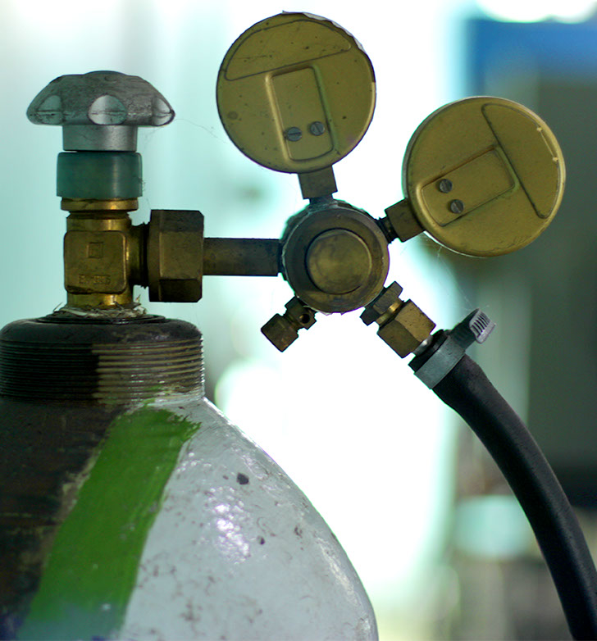
Pressure Hazards
Pressure hazards: High and low pressure hazards include:
Ruptured cylinders: The thrust generated by gas flowing through a puncture or rupture of a cylinder can be 20 times greater than the weight of the cylinder and reach the velocity of 50 feet per second in 1/10th of a second.
Whipping hoses and lines: Compressed air and water hoses can kill when end fittings become loose. Such hoses and lines should be restrained by weighting with sand bags at short intervals, chained, clamped, etc. Never try to grab a whipping hose or line; turn off the controlling valve.
Water hammer: The effect caused by a sudden stop of liquid flow causing a shock wave (water hammer) that can cause a line rupture.
Module 1: identifying hazards

Slide 19
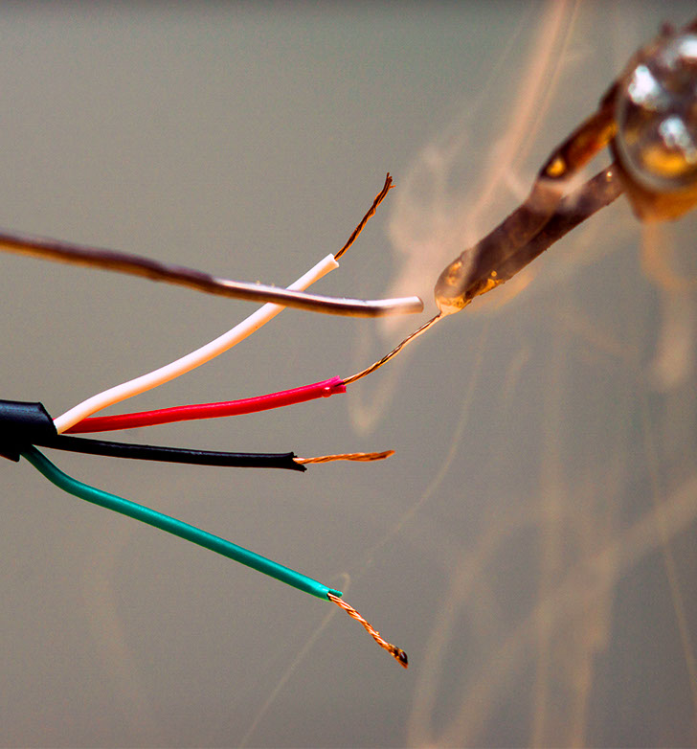
Electrical Contact
Electrical contact: Exposure to electrical current. There are four principal categories of electrical hazards:
Shock: Electrical shock is a sudden and accidental stimulation of the body’s nervous system by an electrical current. Look for bare conductors, insulation failures, buildup of static electricity, and faulty electrical equipment.
Ignition of combustible (or explosive) material: Ignition is usually caused by a spark, arc, or corona effect.
Overheating: High current/high heat that can result in fires, equipment burnout, and burns to employees.
Electrical explosions: Rapid overheating of circuit breakers, transformers, and other equipment may result in an explosion.
Module 1: identifying hazards

Slide 20

Ergonomics
Ergonomics: Improper lifting, lowering, pushing, pulling, and twisting can cause strains and sprains. Ergonomics-related hazards are the most common source of injury in the workplace.
Ergonomic hazards exist in:
The task: Work that includes high force, repetition, frequency, duration, inappropriate posture, and point of operation.
The environment: Noise, temperature, humidity, color, etc.
The worker: Physical/mental capabilities, pre-existing conditions, etc.
Module 1: identifying hazards

Slide 21
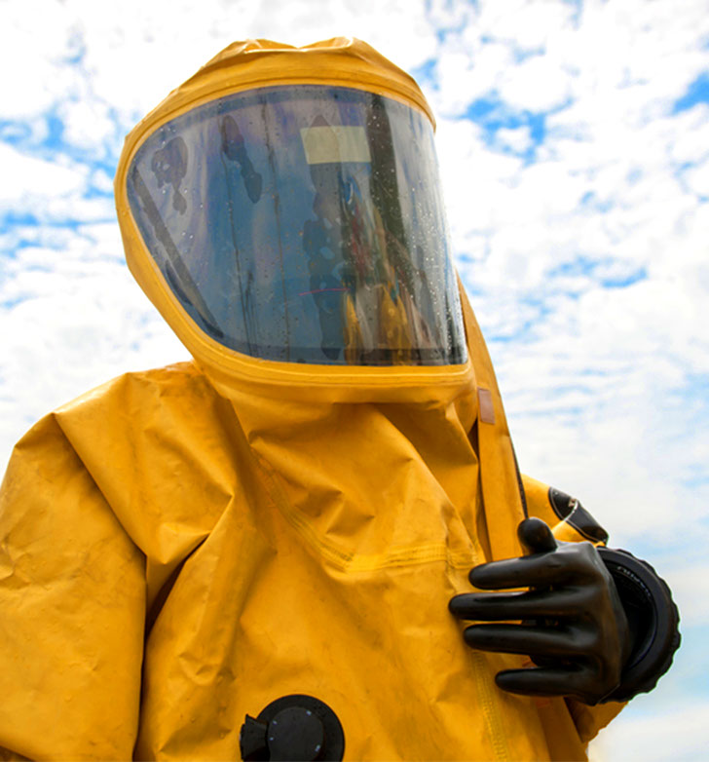
Biohazards
Biohazards: Exposure to plants, animals, or their products that may be infectious, toxic, or contain allergens, may cause illness and disease. People who work with animals, animal products, or animal waste have great risk of infection.
Biohazard agents include:
Bacteria: Microscopic living organisms, usually one-celled, that can be found everywhere. They can be dangerous, such as when they cause infection, or beneficial, as in the process of fermentation.
Viruses: Organisms that depend on a host cell for development and reproduction.
Fungi: May be small or large (mushroom), parasitic organisms growing in a living or dead plant or animal matter.
Protozoa: Any of a large group of one-celled organisms (called protists) that live in water as parasites.
Module 1: identifying hazards

Slide 22

Bloodborne Pathogens
Bloodborne pathogens occupational exposure means reasonably anticipated skin, eye, mucus membrane, or parenteral contact with blood or other potentially infectious materials that may result from the performance of an employee’s duties.
Bloodborne pathogens are microorganisms that are transmitted via human blood and cause disease. They can be transmitted by means of blood, tissue, body fluids, and other potentially infectious materials (OPIM).
While there are many types of pathogens, the focus of this program is on bloodborne pathogens and what employers need to know to be in compliance with Oregon OSHA. In general, the purpose of the standard is to protect employees from the hepatitis B virus (HBV), the human immunodeficiency virus (HIV), and the hepatitis C virus (HCV).
Module 1: identifying hazards

Slide 23

Workplace Violence
Workplace violence: Any violent act that occurs in the workplace and creates a hostile work environment that affects employees’ physical or psychological well-being. A risk factor is a condition or circumstance that may increase the likelihood of violence occurring in a particular setting.
Risk factors include:
Employee contact with the public
Exchanging money
Selling/dispensing alcohol or drugs
Delivering passengers, goods, or services
Mobile workplace (such as taxicabs or police cruisers)
Exposure to unstable or volatile persons (such as in health care or social services)
Employees working alone, late at night/early morning, or in small numbers
Module 1: identifying hazards

Slide 24

Creating a Safe Workplace
Now that you understand workplace hazards, how can you identify them? Oregon OSHA can help. Contact Oregon OSHA Consultation to schedule your free workplace walk-through.
Oregon OSHA Consultation provides many no-cost confidential services, including:
Safety, health, and ergonomic hazard assessments
Recommendations to control and eliminate hazards
Written program evaluations
Industrial hygiene services, such as noise monitoring
Hands-on training on health and safety topics
For more information, call our toll-free number 800-922-2689 or click here.
Module 1: identifying hazards

Slide 25
HAZARD IDENTIFICATION
Module 2: Inspections

Slide 26

Video: Safety Inspection
Module 2: inspections

Slide 27

Types of Inspections
Let’s look a little more in-depth at the types of inspections:
Ongoing: Supervisors and workers continually conduct ongoing inspections as part of their job responsibilities. This includes identifying hazardous conditions and either correcting them immediately or reporting them for corrective action. An example of this is a daily equipment check.
Pre-use: Inspection of new or modified equipment or processes.
Periodic inspections: Is a safety committee walk-through, which is required to cover the entire facility once a quarter. During these inspections, you should look at all safety and health concerns, not just the big issues.
Module 2: inspections

Slide 28
Video: How to Plan a Safety Inspection
Module 2: inspections

Slide 29

Importance of Safety Inspections
As the Safety Committee prepares to perform their quarterly workplace inspection, it can be helpful to review the Oregon OSHA rules and use the rules that apply to your workplace. Become familiar with these rules which, if violated, could result in serious physical harm or fatality.
View the Oregon OSHA Administrative Rules for safety committees and safety walk-throughs.
View our Safety Committees and Safety Meetings booklet.
Module 2: inspections

Slide 30

Assigning Inspection Duties
Those who do safety committee inspections must be trained in hazard identification, but do not have to be safety committee members. This ensures existing and potential hazards are identified and corrective actions are provided to the safety committee for recommendations to management.
A workplace may have equipment and processes in use which would require inspectors to have additional training and knowledge to prevent exposing themselves or others to a hazard. Examples of such equipment and processes include, but are not limited to:
Electrical equipment
Lockout/tagout
Fall protection
Chemical labeling
Machine guarding
Module 2: inspections

Slide 31
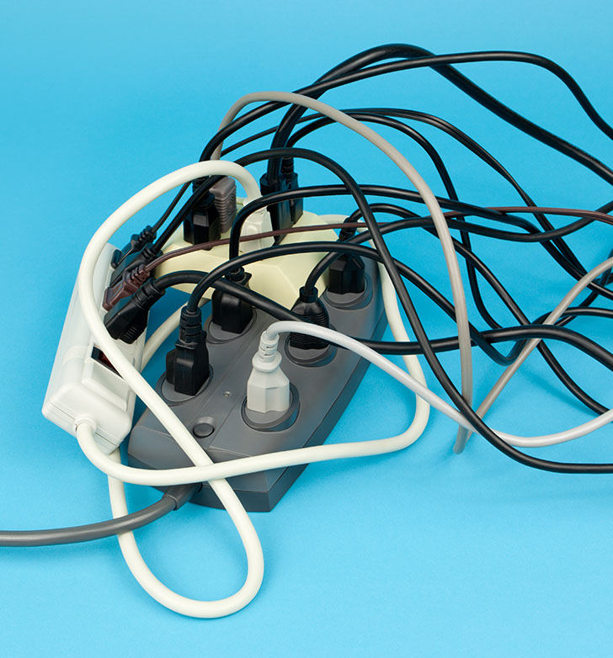
Inspection Duties – A Closer Look
Here are a few examples of what safety committees should and should not do:
YES: Check to make sure lockout/tagout supplies are available, when applicable.
NO: Go over lockout/tagout policies in-depth with employees.
YES: Ensure fall protection equipment is available if needed.
NO: Check the fall protection anchorage on the roof to ensure it will still hold 5,000 pounds.
YES: Ensure electric equipment is safe with a broad overview: frayed cables, missing ground plugs, checking for reverse polarity, or daisy-chained power strips.
NO: An in-depth inspection of electrical equipment requiring the removal of covers, guards, or panels that may expose energized parts.
Module 2: inspections

Slide 32

Workplace Elements to Focus On
Look at all workplace elements:
Environment
Equipment
Processes
People
Environment: Includes such hazards as noise, vibration, lighting, temperature, and ventilation.
Equipment: Includes materials, tools, and apparatus for producing a product or a service. The process involves how the worker interacts with the other elements in a series of tasks or operations.
Module 2: inspections

Slide 33

Workplace Elements to Focus On (continued)
Processes: Involves how the worker interacts with the other elements in a series of tasks or operations. This also includes safety procedures you have in place.
People: Includes employee behavior such as following safety procedures, engaging in horseplay, removing safety controls, such as guards, and coming to work under medication or distracted/tired.
Module 2: inspections

Slide 34

The Power of Conversation
During your safety walk-through, you should talk to employees about their safety concerns.
These conversations help involve the employees in the safety culture and can point out additional safety issues not observed during the walk-through.
Before your walk-through, you may find it helpful to prepare questions in advance. This will help you engage employees in different roles to best identify safety and health issues.
Module 2: inspections

Slide 35

Documenting Hazards for the Inspection Report
As you conduct your inspections, it helps to keep in mind what you may include in your inspection report:
Who: a list of employees, contractors, etc.
What: process, equipment, chemicals, etc.
Where: specific location, building, etc.
When: shift, date, time, weather, etc.
Why: time for quarterly inspection, accident or near miss, lack of training, new task, new equipment, etc.
Module 2: inspections

Slide 36

Roles in Making Safety Changes
Once the safety committee has identified a safety issue in the report, committee members will then recommend ways for management to fix the problem. When doing this, remember there is more than one way to fix a hazard.
Management will then consider the suggestions and assign a qualified person to address the needed changes.
Ultimately, it’s the safety committee’s job to alert management to safety concerns and provide suggestions for correction. While it is management’s responsibility to provide a safe workplace, that does not mean management must do everything recommended by the safety committee. Management and the safety committee should have open communication about what changes will be made and when.
Module 2: inspections

Slide 37

Wrapping Up the Safety Walk-Through
Why shouldn’t you just fix a safety issue during the walk-through and not report it?
While many hazards in the workplace should be corrected immediately, just correcting them without documenting them may not get to the root of the problem or prevent occurrence. By including all observed hazards and employee concerns in your report, management can develop a better understanding of trending issues and concerns.
Also, correcting some hazards, such as replacing a guard to a machine, may require specific training to do so safely. Report such hazards to the person responsible for the area.
Module 2: inspections

Slide 38

To Schedule or Not to Schedule
It’s your choice whether or not to schedule an inspection in advance. Some things to consider include:
Allotting enough time. To accurately estimate how long each inspection will take, the time required for each inspection depends on what is found, how many questions are asked, and the size of the work area.
Announcing the inspections in advance is discouraged as employees may change their work environment and behavior.
Keep in mind, different shifts may have alternative work tasks and safety cultures.
Module 2: inspections

Slide 39
How Many Inspections are Needed
To decide how many inspections are necessary, how long the inspections should last, and how often they are needed, consider:
Fixed locations, such as a factory, must be inspected once a quarter.
Office environments must conduct an inspection once a quarter.
Auxiliary/satellite locations, such as an unmanned warehouse, where workers do not work on a daily basis. These locations must be inspected quarterly.
Mobile work locations, such as remote electrical substations, must be inspected as often as the safety committee determines necessary.
Module 2: inspections

Slide 40
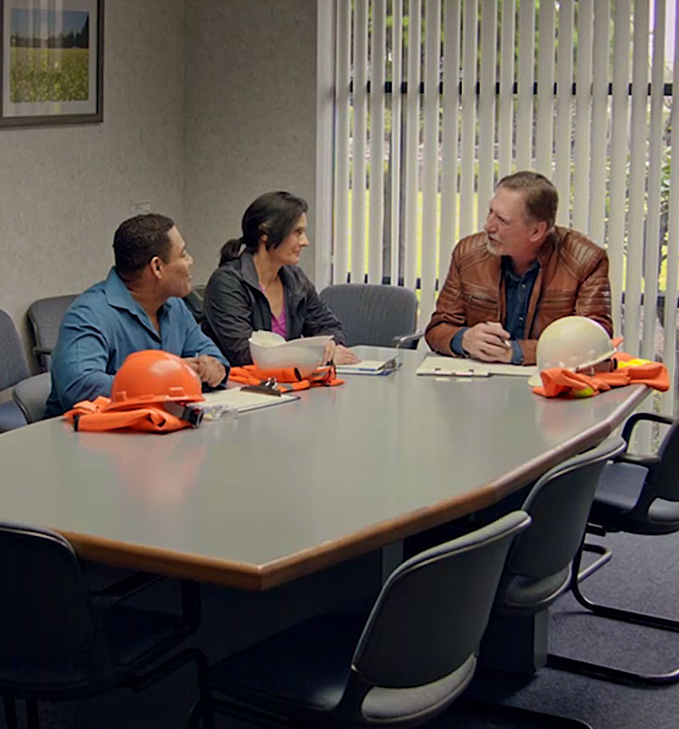
Example Safety Walk-Through Video
In the next slide, you will see an example safety walk-through video. This video shows a safety committee that includes Ken, a corporate safety manager, along with Lynn and Tom, the two employee representatives.
Instead of having a safety committee monthly meeting, they will be conducting their quarterly safety walk-through.
This walk-through takes place at a business that is both an office and a factory with less than 20 employees.
Module 2: inspections

Slide 41
Video: Safety Inspection Walkthrough
Module 2: inspections

Slide 42
HAZARD IDENTIFICATION
Module 3: Analyzing Hazards

Slide 43

Video: Job Hazard Analysis
Module 3: analyzing hazards

Slide 44

Understanding Hazard Analysis
Job Hazard Analysis (JHA) is known by many other names, such as Task Hazard Analysis and Job Safety Analysis. Regardless of what it is called, hazard analysis is a method of identifying, assessing, and controlling hazards associated with specific tasks or jobs. The JHA focuses on the relationship between the worker, the task, the tools, and the work environment.
While JHAs are especially useful to identify hazards before they occur, they are also used for jobs with a history of injuries or near misses.
Module 3: analyzing hazards

Slide 45
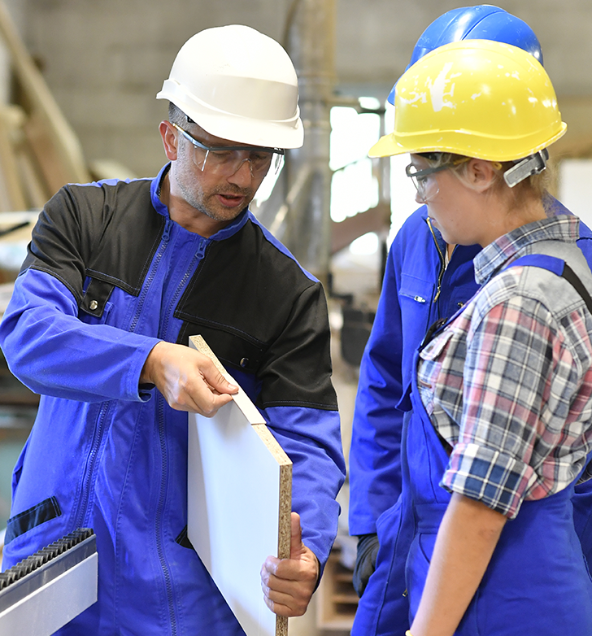
How is a Job Defined?
As you begin to undertake the process of the JHA, it’s important to understand that a “job” in this procedure does not refer to the employees’ job title or occupation, such as forklift operator or roofer. A JHA focuses on the various tasks within each role.
Analyzing a “task” is composed of a series of steps. A typical job includes a number of tasks. For instance, a forklift operator not only operates the forklift, but may perform maintenance, manually load and unload materials, change batteries, or exchange out fuel cylinders, etc. There are hazards associated with each of these essential tasks that can be better managed with the development and use of the JHA.
Module 3: analyzing hazards

Slide 46

Why Develop a Job Hazard Analysis?
Oregon OSHA rules do not specifically require the employer to develop a JHA. However, the employer is required to provide a safe and healthy workplace. The JHA helps fulfill this requirement.
To read more about Oregon OSHA’s standards specific to furnishing a safe workplace, click here.
Module 3: analyzing hazards

Slide 47

Developing the Job Hazard Analysis
JHAs for complex jobs can take time and expertise to develop.
JHAs can be done individually or as a small team. As you consider this, keep in mind that involving the employees performing the jobs throughout the JHA process can provide you with a better understanding of the tasks within the job. Employee involvement can also help you implement needed changes. You may also find it helpful to involve someone with safety training.
The JHA process is also an opportunity for management to involve employees in developing safe work procedures.
Module 3: analyzing hazards

Slide 48

Creating a JHA Worksheet
You may choose to make a Job Hazard Analysis form for your business to meet your operational needs. Should you choose to make your own JHA sheet, here are a few things to include:
A JHA worksheet should:
Be easy to understand
Be completed for each essential task
Contain descriptions of job tasks to be performed
List the basic steps to complete the job
List the hazards
Include measures to be taken to avoid hazards
Once you have completed your JHA it can be included in a job description if desired.
Module 3: analyzing hazards

Slide 49

JHA Development – List Jobs to Include
Next, list jobs. Ask supervisors and employees to identify the various jobs that will require an evaluation in each department.
The number of jobs listed will vary depending on the size of the company, complexity, and type of production processes.
Module 3: analyzing hazards

Slide 50
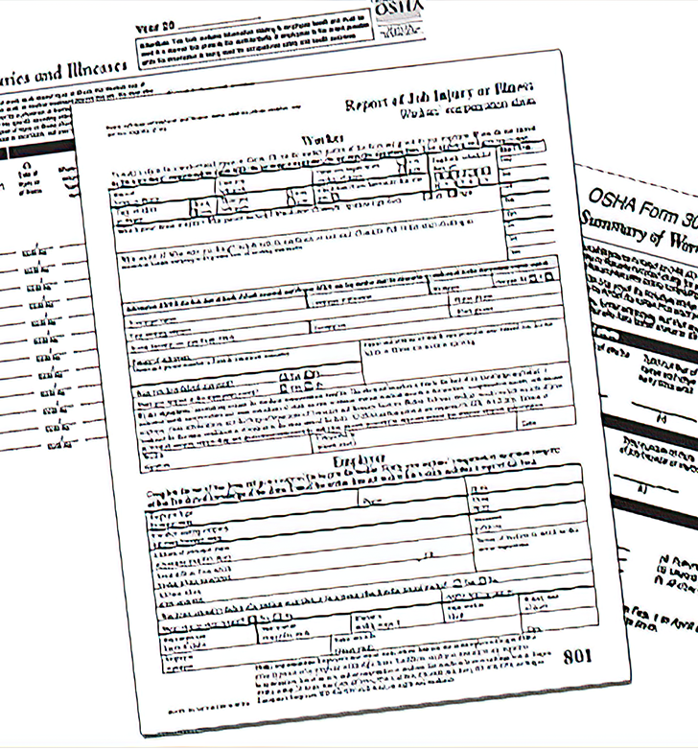
JHA Development – Records Review
Review the following documents:
Safety Committee meeting minutes
OSHA 300 logs documenting injuries
Personal Protective Equipment (PPE) analysis for tasks
Safety Data Sheets associated with tasks
Machinery/Equipment manuals
Accident investigations and incident reports
This will give you a more complete idea of the past hazards, safety concerns noted previously, and manufacturer requirements and recommendations.
Module 3: analyzing hazards

Slide 51

Preparing to Conduct Your JHA
As you begin your JHA, the first thing you should do is conduct an initial job review.
Discuss with your employees the jobs and related hazards they know exist in their current work area. Ask them for ideas to eliminate or control those hazards.
Any problems that can be corrected easily should be noted and corrected as soon as possible. Do not wait to complete the JHA. This will demonstrate a commitment to safety and health and enable you to focus on the hazards and jobs that need more consideration because of their complexity.
Module 3: analyzing hazards

Slide 52

JHA Development – Accident History Review
Review accident history:
Review the history of accidents and illnesses and any “near misses”.
These events may indicate existing hazard controls (if any) may not be adequate and deserve a closer look.
You may discover more “near misses” by discussing the work process with employees doing the tasks.
Note: A “near miss” is a narrowly avoided collision or other accident.
Module 3: analyzing hazards

Slide 53

JHA Development – Prioritizing Risks
Analyzing risk factors can help you decide which JHA to complete first.
Factors that can increase risk include:
Jobs with history of sustained injuries and illnesses
Jobs associated with near misses
Number of employees exposed
Frequency of each exposure
Duration of each exposure
Proximity of employees to the point of danger
Unreasonable workload
Working under stress (hurry, fatigue, illness, personal problems, etc.)
Environment (noise, light, wind, & rain)
Module 3: analyzing hazards

Slide 54
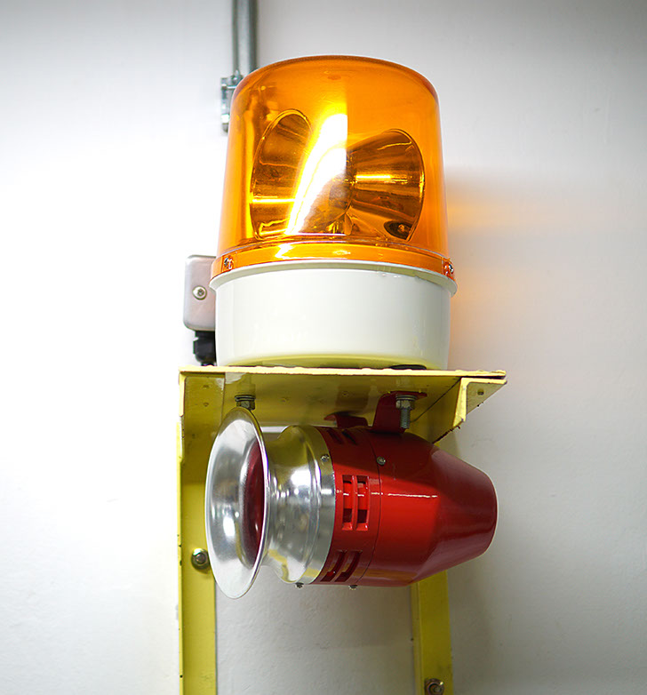
Types of Hazards in the Workplace
As you prepare to conduct your JHA, remember the most common types of hazards:
Falls
Impact
Mechanical
Heat and Temperature
Flammability/Fire
Explosives
Pressure Hazards
Electrical Contact
Ergonomics
Biohazards
Module 3: analyzing hazards

Slide 55
Video: Observe the Jobs and List the Steps
Module 3: analyzing hazards

Slide 56
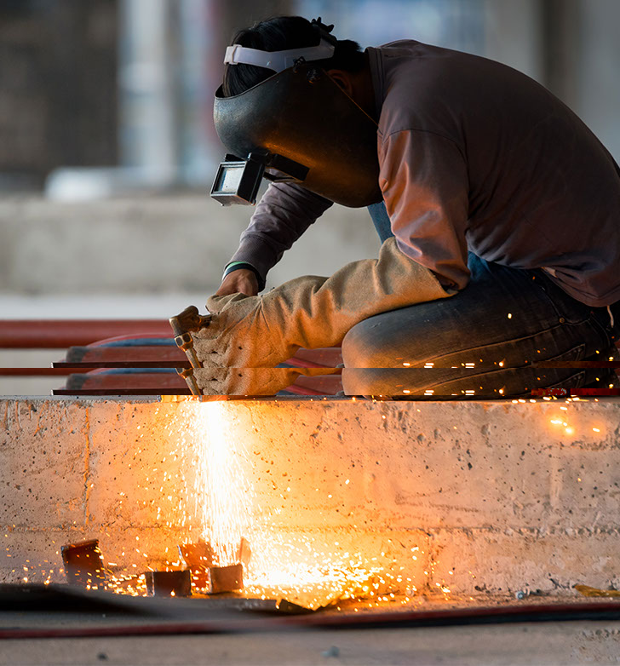
Continued Preparation for Your JHA – Analyze Hazards
The hazards presenting the most risk need to be analyzed first.
To determine risk objectively, use a structured method to prioritize hazards.
In the next slide we will explore ways to observe the job and list the steps.
Module 3: analyzing hazards

Slide 57
Video: How to Identify Hazards
Module 3: analyzing hazards

Slide 58
Video: Understanding Hazard Controls
Module 3: analyzing hazards

Slide 59

Reviewing JHAs for Continual Improvement
Periodically reviewing the job hazard analysis ensures that it remains current and continues to help reduce workplace accidents and injuries. Even if the job has not changed, it is possible that during the review process you will identify hazards that were not identified in the initial analysis.
It is particularly important to review the job hazard analysis if an illness or injury occurs on a specific job. Based on the circumstances, you may determine that you need to change the job procedure to prevent similar incidents in the future.
Any time you revise a JHA, it is important to train all employees affected by the changes in the new job materials, procedures, or protective measures used.
Module 3: analyzing hazards

Slide 60
HAZARD IDENTIFICATION
Module 4: Incident & Accident Analysis

Slide 61


Basics
You should investigate unsafe conditions and behaviors, whether or not they will cause an injury. No matter how minor, these issues should be analyzed to identify and control hazards.
Incident analysis: Allows you to identify, eliminate, and control hazards before they cause an injury. It’s always good practice to carefully analyze non-injury incidents.
Accident analysis: Is an effective tool for uncovering hazards that either were missed earlier or have managed to slip out of the control planned for them.
Both processes are most useful when done with the goal of discovering all of the underlying contributing root causes.
Module 4: incident &
accident analysis

Slide 62

Two Phases
The two primary phases in the incident/accident analysis process are:
Event analysis: Analyze the events (near-misses, accidents) to determine what happened. Identify the events that occurred during and after the injury event or near miss.
Cause analysis: Evaluate each event for direct and contributing causes.
During your incident/accident analysis process, please keep in mind there could be multiple causes to an event. It is common for employers to stop looking once they have identified the first cause, but it’s important to take an in-depth look to identify other potential causes.
Module 4: incident &
accident analysis

Slide 63

Perform a Root Cause Analysis
Evaluate the root cause in the safety management system to identify any failure that may have contributed to the incident or accident. Ask if the system is failing to perform in one or more of these 5 areas:
Training: Was training adequately designed, presented, and documented?
Resources: Were adequate resources and support provided?
Enforcement: Are safety polices and rules consistently enforced?
Supervision: Are supervisors identifying and correcting hazards before workers get hurt?
Leadership: Are supervisors and managers meeting health & safety obligations?
Module 4: incident &
accident analysis

Slide 64

Creating a Safe Workplace
To continue learning about incident and accident analysis, please consider taking our Accident Investigation course. This online training program was created to help you gain the basic skills necessary to conduct an effective accident investigation and complete an Accident Investigation Report.
The Accident Investigation course covers the following topics: securing the scene, collecting the facts, conducting interviews, developing a sequence of events, determining cause, making recommendations, and writing a report.
Click the button below to open the Accident Investigation online course (takes you out of this course).
Accident Investigation Course
Module 4: incident &
accident analysis

Slide 65
HAZARD IDENTIFICATION
Module 5: Controlling Hazards

Slide 66
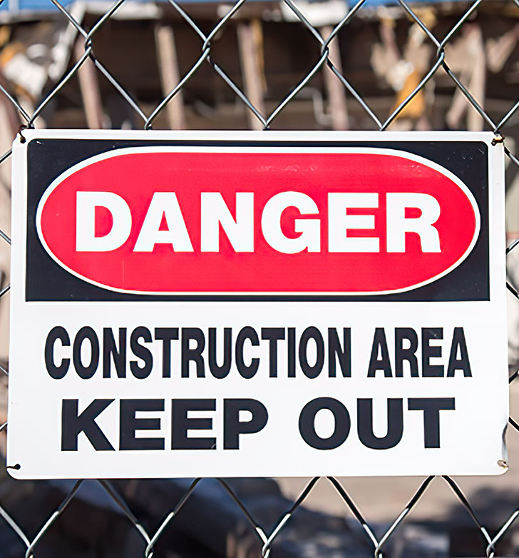

Anticipating and Controlling Hazards
In the last module, we learned how to identify the cause of unsafe work conditions and behaviors. Now, we are going to learn how to control the identified hazards.
To most effectively improve the safety and health management system, we need to anticipate potential hazards before they exist; this is the point of the Safety Audit. If the hazard cannot be anticipated, we need to control existing hazards when they’ve been identified.
Experts agree there are two primary control strategies:
Control the hazard, and
Control the exposure to the hazard.
Module 5: controlling hazards

Slide 67

Understanding Hazard Controls
Eliminating hazards is always the most direct path to workplace safety. When hazards cannot be eliminated, many resources will talk about a hierarchy of controls, starting with Engineering Controls, then Administrative Controls, and Personal Protective Equipment.
Other materials may use different terminology, but the basic principles behind the hierarchy of controls are relatively simple. Fully eliminating the hazard is preferred over a control that limits exposure. Controls that work without employee involvement are more effective than controls that rely on employee behavior.
Module 5: controlling hazards

Slide 68
Controlling Hazards in Your Workplace
Now that you have a better understanding of the importance of hazard elimination and control, how can you accomplish these goals in your workplace? Oregon OSHA can help. Contact Oregon OSHA Consultation to schedule your free workplace walk-through.
The Oregon OSHA Consultation team will make an appointment to visit your workplace, and after a walk-through with your staff, make recommendations to control and eliminate hazards specific to your work.
For more information, call our toll-free number 800-922-2689 or click here to learn more.
Module 5: controlling hazards

Slide 69

Controlling Hazards in the Workplace
For additional help understanding Hazard Control, you may consider taking an Oregon OSHA workshop offered around the state.
These in person training opportunities allow you to:
Learn even more about Hazard Identification and Control.
Ask specific questions from an experienced Oregon OSHA staff member.
Engage in group exercises.
Hear real-life examples.
Visit the Oregon OSHA Public Education page by clicking here or call us at 503-947-7443.
Module 5: controlling hazards

Slide 70
Hazard Tracking Procedures
Tracking hazards is an essential part of any day-to-day safety and health effort. Correcting hazards and documenting these corrections is important, particularly for larger work sites.
Documentation is important because:
It keeps management aware of the status of long-term corrective items.
It provides a record of what occurred, should the hazard reappear at a later date.
It provides timely and accurate feedback.
Module 5: controlling hazards

Slide 71

Conclusion
In the next module, we’ll wrap up all the work we’ve done so far by learning how to write the report.
Now is a great time to collect all your notes, photographs, and documentation. That way you’ll have everything you need ready to go.
Module 5: controlling hazards

Slide 72
HAZARD IDENTIFICATION
Module 6: Writing the Report

Slide 73


Drafting the Final Report
Now that the inspection is complete, the hazards have been assessed, and hazard controls have been identified, the next step is to write a final report. It should include:
The department or area affected.
Date of the inspection along with team members names and titles.
All observed unsafe conditions.
Recommended methods of control.
Your report should describe exactly what hazards were seen and clearly identify its location. Instead of writing “machine guard missing,” write “table saw #2 in the main building is missing the self-adjusting blade guard.”
Module 6: writing the report

Slide 74
Drafting the Final Report (continued)
Report concerns in a brief, factual way. A reader should be able to understand and evaluate the problem and determine how to fix the issue.
After each hazard, you should specify what action you recommend to correct the hazard and set a corrective action date if possible and appropriate.
Each inspection team member should review the report for clarity, accuracy, and completeness.
Module 6: writing the report

Slide 75

List of Aspects to Include in Final Report
As you write your report, keep these factors in mind:
Information on chemicals (SDSs)
Personal Protective Equipment (PPE)
Worker complaints about hazards in the workplace
Workplace rules and regulations - if not being followed
Job procedures and safe work practices
Engineering controls
Emergency procedures - fire, first aid, & rescue
Recommendations from the safety committee
Module 6: writing the report

Slide 76
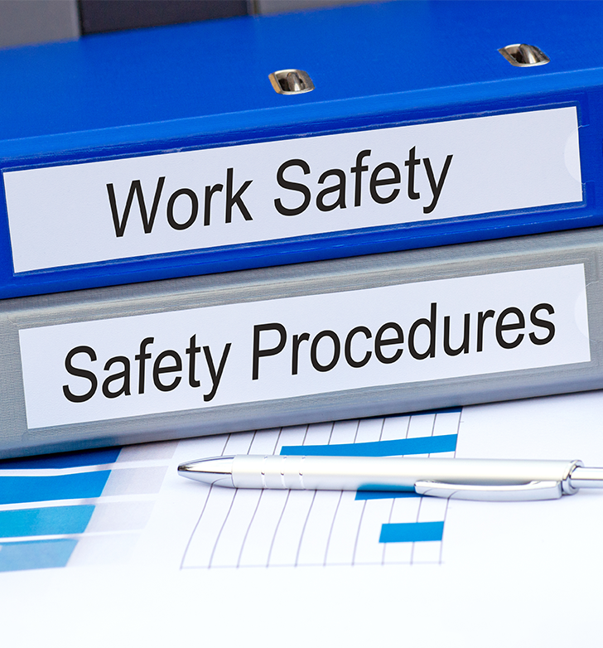
Follow Up and Monitoring
Once you finish your report, what should you do for follow up and monitoring in your workplace?
Review the information collected from previous inspections to see where corrective action was needed. Find out if these changes have been made.
Review accident and injury logs to see if there are any trends.
As tasks and jobs change, re-evaluate risks.
Continue conducting JHAs as new jobs or tasks are introduced.
Module 6: writing the report

Slide 77

Course Conclusion
Workplace safety is a continual improvement process which requires commitment to the wellbeing of employees. Oregon OSHA has many resources to help, including a sample safety inspection report.
Additional resources for Hazard Identification are available on the Oregon OSHA website.
Next up, there is a short quiz. After passing the quiz, you will be given your certificate of completion.
Module 6: writing the report

Slide 78
Video: Module 6
Module 6: analyzing hazards

Slide 79
HAZARD IDENTIFICATION - QUIZ
Question 1: Employers must do everything (_______) (_______) to protect the life, safety and health of such employees.
Cost and effective
Employee requested
Reasonably necessary
Question 2: The most common type of accidents are related to:
Heat and Temperature
Falls
Ergonomics
Module 6: writing the report

Slide 80
HAZARD IDENTIFICATION - QUIZ
Question 3: It’s helpful to post the schedule for safety inspections in advance so employees can clean their work area and prepare ahead of time.
True
False
Question 4: To decide how many inspections are necessary, how long the inspections should last, and how often they are needed, consider:
The company budget to fix issues.
Size & variety of work operations, shifts, equipment & work process.
Employee evaluations so no one gets in trouble.
Module 6: writing the report

Slide 81
HAZARD IDENTIFICATION - QUIZ
Question 5: How often must office environments conduct a workplace inspection?
Quarterly
Annually
Biannually
Question 6: You need to _________ potential hazards before they exist.
Rationalize
Anticipate
Hide
Module 6: writing the report

Slide 82
HAZARD IDENTIFICATION - QUIZ
Question 7: Job Hazard Analysis is:
Also known as task hazard analysis.
Identifying, assessing, and controlling hazards associated with a task.
Focuses on the relationship between the worker, the task, tools, and the environment.
All of the above.
Question 8: Your inspection/walk-through report should:
Describe exactly what hazards were seen and clearly identify their location.
Be as brief as possible.
Include just a few notes about the walk-through you completed.
Module 6: writing the report

Slide 83
HAZARD IDENTIFICATION - QUIZ
Question 9: During your safety walk-through you notice a sign posted for a piece of equipment you have gotten rid of, what do you do?
Make a note to recommend removing the sign as it’s no longer needed.
Realize it won’t hurt to keep the sign posted and move on.
Remember the old machine fondly and move on.
Question 10: Some of the responsibilities of the safety committee are to:
Conduct a quarterly walk-through.
Evaluate all accidents & incidents investigations and make recommendations for ways to prevent similar events.
Have a system which allows employees an opportunity to report hazards and safety & health related suggestions.
All of the above.
Module 6: writing the report

Slide 84
HAZARD IDENTIFICATION - QUIZ ANSWERS
C
B
B
B
A
B
D
A
9) A
10) D
Module 6: writing the report
Notes:
Answers

Slide 85

Where To Go From Here
An excellent resource to utilize is the A-Z Topic Index on the Oregon OSHA website. It has lists of relevant publications, training materials, rules, interpretations, videos, and other miscellaneous materials.
If you want guidance in developing a safer work environment, you may consider our free and confidential consultation service. Our consultants in workplace health and safety can help you reduce accidents, related costs, and help you develop a comprehensive program to manage safety and health. For more information, please visit the consultation page.
File a Complaint
A-Z Topic Index
Consultation Services
Hazard Identification Resources
Module 6: writing the report

Slide 86

Module 6: writing the report

Slide 87

Credits
You’ve completed the Hazard Identification course!
Produced by the Public Education Team of Oregon OSHA:
Roy Kroker, Phillip Wade, Ricardo Rodríguez, Angelina Cox, Tammi Stevens, Tim Wade, Anthony Dey
Stock Images provided by: Getty Images Inc.
Special thanks goes to Capitol Community Television for their support in developing this course.
Module 6: writing the report

