Slide 1
HEAT ILLNESS PREVENTION
Please note: If the online course contains videos, the video links are included in this PPT.
You will need to have an internet connection to play the videos or
you can download the videos and embed them into your copy of this PPT presentation.

Slide 2
Disclaimer
Completing this course will help you understand the rules and some of the hazards related to heat. However, it is your employer’s responsibility to further your training where it is specific to your organization, such as policies and practices. This material should not be considered a substitute for any provisions of the Oregon Safe Employment Act (OSEA), or for any standards issued by Oregon OSHA. Manufacturers, products, or services displayed in this material are for informational purposes only and do not constitute an endorsement by Oregon OSHA.
HEAT ILLNESS PREVENTION

Slide 3
Important
The Heat Illness Prevention rule applies to all Oregon workers covered under the OSEA and is in two divisions:
OAR 437-002-0156 for work activities covered under Division 2 (General Industry).
OAR 437-004-1131 for employers covered under Division 4 (Agriculture).
Since exposure to high temperature conditions is not limited to a specific industry, work activities covered under Division 3 (Construction) and Division 7 (Forest Activities) are also required to comply with OAR 437-002-0156.
The Heat Illness Prevention rules list 7 training requirements and this course satisfies 5 of them: 9(a), 9(c), 9(e), 9(f), and 9(g)
Your employer is responsible for all other requirements.
HEAT ILLNESS PREVENTION

Slide 4
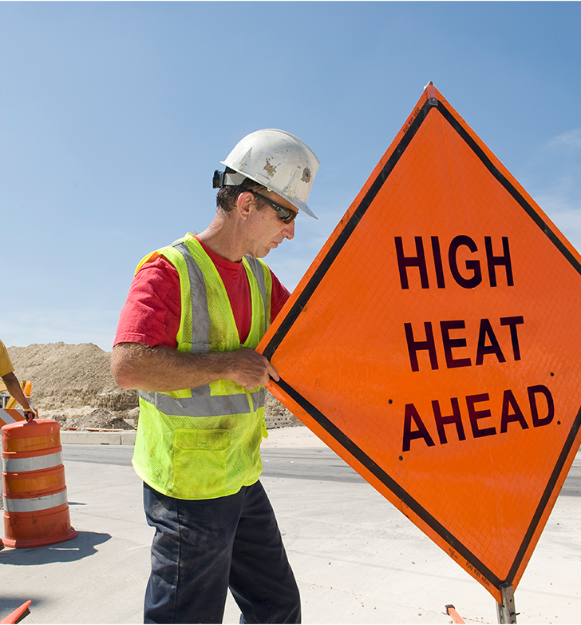
Welcome!
In this course, we will discuss heat illnesses, preventative measures, and the Oregon OSHA Heat Illness Prevention rule found in the Oregon Administrative Rules, Divisions 2 and 4. The rule and its requirements are the same in both divisions. For the remainder of this course, we will mainly reference and link to the rule in Division 2 (General Industry) to simplify navigation.
As a reminder, there are 7 training requirements and this course will satisfy 5 of them:
9(a): Environmental and personal risk factors
9(c): Water consumption
9(e): Types of heat illnesses, signs and symptoms and first aid responses.
9(f): Reporting signs and symptoms of heat illness
9(g): Non-occupational risk factors
Your employer is responsible for providing all other requirements.
HEAT ILLNESS PREVENTION

Slide 5
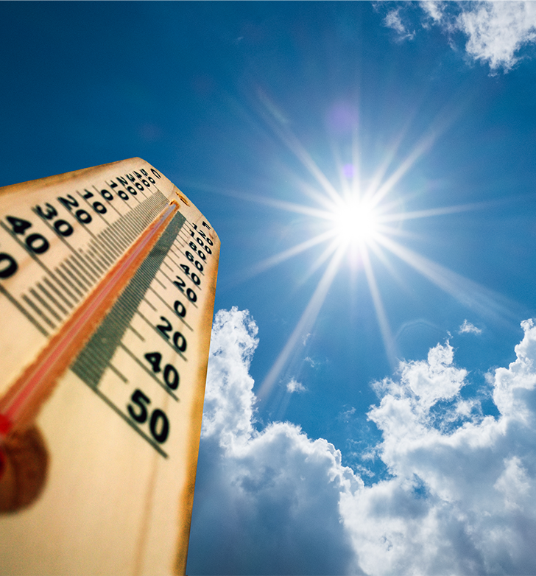
History
In March 2020, Executive Order 20-04 was issued, which included a directive for Oregon OSHA to develop standards for protecting employees from excessive heat. In June 2021, Oregon experienced record-breaking heat with temperatures soaring above 110 degrees Fahrenheit. Many people, such as workers on farms, orchards, construction sites, utilities, and more, could not wait out the heat wave in air-conditioned offices. As Oregon's average yearly temperatures range from 48-68 degrees Fahrenheit, workers were unprepared for this excessive heat that led to deaths and countless cases of heat illnesses.
So, in accordance with the Executive Order, Oregon OSHA adopted the Heat Illness Prevention rules, OAR 437-002-0156 and OAR 437-004-1131 to protect workers at risk. Before we go into details about the protections, first let’s learn what heat illness is!
HEAT ILLNESS PREVENTION

Slide 6
What is Heat Illness?
Heat illnesses are medical conditions resulting from the body’s inability to cope with a particular heat load, such as:
heat stroke,
heat exhaustion,
rhabdomyolysis,
heat syncope, and
heat cramps.
In addition, what could seem like a mild symptom, such as heat cramps, could actually be a symptom of heat stroke and quickly turn into a serious, life-threatening emergency. It is very important to take note of any heat-related symptom and immediately seek remedy.
Next, we’ll discuss each of the illnesses listed above, along with their signs and symptoms and first aid response as outlined by the CDC and NIOSH as well as some related risk factors.
HEAT ILLNESS PREVENTION

Slide 7
Heat Stroke
Heat Stroke is the most serious heat-related illness and occurs when the body becomes unable to control its temperature. During a heat stroke event, the body’s temperature starts rising very quickly, the sweat function stops working correctly, and the body is unable to cool down. If emergency treatment is not given, heat stroke can cause death or permanent disability!
Symptoms include:
Confusion, slurred speech
Loss of consciousness
Hot, dry skin or excessive sweating
Seizures
Very high body temperature
First Aid:
Call 911; stay with the worker until help arrives.
Move the worker to a shaded, cool area and remove outer clothing.
Cool the worker quickly with cold water or ice bath; wet their skin and place cold wet cloths on head, neck, armpits, and groin area, and/or soak clothing with cool water.
Fan the air around the worker to speed cooling.
HEAT ILLNESS PREVENTION

Slide 8
Heat Exhaustion
Heat exhaustion is the body’s response to an excessive loss of water and salt, usually from extreme sweating.
Symptoms include:
Headache
Nausea
Dizziness
Weakness
Irritability
Thirst
Heavy sweating and high body temperature
Decreased urine output
First Aid:
Get medical attention or call 911 and stay with the worker until help arrives.
Move worker from hot area and give them cool water to drink slowly and frequently.
Remove unnecessary clothing, including shoes and socks.
Cool them with cold, wet cloths and/or have them wash their head, face, and neck with cold water.
HEAT ILLNESS PREVENTION

Slide 9
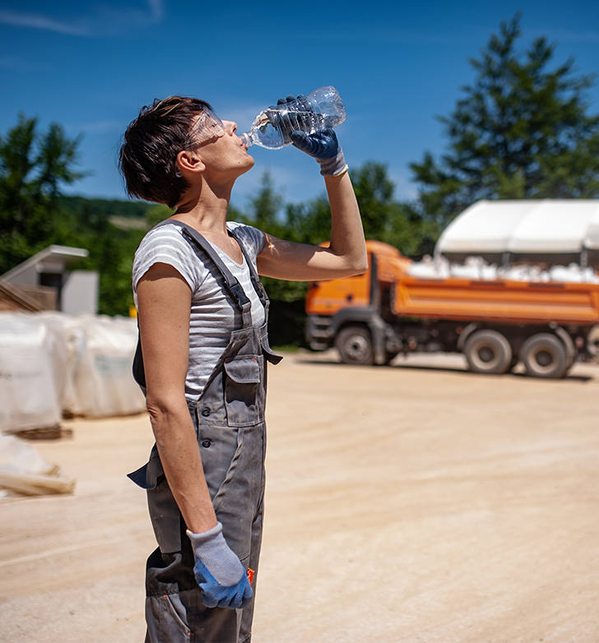
Rhabdomyolysis
Rhabdomyolysis is the rapid breakdown, rupture, and death of muscle associated with heat stress and prolonged physical exertion. When the muscle tissue dies, electrolytes and large proteins are released into the bloodstream which can cause irregular heart rhythms and seizures and damage the kidneys.
Symptoms include:
Muscle cramps and/or pain
Abnormally dark urine (tea or cola colored)
Weakness
Exercise intolerance
Could be asymptomatic
First Aid
Stop activity and drink water.
Seek immediate medical attention and ask to be checked for rhabdomyolysis.
HEAT ILLNESS PREVENTION

Slide 10
Heat Syncope
Heat syncope is a fainting episode or dizziness that usually occurs with prolonged standing or sudden rising from a seated position. Dehydration and lack of acclimatization can also lead to heat syncope.
Symptoms include:
Fainting
Dizziness or light-headedness
Heat syncope can be a symptom of heat exhaustion
First Aid:
Sit or lie down in a cool place.
Slowly drink water, clear juice, or a sports drink (non-caffeinated).
HEAT ILLNESS PREVENTION

Slide 11
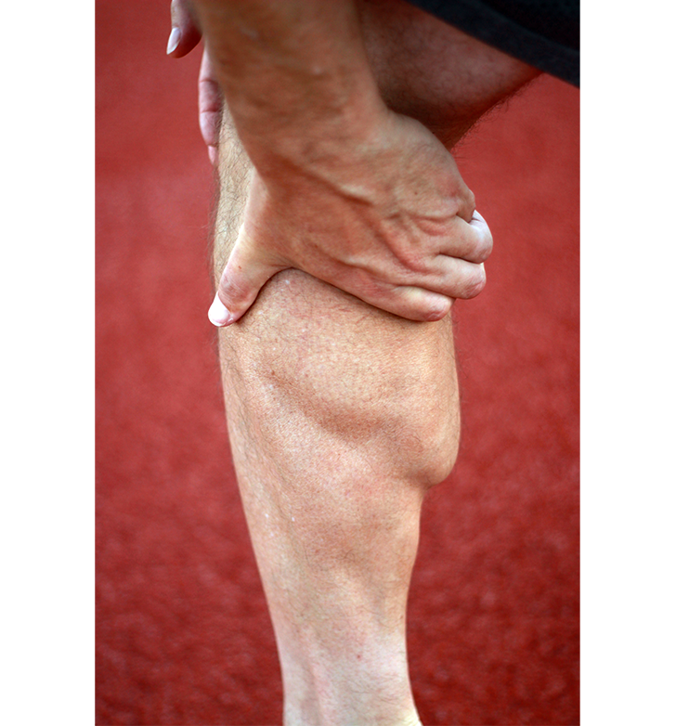
Heat Cramps
Heat cramps usually affect workers who sweat profusely during strenuous activity because the sweating depletes the body’s salt and moisture levels. Low salt levels in muscles can cause painful cramps.
Symptoms include:
Muscle cramps, pain, or spasms in the abdomen, arms, or legs
Heat cramps can be a symptom of heat exhaustion
First Aid:
Drink water and have a snack every 15-20 minutes.
Avoid salt tablets.
Get medical help if worker has pre-existing heart conditions, is on a low sodium diet, or if the cramps do not subside within 1 hour.
HEAT ILLNESS PREVENTION

Slide 12
Responding to Signs and Symptoms
Since heat illnesses can quickly progress from mild symptoms into a serious or life-threatening condition, it is critical to respond immediately. In addition to the first aid responses we discussed in the previous slides, make sure you promptly report the signs and symptoms of heat-related illnesses to your employer and/or supervisor. This will help them respond quickly to the situation, as well as to adjust the workforce or work environment if needed.
If working alone, pay attention to any signs or symptoms that may be heat-related and make sure there is a way to contact help if it becomes necessary.
HEAT ILLNESS PREVENTION

Slide 13
Personal and Non-Personal Occupational Risk Factors
There are many personal and non-occupational risk factors that can increase the body’s sensitivity to heat. In the next two slides, we’ll describe some, but not all, risk factors.
Heart disease: High heat causes an extra workload for the already strained heart and blood vessels, blocking the ability for the body to cool down.
Diabetes: can affect sweat glands, cause dehydration to occur in the body sooner, and affect how the body uses insulin.
Asthma and Chronic Obstructive Pulmonary Disease (COPD): The low air flow during high heat and humidity causes pollutants to be trapped in the air, leading to breathing difficulties and asthma flare-ups.
(List continues on next slide.)
HEAT ILLNESS PREVENTION

Slide 14
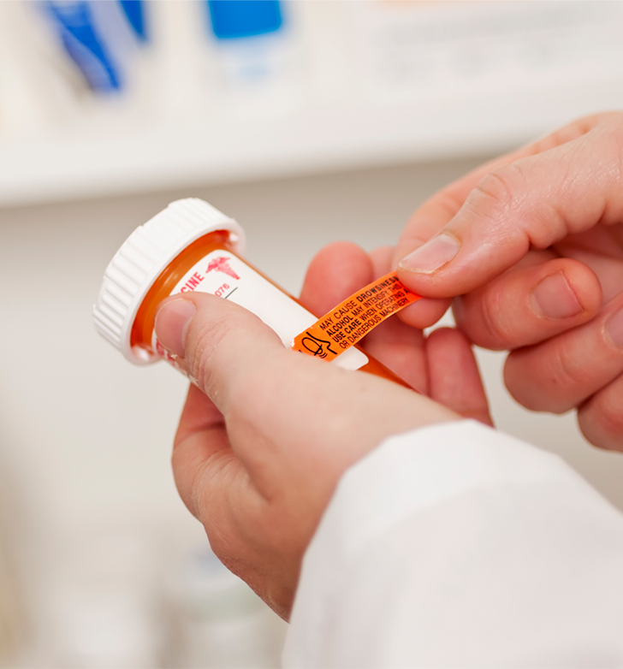
Risk Factors (cont.)
Obesity: reduces the body’s effectiveness to shed excess heat and regulate the body temperature.
Kidney disease: Too much fluid intake can cause swelling, high blood pressure, trouble breathing, and heart failure. Extra fluid in the body can also make dialysis treatments more difficult.
Use of medications: can dehydrate the body, decrease the body’s ability to regulate its temperature, increase heat sensitivity and increase the risk for heat illnesses.
Use of drugs and/or alcohol: can dehydrate the body, raise the body’s internal temperature, put more stress on the liver, and negatively impact the brain and body’s normal response functions.
Every individual has a unique health history that influences the way their body handles heat. If you have underlying conditions and/or use medications, read the medication warnings carefully and check with your doctor to learn more about specific heat-related concerns for your condition and/or medication.
HEAT ILLNESS PREVENTION

Slide 15
Preventing Heat Illness
Now it’s time to get into the Heat Illness Prevention rules and the protections mentioned earlier in the course! The rules require several preventative practices of employers at different heat index thresholds and explains that employers must provide employees with:
access to shade,
cool or cold drinking water,
written plans for acclimatization, emergency medical, and heat illness prevention, and
“high heat practices” (communications, scheduled rest breaks).
We will explore these in more detail over the next few slides, but first let’s talk about the heat index and some environmental risk factors.
HEAT ILLNESS PREVENTION

Slide 16
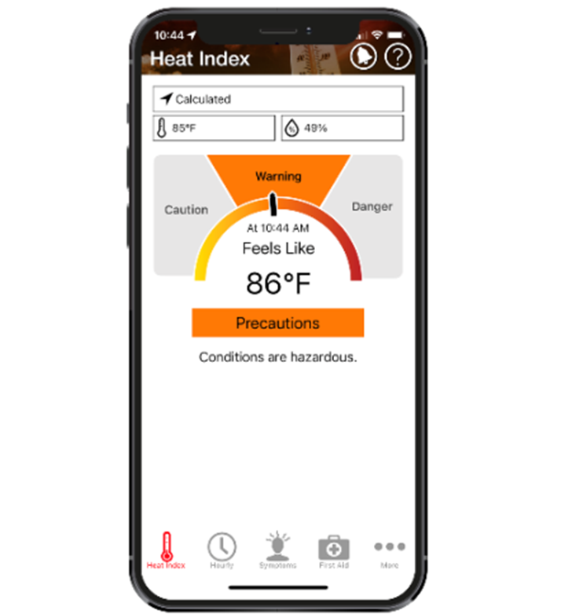
Heat Index
The heat index is what the temperature feels like to the human body when relative humidity is combined with the air temperature in the shade. The humidity impacts the body's comfort and ability to regulate its internal temperature; it feels warmer in humid conditions and cooler in dry conditions. The heat index does not measure effects of wind, sunlight, radiant heat, workload or exertion. However, employers should consider these factors when planning the work schedules because all of the factors can impact the health and safety of employees. For example, direct sunlight can increase the heat index up to 15°!
An easy and quick way to figure out the heat index is by using the Heat Safety Tool developed by NIOSH and OSHA Watch the short video tutorial on the next slide!
HEAT ILLNESS PREVENTION

Slide 17
Video: Heat Safety Tool Tutorial
HEAT ILLNESS PREVENTION
Notes:
https://youtu.be/T5VRl6_3XKc

Slide 18
Environmental Risk Factors
As air temperature rises, some environmental factors that can influence the work conditions include:
Direct sunlight, airspeed, and humidity. Any of these can increase the heat burden on the body. For example, high humidity makes it more difficult for the body to cool itself through sweating.
Sequential days of any of the environmental conditions listed above. The heat burden increases because overnight temperatures do not drop down low enough to provide relief.
Heat sources in the work area, such as ovens and furnaces, that produce radiant heat.
The use of personal protective equipment (PPE) and clothing that can trap heat in and reduce the body’s ability to remove excess heat. PPE should be removed during the preventative rest breaks to help the body cool down.
The level of physical activity being performed.
Employers should keep these factors in mind when scheduling work shifts, rest breaks, and recovery periods. Now let’s explore the rule requirements!
HEAT ILLNESS PREVENTION

Slide 19
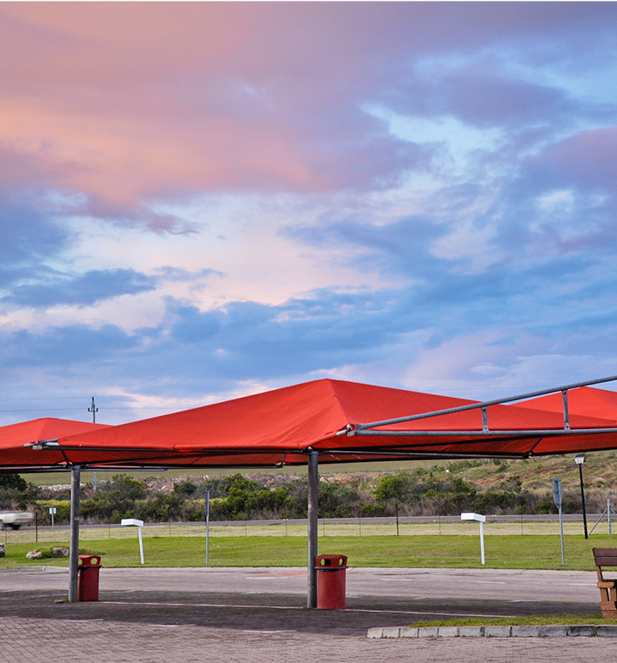
Access to Shade
In the Heat Illness Prevention rules, shade is defined as the blockage of direct sunlight. For employees in an outdoor work area with a heat index of 80° Fahrenheit or greater, the employer must provide access to a shaded area. The shade must be readily available and big enough to accommodate all employees on the rest or meal period so they can sit in a normal posture and be fully shaded. The shade area should be located near the work area and be open to the outside air or provide mechanical ventilation for cooling. Trees or bushes could be used as long as the shape of the shaded area provides enough shadow to protect employees.
For further details and exceptions to the shade requirement, review section (3).
HEAT ILLNESS PREVENTION

Slide 20
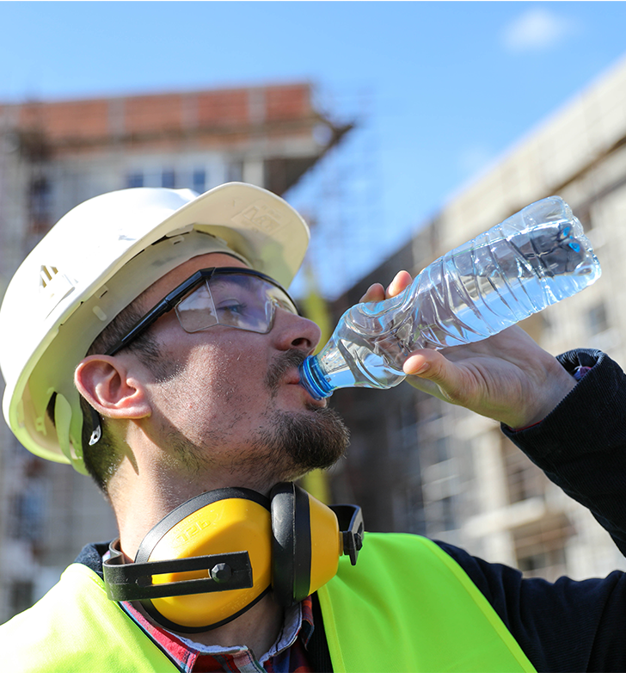
Drinking Water
Keeping your body hydrated with small drinks of water frequently throughout the day is one of the most effective ways to prevent heat illness. Typically, working outdoors in high heat with a heavy workload, makes the body sweat more; water and electrolytes are lost through sweat, which speeds up the dehydration process. The body has an easier time staying hydrated with frequent, small amounts of water, rather than trying to process infrequent, large gulps of water after dehydration has already set in.
With this in mind, the rules require the employer to supply enough cold or cool drinking water (35-77°F) for each employee to drink up to 32 ounces every hour, at no cost to the employee, when the heat index is 80°F or higher. The employees must also be given plenty of opportunities to drink the water.
It is important to note that other Oregon OSHA rules require employers to provide water to employees, but the quantities are not detailed like in the Heat Illness Prevention rules. For further details and exceptions to the specific water quantity requirements, review section (4).
HEAT ILLNESS PREVENTION

Slide 21
Acclimatization
Acclimatization means letting the body adjust gradually to the new climate or conditions. Typically, for a physically fit and healthy individual, the acclimatization process takes 1-2 weeks of at least 2 hours of working in the heat per day. Once acclimated to the heat, some of the beneficial adjustments include:
more efficient sweating with less electrolytes lost,
stabilized circulation, and
the ability to work with a lower core temperature and heart rate.
The rules require employers to create an acclimatization plan or choose an existing one developed by the CDC and NIOSH. Employers must fulfill the requirement of training their employees on the methods of their acclimatization plan and the importance of acclimatization. (See section 7.)
HEAT ILLNESS PREVENTION

Slide 22
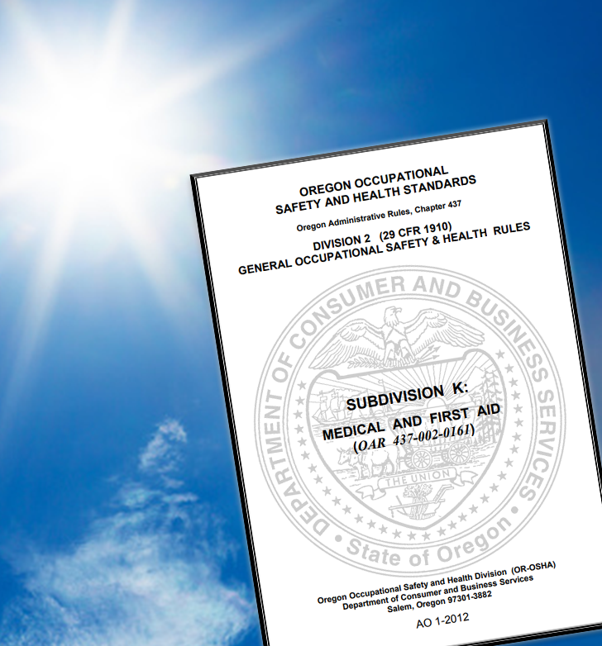
Employer-Specific Plans
In addition to an acclimatization plan, in the next couple of slides we will discuss 2 other plans employers are required to have in place:
Emergency Medical Plan
Heat Illness Prevention Plan
All employers in Oregon are already required to have an Emergency Medical Plan. The Heat Illness Prevention rules require conditions related to excessive heat exposure for employees to be included in that plan. Click on the links below for more information about Emergency Medical Plans for each division:
Division 2 (General Industry) OAR 437-002-0161(4)
Division 3 (Construction) 29 CFR 1926.50
Division 4 (Agriculture) 437-004-1305(4)
Division 7 (Forest Activities) 437-007-0220
HEAT ILLNESS PREVENTION

Slide 23
Heat Illness Prevention Plan
Employers also must have and maintain a Heat Illness Prevention Plan in writing and have it available at their worksites to employees and Oregon OSHA. The plan should describe:
heat hazard and prevention training for employees,
how to recognize and respond to symptoms of dehydration and heat illnesses,
how drinking water will be provided to the work area,
how and where the shaded rest and recovery areas will be provided,
the work/rest schedule, and
the acclimatization procedures.
See section 8 for details required to be included in the plans. Check with your employer to learn about the plans developed specifically for your worksite!
HEAT ILLNESS PREVENTION
Notes:
See section 8 for details required to be included in the plans, [and review this sample plan.]
***add the [text and hyperlink] when Oregon OSHA’s sample plan gets posted!***

Slide 24
High Heat Practices
The Heat Illness Prevention rules call for extra protections when the heat index hits 90°F. If employers use hazard controls, such as scheduling work during cooler parts of the day or adding air conditioning, but the heat index of the employee’s work area remains at 90°F or higher, specific high heat practices must be followed. They include:
All employees must be able to contact a supervisor at any time, when necessary, and communication must be in a language and vocabulary understood by all.
Ensuring prompt identification of any employee with heat illness signs or symptoms by frequent communication with employees who are working alone, or using a mandatory buddy system, or other equally effective observation and/or communication method.
Authorizing and equipping employees to call emergency services and ensure medical care is immediately available (per OAR 437-002-0161(4) and OAR 437-004-1305(4)).
(List continues on next slide.)
HEAT ILLNESS PREVENTION

Slide 25
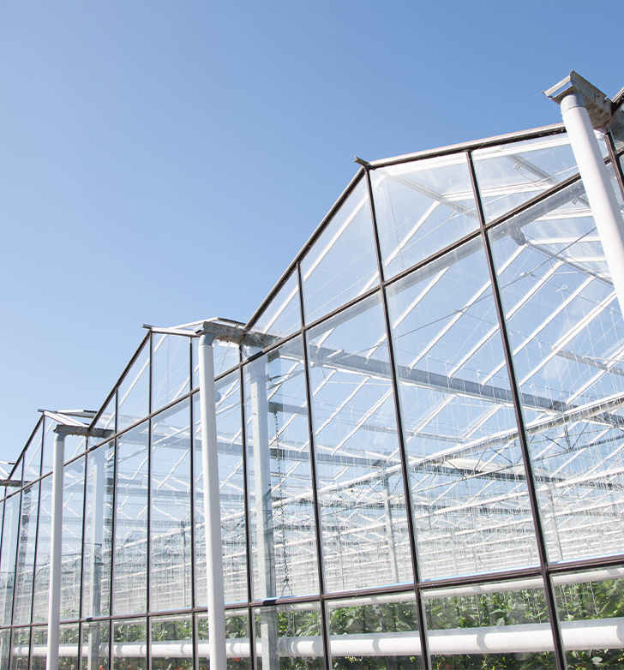
High Heat Practices (cont.)
In buildings and structures that do not have mechanical ventilation cooling systems, employers must measure the temperature and humidity to determine the indoor heat index.
Develop and use a written heat illness prevention rest break schedule. See section 5(e)(A-C) for details as well as the NIOSH charts for minimum rest break durations and intervals.
Preventative rest breaks must be at no cost to the employee.
Please note, the purpose of the rest breaks is to allow the body to cool down and recover from working in the high heat. When scheduling rest breaks, employers should take into consideration the effect of working in direct sunlight, how strenuous the workload is, and if personal protective equipment (PPE) is being worn.
You are almost done with the course! Next, we’ll discuss employee rights and proceed with a quiz.
HEAT ILLNESS PREVENTION

Slide 26
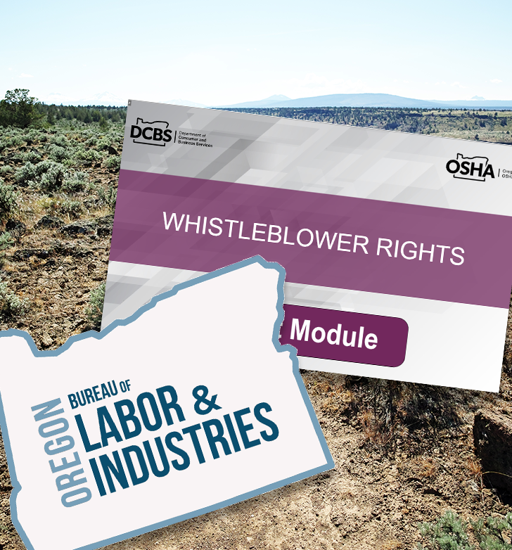
Employee Rights
The employer’s procedures for complying with the requirements of this rule must include how employees can exercise their rights without fear of retaliation. Oregon law 654.062(5) protects employees who raise safety or health concerns and employees should report any safety or health violation to their employer and/or to their employer’s safety committee. Employees may also report safety and health violations to Oregon OSHA whether or not they have reported them to their employer.
For additional information about how to report a concern or violation, please visit osha.oregon.gov/workers or contact the nearest Oregon OSHA Enforcement office.
If an employee believes they have been the object of retaliation or discrimination, they may file a complaint with the Bureau of Labor and Industries (BOLI), Civil Rights Division. Check out Oregon OSHA’s Whistleblower Rights online course for detailed information on this topic.
HEAT ILLNESS PREVENTION

Slide 27
Overview
We covered a lot of information in this course regarding the Heat Illness Prevention rule including:
Types of heat illnesses, such as heat stroke and heat exhaustion;
Signs and symptoms of heat illnesses and the necessary first aid responses;
Employers’ requirements to provide protections to their employees at different heat index thresholds, such as access to shade and drinking water at 80°F, and additional rest breaks at 90°F.
Additional factors that can increase sensitivity to heat such as heart disease, asthma, medication use, wearing PPE, and working in the direct sunlight; and
Employees’ rights to these protections without retaliation from their employer.
Check with your employer for the plans and procedures specific to your worksite for how the rule requirements will be implemented.
To conclude this course, next is a quiz and additional resources.
HEAT ILLNESS PREVENTION

Slide 28
HEAT ILLNESS PREVENTION - QUIZ
Question 1: Mild symptoms of heat illness can quickly turn into serious health conditions if not identified and treated promptly.
True
False
Question 2: The following are types of heat illnesses (select all that apply):
Heat stroke
Heat Exhaustion
Rhabdomyolysis
Heat syncope
HEAT ILLNESS PREVENTION

Slide 29
HEAT ILLNESS PREVENTION - QUIZ
Question 3: The heat index measures (select all that apply):
Air temperature
Direct Sunlight
Humidity
Radiant Heat
Question 4: The Heat Illness Prevention rules require employers to provide enough cold to cool drinking water so that employees may drink up to __ ounces per hour.
16
24
32
48
HEAT ILLNESS PREVENTION

Slide 30
HEAT ILLNESS PREVENTION - QUIZ
Question 5: Under the Heat Illness Prevention rules, employers are required to provide shaded area for rest breaks when the heat index equals or exceeds:
80°F
90°F
100°F
110°F
Question 6: “High Heat Practices” must be followed when the heat index equals or exceeds:
80°F
90°F
100°F
110°F
HEAT ILLNESS PREVENTION

Slide 31
HEAT ILLNESS PREVENTION - QUIZ
Question 7: The purpose of employer-provided rest breaks when the heat index is 90°F or higher is to allow the body to cool down and recover when working in high heat conditions.
True
False
Question 8: Acclimatization is:
Learning about climate change.
Letting the body adjust gradually to a new climate or new conditions.
Maintaining a consistent climate-controlled area at all times.
HEAT ILLNESS PREVENTION

Slide 32
HEAT ILLNESS PREVENTION - QUIZ
Question 9: Wearing personal protective equipment (PPE) can trap heat in and make it harder for the body to cool down.
True
False
Question 10: Personal or non-occupational risk factors that can increase the heat burden on the body and increase the risk of heat illness include (select all that apply):
Heart disease
Asthma
Obesity
The use of medications, drugs and/or alcohol
HEAT ILLNESS PREVENTION

Slide 33
HEAT ILLNESS PREVENTION
HEAT ILLNESS PREVENTION - QUIZ ANSWERS
A
A, B, C, D
A, C
C
A
B
A
B
9) A
10) A, B, C, D
Notes:
Answers

Slide 34
Where To Go From Here
An excellent resource to utilize is the A-Z Topic Index on the Oregon OSHA website. It has lists of relevant publications, training materials, rules, interpretations, videos, and other miscellaneous materials.
If you want guidance in developing a safer work environment, you may consider our free and confidential consultation service. Our consultants in workplace health and safety can help you reduce accidents, related costs, and help you develop a comprehensive program to manage safety and health. For more information, please visit the consultation page.
File a Complaint
A-Z Topic Index
Consultation Services
Heat Illness Prevention Resources
HEAT ILLNESS PREVENTION

Slide 35
HEAT ILLNESS PREVENTION

Slide 36
Credits
Congratulations! You’ve completed the Heat Illness Prevention course and quiz!
Produced by the Public Education Team of Oregon OSHA:
Tammi Stevens, Phillip Wade, Ricardo Vazquez Rodríguez, Angelina Cox, Tim Wade, Anthony Dey
Stock Images provided by: Getty Images Inc.
HEAT ILLNESS PREVENTION

