Slide 1
JOB HAZARD ANALYSIS
Module 1: Introduction
Please note: If the online course contains videos, the video links are included in this PPT.
You will need to have an internet connection to play the videos or
you can download the videos and embed them into your copy of this PPT presentation.

Slide 2
Disclaimer
Completing this course will help you understand job hazard analysis. However, it is your employer’s responsibility to further your training where it is specific to your organization, such as permits, policies, and practices. This material should not be considered a substitute for any provisions of the Oregon Safe Employment Act, or for any standards issued by Oregon OSHA. Manufacturers, products, or services displayed in this material are for informational purposes only and do not constitute an endorsement by Oregon OSHA.
This course does not fulfill employee safety training requirements found in Oregon OSHA rules.
Module 1: introduction

Slide 3
Course Goals
This online course will help employees, employers, safety committee members, and management to understand their role in Job Hazard Analysis (JHA) and developing pre-work plans. Specifically:
Who should conduct a JHA.
The definition of a JHA and the difference between a JHA and a pre-work plan.
Where JHAs and pre-work plans should be prepared.
When they should be completed.
Why JHAs are important to a safe work culture.
Module 1: introduction

Slide 4
JHA An Introduction
Module 1: introduction

Slide 5
Understanding Hazard Analysis
Job Hazard Analysis (JHA), is known by many other names including Task Hazard Analysis and Job Safety Analysis. Regardless of what it is called, hazard analysis is a method of identifying the risks of the job, assessing the risk level, and controlling hazards associated with specific tasks or jobs. The JHA focuses on the relationship between the worker, the task, the tools, and the work environment.
While JHAs are especially useful to identify hazards before they occur, they are also used for jobs with a history of injuries or near misses.
Module 1: introduction

Slide 6
Who Should Conduct the JHA
Those who complete the JHA must be trained in hazard identification, but do not have to be safety committee members. A workplace may have equipment and processes in use which would require inspectors to have additional training and knowledge to prevent exposing themselves or others to a hazard. This will also better ensure existing and potential hazards are identified and corrective actions are provided. Examples of such equipment and processes include, but are not limited to:
Electrical equipment
Lockout/Tagout
Fall protection
Chemical labeling
Machine guarding
Module 1: introduction

Slide 7
Involve Others to Get a Full Picture
JHAs for complex jobs can take time and expertise to develop.
JHAs can be done individually or as a small team. As you consider this, keep in mind that involving the employees performing the jobs throughout the JHA process can provide you with a better understanding of the tasks within the job. Employee involvement can also help you implement needed changes. You may also find it helpful to involve someone with safety training.
The JHA process is also an opportunity for management to involve employees in developing safe work procedures.
Module 1: introduction

Slide 8
How is a Job Defined?
As you begin to undertake the process of the JHA, it’s important to understand that a “job” in this procedure does not refer to the employees’ job title or occupation such as forklift operator or roofer. A JHA focuses on the various tasks within each role.
Analyzing a “task” is composed of a series of steps. A typical job includes a number of tasks. For instance, a forklift operator not only operates the forklift, but may perform maintenance, manually load and unload materials, change batteries, or exchange out fuel cylinders, etc. There are hazards associated with each of these essential tasks that can be better managed with the development and use of the JHA.
Module 1: introduction

Slide 9
Job Hazard Analysis Versus Pre-Work Plans
You may have also heard of a pre-work plan. How does a JHA differ from a pre-work plan?
A JHA is prepared for a job that is routine.
A pre-work plan is completed for a job that is not routine. Often pre-work plans are prepared before the new job or task begins. This is a way to make sure non-routine hazards are controlled. However, just because the job is not routine, employees may still be familiar with individual steps. For example: A non-routine job of repairing a piece of equipment may include welding. This task has already been assessed for hazards, and controls have already been identified.
Module 1: introduction

Slide 10
Where Should JHAs be Performed?
JHAs should be conducted on the job if possible. JHAs are most effective when you can watch an employee actually do the work.
Later in the course we’ll discuss preparation which takes place before the JHA or pre-work plan. This research and document review is best done in an office where you can read and make notes.
Module 1: introduction

Slide 11
Module 1 Overview
You’ve completed module 1!
A Job Hazard Analysis is used to identify potential hazards in the workplace and minimize the associated risks. Only those who are trained in hazard identification should take on the important role of documenting hazards. When conducting a JHA, it’s important to get input from the employees who perform the job tasks in order to get a more comprehensive picture/analysis. Doing so will help when developing a JHA.
Module 1: introduction

Slide 12
Module 2: Developing a JHA
JOB HAZARD ANALYSIS

Slide 13
Welcome to Module 2
In the previous module you learned what a Job Hazard Analysis (JHA) is and how it’s performed. In this module, we will cover when and why a JHA is used, and how to review records. You will also learn how to prioritize risks.
Module 2: developing a JHA

Slide 14
When Should a Job Hazard Analysis be Performed?
Deciding when to conduct your hazard analysis is the first step.
A JHA should be completed:
Any time a new job task is introduced into the workplace.
When a current job task is changed or modified.
After periodic review shows a need for change.
Upon request of an employee or supervisor.
Remember, a JHA should be a living document which is open to modification as the job evolves and job tasks change.
Module 2: developing a JHA

Slide 15
Timing Factors to Consider
If possible, the JHA or pre-work plan should be completed before the job is performed.
There are other factors you should consider when deciding when to complete a JHA or pre-work plan. Prioritize jobs by:
How many people could get hurt or sick?
How severely could they get hurt or sick?
This is a simple version of a risk assessment.
Module 2: developing a JHA

Slide 16
Why Develop a Job Hazard Analysis?
Oregon OSHA rules do not specifically require the employer to develop a JHA or pre-work plan. However, the employer is required to provide a safe and healthy workplace. These documents help to fulfill this requirement.
To read more about Oregon OSHA’s standards specific to furnishing a safe workplace, click here.
Module 2: developing a JHA

Slide 17
Creating a JHA Worksheet
You may choose to make a Job Hazard Analysis form for your business to meet your operational needs. Should you choose to make your own JHA sheet, here are a few things to help create your own JHA:
Be easy to understand.
Be completed for each essential task.
Contain descriptions of job tasks to be performed.
Have a list of basic steps to complete the job.
List the hazards.
Include measures to be taken to avoid hazards.
Once you have completed your JHA, it can be included in a job description if desired. Click here to view a sample JHA worksheet.
Module 2: developing a JHA

Slide 18
Before You Conduct Your JHA
Before you conduct your JHA, there are some documents you may wish to review and some research you may wish to conduct.
In the next few slides we will go more in-depth about these ideas and help you prepare.
Module 2: developing a JHA

Slide 19
JHA Development – Records Review
Review the following reports:
Safety Committee meeting minutes
OSHA 300 logs documenting injuries
This written hazard assessment for PPE⁽³⁾
Safety Data Sheets associated with tasks
Machinery/Equipment manuals
Accident investigations and incident reports
Reviewing these documents will give you a more complete idea of the past hazards, safety concerns noted previously, and manufacturer requirements and recommendations.
Module 2: developing a JHA

Slide 20
JHA Development – Employee Conversations
Before beginning your JHA, the first thing you should do is conduct an initial job review.
Discuss with your employees the jobs and related hazards they know exist in their current work area. Ask them for ideas to eliminate or control those hazards.
Any problems that can be corrected easily should be noted and corrected as soon as possible. Do not wait to complete the JHA. This will demonstrate a commitment to safety and health and enable you to focus on the hazards and jobs that need more consideration because of their complexity.
Module 2: developing a JHA

Slide 21
JHA Development – Accident History Review
Review accident history:
Review the history of accidents and illnesses and any “near misses”.
These events may indicate existing hazard controls (if any) may not be adequate and deserve a closer look.
You may discover more “near misses” by discussing the work process with employees doing the tasks.
Module 2: developing a JHA

Slide 22
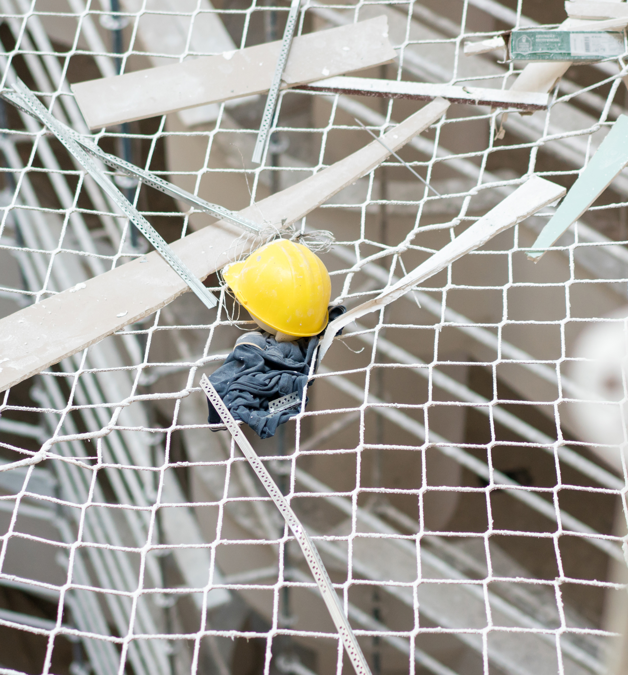
JHA Development – Prioritizing Risks
Analyzing risk factors can help you decide which JHA to complete first. Factors that can increase risk include:
Jobs with a history of sustained injuries
Jobs associated with near misses
Number of employees exposed
Frequency of each exposure
Duration of each exposure
Proximity of employees to the point of danger
Unreasonable workload
Working under stress (hurry, fatigue, illness, personal problems, etc.)
Environment (noise, light, wind, & rain)
Module 2: developing a JHA

Slide 23
Module 2 Overview
You have completed module 2!
You learned timing factors such as how many and how severely someone can get hurt or sick. We also learned how to create a Job Hazard Analysis worksheet, as well as some helpful research to do before conducting a JHA. Another thing we learned was how to prioritize certain risks.
In the next module, we’ll learn about different types of workplace hazards as well as how to control hazards.
Module 2: developing a JHA

Slide 24
Module 3: Workplace Hazards
JOB HAZARD ANALYSIS

Slide 25
Welcome to Module 3!
So far, we covered what a Job Hazard Analysis is and who conducts it. We also learned how to develop a JHA and to prioritize hazards.
Now it’s time to learn about different workplace hazards and how to control them!
Module 3: workplace hazards

Slide 26
Near Miss and Falls
Near Miss: a narrowly avoided collision or other accident.
Fall Hazards: Most common type of accidents, specifically falls to below.
The severity of injury from a fall depends on three factors:
Velocity of initial impact
Magnitude of deceleration - due to hardness of the surface
Orientation of the body on impact
Module 3: workplace hazards

Slide 27
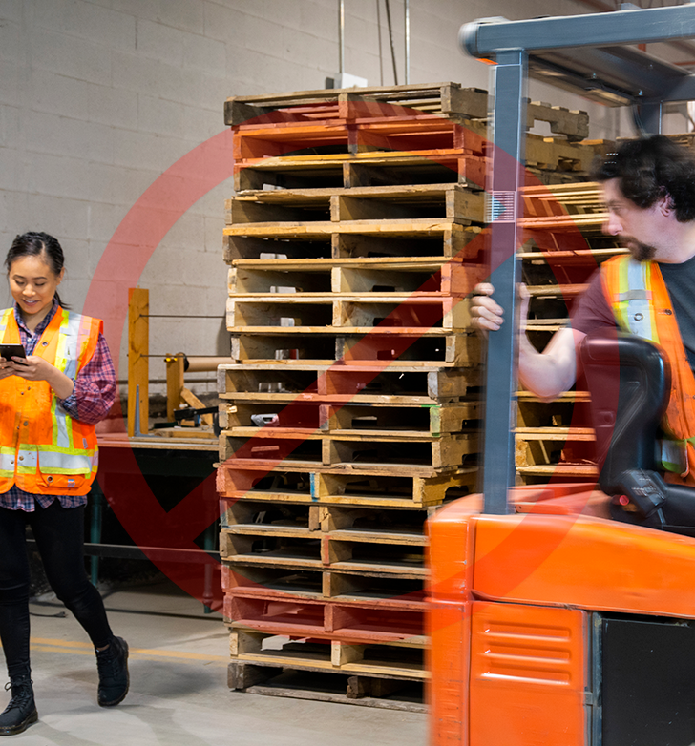
Impact
Impact: Impacts resulting in being struck by and struck against may cause serious accidents.
The severity of injury from impacting objects depends on three factors:
Velocity of the impact
Characteristics of the object (size, hardness, shape, etc.)
Body part(s) impacted
Module 3: workplace hazards

Slide 28
Mechanical
Mechanical: There are as many hazards created by moving machine parts as there are types of machines. Mechanical hazards cause caught-in, caught-on, and crush accidents that can cut, crush, amputate, break bones, strain muscles, and even asphyxiation.
Mechanical hazards motions include:
Rotating
Reciprocation
Transverse
Module 3: workplace hazards

Slide 29
Heat and Temperature
Heat and Temperature: Overexposure to heat and temperature extremes may result in a range of injuries from burns to frostbite. Temperature indicates the level of heat present.
Heat is produced as a result of: Chemical reaction, combustion, electrical current, mechanical motion, and metabolism.
Heat is transferred by:
Convection: Heat is transferred by molecules moving through a fluid, gas, or liquid.
Radiation: Occurs when a body’s temperature is above absolute zero.
Conduction: Heat is transferred through a substance or between substances without physical movement of the substance itself.
Module 3: workplace hazards

Slide 30
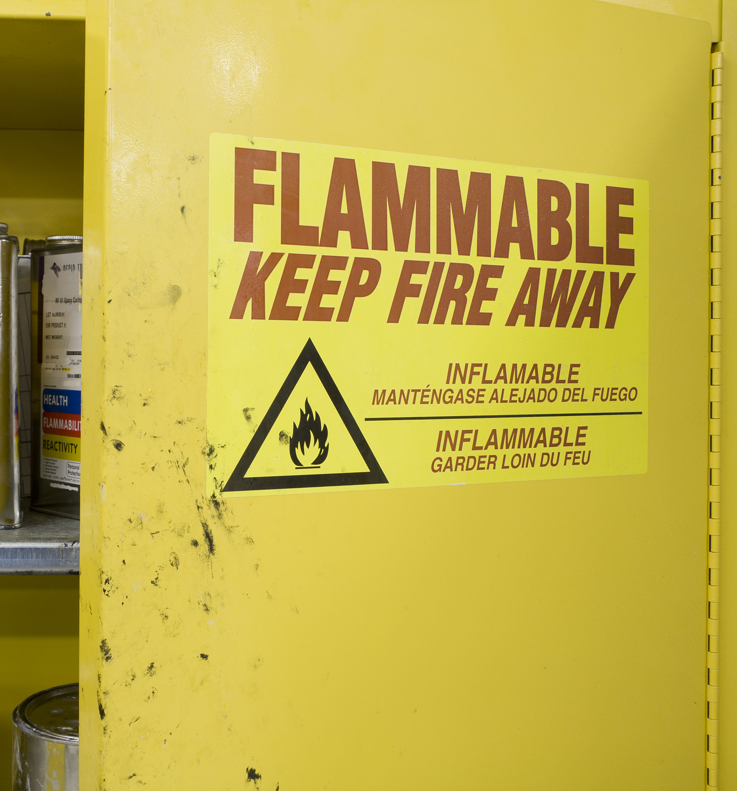
Flammability/Fire
Flammability/Fire: Fire may cause burn injuries. In order for combustion to take place, the fuel and oxidizer (oxygen) must be present in gaseous form.
Flammable materials include: fuel, solvents, cleaning agents, lubricants, coatings, chemicals, refrigerants, insecticides, plastics, hydraulic fluid, vegetation, wood/paper, fabrics, metals, and rubber products.
Module 3: workplace hazards

Slide 31
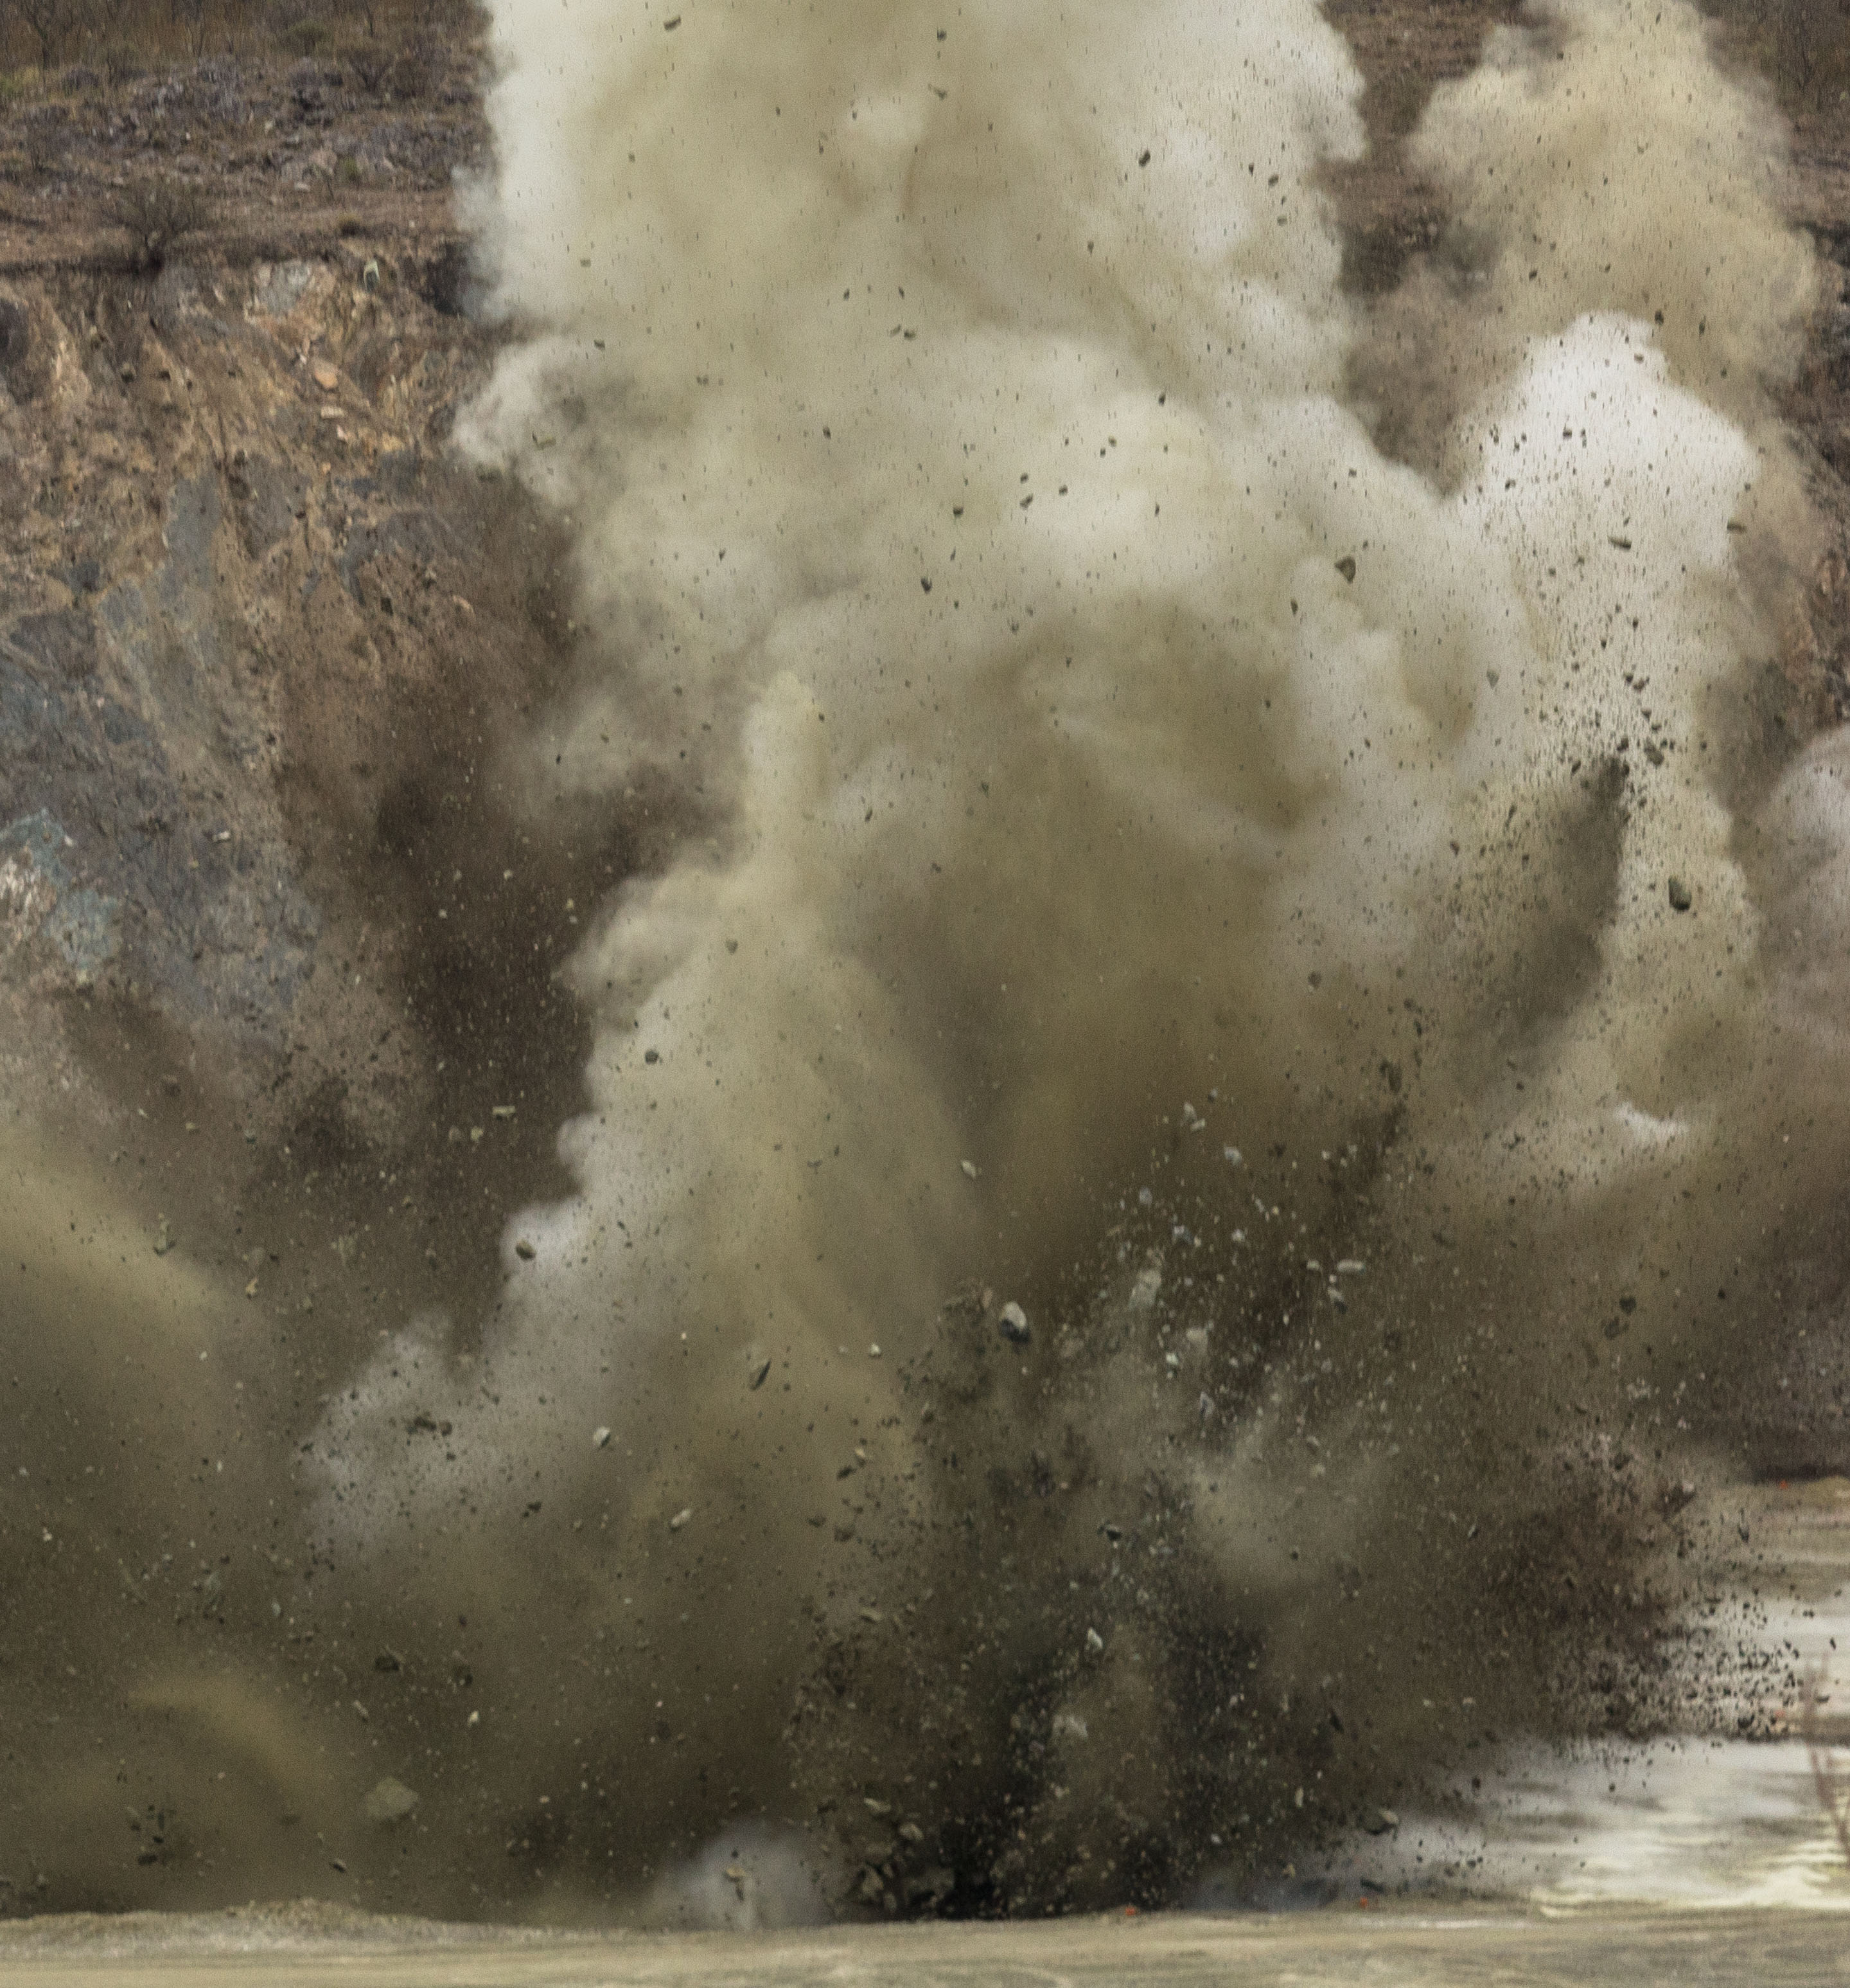
Explosives
Explosives: The results of an explosion may range from minor injury to major catastrophe.
Many types of explosions may occur due to: chemicals, dusts, solids, vapors, gasses, and equipment.
Module 3: workplace hazards

Slide 32
Pressure Hazards
High and low pressure hazards include:
Ruptured cylinders: The thrust generated by gas flowing through a puncture or rupture of a cylinder can be 20 times greater than the weight of the cylinder and reach the velocity of 50 feet per second in 1/10th of a second.
Whipping hoses and lines: Compressed air and water hoses can kill when end fittings become loose. Such hoses and lines should be restrained by weighting with sand bags at short intervals, chained, clamped, etc. Never try to grab a whipping hose or line, turn off the controlling valve.
Water hammer: The effect caused by a sudden stop of liquid flow causing a shock wave (water hammer) that can cause a line rupture.
Module 3: workplace hazards

Slide 33
Electrical Contact
Electrical Contact: Exposure to electrical current.
There are four principal categories of electrical hazards:
Shock: Electrical shock is a sudden and accidental stimulation of the body’s nervous system by an electrical current. Look for bare conductors, insulation failures, buildup of static electricity, and faulty electrical equipment.
Ignition of combustible (or explosive) material: Ignition is usually caused by a spark, arc, or corona effect.
Overheating: High current high heat that can result in fires, equipment burnout, and burns to employees.
Electrical explosions: Rapid overheating of circuit breakers, transformers, and other equipment may result in an explosion.
Module 3: workplace hazards

Slide 34
Ergonomics
Ergonomics: Improper lifting, lowering, pushing, pulling, and twisting can cause strains and sprains. Ergonomics-related hazards are the most common source of injury in the workplace.
Ergonomic hazards exist in:
The task: Work that includes high force, repetition, frequency, duration, inappropriate posture, and point of operation.
The environment: Noise, temperature, humidity, color, etc.
The worker: physical/mental capabilities, pre-existing conditions, etc.
Module 3: workplace hazards

Slide 35
Biohazards
Biohazards: Exposure to plants, animals, or their products that may be infectious, toxic, or cause allergies may cause illness and disease. People who work with animals, animal products, or animal waste have great risk of infection.
Biohazard agents include:
Bacteria: Microscopic living organisms, usually one-celled, that can be found everywhere. They can be dangerous, such as when they cause infection, or beneficial, as in the process of fermentation.
Viruses: Organisms that depend on a host cell for development and reproduction.
Fungi: May be small or large (mushroom), parasitic organisms growing in a living or dead plant or animal matter.
Protozoa: Any of a large group of one-celled organisms (called protists) that live in water as parasites.
Module 3: workplace hazards

Slide 36
Bloodborne Pathogens
Bloodborne Pathogens Occupational Exposure means reasonably anticipated skin, eye, mucus membrane, or parenteral contact with blood or other potentially infectious materials that may result from the performance of an employee’s duties.
Bloodborne Pathogens are microorganisms that are transmitted via human blood and cause disease. They can be transmitted by means of blood, tissue, body fluids, and Other Potentially Infectious Materials (OPIM). While there are many types of pathogens, the focus of this program is on bloodborne pathogens and what employers need to know to be in compliance with Oregon OSHA.
In general, the purpose of the standard is to protect employees from the hepatitis B virus (HBV), the human immunodeficiency virus (HIV), and the hepatitis C virus (HCV).
Module 3: workplace hazards

Slide 37
Workplace Violence
Workplace Violence: Any violent act that occurs in the workplace and creates a hostile work environment which affects employees’ physical or psychological well-being. A risk factor is a condition or circumstance that may increase the likelihood of violence occurring in a particular setting.
Risk factors include:
Employee contact with the public
Exchanging money
Selling/dispensing alcohol or drugs
Delivering passengers
Goods, or services
Mobile workplace (such as taxicabs or police cruisers)
Exposure to unstable or volatile persons (such as in healthcare or social services)
Employees working alone
Late at night/early morning
In small numbers
Module 3: workplace hazards

Slide 38
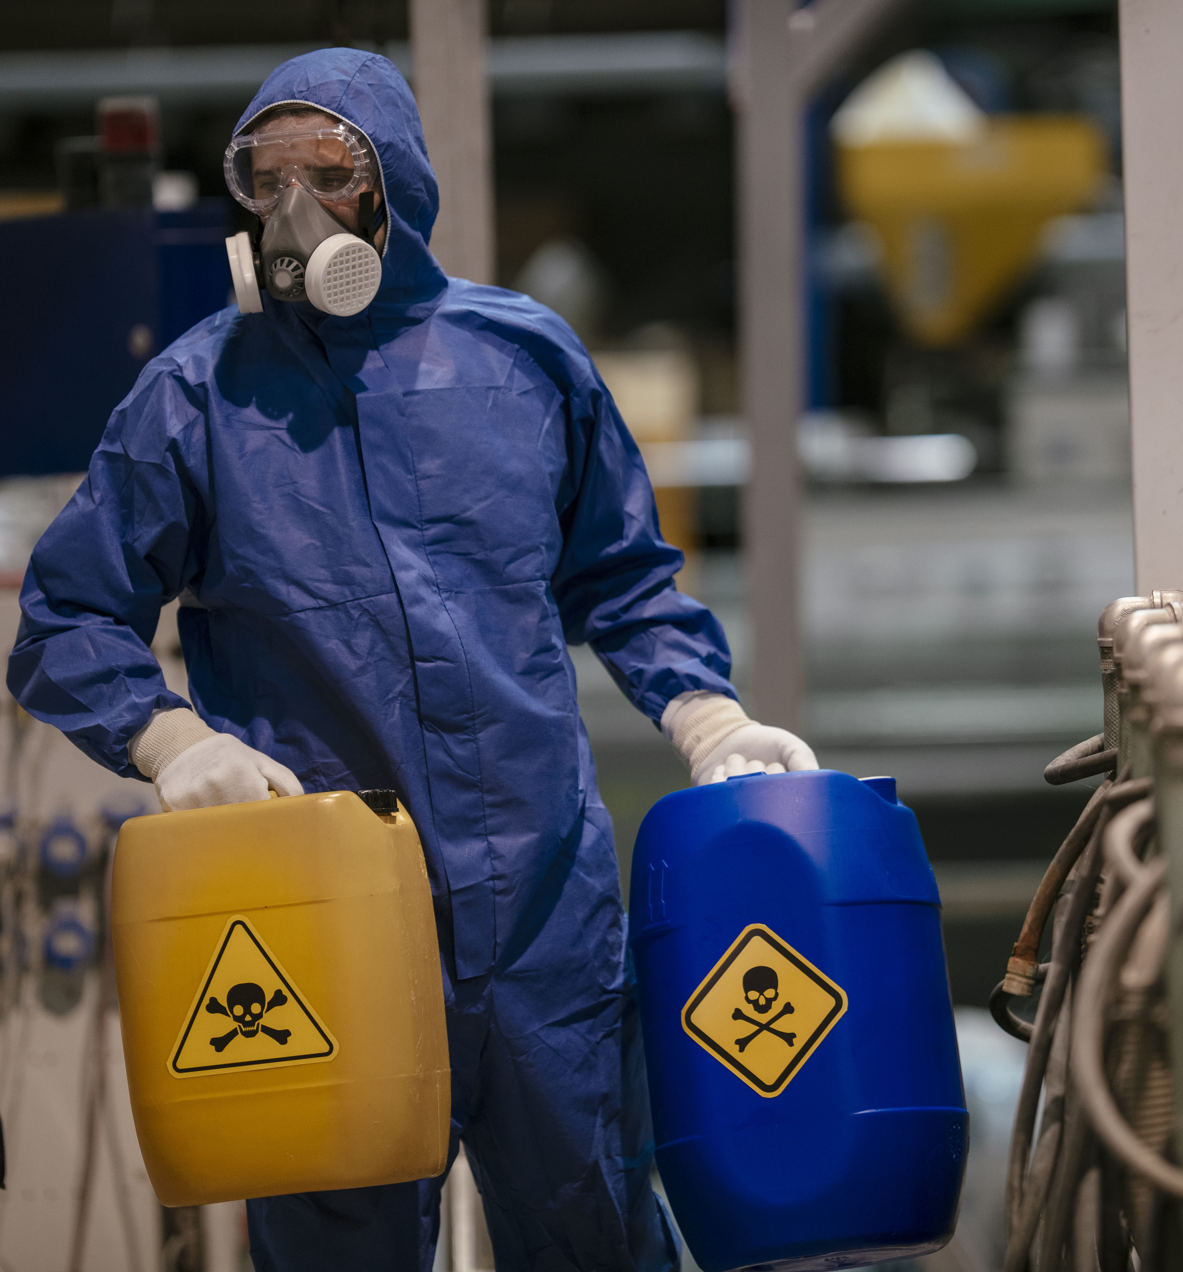
Toxics
Toxics: A material is toxic if a small quantity can cause an injurious effect, such as tissue damage, cancer, and/or mutations. It’s important to consider the routes of entry of toxic materials into the human body.
There are four possible routes of entry:
Inhalation: breathing in toxics is the most common and dangerous route.
Ingestion: Toxics enter through the gastrointestinal tract.
Absorption: Toxics pass through skin into the bloodstream.
Injection: Toxics can be injected into the body (needles, etc.) the least common yet most direct route of entry.
Module 3: workplace hazards

Slide 39
Vibration/Noise
Vibration and Noise: Tools, equipment, and surfaces that vibrate can create noise, and potentially expose a worker to vibration related hazards.
These include:
Segmental vibration: This is when the hands or some other body part is exposed to a vibrating tool or work-surface.
Segmental vibration is a known source for causing injuries to the:
Hands
Wrists
Forearms
Upper Body
Whole-body vibrations: This is most commonly experienced in moving vehicles and impacts the spine. The lower back is particularly susceptible to fatigue and injury from exposures.
Module 3: workplace hazards

Slide 40
JHA Steps and Tasks
Module 3: workplace hazards

Slide 41
Determining Risk Level of Workplace Hazards
The hazards presenting the most risk need to be analyzed first. To determine the level of risk objectively, it can be helpful to use a structured method to analyze risks and prioritize hazards. Review the hazard assessment materials below for examples of different methods.
Hazard assessment and certification form
Hazard ID and assessment
Hazard assessment booklet
Module 3: workplace hazards

Slide 42
JHA Identifying Hazards
Module 3: workplace hazards

Slide 43
Hazards Cause Accidents – the Final Effects (1 of 6)
Struck-By: A person is forcefully struck by an object. The force of contact is provided by an object.
-An example of a struck-by incident is a worker being hit by a vehicle, or a logger being hit by a tree.
Caught-Between: A person is crushed, pinched, or otherwise caught between a moving and a stationary object or between two moving objects.
-An example of a caught-between incident includes a vehicle coming off of a jack, rolling into a wall, and crushing a person between the car and vehicle.
Module 3: workplace hazards

Slide 44
Hazards Cause Accidents – the Final Effects (2 of 6)
Struck-Against: A person forcefully strikes an object. The person provides the force of energy.
-An example of a struck-against incident is someone walking or running through a sliding glass door. Or a worker hitting their head on a beam while going downstairs.
Falls-to-Surface: A person slips or trips and falls to the surface he/she is standing/walking on.
-An example of a fall-to-surface incident would include an office worker tripping and falling over an extension cord. This could also include a person slipping on a wet floor.
Module 3: workplace hazards

Slide 45
Hazards Cause Accidents – the Final Effects (3 of 6)
Contact-By: Contact by a substance or material that, by its very nature, is harmful and causes injury.
-An example of a contact-by incident includes an employee being splashed by bleach or other harmful substance and getting it in their eyes.
Fall-to-Below: A person slips or trips and falls to a level below the one he/she was walking or standing on.
-An example of a fall-to-below incident would include a fall from any form of elevation, this includes a roofer falling off of the roof or an employee falling off of a ladder.
Module 3: workplace hazards

Slide 46
Hazards Cause Accidents – the Final Effects (4 of 6)
Contact-With: A person comes in contact with a harmful substance or material. The person initiates the contact.
-An example of a contact-with incident includes an employee being exposed to a bloodborne pathogen, silica, asbestos, or other harmful substance.
Overexertion: A person overextends or strains himself/herself while performing work. This is a top 10 cause of workplace injury.
-An example of this type of injury includes any type of lifting injury or a strain due to improper ergonomics.
Module 3: workplace hazards

Slide 47
Hazards Cause Accidents – the Final Effects (5 of 6)
Caught -On: A person or part of his/her clothing or equipment is caught on an object that is either moving or stationary.
-An example of a caught-on incident would be an employees sleeve getting caught in a rotating shaft resulting in their arm being sucking into the machine.
Bodily Reaction: Caused solely from stress imposed by free movement of the body. Sudden motions, bends, slips, or trips without falling. This is a common cause of injury.
-An example of this would include suddenly shifting to balance a falling load and straining your back. Or tipping on a stair that's 2 inches higher than the others in the flight of stairs.
Module 3: workplace hazards

Slide 48
Hazards Cause Accidents – the Final Effects (6 of 6)
Caught-In: A person or part of him/her is trapped or otherwise caught in an opening or enclosure.
-An example of a caught-in incident includes a person get caught in a dump truck bed as the bed closes.
Overexposure: Over a period of time, a person is exposed to harmful energy (noise, heat), lack of energy (cold), or substance (toxic chemicals/atmospheres).
-An example of overexposure includes heatstroke or hypothermia.
Module 3: workplace hazards

Slide 49
JHA Hazard Controls
Module 3: workplace hazards

Slide 50
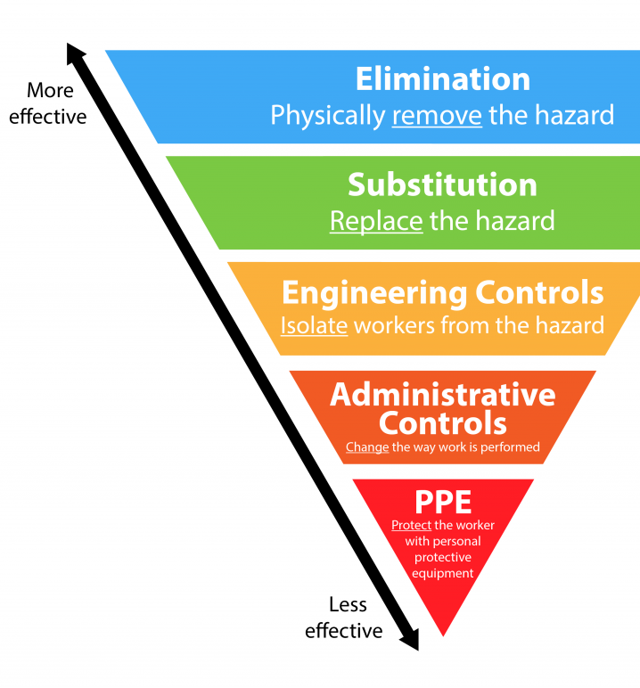
Understanding Hazard Controls
Now that you’ve identified hazards, you need to control them. Eliminating hazards is always the most direct path to workplace safety. When hazards cannot be eliminated, many resources will talk about a hierarchy of controls starting with Engineering Controls, then Administrative Controls, and Personal Protective Equipment.
Other materials may use different terminology, but the basic principles behind the hierarchy of controls are relatively simple. Fully eliminating the hazard is preferred over a control that limits exposure. Controls that work without employee involvement are more effective than controls that rely on employee behavior.
Module 3: workplace hazards

Slide 51
Controlling the Hazards in Your Workplace
How can you accomplish hazard elimination and control in your workplace? Oregon OSHA can help. Contact Oregon OSHA Consultation to schedule your free workplace walk-through.
The Oregon OSHA Consultation team will make an appointment to visit your workplace and, after a walk-through with your staff, make recommendations to control and eliminate hazards specific to your work.
For more information, call our toll-free number 800-922-2689 or click here to learn more.
Module 3: workplace hazards

Slide 52
JHA Writing a Job Procedure
Module 3: workplace hazards

Slide 53
Module 3 Overview
You have completed module 3!
You learned about different types of hazards that you might come in contact with depending on your line of work. Some of which include, flammability, ergonomics, workplace violence, bloodborne pathogens, and toxicants to name a few. We also learned about different types of hazards as well as understanding them, which helps to control them.
In the next module, we’ll learn about how to review for improvement as well as how to properly document the end process to a Job Hazard Analysis.
Module 3: workplace hazards

Slide 54
Module 4: Conclusion
JOB HAZARD ANALYSIS

Slide 55
Completing Your Documentation
You’ve completed your JHA, now it’s time to write down your hazard assessment along with instructions on how to complete the job safely.
When you write your hazard assessment here are a few things to remember:
Include details about a step by step process.
Make sure to address all hazards and direct the employee in a way that will eliminate or control risk.
Review the report with the employees who do the job to make sure they understand the instructions.
Review the report with the supervisors to include their thoughts.
Module 4: conclusion

Slide 56
Making Sure the JHA Meets the Needs of the Job
After implementing your JHA, it’s important to come back a few weeks or months later and talk to the supervisor(s) and employee(s) about the JHA.
During this re-evaluation you can ask the employee(s) if there are any remaining safety concerns.
The supervisor(s) may be able to let you know if any steps have been skipped and if so, what about the JHA can be revisited.
Module 4: conclusion

Slide 57
Reviewing the JHA for Continual Improvement
Periodically reviewing the job hazard analysis ensures that it remains current and continues to help reduce workplace accidents and injuries. Even if the job has not changed, it is possible that during the review process you will identify hazards that were not identified in the initial analysis.
It is particularly important to review the job hazard analysis if an illness or injury occurs on a specific job. Based on the circumstances, you may determine that you need to change the job procedure to prevent similar incidents in the future.
Any time you revise a JHA, it is important to train all employees affected by the changes in the new job materials, procedures, or protective measures used.
Module 4: conclusion

Slide 58
Congratulations!
You have completed the Job Hazard Analysis training! You finished modules one, two, three, and four. Coming up next is a set of quiz questions.
Let’s get started!
Module 4: conclusion

Slide 59
HAZARD IDENTIFICATION - QUIZ
Question 1: A JHA should be completed by:
The executive manager.
One person designated by the Safety Committee.
A person or team of people who understands the job being evaluated.
The employee of the month.
Question 2: What is a Job Hazard Analysis (JHA)?
Also known as a pre-work plan, it removes workplace hazards.
JHA’s are prepared for a job that is routine.
A method of identifying the risks of the job, assessing the risk level, and controlling the hazards.
Both B and C
Module 4: conclusion

Slide 60
HAZARD IDENTIFICATION - QUIZ
Question 3: What’s the difference between a JHA and a pre-work plan?
A JHA and a pre-work plan are the same.
A JHA is for a task that is routine, a pre-work plan is for a job that is not routine.
A JHA is temporary and a pre-work plan is permanent.
A pre-work plan is only for jobs with heavy machines.
Question 4: Where should you conduct the JHA?
In the office where you can focus.
In a safe, climate controlled area.
The location is not important.
On the site where the job is performed whenever possible.
Module 4: conclusion

Slide 61
HAZARD IDENTIFICATION - QUIZ
Question 5: When should you conduct a JHA?
When a new job or task is introduced.
When a current job or task is changed or modified.
Upon request of an employee or supervisor.
All of the above.
Question 6: Why are JHA’s important to a safe workplace?
No one really knows why, but it’s the way it’s always been.
Once you conduct a JHA you no longer need to think about safety.
To advance workplace safety and health.
Module 4: conclusion

Slide 62
HAZARD IDENTIFICATION - QUIZ
Question 7: A JHA is to help keep employees safe in the workplace.
True
False
Question 8: What are types of Hazards in the workplace? (select all that apply)
Explosives
Vibration and Noise
Employees
Bloodborne Pathogens
Module 4: conclusion

Slide 63
HAZARD IDENTIFICATION - QUIZ
Question 9: A JHA worksheet should include a list of hazards, description of job tasks to be performed, and be easy to understand.
True
False
Question 10: When writing your hazard assessment, it’s important to include: (select all that apply)
Detailed step by step process
Review the report with employees who do the job with the hazard
A list of every employees’ hobbies, skills, and attributes
Review reports with supervisors to add their input in your notes
Module 4: conclusion

Slide 64
HAZARD IDENTIFICATION - QUIZ ANSWERS
C
D
B
D
D
C
A
A, B, D
9) A
10) A, B, D
Module 4: conclusion
Notes:
Answers

Slide 65
Where To Go From Here
An excellent resource to utilize is the A-Z Topic Index on the Oregon OSHA website. It has lists of relevant publications, training materials, rules, interpretations, videos, and other miscellaneous materials.
If you want guidance in developing a safer work environment, you may consider our free and confidential consultation service. Our consultants in workplace health and safety can help you reduce accidents, related costs, and help you develop a comprehensive program to manage safety and health. For more information, please visit the consultation page.
File a Complaint
A-Z Topic Index
Consultation Services
Job Hazard Analysis Resources
Module 4: conclusion

Slide 66
Module 4: conclusion

Slide 67
Credits
You’ve completed the Job Hazard Analysis course!
Produced by the Public Education Team of Oregon OSHA:
Roy Kroker, Phillip Wade, Ricardo Rodríguez, Angelina Cox, Tammi Stevens, Tim Wade, Anthony Dey, Stacy Cooke.
Stock Images provided by:
Getty Images Inc.
Module 4: conclusion

