Slide 1
LADDER SAFETY
Module 1: Introduction

Slide 2
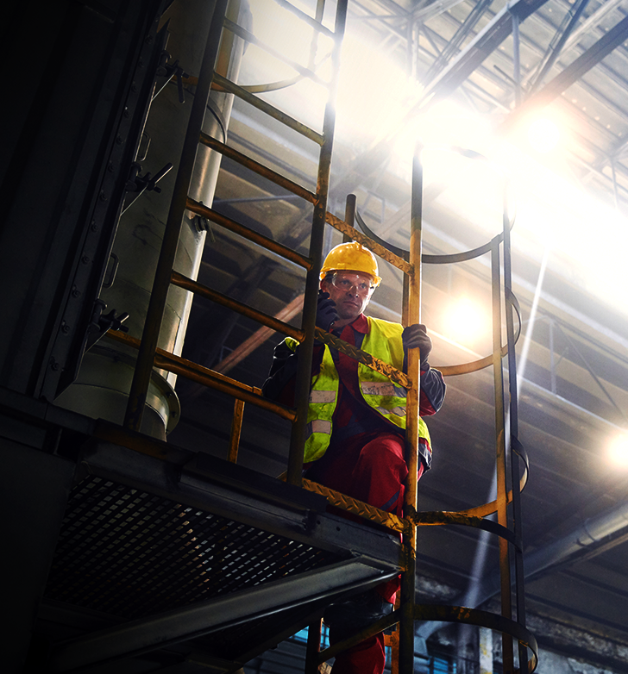
Disclaimer
Completing this course will help you understand the rules and some of the hazards related to ladder safety. However, it is your employer’s responsibility to further your training where it is specific to your organization, such as permits, policies, and practices. This material should not be considered a substitute for any provisions of the Oregon Safe Employment Act, or for any standards issued by Oregon OSHA. Manufacturers, products, or services displayed in this material are for informational purposes only and do not constitute an endorsement by Oregon OSHA.
LADDER SAFETY: introduction

Slide 3
Video: The Dangers of Ladders
LADDER SAFETY: introduction

Slide 4
Video: Overview of Ladder Safety
LADDER SAFETY: introduction

Slide 5
Video: OSHA Standards
LADDER SAFETY: introduction

Slide 6
Module 2: Safe Work Practices
LADDER SAFETY

Slide 7
Video: Right Ladder for the Job
LADDER SAFETY: safe work practices

Slide 8
Selecting the Right Ladder
Selecting the right ladder is very important. Selecting the wrong ladder could lead to serious injury or death. Many people are only familiar with common types of ladders, but there are many types that perform better for different tasks.
Below are a few things you should consider when selecting your ladder:
Work Environment
Ladder Type
Load Capacity
Material
Height and Reach
Maneuverability
Condition of Ladder
LADDER SAFETY: safe work practices

Slide 9
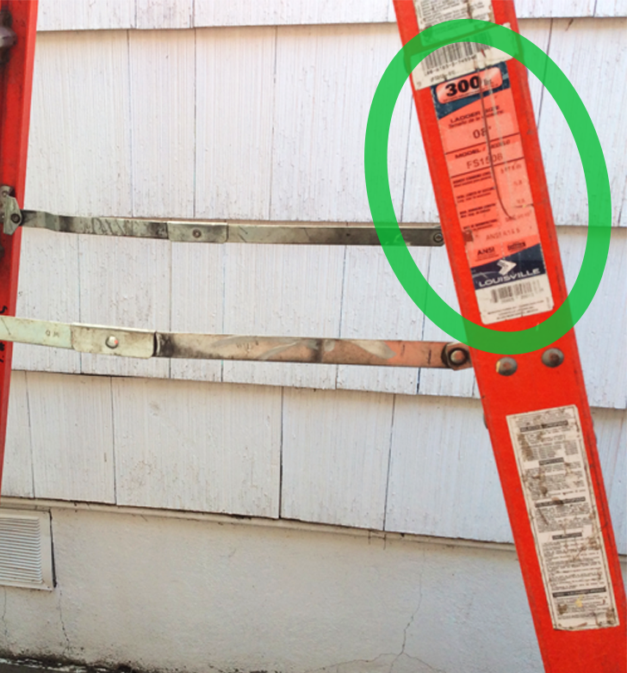
Load Capacities
Each Ladder type has a load capacity rating based on the kind of ladder. There are 5 different load capacities, and each have their own label.
Type III (200 lbs.) Typical uses include painting, yard work, and household chores.
Type II (225 lbs.) Typical uses include light commercial, painting, cleaning, and light repair.
Type I (250 lbs.) Typical uses include maintenance, and drywall.
Type IA (300 lbs.) Typical uses include construction, and roofing.
Type IAA (375 lbs.) Typical uses include heavy duty, industrial, and construction.
The maximum weight includes both the weight of the worker, and materials or equipment the worker might be carrying.
*Overloading a ladder could cause it to fail.
LADDER SAFETY: safe work practices

Slide 10
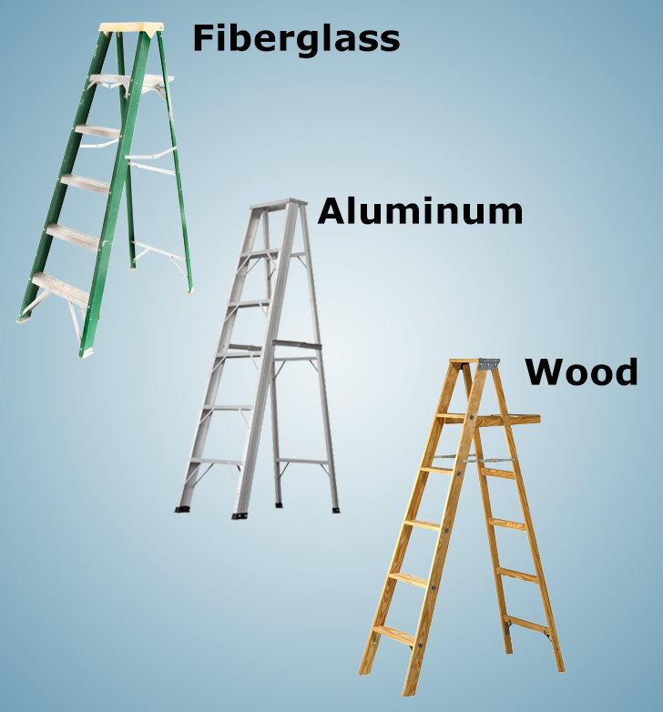
Ladder Material
Fiberglass Ladder:
Fiberglass ladders are strong, lightweight, and electrically non-conductive.
Aluminum Ladder:
Aluminum ladders are lightweight, and must not be used when performing tasks on, or near electrical wiring.
Wood Ladder:
Wood ladders are heavier than both aluminum and fiberglass ladders. They can rot, but are electrically non-conductive.
LADDER SAFETY: safe work practices

Slide 11
Video: Ladder Training Example
LADDER SAFETY: safe work practices

Slide 12
Video: Inspection/Maintenance
LADDER SAFETY: safe work practices

Slide 13
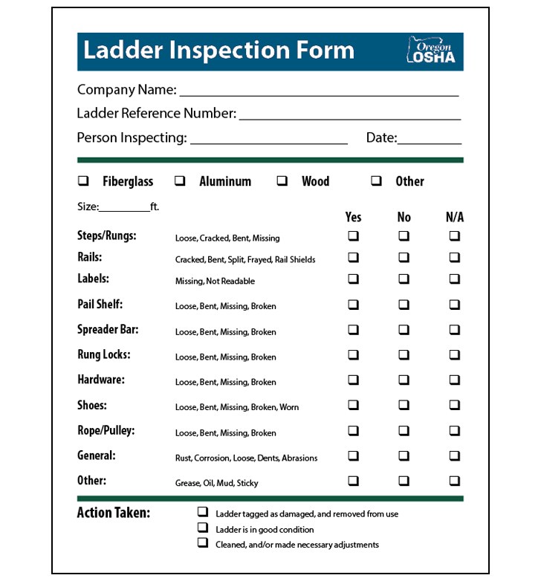
Inspection Form
Even though Oregon OSHA does not require you to keep a record of your ladder inspections, it is much easier to prove you did it if you have the paperwork.
The benefit is you can also see if there are trends developing, like defective parts.
If any defect or damage is found during the inspection, you must do the following:
Tag the ladder “Dangerous, DO NOT USE!”
Repair the ladder immediately to original condition, or destroy the ladder.
Click the link to view the ladder inspection form.
Ladder Inspection Form
LADDER SAFETY: safe work practices

Slide 14
Module 3: Portable Ladders
LADDER SAFETY

Slide 15
Video: Portable Ladder Overview
LADDER SAFETY: portable ladders

Slide 16
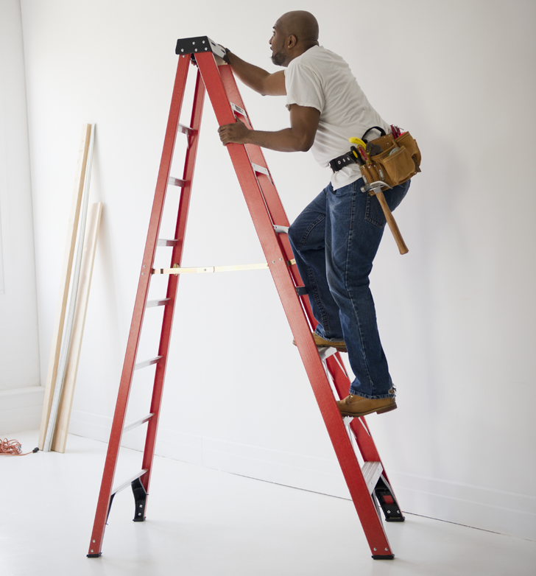
Tips for Using a Ladder
Do not exceed the maximum total load.
Do not exceed the maximum users on the ladder.
Keep your belt buckle between the rails when using the ladder.
Maintain at least 3 points of contact while ascending or descending the ladder.
Wear suitable footwear when using the ladder.
Do not overreach while on the ladder.
Do not move the ladder while on it.
Do not push or pull objects while on the ladder.
LADDER SAFETY: portable ladders

Slide 17
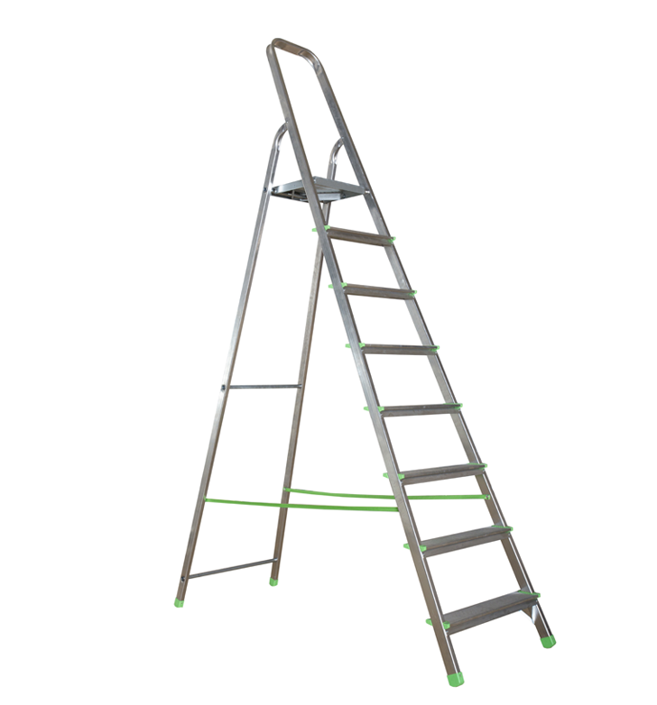
Self-Supporting Ladders
Self-supporting ladders are ladders that have three or four side rails. When these ladders are setup, they have the ability to stand on their own without any assistance, such as a wall.
*Multiple-configuration ladders such as articulated ladders, based on the manufacturer’s approved configuration selected by the user, will either be self supporting or non-self supporting. A ladder cannot be both at the same time.
LADDER SAFETY: portable ladders

Slide 18
Video: New Generation Ladders
LADDER SAFETY: portable ladders

Slide 19
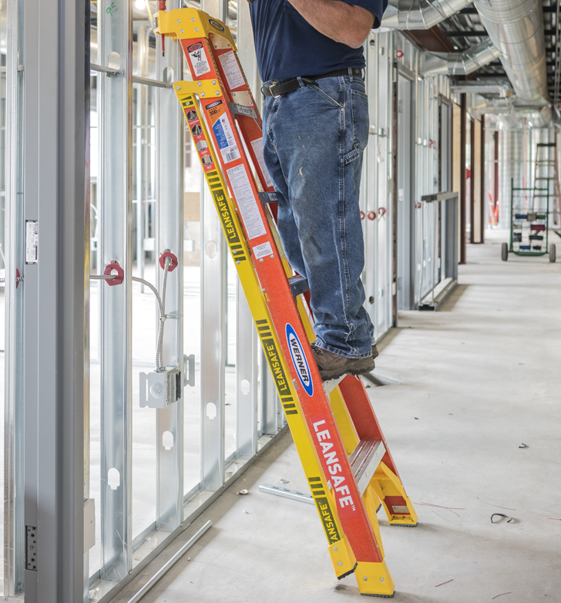
Lean Safe Ladders
Lean safe ladders are uniquely designed to securely lean against flat wall surfaces, wall corners, poles, and wall studs. They also can perform as standard stepladders.
Leaning a standard stepladder is not an option on a jobsite, so always read your manufacturer’s instructions, and make sure you have the right ladder for the job.
LADDER SAFETY: portable ladders

Slide 20
Telescopic Extension Ladders
Telescopic extension ladders are uniquely designed to collapse for easy transportation, and storage.
There are a variety of telescopic extension ladders that come with different specifications. Always read your manufacturer’s instructions, and make sure you have the right ladder for the job.
LADDER SAFETY: portable ladders

Slide 21
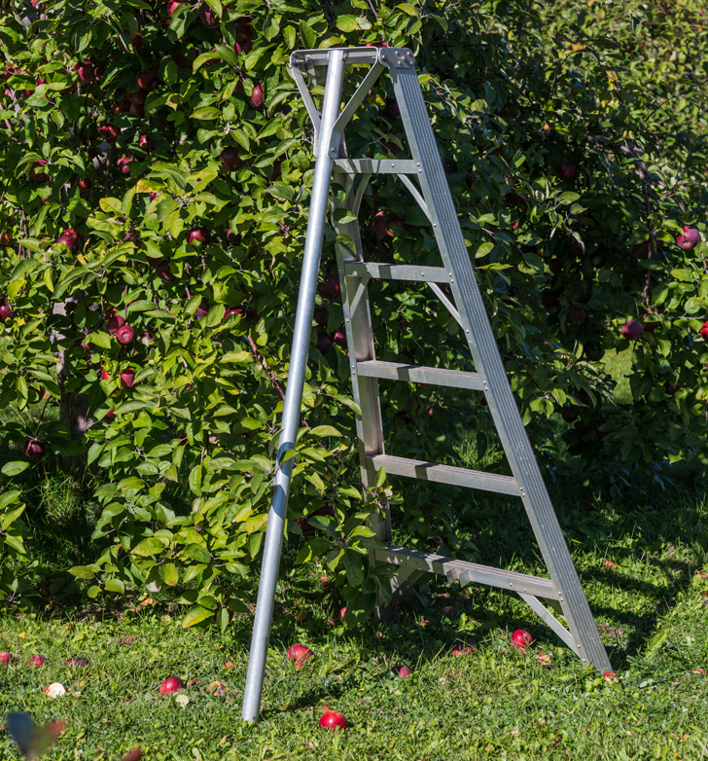
Orchard Ladders
Orchard ladders lack a locking spreader bar between the front and rear legs.
An orchard ladder’s feet are metal and designed to slightly penetrate firm soil to create a secure footing.
They lack slip-resistant pads needed for use on hard surfaces; therefore, an orchard ladder would not be appropriate on polished concrete even though the concrete is both level and firm.
LADDER SAFETY: portable ladders

Slide 22
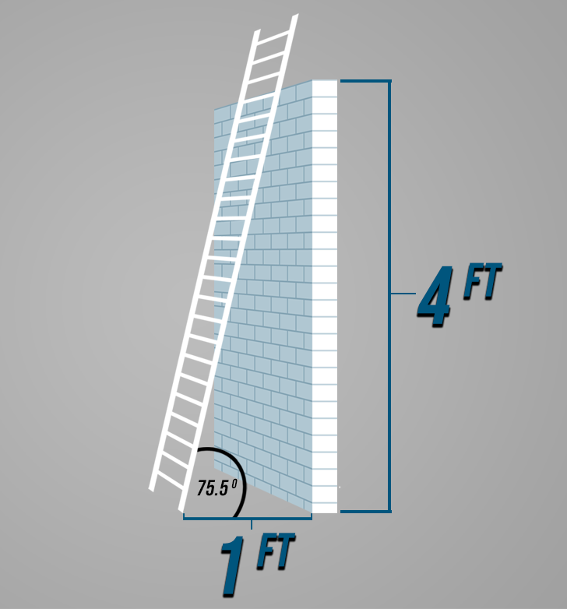
Non-Self-Supporting Ladders
Non-self-supporting ladders, when erected, have two side rails (legs) and must lean against a strong, stable structure to remain standing. This structure provides all non-self-supporting ladders with an “upper-support” also known as a “top support.”
A signature requirement for all non-self-supporting ladders, unless instructed otherwise by the manufacturer, is ensuring that the ladder is set up at the proper angle of 75.5 degrees from the horizon.
*Multiple-configuration ladders such as articulated ladders, based on the manufacturer’s approved configuration selected by the user, will either be self-supporting or non-self-supporting. A ladder cannot be both at the same time.
LADDER SAFETY: portable ladders

Slide 23
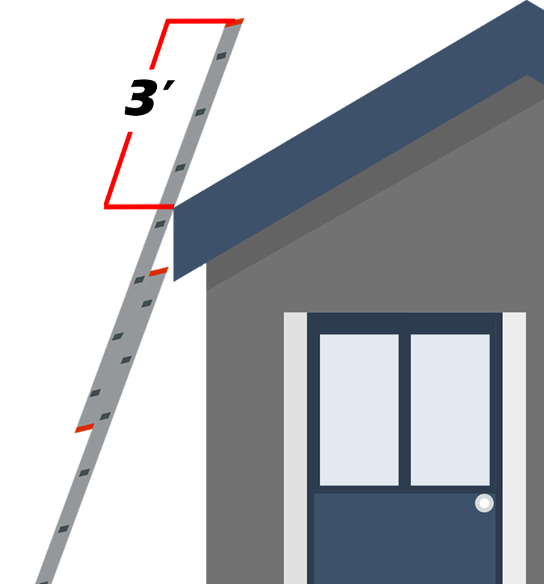
Access to Upper Landing
When portable ladders are used for access to an upper landing, they need to have the side rails extended at least 3 feet above the upper landing.
*Do not place any weight on the rungs located above the upper landing when using non-self-supporting ladders to access an upper level.
LADDER SAFETY: portable ladders

Slide 24
Video: Ladder Accessories
LADDER SAFETY: portable ladders

Slide 25
Video: Portable Ladder Setup
LADDER SAFETY: portable ladders

Slide 26
NIOSH Ladder Safety App
Click the link, or scan the QR Code to download the NIOSH Ladder app.
The app can help with:
Planning
Selection
Inspection
Set-up
Proper Use
Accessories
*The app is only available on mobile devices
(e.g. cellphones, tablets).
NIOSH Ladder Safety App
LADDER SAFETY: portable ladders

Slide 27
How to Use Them
Click the link to review a guide that has more information on portable ladders.
Portable Ladder Guide
LADDER SAFETY: portable ladders

Slide 28
Module 4: Other Ladders
LADDER SAFETY

Slide 29
Video: Mobile Ladder Stands
LADDER SAFETY: other ladders

Slide 30
Video: Fixed Ladders
LADDER SAFETY: other ladders

Slide 31
Video: Ladder Safety Systems
LADDER SAFETY: other ladders

Slide 32
Oregon Fall Protection for Fixed Ladders
Fixed ladders (over 24 ft), installed before November 1, 2019
The following four options are acceptable until December 1, 2036:
1. Personal fall arrest system
2. Ladder safety system
3. Cage
4. Well
Fixed ladders (over 24 ft), installed on or after November 1, 2019
The following two options are acceptable:
1. Personal fall arrest system
2. Ladder safety system
LADDER SAFETY: other ladders

Slide 33
Module 5: Conclusion
LADDER SAFETY

Slide 34
Video: Hazards / Common Mistakes
LADDER SAFETY: conclusion

Slide 35
Video: Storage
LADDER SAFETY: conclusion

Slide 36
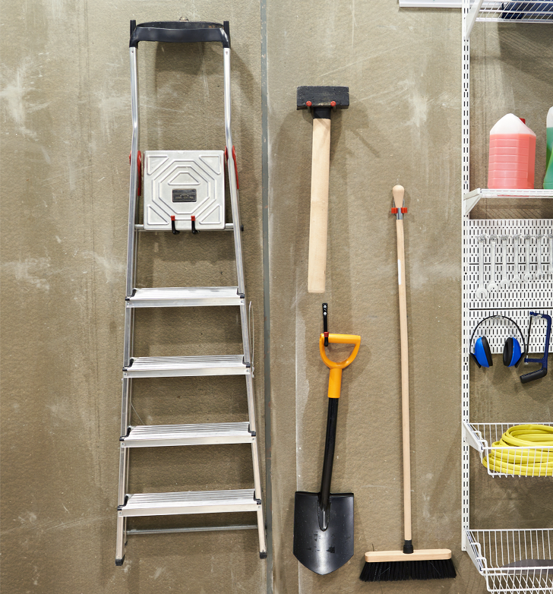
How to Store Your Ladder
Use a well-ventilated storage area.
Store wood and fiberglass ladders away from excessive moisture, heat, and sunlight.
Keep them away from stoves, steam pipes, or radiators.
Store non-self-supporting ladders in flat racks or on wall brackets that will prevent them from sagging.
Store stepladders vertically, in a closed position, to reduce the risk of sagging or twisting.
Secure them so that they won‘t tip over if they are struck.
Keep material off ladders while they are stored.
LADDER SAFETY: conclusion

Slide 37
Ladder Safety – QUIZ
Question 1
Oregon OSHA requires you to keep a written record of your ladder inspections.
A. True
B. False
Question 2
What type of ladder would you use to climb up on a roof?
Step ladder
Extension ladder
Orchard ladder
LADDER SAFETY: conclusion

Slide 38
Ladder Safety – QUIZ
Question 3
One way to make sure the ladder doesn’t fall over is to tie it to the structure, another is:
There is no other way to make sure
Ensure that the base is solid and level
Put cones around the base
Make sure the top is touching the structure
Question 4
Which ladder should you choose to change a light bulb located on an 8-foot tall ceiling?
3-foot stepladder
6-foot stepladder
16-foot straight ladder
24-foot extension ladder
LADDER SAFETY: conclusion

Slide 39
Ladder Safety – QUIZ
Question 5
What can affect the integrity of your ladder?
Sunlight
Chemicals
Electricity
All of the above
Question 6
Which is the strongest ladder load capacity rating?
Type IAA
Type IA
Type II
Type I
LADDER SAFETY: conclusion

Slide 40
Ladder Safety – QUIZ
Question 7
For an extension ladder, you need a ration of this amount for the proper climbing angle:
2:1
3:1
4:1
6:1
Question 8
How many points of bodily contact should you have when ascending or descending a ladder?
At least 1
At least 2
At least 3
none
LADDER SAFETY: conclusion

Slide 41
Ladder Safety – QUIZ
Question 9
You should avoid using ladders near unprotected:
Walls
Doorways
Windows
All of the above
Question 10
You should secure and extend the ladder by at least how many feet above the level you are accessing?
3
2
1
None of the above
LADDER SAFETY: conclusion

Slide 42
Ladder Safety – QUIZ
Question 11
You should inspect your ladder before it is used.
True
False
Question 12
What do you need to take into consideration when calculating ladder load capacity?
Body weight
Tools
Materials
All of the above
LADDER SAFETY: conclusion

Slide 43
Ladder Safety – QUIZ ANSWERS
B
B
B
B
D
A
C
C
B
A
A
D
LADDER SAFETY: conclusion

Slide 44
Where To Go From Here
Oregon OSHA’s online A-Z topic index is an excellent resource for you to use. It lists relevant publications, training material, rules, interpretations, videos, and other miscellaneous material.
If you want guidance in developing a safer work environment, you may consider our free and confidential consultation service. Our consultants in workplace safety, industrial hygiene, and ergonomics can help you reduce accidents, related costs, and help you develop a comprehensive program to manage safety and health.
LADDER SAFETY: conclusion

