Slide 1
LOCKOUT / TAGOUT
Module 1: Introduction

Slide 2
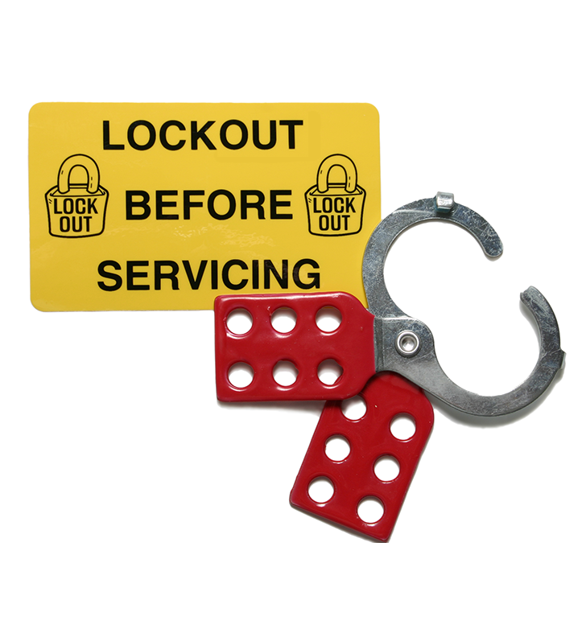
Welcome
This course covers the Control of Hazardous Energy⁽¹⁾ (Lockout/Tagout) standard found in the Oregon Administrative Rules, division 2 subdivision J.
The goal of the standard is to protect employees who could be injured as a result of the unexpected release of hazardous energy. The requirements apply when an employee is doing service or maintenance on equipment and could be injured by the unexpected startup or release of hazardous energy. Lockout/tagout is the primary method of controlling hazardous energy.
Service or maintenance includes erecting, installing, constructing, repairing, adjusting, inspecting, unjamming, setting up, trouble-shooting, testing, cleaning, and dismantling equipment or processes.
In this course, equipment means equipment and machines, whether fixed or mobile.
Module 1: introduction

Slide 3
Navigating this Course
Overall, this course will take about 1 hour to complete. It’s divided into 4 modules, each covering a different aspect of the lockout/tagout process. If you need to pause at any point, you’ll want to make a note of which module you are in by noting the title in the bottom left. Finally, the information button provides a number of links to helpful resources at any point throughout the course.
If you have any questions along the way, feel free to give us a call at 503-947-7443 or email ed.web@dcbs.oregon.gov.
In this course, equipment means equipment and machines, whether fixed or mobile.
Module 1: introduction

Slide 4
For More Information
For more information on this subject, including the student workbook for this class, please reference the A to Z Topics list using topic index: control of hazardous energy⁽²⁾, on the Oregon OSHA website. This information will include letters of interpretation, program directives, and emphasis programs. The control of hazardous energy is related to an emphasis program (see program directive A-280⁽³⁾).
Module 1: introduction

Slide 5
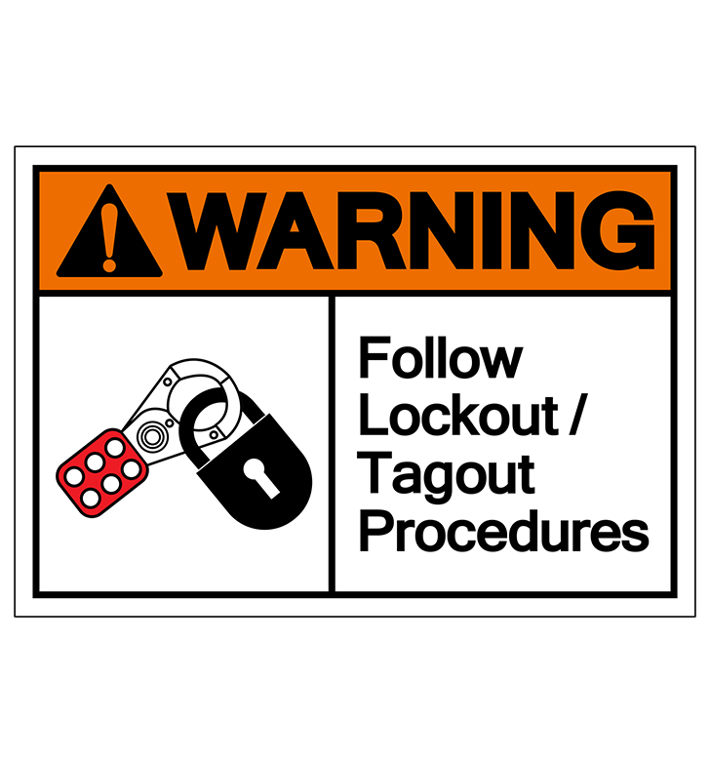
Scope and Application
The scope of this rule as it applies to Oregon employers is that all employers are subject to the lockout standard. There are two more lockout rules that are used as well. These are specific to certain industries:
Division 2, Subdivision S⁽⁴⁾
Division 2, Subdivision RR⁽⁵⁾
Both are for work done under the exclusive control of electric utilities and industries working on electrical utilities. Both of these are lockout standards for electricity.
Module 1: introduction

Slide 6
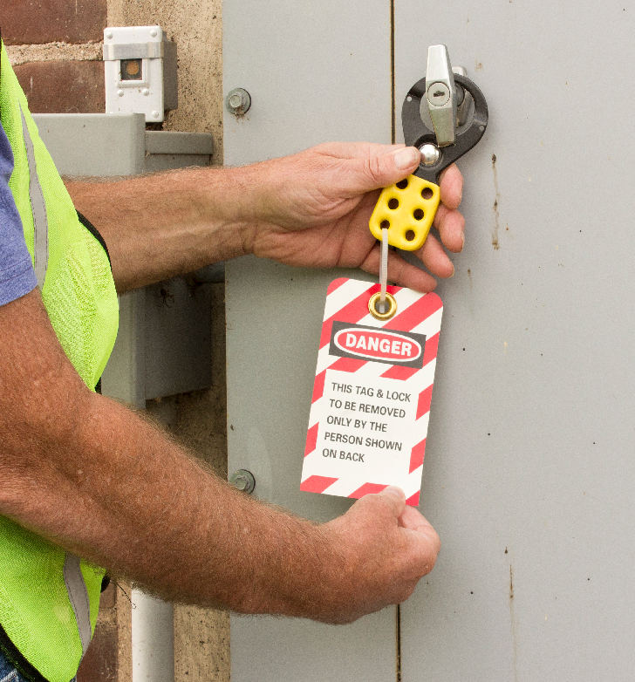
Course Goals
After this course, you will learn how to:
Achieve a zero energy state for equipment that is being worked on, and
Implement energy control procedures, training, and inspection requirements.
This is achieved by addressing two points:
Preventing the expected release of energy or startup, and
Preventing the re-accumulation of that energy.
Next up, let’s define our terms!
Module 1: introduction

Slide 7
Definitions: Lockout
Lockout:
The placement of a lockout device on an energy isolating device, in accordance with an established procedure, ensuring that the energy isolating device and the equipment being controlled cannot be operated until the lockout device is removed.
Lockout Device:
A device that utilizes a positive means such as a lock, either key or combination type, to hold an energy isolating device in a safe position and prevent the energizing of a machine or equipment. Included are blank flanges and bolted slip blinds.
Module 1: introduction

Slide 8
Definitions: Tagout
Tagout:
The placement of a tagout device on an energy isolating device, in accordance with an established procedure, to indicate that the energy isolating device and the equipment being controlled may not be operated until the tagout device is removed.
Tagout Device:
A prominent warning device, such as a tag and a means of attachment, which can be securely fastened to an energy isolating device in accordance with an established procedure, to indicate that the energy isolating device and the equipment being controlled may not be operated until the tagout device is removed.
Module 1: introduction

Slide 9
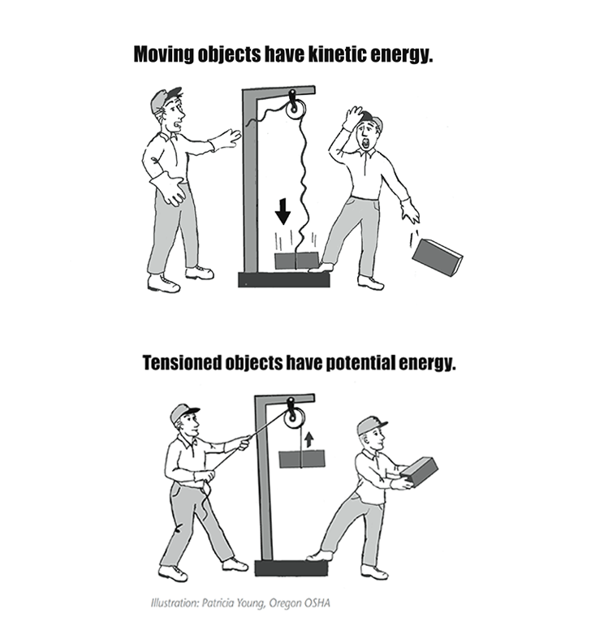
Energy Sources
Energy is the power for doing work. Energy exists in different types, but all are associated with motion. Regardless of the type, energy exists in two basic states: potential energy and kinetic energy.
Tensioned objects such as suspended loads have potential energy – energy that has the opportunity for motion. Releasing the load converts potential energy to kinetic energy, causing the load to drop.
Module 1: introduction

Slide 10
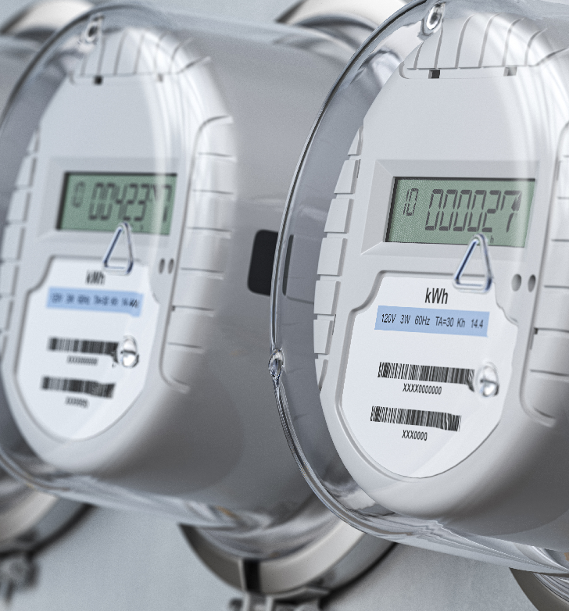
Hazardous Energy
Energy that is unexpected may be hazardous. This hazardous energy may be obvious, but often it is not. Hazardous energy is a threat if you do any of the following:
Service or maintain equipment that could start or move unexpectedly.
Work near equipment when it’s being serviced.
Remove or go around equipment guards.
Fail to follow established energy control procedures.
Simply turning the power off does not make the equipment safe! It is critical that those who service or repair equipment know how hazardous energy could harm them and how to control it. On the next slide, we’ll look at examples of common energy sources.
Module 1: introduction

Slide 11
Energy Sources (continued)
Energy becomes hazardous when it builds to a dangerous level or is released in a quantity that could injure a worker. Here is a list of common energy sources you may encounter:
Electrical
Pneumatic
Hydraulic
Gravity
Mechanical
Thermal
Chemical
Radiation
Nuclear
Module 1: introduction

Slide 12
Work Injury Statistics
It’s worth noting that approximately 3 million workers service equipment and face the greatest risk of injury if lockout/tagout is not properly implemented. Compliance with the lockout/tagout standard prevents an estimated 120 fatalities and 50,000 injuries each year. Workers injured on the job from exposure to hazardous energy lose an average of 24 workdays for recuperation.
Source: US Department of Labor
Module 1: introduction

Slide 13
Overview
If an employee can be injured, then the standard applies and must be followed.
If you have any questions, please reach out to an Oregon OSHA Consultant.⁽⁶⁾
Congratulations! You have finished Module 1.
Module 1: introduction

Slide 14
Class Discussion
Take this opportunity to ask/answer questions about the previous module and to summarize the web link addresses discussed in the module.
Module 1 Resources
(1) https://osha.oregon.gov/OSHARules/div2/div2J.pdf#1910-147
(2) https://osha.oregon.gov/Pages/topics/control-of-hazardous-energy.aspx
(3) https://osha.oregon.gov/OSHARules/pd/pd-280.pdf
(4) https://osha.oregon.gov/OSHARules/div2/div2S.pdf
(5) https://osha.oregon.gov/OSHARules/div2/div2RR.pdf
(6) https://osha.oregon.gov/consult/Pages/index.aspx
Module 1: introduction

Slide 15
LOCKOUT / TAGOUT
Module 2: Procedures

Slide 16
Module Goals
Welcome to Module 2! This section will cover the Lockout and Tagout processes you need to follow when preparing equipment for servicing or maintenance.
After this module you will be able to:
Identify the parts of an energy control program.
Learn how to perform an effective and safe lockout and tagout.
Learn how to properly test equipment to confirm a zero energy state.
Let’s begin!
Module 2: procedures

Slide 17
What is an Energy Control Program?
The standard contains a requirement for the employer to create an Energy Control Program. This program must accomplish three critical activities to ensure employees’ safety when they are servicing or working near equipment that could expose them to hazardous energy:
1. Develop written procedures for controlling hazardous energy.
2. Train employees in the procedures.
3. Conduct inspections of the procedures at least annually.
This module focuses on the first item, which is developing and writing procedures for controlling hazardous energy. There are certain exceptions to this requirement and the standard outlines the list of criteria⁽¹⁾ to qualify. We will be discussing items 2 and 3 in future modules.
Check out Oregon OSHA’s sample program⁽²⁾ available to assist employers.
Module 2: procedures

Slide 18
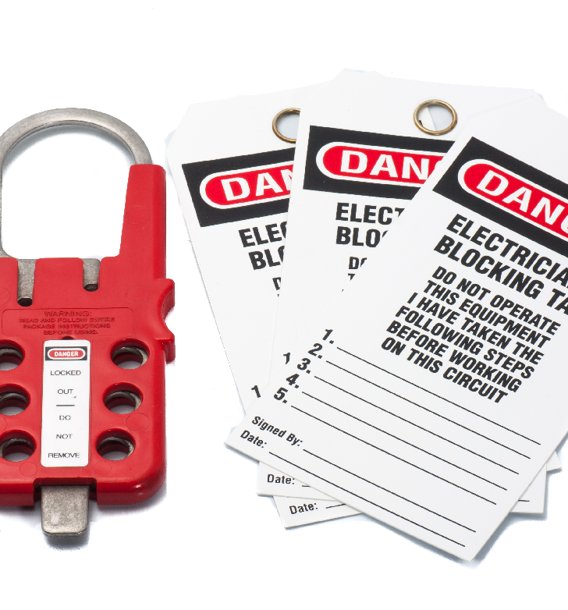
Program Enforcement
Your employer is required to enforce their own lockout program. This aspect is critical for the success of the program; it holds employees accountable and establishes a foundation to work from. It will also ensure that effective training and inspections are conducted. A large part of this program is to identify who is responsible and accountable for everything that happens. So, where do you begin? Let’s review a few practical steps on the next slide.
Module 2: procedures

Slide 19
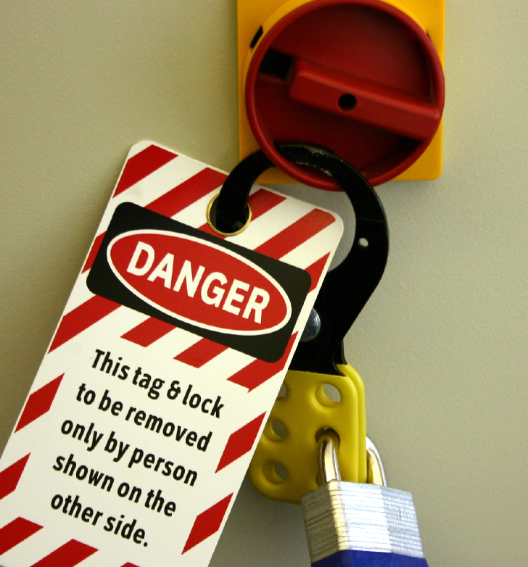
Lockout/Tagout Procedures
So, where do you begin? Although not required, here are five steps that any company can start with:
List all equipment
Identify equipment that has potential for unexpected start-up (always check with the manufacturer if unsure)
Determine maintenance steps and review for hazards that require lockout/tagout
Review procedures
Post equipment specific procedures
Next, let’s examine procedures for documenting your program.
Module 2: procedures

Slide 20
Written Program
As we discussed, the first component of an energy control plan is documenting energy control procedures. This is for use by authorized employees who lockout or tagout equipment when they perform service and maintenance. Written energy control procedures must include the following:
The intended use of the procedure
Steps for shutting down, isolating, blocking, and securing equipment
Steps for the placement, removal, and transfer of lockout devices
Test methods to verify equipment has reached a safe, zero energy state
Please reference our sample documentation⁽³⁾ for further clarification on how to develop these written procedures.
Module 2: procedures

Slide 21
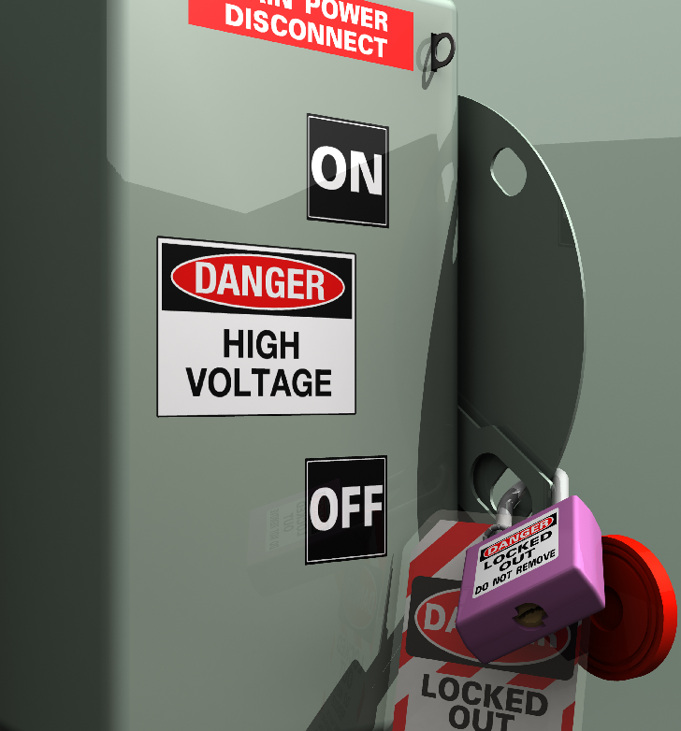
Procedure Goals
Well-written energy control procedures accurately instruct employees to do all of the following:
Inform all affected employees of equipment shutdown
Shut down equipment in the proper order
Identify and engage energy-isolating devices or block hazardous energy
Lockout or tagout the energy-isolating devices
Remove, drain, neutralize, or block any potential (stored) energy
Verify the equipment is isolated from hazardous energy and rendered inoperative
Module 2: procedures

Slide 22
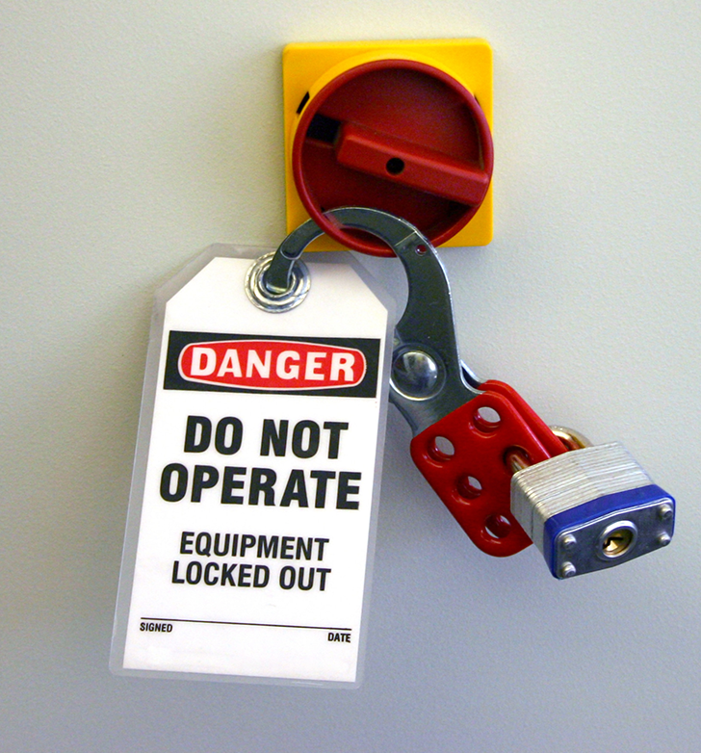
Energy Control Procedures
The lockout/tagout standard⁽⁴⁾ contains a requirement to create your own energy control procedures. These procedures have some rule specific requirements. There are 5 statements that must be covered:
Statement of intended use
Specific procedures
Shut down
Isolating
Blocking
Securing
Place/remove locks & tags
Responsibility for Lockout/Tagout devices
Testing and verification procedures
Methods of ensuring compliance (Accountability)
Module 2: procedures

Slide 23
Six Steps to an Effective Lockout
Once you’ve completed your energy control procedures, perform these six energy control steps to achieve an effective lockout on equipment:
Preparation
Shutdown
Energy Isolation
Lockout and Tagout Application
Controlling Stored Energy
Verify
We will be discussing these six steps in detail over the next few slides.
Module 2: procedures

Slide 24
Step 1: Preparation
This is the time to ensure that the authorized employee knows what they are going to accomplish. Having a checklist handy will ensure all the necessary ingredients are available to make this successful. Some things to think about are:
Types and magnitude of energy
Hazards posed by that energy
Methods to effectively control the energy
How to communicate the shutdown with all employees
Module 2: procedures

Slide 25
Step 2: Shutdown
As simple as it may sound, it's important that you don't skip this step. Following the manufacturer's shutdown procedures is the best way to avoid unnecessary injury:
Ensure all equipment is turned off according to the corresponding operating procedures, and
If more than one authorized employee is involved with the shutdown, a team lead needs to coordinate the process.
Module 2: procedures

Slide 26
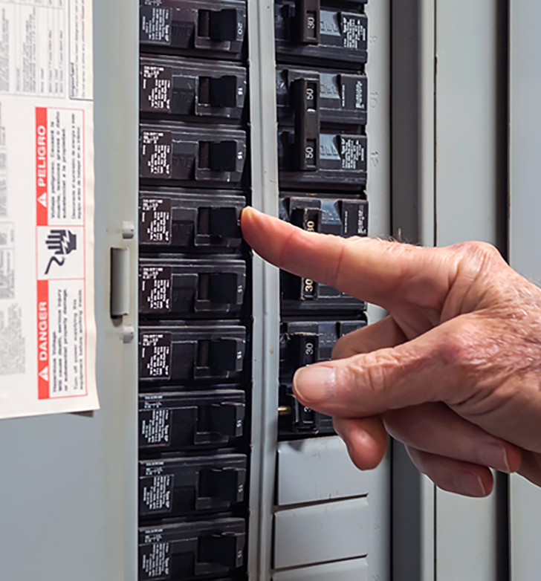
Step 3: Energy Isolation
The authorized employee must place and verify the operation of an isolation device, such as a circuit breaker, or fuse on the energy source that physically controls the energy. Push buttons and selector switches do not provide that physical isolation, because they do not physically separate equipment from energy. Energy-isolating devices can be:
Disconnect switches (main)
Line valves
Manually operated electrical circuit breakers
Bolted blank flanges
Bolted slip blinds
Safety blocks
Any similar device used to block or isolate energy
Module 2: procedures

Slide 27
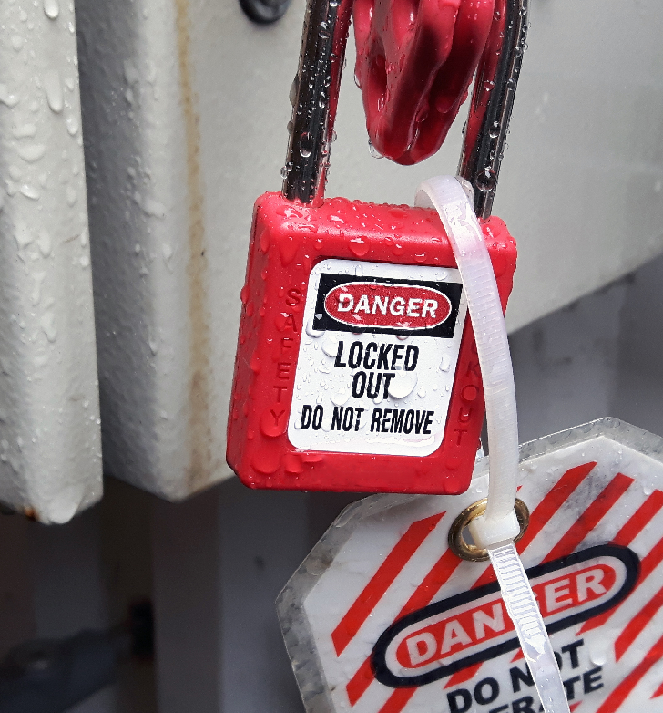
Step 4: Lockout and Tagout Application
Once you arrive at this step, you have 3 options:
Lockout
Tagout
Lockout/Tagout
Lockout follows an established procedure for placing a lockout device such as a padlock on an energy-isolating device to create a physical barrier of protection. If an energy isolating device can accept a lockout device, you must use lockout – no exceptions! As a best practice, many employers use a combination of lockout devices and tags commonly referred to as lockout/ tagout or lockout/tagout. The lockout device, when secured on an energy-isolating device, provides the mandatory physical employee protection while the use of tags serves as both a visual and written notification to others.
Module 2: procedures

Slide 28
Step 5: Controlling Stored Energy
After equipment has been de-energized the authorized employee must ensure that energy is:
Relieved
Disconnected
Restrained
Recheck and verify once the authorized employee has completed the steps above, as some energy sources may reaccumulate their stored energy. Capacitors; coiled springs; elevated equipment parts; rotating flywheels; and air, gas, steam, chemical, and hydraulic systems are sources of stored energy. If the energy could return to a hazardous level, make sure that it remains isolated from the equipment until all service work is finished.
Module 2: procedures

Slide 29
Step 6: Verify
Verification means purposely confirming that equipment is separated from its energy source; therefore it is “isolated.” The authorized employee must verify that:
Equipment has been properly turned off/shut down.
Energy-isolating devices were identified and used to effectively isolate energy.
Lockout or tagout devices have been attached to the energy-isolating devices.
Stored energy has been removed or controlled.
Module 2: procedures

Slide 30
Just Checking In...
Once the authorized employee and all other parties involved have completed the six steps to an effective lockout/tagout program, it is time to discuss how to release an item from lockout/tagout and other special lockout/tagout applications such as group lockout!
Module 2: procedures

Slide 31
Releasing From Lockout
There are 3 categories that have items to check on prior to releasing the equipment from lockout or tagout. You must ensure all of these items are accounted for and checked off:
Equipment
A) Remove all non essential items
B) Ensure the equipment is reassembled properly
2. Employees
A) All employees need to be outside of any dangerous areas
B) Notify your manager and other affected employees when
restarting the equipment
3. Remove energy control device
A) Only the authorized employee who attached the device is
permitted to remove it. If this employee is unable to
remove the device, the rule outlines an exception here⁽⁵⁾.
Module 2: procedures

Slide 32
Testing or Positioning
When the equipment that is locked out (controlled device) needs to be removed for testing, the following actions must be taken:
Clear the piece of equipment
Remove employees from the equipment
Remove lockout/tagout (energy isolation device) device
Energize and test or position
Deenergize and follow the 6 energy control steps again
This process also needs to be a part of your energy control program.
Module 2: procedures

Slide 33
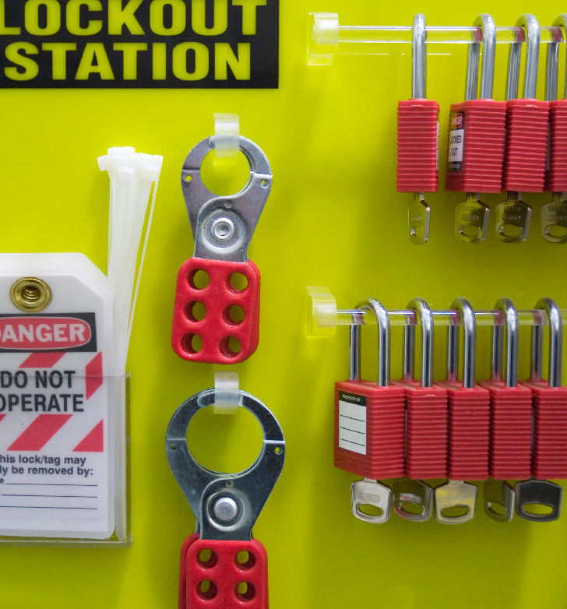
Hardware Requirements
Let’s talk about the hardware that is used to protect the workers while they perform lockout/tagout procedures. Any locks, tags, chains, wedges, key blocks, adapter pins, self-locking fasteners, or other hardware must be provided by the employer. In addition, lockout and tagout devices must be:
Durable to withstand environmental conditions
Standardized by color, shape, or size
Substantial to prevent accidental removal
Identify the employee applying the device
The rule outlines these requirements⁽⁶⁾ in detail, which includes separate requirements for lockout and tagout, as each of these devices serves different functions. Please take a moment to read these requirements.
Module 2: procedures

Slide 34
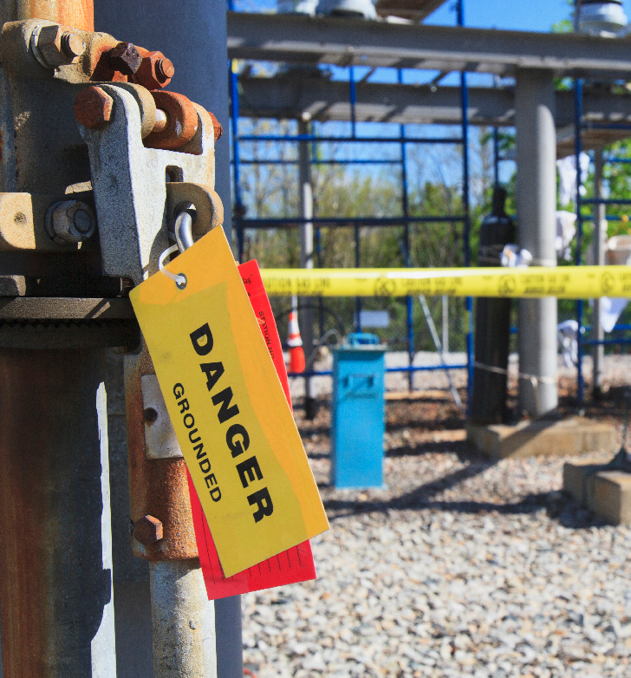
Tagout Requirements
Tagout is a procedure for placing a warning tag or sign (a tagout device) on an energy isolating device that cannot accept a lockout device. Tagout devices must control hazardous energy at least as effectively as lockout devices. They must be attached with a single-use, self-locking material such as a nylon cable tie with a minimum unlocking strength of 50 pounds. Since tagout devices do not provide the same physical barrier to hazardous energy as lockout devices, it is harder to ensure that they are equally effective. An additional measure of protection must be taken to provide equivalent protection. For this reason, some employers call this system “Tagout Plus.”
Module 2: procedures

Slide 35
Outside Personnel
Whenever outside servicing personnel are going to service equipment that requires lockout/tagout you and the contractor must understand one another’s lockout/tagout procedures. Review your contractor’s energy control program before the contractor does any on-site work. Your employees must also understand and comply with the contractor’s energy control program. To prevent accidents, share with the contractor the unique aspects of your equipment.
Bottom Line: Everyone shares information on how to perform lockout or tagout at said facility
Module 2: procedures

Slide 36
Shift Changes
Employers must ensure the continuity of employee protection by providing for the orderly transfer of lockout or tagout device protection between employees. This will help to minimize exposure to hazards from the unexpected energization or start-up of the equipment or the release of stored energy. When changing shifts employers must:
Ensure that everyone is on the same page during maintenance.
Have a discussion about procedures; it helps ensure continuity is put in place for the lockout and tagout procedures.
Another important element for ensuring continual protection is to require each oncoming employee to verify the system was effectively de-energized and isolated (everyone must remove themselves from the equipment before re-verification is done).
Module 2: procedures

Slide 37
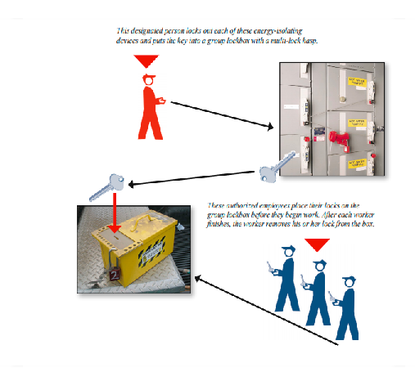
Group Lockout
In many workplaces, a group of authorized employees may need to service equipment that has several energy sources and several energy-isolating devices. Under group lockout, just one designated person in the group assumes responsibility for securing each energy-isolating device.
The minimum requirements of this program is that the employer has a written procedure for group lockout. It gives one authorized employee responsibility for the group. Their responsibilities consist of:
Ensuring that the lockout/tagout is effective, and coordinates for the entire group.
Being the final person who removes the lockout or tagout devices when the service or maintenance is completed.
If there are multiple groups, they coordinate with those groups to ensure that the lockout or tagout is continuous during maintenance.
Bottom Line: Every employee attaches their control device to the group device and the group device cannot be removed until all the individual devices are removed from the group device. All of this information must be in a document that employees can use to refresh their memories.
For more information, please reference the group lockout/tagout⁽⁷⁾ section of the rule.
Module 2: procedures

Slide 38
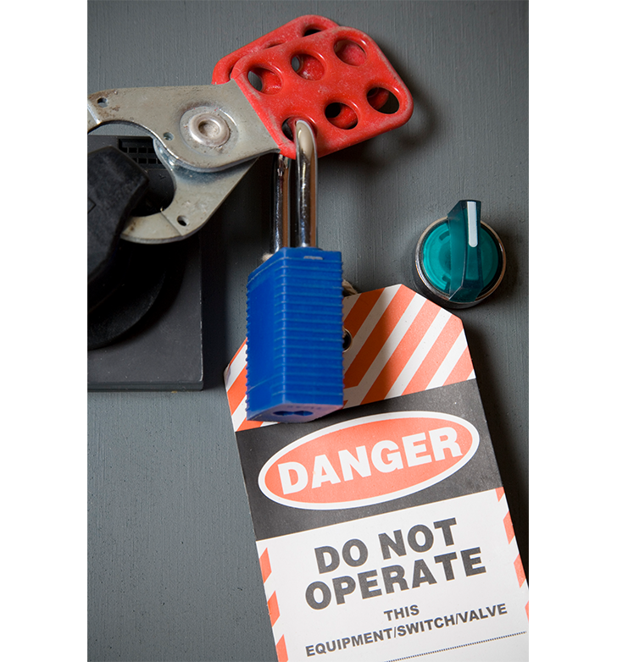
Overview
Lockout/tagout is the only way to fully guarantee a zero energy state for any equipment being serviced or maintenanced. By following the six steps to an effective lockout and crafting a well detailed written procedure, you can ensure your employees will be safe from any accidental discharge of energy.
You’ve completed module 2! In the next module, we’ll look at training procedures to help you stay protected and safe!
Module 2: procedures

Slide 39
Class Discussion
Take this opportunity to ask/answer questions about the previous module and to summarize the web link addresses discussed in the module.
Module 2 Resources
https://osha.oregon.gov/OSHAPubs/3326.pdf
(2) https://osha.oregon.gov/OSHAPubs/pubform/sample-lockout.pdf#page=3
(3) https://osha.oregon.gov/OSHAPubs/pubform/energy-control-procedure.pdf
(4) https://osha.oregon.gov/OSHARules/div2/div2J.pdf#page=79
(5) https://osha.oregon.gov/OSHARules/div2/div2J.pdf#page=84
(6) https://osha.oregon.gov/OSHARules/div2/div2J.pdf#page=80
(7) https://osha.oregon.gov/OSHARules/div2/div2J.pdf#page=85
Module 2: procedures

Slide 40
LOCKOUT / TAGOUT
Module 3: Training and Inspections

Slide 41
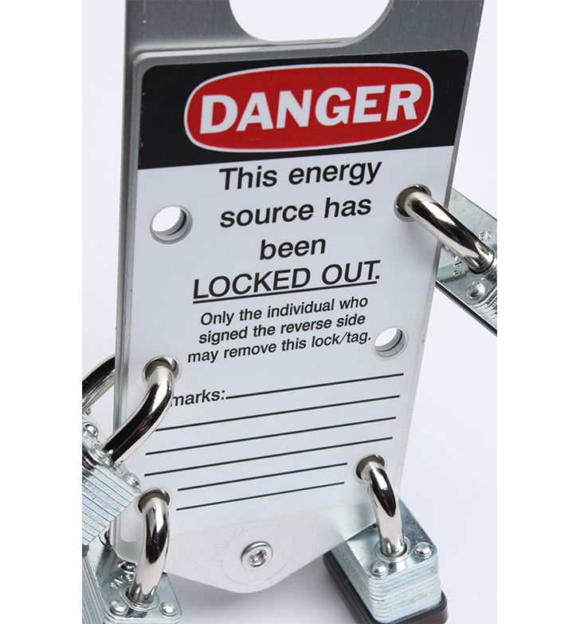
Module Goals
Welcome to module 3! This section addresses training practices and inspection requirements to reduce injuries from re-energized hazards that workers face.
After this module you will be able to:
Identify the correct training for each category of employee
Understand requirements of tagout training
Retrain eligible employees
Properly document your training and inspections
Know the required elements for inspections
How to prepare for a lockout or tagout inspection
Let’s begin!
Module 3: training and inspections

Slide 42
General Requirements
All employees must be trained to know basic hazardous-energy concepts and the purpose of the devices used to control it. They should also know what tasks might expose them to hazardous energy and how it can be controlled. Some employees need to know more about hazardous energy than others. What they need to know depends on whether they service the equipment or just work near the equipment while it is being serviced. Over the next few slides, we’ll cover the training requirements for 3 categories of workers:
Authorized employees,
Affected employees, and
Other employees.
Module 3: training and inspections

Slide 43
1. Authorized Employees
Oregon OSHA uses the terms authorized employees for those who service equipment and affected employees for those who work in areas where the equipment is serviced. Authorized employees lockout or tagout equipment and service or maintain the equipment. Many companies train their authorized employees using equipment specific written energy control procedures. Required training includes:
How to find and recognize hazardous energy source
How to identify the types and magnitudes of energy used in the workplace
How to isolate energy source
Module 3: training and inspections

Slide 44
2. Affected Employees
Affected employees use equipment serviced by others under lockout or tagout procedures or work in an area affected by the procedures. An affected employee becomes an authorized employee when the employee is assigned to perform service or maintenance on the equipment. Required training includes:
The purpose of energy control procedures
How energy control procedures are applied
How energy control procedures will protect them
Module 3: training and inspections

Slide 45
3. Other Employees
Other employees whose work operations are or may be in an area where energy control procedures may be utilized, they must be instructed about the procedure, and not to restart or re-energize machines or equipment that are locked out or tagged out.
Module 3: training and inspections

Slide 46
Tagout Training
At a basic level, tagout training must emphasize the following points:
Tags are warning devices only, and do not provide protection
Tags must not be removed or bypassed
Tags must be legible and understandable
Tags must withstand environmental conditions
Employees are mindful that tags provide a false sense of security
Tags must be securely attached
For more details, please reference Oregon OSHA’s standard⁽²⁾.
Module 3: training and inspections

Slide 47
Re-training
Retrain employees when work conditions change. Authorized and affected employees must be retrained whenever:
Job assignments change
Equipment or work processes present a new hazard
Energy control procedures change
They do not follow established energy control procedures.
The retraining will reestablish employee proficiency and introduce new or revised control methods and procedures, as necessary.
Module 3: training and inspections

Slide 48
Training Documentation
Every time you train someone on the lockout/tagout process, documentation is required that contains the employee’s name and the training date. These training records for each authorized and affected employee must be current. Here are some optional additions to improve your documentation:
Topics that were covered
Who conducted the training
How it was done
Any other describing details that pertain to the Lockout/Tagout process
Module 3: training and inspections

Slide 49
Inspections
Now that you have a general understanding about the training requirements, it is time to cover inspection procedures and requirements.
Lockout/tagout inspections take place at least once a year. The inspector must be an authorized employee, and must watch another authorized employee perform the lockout procedures. Additionally, inspections can be scheduled or done at random. A successful inspection must confirm:
The energy control procedure is correct
The energy control procedure is being followed
The energy control procedure addresses all energy sources
Employees understand the energy control procedure
Employees understand their energy control responsibilities
Module 3: training and inspections

Slide 50
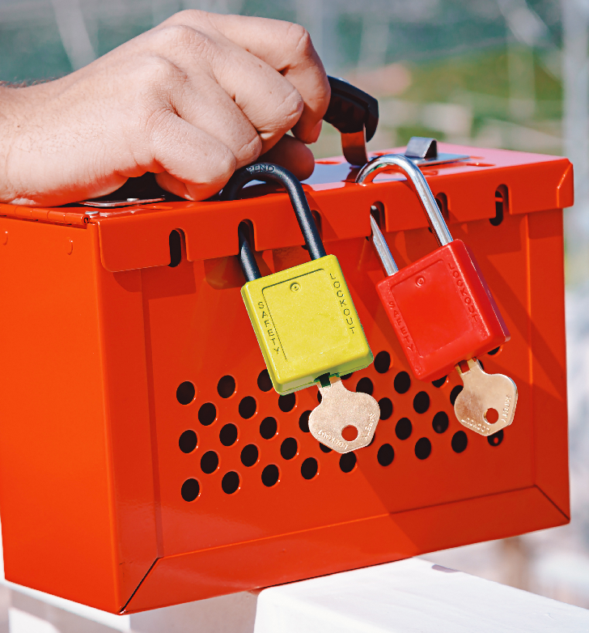
Lockout Inspection
At a minimum, there are two people involved in the lockout inspection: the inspector, and an authorized employee. The inspector observes the authorized employee perform the lockout process, ensuring that the proper procedures are being followed.
If the inspection covers a procedure for equipment with an energy isolating device that can be locked out, the inspector must review the procedure with the authorized employees who use it to service the equipment. The inspector can review the procedure with the authorized employees individually or in a group.
Module 3: training and inspections

Slide 51
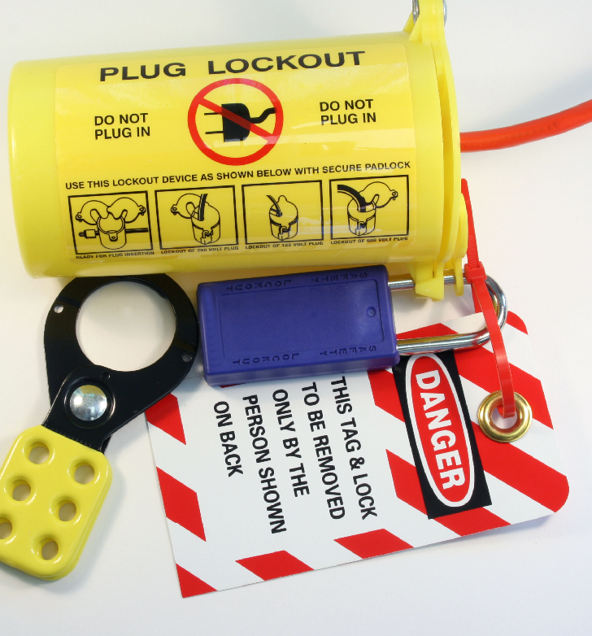
Tagout Inspection
At a minimum, there are two people involved in the tagout inspection: the inspector and the authorized employee. The inspector observes the authorized employee perform the tagout process, ensuring that they are following the proper procedures. While this happens, the affected employee(s) watches the entire inspection to better understand the tagout process.
Like lockout inspections, if the inspection covers a procedure for equipment with an energy-isolating device that can only be tagged out, the inspector must review the procedure with the authorized employees who use it to service the equipment and with affected employees who may work in the area when the equipment is serviced. The inspector can review the procedure with the authorized and affected employees individually or in a group.
Module 3: training and inspections

Slide 52
Take Action
When an inspection reveals employees not following the energy control procedure or discovers that the procedure is not fully protecting them, the employer must take corrective action. Corrective actions could include:
Revising the procedure to correct deficienci
Acquiring additional or more-specific lockout or tagout devices to provide employees with appropriate equipment to complete the energy control procedure
Providing additional employee training
Increasing oversight of those that use energy control procedures
Module 3: training and inspections

Slide 53
Inspection Documentation
The employer must certify that the energy control procedure has been inspected. The certification must contain the following information:
The equipment on which the procedure is used
The date of the inspection
The employees included in the inspection
The person who did the inspection
Feel free to download Oregon OSHA’s lockout inspection form⁽³⁾.
Module 3: training and inspections

Slide 54
Overview
Proper training and inspection can save money and lives if done correctly, and is time efficient as well! For these procedures to be effective, you and your employer must work together to implement these elements at your workplace. A best practice is to record findings of successes and deficiencies and incorporate them into your inspection records to improve training, procedures, and accountability.
You’ve completed module 3! The next (and final) module will contain a quiz.
Module 3: training and inspections

Slide 55
Class Discussion
Take this opportunity to ask/answer questions about the previous module and to summarize the web link addresses discussed in the module.
Module 3 Resources
https://www.cdc.gov/infectioncontrol/basics/standard-precautions.html
(2) https://osha.oregon.gov/OSHARules/div2/div2J.pdf#page=82
(3) https://osha.oregon.gov/OSHAPubs/pubform/lockout-inspection-form.pdf
Module 3: training and inspections

Slide 56
LOCKOUT / TAGOUT
Module 4: Conclusion

Slide 57
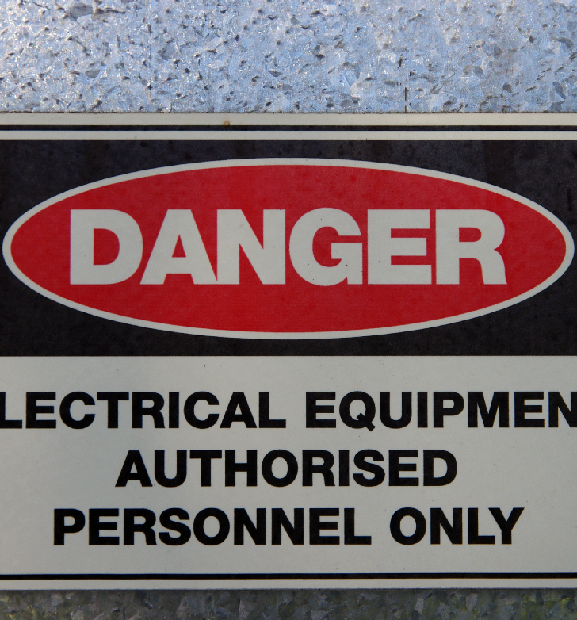
Module Goals
Welcome to module 4! We’ve covered a lot of information about the lockout/tagout process and the procedures that are available to workers’ to reduce the risk of injury. In this final module, we’ll take a quiz to test your knowledge on the lockout/tagout standard!
After you successfully pass the quiz, you will be asked to enter your name and email address and CCB number if that’s applicable. A certificate of completion will then be emailed to you.
Let’s get started!
Module 4: conclusion

Slide 58
Just a Reminder...
Remember, employee safety does not reside in a specific device, whether a tag or lock. Instead, safety is found in a comprehensive program that includes the use of controls, effective procedures, and careful training combined with the assurance of accountability.
Please take a moment to review Oregon OSHA’s sample lockout/tagout policy⁽¹⁾ for your workplace.
Module 4: conclusion

Slide 59
Ask the Big Questions!
Now that you know the correct processes and procedures for lockout/tagout, you are fully ready to implement an effective energy control program in your workplace!
Remember, when your process is in doubt, ask yourself these questions:
Is all the energy deenergized?
Is the current protection adequate?
Do all authorized employees know their responsibilities?
Do the procedures work?
Module 4: conclusion

Slide 60
Lockout Tagout Quiz
Question 1: A lockout device is a device that positively prevents a machine from being:
Started up
Becoming electrically energized
Turned on
All of the above
Question 2:The employees that need lockout/tagout training are:
Authorized Employees
Affected Employees
Other Employees
All of the above
Module 4: conclusion

Slide 61
Lockout Tagout Quiz
Question 3: Oregon OSHA requires that employers establish a “documented energy control procedures.”
False
True
Question 4: Lockout means “The placement of a tagout device on an energy-isolating device to indicate that the device and the equipment being controlled may not be operated until the tagout device is removed.”
True
False
Module 4: conclusion

Slide 62
Lockout Tagout Quiz
Question 5: A lockout device is “A device that uses a positive means, such as a lock, to hold an energy - isolating device in a safe position and prevent the energizing of a machine or equipment.”
True
False
Question 6: Which statement is true?
Tags are only warning devices
Tagout devices can always be used in place of lockout devices
Tags may be removed by affected employees once lockout/tagout is complete
Tags provide equivalent security to using a lock
Module 4: conclusion

Slide 63
Lockout Tagout Quiz
Question 7: If an energy isolating device can accept a lockout device, you must use lockout instead of tagout.
True
False
Question 8: What type of employee is responsible for implementing the energy-control procedures when performing service or maintenance activities?
Affected Employees
Certified Employees
Authorized Employees
Other Employees
Module 4: conclusion

Slide 64
Lockout Tagout Quiz
Question 9: What is the unlocking strength requirement for a tag in the “tagout” process?
75 grams
50 lbs
100kg
25 lbs
Question 10: Employers are to certify that periodic inspections have been performed on equipment that require energy control procedures.
True
False
Module 4: conclusion

Slide 65
Lockout Tagout Quiz- Answers
D
D
B
B
A
A
A
C
9) B
10) A
Module 4: conclusion

Slide 66
Where To Go From Here?
An excellent resource to utilize is the A-Z Topic Index⁽²⁾ on the Oregon OSHA website. It has a list of relevant publications, training materials, rules, interpretations, videos, and other miscellaneous materials.
If you want guidance in developing a safer work environment, you may consider our free and confidential consultation services. Our consultants in workplace safety and health can help you reduce accidents, related costs, and help you develop a comprehensive program to manage safety and health. For more information, please visit the consultation page⁽³⁾.
Module 4: conclusion

Slide 67
Class Discussion
Take this opportunity to ask/answer questions about the previous module and to summarize the web link addresses discussed in the module.
Module 4 Resources
https://osha.oregon.gov/OSHAPubs/pubform/sample-lockout.pdf
(2) https://osha.oregon.gov/Pages/az-index.aspx
(3) https://osha.oregon.gov/consult/Pages/index.aspx
Module 4: conclusion

Slide 68
Congratulations
You’ve completed the lockout/tagout online course.
Produced by the Public Education Team of Oregon OSHA:
Roy Kroker, Andrew Stengel, Phillip Wade, Angelina Cox, Ricardo Rodríguez, Tim Wade
Technical Assistance: Larry Fipps
Images provided by: Getty Images Inc. and Envato Elements
Module 4: conclusion

