Slide 1



SAFETY COMMITTEES & SAFETY MEETINGS
Module 1: Introduction
Please note: If the online course contains videos, the video links are included in this PPT.
You will need to have an internet connection to play the videos or
you can download the videos and embed them into your copy of this PPT presentation.

Slide 2


Disclaimer
Completing this course along with the other two courses found in the Safety Committee Suite will help meet the basic requirements for safety committee member training. It is your employer’s responsibility to further your training where it is specific to your organization, such as forms, policies, and practices.
This material should not be considered a substitute for any provisions of the Oregon Safe Employment Act or for any standards issued by Oregon OSHA. Manufacturers, products, or services displayed in this material are for informational purposes only and do not constitute an endorsement by Oregon OSHA.
SCSM: introduction

Slide 3

Course Goals
Welcome to the Safety Committees and Safety Meetings online course! The goals of this course are to help you understand the:
History behind the creation of the safety committees and safety meetings rules,
Differences between safety committees and safety meetings and the requirements for each,
Specific requirements for safety committee members, and
Division-specific requirements.
In this module, we will discuss the history of the rule and the differences between committees and meetings. Let’s get started!
SCSM: introduction

Slide 4
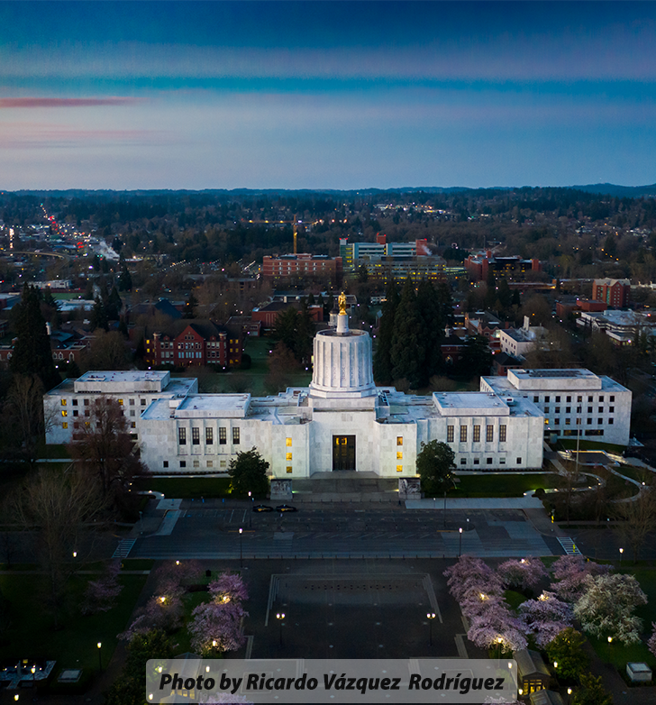
History of the Rule
Did you know that at the federal level, there are no Safety Committees and Safety Meetings rules? It is a rule created in the late 1980’s specifically for Oregon workers due to Oregon ranking as one of the highest in the country for workplace injury claims, medical costs related to those injuries, and workers’ compensation insurance premiums.
Representatives from labor, management, and the legislature joined together to brainstorm how to increase workplace safety and create an affordable workers’ compensation system. This resulted in the creation of the Safety Committees rules. In the subsequent years after adopting the rule, Oregon saw injury claims and premiums start to decrease.
After being in effect for almost two decades and receiving feedback from employees and employers, the rule went through some revisions in 2008 and 2010 to make it easier for everyone to meet the intent of the rule. And now, Oregon has one of the lowest workers’ compensation rates in the nation.
SCSM: introduction

Slide 5

Purpose of the Rule
Purpose: Bring workers and management together in a non-adversarial, cooperative effort to promote safety and health. Safety committees and safety meetings will assist you in making continuous improvement to your safety and health programs.
During the rule’s creation, the goal was for everyone to benefit by improving workplace safety in Oregon. Two key terms to pay attention to in the above statement are:
Non-adversarial, cooperative effort. It is not a blame game, but rather about working together cooperatively, where all parties should feel empowered to bring up safety and health concerns.
Continuous improvement. It is not just a one-time safety check and done; it is an ongoing effort to make, and keep, the workplace as safe as possible.
As we go through the rule in more detail, you will see these key concepts show up in the requirements.
SCSM: introduction

Slide 6

Safety Matters
Safety committees and meetings provide an important key to employees feeling safe in their jobs. When they know the process for reporting hazards, who they can talk to about their safety or health concerns, and that there is a committee dedicated to such issues, employees feel empowered to report and find solutions for their concerns.
However, when a company does not put an emphasis on safety, issues are bound to happen. Perhaps they believe accidents won’t happen to them, or that shortcuts don’t pose a big risk. In the next slide, let’s take a look at an example of a recent accident.
SCSM: introduction

Slide 7
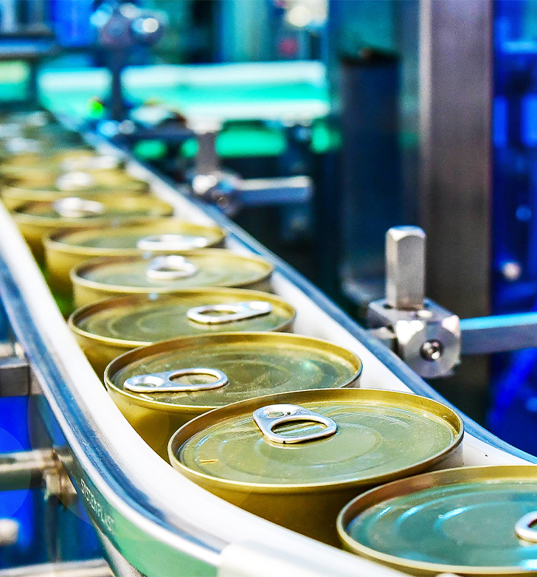
Safety Matters - Example
An employee working at a food processing plant in eastern Oregon was exposed to multiple hazards during her work shift, resulting in an accident that amputated 3 of her fingers. During the accident investigation, it was learned that the company had a safety committee, but had no employee representation and no process for reporting hazards. The few managers who were on the committee had never been trained on the responsibilities of a safety committee, hazard identification, or accident investigation. Furthermore, the quarterly workplace inspections were not being completed and no employees knew that the committee existed. It is possible that this accident could have been prevented if there had been an effective safety committee following the basic rule requirements of completing worksite inspections, identifying hazards, and recommending solutions.
SCSM: introduction

Slide 8

Safety Matters (continued)
The previous example shows one possible outcome when safety isn’t a top priority and safety committees or meetings are not effectively utilized. Will safety committees and/or safety meetings prevent all accidents from occurring? Unfortunately, the answer is no. But it is a vital step to establishing a safe workplace and an environment where employers and employees are encouraged to strive for safety by identifying and fixing hazards on a continual basis.
Now let’s learn about the differences between a safety committee and a safety meeting.
SCSM: introduction

Slide 9
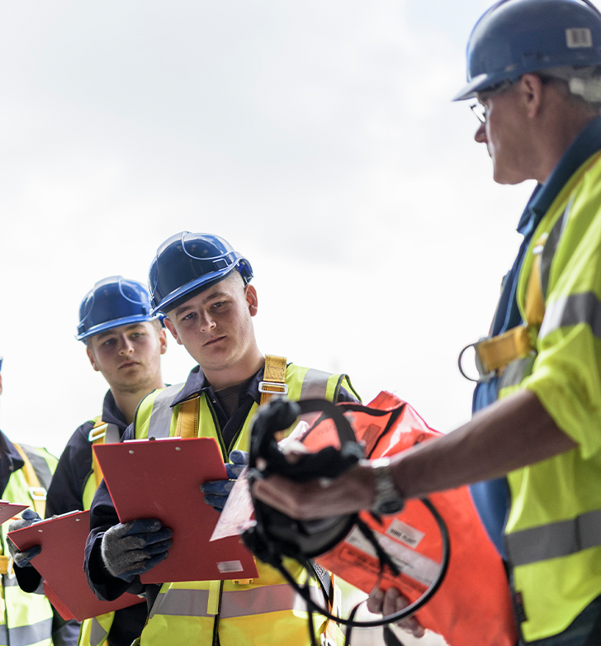
Committee vs. Meeting
We will get into specific requirements of the rule in the next module, but first, let’s explain what safety committees and safety meetings are.
A safety committee is a group made up of employees and management who meet regularly and are responsible for identifying safety and health concerns in their workplace, as well as developing solutions or recommendations to address those concerns.
A safety meeting is a company-wide meeting with all available employees and management in attendance, where current safety and health topics and the current state of issues are presented.
Both the committee and meetings focus must be on safety and health concerns in the workplace which relate to the employees working there. You are only required to implement one of these, depending on how your company is structured.
SCSM: introduction

Slide 10
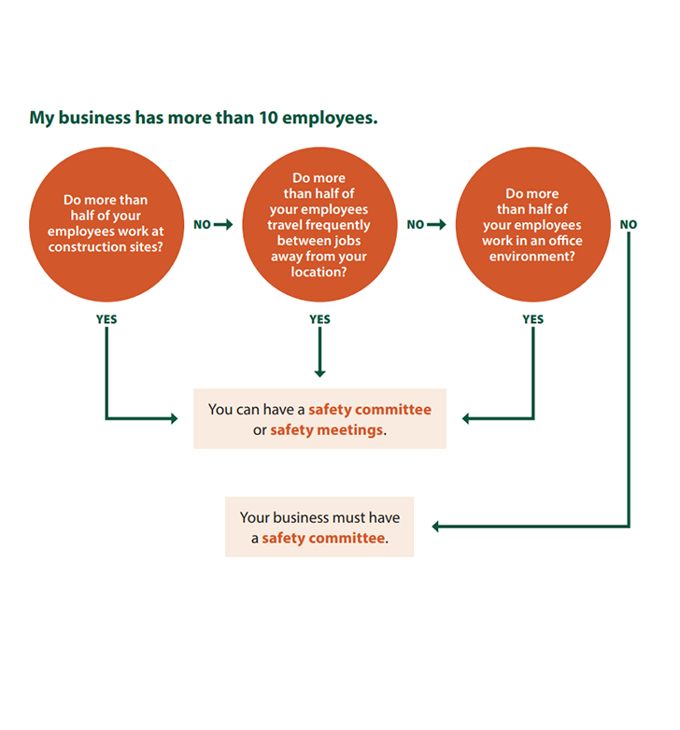
Committee or Meeting
How a company chooses a safety committee or safety meeting all depends on your company: the work you do, the locations, how many employees work at the company, and which option is the most effective.
If your business has more than 10 employees, it’s important to ask the following questions:
Do more than half your employees work on construction sites?
Do more than half your employees travel frequently between jobs away from your location?
Do more than half of your employees work in an office environment?
If you answered yes to any of the questions above, you can have either a safety committee or safety meetings. If you answered no to any of the questions, you must at least have a safety committee (but you could have both if you choose to).
If your business has 10 or fewer employees, you can have either a safety committee or safety meetings.
SCSM: introduction

Slide 11
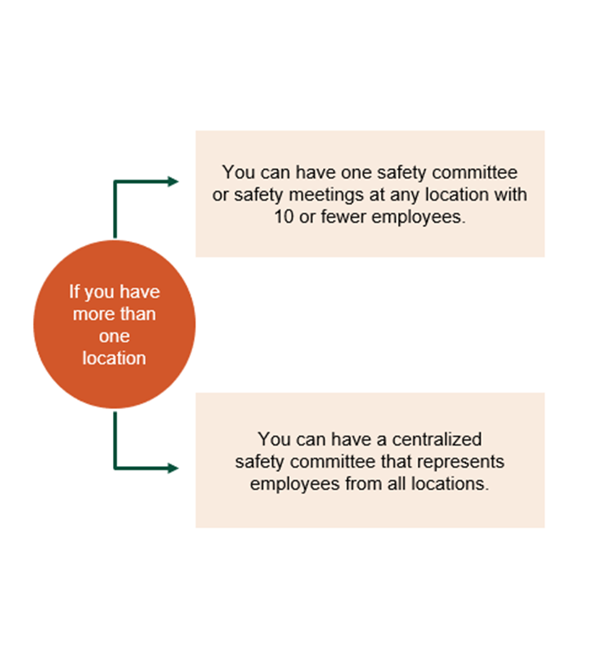
Multiple Location Employers
If your business has more than one location, there are two more options for you to choose from. You can have:
A centralized safety committee, or
Safety meetings at any location that has 10 or fewer employees.
Centralized safety committees follow the same requirements and must represent the safety and health concerns of employees from all locations during the meetings. Centralized safety committees can be a good option to save time and resources while still being effective in voicing concerns for all locations.
We will cover the specific requirements for centralized safety committees in the next module.
SCSM: introduction

Slide 12
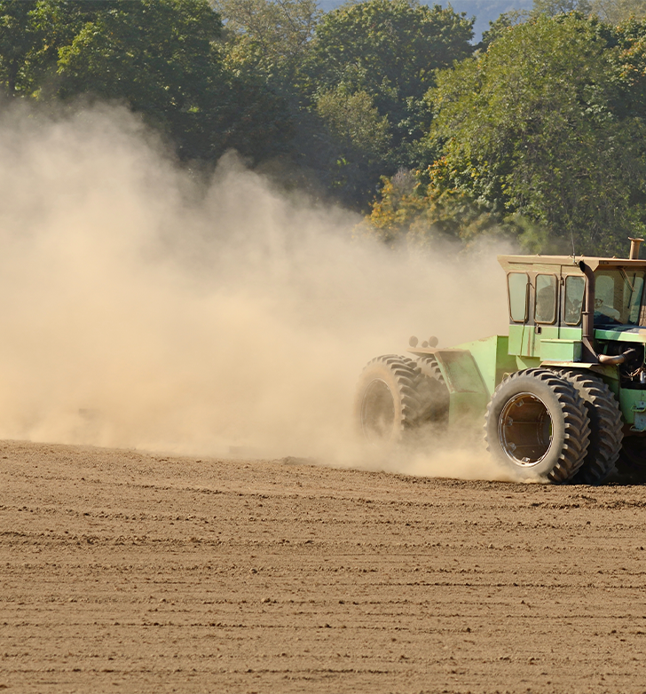
Exemptions
Safety Committees and Safety Meetings OAR 437-001-0765 applies to all public and private employers in Oregon who are subject to Oregon OSHA jurisdiction, except if you are:
The sole owner and only employee of a corporation,
A member of a board or commission and do not participate in the day-to-day activities of the company. You are not considered an employee for purposes of this rule, or
Engaged in agricultural activities covered by Division 4 or engaged in forest activities covered by Division 7. You must comply with the division rules that apply to your company.
We will take a closer look at the rules that apply to fire services, agriculture, and forest activities later in Module 3.
SCSM: introduction

Slide 13

Module 1 Overview
You’ve completed module 1! You learned about the inspiration behind the Safety Committees and Safety Meetings rules in Oregon and the importance of workers and managers working together to promote workplace safety and health. We explained the differences between a safety committee and a safety meeting and some factors to consider when deciding which to have for your company, such as the number of employees and type of work performed.
In the next module, we will dive into the specific requirements outlined in OAR 437-001-0765 for safety committees, committee members, and safety meetings.
SCSM: introduction

Slide 14
SAFETY COMMITTEES & SAFETY MEETINGS
Module 2: Rule Requirements

Slide 15


Welcome to Module 2
In the previous module, we learned the difference between a safety committee and a safety meeting. Now we will discuss what OAR 437-001-0765 requires for each. We will cover the following:
Safety committee (SC) member selection,
Safety committee duties and member requirements,
Safety committee inspections and investigations,
Safety committee meetings, and
Safety meeting requirements.
Let’s start with learning about selecting members of the safety committee.
SCSM: rule requirements

Slide 16
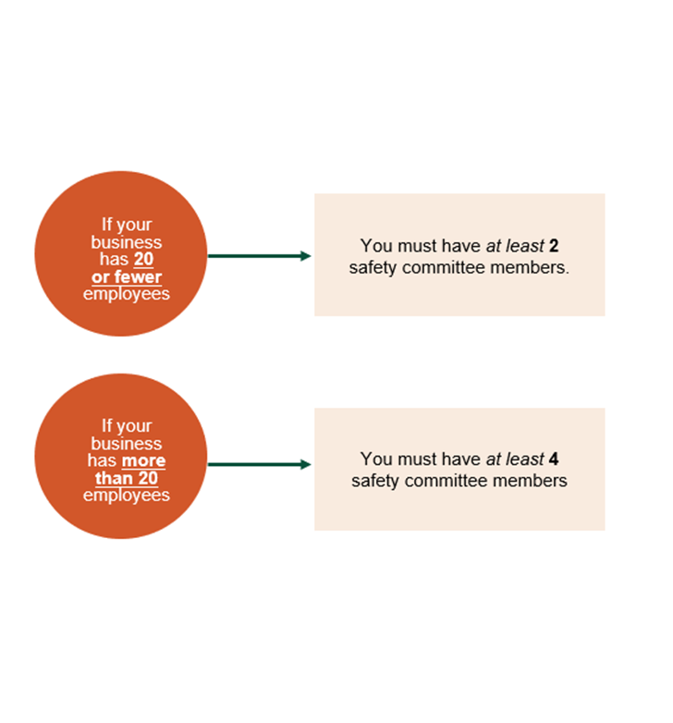
Selecting SC Members
The rule has requirements about the number of members on the committee as well as who serves on it. If your company has 20 or fewer employees, you must have at least 2 safety committee members. If there are more than 20 employees, you must have at least 4 members. Safety committee members must represent the major activities of the business. In many cases, companies choose to have a person from each department of the company on the committee, although it is not necessary as long as all major activities are represented.
Any employee who wants to be part of their company’s safety committee can join, but there must be an equal number of members who represent employees and members who represent employers. However, if everyone agrees, the committee is allowed to have a majority of employee representatives (not employer representatives). The point is to have fair representation and a cooperative, non-adversarial environment for employees to report issues.
SCSM: rule requirements

Slide 17

Safety Committee Members
The safety committee must have a majority of members agree on a chairperson, and all committee members must:
Serve on the safety committee for a minimum of 1 year, when possible,
Receive training in accident and incident investigations so they can evaluate those events,
Receive training in hazard identification so they can effectively identify hazards,
Receive notes from each meeting, and
Be paid at their regular rate of pay (meetings are held on company time).
Of course, as people rotate in and out of jobs and companies, sometimes it can be difficult to meet the one-year goal of serving on the committee. But, with the amount of training that committee members are required to receive, it is helpful to both the company and the employee if they can serve for that minimum time, to utilize the training and gain experience with the safety committee processes.
Let’s learn more about the above requirements in the next few slides.
SCSM: rule requirements

Slide 18

Accident Investigation
Safety committee members must receive training in accident and incident investigations. Although the rule does not require safety committee members to conduct the investigation, they often do. It is important that committee members understand the elements involved in an accident investigation so they can evaluate the investigation reports and provide recommendations to prevent recurrences of the accident.
There are many resources available to learn about accident investigations, including Oregon OSHA’s free online course to meet the training requirements of basic Accident Investigation principles. This course is also included in the Safety Committee Suite.
SCSM: rule requirements

Slide 19

Hazard Identification
Each safety committee member must also receive training in hazard identification. This is because the safety committee is responsible for establishing a procedure for conducting safety and health inspections for their workplace. Again, the rule does not require the safety committee members to conduct the inspections. However, whoever conducts the inspections must be trained in hazard identification; since safety committee members are required to be trained in it, they are a logical choice to perform the inspections.
Along with establishing a procedure to conduct workplace safety and health inspections, the safety committee must also establish a procedure for reviewing the inspection reports and making recommendations to management.
Go to the next slide to watch a video from our Hazard Identification online course that shows an example of a worksite inspection. This course is also included in the Safety Committee Suite and provides training in the principles of hazard identification.
SCSM: rule requirements

Slide 20
Video: Hazard Identification - The Safety Inspection
SCSM: rule requirements
Notes:
Replace “Link video here” text with the Title of the video. Hyperlink the title to the video.
Ideal Text Font/Size: Arial, 44.
***Delete this note before uploading finished PPT to O:drive and website.***

Slide 21

Worksite Inspections
Safety and health inspections focus on finding hazards in the workplace so they can be fixed before an accident occurs. These inspections need to occur quarterly for primary fixed locations, office environments, and auxiliary and satellite locations. Other worksites, such as mobile work locations or infrequently visited sites, are also required to be inspected, but it does not have to be on a quarterly basis. The safety committee can decide the appropriate frequency of those inspections.
SCSM: rule requirements

Slide 22

Safety Committee Meeting Notes
The rule requires written records of each safety committee meeting, and in addition to being sent to each committee member, they also need to be made available to all employees and kept on file for 3 years. The records must contain the following information from each meeting:
Names of attendees,
The meeting date,
All the safety and health issues discussed, including tools, equipment, work environment, and work practice hazards
Recommendations for corrective action with a reasonable date by which management agrees to respond,
Which person is responsible for following up on the recommended corrective actions,
All reports, evaluations, and recommendations that were made by the committee.
(continued on next slide)
SCSM: rule requirements

Slide 23
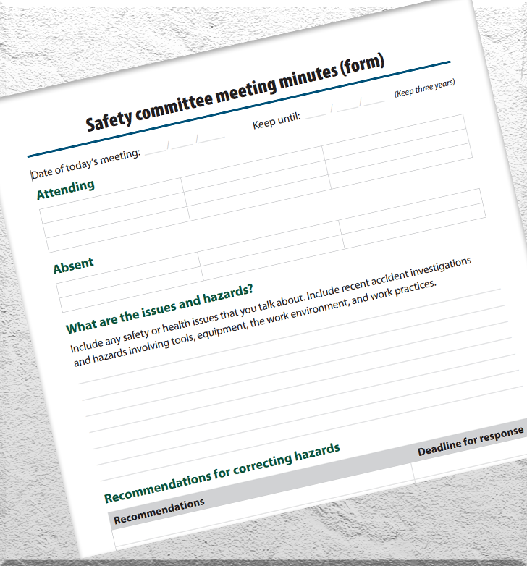
SC Meeting Notes (cont.)
You might be wondering why all of that information needs to be in the notes and kept for 3 years. Here are just a few reasons:
It helps keep the employer accountable. If a hazard is reported with a date on file for management to respond and fix it, there is a much higher chance they will follow-through than if there is no written record of it.
The written records are accessible to all employees, which increases safety in the workplace because everyone has knowledge of the hazards and recommended solutions.
If an accident does occur, the records help show if it was due to a hazard that was reported and never fixed or if the hazard was not identified. The records help to assess if the safety committee is being effective in its inspections, hazard identification, and recommendations.
Some companies choose to email the notes to all employees, some print a copy and post it in the employee break room, and some post them on their internal website that all employees can access. Here is a sample form for recording safety committee meeting notes.
SCSM: rule requirements

Slide 24

Regular Rate of Pay
The meetings of the safety committee must be held on company time, and the members must all be paid their regular rate of pay. The employer is not allowed to drop the rate of pay down to a lower wage for any employees during safety committee meetings. If the meeting is held during a time when the employee would earn overtime, then the employee’s regular rate of overtime needs to be paid.
SCSM: rule requirements

Slide 25

Safety Committee Meeting Frequency
The frequency of safety committee meetings is determined by the type of work the company does. For companies where employees do mostly office work, only one meeting per quarter is required. For all other work situations, the safety committee must meet monthly, except for the months when quarterly worksite inspections occur.
SCSM: rule requirements

Slide 26

Centralized Safety Committee
We mentioned the centralized safety committee option in Module 1 for businesses that have multiple locations. If your business chooses to go with a centralized safety committee, employees from each location do not have to attend the committee meeting as long as someone at the meeting represents each location’s concerns. Centralized safety committees are required to have a written policy that:
States management’s commitment to workplace safety and health,
Requires employee involvement and describes what that looks like,
Describes how management and employees will be held accountable for safety and health, and
Describes specific methods for identifying and correcting safety and health hazards at each location.
In addition, the committee members must write a comprehensive review of the centralized safety committee’s activities. This written review is required on a yearly basis to determine the effectiveness of the centralized safety committee.
SCSM: rule requirements

Slide 27

Reminder
Remember, a safety committee's role is to help voice health and safety concerns for all employees. A safety committee works with management to help eliminate or control hazards in the workplace through inspections, evaluations, and recommendations.
That wraps up the safety committee requirements; now let’s learn about safety meetings!
SCSM: rule requirements

Slide 28
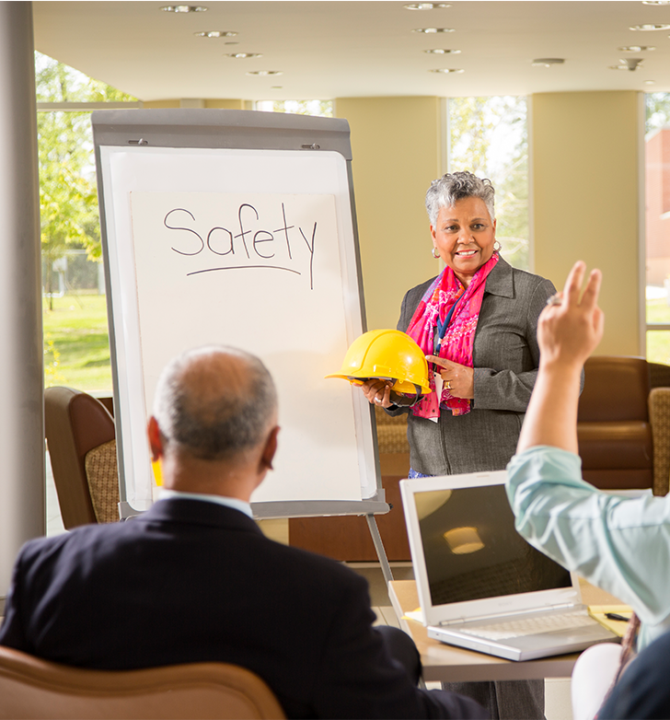
Safety Meetings
Let’s spend some time discussing safety meetings - not to be confused with safety committee meetings. Safety meetings are often the preferred option for employers who are small, mobile, work in construction or mainly office environments. The intent of safety meetings is to ensure all employees are able to voice their safety concerns and hear about the current safety and health measures that have been implemented. Because of this, safety meetings must be held on a date where the highest number of employees are available to attend.
In addition to the above, there must be at least one employer representative in attendance who is authorized to ensure the issues brought up in the meeting are corrected. The safety meetings must be held on company time and all attendees must be paid at their regular rate of pay.
SCSM: rule requirements

Slide 29

Safety Meetings: Frequency and Topics
Just like with safety committees, the type of work the business does determines the minimum frequency that safety meetings need to take place. Your safety meetings must occur at least monthly or quarterly, depending on the type of work.
If employees do mostly office work: Meet at least quarterly.
If you employ construction workers: Meet at least monthly and before the start of every job that lasts longer than one week.
All other employers: Meet at least monthly.
All safety meetings must include discussions of:
Safety and health issues, and
Accident investigations, causes, and the suggested measures to correct them.
SCSM: rule requirements

Slide 30
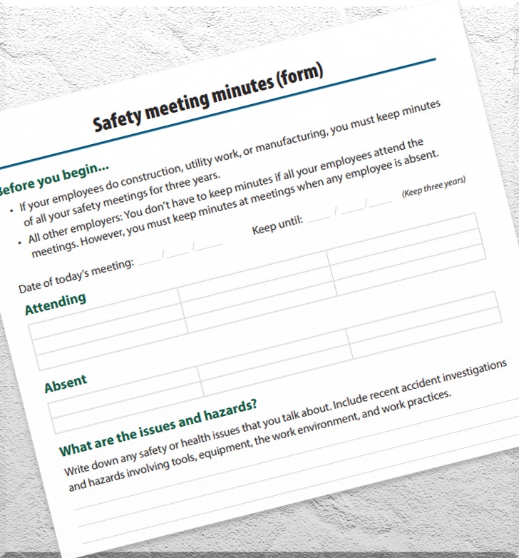
Written Records of Safety Meetings
There are different requirements for written records of the safety meetings, depending on the type of work activities the company does. If your employees are involved in construction, utility work, or manufacturing, you must keep written notes of all safety meetings for 3 years.
For all other types of work, you are not required to keep notes as long as all employees attend the meetings. If any employee is absent from the meeting, you must take meeting notes and make them available to the absent employees.
The notes should contain the following information:
The meeting date,
Attendees’ names (use a sign-in sheet to document attendance),
All safety and health issues discussed during the meeting.
Oregon OSHA provides an example form for recording safety meeting notes.
SCSM: rule requirements

Slide 31
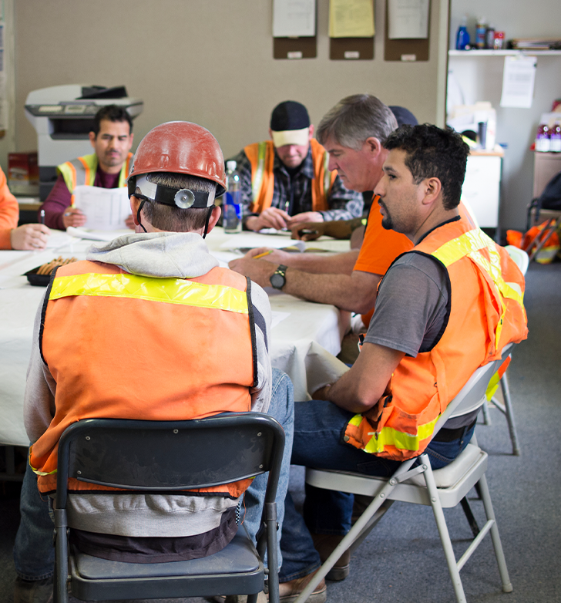
Multi-Employer Worksites
A multi-employer worksite is where employees, whether full-time, temporary, or contract, report to different employers who work on-site together. This commonly occurs on large construction sites with several teams of general contractors and subcontractors. If your employees attend the main contractor’s safety meetings, you may use the written notes of those meetings for your records if you do not hold your own meetings. However, you still must meet to discuss accidents involving any of your employees.
SCSM: rule requirements

Slide 32

Module 2 Overview
You’ve completed module 2! We discussed the rule requirements for safety committees and safety meetings, such as the minimum number of people required to be on a committee and that there must be an equal number of members representing employees as members representing employers. You learned that safety meetings must be scheduled when the highest number of employees are available to attend, and the frequency of committee meetings and safety meetings depends on the type of work. Also, we explained that the rule requires safety committee members to be trained in accident investigation principles and hazard identification (whether or not they are the ones conducting the investigations and inspections).
In the final module, we will discuss industry-specific requirements and some real workplace examples of safety committees and safety meetings.
SCSM: rule requirements

Slide 33
SAFETY COMMITTEES & SAFETY MEETINGS
Module 3: Division Specifics

Slide 34
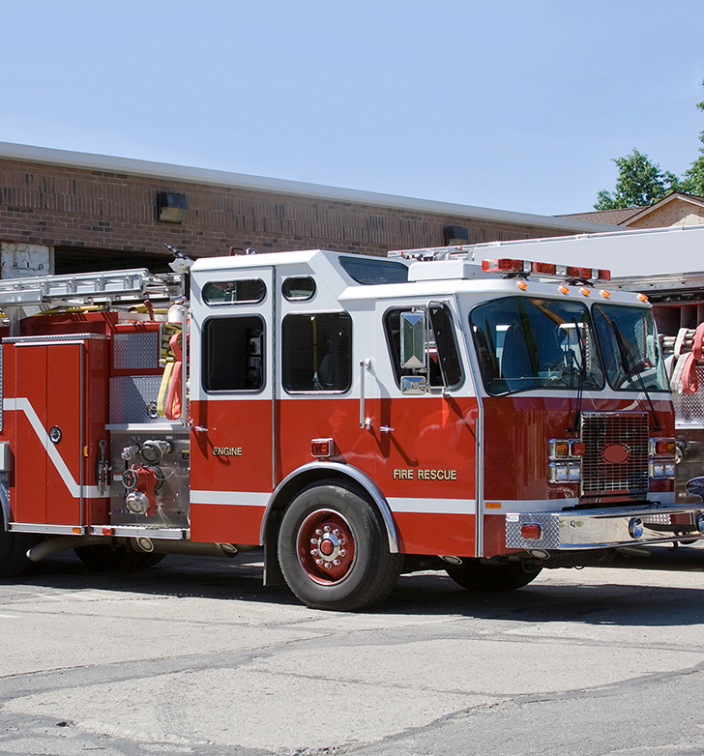

Welcome to Module 3!
In the first two modules, we covered all the requirements outlined in the Safety Committees and Safety Meetings rule found in Division 1. In this module, we will take a closer look at:
The rules in Divisions 2 (pertaining to fire services), 4 (Agriculture), and 7 (Forest activities) that are related to safety committees and meetings,
Examples of how different companies implement the rules in their workplaces, and
Some resources for improving employee engagement and participation in safety committees and safety meetings.
Let’s get started with Division 2 regarding fire services.
SCSM: division specifics

Slide 35
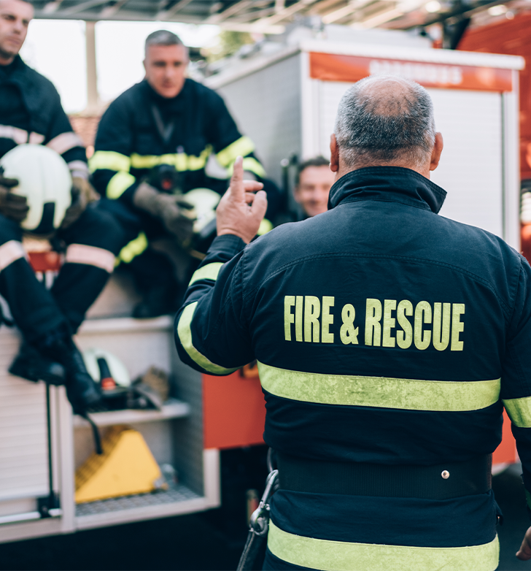
Fire Service Activities
During the initial discussions when creating the Safety Committees and Safety Meetings rule, fire service representatives requested to have the ability to create separate committees or meetings apart from the public works meetings of the city, county, or district they support. Thus, employers engaged in fire service activities must establish a separate fire service safety committee or safety meeting. They may still attend the public works or city meetings, but must have their separate committees or meetings as well.
OAR 437-002-0182(8) also calls for safety committees to include both career and volunteer firefighters when applicable.
Next, we will explore the Division 4 Agriculture rule.
SCSM: division specifics

Slide 36

Division 4, Agriculture
OAR 437-004-0251 is Division 4’s version of the rule. Most of the requirements remain the same as the Division 1 rule, but there are a few additional requirements specified. Let’s look at the additional items for safety committees first.
First and foremost, the safety information must be communicated in a way that the employees can understand. It could be translated into the employee’s primary language, presented through visual media, or any other effective method.
Employees must have training on the purpose and operation of the safety committee, as well as in hazard identification and principles of accident investigation. This ties into OAR 437-004-0099(3), General Standards. Quarterly workplace inspections are to be completed by a competent person, which includes looking for hazards at the workplace. Because safety committee members must have training in hazard identification, oftentimes current or former committee members are well suited to conduct the inspections.
(continued on next slide)
SCSM: division specifics

Slide 37

Division 4, Safety Committees
In addition to inspections, OAR 437-004-0099(4) requires that all work-related injuries that result in lost time from work must be investigated so as to figure out how to prevent a repeat of the injury. The person(s) who investigates the event must be trained in the principles of accident investigation. Again, this could be a safety committee member because they have the training.
OAR 437-004-0251(3)(f) requires the records of the safety committee meetings to include the standard information such as meeting date, names of those in attendance, all reports, inspections, evaluations, recommendations, and any other safety and health related items discussed. Additionally, management responses must be recorded along with the date that management agreed to address the specific recommendations.
Note: Remember to include both full time and part time employees when determining whether a safety committee or safety meeting is needed. For additional information, please see our English/Spanish fact sheet.
SCSM: division specifics

Slide 38

Division 4, Agriculture, Safety Meeting Requirements
Now that we’ve covered the requirements for committees, let’s discuss safety meetings. Safety meetings in Division 4 also have the same requirements as Division 1, but with a few additions.
Employees must be made aware of safety meetings, when and where they are held, and how information is shared between management and workers.
Employees must know that they have a right to have their safety and health concerns heard and questions answered at safety meetings.
Employees must know the method or system that is used for reporting safety and health concerns, incidents, and accidents.
(continued on next slide)
SCSM: division specifics

Slide 39

Division 4, Safety Meeting Requirements (continued)
Besides sharing relevant information about safety and health issues, the safety meetings must also:
Include reports from the quarterly workplace safety inspections and from investigations of any work-related, time-lost injuries, as well as the suggested corrective measures.
Provide opportunities for employees to ask questions, raise safety and health concerns, and make suggestions to improve safety and health in the workplace.
Present information in a way that can be understood by all employees.
Seasonal workers can attend safety meetings, but are not required by the rule to be in attendance. There’s a different rule pertaining to Seasonal workers; let’s look at that in the next slide.
SCSM: division specifics

Slide 40

Division 4, Seasonal Workers
OAR 437-004-0240 Safety Orientation for Seasonal Workers defines a seasonal worker as an employee who works in a job tied to a specific time of year for less than 10 months in a calendar year.
Before the seasonal worker begins work for the first time or when work conditions/locations change, this rule requires employers to provide the following information in a language or manner that workers can understand:
Safety and health rules for their work.
How to contact supervisors in case of an accident, illness, or any safety or health problem.
How to treat injured or sick workers and get emergency help.
Where safety and health information is posted.
That concludes the specific Division 4 requirements. Let’s move onto Division 7 Forest Activities!
SCSM: division specifics

Slide 41
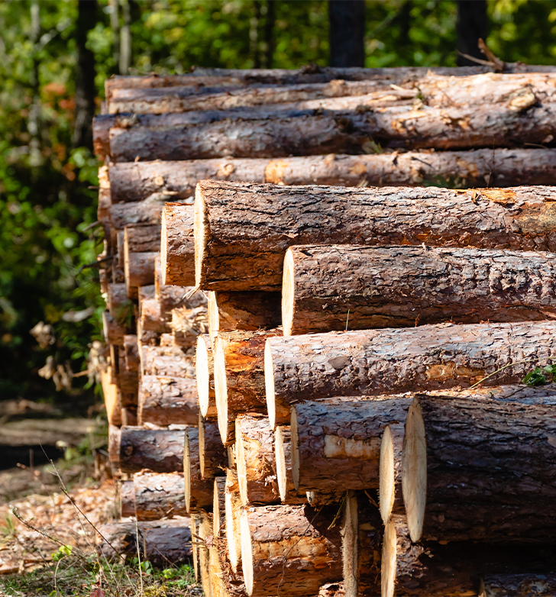
Division 7, Forest Activities
Division 7 does not have a Safety Committees and Safety Meetings rule. Instead, there are similar requirements in the Safety and Health Program (Subdivision B) and Planning, First Aid and Work Conditions (Subdivision C) rules.
Within the Safety and Health Program, OAR 437-007-0125 Accident Investigation, requires:
Every fatal and recordable injury/illness to be investigated.
Near misses* to be discussed with employees.
Measures to be identified to prevent a recurrence of the near misses (as well as fatalities and recordable injuries/illnesses) and all employees informed of the measures.
Steps to be taken to prevent recurrence of near misses, fatal and recordable injury/illness.
Written results of investigations and corrective measures to be kept on record for 3 years.
*Near miss: an event that could have resulted in personal harm or property damage.
SCSM: division specifics

Slide 42
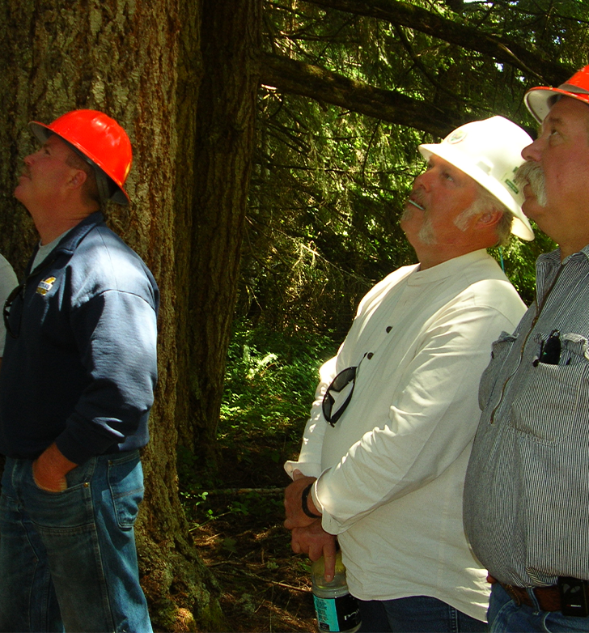
Div. 7, Employee Involvement
Also within the Safety and Health Program of Forest Activities, is OAR 437-007-0130 Employee Involvement. This rule is a bit different because it requires that safety meetings are conducted with all employees on a monthly basis. However, the rule allows the employer to find the best method that works for them, such as meetings with individual employees, separate crews, or with the entire staff at one time. It also specifies that:
Employees are required to report safety and health hazards and qualified* employees must take corrective action and eliminate hazards.
Employers must encourage their employees to participate in site planning and pre-work safety meetings to discuss known hazards and conditions of the site.
You can see the theme from the Division 1 rule of continuous improvement in a cooperative, non-adversarial manner still shines through in these Division 7 rules! Now let’s look at the rule that falls under Subdivision C on the next slide.
*Qualified: certified as being trained to perform a particular job or activity.
SCSM: division specifics

Slide 43
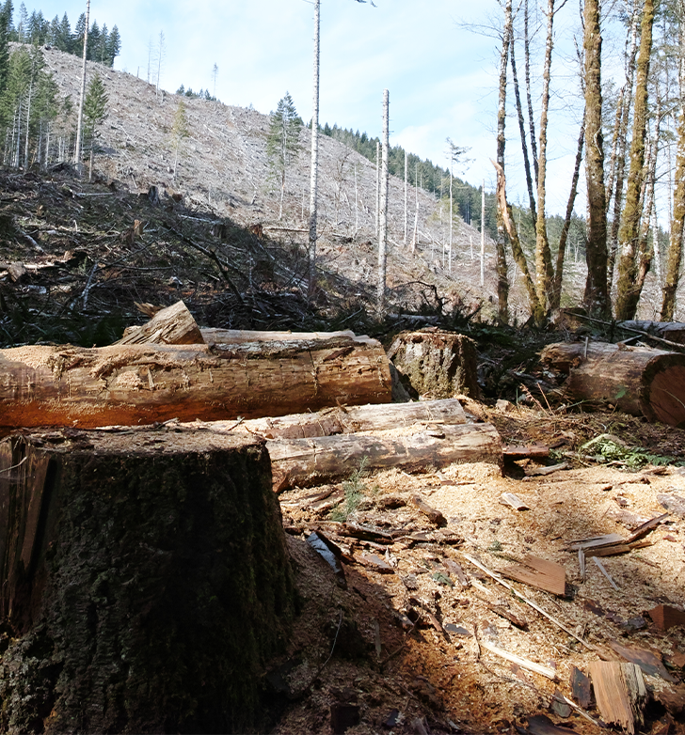
Division 7, Site Planning
OAR 437-007-0200 Site Planning and Implementation sets requirements for any forest activity that will last more than 1 day. Before the start of that activity, employers must:
Conduct an onsite safety survey.
Hold a pre-work safety meeting with employees to discuss the site conditions, known hazards, and the emergency medical evacuation plan.
Document the pre-work safety meeting and keep the documentation for the duration of the site-specific work. The pre-work safety meeting could count towards the monthly safety meeting requirement. If the employer uses it as such, they need to keep the documentation for 3 years.
That wraps up our section on the division-specific requirements. Now let’s take a look at Safety Committees and Safety Meetings rules in the real world!
SCSM: division specifics

Slide 44

Examples in Oregon
We have discussed the requirements for safety committees and safety meetings that apply to the Oregon workplace, including specifics in agricultural and forest activities, as well as fire services. In the next few slides, we will show you examples of safety committees and/or safety meetings that employees and employers have shared with us from across the state.
Please note: Names of companies have been withheld as Oregon OSHA does not endorse any particular company or method. The following examples are solely to demonstrate different ways that employers have implemented the rule in their workplaces.
SCSM: division specifics

Slide 45
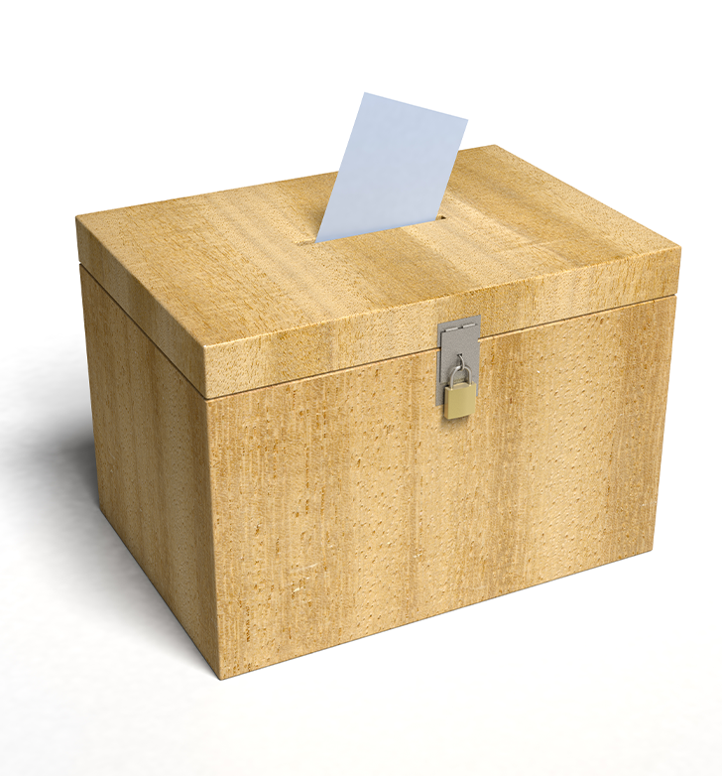
Example 1: Construction
A construction company located in Central Oregon created a “Safety Suggestion box” where employees could not only report a hazard, but also suggest a solution. They could remain anonymous or include their name. The company came up with prizes for “best solution” and “most creative, viable solution” and would share the ideas at the monthly safety meetings. The Safety Coordinator reported that when employees became part of the solution process and took ownership in creating a safer work environment, morale increased and injuries decreased.
SCSM: division specifics

Slide 46
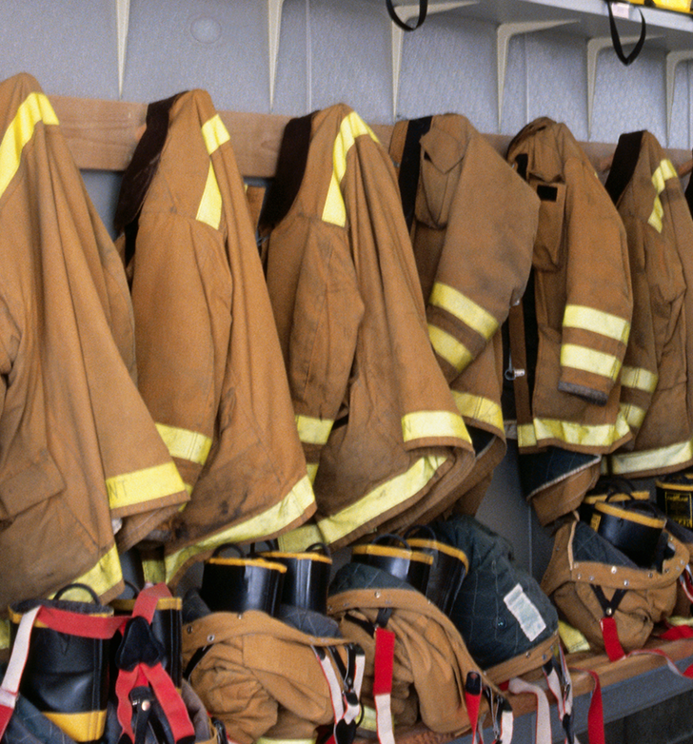
Example 2: Fire Services / Centralized Safety Committee
A fire district in Oregon utilizes a centralized safety committee because they have more than 20 fire stations and 4 work sites spread throughout their service area. They have 16 committee members who represent various divisions and work sites such as operations, training, facilities maintenance, fleet maintenance, fire prevention, and office environments.
Station captains and managers are responsible for the overall safety of their fire stations and work sites. Safety inspections are completed quarterly at all of them. The station captains/managers conduct 3 of those inspections while members of the safety committee conduct the 4th inspection. The district has a great way to get new and experienced members involved in sharing knowledge during quarterly inspections! They pair a seasoned safety committee member with a newer member. During the inspection process, the newer member gains the necessary knowledge to conduct an inspection, and the seasoned member is exposed to new perspectives and ideas.
SCSM: division specifics

Slide 47
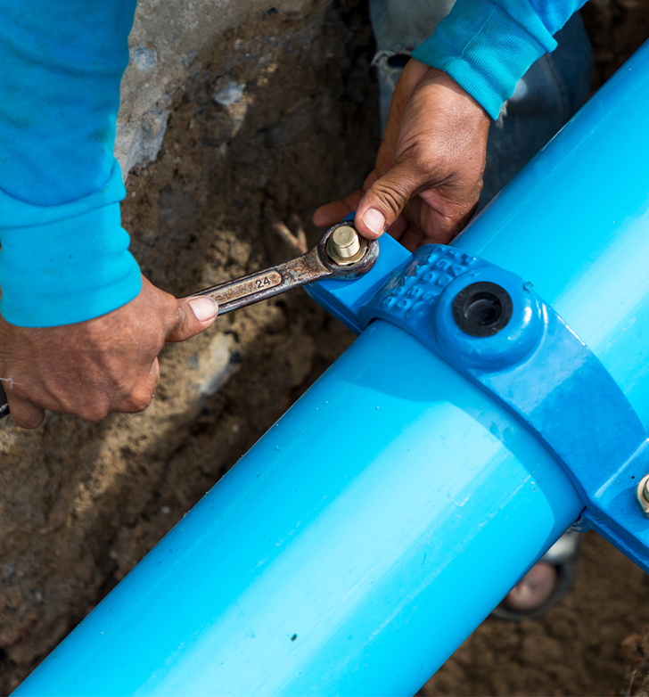
Example 3: Water Utility
A water-utility company located in Northwest Oregon holds monthly safety committee meetings as well as bi-weekly “Safety Talks” for the field crew employees:
One Friday per month the crew representative who serves on the safety committee reports to the team about the topics the safety committee discussed and any accidents that have occurred.
One Friday per month the Safety Coordinator, team lead, or other designated employee, discusses a specific safety topic relevant to their job. Some past examples include “Heat Safety” and “Grinder Safety”.
SCSM: division specifics

Slide 48

Example 4: Orchards
A hazelnut orchard operation conducts most of their safety meetings in one of the equipment barns or while walking in the orchard. During the meetings, they remind all of the workers about safe equipment operating practices, proper personal protective equipment (PPE), and common hazards to be aware of and avoid while on the job. Holding their meetings in the equipment barn and in the orchard allows everyone to see the current conditions of the worksite and equipment. This helps to minimize hazards even further because everyone is focusing on worksite safety during these meetings and if any hazard is noticed, it gets fixed immediately.
SCSM: division specifics

Slide 49

Example 5: Grass Seed Farm
A grass seed farm in the Willamette Valley holds monthly safety meetings as well as morning safety checks. Every morning, during their daily check-in and task assignment, the owner and maintenance manager discuss tasks completed the day before and check in with employees about how equipment worked and any concerns that were identified. It’s a great way to ensure that preventative maintenance is completed and engages employees in problem solving.
SCSM: division specifics

Slide 50

Example 6: Landscaping
A landscaping company in the Portland metro area developed an effective way to ensure all their employees know about safety. Each month the safety committee discusses safety and health issues and gives a demonstration on how to use a tool or specific piece of equipment safely. The demonstration is provided to the whole company, not just the SC, and includes correctly donning and doffing the PPE that is required for that tool. After the demonstration is completed, the presenter gets to select the co-worker who will demonstrate at the next month’s meeting! In addition, the company also created a visual guide to help employees know which PPE is required for which tools and tasks.
SCSM: division specifics

Slide 51

Example 7: Logging
A logging company in Southern Oregon has each team leader keep a safety booklet in their truck. This booklet has laminated pages with safety topics and information, as well as blank pages for notes. This booklet is used during the site-specific meetings as well as the monthly safety meetings for topic discussion, to document notes about the meeting, and have the crew sign in for attendance.
The team leader then transfers the notes to the office binder where they are kept on file for the 3-year duration.
SCSM: division specifics

Slide 52
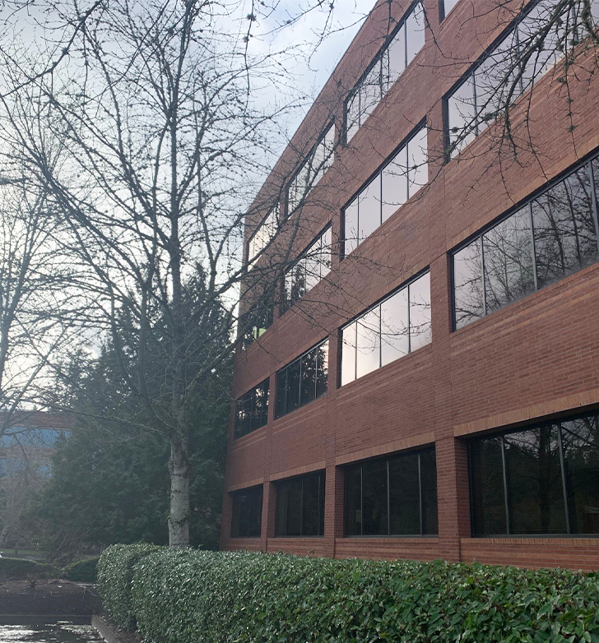
Example 8: Office Environment
A software company in western Oregon trains and utilizes their Facilities department for the hazard identification role of the safety committee. Each work day, the Facilities crew walks the campus, documents and fixes hazards both inside the office buildings and on the walking paths outside. Two of the employees in the Facilities department are also members of the safety committee and provide a report of their work at the quarterly meetings.
SCSM: division specifics

Slide 53

Additional Resources
Oregon OSHA has a playbook of ideas to help keep your safety committees and safety meetings energized! This playbook is considered a “living document” and is updated periodically. If you have a great idea to share, we would love to include it! Email us at ed.web@dcbs.oregon.gov.
SAIF, a workers’ compensation insurance carrier in Oregon, also has resources available on their website.
Please note: If you are unable to exactly meet all the requirements of Safety Committees and Safety Meetings rule but have other methods in place that meet the intent of the rule, you may apply for approval from Oregon OSHA for an “innovation” exception.
SCSM: division specifics

Slide 54

Overview
In this final module we went through the different requirements related to safety committees and meetings in Division 2 for Fire Services, Division 4 for Agriculture, and Division 7 for Forest Activities. We also shared examples of how some employers implement safety committees and meetings in workplaces around the state of Oregon.
Throughout the course, we have seen the continuous improvement theme of the rule reflected often. Remember, safety and health is more than a one-time checklist. Whether your workspaces, tasks, and conditions change frequently or not, it is important to keep safety and health as a priority, and look for ways to improve. It is also important that the work climate encourages a cooperative relationship between management and workers to address workplace safety and health concerns.
Coming up next is a set of quiz questions.
SCSM: division specifics

Slide 55
SAFETY COMMITTEES & SAFETY MEETINGS - QUIZ
Question 1: The purpose of safety committees and safety meetings is to bring workers and management together in a non-adversarial, cooperative effort to promote safety and health.
True
False
Question 2: If you have a safety committee and your company has more than 20 employees, what is the minimum number of safety committee members required?
2
4
6
8
SCSM: division specifics

Slide 56
SAFETY COMMITTEES & SAFETY MEETINGS - QUIZ
Question 3: When attending safety committee meetings or safety meetings, employees must give up their pay for time spent in the meeting.
True
False
Question 4: If your company has safety meetings, all available employees must attend the safety meetings.
True
False
SCSM: division specifics

Slide 57
SAFETY COMMITTEES & SAFETY MEETINGS - QUIZ
Question 5: OAR 437-001-0765 requires safety committee members to be trained in the following topics: (select all that apply)
Principles of accident investigation
Effective writing
Hazard identification
De-escalation techniques
Question 6: If you have a safety committee, it must have a majority of members representing employers.
True
False
SCSM: division specifics

Slide 58
SAFETY COMMITTEES & SAFETY MEETINGS - QUIZ
Question 7: If you hold safety meetings and your business does construction activities, utility work, or manufacturing, you must keep written records of your meetings for:
6 months
2 years
3 years
4 years
Question 8: If your company has a safety committee, the written records of the safety committee meetings must be kept for a period of:
0 months, it is not required for safety committees.
1 year
2 years
3 years
SCSM: division specifics

Slide 59
SAFETY COMMITTEES & SAFETY MEETINGS - QUIZ
Question 9: Safety committee members are responsible for evaluating accident investigations and making recommendations.
True
False
Question 10: Employers who are covered under Division 4 (Agriculture) or Division 7 (Forest Activities) have separate requirements regarding safety committees and safety meetings.
True
False
SCSM: division specifics

Slide 60
SAFETY COMMITTEES & SAFETY MEETINGS - QUIZ ANSWERS
A
B
B
A
A, C
6) B
7) C
8) D
9) A
10) A
SCSM: division specifics
Notes:
Answers

Slide 61

Where To Go From Here
An excellent resource to utilize is the A-Z Topic Index on the Oregon OSHA website. It has lists of relevant publications, training materials, rules, interpretations, videos, and other miscellaneous materials.
If you want guidance in developing a safer work environment, you may consider our free and confidential consultation service. Our consultants in workplace health and safety can help you reduce accidents, related costs, and help you develop a comprehensive program.
SCSM Resources
Oregon OSHA Online Courses
Consultation Services
File a Complaint
SCSM: division specifics

Slide 62

SCSM: division specifics

Slide 63

Credits
You’ve completed the Safety Committees and Safety Meetings course!
Produced by the Public Education Team of Oregon OSHA:
Tammi Stevens, Phillip Wade, Ricardo Vázquez Rodríguez, Angelina Cox, Tim Wade, Anthony Dey
Stock media provided by: Getty Images Inc., Envato Images
SCSM: division specifics

