Slide 1
Module 1: Introduction
SILICA SAFETY

Slide 2
Completing this course will help you understand the rules and some of the hazards related to silica. It is your employer’s responsibility to further your training where it is specific to your organization, such as permits, policies, and practices. This material should not be considered a substitute for any provisions of the Oregon Safe Employment Act, or for any standards issued by Oregon OSHA. Manufacturers, products, or services displayed in this material are for informational purposes only and do not constitute an endorsement by Oregon OSHA.
Disclaimer
Module 1: introduction

Slide 3
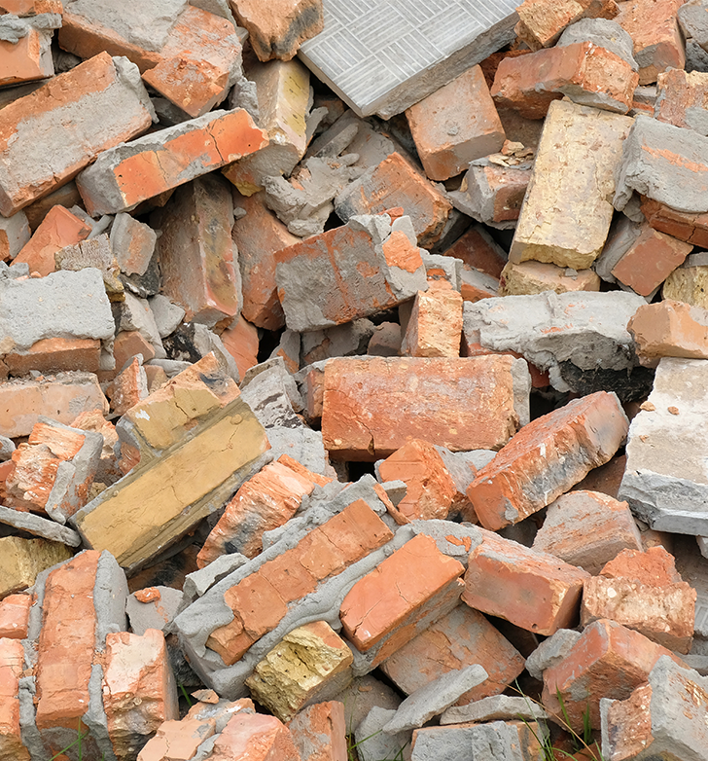
Welcome!
In this course we will cover the hazards of airborne crystalline silica dust exposure, diseases like silicosis, and the Oregon OSHA silica rule found in the Oregon Administrative Rules, Division 2, Subdivision Z.
The silica standard lists 12 training requirements and this course covers 6 of them:
1a through 1d, 2a, and 2d
Your employer is responsible for all other requirements.
Module 1: introduction

Slide 4
Video: STOP SILICOSIS
Module 1: introduction

Slide 5
Silica: It’s Not Just Dust
Hundreds of employees die each year in the U.S. due to disease by overexposure to airborne crystalline silica dust, and there are many more silicosis cases that go misdiagnosed or unrecognized. The original permissible exposure limit (PEL) used by Oregon OSHA to protect workers from silica was set in 1971. Since then, studies have shown that the PEL was not protective enough to prevent a significant risk of developing silicosis, lung cancer, chronic obstructive pulmonary disease, and kidney disease. In response to these findings, Oregon OSHA revised the Silica rule. We’ll discuss more about the requirements of the rule throughout this course.
Module 1: introduction

Slide 6
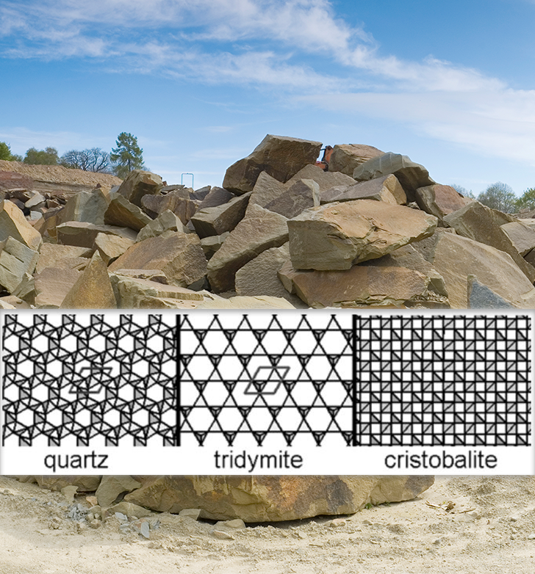
What is Crystalline Silica?
Silica, or silicon dioxide, is one of the most common minerals on earth and there are different forms: crystalline and non-crystalline (amorphous type). Crystalline silica is a specific type of silicate and is found as a naturally occurring component of sand, rock, soil, clays, granite, certain minerals, and some living organisms.
The three types of crystalline silica that are of concern to human health are quartz (most common), cristobalite, and tridymite. These variations differ by their crystal formation pattern shown here and have differing toxicity levels, but all are hazardous to humans.
Module 1: introduction

Slide 7
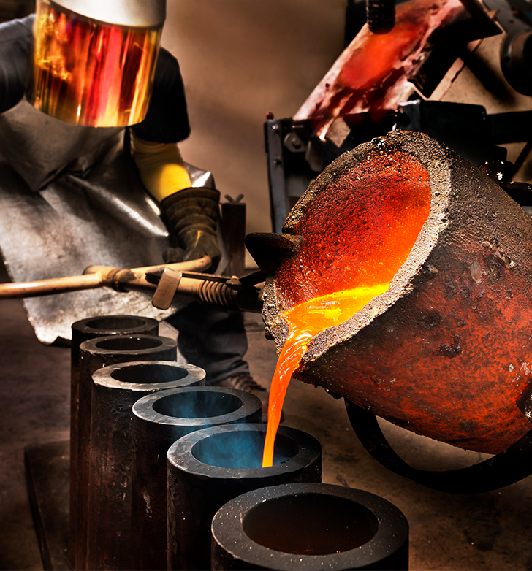
Amorphous Silica
Amorphous silica is found in many materials, including glass and diatomaceous earth. It does not cause silicosis. However, high heat and pressure can change non-hazardous amorphous silica to hazardous, crystalline silica. This occurs in foundry operations where the casting shell is amorphous silica and can be converted to cristobalite during the pouring process due to the high temperature and long cooling time.
Module 1: introduction

Slide 8
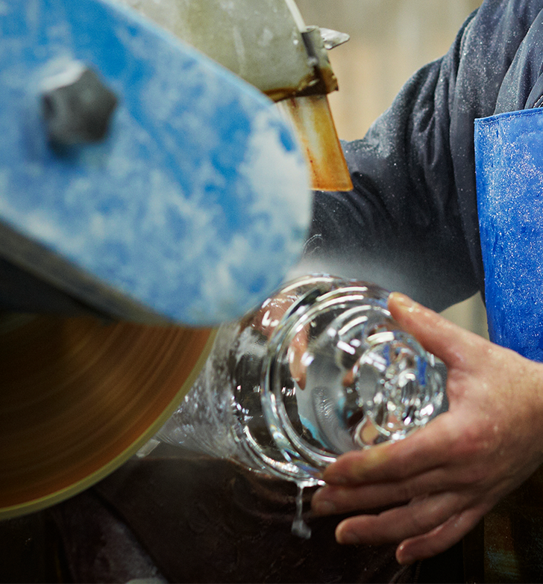
Standard Glass
Standard glass is the most common form of amorphous silica. Very finely powdered crystalline silica sand is used to manufacture glass, which means that the process of glass making can be hazardous before it is heated. The heating process melts the crystalline silica crystals and changes the form to amorphous silica (non-crystalline silica)
Module 1: introduction

Slide 9
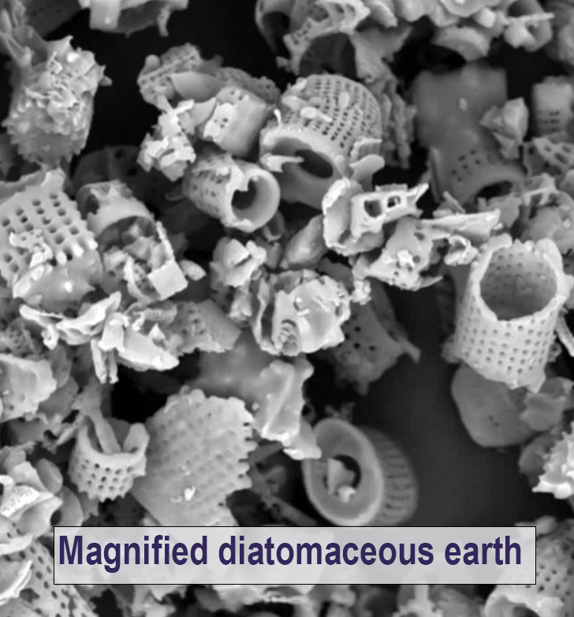
Diatomaceous Earth
Diatomaceous earth produced naturally is mainly made up of amorphous silica, but some diatomaceous earth products can contain high concentrations of cristobalite (30%). Different grades of diatomaceous earth contain more or less crystalline silica, depending on the treatment applied.
Natural-grade products, such as animal or human food supplements, are dried at relatively low temperatures. These products remain in their natural state of amorphous silica, and are not considered harmful, but they may contain up to 3% natural crystalline silica.
Calcinated products, such as pool filtering aids, are dried at very high temperatures - usually higher than 1000°C. Under the high heat, the amorphous silica transforms into crystalline silica, mainly in the form of cristobalite, which is twice as toxic as quartz. Consequently, calcinated diatomite can contain up to 70% crystalline silica!
Module 1: introduction

Slide 10
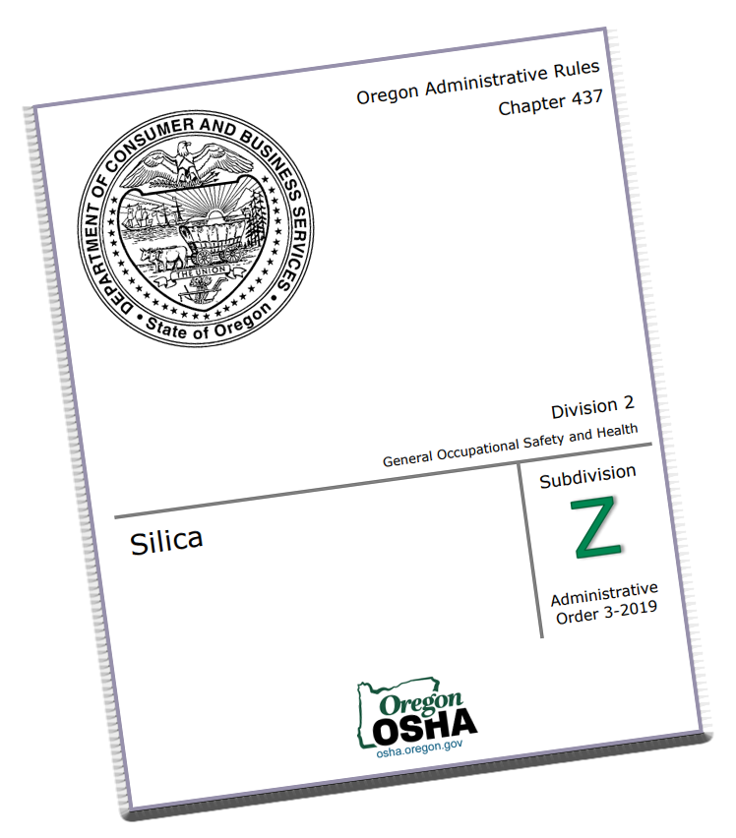
Oregon OSHA Silica Standard
As of July 1, 2018, all workplaces with potential airborne exposure to crystalline silica, including quartz, cristobalite, and tridymite, must comply with the current Oregon OSHA Silica Standard.
Oregon OSHA combined the 2016 federal construction and general industry (including maritime) silica rules into one set of rules applicable to these industries. The rules not only reduce the exposure limit, they take a comprehensive approach to protect workers by creating an action level and requiring exposure assessments, engineering and other controls, a written exposure control plan, respiratory protection, medical surveillance, regulated/restricted access areas, education and training, and recordkeeping. We’ll discuss all of that in more detail in Module 4!
Module 1: introduction

Slide 11
Silica Standard Exemptions
Exemptions from the respirable crystalline silica rules include:
1. Agricultural operations.
2. Exposures resulting from processing absorptive clays (such as kitty litter). This exclusion is because this type of silica is typically occluded (blocked with ions) or coated and does not pose the same level of health risks as crystalline silica.
3. Operations where objective data demonstrate employee exposures will remain below the “action level” of 25 micrograms per cubic meter (μg/m3) as an eight-hour time-weighted average (TWA) under any foreseeable conditions.
Module 1: introduction

Slide 12
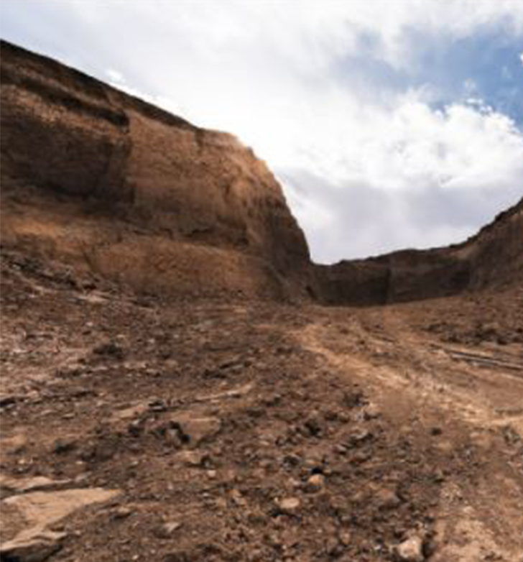
Overview
You’ve completed module 1! Silica is one of the most common minerals on our planet. There are different forms of silica: crystalline and non-crystalline forms (amorphous type) and three types of crystalline silica of concern to human health: quartz, cristobalite, and tridymite. Different products and processes can expose workers to respirable crystalline silica, which we will discuss further in this training. Oregon OSHA combined the revised silica rules with the federal standards and this training helps to explain the rules and risks of silica exposure.
In the next module, we’ll look at health issues caused by silica.
Module 1: introduction

Slide 13
Module 2: Silica Illnesses
SILICA SAFETY

Slide 14
Welcome to Module 2
While this section begins with a brief history of silica, it mostly deals with health hazards that respirable crystalline silica dust exposure presents to workers. These conditions include:
Silicosis
Tuberculosis
Cancer
Kidney failure
Other silica-related diseases
Let’s get started.
Module 2: silica illnesses

Slide 15
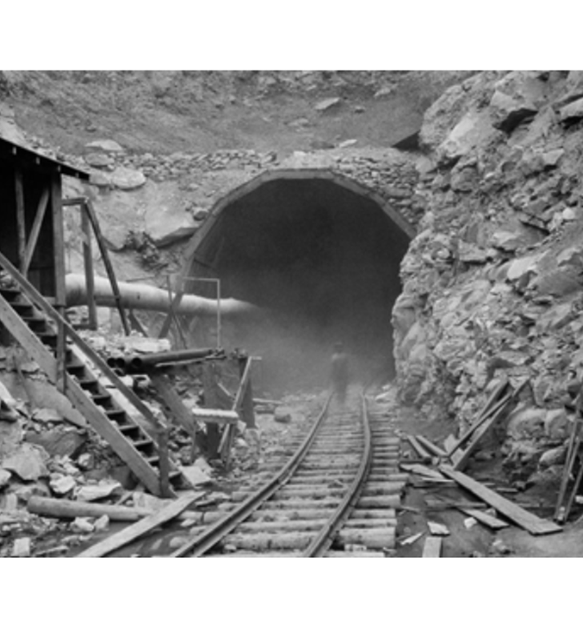
History of Silica
Silica is used today in many different industrial activities and commercial products. Some industries such as mining, construction, and granite quarrying involve disturbing silica-containing materials. Many industries, including dental labs, pottery and ceramics, glass making, abrasive blasting, and cement production, utilize sand and other silica-containing products.
Silica exposure has long been recognized as a serious health hazard for workers. In the Hawk’s Nest tunnel construction disaster of 1930, hundreds of workers died and approximately 1,500 more were disabled because of breathing respirable crystalline silica dust.
Module 2: silica illnesses

Slide 16
Silica Exposure
It’s estimated that more than 2.3 million workers in the United States are potentially exposed to dust containing crystalline silica — with nearly 90% of those workers employed in the construction industry. According to Federal OSHA, more workers died in 2014 from silicosis than from being caught in or crushed by collapsing materials, such as in trench and structure collapses.
Module 2: silica illnesses

Slide 17
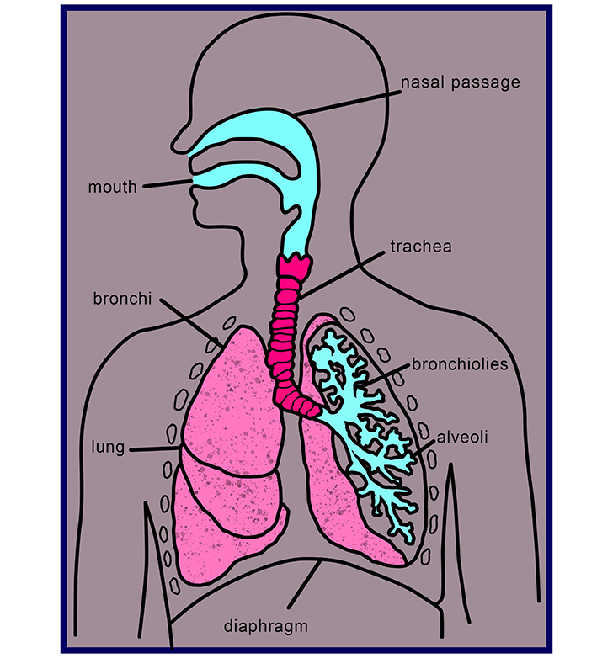
Respirable Crystalline Silica
For crystalline silica to present a serious health hazard, the dust must be in the air and “respirable”. Respirable means the dust particles are so tiny that they bypass being trapped by the nose, throat, or bronchi and travel deep into the lungs, unlike larger particles that can get expelled from the body via being coughed out or swallowed.
Instead, those tiny respirable particles penetrate the small air sacs, alveoli, where oxygen is absorbed into the bloodstream. Once that occurs, silica particles can start to cause scarring of the lung tissue and irreversible damage to the lungs.
Module 2: silica illnesses

Slide 18
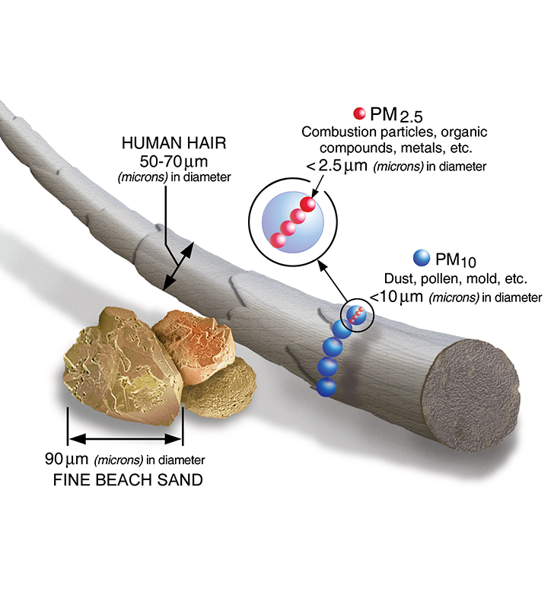
Respirable Size Particles
To get an idea of what “respirable-sized” actually looks like, look at the image to the left. Grains of sand on a beach are larger than respirable particles. Very fine beach sand is 60 micrometers (µm). For a particle to be respirable it must be less than 5 µm.
Crystalline silica can become respirable-size particles when workers grind, cut, drill, or crush materials that contain crystalline silica such as stone or tile. Typically, respirable particulates are generated by mechanical or physical force such as grinding, sawing, or jack hammering. But it can also occur when mixing or handling raw materials. For example, opening bags that have silica-containing products and pouring out the contents can generate airborne crystalline silica dust.
Module 2: silica illnesses

Slide 19
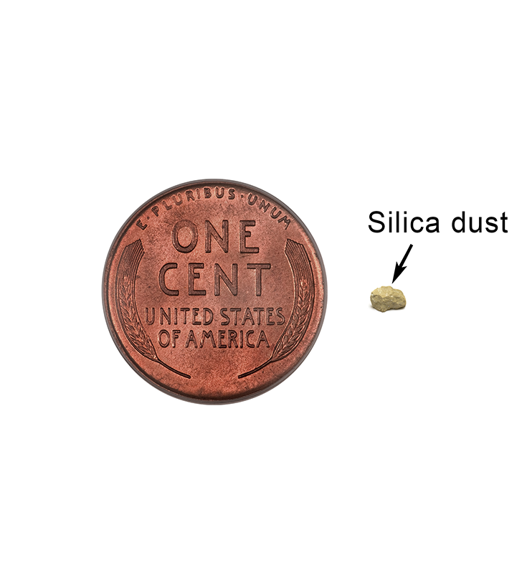
Small Amount is Too Much
It does not take much respirable crystalline silica to cause damage. The small amount you see next to the penny will start causing lung damage if you inhaled that amount over the course of 8 hours. Also, that tiny amount of airborne respirable silica dust would not be visible to the naked eye.
Now think about some of the dust clouds you have seen at various construction sites. If the construction activities involved silica-containing materials, accumulating that small amount of airborne respirable silica dust within an 8-hour timeframe could result in a serious exposure!
Module 2: silica illnesses

Slide 20
Health Hazards
Several types of adverse lung health effects have been associated with respirable crystalline silica exposures. Some of these diseases are:
Silicosis
Tuberculosis (TB)
Cancer
Kidney and immune system diseases
Other respiratory diseases
Let’s discuss these further in the next few slides
Module 2: silica illnesses

Slide 21
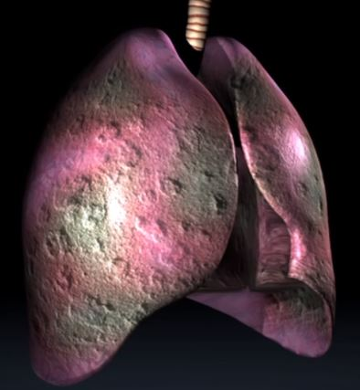
Silicosis
The crystalline silica particles damage lung tissue, causing formation of scar tissue around dead cells. The scarring spreads and can develop into a disease condition referred to as silicosis, a slowly progressive, irreversible, and potentially fatal disease. Even with the cessation of exposure, disease progression can continue once established. There are three types of silicosis; acute, chronic, and accelerated.
Initially, workers with silicosis may have no symptoms. As the disease progresses, however, symptoms begin to emerge. Symptoms may include difficulty breathing, coughing, weight loss, weakness, fever, and night sweats. Significant loss of lung capacity and gas exchange function, and increased airflow obstruction occur in the later stages of silicosis. Respiratory failure may occur with advanced and severe cases. On average, those with silicosis have a life span approximately 11 years shorter than those without the disease according to NIOSH.
Module 2: silica illnesses

Slide 22
Video: SILICA EXPOSURE
Module 2: silica illnesses

Slide 23
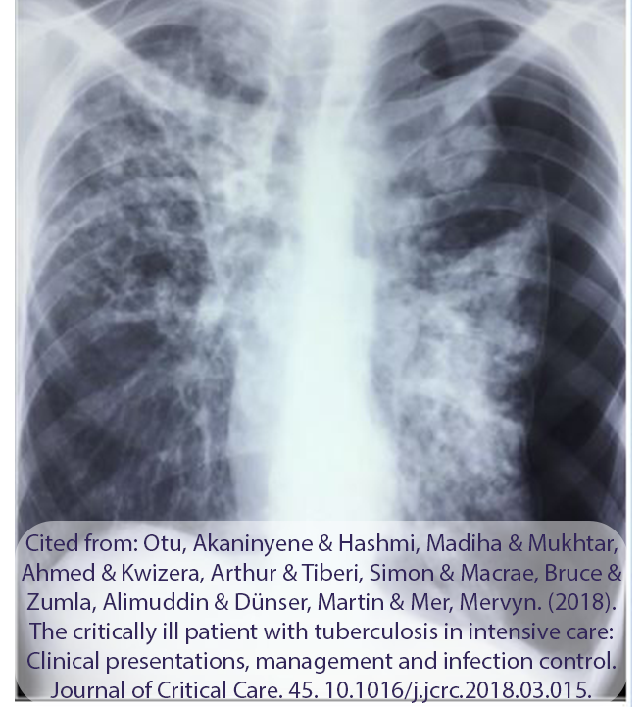
Tuberculosis
One of the common infections that occurs is tuberculosis (TB). TB is a disease caused by bacteria that typically affects the lungs, but can also affect the brain, kidneys, or spine. The bacteria multiplies inside the affected organ and destroys the tissue.
Many people infected with the bacteria that cause tuberculosis don't have symptoms. Only when someone has the “active form” of the bacteria will symptoms occur, and they usually include cough (sometimes blood-tinged), weight loss, night sweats, and fever. Patients with active symptoms will require a long course of treatment involving multiple antibiotics. If left untreated, TB can be fatal.
Module 2: silica illnesses

Slide 24
Cancer
The International Agency for Research on Cancer has classified respirable crystalline silica as a Group 1 human carcinogen. This means there is sufficient scientific evidence that it causes cancer in humans. The most studied type of cancer associated with the inhalation of respirable crystalline silica is lung cancer. However, increases in risk of other cancers such as larynx, nasopharynx, stomach, and esophageal have also been suggested in scientific studies.
Module 2: silica illnesses

Slide 25
Kidney and Immune System Diseases
Several types of kidney disease have been associated with silica exposure. A Michigan State University study of 583 individuals with silicosis concluded that chronic kidney disease should be considered a complication of silicosis.
Autoimmune diseases, such as scleroderma, rheumatoid arthritis, and systemic lupus erythematosus, have also been linked to silica exposures.
Module 2: silica illnesses

Slide 26
Other Respiratory Diseases
Exposure to respirable crystalline silica increases the risk of other lung diseases, primarily Chronic Obstructive Pulmonary Disease (COPD), which includes emphysema and chronic bronchitis. The main symptom of COPD is shortness of breath due to difficulty breathing air into the lungs. COPD is not usually reversible and may worsen over time and require inhalation assistance such as oxygen therapy or inhalers.
Module 2: silica illnesses

Slide 27
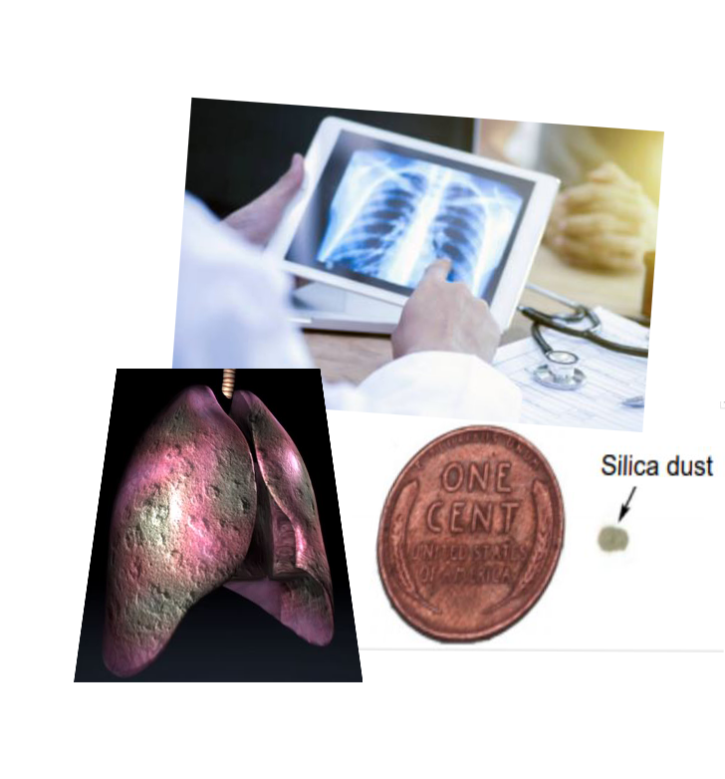
Overview
You have completed Module 2. We covered some history of silica and how workers’ deaths in the 1930’s brought awareness of the dangers of silica to the public’s knowledge. We learned how a small amount of respirable-sized crystalline silica particles can enter deep into the lungs and cause terrible illnesses. Among those are: Silicosis, TB, cancer, kidney failure, autoimmune diseases, and COPD.
Now that you know the potential serious health effects of silica exposure, you can understand why Oregon OSHA adopted the stricter PEL rules to protect workers from the health hazards of respirable crystalline silica. In the next module we will learn about jobs that have high potential of silica exposure.
Module 2: silica illnesses

Slide 28
Module 3: Silica Exposure
SILICA SAFETY

Slide 29
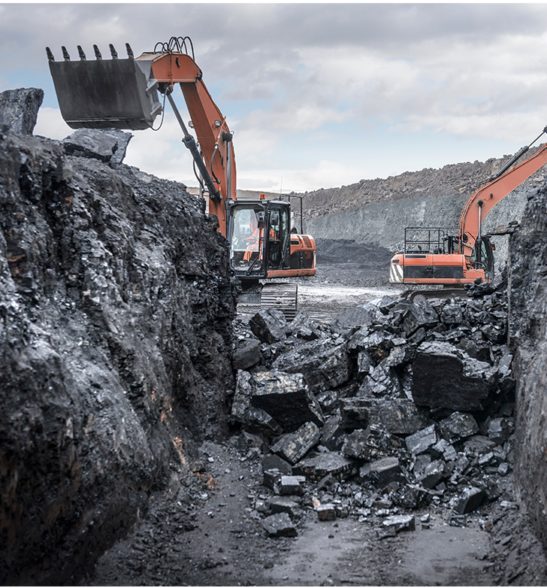
Welcome to Module 3
In the previous module, you learned about the health hazards of respirable crystalline silica. In this module, we will cover types of silica-containing materials and activities that can cause silica to become respirable and airborne.
Module 3: silica exposure

Slide 30
Building Materials Containing Silica
It is important to familiarize yourself with common materials that contain silica so that you can identify them at a worksite and be aware of the potential risks. The following building materials may contain silica in the form of quartz: Material Quartz Amount
Engineered stone 80 - 95%
Granite 30 - 70%
Ceramic tiles 5 - 45%
Autoclaved aerated concrete 20 - 40%
Concrete up to 30%
Fibrous cement siding 25%
Brick 5 -15%
Black asphalt 5 - 12%
Marble up to 5%
As you look at this list, you’ll notice bricks toward the bottom with 5 - 15% quartz content. This might make it seem like they are less hazardous to work with, but that is not necessarily the case. Next, watch a video about one bricklayer’s experience.
Module 3: silica exposure

Slide 31
Video: DEADLY DUST - A BRICKLAYER’S JOB NEARLY KILLS HIM
Module 3: silica exposure

Slide 32
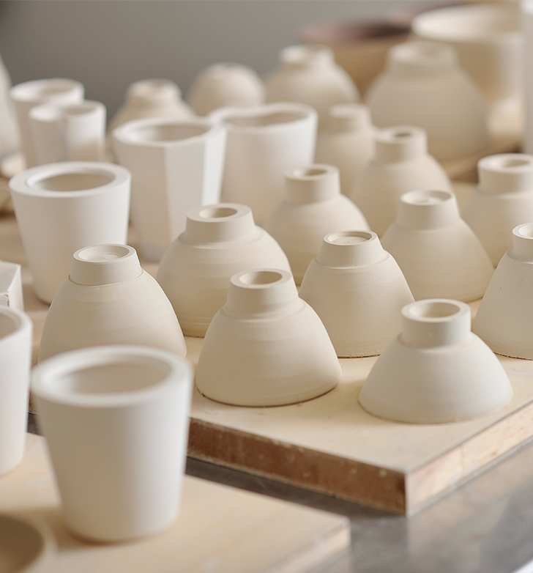
Other Materials Containing Silica
Remember from Module 1 that silica is one of the earth’s most common minerals. In addition to the materials listed on the previous slide, silica may be found in these materials as well:
Abrasives containing sand
Asphalt
Cement
Ceramics
Clays
Drywall compound
Filter Aids containing diatomaceous earth or sand
Grout
Mortar
Paints
Pavement
Polishing compound
Portland cement, if containing sand
Sand
Soil
Sorbents
Stone
Module 3: silica exposure

Slide 33
Construction Activities
Construction has some of the highest exposure potential to silica because of the materials used and the associated job tasks performed. Construction activities that may put silica in the air include, but are not limited to:
Abrasive blasting using silica sand,
Chipping, hammering, and drilling rock,
Crushing, loading, hauling, and dumping rock,
Demolition of concrete or masonry structures,
Dry sweeping or using pressurized air to blow concrete, rock, or sand dust, and
Sawing, hammering, drilling, grinding, and chipping of masonry, concrete, or fiber cement siding.
Module 3: silica exposure

Slide 34
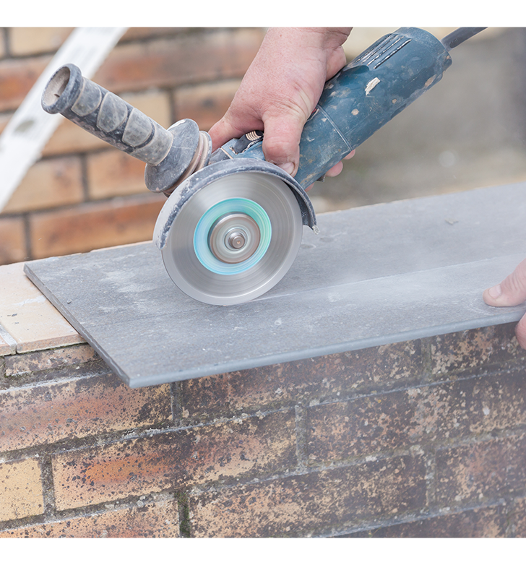
General Industry Exposures
Exposure to respirable silica can occur when workers cut, saw, drill, or crush brick, ceramic tiles, rock and stone products. It can also occur in general operations that process or use large quantities of sand, such as foundries and glass production, pottery, and concrete products industries.
Some examples of activities in general industry that may put respirable silica in the air are:
Removing paint with a power sander,
Dry-cutting ceramic tile, and
Mixing clay for pottery work.
Module 3: silica exposure

Slide 35
Agriculture Exposure
Although agriculture is not included in the revised rules, it is still important to note that some agriculture tasks may put silica in the air, such as tilling and harvesting. In Oregon, potatoes, onion, and beet processing has been directly associated with silica exposure. This is because there is higher silica-quartz content in the soil in eastern Oregon where these vegetables are grown. Therefore, tilling soil, harvesting, and processing in those locations carries potential for silica exposure. You can read more information on respirable silica limits related to agriculture in OAR 437, Division 4.
Module 3: silica exposure

Slide 36
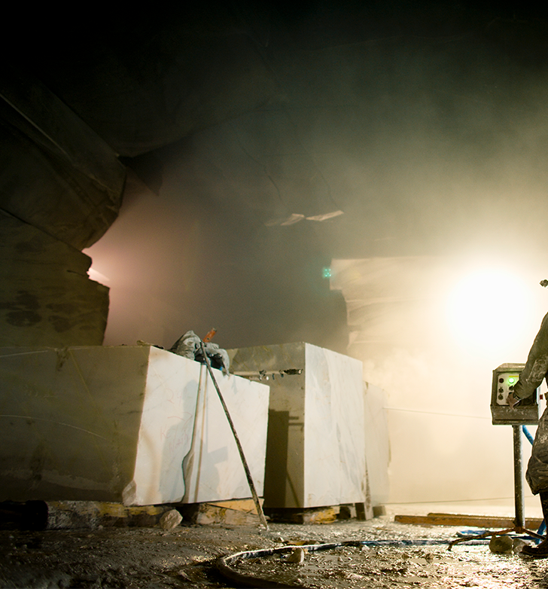
Mining Exposure
Historically, mining has been one of the highest risk industries for worker exposure to crystalline silica dust. Even though mining is under the federal jurisdiction of Mine Safety and Health Administration (MSHA), its high probability for silica exposure warrants a quick mention! The most common mining activities where exposure may be elevated include the drilling of rock, crushing, and loading of mine material.
The National Institute for Occupational Safety and Health (NIOSH) recommends that worker protections include wet drilling, local exhaust ventilation systems, and pressurized cabs on vehicles and equipment to protect operators. Additionally, companies should wet down haulage roads every four hours when silica dust is present.
Module 3: silica exposure

Slide 37
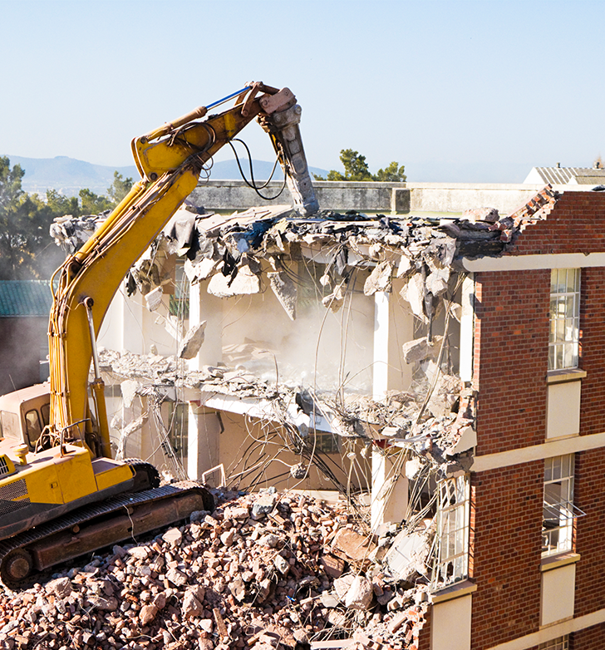
Overview
You have completed Module 3! You learned about common materials that contain silica, including engineered stone, bricks, ceramic tiles, granite, and more. We also covered a variety of industries and job duties that can produce or come into contact with respirable silica such as: dry sweeping rock or sand dust, cutting or drilling silica-containing materials, loading and hauling rock, and demolishing concrete or masonry structures.
In the next module we’ll learn how workers can be protected from hazardous respirable silica!
Module 3: silica exposure

Slide 38
Module 4: Protecting Workers
SILICA SAFETY

Slide 39
Welcome to Module 4
You made it to the last module of training material! (There is one more module, but it is just the quiz and conclusion.)
So far, we covered what silica is, its various forms and types, history, health hazards, and jobs and tasks that have a high potential of exposure to respirable silica.
Now it’s time to learn about the Oregon OSHA silica rule and the protections in place for employees who are potentially exposed to crystalline silica!
Module 4: protecting workers

Slide 40
Oregon OSHA Silica Rule Overview
There are many components to the Silica rule to protect workers in general industry and construction activities from silica exposure. An overview of each component will be covered in this module. The components, as they appear in the rule, are:
Permissible Exposure Limit (PEL)
Exposure assessment
Specified exposure control methods
Regulated and restricted access areas
Methods of compliance
Respiratory protection
Housekeeping
Medical surveillance
Communication
Recordkeeping
Click on the rule links throughout the module for full details.
Module 4: protecting workers

Slide 41
1. Permissible Exposure Limit
The silica Permissible Exposure Limit (PEL) means the maximum amount of airborne respirable crystalline silica allowed over the course of an 8-hour work day. The rule sets that limit to no more than 50 micrograms per cubic meter of air (50 µg/m3) in an 8-hour time weighted average (TWA). It is important to note that the rule also sets an “action level”. The action level is 25 ug/m3.
To give you a reference of size, half of one ounce is approximately 14 grams. One microgram (µg) is one millionth of a gram.
The next element in the rule outlines the actions an employer must take to determine if and how much respirable silica is in the workplace.
Module 4: protecting workers

Slide 42
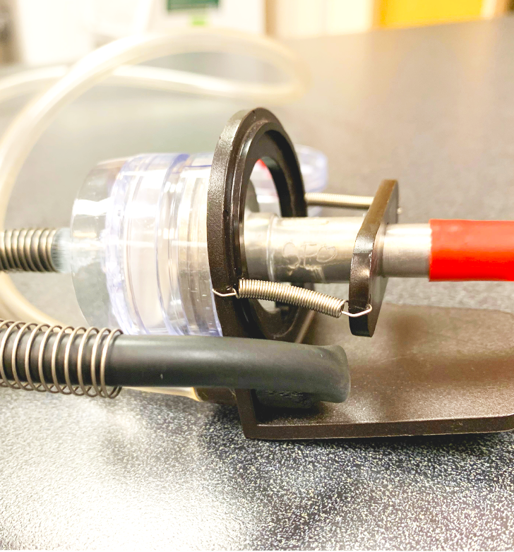
2. Exposure Assessment
Air monitoring is a process that measures respirable crystalline silica exposure and can be performed by an Oregon OSHA consultant, or any other qualified person. The person uses a specialized device to sample airborne respirable particles from the air in the employee’s breathing zone. The collected samples are then analyzed to determine if and how much respirable crystalline silica is present. If the analyzed samples are below the action level, no further monitoring is necessary. However, if they are:
At or above the action level (25 µg/m3), another sample is required within 6 months.
Above the PEL (50 µg/m3), another sample is required within 3 months.
Employees must be notified in writing of their exposure assessment results. Timelines for notification, specific situations and industries are referenced in rule 437-002-1056.
Module 4: protecting workers

Slide 43
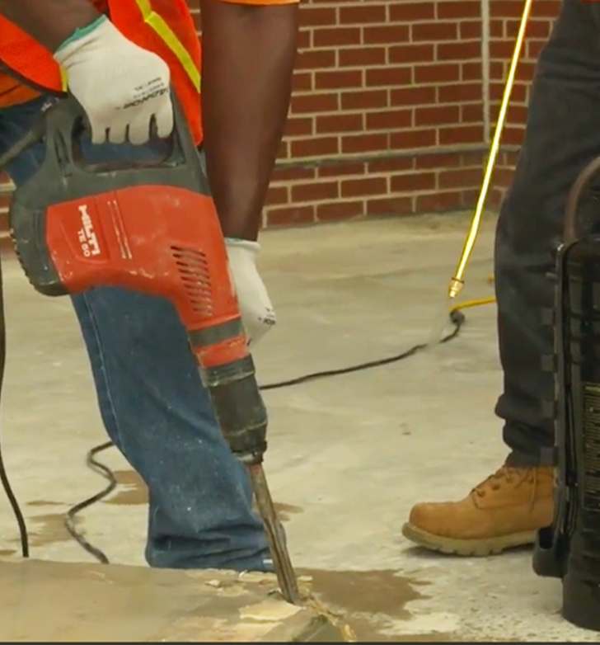
3. Exposure Control Methods
This rule, which includes Table 1, outlines specific tasks and control measures that, when implemented, do not require the exposure assessment that we discussed in the previous slide. These exemptions only apply to construction and construction-like activities. For example, an exposure assessment would not be required if you use a jackhammer with a continuous stream of water at the point of impact and dust is not visibly in the air or meets Table 1 requirements. See the next slide for a video example!
See fact sheet FS-66, and section 437-002-1057 for all the details.
Module 4: protecting workers

Slide 44
Video: EXAMPLE OF JACKHAMMER WITH CONTINUOUS WATER STREAM
Module 4: protecting workers

Slide 45
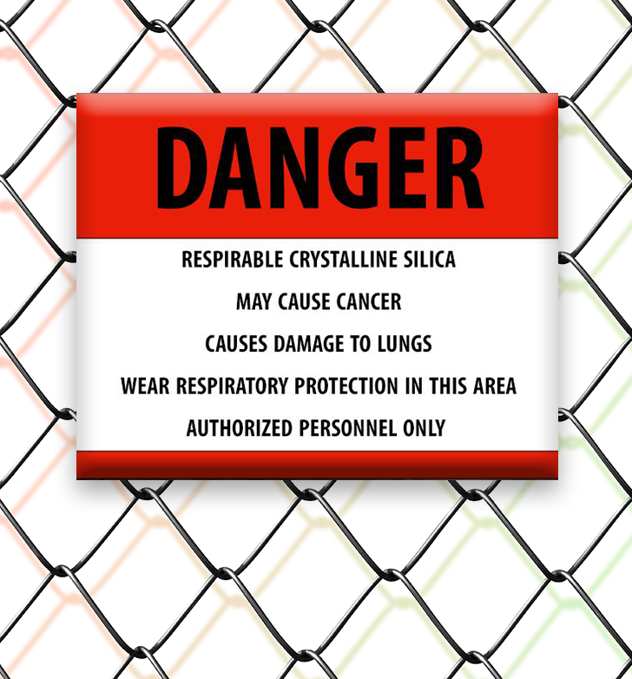
4. Regulated and Restricted Access
If employees will be exposed to respirable crystalline silica levels in excess of the PEL, there must be a regulated area designated, separated from the rest of the workplace. The purpose is to minimize the number of employees exposed. Specific warning signs must be posted at all entrances to the regulated areas (see section 437-002-1058 for sign verbiage). Access to regulated areas must be limited to authorized persons and respirators must be provided to, and used by, all who enter the area.
For construction activities, there must be written procedures to restrict access and minimize the number of employees to the area where the PEL is exceeded. More details can be found in 437-002-1059(2).
Module 4: protecting workers

Slide 46
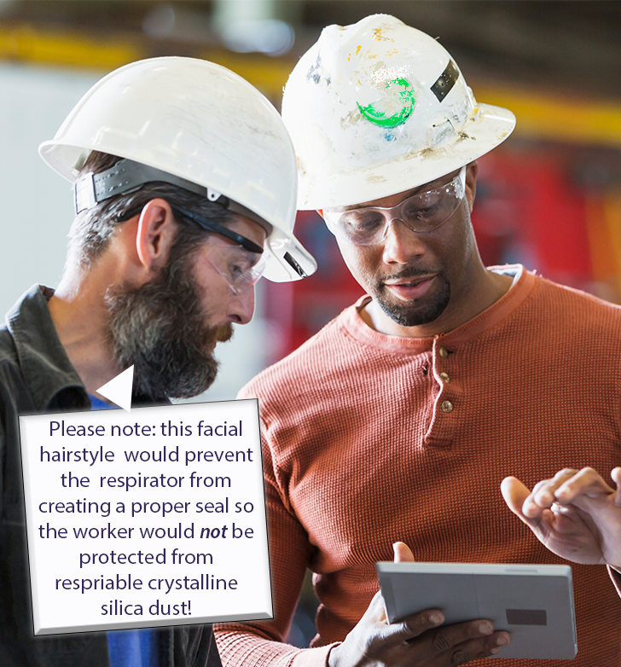
5. Methods of Compliance
The silica standard requires a written exposure plan and implementation of engineering or work practice controls to bring the respirable crystalline silica exposure down to the PEL, or to the lowest feasible level with the supplementation of respirator use. The next two slides provide examples of both types of controls.
A written exposure plan needs to contain a description of:
Tasks that involve silica exposure in the workplace,
Engineering controls, work practices, and respiratory protection for each task, and
Housekeeping measures used.
The written plan needs to be reviewed and evaluated at least once a year, updated as needed, and available to all who need it. For employees engaged in construction activities or using methods allowed in Table 1, the designated competent person must regularly inspect job sites, materials, and equipment to implement the written exposure control plan and make corrections when necessary.
Module 4: protecting workers

Slide 47
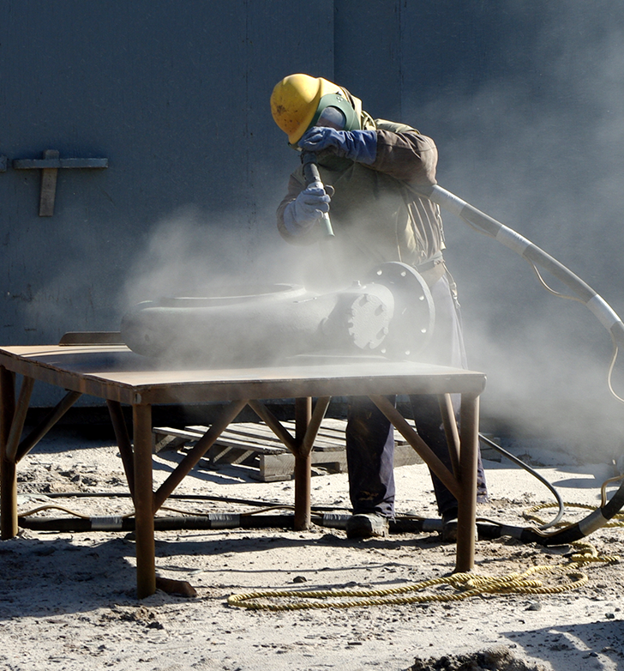
Examples of Engineering Controls
Hazard controls are planned methods of completing tasks in ways that reduce or eliminate employees’ exposure to silica, including engineering controls. Some controls are quite simple, while others require more involvement. A few examples are:
Substitute silica sand with a wide range of silica-free abrasives for abrasive blasting.
Use building materials that do not contain crystalline silica.
Use shears instead of saws when cutting fibrous cement siding.
Use powered tools with manufacturer-approved integrated water delivery or dust collection systems. (See next slides for video examples!)
More than one control measure may be necessary to protect workers from silica exposure.
Module 4: protecting workers

Slide 48
Video: EXAMPLE OF MASONRY SAW WITH INTEGRATED WATER DELIVERY SYSTEM
Module 4: protecting workers

Slide 49
Examples of Work Practice Controls
Work practice controls, also known as administrative controls, are changes in work procedures with the goal of reducing the duration, frequency, and severity of exposure to silica. This is accomplished through written safety policies, rules, supervision, schedules, and training. Some examples of work practice controls include:
Scheduling shifts to minimize the number of employees exposed during tasks that result in silica exposure,
Making policies to require washing hands and changing clothes after handling silica-containing materials,
Adding surveillance to ensure tools and work processes are preventing visible airborne crystalline silica dust,
Implementing housekeeping practices to keep the worksite clean and free of silica dust, and
Using signs and labels.
Module 4: protecting workers

Slide 50
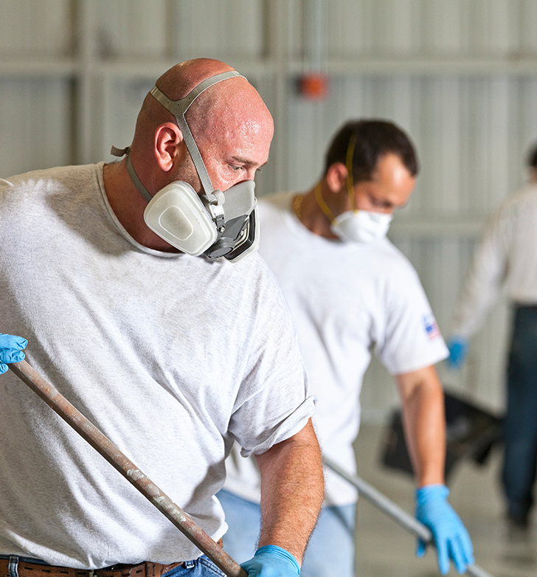
6. Respiratory Protection
Employers must provide workers with appropriate respirators that comply with this Oregon OSHA rule and the Federal OSHA respiratory protection rule. Respiratory protection is required when:
Exposures exceed the permissible exposure limit (PEL) during installation or implementation periods of engineering and work practice controls,
Exposures exceed the PEL during maintenance and repair tasks,
Engineering and work practice controls have been implemented but are still not enough to reduce the respirable crystalline silica exposures below the PEL,
Respirators are specified in Table 1, and
An employee is in a regulated area.
Remember, there are many types of respirators, from nose and mouth covering to a full-face respirator.
Module 4: protecting workers

Slide 51
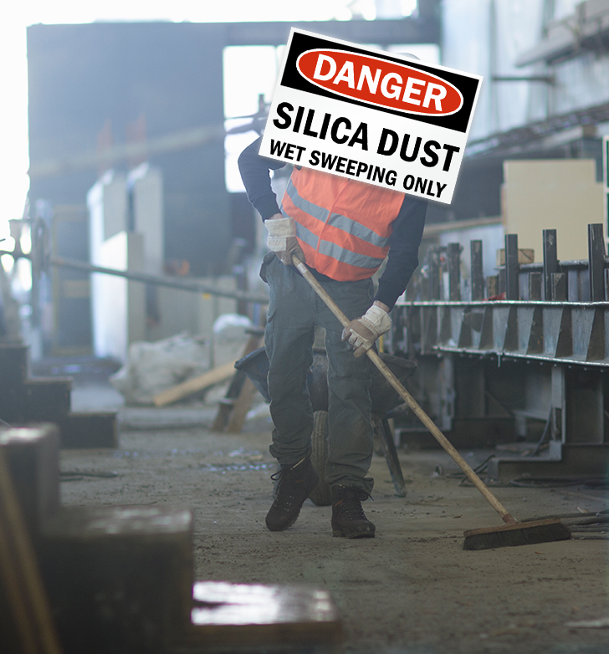
7. Housekeeping
Employers covered under the silica rule scope 437-002-1053 must follow these housekeeping requirements:
Do not allow dry sweeping or dry brushing, unless other methods are not feasible.
Do not allow cleaning with compressed air where those activities could contribute to airborne respirable crystalline silica dust exposure, unless it is with a system that effectively captures the dust created by the compressed air, or no other method is feasible.
Module 4: protecting workers

Slide 52
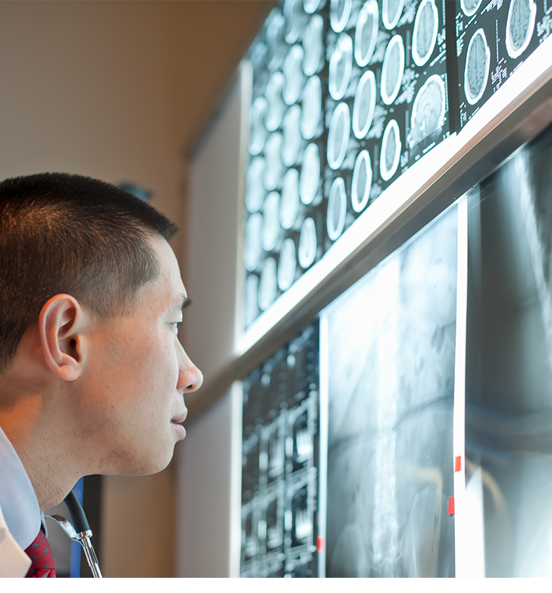
8. Medical Surveillance
The Silica standard requires that medical surveillance is available, at no cost, to each employee who is:
- Occupationally exposed to silica at or above the action level (25 µg/m3) for 30 or more days a year, or
- Engaged in construction-like activities and uses a respirator for 30 or more days a year.
There are many important requirements within the medical surveillance component including the examination, the details contained in the written reports from a physician, and the communication between physician and employee. See rule 437-002-1062 for the complete details.
Module 4: protecting workers

Slide 53
9. Communication of Silica Hazards (I)
Your company or employer should already have a program in place for communicating hazards to employees to comply with the federal hazard communication standard (HCS) 1900.1200.
The Oregon-OSHA Silica standard requires that silica hazards are included in your existing HCS program. Each employee must have access to safety data sheets (we’ll cover this in an upcoming slide), container labels, and training to comply with the HCS and Silica requirements, and the following four hazards, at minimum, must be addressed:
Cancer
Lung effects
Immune system effects
Kidney effects
Module 4: protecting workers

Slide 54
9. Communication of Silica Hazards (II)
In addition to the information discussed on the previous slide, each employee should have access to a copy of the Silica rule and be able to demonstrate knowledge and understanding of:
Health hazards associated with respirable crystalline silica exposure,
Specific workplace tasks with silica exposure,
Specific controls implemented by the employer,
Subdivision Z Silica rule,
Medical surveillance program, and
When a “competent person” is required and the identity of the designated competent person.
Module 4: protecting workers

Slide 55
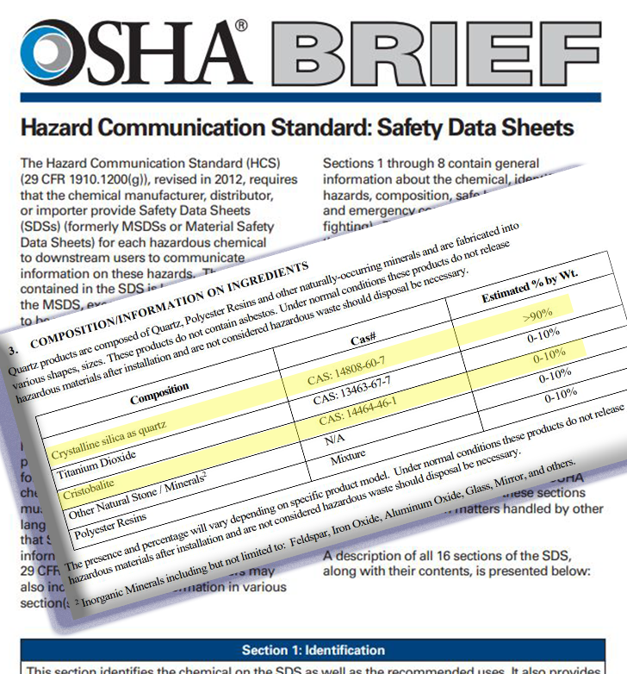
Safety Data Sheets
A Safety Data Sheet (SDS) is required from the manufacturer, distributor, or importer of hazardous materials to communicate hazards to the users. SDS’s have 16 sections and follow a standard format for all materials; this makes it easy to locate the information quickly. To help you get familiar with it, here are four sections that are frequently referenced:
Section 1: Identifies the product, the usage recommendations and restrictions.
Section 2: Provides precautionary and hazard statements including “May cause cancer (inhalation)”.
Section 3: Lists the ingredients’ information and composition percentages. In the example to the left, the product has two types of silica listed: quartz and cristobalite.
Section 8: Provides guidance for exposure controls and personal protective equipment.
More information about each section of the safety data sheet can be found on the SDS fact sheet.
Module 4: protecting workers

Slide 56
10. Recordkeeping
Employers must maintain accurate records of all exposure measurements and must include specific information such as date of measurement, tasks monitored, sampling methods used, the lab that performed the analysis, and names of all employees who were monitored.
Records of objective data must include the crystalline silica-containing material, the source of the objective data, the testing protocol and results, a description of the process or task on which the data was based, and any other relevant information.
Medical surveillance records must include the employee’s name, a copy of the information that was provided to the physician and specialist, and the written medical opinions from the physician and specialist.
Module 4: protecting workers

Slide 57
Enforcement
Due to the severity of the health hazards caused by respirable crystalline silica exposure, Oregon OSHA has silica in its “Local Emphasis Program.” Compliance officers are always on the lookout to ensure worksites are following the silica standards so workplace incidents involving silicosis are reduced and eliminated.
Oregon OSHA may inspect for silica hazards:
When there is visible dust and employees appear to be inadequately protected (for example, during construction or demolition).
During a scheduled inspection.
During “Local Emphasis Program: Silicosis” inspections.
Based on complaints or referrals.
Module 4: protecting workers

Slide 58
Conclusion
If you think you have contact with silica in your workplace, ask the following questions:
Has your workplace been evaluated?
Has your work practice been evaluated?
Do you have protections in place?
Has your protection been assessed?
Don’t know the answers to those questions? Call Oregon OSHA at 800-922-2689 or reach out to your workers compensation insurance carrier.
Module 4: protecting workers

Slide 59
Module 5: Conclusion
SILICA SAFETY

Slide 60
Module 5: conclusion
SILICA SAFETY Quiz
Question 1: What does PEL stand for?
Protective Emission Limit
Preserved Exposure Level
Permissible Exposure Limit
Provisional Emission Layer
Question 2: What is the unit of measure for the silica PEL?
Millimeters
Minutes
Milligrams
Micrograms

Slide 61
SILICA SAFETY Quiz
Question 3: What is the action level for silica exposure in an 8-hour day?
25 micrograms/cubic meter of air
35 micrograms/cubic meter of air
50 micrograms/cubic meter of air
75 micrograms/cubic meter of air
Question 4: What is the permissible exposure limit for crystalline respirable silica?
75 µg/m3 in an 8-hour TWA day
50 µg/m3 in an 8-hour TWA day
25 µg/m3 in an 8-hour TWA day
10 µg/m3 in an 8-hour TWA day
Module 5: conclusion

Slide 62
SILICA SAFETY Quiz
Question 5: What are three common forms of silica?
Quartz
Gold
Tridymite
Cristobalite
Question 6: What are some of the health hazards associated with respirable crystalline silica dust exposure that were discussed in this training?
Silicosis
Tuberculosis
COPD
Kidney disease
Module 5: conclusion

Slide 63
SILICA SAFETY Quiz
Question 7: Symptoms of silicosis may include: (select all that apply)
Difficulty breathing
Coughing
Weight loss
Weakness
Question 8: Hazard controls help minimize or eliminate respirable crystalline silica dust exposure. Which of the choices would minimize or eliminate silica dust exposure?
Using shears instead of power saws to cut fibrous cement siding.
Using power tools with integrated water delivery systems.
Dry sweeping.
Using materials which do not contain silica.
Module 5: conclusion

Slide 64
SILICA SAFETY Quiz
Question 9: Common building materials that can contain silica are: (select all that apply)
Lumber
Bricks
Granite
Ceramic tile
Question 10: If you are unsure if the material you are working with contains silica, you should check the label and the __________.
safety data sheet (SDS)
shipping receipt
manufacturer’s warranty
billing invoice
Module 5: conclusion

Slide 65
SILICA SAFETY Quiz
Question 11: Oregon OSHA has qualified people who can provide silica exposure assessments at your workplace.
True
False
Module 5: conclusion

Slide 66
SILICA SAFETY Quiz - Answers
C
D
A
B
A, C, D
A, B, C, D
A, B, C, D
A, B, D
9) B, C, D
10) A
11) A
Module 5: conclusion
Notes:
Answers

Slide 67
Where To Go From Here
An excellent resource to utilize is the A-Z Topic Index on the Oregon OSHA website. It has lists of relevant publications, training materials, rules, interpretations, videos, and other miscellaneous materials.
If you want guidance in developing a safer work environment, you may consider our free and confidential consultation service. Our consultants in workplace health and safety can help you reduce accidents, related costs, and help you develop a comprehensive program to manage safety and health. For more information, please visit the consultation page.
File a Complaint
A-Z Topic Index
Consultation Services
Silica Resources
Module 5: conclusion

Slide 68
Module 5: conclusion

Slide 69
Credits
You’ve completed the Silica Safety course!
Produced by the Public Education Team of Oregon OSHA:
Roy Kroker, Tammi Stevens, Phillip Wade, Ricardo Rodríguez, Angelina Cox, and Tim Wade
Stock Images provided by: Getty Images Inc.
Module 5: conclusion

