Slide 1



WALKING-WORKING SURFACES
Module 1: Introduction
Please note: If the online course contains videos, the video links are included in this PPT.
You will need to have an internet connection to play the videos or
you can download the videos and embed them into your copy of this PPT presentation.

Slide 2


Disclaimer
Completing this course will help you understand the rules and some of the hazards related to walking-working surfaces. However, it is your employer’s responsibility to further your training where it is specific to your organization, such as permits, policies, and practices. This material should not be considered a substitute for any provisions of the Oregon Safe Employment Act, or for any standards issued by Oregon OSHA. Manufacturers, products, or services displayed in this material are for informational purposes only and do not constitute an endorsement by Oregon OSHA.
WALKING-WORKING SURFACES: introduction

Slide 3
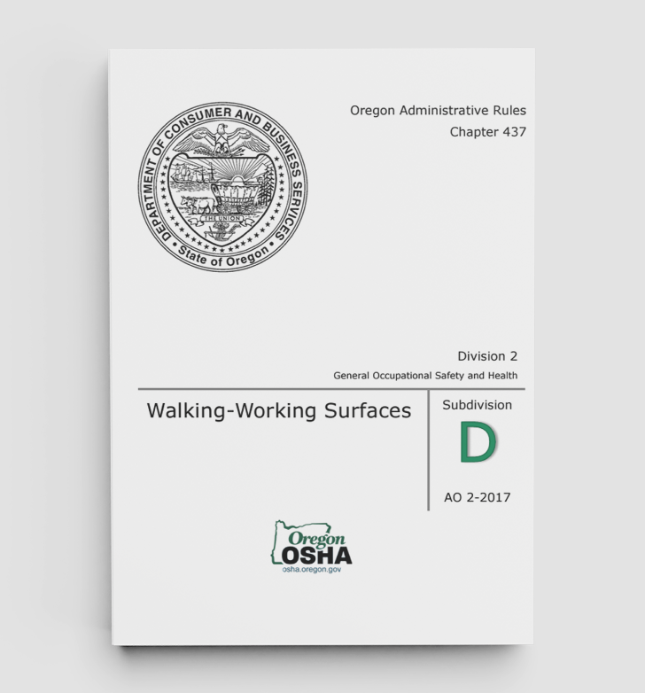
Introduction
Welcome to Walking-Working Surfaces! A walking-working surface is any horizontal or vertical surface on or through which an employee walks, works, or gains access to a work area or workplace location. This course provides a comprehensive overview of key aspects of the walking-working surfaces rules and solutions to alleviate related hazards. Oregon OSHA adopted Federal OSHA’s national rules for walking-working surfaces in the Division 2 General Industry standard (Division 2, Subdivision D) in May of 2017. These rules apply to walking-working surfaces (WWS) in all general industry workplaces in Oregon and cover a wide range of requirements. This includes ladders, ramps and runways, step bolts, manhole steps, stairways, dockboards, scaffolding, and fall protection systems.
WALKING-WORKING SURFACES: introduction
Notes:
https://osha.oregon.gov/OSHARules/div2/div2D.pdf

Slide 4

Construction Activities
It’s important to note that WWS rules adopted in May of 2017 do not cover construction activities, as those requirements are housed in the Division 3 Construction standard (Division 3, Subdivision M, Subdivision L, and Subdivision X). There are differences between the requirements for general industry and construction activities. If you would like to learn more about this, we recommend taking another online course titled “Fall Protection in Construction”. Finally, the WWS rules for agricultural operation in Division 4 were not amended by the May 2017 general industry WWS rule adoption.
In this first module we’ll cover who is affected, fall protection trigger heights, and the general requirements.
Let’s get started!
WALKING-WORKING SURFACES: introduction
Notes:
https://osha.oregon.gov/OSHARules/div3/div3m.pdf
https://osha.oregon.gov/edu/courses/Pages/fall-protection-construction.aspx

Slide 5
Video: What is a WWS?
WALKING-WORKING SURFACES: introduction
Notes:
https://vimeo.com/1047335647/99ff4f389a

Slide 6

Surface Conditions
The employer must ensure:
All places of employment, passageways, storerooms, service rooms, and walking-working surfaces are kept in a clean, orderly, and sanitary condition.
The floor of each workroom is maintained in a clean and, to the extent feasible, in a dry condition. When wet processes are used, drainage must be maintained and, to the extent feasible, dry standing places, such as false floors, platforms, and mats must be provided.
Walking-working surfaces are maintained free of hazards such as sharp or protruding objects, loose boards, corrosion, leaks, spills, snow, and ice.
WALKING-WORKING SURFACES: introduction

Slide 7
Video: Who is Affected
WALKING-WORKING SURFACES: introduction
Notes:
https://vimeo.com/864569783/035f0e1fdd

Slide 8
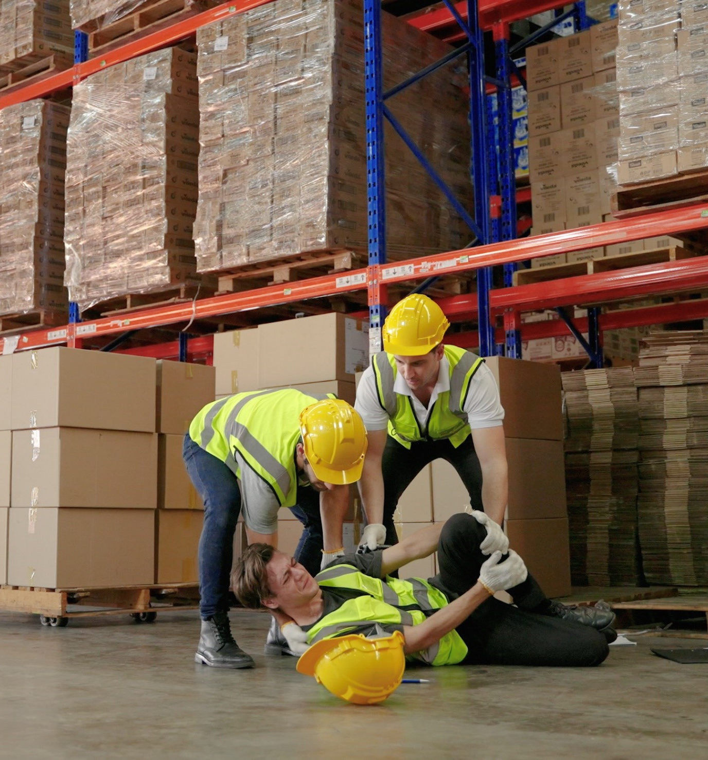
Surface Conditions
Falls from heights and to the same level (a working surface) are among the leading causes of serious work-related injuries and deaths. The Bureau of Labor Statistics reported that in 2021-2022, approximately 450,540 serious injuries (lost-workday) occurred to U.S. workers directly affected by the rules for walking-working surfaces. For more information, please visit the Bureau of Labor Statistics webpage.
WALKING-WORKING SURFACES: introduction
Notes:
https://www.bls.gov/iif/latest-numbers.htm

Slide 9
Video: Inspection/Maintenance
WALKING-WORKING SURFACES: introduction
Notes:
1. https://vimeo.com/994225613/fceb3d9ff5

Slide 10
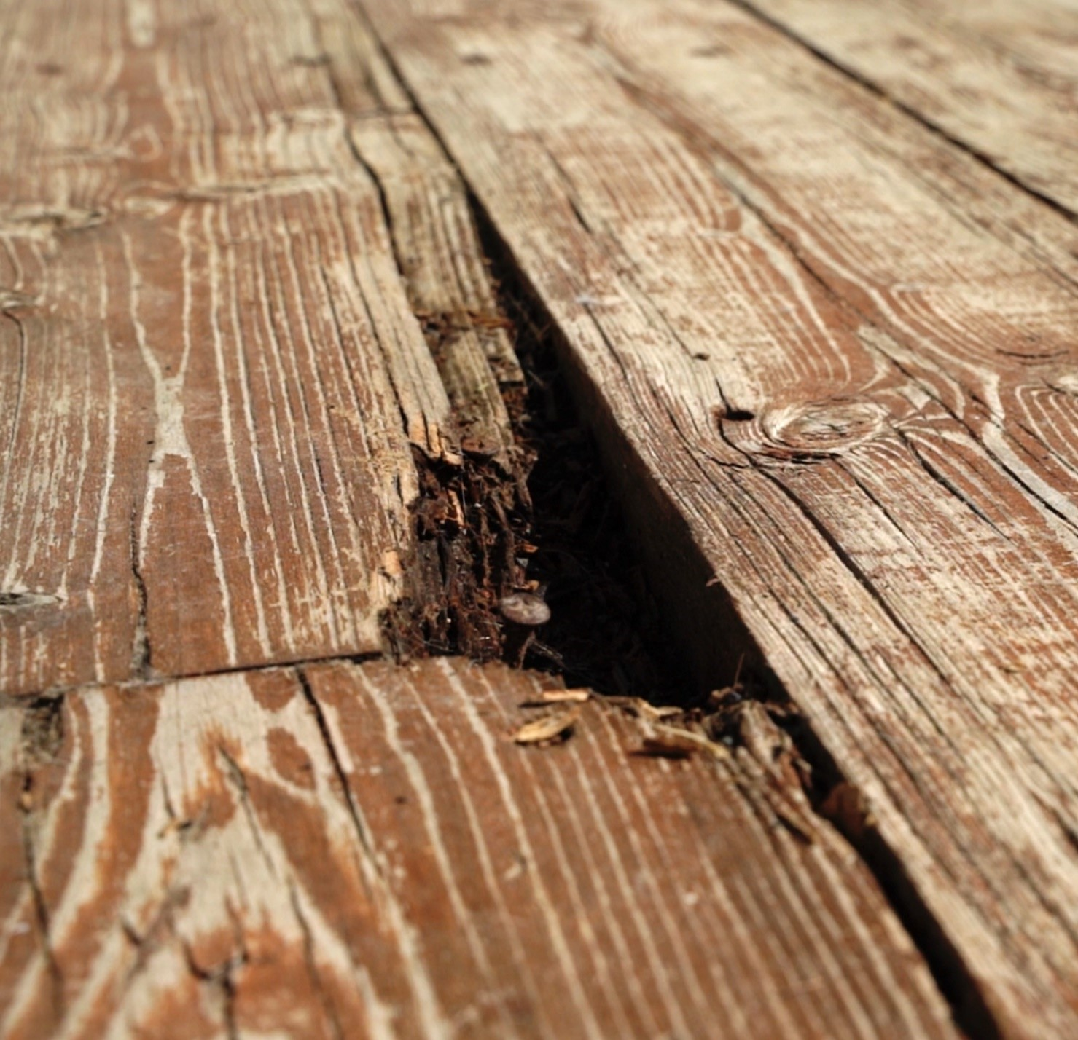
Inspection, Maintenance, & Repair
Employers must ensure:
Walking-working surfaces are inspected, regularly and as necessary, and maintained in a safe condition.
Hazardous conditions on walking-working surfaces are corrected or repaired before an employee uses the walking-working surface again. If the correction or repair cannot be made immediately, the hazard must be guarded to prevent employees from using the walking-working surface until the hazard is corrected or repaired.
When any correction or repair involves the structural integrity of the walking-working surface, a qualified person performs or supervises the correction or repair.
WALKING-WORKING SURFACES: introduction

Slide 11
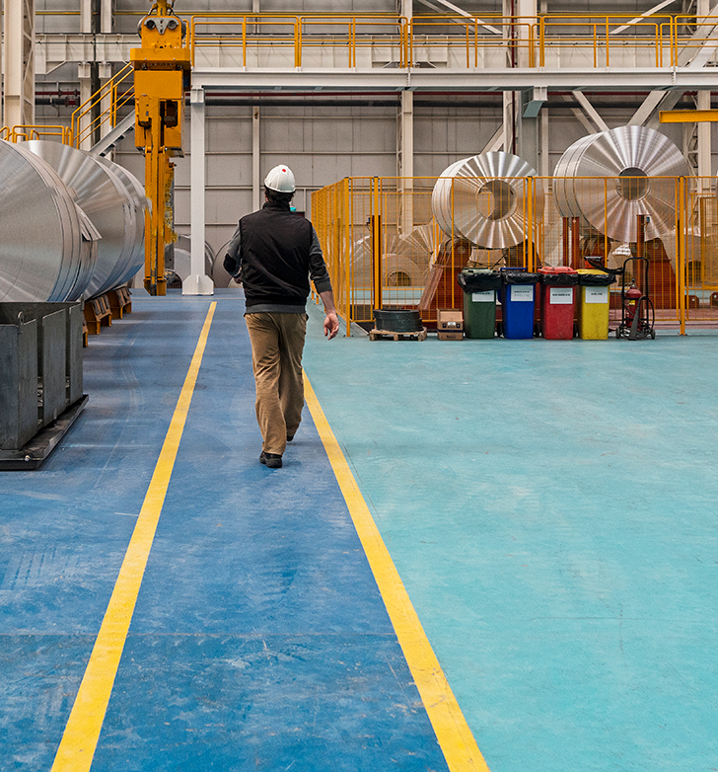
Additional Oregon Requirements
Employers must ensure:
Aisles, passageways, and walkways are of adequate width for their intended or actual use, and in no event shall they be less than 22 inches wide.
Aisles, passageways, walkways, and inclines are maintained free of holes, unevenness, or any unnecessary obstructions or debris that may create a hazard.
WALKING-WORKING SURFACES: introduction
Notes:
https://osha.oregon.gov/OSHARules/div2/div2D.pdf

Slide 12
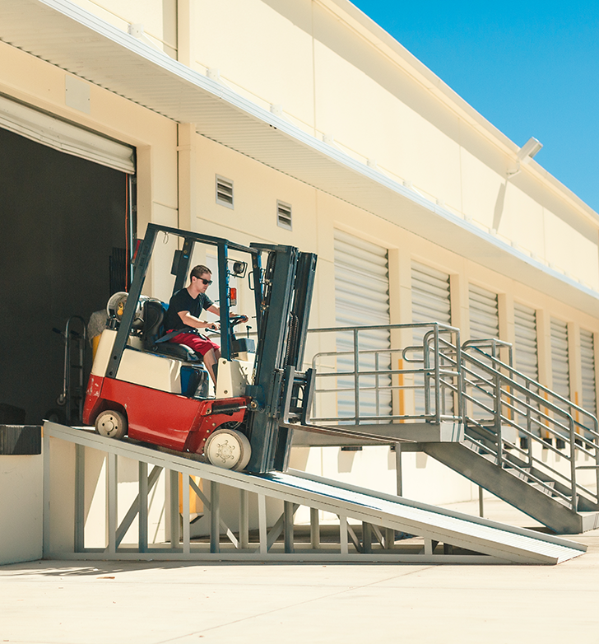
Additional Oregon Requirements
Additional Oregon requirements for walking-working surfaces include:
(437-002-0022) Protective barriers; provisions for safety in plant design, layout, and operation; and requirements for aisles, passageways, walkways, and inclines.
(437-002-0032) Ramp and runway requirements for vehicles. This is covered in the next module.
(437-002-0033) Piers and wharves requirements.
Please take a moment to review these Oregon-specific requirements.
WALKING-WORKING SURFACES: introduction
Notes:
https://osha.oregon.gov/OSHARules/div2/div2D.pdf#page=13
https://osha.oregon.gov/OSHARules/div2/div2D.pdf#page=14
https://osha.oregon.gov/OSHARules/div2/div2D.pdf#page=15

Slide 13
Knowledge Check - Module 1
Question 1: A walking-working surface is defined as “... any horizontal or vertical surface on or through which an employee walks, works, or gains access to a work area or workplace location.”
True
False
Question 2: All places of employment, passageways, storerooms, service rooms, and walking-working surfaces must be kept in a:
clean, orderly, and sanitary condition.
Clean and standard fashion.
Clean and marked area.
WALKING-WORKING SURFACES: introduction

Slide 14
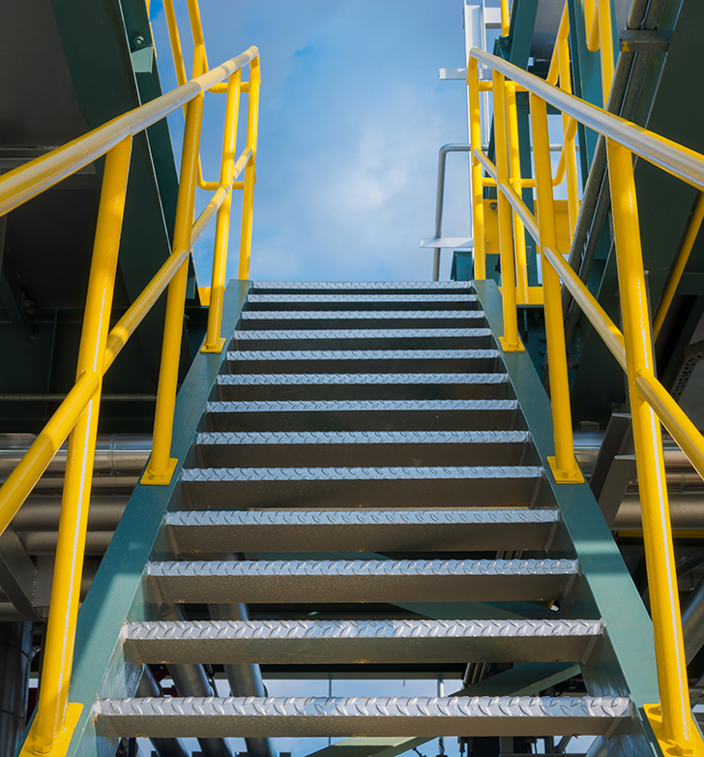
Conclusion
You’ve completed module 1! The general industry Walking-Working Surfaces rules cover a wide range of employers and workplaces. In addition to this course, we recommend that you review the rules (Division 2, Subdivision D) for a complete understanding of the requirements.
WALKING-WORKING SURFACES: introduction
Notes:
https://osha.oregon.gov/OSHARules/div2/div2D.pdf

Slide 15
Module 2: Fall Protection Systems
WALKING-WORKING SURFACES

Slide 16


Introduction
Welcome to module 2! In this section we will cover fall protection systems. These items include:
General requirements
Guardrail systems
Handrail and stair rail systems
Safety net systems
Designated areas
Covers
Ladder safety systems
Personal fall protection systems
Grab handles
Let’s get started!
WALKING-WORKING SURFACES: fall protection systems

Slide 17

Fall Protection
Oregon OSHA’s general industry standards require employers to identify the potential for falls in the workplace and establish appropriate fall protection when they identify fall hazards. These measures and equipment are designed to prevent injuries or fatalities caused by falls, particularly in workplaces where people work at heights. If you would like to follow along in the rule, please reference 1910.29.
WALKING-WORKING SURFACES: fall protection systems

Slide 18
Video: What is Fall Protection?
WALKING-WORKING SURFACES: fall protection systems

Slide 19
Video: Trigger Heights
WALKING-WORKING SURFACES: fall protection systems

Slide 20
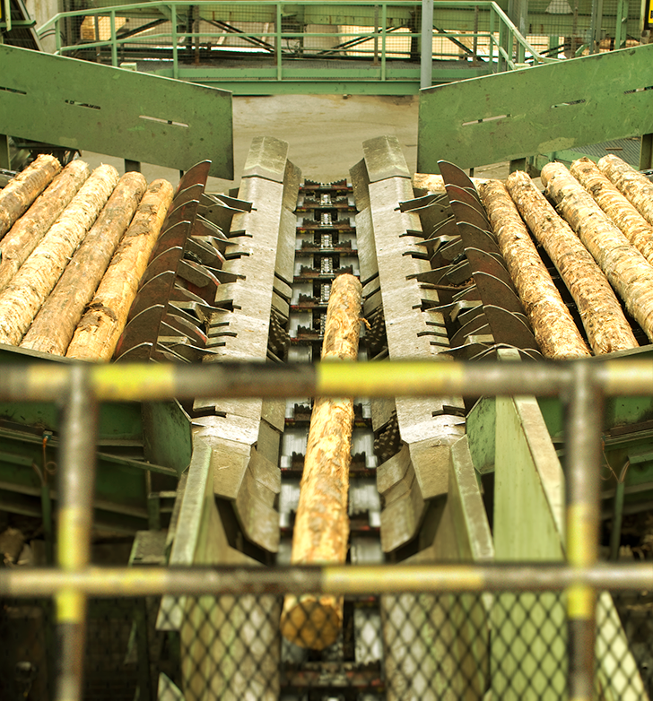
Trigger Heights
Four feet above the ground or a lower level is widely recognized among general industry employers as the “trigger height” that requires you to take action to protect your employees from fall hazards.
Please note that many general industry site specific situations have trigger heights that differ from four feet. Working above or adjacent to dangerous equipment requires action to protect employees from falls onto that equipment, regardless of height, while scaffolds have fall protection trigger heights above four feet. To learn more about trigger heights for your specific environment, please reference 1910.28 and this Oregon OSHA fact sheet.
WALKING-WORKING SURFACES: fall protection systems
Notes:
https://osha.oregon.gov/OSHARules/div2/div2D.pdf#page=53
https://osha.oregon.gov/OSHAPubs/factsheets/fs58.pdf

Slide 21

General Requirements
The employer must:
Ensure that all required fall protection systems identified in 1910.28(b)(1) through 1910.28(b)(15) meet the specified requirements found in 1910.29.
Be responsible for providing, installing, and adhering to all fall protection systems and requirements before any employee starts work that involves fall or falling object risks.
WALKING-WORKING SURFACES: fall protection systems
Notes:
https://osha.oregon.gov/OSHARules/div2/div2D.pdf#page=44

Slide 22
Video: Guardrails, Handrails, and Stair Rails
WALKING-WORKING SURFACES: fall protection systems

Slide 23
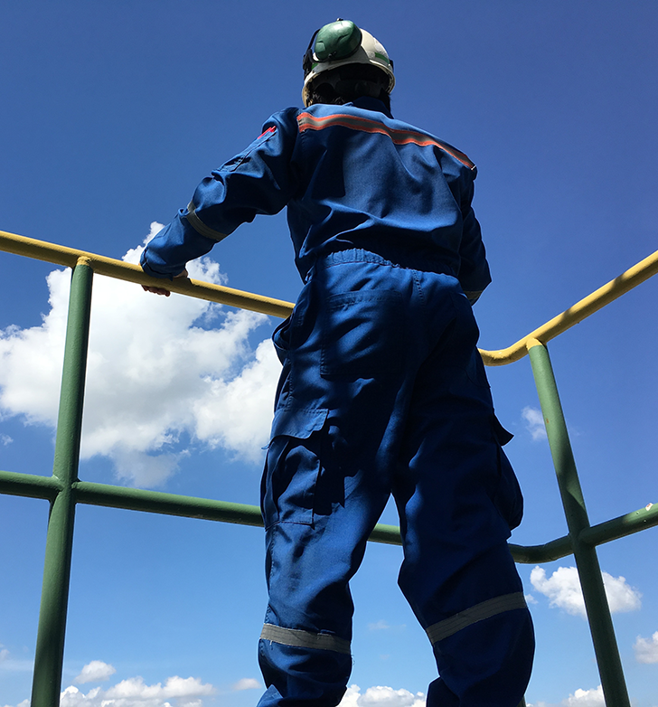
Guardrail Systems
In general industry environments, guardrail systems are a primary form of fall protection used to prevent workers from falling off elevated surfaces such as platforms, walkways, and openings. Guardrail systems are defined as:
“...a barrier erected along an unprotected or exposed side, edge, or other area of a walking-working surface to prevent employees from falling to a lower level.”
These systems consist of top rails, midrails, and sometimes toeboards, designed to withstand specific force requirements. Guardrails are a preferred method of fall protection as they offer passive safety without requiring worker interaction. In the next slide we’ll briefly summarize some of the requirements found in the rules.
WALKING-WORKING SURFACES: fall protection systems

Slide 24
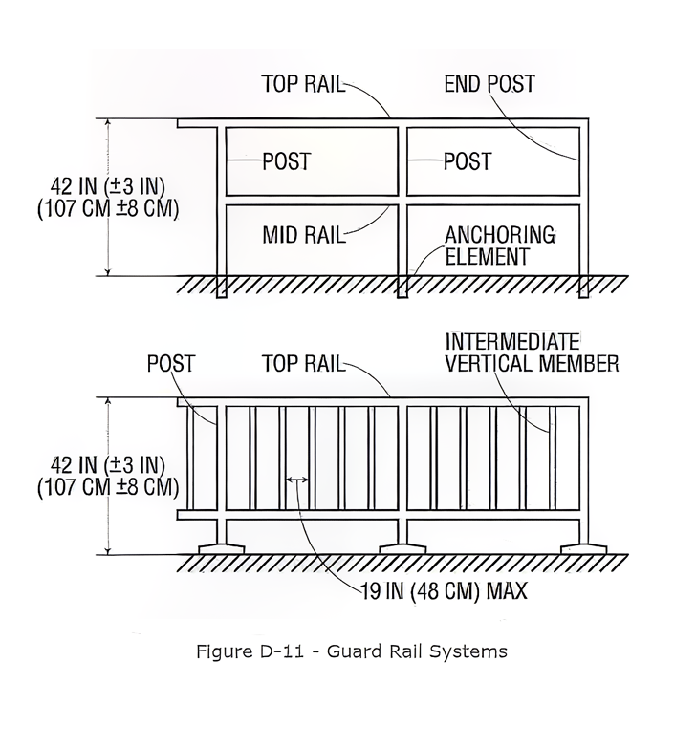
Guardrail Requirements
Under 1910.29(b), employers must ensure guardrail systems meet the following general standards, which have been summarized below:
Height (b)(1). Top rails must be installed at least 39 inches above the walking-working surface.
Intermediate protection (b)(2). Where no sufficiently tall wall or parapet exists, midrails, screens, mesh, balusters, or equivalent members must close the gap between the top rail and the surface, spaced within set limits.
Strength (b)(3)–(5). Guardrails and intermediate members must withstand specified minimum forces without failing or dropping below 39 inches.
Construction (b)(6)–(9). Rails must be smooth, free of hazardous projections, sufficiently thick, and not made of banding material.
Special locations (b)(10)–(14). Additional requirements apply to guardrails at hoist areas, around holes, and along ramps and runways.
Inspection (b)(15). Rope-based rails must be periodically inspected to confirm they still meet strength requirements.
For more information about these requirements for guardrail systems in general industry workplaces, please reference this Oregon OSHA factsheet.
WALKING-WORKING SURFACES: fall protection systems
Notes:
https://osha.oregon.gov/OSHARules/div2/div2D.pdf#page=53
https://osha.oregon.gov/OSHAPubs/factsheets/fs04.pdf

Slide 25

Handrail and Stair Rail Systems
1910.29 of Division 2, Subdivision D of the Oregon OSHA Walking-Working Surfaces rules outlines specific requirements for handrails and stair rail systems to ensure their safe use. Let’s start with the definitions:
“Stair rail or stair rail system means a barrier erected along the exposed or open side of stairways to prevent employees from falling to a lower level.”
“Handrail means a rail used to provide employees with a handhold for support.”
WALKING-WORKING SURFACES: fall protection systems

Slide 26

Handrails and Stair Rails System Requirements
The fall protection requirements in 1910.29(f) for handrails and stair rail systems are divided into 7 areas:
Height requirements
Finger clearance
Surface smoothness
Opening restrictions
Handhold design
Projection hazards
Strength criteria
We’ll take a closer look at these topics over the next few slides.
WALKING-WORKING SURFACES: fall protection systems

Slide 27
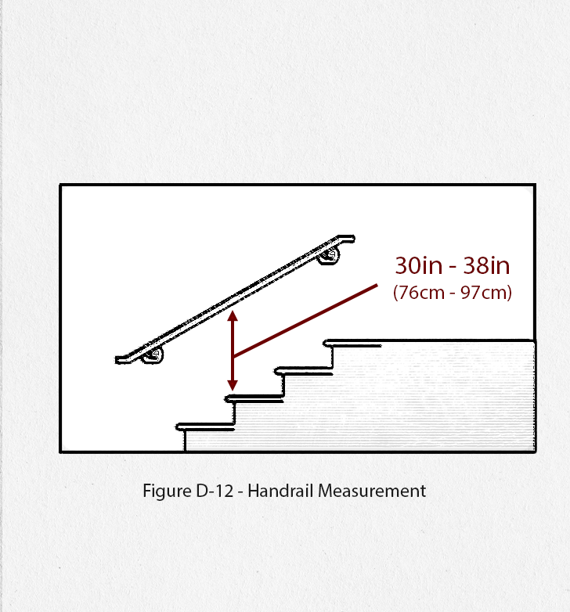
Height Requirements
The employer must ensure:
Handrails are not less than 30 inches (76 cm) and not more than 38 inches (97 cm), as measured from the leading edge of the stair tread to the top surface of the handrail (see Figure D–12).
The height of stair rail systems installed before January 1, 2018, is not less than 30 inches (76 cm) from the leading edge of the stair tread to the top surface of the top rail; and
The height of stair rail systems installed on or after January 1, 2018, is not less than 42 inches (107 cm) from the leading edge of the stair tread to the top surface of the top rail.
WALKING-WORKING SURFACES: fall protection systems

Slide 28
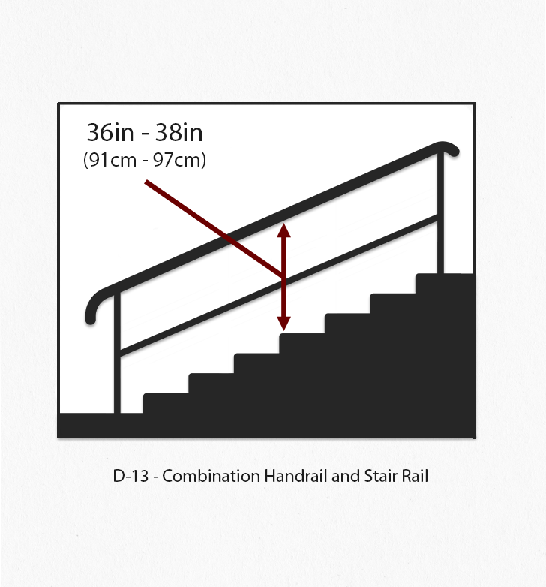
Height Requirements (continued)
The employer must ensure:
The top rail of a stair rail system may serve as a handrail only when:
(A) The height of the stair rail system is not less than 36 inches (91 cm) and not more than 38 inches (97 cm) as measured at the leading edge of the stair tread to the top surface of the top rail (see Figure D–13); and
(B) The top rail of the stair rail system meets the other handrail requirements in paragraph (f) of this section.
WALKING-WORKING SURFACES: fall protection systems

Slide 29

Handrails and Stair Rail Requirements (continued)
Finger clearance. The minimum clearance between handrails and any other object is 2.25 inches (5.7 cm).
Surfaces. Handrails and stair rail systems are smooth-surfaced to protect employees from injury, such as punctures or lacerations, and to prevent catching or snagging of clothing.
Openings in stair rails. No opening in a stair rail system exceeds 19 inches (48 cm) at its least dimension.
Handhold. Handrails have the shape and dimension necessary so that employees can grasp the handrail firmly.
Projection hazards. The ends of handrails and stair rail systems do not present any projection hazards.
Strength criteria. Handrails and the top rails of stair rail systems are capable of withstanding, without failure, a force of at least 200 pounds (890 N) applied in any downward or outward direction within 2 inches (5 cm) of any point along the top edge of the rail.
We’ve completed the handrail and stair rail systems section!
WALKING-WORKING SURFACES: fall protection systems

Slide 30
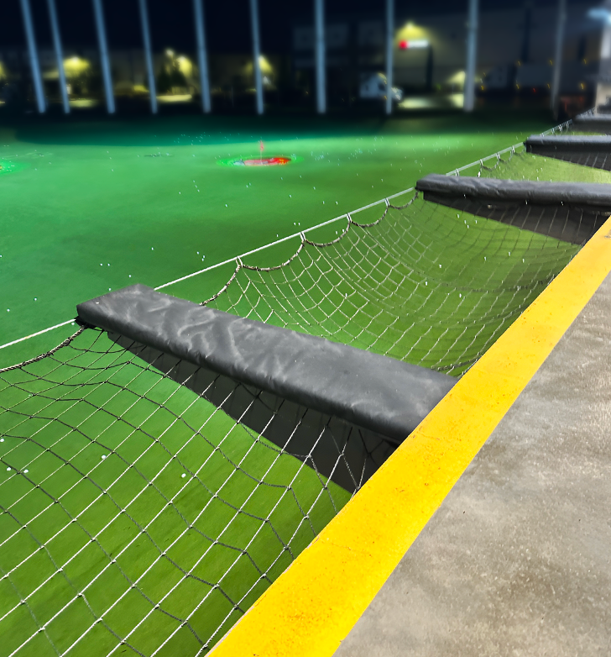
Safety Net Systems
Safety net systems are a form of fall protection designed to catch workers who fall from elevated work surfaces, preventing them from hitting the ground or other dangerous surfaces. These nets are installed below or around work areas at heights, such as on construction sites, bridges, or scaffolding. Safety nets are particularly useful in environments where guardrails or personal fall arrest systems are impractical. They must meet specific strength, durability, and installation standards to ensure they can effectively prevent injuries. For more information on this topic, please refer to 29 CFR part 1926, subpart M.
WALKING-WORKING SURFACES: fall protection systems
Notes:
https://osha.oregon.gov/OSHARules/div3/div3M.pdf#page=19

Slide 31
Video: Designated Area
WALKING-WORKING SURFACES: fall protection systems

Slide 32
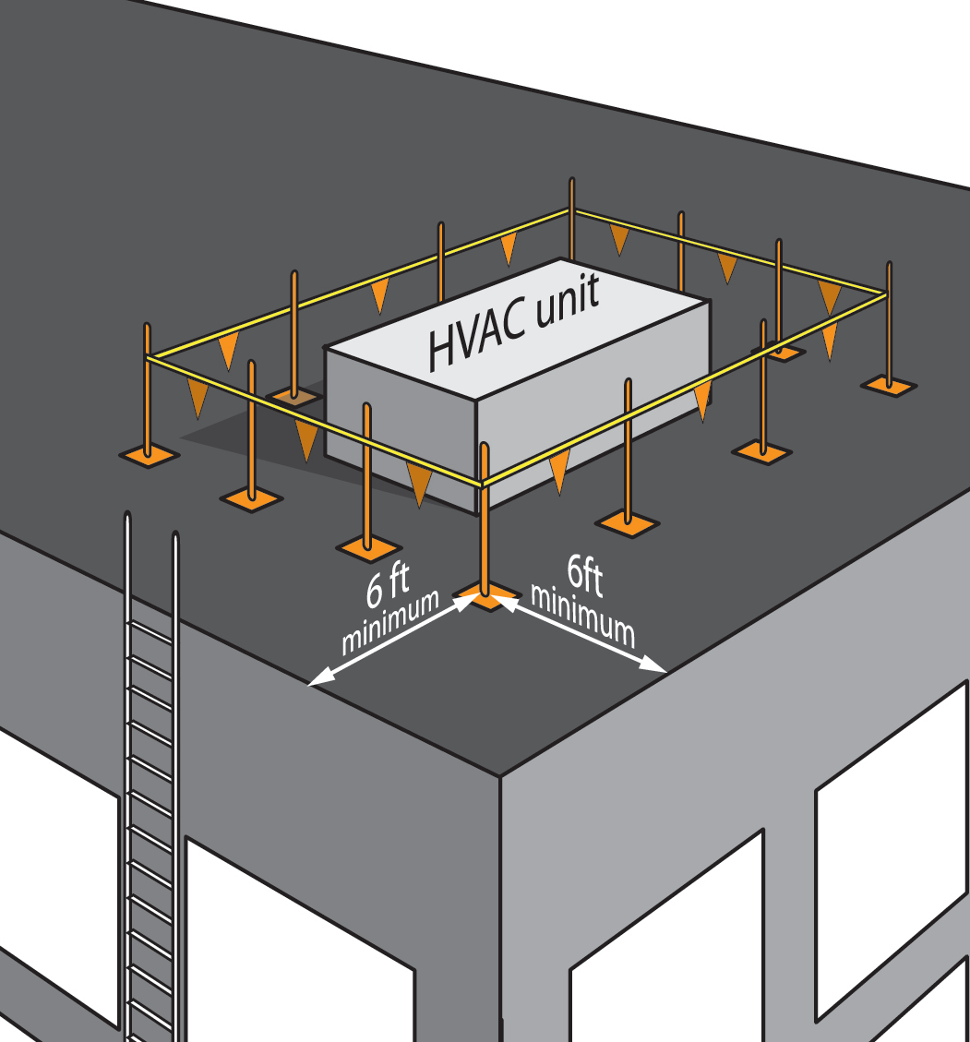
Designated Area
When employees work on a low-slope roof (a roof with a pitch of 2 in 12 or less), a non-traditional type of fall protection (the designated area) can be used in special situations. A designated area is a distinct portion of a walking-working surface delineated by a warning line in which employees may work without additional fall protection when performing work on low-slope roofs. A warning line is a rope, wire, tape, or chain that warns the employees that they are approaching an unprotected side or edge. Let’s take a look at the requirements for designated areas.
WALKING-WORKING SURFACES: fall protection systems

Slide 33
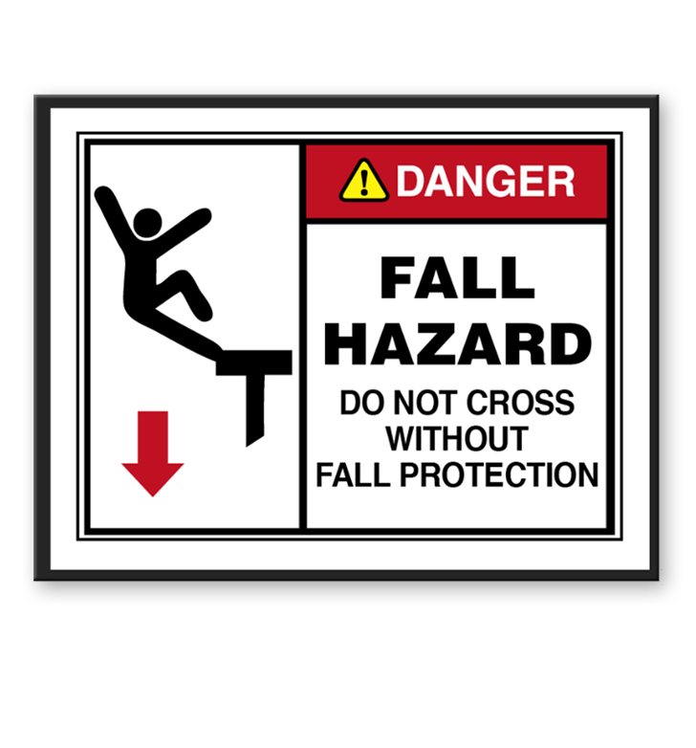
Designated Area Requirements
When the employer uses a designated area, they must ensure:
Employees remain within the designated area while work operations are underway; and
The perimeter of the designated area is delineated with a warning line consisting of a rope, wire, tape, or chain that meets the requirements of paragraphs 1910.29 (d)(2) and (3) of this section of the rule.
WALKING-WORKING SURFACES: fall protection systems
Notes:
https://osha.oregon.gov/OSHARules/div3/div3M.pdf#page=19

Slide 34
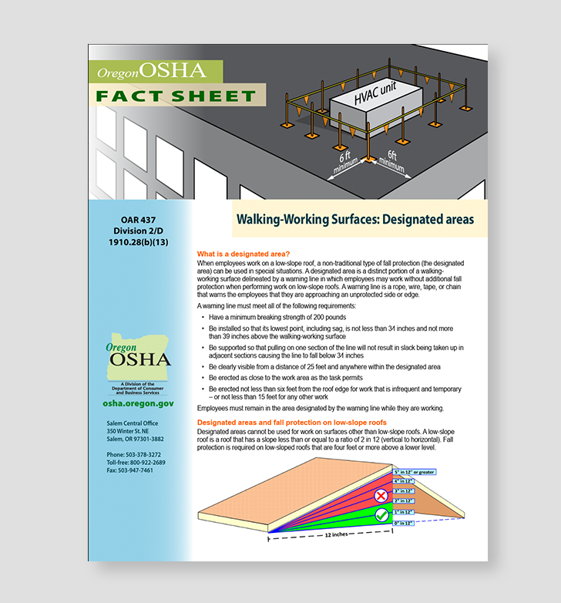
Designated Areas – Mobile Equipment
When mobile mechanical equipment is used to perform work that is both temporary and infrequent in a designated area, the employer must ensure the warning line is erected not less than 6 feet (1.8 m) from the unprotected side or edge that is parallel to the direction in which the mechanical equipment is operated, and not less than 10 feet (3 m) from the unprotected side or edge that is perpendicular to the direction in which the mechanical equipment is operated.
If you would like to learn more about designated areas, please reference the Oregon OSHA factsheet here.
WALKING-WORKING SURFACES: fall protection systems
Notes:
https://osha.oregon.gov/OSHAPubs/factsheets/fs75.pdf

Slide 35
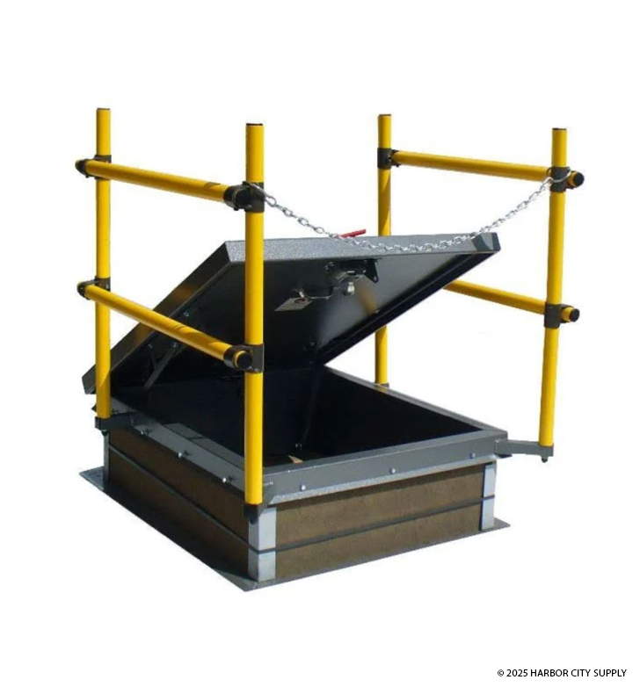
Covers
The employer must ensure each cover for a hole in a walking-working surface meets the requirements of 1910.29(e):
Is capable of supporting without failure, at least twice the maximum intended load that may be imposed on the cover at any one time; and
Is secured to prevent accidental displacement.
We’ll explain more about holes in the next module.
WALKING-WORKING SURFACES: fall protection systems
Notes:
https://osha.oregon.gov/OSHARules/div2/div2D.pdf#page=56

Slide 36
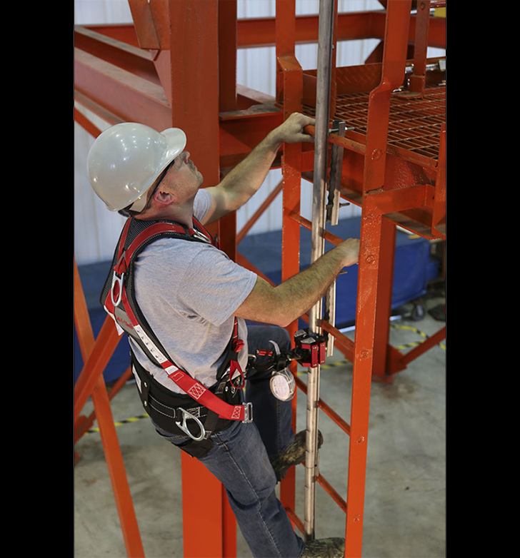
Ladder Safety Systems
Our next topic is ladder safety systems. These are defined as:
“...a system designed to eliminate or reduce the possibility of falling from a ladder. A ladder safety system usually consists of a carrier, safety sleeve, lanyard, connectors, and body harness. Cages and wells are not ladder safety systems.”
WALKING-WORKING SURFACES: fall protection systems

Slide 37
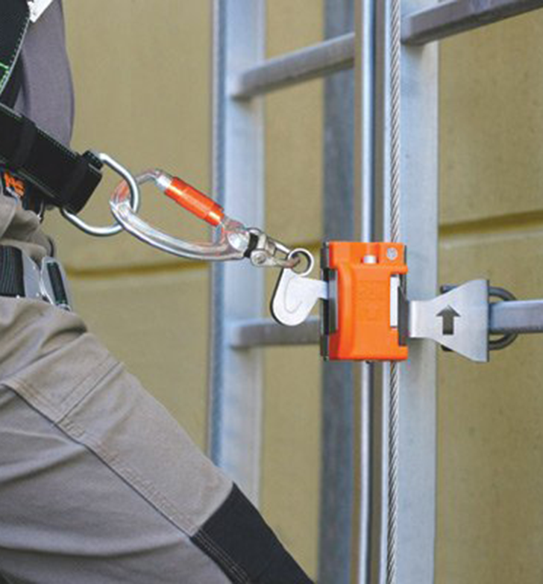
Ladder Safety Systems
The employer must ensure ladder safety systems meet the requirements in 1910.29(i):
Each ladder safety system allows the employee to climb up and down using both hands and does not require that the employee continuously hold, push, or pull any part of the system while climbing;
The connection between the carrier or lifeline and the point of attachment to the body harness or belt does not exceed 9 inches (23 cm);
Mountings for rigid carriers are attached at each end of the carrier, with intermediate mountings spaced, as necessary, along the entire length of the carrier so the system has the strength to stop employee falls;
(Continued on next slide)
WALKING-WORKING SURFACES: fall protection systems
Notes:
https://osha.oregon.gov/OSHARules/div2/div2D.pdf#page=61

Slide 38
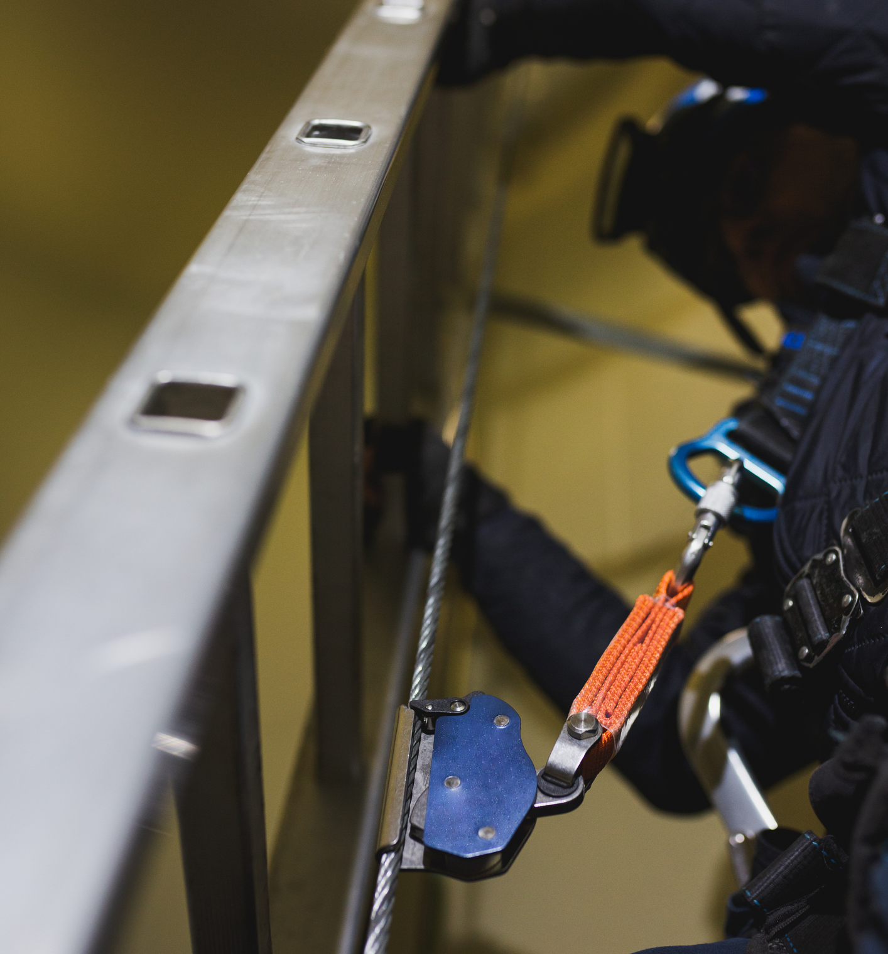
Ladder Safety Systems (continued)
The employer must ensure:
Mountings for flexible carriers are attached at each end of the carrier and cable guides for flexible carriers are installed at least 25 feet (7.6 m) apart but not more than 40 feet (12.2 m) apart along the entire length of the carrier;
The design and installation of mountings and cable guides does not reduce the design strength of the ladder; and
Ladder safety systems and their support systems are capable of withstanding, without failure, a drop test consisting of an 18-inch (41-cm) drop of a 500-pound (227-kg) weight.
We’ll discuss fixed ladders further in module 6.
WALKING-WORKING SURFACES: fall protection systems

Slide 39
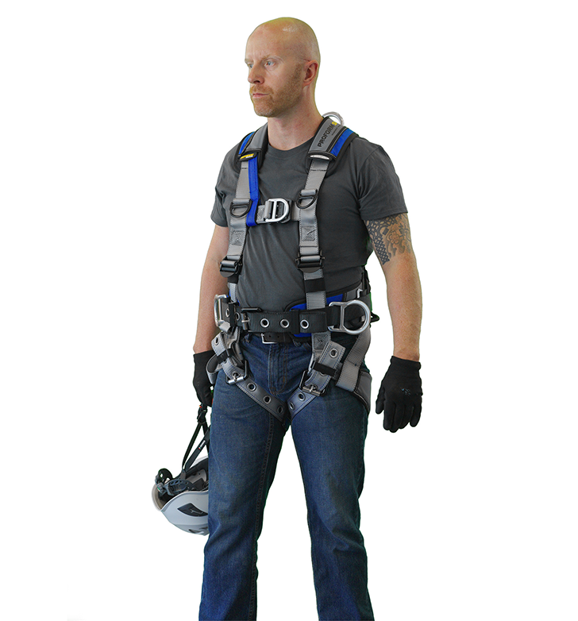
Personal Fall Protection Systems
Body belts, fully body harnesses, and other components used in personal fall arrest systems, work positioning systems, and travel restraint systems must meet the requirements of 1910.140 in the Personal Protective Equipment standard found in Division 2, Subdivision I.
For more information on personal fall protection systems, please visit our online course, Fundamentals of Fall Protection.
WALKING-WORKING SURFACES: fall protection systems
Notes:
https://osha.oregon.gov/OSHARules/div2/div2i.pdf#page=89
https://osha.oregon.gov/edu/courses/pages/fall-protection-online-course.aspx

Slide 40
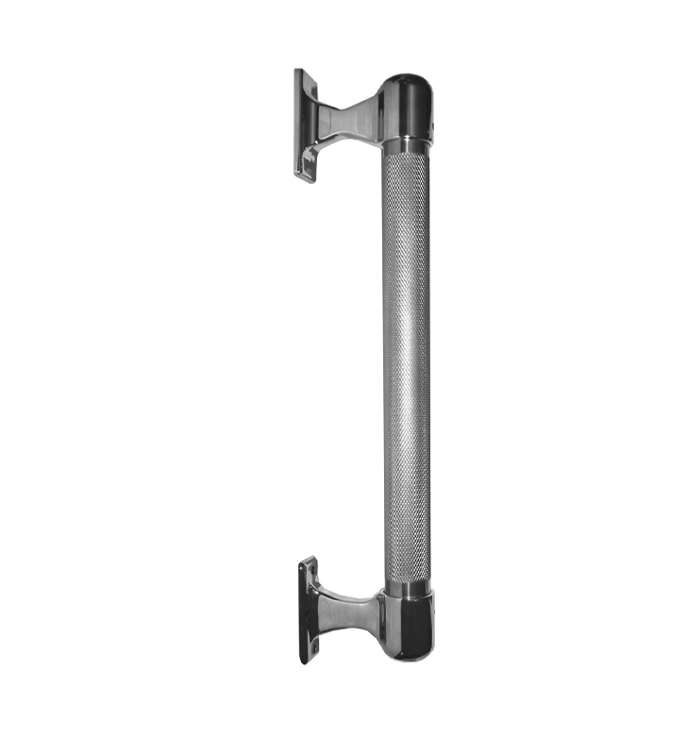
Grab Handles
Grab handles are individual horizontal or vertical handholds installed to provide access above the height of the ladder. The employer must ensure each grab handle meets the requirements in 1910.29(l):
Is not less than 12 inches (30 cm) long;
Is mounted to provide at least 3 inches (8 cm) of clearance from the framing or opening; and
Is capable of withstanding a maximum horizontal pull-out force equal to two times the maximum intended load or 200 pounds (890 N), whichever is greater.
WALKING-WORKING SURFACES: fall protection systems
Notes:
https://osha.oregon.gov/OSHARules/div2/div2D.pdf#page=62

Slide 41
Knowledge Check 1
Knowledge Check 2
Which of the following are fall protection systems (check all that apply)?
Guardrails
Covers
Personal Fall Arrest
Hoist Areas
Low-slope Roofs
In general industry, the most common trigger height where fall protection is required above a lower level is:
2 feet
4 feet
6 feet
10 feet
WALKING-WORKING SURFACES: fall protection systems

Slide 42

Module 2 Conclusion
You’ve completed module 2! Fall protection systems are designed to prevent workers from falling from elevated surfaces and typically include guardrails, personal fall protection systems such as personal fall arrest systems, travel restraint systems or positioning systems, covers, and handrails. Together, these protective strategies create a safer work environment, reducing the risk of serious injuries from falls to the same level or lower level.
In the next module, we’ll examine situations where these fall protection systems can be used to protect workers.
WALKING-WORKING SURFACES: fall protection systems

Slide 43
Module 3: Fall Hazards
WALKING-WORKING SURFACES

Slide 44
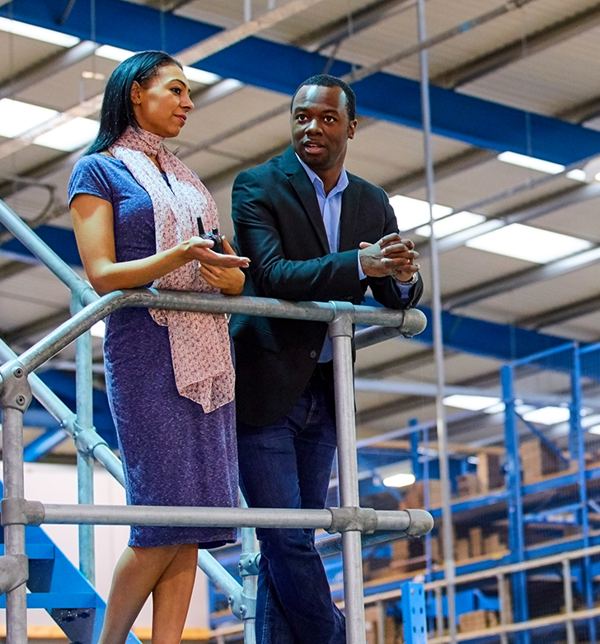

Fall Protection
In the previous module we explained the available fall protection systems for protecting workers. In this module we’ll discuss situations where employers are required to install these systems and ensure that they use them. These include:
General requirements
Unprotected sides and edges
Hoist areas
Holes
Openings
Repair pits
Outdoor advertising
Slaughtering facility platforms
Low-slope roofs
Dangerous equipment
Walking-working surfaces not otherwise addressed
Falling object protection
There are additional places where fall protection is required, which will be covered in the next few modules. If you’re following along in the rule, please reference 1910.28.
WALKING-WORKING SURFACES: fall hazards
Notes:
https://osha.oregon.gov/OSHARules/div2/div2D.pdf#page=43

Slide 45
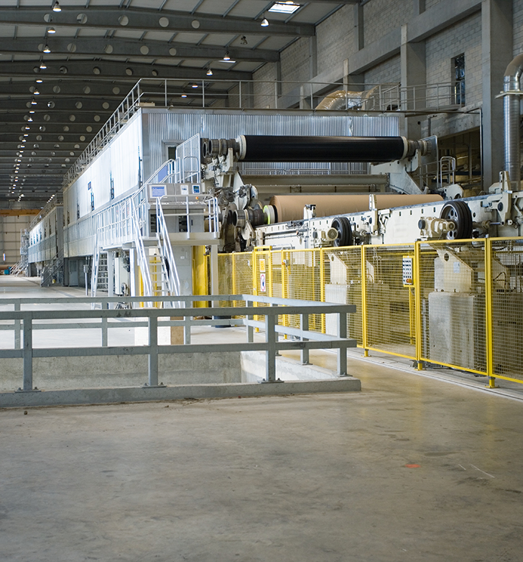
General Requirements
The Walking-Working Surfaces rule requires employers to provide protection for each employee exposed to falls and falling object hazards. The employer must ensure that all fall protection and falling object protection meets the criteria from the Walking-Working Surfaces rule.
It’s important to note that there are exceptions to these requirements, which are outlined here.
WALKING-WORKING SURFACES: fall hazards
Notes:
https://osha.oregon.gov/OSHARules/div2/div2D.pdf#page=43

Slide 46
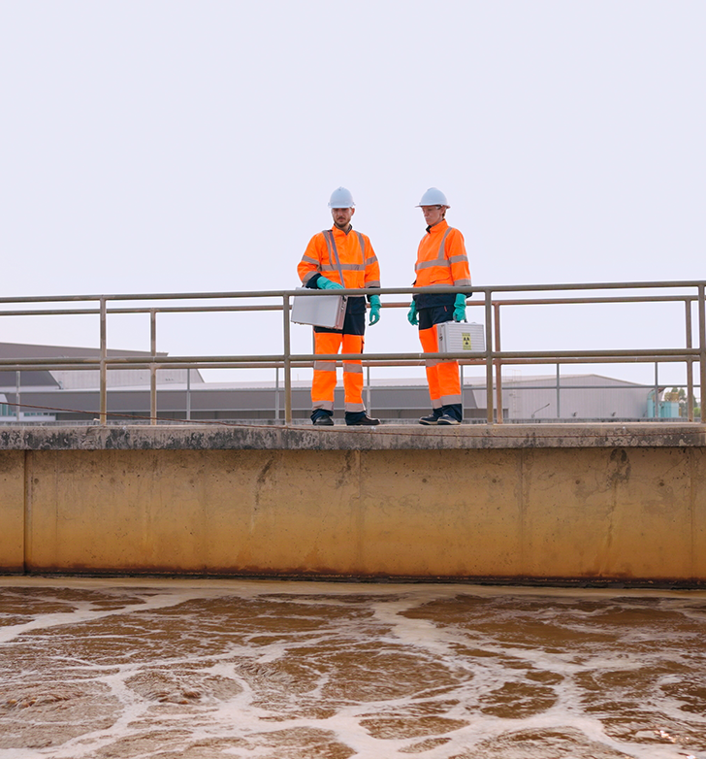
Unprotected Sides and Edges
Employers must ensure that each employee on a walking-working surface with an unprotected side or edge that is 4 feet (1.2 m) or more above a lower level is protected from falling by one or more of the following:
(A) Guardrail systems;
(B) Safety net systems; or
(C) Personal fall protection systems, such as personal fall arrest, travel restraint, or positioning systems.
WALKING-WORKING SURFACES: fall hazards

Slide 47

Fall Protection Exceptions
When the employer can demonstrate that the use of fall protection systems is not feasible on the working side of a platform used at a loading rack, loading dock, or teeming platform, the work may be done without a fall protection system, provided:
(A) The work operation for which fall protection is infeasible is in process;
(B) Access to the platform is limited to authorized employees; and,
(C) The authorized employees are trained in accordance with 1910.30 (Training Requirements).
WALKING-WORKING SURFACES: fall hazards
Notes:
https://osha.oregon.gov/OSHARules/div2/div2D.pdf#page=63

Slide 48
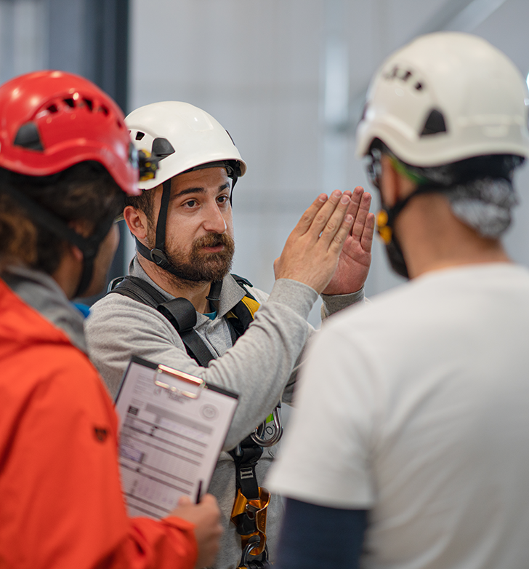
Equipment Hazards
(1) The employer must train each employee in the proper care, inspection, storage, and use of equipment covered in this module before an employee uses the equipment.
(2) The employer must train each employee who uses a dockboard to properly place and secure it to prevent unintentional movement.
(3) The employer must train each employee who uses a rope descent system in proper rigging and use of the equipment. These requirements are discussed in module 5.
WALKING-WORKING SURFACES: fall hazards

Slide 49
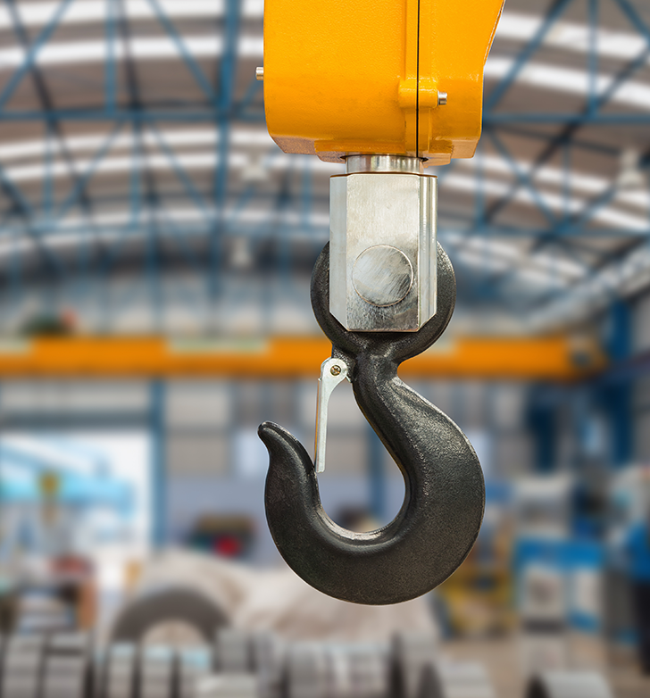
Hoist Areas
Hoist area means “any elevated access opening to a walking-working surface through which equipment or materials are loaded or received.” This is typically a designated space where lifting operations take place, requiring specific safety measures to protect workers from falls.
1. The employer must ensure that each employee in a hoist area is protected from falling 4 feet (1.2 m) or more to a lower level by:
(A) A guardrail system;
(B) A personal fall arrest system; or
(C) A travel restraint system.
(Continued on next slide)
WALKING-WORKING SURFACES: fall hazards

Slide 50

Hoist Areas (continued)
2. When any portion of a guardrail system, gate, or chains is removed, and an employee must lean through or over the edge of the access opening to facilitate hoisting, the employee must be protected from falling by a personal fall arrest system.
3. If grab handles are installed at hoist areas, they meet the requirements of 1910.29(l), which were discussed in the previous module.
WALKING-WORKING SURFACES: fall hazards
Notes:
https://osha.oregon.gov/OSHARules/div2/div2D.pdf#page=62

Slide 51
Video: Holes and Openings
WALKING-WORKING SURFACES: fall hazards

Slide 52
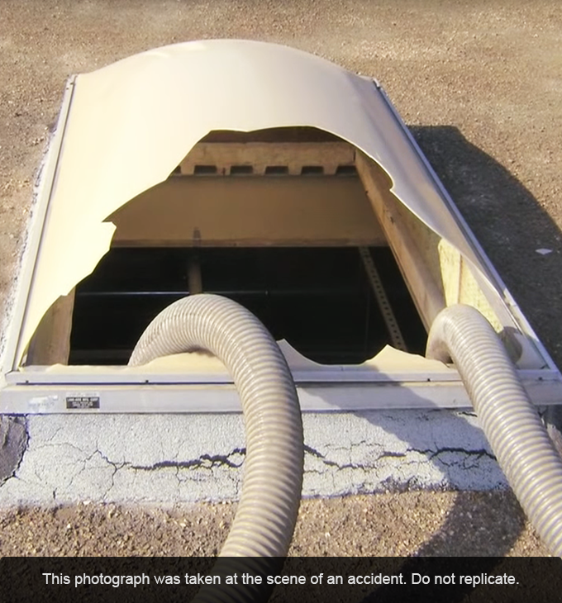
Fall Protection for Holes
1. Each employee must be protected from falling through any hole (including skylights) that is 4 feet (1.2 m) or more above a lower level by one or more of the following:
              (A) Covers;
              (B) Guardrail systems;
              (C) Travel restraint systems; or
              (D) Personal fall arrest systems.
2. Each employee must be protected from tripping into or stepping into or through any hole that is less than 4 feet (1.2 m) above a lower level by covers or guardrail systems.
WALKING-WORKING SURFACES: fall hazards

Slide 53
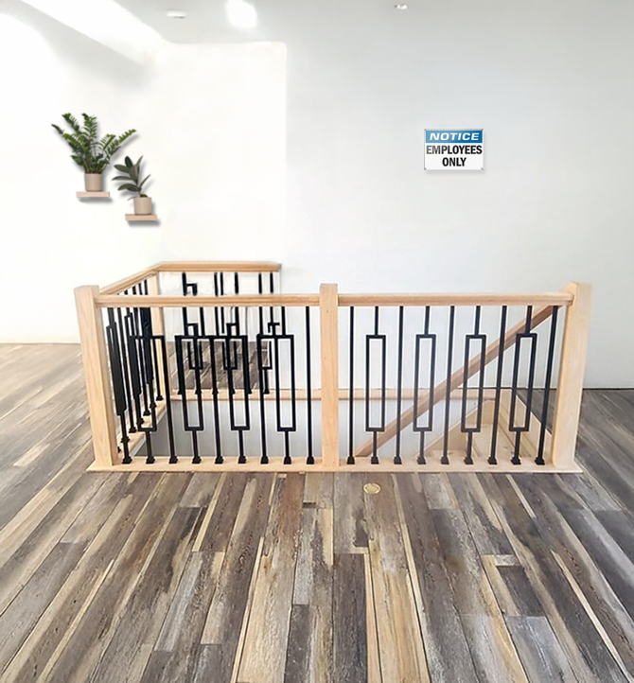
Hole Safety Requirements
Each employee must be protected from falling into a stairway floor hole by a fixed guardrail system on all exposed sides, except at the stairway entrance. However, for any stairway used less than once per day where traffic across the stairway floor hole prevents the use of a fixed guardrail system (e.g., holes located in aisle spaces), the employer may protect employees from falling into the hole by using a hinged floor hole cover that meets the criteria in 1910.29 and a removable guardrail system on all exposed sides, except at the entrance to the stairway.
WALKING-WORKING SURFACES: fall hazards
Notes:
https://osha.oregon.gov/OSHARules/div2/div2D.pdf#page=56

Slide 54
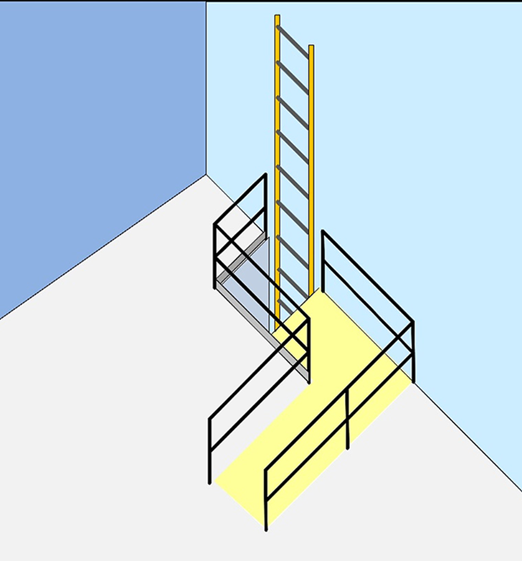
Hole Safety Requirements (continued)
Each employee must be protected from falling into a ladderway floor hole or ladderway platform hole by a guardrail system and toeboards erected on all exposed sides, except at the entrance to the hole, where a self-closing gate or an offset must be used.
Toeboards are defined as a vertical barrier at floor level along exposed edges of a floor opening, wall opening, platform, runway, or ramp to prevent things from falling.
WALKING-WORKING SURFACES: fall hazards

Slide 55
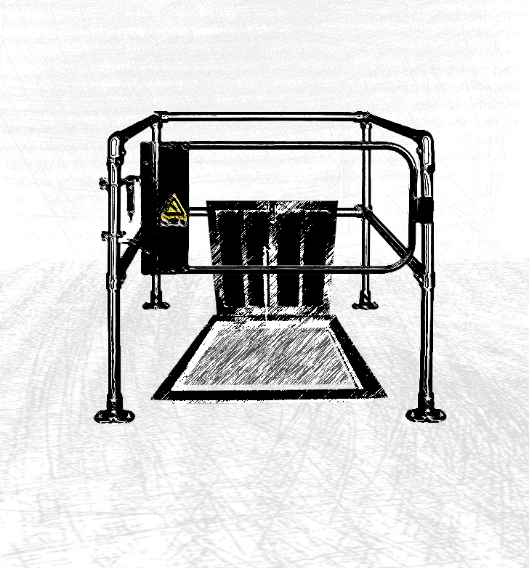
Hole Safety Requirements (continued)
Each employee must be protected from falling through a hatchway and chute floor hole by:
(A) A hinged floor-hole cover that meets the criteria in 1910.29 and a fixed guardrail system that leaves only one exposed side. When the hole is not in use, the employer must ensure the cover is closed or a removable guardrail system is provided on the exposed sides;
(B) A removable guardrail system and toeboards on not more than two sides of the hole and a fixed guardrail system on all other exposed sides. The employer must ensure the removable guardrail system is kept in place when the hole is not in use; or
(C) A guardrail system or a travel restraint system when a work operation necessitates passing material through a hatchway or chute floor hole.
WALKING-WORKING SURFACES: fall hazards
Notes:
https://osha.oregon.gov/OSHARules/div2/div2D.pdf#page=56

Slide 56
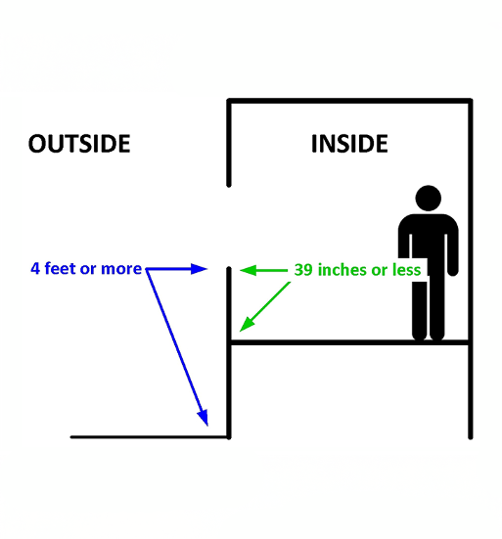
Openings
As you may recall, openings are found in vertical surfaces. Employers are required to protect their workers around these openings when certain conditions are met. When the inside bottom edge of the opening is less than 39 inches (99 cm) above that walking-working surface and the outside bottom edge of the opening is 4 feet (1.2 m) or more above a lower level, workers must be protected from falling by the use of:
(i) Guardrail systems;
(ii) Safety net systems;
(iii) Travel restraint systems; or,
(iv) Personal fall arrest systems.
WALKING-WORKING SURFACES: fall hazards

Slide 57

Repair Pits
Repair pits are designed to allow easy working access of an underside vehicle for inspection, maintenance, and repair. The use of a fall protection system is not required for a repair pit, service pit, or assembly pit that is less than 10 feet (3 m) deep, provided the employer does all of the following:
Limits access within 6 feet (1.8 m) of the edge of the pit to authorized employees trained in accordance with 1910.30 Training Requirements;
Applies floor markings that meet the requirements found in 1910.28 (b)(8)(ii); and
Posts readily visible caution signs that meet the requirements of 1910.145 and state ‘‘Caution—Open Pit.’’
WALKING-WORKING SURFACES: fall hazards
Notes:
https://osha.oregon.gov/OSHARules/div2/div2D.pdf#page=63
https://osha.oregon.gov/OSHARules/div2/div2D.pdf#page=47
https://osha.oregon.gov/osharules/div2/div2j.pdf

Slide 58

Outdoor Advertising (billboards)
Oregon OSHA requires employers to protect employees from fall hazards while working on billboards. These requirements include:
1. Fixed ladders must comply with Oregon OSHA requirements (see module 6).
2. When an employee climbs a fixed ladder that is not equipped with a cage, well, personal fall arrest system, or a ladder safety system the employer must ensure the employee:
Receives training and demonstrates the physical capability to perform the necessary climbs in accordance with 1910.29(h);
Wears a body harness equipped with an 18-inch (46 cm) rest lanyard;
Keeps both hands free of tools or material when climbing on the ladder; and
Is protected by a fall protection system upon reaching the work position.
WALKING-WORKING SURFACES: fall hazards
Notes:
https://osha.oregon.gov/OSHARules/div2/div2D.pdf#page=60

Slide 59
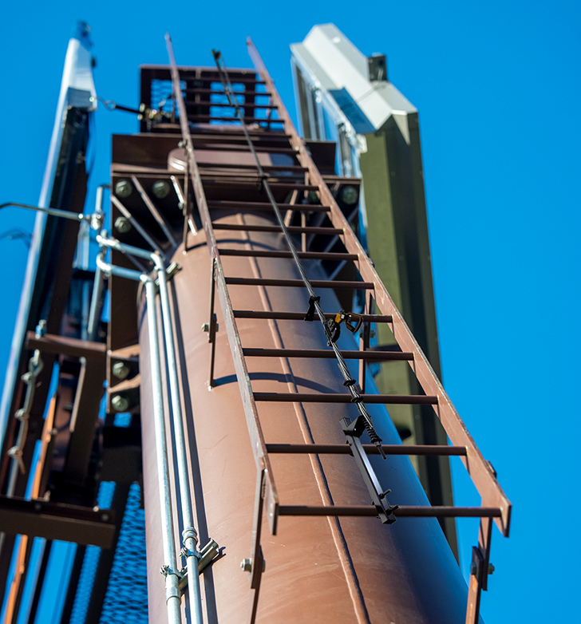
Outdoor Advertising Fixed Ladders
Employers must ensure that each employee engaged in outdoor advertising who climbs a fixed ladder without fall protection:
Is physically capable, as demonstrated through observations of actual climbing activities or by a physical examination, to perform the duties that may be assigned, including climbing fixed ladders without fall protection;
Has successfully completed a training or apprenticeship program that includes hands-on training on the safe climbing of ladders and is retrained as necessary to maintain the necessary skills;
Has the skill to climb ladders safely, as demonstrated through formal classroom training or on-the-job training, and performance observation; and
Performs climbing duties as a part of routine work activity.
WALKING-WORKING SURFACES: fall hazards

Slide 60
Video: Low-Slope Roofs
WALKING-WORKING SURFACES: fall hazards

Slide 61
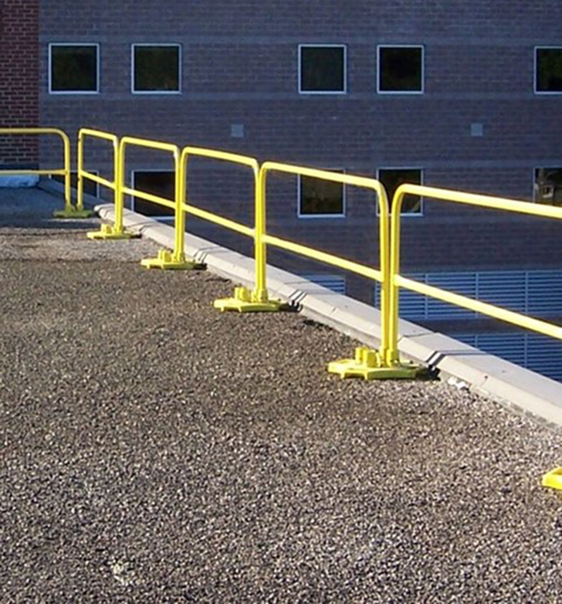
Low-Slope Roofs
There are specific requirements for working on low-slope roofs as outlined in the next few slides:
1. When work is performed less than 6 feet (1.8 m) from the roof edge, the employer must ensure each employee is protected from falling by a guardrail system, safety net system, travel restraint system, or personal fall arrest system.
2. When work is performed at least 6 feet (1.6 m) but less than 15 feet (4.6 m) from the roof edge, the employer must ensure each employee is protected from falling by using a guardrail system, safety net system, travel restraint system, or personal fall arrest system. The employer may use a designated area when performing work that is both infrequent and temporary.
(Continued on next slide)
WALKING-WORKING SURFACES: fall hazards
Notes:
https://osha.oregon.gov/OSHAPubs/factsheets/fs75.pdf

Slide 62
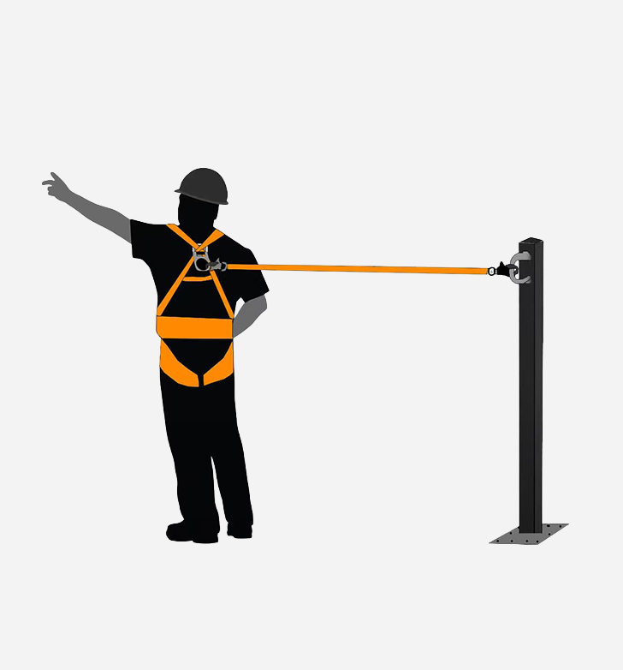
Low-Slope Roofs (Continued)
3. When work is performed 15 feet (4.6 m) or more from the edge of the low-sloped roof, the employer must:
Protect each employee from falling by a guardrail system, safety net system, travel restraint system, or personal fall arrest system or a designated area. The employer is not required to provide any fall protection, provided the work is both infrequent and temporary; and
Implement and enforce a work rule prohibiting employees from going within 15 feet (4.6 m) of the roof edge without using appropriate fall protection.
WALKING-WORKING SURFACES: fall hazards

Slide 63
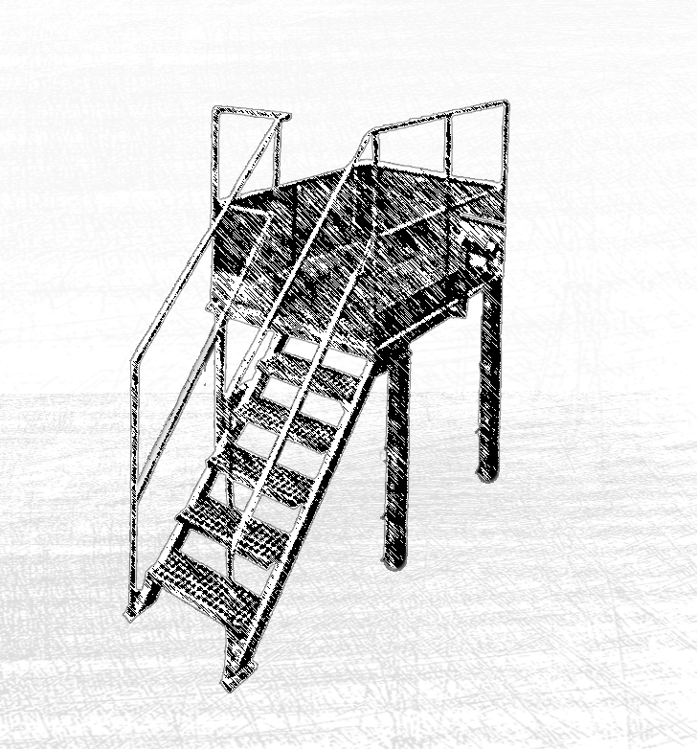
Slaughtering Facility Platforms
A slaughtering facility platform is a raised area in a slaughterhouse where personnel stand to inspect carcasses and perform other tasks. Employers must protect each employee on the unprotected working side of a slaughtering facility platform that is 4 feet (1.2 m) or more above a lower level from falling by using:
Guardrail systems; or
Travel restraint systems.
In the next slide, we’ll talk about situations where fall protection isn’t required.
WALKING-WORKING SURFACES: fall hazards

Slide 64
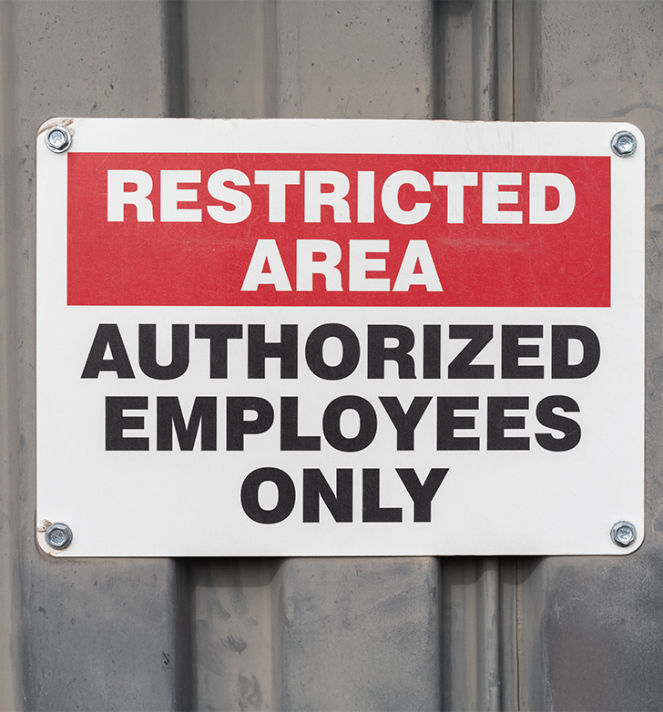
Slaughtering Facility Platforms (continued)
When the employer can demonstrate the use of a guardrail or travel restraint system is not feasible, the work may be done without those systems, provided:
The work operation for which fall protection is infeasible is in process;
Access to the platform is limited to authorized employees; and
The authorized employees are trained in accordance with § 1910.30.
WALKING-WORKING SURFACES: fall hazards

Slide 65

Dangerous Equipment
Dangerous equipment may include items such as vats, tanks, electrical equipment, or machinery with protruding parts. Because of the function or design, this type of equipment can cause harm to an employee who falls into or onto it.
Each employee less than 4 feet (1.2 m) above dangerous equipment must be protected from falling into or onto the dangerous equipment by a guardrail system or a travel restraint system, unless the equipment is covered or guarded to eliminate the hazard.
If an employee is 4 feet or more above dangerous equipment, they must be protected from falling by: guardrails systems, safety net systems, travel restraint systems, or personal fall arrest systems.
WALKING-WORKING SURFACES: fall hazards

Slide 66
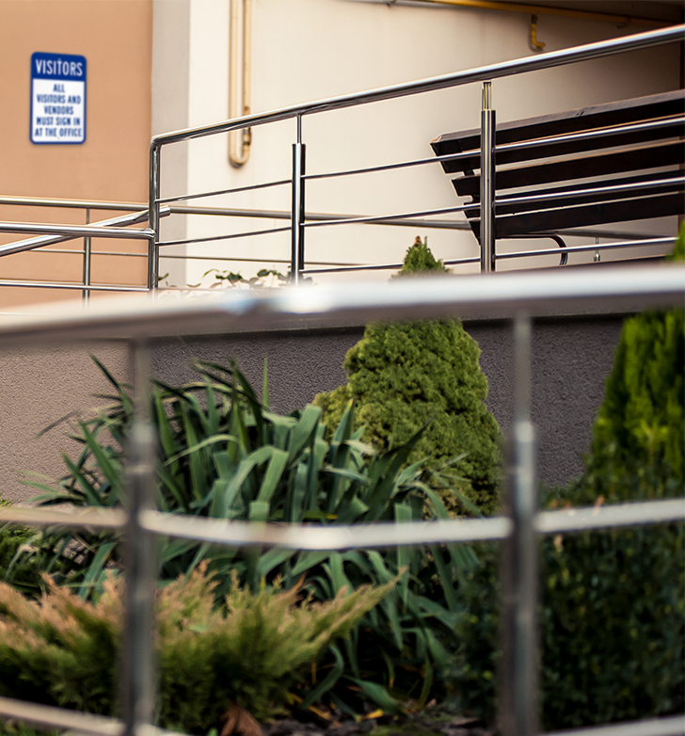
Other Walking-Working Surfaces
In other situations not covered by this rule, the employer must still ensure each employee on a walking-working surface 4 feet (1.2 m) or more above a lower level is protected from falling by:
(i) Guardrail systems;
(ii) Safety net systems; or
(iii) Personal fall protection systems, such as personal fall arrest, travel restraint, or positioning systems.
WALKING-WORKING SURFACES: fall hazards

Slide 67
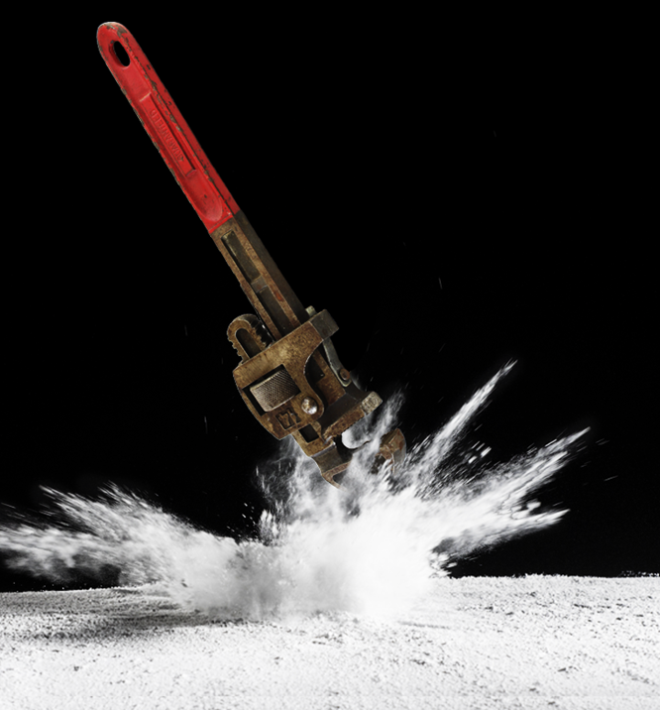
Protection from Falling Objects
When an employee is exposed to falling objects, the employer must ensure that each employee wears head protection that meets Oregon OSHA requirements. In addition, the employer must protect employees from falling objects by implementing one or more of the following:
Erecting toeboards, screens, or guardrail systems to prevent objects from falling to a lower level;
Erecting canopy structures and keeping potential falling objects far enough from an edge, hole, or opening to prevent them from falling to a lower level; or
Barricading the area into which objects could fall, prohibiting employees from entering the barricaded area, and keeping objects far enough from an edge or opening to prevent them from falling to a lower level.
We’ll discuss toeboards in the next slide.
WALKING-WORKING SURFACES: fall hazards
Notes:
https://osha.oregon.gov/OSHARules/div2/div2I.pdf

Slide 68
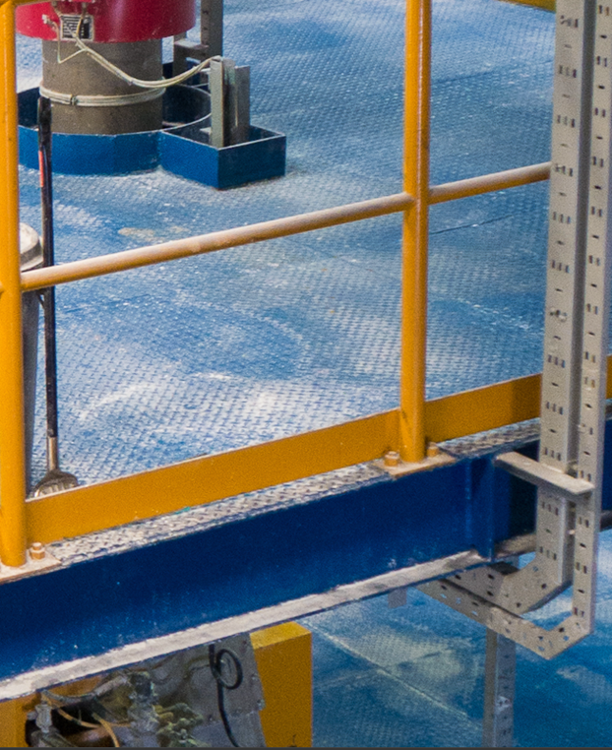
Toeboard Requirements
Employers must ensure toeboards used for falling object protection:
1. Are erected along the exposed edge of the overhead walking-working surface for a length that is sufficient to protect employees below.
2. Have a minimum vertical height of 3.5 inches (9 cm) as measured from the top edge of the toeboard to the level of the walking-working surface.
3. Do not have more than a 0.25 inch (0.5-cm) clearance or opening above the walking-working surface.
4. Are solid or do not have any opening that exceeds 1 inch (3 cm) at its greatest dimension.
(continued on next slide)
WALKING-WORKING SURFACES: fall hazards

Slide 69
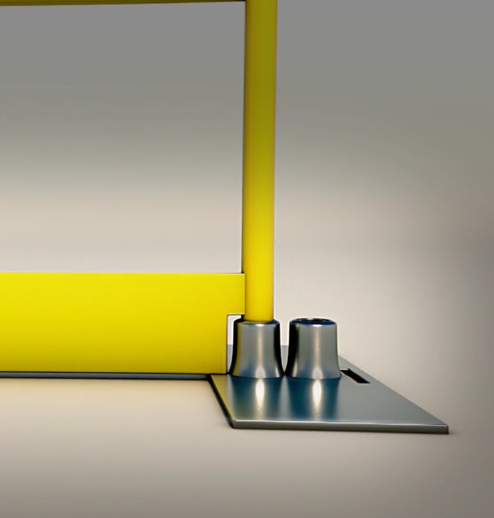
Toeboard Requirements (continued)
Employers must ensure toeboards used for falling object protection:
5. Have a minimum height of 2.5 inches (6 cm) when used around vehicle repair, service, or assembly pits. Toeboards may be omitted around vehicle repair, service, or assembly pits when the employer can demonstrate that a toeboard would prevent access to a vehicle that is over the pit.
6. Are capable of withstanding, without failure, a force of at least 50 pounds (222 N) applied in any downward or outward direction at any point along the toeboard.
WALKING-WORKING SURFACES: fall hazards

Slide 70

Guardrail Systems
To help protect workers from falling objects, the employer must ensure:
Where tools, equipment, or materials are piled higher than the top of the toeboard, paneling or screening is installed from the toeboard to the midrail of the guardrail system and for a length that is sufficient to protect employees below. If the items are piled higher than the midrail, the employer also must install paneling or screening to the top rail and for a length that is sufficient to protect employees below; and
All openings in guardrail systems are small enough to prevent objects from falling through the opening.
WALKING-WORKING SURFACES: fall hazards

Slide 71
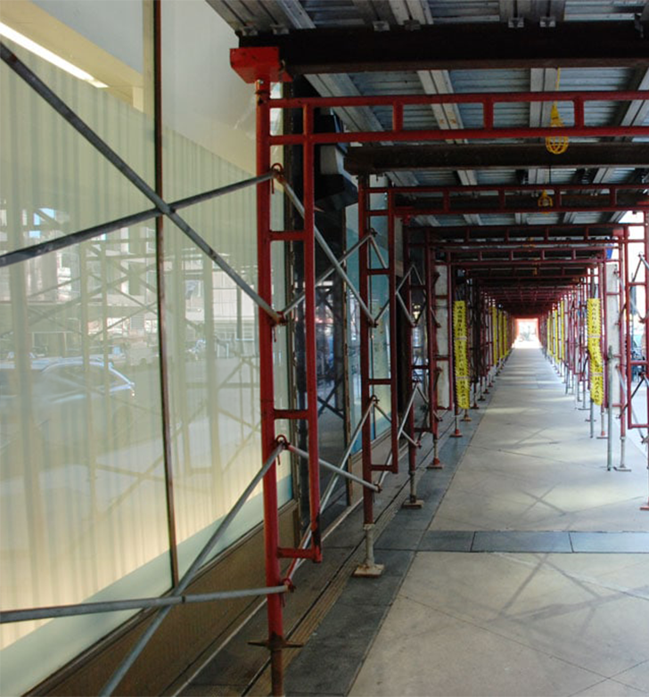
Canopies
Canopies can be used as a structure designed to rest over an area that are capable of withstanding the impact force of dropped objects or tools. The employer must ensure canopies used for falling object protection are strong enough to prevent collapse and to prevent penetration by falling objects.
WALKING-WORKING SURFACES: fall hazards

Slide 72
Knowledge Check 1
Knowledge Check 2
The trigger height for fall protection while working above dangerous equipment is:
4 feet
6 feet
Any height
8 feet*
When an employee is exposed to falling objects, they must wear head protection.
True
False
WALKING-WORKING SURFACES: fall hazards

Slide 73

Module 3 Conclusion
You’ve completed module 3! This module covered various situations where employers must select a compliant fall protection system and ensure it is installed in where it is required by the walking-working surfaces rule. This includes unprotected sides and edges, hoist areas, holes, openings, outdoor advertising, slaughtering facility platforms, low-slope roofs, and walking-working surfaces not otherwise specified. Specific guidelines are provided for each situation, such as for holes, ladderways, and roof edges. In rare cases, fall protection can be waived if it’s proven infeasible, and workers are properly trained and authorized. Complementing these systems, falling object protection aims to safeguard workers below from tools or materials that may accidentally drop, utilizing measures like head protection, toe boards, canopies, and guardrail screens.
WALKING-WORKING SURFACES: fall hazards

Slide 74
Module 4: Step bolts, Stairways, and More
WALKING-WORKING SURFACES

Slide 75
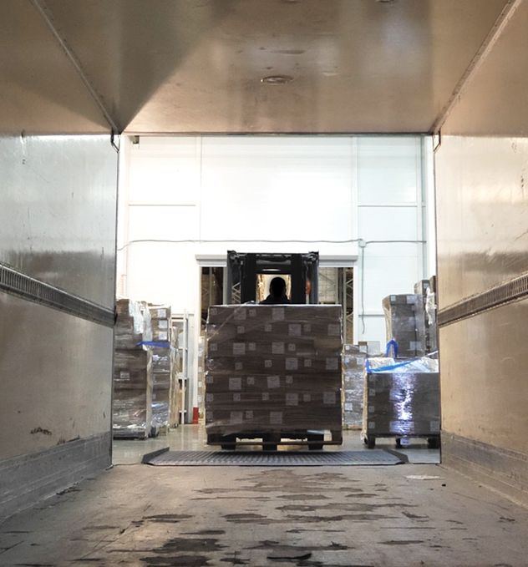

Introduction
Welcome to Module 4! In this section we will cover WWS requirements for the following topics:
Step bolts
Manhole steps
Stairways
Dockboards
Ramps/runways
Let’s get started!
WALKING-WORKING SURFACES: step bolts, stairways, and more

Slide 76
Video: Step Bolts and Manhole Steps
WALKING-WORKING SURFACES: step bolts, stairways, and more

Slide 77
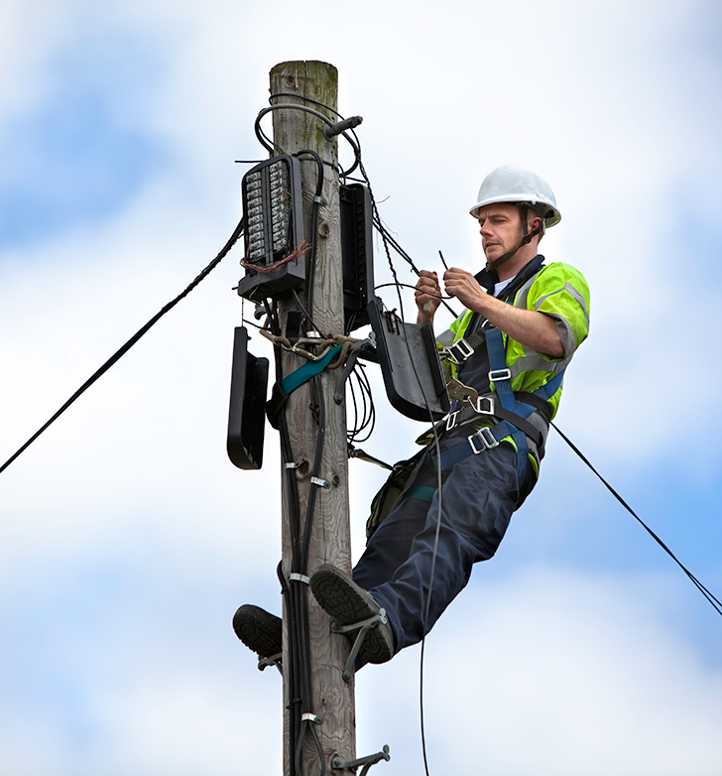
Step Bolts
The WWS rule addresses nine specific requirements for step bolts, which can be referenced in 1910.24 (a)(1)-(9). The employer must ensure that:
Each step bolt installed on or after January 1, 2018 in an environment where corrosion may occur is constructed of, or coated with, material that protects against corrosion;
Each step bolt is designed, constructed, and maintained to prevent the employee’s foot from slipping off the end of the step bolt;
(Continued on next slide)
WALKING-WORKING SURFACES: step bolts, stairways, and more
Notes:
https://osha.oregon.gov/OSHARules/div2/div2D.pdf#page=26

Slide 78
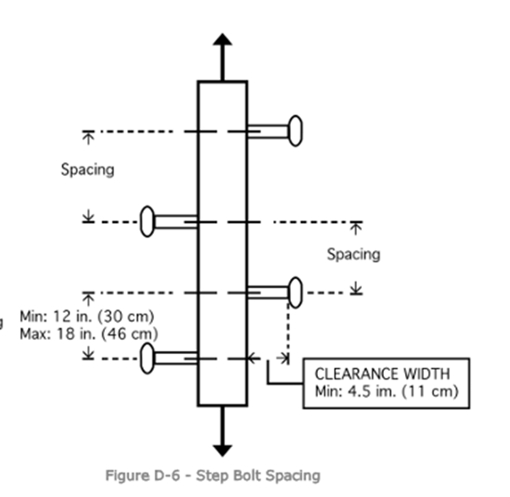
Step Bolt Requirements
The employer must ensure that:
Step bolts are uniformly spaced at a vertical distance of not less than 12 inches (30 cm) and not more than 18 inches (46 cm) apart, measured center to center (see Figure D–6). The spacing from the entry and exit surface to the first step bolt may differ from the spacing between the other step bolts;
Each step bolt has a minimum clear width of 4.5 inches (11 cm);
The minimum perpendicular distance between the centerline of each step bolt to the nearest permanent object in back of the step bolt is 7 inches (18 cm). When the employer demonstrates that an obstruction cannot be avoided, the distance must be at least 4.5 inches (11 cm);
(Continued on next slide)
WALKING-WORKING SURFACES: step bolts, stairways, and more

Slide 79
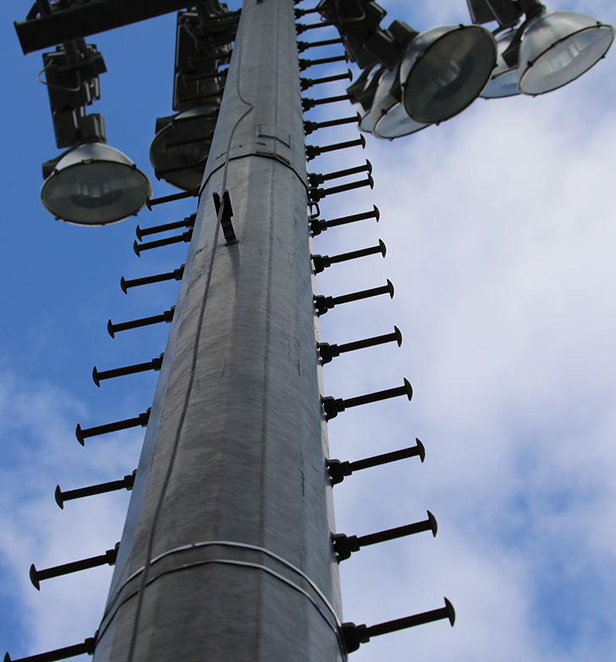
Step Bolts Requirements (continued)
The employer must ensure that:
Each step bolt installed before January 1, 2018 is capable of supporting its maximum intended load;
Each step bolt installed on or after January 1, 2018 is capable of supporting at least four times its maximum intended load;
Each step bolt is inspected at the start of the work shift and maintained in accordance with § 1910.22; and
Any step bolt that is bent more than 15 degrees from the perpendicular in any direction is removed and replaced with a step bolt that meets the requirements of this section before an employee uses it.
It’s time to move on to manhole steps!
WALKING-WORKING SURFACES: step bolts, stairways, and more
Notes:
https://osha.oregon.gov/OSHARules/div2/div2D.pdf#page=12

Slide 80
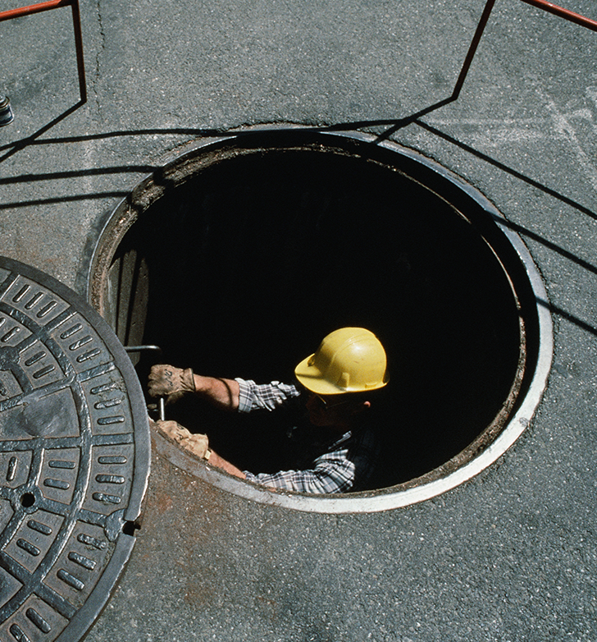
Manhole Steps
The WWS rule addresses several requirements for manhole steps, which can be referenced in 1910.24 (b)(1)-(3). The employer must ensure that:
Each manhole step is capable of supporting its maximum intended load.
If installed after Jan. 1, 2018, they must meet specific requirements for slip resistance, corrosion resistance, width, and vertical spacing. We’ll go into this on the next slide.
Each manhole step is inspected at the start of the work shift and maintained in accordance with 1910.22.
WALKING-WORKING SURFACES: step bolts, stairways, and more
Notes:
https://osha.oregon.gov/OSHARules/div2/div2D.pdf#page=28
https://osha.oregon.gov/OSHARules/div2/div2D.pdf#page=12

Slide 81
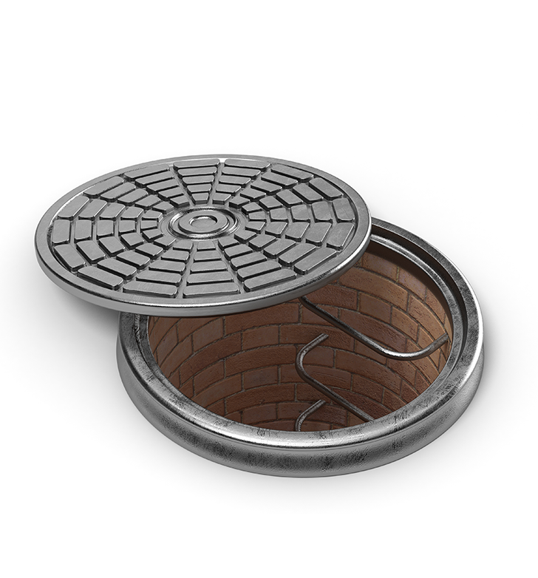
Manhole Steps Specific Requirements
Let’s dive into the specific requirements for manhole steps installed on or after January 1, 2018. Employers must ensure that each manhole step:
Has a corrugated, knurled, dimpled, or other surface that minimizes the possibility of an employee slipping;
Is constructed of, or coated with, material that protects against corrosion if the manhole step is located in an environment where corrosion may occur;
Has a minimum clear step width of 10 inches (25 cm);
Is uniformly spaced at a vertical distance not more than 16 inches (41cm) apart, measured center to center between steps. The spacing from the entry and exit surface to the first manhole step may differ from the spacing between the other steps;
(Continued on next slide)
WALKING-WORKING SURFACES: step bolts, stairways, and more

Slide 82
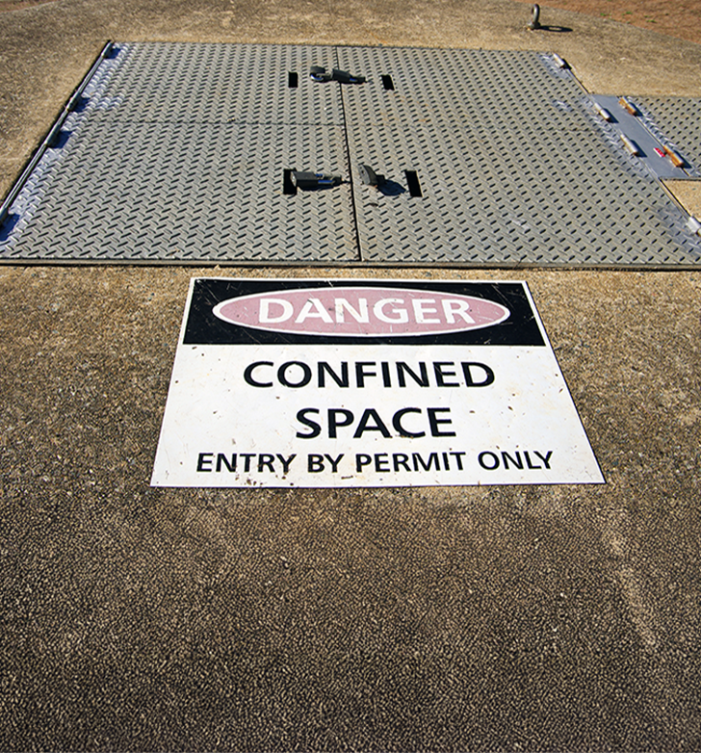
Manhole Steps Specific Requirements (continued)
Employers must ensure that each manhole step:
Has a minimum perpendicular distance between the centerline of the manhole step to the nearest permanent object in back of the step of at least 4.5 inches (11 cm); and
Is designed, constructed, and maintained to prevent the employee’s foot from slipping or sliding off the end.
Additionally, it’s important to note that some manholes are confined spaces, which can present conditions that are immediately dangerous to workers if such conditions are not properly identified, evaluated, tested, and controlled. To learn more about confined spaces, please visit the Oregon OSHA Topic Page.
WALKING-WORKING SURFACES: step bolts, stairways, and more
Notes:
https://osha.oregon.gov/Pages/topics/confined-spaces.aspx

Slide 83
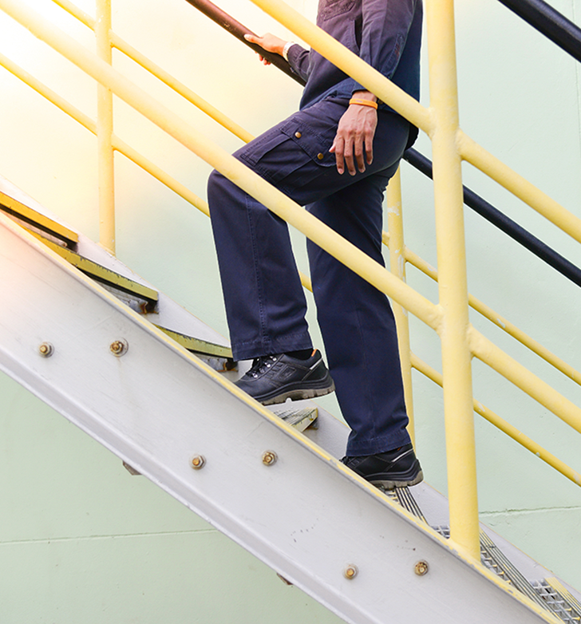
Introduction to Stairways
In this section, we’ll discuss requirements for stairways (stairs). Let’s start with two important definitions.
Stairways are defined as:
“...risers and treads that connect one level with another, and includes any landings and platforms in between those levels. Stairways include standard, spiral, alternating tread-type, and ship stairs.”
Standard stairs are defined as:
“…a fixed or permanently installed stairway. Ship, spiral, and alternating tread-type stairs are not considered standard stairs.”
In the next slide, let’s watch a video providing a brief summary and examples of different types of stairs.
WALKING-WORKING SURFACES: step bolts, stairways, and more

Slide 84
Video: Stairways
WALKING-WORKING SURFACES: step bolts, stairways, and more

Slide 85
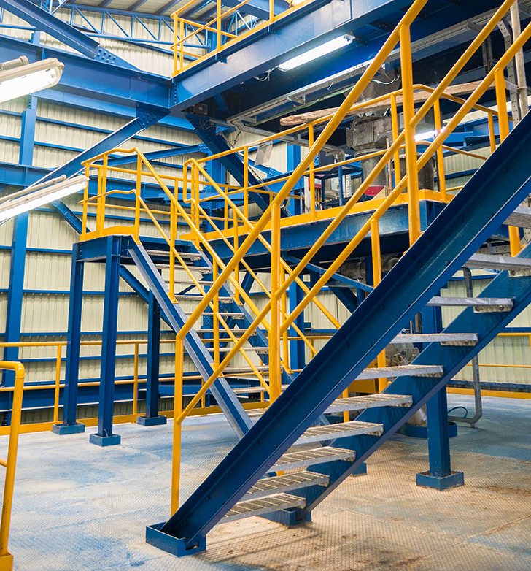
Stairways Requirements
The WWS rule covers all stairways, except those serving floating roof tanks, stairs on scaffolds, stairs designed into machines or equipment, and stairs on self-propelled motorized equipment. The rule divides the requirements into sections and we will discuss:
General requirements
Standard stairs
Spiral stairs
Ship stairs
Alternating tread-type stairs
Let’s start with the general requirements!
WALKING-WORKING SURFACES: step bolts, stairways, and more

Slide 86

Stairways General Requirements
The employer must ensure that:
Handrails, stair rail systems, and guardrail systems are provided in accordance with 1910.25 and 1910.28(11).
Vertical clearance above any stair tread to any overhead obstruction is at least 6 feet, 8 inches (203 cm), as measured from the leading edge of the tread. Spiral stairs must meet the vertical clearance requirements in paragraph (d)(3) of this section (1910.25).
Stairs have uniform riser heights and tread depths between landings.
Stairway landings and platforms are at least the width of the stair and at least 30 inches (76 cm) in depth, as measured in the direction of travel.
(Continued on next slide)
WALKING-WORKING SURFACES: step bolts, stairways, and more
Notes:
https://osha.oregon.gov/OSHARules/div2/div2D.pdf#page=43
https://osha.oregon.gov/OSHARules/div2/div2D.pdf#page=32

Slide 87

Stairways General Requirements (continued)
5. The employer must ensure that when a door or a gate opens directly on a stairway, a platform is provided, and the swing of the door or gate does not reduce the platform’s effective usable depth to:
Less than 20 inches (51 cm) for platforms installed before January 1, 2018.
Less than 22 inches (56 cm) for platforms installed on or after January 1, 2018 (see Figure D–7).
(Continued on next slide)
WALKING-WORKING SURFACES: step bolts, stairways, and more

Slide 88

Stairways General Requirements (continued)
The employer must ensure that:
6. Each stair can support at least five times the normal anticipated live load, but never less than a concentrated load of 1,000 pounds (454 kg) applied at any point.
7. Standard stairs are used to provide access from one walking-working surface to another when operations necessitate regular and routine travel between levels, including access to operating platforms for equipment. Winding stairways may be used on tanks and similar round structures when the diameter of the tank or structure is at least 5 feet (1.5 m).
(Continued on next slide)
WALKING-WORKING SURFACES: step bolts, stairways, and more

Slide 89

Stairways General Requirements (continued)
The employer must ensure that:
8. Spiral, ship, or alternating tread-type stairs are used only when the employer can demonstrate that it is not feasible to provide standard stairs. They are required to be installed, used, and maintained in accordance with manufacturer’s instructions.
We’ve completed the general requirements, let’s move on to standard stairs.
WALKING-WORKING SURFACES: step bolts, stairways, and more

Slide 90

Standard Stair Requirements
In addition to the general requirements from the last few slides, the employer must ensure standard stairs:
Are installed at angles between 30 to 50 degrees from the horizontal;
Have a maximum riser height of 9.5 inches (24 cm);
Have a minimum tread depth of 9.5 inches (24 cm); and
Have a minimum width of 22 inches (56 cm) between vertical barriers (see Figure D–8).
There are some exceptions to these requirements for standard stairs that were installed before January 1, 2018. Please reference 1910.25 (c)(5) for more information.
WALKING-WORKING SURFACES: step bolts, stairways, and more
Notes:
https://osha.oregon.gov/OSHARules/div2/div2D.pdf#page=31

Slide 91

Spiral Stair Requirements
In addition to the general requirements, the employer must ensure spiral stairs:
Have a minimum clear width of 26 inches (66 cm);
Have a maximum riser height of 9.5 inches (24 cm);
Have a minimum headroom above spiral stair treads of at least 6 feet, 6 inches (2 m), measured from the leading edge of the tread;
Have a minimum tread depth of 7.5 inches (19 cm), measured at a point 12 inches (30 cm) from the narrower edge; and
Have a uniform tread size.
WALKING-WORKING SURFACES: step bolts, stairways, and more

Slide 92

Ship Stair Requirements
In addition to the general requirements, the employer must ensure ship stairs:
Are installed at a slope of 50 to 70 degrees from the horizontal;
Have open risers with a vertical rise between tread surfaces of 6.5 to 12 inches (17 to 30 cm);
Have minimum tread depth of 4 inches (10 cm); and
Have a minimum tread width of 18 inches (46 cm).
WALKING-WORKING SURFACES: step bolts, stairways, and more

Slide 93

Alternating Tread-Type Stairs
In addition to the general requirements, the employer must ensure that alternating tread-type stairs have:
A series of treads installed at a slope of 50 to 70 degrees from the horizontal;
A distance between handrails of 17 to 24 inches (51 to 61 cm);
A Minimum tread depth of 8.5 inches (22 cm);
Open risers if the tread depth is less than 9.5 inches (24 cm);
A minimum tread width of 7 inches (18 cm), measured at the leading edge of the tread (i.e., nosing).
WALKING-WORKING SURFACES: step bolts, stairways, and more

Slide 94

Fall Protection for Stairways
The employer must ensure:
1. Each employee exposed to an unprotected side or edge of a stairway landing that is 4 feet (1.2 m) or more above a lower level is protected by a guardrail or stair rail system.
2. Each flight of stairs has at least 3 treads and at least 4 risers, and is equipped with stair rail systems and handrails and follows the requirements in Table D-2 of 1910.28(b)(11).
3. Each ship stair and alternating tread type stairs are equipped with handrails on both sides.
Our discussion of stairways is complete, it’s time to move on to dockboards!
WALKING-WORKING SURFACES: step bolts, stairways, and more
Notes:
https://osha.oregon.gov/OSHARules/div2/div2D.pdf#page=50

Slide 95
Video: Dockboards
WALKING-WORKING SURFACES: step bolts, stairways, and more

Slide 96

Dockboard Requirements
The WWS rule outlines five requirements for dockboards in 1910.26 (a) - (e). Employers must ensure that:
Dockboards are capable of supporting the maximum intended load in accordance with 1910.22(b);
Dockboards put into initial service on or after January 1, 2018 are designed, constructed, and maintained to prevent transfer vehicles from running off the dockboard edge;
Exception to this requirement: When the employer demonstrates there is no hazard of transfer vehicles running off the dockboard edge, the employer may use dockboards that do not have runoff protection.
(Continued on next slide)
WALKING-WORKING SURFACES: step bolts, stairways, and more
Notes:
https://osha.oregon.gov/OSHARules/div2/div2D.pdf#page=34

Slide 97

Dockboard Requirements (continued)
Employers must ensure that:
(c) Portable dockboards are secured by anchoring them in place or using equipment or devices that prevent the dockboard from moving out of a safe position. When the employer demonstrates that securing the dockboard is not feasible, the employer must ensure there is sufficient contact between the dockboard and the surface to prevent the dockboard from moving out of a safe position;
(Continued on next slide)
WALKING-WORKING SURFACES: step bolts, stairways, and more

Slide 98

Dockboard Requirements (continued)
Employers must ensure that:
(d) Measures, such as wheel chocks or sand shoes, are used to prevent the transport vehicle (e.g. a truck, semitrailer, trailer, or rail car) on which a dockboard is placed, from moving while employees are on the dockboard; and
(e) Portable dockboards are equipped with handholds or other means to permit safe handling of dockboards.
WALKING-WORKING SURFACES: step bolts, stairways, and more

Slide 99

Fall Protection for Dockboards
In 1910.28(b)(4), the employer must ensure that each employee on a dockboard is protected from falling 4 feet (1.2 m) or more to a lower level by a guardrail system or handrails. There are exceptions to this requirement when the following conditions are met:
Dockboards are being used solely for materials-handling operations using motorized equipment;
Employees engaged in these operations are not exposed to fall hazards greater than 10 feet (3 m); and
Those employees have been trained properly. We’ll discuss these requirements in an upcoming module.
WALKING-WORKING SURFACES: step bolts, stairways, and more

Slide 100
Video: Runways & Ramps
WALKING-WORKING SURFACES: step bolts, stairways, and more

Slide 101

Fall Protection for Runways
In this slide, we’ll cover the fall protection requirements for runways and similar walkways found in 1910.28(b)(5).
The employer must ensure each employee on a runway or similar walkway is protected from falling 4 feet (1.2 m) or more to a lower level by a guardrail system.
When the employer can demonstrate that it is not feasible to have guardrails on both sides of a runway used exclusively for a special purpose, the employer may omit the guardrail on one side of the runway, provided the employer ensures:
The runway is at least 18 inches (46 cm) wide; and
Each employee is provided with and uses a personal fall arrest system or travel restraint system.
WALKING-WORKING SURFACES: step bolts, stairways, and more

Slide 102

Vehicles on Ramps and Runways
The employer must ensure ramps and runways for vehicles:
(a) Have adequate width and evenness for safe operation of equipment.
(b) Are provided with timber guards (bull rails) of not less than nominal 6-inch by 6-inch material set on nominal 3-inch blocks, or the equivalent, placed parallel to and secured to the sides of the ramp or runway.
WALKING-WORKING SURFACES: step bolts, stairways, and more

Slide 103
Knowledge Check 1
Knowledge Check 2
When working with step bolts, each step bolt must be inspected at the start of the work shift.
True
False
Each employee exposed to an unprotected side or edge of a stairway landing that is 4 feet or more above a lower level must be protected by a guardrail or stair rail system.
True
False
WALKING-WORKING SURFACES: step bolts, stairways, and more

Slide 104

Module 4 Overview
You’ve completed module 4! In this module, we’ve covered:.
Step bolts must have corrosion resistance, slip prevention, uniform spacing, and load-bearing capacity, with additional standards for step bolts installed after January 1, 2018.
Manhole steps must have slip-resistant surfaces, be corrosion-resistant, meet width and spacing standards, and be inspected regularly.
Stairways must adhere to general requirements, including handrails, riser and tread uniformity, and specific rules for standard, spiral, ship, and alternating tread-type stairs.
Dockboards must be stable, have runoff protection, and ensure safety through secure placement and transport vehicle restraints.
Runways and walkways must incorporate fall protection if they are 4 feet or above a lower surface.
Let’s move on to the next module!
WALKING-WORKING SURFACES: step bolts, stairways, and more

Slide 105
Module 5: Scaffolds, Rope Descent and Access
WALKING-WORKING SURFACES

Slide 106


Welcome to module 5!
The focus of this module will be:
Scaffolds
Rope descent systems
Rope access systems
If you’re following along in the WWS rule, please reference 1910.27 (1)-(6).
WALKING-WORKING SURFACES: scaffolds, rope descent and access
Notes:
https://osha.oregon.gov/OSHARules/div2/div2D.pdf#page=34

Slide 107

Scaffolding Requirements
Scaffolds used in general industry settings must meet all the requirements found in Division 3, Subdivision L (Scaffolding) regulations for construction. Employees who erect, dismantle, move, or work from a scaffold must be trained according to the requirements in 1926.454, Scaffolding, Training requirements. Scaffolds are defined as:
“...any temporary elevated platform (supported or suspended) and its supporting structure (including points of anchorage), used for supporting employees or materials or both.”
For more information about scaffolding requirements, please visit the Scaffolds A-Z Topic Index page.
WALKING-WORKING SURFACES: scaffolds, rope descent and access
Notes:
https://osha.oregon.gov/OSHARules/div3/div3L.pdf
https://osha.oregon.gov/Pages/topics/scaffolds.aspx

Slide 108

Rope Descent and Rope Access
The WWS rule has requirements that apply to rope descent and rope access. This section is divided into the following topics:
Scope and application
Definitions
Personal protective equipment
Anchorage (permanent and temporary)
Rope descent
Rope access
Let’s get started with a video overview!
WALKING-WORKING SURFACES: scaffolds, rope descent and access

Slide 109
Video: Rope Descent & Rope Access
WALKING-WORKING SURFACES: scaffolds, rope descent and access

Slide 110

Scope and Application
OAR 437-002-2027 establishes safety requirements for rope descent and rope access systems, which are used for tasks such as cleaning buildings, inspecting dams and bridges, and reaching difficult areas. The requirements of this rule include the cleaning of buildings or structures, the inspection of dams and spillways, access to interior or exterior structural and architectural components of buildings, highway/bridge inspection and maintenance, powerplant penstocks and other difficult access areas.
Next, we’ll cover a few of the definitions for this topic.
WALKING-WORKING SURFACES: scaffolds, rope descent and access
Notes:
https://osha.oregon.gov/OSHARules/div2/div2D.pdf#page=35

Slide 111

Definitions
“Access is the means of reaching a workspace of a work area.”
“Anchorage means a secure point of attachment for equipment such as lifelines, lanyards, deceleration devices, and rope descent systems.”
“Rope access means the use of rope access equipment where two ropes are used; one as the primary means of support and a second for fall arrest protection. The employee accesses the work area by ascending, descending, or traversing along both ropes by alternating connections and weight between the two ropes. Rope access may also be called industrial rope access but is not limited to industrial applications.”
WALKING-WORKING SURFACES: scaffolds, rope descent and access

Slide 112

Rope Descent System Definition
“Rope descent system means a suspension system that allows an employee to descend in a controlled manner and, as needed, stop at any point during the descent. A rope descent system usually consists of a roof anchorage, support rope, a descent device, carabiner(s) or shackle(s), and a chair (seatboard). A rope descent system also is called controlled descent equipment or apparatus. Rope descent systems do not include industrial rope access systems.”
WALKING-WORKING SURFACES: scaffolds, rope descent and access

Slide 113

Personal Protective Equipment
The employer must ensure personal protective equipment is meeting the requirements of Division 2/I when rope descent systems or rope access methods are used. Please visit the Oregon OSHA Personal Protective Equipment Topic Page for more information.
Over the next few slides, we’ll discuss anchors, so let’s start with the definition:
“Anchorage means a secure point of attachment for equipment such as lifelines, lanyards, deceleration devices, and rope descent systems.”
WALKING-WORKING SURFACES: scaffolds, rope descent and access
Notes:
https://osha.oregon.gov/OSHARules/div2/div2I.pdf
https://osha.oregon.gov/Pages/topics/personal-protective-equipment.aspx

Slide 114

Anchorage (Permanent)
Requirements for permanent anchorages on buildings:
Before any rope descent or rope access system is used, the building owner must inform the employer, in writing, that the building owner has identified, tested, certified, and maintained each permanent anchorage so it is capable of supporting at least 5,000 pounds (22.24 kN), in any direction, for each employee attached. The information must be based on an annual inspection by a qualified person and certification of each anchorage by a qualified person, as necessary, and at least every 10 years.
WALKING-WORKING SURFACES: scaffolds, rope descent and access

Slide 115

Anchorage (Permanent) Continued
Requirements for permanent anchorages on buildings.
B. The employer must ensure that no employee uses any permanent anchorage before the employer has obtained written information from the building owner that each anchorage meets the requirements discussed on the previous slide. The employer must keep the information for the duration of the job.
WALKING-WORKING SURFACES: scaffolds, rope descent and access

Slide 116

Anchorage (Temporary)
Anchorages for rope descent or rope access systems on structures or natural surroundings other than buildings must be independent from each other (primary support rope and secondary fall arrest system) and must be:
Capable of supporting at least 5,000 pounds (22.24 kN) for each employee attached; or
Designed, installed, and used, under the supervision of a qualified person, as part of a complete system that maintains a safety factor of at least two.
In the next section, we’ll discuss requirements that only apply to rope descent systems.
WALKING-WORKING SURFACES: scaffolds, rope descent and access

Slide 117

Rope Descent Systems
The employer must ensure:
No rope descent system is used for heights greater than 300 feet (91m) above grade unless the employer demonstrates that it is not feasible to access such heights by any other means or that those means pose a greater hazard than using a rope descent system;
The rope descent system is used in accordance with instructions, warnings, and design limitations set by the manufacturer or under the direction of a qualified person;
Each employee who uses the rope descent system is trained, following the requirements found in 1910.30;
We’ll cover these training requirements later in this module.
WALKING-WORKING SURFACES: scaffolds, rope descent and access
Notes:
https://osha.oregon.gov/OSHARules/div2/div2D.pdf#page=63

Slide 118

Rope Descent Systems (continued)
The employer must ensure:
(d) The rope descent system is inspected at the start of each workshift that it is to be used. The employer must ensure damaged or defective equipment is removed from service immediately and replaced;
(e) The rope descent system has proper rigging, including anchorages and tiebacks, with particular emphasis on providing tiebacks when counterweights, cornice hooks, or similar non-permanent anchorages are used;
(Continued on next slide)
WALKING-WORKING SURFACES: scaffolds, rope descent and access

Slide 119

Rope Descent Systems (continued)
The employer must ensure:
(f) Each employee uses a separate, independent personal fall arrest system that meets the requirements of 1910.140 in Division 2, Subdivision I (requirements for personal fall protection systems);
(g) All components of each rope descent system, except seat boards, are capable of sustaining a minimum rated load of 5,000 pounds (22.2 kN). Seat boards must be capable of supporting a live load of 300 pounds (136 kg);
(h) Prompt rescue of each employee is provided in the event of a fall, equipment malfunction or entanglement;
(Continued on next slide)
WALKING-WORKING SURFACES: scaffolds, rope descent and access
Notes:
https://osha.oregon.gov/OSHARules/div2/div2I.pdf#page=89

Slide 120

Rope Descent Systems (continued)
The employer must ensure:
(i) The ropes of each rope descent system are effectively padded or otherwise protected, where they can contact edges of the building, anchorage, obstructions, or other surfaces, to prevent them from being cut or weakened;
(j) Stabilization is provided at the specific work location when descents are greater than 130 feet (39.6 m);
(k) No employee uses a rope descent system when hazardous weather conditions, such as storms or gusty or excessive wind, are present;
(Continued on next slide)
WALKING-WORKING SURFACES: scaffolds, rope descent and access

Slide 121

Rope Descent Systems (continued)
The employer must ensure:
(m) The ropes of each rope descent system are protected from exposure to open flames, hot work, corrosive chemicals, and other destructive conditions;
(n) The ropes of each rope descent system are made from industrial synthetic fibers and classified as life-safety rope. Ropes made from natural fibers and polypropylene cannot be used for rope descent;
(o) Descent control devices include automatic locks that will engage and prevent an uncontrolled descent in case the employee lets go or loses control of the device;
(Continued on next slide)
WALKING-WORKING SURFACES: scaffolds, rope descent and access

Slide 122

Rope Descent Systems (continued)
The employer must ensure:
(p) Anchorages for rope descent systems meet the requirements for anchorages discussed earlier; and
(q) A pre-work briefing is conducted with each employee involved in rope descent to include, but is not limited to:
The objective(s) of the work to be performed.
Site-specific hazards.
Environmental conditions that could affect the safety of the employee using the system.
Emergency procedures to be followed (e.g., employee rescue).
WALKING-WORKING SURFACES: scaffolds, rope descent and access

Slide 123

Rope Access Systems
Our next topic covers the requirements that apply only to rope access systems. These items are divided into the following sections:
Exceptions
Written rope access program
Program administration
Training and evaluation
Rope access use
Let’s get started!
WALKING-WORKING SURFACES: scaffolds, rope descent and access

Slide 124

Exceptions
Please keep in mind that the rope access requirements do not apply to the following:
Emergency search and rescue operations.
Entertainment performances and rehearsals. This exception does not apply to the set up, dismantling or operation of; stages, sound systems, lighting systems, pyrotechnics, associated supporting structures or props.
Tree and shrub service activities covered by Division 2, Subdivision R.
In the next slide, we’ll kick off this topic with a quick video overview!
WALKING-WORKING SURFACES: scaffolds, rope descent and access
Notes:
https://osha.oregon.gov/OSHARules/div2/div2R.pdf#page=7

Slide 125
Video: Rope Access Program
WALKING-WORKING SURFACES: scaffolds, rope descent and access

Slide 126

Written Rope Access Program
The employer must develop, implement and maintain a written Rope Access Program that includes, but not be limited to the following elements:
Identification of a program administrator responsible for the overall rope access program.
Methods of access and anchorage used by the employer.
Listing of specific rope skills (i.e. ascending, descending, traversing, aid climbing, etc.) necessary to complete the work.
Employee selection criteria.
Equipment selection and inspection criteria.
Roles and responsibilities of rope access team members.
(Continued on next slide)
WALKING-WORKING SURFACES: scaffolds, rope descent and access

Slide 127

Written Rope Access Program (continued)
The employer must develop, implement and maintain a written Rope Access Program that includes, but not be limited to the following elements:
Communication systems.
Employee training program.
Rescue and emergency protocol.
Identification of any unique site hazards that may affect the safety of employees using rope access equipment and methods.
Pre-work briefings.
The employer must ensure that the rope access program is administered by a program administrator knowledgeable in the elements of the written rope access program as required in the written rope access requirements mentioned earlier.
WALKING-WORKING SURFACES: scaffolds, rope descent and access

Slide 128
Video: Training
WALKING-WORKING SURFACES: scaffolds, rope descent and access

Slide 129

Training and Evaluation
The employer must conduct training according to the requirements of 1910.30, and ensure:
Employees who use rope access equipment and/or are engaged in rope access activities are trained and evaluated by persons with the qualifications and experience necessary to effectively instruct the employee in the proper fundamentals of rope access, equipment, and techniques described in the written rope access requirements mentioned earlier;
Employees, prior to engaging in rope access activities, are trained in accordance with the written Rope Access Program, including applicable equipment, skills and rescue methods required of the work;
(Continued on next slide)
WALKING-WORKING SURFACES: scaffolds, rope descent and access
Notes:
https://osha.oregon.gov/OSHARules/div2/div2D.pdf#page=63

Slide 130

Training and Evaluation (continued)
The employer must conduct training according to the requirements of 1910.30, and ensure:
Employees, prior to engaging in rope access activities, are evaluated by a hands-on demonstration by the employee of his/her skills;
Employees, at a minimum, who perform rope access activities receive annual refresher training in accordance with 1910.30 and the written Rope Access Program;
Employees, at a minimum, who perform rope access activities are annually reevaluated (e.g., hands-on demonstration) of their ability to perform work in accordance with the written Rope Access Program;
(Continued on next slide)
WALKING-WORKING SURFACES: scaffolds, rope descent and access
Notes:
https://osha.oregon.gov/OSHARules/div2/div2D.pdf#page=63

Slide 131

Training and Evaluation (continued)
The employer must conduct training according to the requirements of 1910.30, and ensure:
Employees who perform rope access are retrained and reevaluated before further engaging in rope access activities when the employer has reason to believe the employee does not have the understanding or skills required by 1910.30 and the written Rope Access Program. Additionally, when the employer has reason to believe the employee has violated a condition of the written Rope Access Program, the employee must be retrained and reevaluated. Retraining and reevaluation under this subsection may be limited to the specific topics, concepts or skills which the employer believes, or the employee has demonstrated, are deficient;
(Continued on next slide)
WALKING-WORKING SURFACES: scaffolds, rope descent and access

Slide 132

Training and Evaluation (continued)
The employer must conduct training according to the requirements of 1910.30, and ensure:
All training, retraining, evaluation and reevaluation events are documented, and retained for three years; and
Documentation of employee training, retraining, evaluation and reevaluation include the following:
Name of the employee;
Skills included in the training or evaluation;
Date(s) of the training or retraining;
Date(s) of the evaluation or reevaluation;
Identity of the person(s) performing the training or evaluation.
WALKING-WORKING SURFACES: scaffolds, rope descent and access

Slide 133

Rope Access Use
When rope access is used, the employer must ensure:
There are at least two rope access trained employees present at the physical location where rope access is being performed;
No employee uses a rope access system when hazardous weather conditions, such as storms or excessive wind, are present;
Anchorages for rope access systems meet the anchorage requirements discussed earlier.
Each employee using a rope access system 4 feet (1.2 m) or more above a lower level is protected from falling by a personal fall arrest system in compliance with the Personal Fall Protection Systems requirements section of 1910.140 in 2/I. However, there are 4 exceptions to this, which can be viewed here.
(Continued on next slide)
WALKING-WORKING SURFACES: scaffolds, rope descent and access
Notes:
https://osha.oregon.gov/OSHARules/div2/div2I.pdf#page=89
https://osha.oregon.gov/OSHARules/div2/div2D.pdf#page=41

Slide 134

Requirements for Components
E. Components used for rope access support, positioning, transfer and back-up (fall protection) must meet the following minimum requirements:
Primary support ropes and secondary fall arrest ropes are made from industrial synthetic fibers and classified as life-safety rope. Ropes made from natural fibers or polypropylene cannot be used for rope access.
Primary support ropes and secondary fall arrest ropes have a minimum rated breaking strength before being knotted, swaged or eye-spliced of 6,000 pounds (26.69 kN) as established by the rope manufacturer.
(Continued on next slide)
WALKING-WORKING SURFACES: scaffolds, rope descent and access

Slide 135

Requirements for Components (continued)
E. Components used for rope access support, positioning, transfer and back-up (fall protection) must meet the following minimum requirements:
Combination harnesses (designed and manufactured for rope access positioning and employee fall protection) are capable of sustaining a minimum rated load of 3,600 pounds (16.01 kN).
Connectors must have an automatic locking feature and are capable of sustaining a minimum rated load of 5,000 pounds (22.24 kN).
(Continued on next slide)
WALKING-WORKING SURFACES: scaffolds, rope descent and access

Slide 136

Requirements for Components (continued)
E. Components used for rope access support, positioning, transfer and back-up (fall protection) must meet the following minimum requirements:
Descent control devices include automatic locks that will engage and prevent an uncontrolled descent in case the employee lets go or loses control of the device and are capable of sustaining a minimum rated load of 3,000 pounds (13.35 kN).
Manufactured lanyards (cowstails) are capable of sustaining a minimum rated load of 5,000 pounds (22.24 kN) as established by the manufacturer.
Job-made lanyards (cowstails), when constructed of rope, meet the first two requirements of this section.
(Continued on next slide)
WALKING-WORKING SURFACES: scaffolds, rope descent and access

Slide 137

Requirements for Components (continued)
E. Components used for rope access support, positioning, transfer and back-up (fall protection) must meet the following minimum requirements:
Back-up devices (for arresting falls) must be capable of sustaining a minimum rated load of 3,600 pounds (16.01 kN).
Auxiliary equipment designed to allow an employee to move along a line (rope) such as rope clamps, rope grabs, chest ascenders, foot ascender and hand ascenders must be capable of sustaining a minimum rated load of 1,000 pounds (4.49 kN).
WALKING-WORKING SURFACES: scaffolds, rope descent and access

Slide 138

Rope Access Use
When rope access is used, the employer must ensure:
F. Rope access system components are used in accordance with instructions, warnings, and design limitations set by the manufacturer or under the direction of a qualified person;
G. Rope access system components are inspected at the start of each workshift that it is to be used. The employer must ensure damaged or defective equipment is removed from service immediately and replaced;
H. Prompt rescue of each employee is provided in the event of a fall, equipment malfunction or entanglement, or assure employees are able to rescue themselves;
(Continues on next slide)
WALKING-WORKING SURFACES: scaffolds, rope descent and access

Slide 139

Rope Access Use (continued)
When rope access is used, the employer must ensure:
I. The ropes of each rope access system are effectively padded or otherwise protected, where they can contact edges of the building, anchorage, obstructions, structure, or other surfaces, to prevent them from being cut or weakened;
J. The ropes of each rope access system are protected from exposure to open flames, hot work, corrosive chemicals, and other destructive conditions;
K. Equipment, such as tools are secured by a tool lanyard or similar method to prevent it from falling where employees below are exposed to falling objects;
(Continued on next slide)
WALKING-WORKING SURFACES: scaffolds, rope descent and access

Slide 140

Rope Access Use (continued)
When rope access is used, the employer must ensure:
L. A pre-work briefing is conducted with each employee involved in rope access to include, but is not limited to:
The objective(s) of the work to be performed.
Site-specific hazards.
Environmental conditions that could affect the safety of the employee using the system.
Emergency procedures to be followed (e.g., employee rescue).
WALKING-WORKING SURFACES: scaffolds, rope descent and access

Slide 141
Knowledge Check 1
Knowledge Check 2
Employers must ensure that no employee uses a rope descent system during hazardous weather conditions.
True
False
Employees who perform rope access activities must receive refresher training and be re-evaluated in accordance to the Rope Access Program, at a minimum of:
Every 3 months
Once a year
Every 3 years
WALKING-WORKING SURFACES: scaffolds, rope descent and access

Slide 142

Module 5 Conclusion
You’ve completed module 5! This module covered the safety requirements for scaffolds, rope descent systems, and rope access systems.
Scaffolds are temporary platforms that have specific requirements in Division 3, Subdivision L (Scaffolding).
Rope descent systems allow controlled descents from heights with specific requirements for anchorage, equipment inspection, and employee training.
Rope access systems require a comprehensive written program that includes employee training, equipment selection, and emergency protocols.
Both systems require the use of personal protective equipment (PPE) and regular inspections of anchorages, ropes, and other components. Employers must conduct hands-on training, annual reevaluations, and document all training and evaluations to comply with Oregon OSHA standards.
WALKING-WORKING SURFACES: scaffolds, rope descent and access
Notes:
https://osha.oregon.gov/OSHARules/div3/div3L.pdf

Slide 143
Module 6: Ladder Requirements
WALKING-WORKING SURFACES

Slide 144


Welcome to Module 6
In the previous module, we discussed scaffolds, rope access, and rope descent. In this module, we will discuss requirements for ladders. A ladder is defined as:
“...a device with rungs, steps, or cleats used to gain access to a different elevation.”
Let’s dive in!
WALKING-WORKING SURFACES: ladder requirements

Slide 145

Ladder Safety Online Course
Before we begin, please note that while this module covers the requirements for ladders found in the Walking-Working Surfaces rule, it is not a comprehensive guide to ladder safety. For example, this module doesn’t cover ladder inspection. Before using a ladder, always inspect it. A competent person must periodically inspect ladders for defects and after any occurrence that could make them unsafe. To learn more about ladder safety, we recommend that you take our Ladder Safety online course or review this topic page. Clicking these links will open a new window in your browser.
With that said, let’s continue!
WALKING-WORKING SURFACES: ladder requirements
Notes:
https://osha.oregon.gov/edu/courses/Pages/portable-ladder-safety-online-course.aspx

Slide 146

Ladder Requirements
The Walking-Working Surfaces (WWS) rule covers all ladders, except ladders used in emergencies (such as firefighting, rescue, and law enforcement activities) and ladders that are an integral part of machines or equipment. In this module, we’ll cover the following topics:
General requirements
Portable ladders
Fixed ladders
Mobile ladder stands
Mobile ladder stand platforms
WALKING-WORKING SURFACES: ladder requirements

Slide 147

Ladder General Requirements
The general requirements section from the rule applies to all ladders, (e.g. portable ladders, fixed ladders, and step stools). It lists 11 requirements that employers and manufacturers must follow, which include:
(1)-(4) Ladder rungs, steps, and cleats
Spacing, positioning, and size requirements
(5)-(7) Ladder condition
Structural defects, damage, and cut hazards
(8)-(13) Ladder usage
Design, inspections, tagging, removal, climbing, and loads
For more information on these topics, please click on the link above to review the corresponding section of the rule.
WALKING-WORKING SURFACES: ladder requirements
Notes:
https://osha.oregon.gov/OSHARules/div2/div2D.pdf#page=15

Slide 148
Video: Portable Ladder Overview
WALKING-WORKING SURFACES: ladder requirements

Slide 149

Portable Ladder Requirements
Over the next few slides, we’ll outline the requirements for portable ladders, which are defined as:
“… a ladder that can readily be moved or carried, and usually consists of side rails joined at intervals by steps, rungs, or cleats.”
Employers must ensure that:
Rungs and steps of portable metal ladders are corrugated, knurled, dimpled, coated with skid-resistant material, or otherwise treated to minimize the possibility of slipping;
Ladders are not loaded beyond the maximum intended load, which includes the weight of the employee and any tools, equipment, or materials being carried.
Ladders are used only on stable and level surfaces unless they are secured or stabilized to prevent accidental displacement;
(Continued on next slide)
WALKING-WORKING SURFACES: ladder requirements

Slide 150

Portable Ladder Requirements (continued)
Employers must ensure that:
No portable single rail ladders are used;
No ladder is moved, shifted, or extended while an employee is on it;
Ladders placed in locations such as passageways, doorways, or driveways where they can be displaced by other activities or traffic:
(i) Are secured to prevent accidental displacement;
(ii) Are guarded by a temporary barricade, such as a row of traffic cones or caution tape, to keep the activities or traffic away from the ladder;
The cap (if equipped) and top step of a stepladder are not used as steps;
Portable ladders used on slippery surfaces are secured and stabilized;
(Continued on next slide)
WALKING-WORKING SURFACES: ladder requirements

Slide 151

Portable Ladder Requirements (continued)
Employers must ensure that:
The top of a non-self-supporting ladder is placed so that both side rails are supported, unless the ladder is equipped with a single support attachment;
Portable ladders used to gain access to an upper landing surface have side rails that extend at least 3 feet (0.9 m) above the upper landing surface (see Figure D–1);
Ladders and ladder sections are not tied or fastened together to provide added length unless they are specifically designed for such use;
Ladders are not placed on boxes, barrels, or other unstable bases to obtain additional height.
WALKING-WORKING SURFACES: ladder requirements

Slide 152

Additional Oregon Rules for Portable Ladders
There are Oregon-specific requirements that apply to portable ladders, including job-made ladders (temporary ladders constructed on-site). This section of the rule covers two main types of ladders:
1. Non-self-supporting ladders, which require external support (e.g., leaning against a wall)
2. Self-supporting ladders, which stand independently (e.g., stepladders)
For more information, please reference 437-002-0026.
WALKING-WORKING SURFACES: ladder requirements
Notes:
https://osha.oregon.gov/OSHARules/div2/div2D.pdf#page=24

Slide 153

Fixed Ladders
Our next topic is fixed ladders, which are ladders that are permanently attached to a structure, building, or piece of equipment. Unlike portable ladders, fixed ladders are stationary and typically used to access roofs, platforms, towers, or other elevated work areas that require regular maintenance or inspection. They are commonly found in industrial settings, such as factories, warehouses, and utilities. They must meet specific safety standards to ensure the safety of the users.
Over the next few slides, we’ll review requirements for fixed ladders, starting with an introductory video. Unlike portable ladders, there are fall protection requirements under certain circumstances.
WALKING-WORKING SURFACES: ladder requirements

Slide 154
Video: Fixed Ladders
WALKING-WORKING SURFACES: ladder requirements

Slide 155

Fixed Ladder Requirements
Employers must ensure that:
Fixed ladders are capable of supporting their maximum intended load;
The minimum perpendicular distance from the centerline of the steps or rungs, or grab bars, or both, to the nearest permanent object in back of the ladder is 7 inches (18 cm), except for elevator pit ladders, which have a minimum perpendicular distance of 4.5 inches (11 cm);
Grab bars do not protrude on the climbing side beyond the rungs of the ladder that they serve;
(Continued on next slide)
WALKING-WORKING SURFACES: ladder requirements

Slide 156

Fixed Ladder Requirements (continued)
Employers must ensure that:
The side rails of through or sidestep ladders extend 42 inches (1.1 m) above the top of the access level or landing platform served by the ladder. For parapet ladders, the access level is:
(i) The roof, if the parapet is cut to permit passage through the parapet; or
(ii) The top of the parapet, if the parapet is continuous;
For through ladders, the steps or rungs are omitted from the extensions, and the side rails are flared to provide not less than 24 inches (61cm) and not more than 30 inches (76 cm) of clearance. When a ladder safety system is provided, the maximum clearance between side rails of the extension must not exceed 36 inches (91 cm);
(Continued on next slide)
WALKING-WORKING SURFACES: ladder requirements
Notes:
https://osha.oregon.gov/OSHARules/div2/div2D.pdf#page=10

Slide 157

Fixed Ladder Requirements (continued)
Employers must ensure that:
For side-step ladders, the side rails, rungs, and steps must be continuous in the extension (see Figure D–2);
Grab bars extend 42 inches (1.1 m) above the access level or landing platforms served by the ladder;
The minimum size (cross-section) of grab bars is the same size as the rungs of the ladder;
(Continued on next slide)
WALKING-WORKING SURFACES: ladder requirements
Notes:
https://osha.oregon.gov/OSHARules/div2/div2D.pdf#page=10

Slide 158

Fixed Ladder Requirements (continued)
Employers must ensure that:
When a fixed ladder terminates at a hatch (see Figure D–3), the hatch cover:
(i) Opens with sufficient clearance to provide easy access to or from the ladder; and
(ii) Opens at least 70 degrees from horizontal if the hatch is counterbalanced;
Individual-rung ladders are constructed to prevent the employee’s feet from sliding off the ends of the rungs (see Figure D–4);
Fixed ladders having a pitch greater than 90 degrees from the horizontal are not used;
(Continued on next slide)
WALKING-WORKING SURFACES: ladder requirements

Slide 159

Fixed Ladder Requirements (continued)
The employer must ensure that:
The step-across distance from the centerline of the rungs or steps is:
(i) For through ladders, not less than 7 inches (18 cm) and not more than 12 inches (30 cm) to the nearest edge of the structure, building, or equipment accessed from the ladders;
(ii) For side-step ladders, not less than 15 inches (38 cm) and not more than 20 inches (51 cm) to the access points of the platform edge;
(Continued on next slide)
WALKING-WORKING SURFACES: ladder requirements

Slide 160

Fixed Ladder Requirements (continued)
The employer must ensure that:
Fixed ladders that do not have cages or wells have:
(i) A clear width of at least 15 inches (38 cm) on each side of the ladder centerline to the nearest permanent object; and
(ii) A minimum perpendicular distance of 30 inches (76 cm) from the centerline of the steps or rungs to the nearest object on the climbing side. When unavoidable obstructions are encountered, the minimum clearance at the obstruction may be reduced to 24 inches (61 cm), provided deflector plates are installed (see Figure D–5).
WALKING-WORKING SURFACES: ladder requirements

Slide 161
Video: Ladder Safety Systems
WALKING-WORKING SURFACES: ladder requirements

Slide 162

Fixed Ladder Fall Protection
For fixed ladders that extend more than 24 feet (7.3 m) above a lower level, the employer must ensure:
Existing fixed ladders. Each fixed ladder installed before November 1, 2019, is equipped with a personal fall arrest system, ladder safety system, cage, or well;
New fixed ladders. Each fixed ladder installed on and after November 1, 2019, is equipped with a personal fall arrest system or a ladder safety system;
(Continued on next slide)
WALKING-WORKING SURFACES: ladder requirements

Slide 163

Fixed Ladder Fall Protection (continued)
For fixed ladders that extend more than 24 feet (7.3 m) above a lower level, the employer must ensure:
Replacement. When a fixed ladder, cage, or well, or any portion of a section thereof, is replaced, a personal fall arrest system or ladder safety system is installed in at least that section of the fixed ladder, cage, or well where the replacement is located;
Final deadline. On and after December 1, 2036, all fixed ladders are equipped with a personal fall arrest system or a ladder safety system.
WALKING-WORKING SURFACES: ladder requirements

Slide 164

Fixed Ladder Fall Protection (continued)
When a one-section fixed ladder is equipped with a personal fall protection or a ladder safety system or a fixed ladder is equipped with a personal fall arrest or ladder safety system on more than one section, the employer must ensure:
The personal fall arrest system or ladder safety system provides protection throughout the entire vertical distance of the ladder, including all ladder sections; and
The ladder has rest platforms provided at maximum intervals of 150 feet (45.7 m).
WALKING-WORKING SURFACES: ladder requirements

Slide 165

Fixed Ladder Fall Protection (continued)
The employer must ensure ladder sections having a cage or well:
Are offset from adjacent sections; and
Have landing platforms provided at maximum intervals of 50 feet (15.2 m).
The employer may use a cage or well in combination with a personal fall arrest system or ladder safety system provided that the cage or well does not interfere with the operation of the system.
WALKING-WORKING SURFACES: ladder requirements

Slide 166

Cages, Wells, and Platforms
When cages, wells, and platforms are used with fixed ladders, the employer must ensure:
Cages and wells installed on fixed ladders are designed, constructed, and maintained to permit easy access to, and egress from, the ladder that they enclose (see Figures D–14 and D–15);
Cages and wells are continuous throughout the length of the fixed ladder, except for access, egress, and other transfer points;
Cages and wells are designed, constructed, and maintained to contain employees in the event of a fall, and to direct them to a lower landing; and
Platforms used with fixed ladders provide a horizontal surface of at least 24 inches by 30 inches (61 cm by 76 cm).
WALKING-WORKING SURFACES: ladder requirements

Slide 167

Mobile Ladder Stands and Platforms
Our final topic for ladders will cover mobile ladder stands and mobile ladder platforms. Let’s start by defining these terms:
“Mobile ladder stand (ladder stand) means a mobile, fixed-height, self supporting ladder that usually consists of wheels or casters on a rigid base and steps leading to a top step. A mobile ladder stand also may have handrails and is designed for use by one employee at a time.”
“Mobile ladder stand platform means a mobile, fixed-height, self-supporting unit having one or more standing platforms that are provided with means of access or egress.”
WALKING-WORKING SURFACES: ladder requirements

Slide 168
Video: Mobile Ladder Stands
WALKING-WORKING SURFACES: ladder requirements

Slide 169

Mobile Ladder Stands and Platforms
The WWS rule divides the requirements for mobile ladder stands and mobile ladder platforms into three topics:
General requirements
Design requirements for mobile ladder stands
Design requirements for mobile ladder platforms
We’ll focus on the general requirements and if you would like to read the design requirements, please reference 1910.23 (e).
WALKING-WORKING SURFACES: ladder requirements
Notes:
https://osha.oregon.gov/OSHARules/div2/div2D.pdf#page=22

Slide 170

General Requirements
The employer must ensure the following requirements for mobile ladder stands and platforms are met:
Step Width: Must have a step width of at least 16 inches (41 cm).
Slip Resistance: Steps and platforms must be slip-resistant, either as part of the design or through a secondary process like coating or applying slip-resistant tape.
Load Capacity: Must support at least four times their maximum intended load, including the weight on the wheels or casters.
Handrails: For stands and platforms with a top step height of 4 feet or more, handrails must be between 29.5 inches (75 cm) and 37 inches (94 cm) high, with removable gates or chains allowed in special cases.
(continued on next slide)
WALKING-WORKING SURFACES: ladder requirements

Slide 171

General Requirements (continued)
The employer must ensure the following requirements for mobile ladder stands and platforms are met:
Height Stability: The work-surface height should not exceed four times the shortest base dimension without additional support. For taller stands, stabilizing measures like outriggers or counterweights must be used.
Movement Control: Must have a system to prevent horizontal movement when in use and must not be moved while an employee is on it.
WALKING-WORKING SURFACES: ladder requirements

Slide 172
Knowledge Check 1
Knowledge Check 2
The WWS rule does not apply to portable or fixed ladders.
True
False
Portable ladders used to gain access to an upper landing surface must have side rails that extend at least ____ past the landing:
2 feet
3 feet
4 feet
5 feet
WALKING-WORKING SURFACES: ladder requirements

Slide 173

Module 6 Overview
In summary, the WWS rule applies to all ladders, except those used in emergencies and those integral to machines or equipment. It covers general requirements for all ladders, including:
Portable ladders
Fixed ladders
Mobile ladder stands
Mobile ladder platforms
Employers must ensure their ladders meet specific standards, such as slip resistance, load capacity, and proper use. Fixed ladders have additional safety requirements like fall protection, minimum clearances, grab bars, and handrails. Mobile ladder stands and platforms must have uniformly spaced steps, sufficient handrails, and stabilization to prevent overturning, with design adjustments allowed for specific use cases.
Let’s proceed to module 7!
WALKING-WORKING SURFACES: ladder requirements

Slide 174
Module 7: Training and Conclusion
WALKING-WORKING SURFACES

Slide 175


Welcome to Module 7
We have covered a lot of information in this course! In this module, we’ll conclude the course with:
Training requirements
Knowledge test
Certificate of completion
Resources
Let’s get started!
WALKING-WORKING SURFACES: training and conclusion

Slide 176
Video: Importance of Training
WALKING-WORKING SURFACES: training and conclusion

Slide 177

Training Requirements
Workplace training saves lives, reduces injuries and fatalities, and helps companies maintain a productive, compliant, and safe working environment. The WWS rule has a section that covers training requirements and is divided into 4 sections:
Fall hazards
Equipment hazards
Retraining
Understanding
Over the next few slides, we’ll cover steps that employers must take when employees are exposed to falls.
WALKING-WORKING SURFACES: training and conclusion

Slide 178

Fall Hazards
1. Before any employee is exposed to a fall hazard, the employer must provide training for each employee who uses personal fall protection systems or who is required to be trained as specified elsewhere in this subpart.
2. The employer must ensure that each employee is trained by a qualified person.
(Continued on next slide)
WALKING-WORKING SURFACES: training and conclusion

Slide 179

Fall Hazards (Continued)
3. The employer must train each employee in at least the following topics:
(i) The nature of the fall hazards in the work area and how to recognize them;
(ii) The procedures to be followed to minimize those hazards;
(iii) The correct procedures for installing, inspecting, operating, maintaining, and disassembling the personal fall protection systems that the employee uses; and
(iv) The correct use of personal fall protection systems and equipment mentioned in the previous slide, including, but not limited to, proper hook-up, anchoring, and tie-off techniques, and methods of equipment inspection and storage, as specified by the manufacturer.
WALKING-WORKING SURFACES: training and conclusion

Slide 180

Equipment Hazards
Our next topic covers what employers are required to do when their workers are exposed to equipment hazards.
1. The employer must train each employee in the proper care, inspection, storage, and use of equipment covered by the walking-working surfaces rule (Division 2 Subdivision D) before an employee uses it.
2. The employer must train each employee who uses a dockboard to properly place and secure it to prevent unintentional movement.
3. The employer must train each employee who uses a rope descent system in proper rigging and use of the equipment covered in module 5.
4. The employer must train each employee who uses a designated area in the proper set-up and use of the area.
WALKING-WORKING SURFACES: training and conclusion

Slide 181

Retraining
The employer must retrain an employee when the employer has reason to believe the employee does not have the understanding and skill mentioned in the previous slides. Situations requiring retraining include, but are not limited to, the following:
(1) When changes in the workplace render previous training obsolete or inadequate;
(2) When changes in the types of fall protection systems or equipment to be used render previous training obsolete or inadequate; or
(3) When inadequacies in an affected employee’s knowledge or use of fall protection systems or equipment indicate that the employee no longer has the requisite understanding or skill necessary to use equipment or perform the job safely.
WALKING-WORKING SURFACES: training and conclusion

Slide 182

Understanding
The employer must provide information and training to each employee in a manner that the employee understands. Some examples of this may include:
Simple: Avoid jargon or technical terms unless necessary
Relatable: Focus on topics that specifically relate to the employees job responsibilities
Accessible: Ensure your training materials are accessible to people with disabilities
Multi-lingual: Offer materials and sessions in their preferred languages
Visual: Incorporate visual references to demonstrate key points
WALKING-WORKING SURFACES: training and conclusion

Slide 183

You’re Almost Done!
Remember, Oregon OSHA has many resources to help you understand which rules and requirements apply for your situation. Check out Oregon OSHA's A-Z Topic Index, available on our website. Please note that you can always find the Walking-Working Surfaces rule on our website here.
You’ve completed the Walking-Working Surfaces online course. Now, let’s watch a short video in the next slide and then you can proceed to the quiz to earn your certificate of completion.
WALKING-WORKING SURFACES: training and conclusion
Notes:
https://osha.oregon.gov/Pages/az-index.aspx
https://osha.oregon.gov/OSHARules/div2/div2D.pdf

Slide 184
WALKING-WORKING SURFACES - QUIZ
Question 1: A walking-working surface is defined as “... any horizontal or vertical surface on or through which an employee walks, works, or gains access to a work area or workplace location.”
True
False
Question 2: All places of employment, passageways, storerooms, service rooms, and walking-working surfaces must be kept in a:
clean, orderly, and sanitary condition.
clean and standard fashion.
clean and marked area.
WALKING-WORKING SURFACES: training and conclusion

Slide 185
WALKING-WORKING SURFACES - QUIZ
Question 3: Which of the following are fall protection systems (check all that apply)?
Guardrails
Covers
Personal Fall Arrest
Hoist Areas
Low-slope Roofs
Question 4: In general industry, the most common trigger height where fall protection is required above a lower level is:
2 feet
4 feet
6 feet
10 feet
WALKING-WORKING SURFACES: training and conclusion

Slide 186
WALKING-WORKING SURFACES - QUIZ
Question 5: The trigger height for fall protection while working above dangerous equipment is:
4 feet
6 feet
Any height
8 feet
Question 6: Each employee exposed to an unprotected side or edge of a stairway landing that is 4 feet or more above a lower level must be protected by a guardrail or stair rail system.
True
False
WALKING-WORKING SURFACES: training and conclusion

Slide 187
WALKING-WORKING SURFACES - QUIZ
Question 7: The Oregon OSHA Division 2 Walking-Working Surfaces rules apply to both general industry and construction activities.
True
False
Question 8: Permanent anchorages on buildings for rope access or rope descent systems must be capable of supporting:
1,000 lbs
2,500 lbs
5,000 lbs
6,000 lbs
WALKING-WORKING SURFACES: training and conclusion

Slide 188
WALKING-WORKING SURFACES - QUIZ
Question 9: Portable ladders used to gain access to an upper landing surface must have side rails that extend at least ____ past the landing:
2 feet
3 feet
4 feet
5 feet
Question 10: Before any employee is exposed to a fall hazard, the employer is not required to provide training for each employee who uses personal fall protection systems.
True
False
WALKING-WORKING SURFACES: training and conclusion

Slide 189
WALKING-WORKING SURFACES - QUIZ ANSWERS
1) A
2) A
3) A, B, C
4) B
5) C
6) A
7) B
8) C
9) B
10) B
WALKING-WORKING SURFACES: training and conclusion

Slide 190

Where To Go From Here
An excellent resource to utilize is the A-Z Topic Index on the Oregon OSHA website. It has lists of relevant publications, training materials, rules, interpretations, videos, and other miscellaneous materials.
If you want guidance in developing a safer work environment, you may consider our free and confidential consultation service. Our consultants in workplace health and safety can help you reduce accidents, related costs, and help you develop a comprehensive program.
Walking-Working Surfaces Resources
Oregon OSHA Online Courses
Consultation Services
File a Complaint
WALKING-WORKING SURFACES: training and conclusion
Notes:
https://osha.oregon.gov/Pages/az-index.aspx
https://osha.oregon.gov/consult/Pages/index.aspx

Slide 191
Credits
You’ve completed the Walking-Working Surfaces course!
Produced by the Public Education Team of Oregon OSHA:
Phillip Wade, Ricardo Vázquez Rodríguez, Tammi Stevens, Angelina Cox
Stock media provided by:
Getty Images Inc. and Envato Elements
Special Thanks:
Capital Community Media
WALKING-WORKING SURFACES: training and conclusion

