Slide 1



WHISTLEBLOWER RIGHTS

Slide 2

Disclaimer
This training is provided as a public service, intended to educate employees and assist employers in complying with Oregon Occupational safety and health rules. It is not a substitute, or an addition to the Oregon Safe Employment Act or any rules issued by Oregon OSHA. Manufacturers, products, or services displayed in this material are for informational purposes only and do not constitute an endorsement by Oregon OSHA.
Whistleblower Rights may not be the same for all states. Please consult with www.osha.gov or your state’s OSHA entity for more information.
Whistleblower Rights

Slide 3

Course Goals
This course will help employees and employers understand the whistleblower rights found in the Oregon Safe Employment Act, Oregon Revised Statute (ORS) 654.062. We’ll discuss in greater detail the Oregon Safe Employment Act (OSEA) later in the course.
You may be wondering what a whistleblower is. In this course’s context, it is the term used when an employee or prospective employee has raised a safety or health complaint in the workplace.
In addition, this course will cover:
the purpose of the OSEA,
the definition of employee,
the definition and example of retaliation,
protection from retaliation in the workplace,
what a protected activity looks like,
the process for filing complaints,
how Oregon OSHA Compliance Officers (CO) are involved, and
available resources on this topic.
Whistleblower Rights

Slide 4
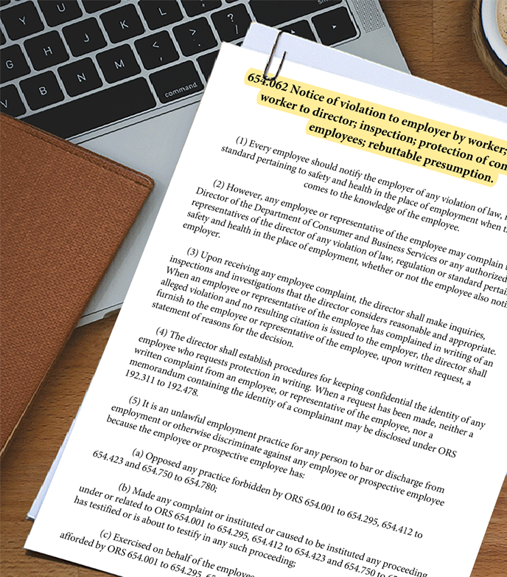
The Oregon Safe Employment Act (ORS) 654.062
Stemming from the federal Occupational Safety and Health Act of 1970 and enacted by the legislature, the Oregon Safe Employment Act became the heart for workplace safety and health in Oregon in 1973. The act ensures safe and healthful working conditions for all working Oregonians and authorizes Oregon OSHA to enforce the state's workplace safety and health rules.
The rights of a whistleblower are found in the Oregon Safe Employment Act, Oregon Revised Statute ORS 654.062, and prohibits retaliation against employees or prospective employees due to:
“an employee’s or prospective employee’s complaint about, or opposition to, health and safety hazards in the workplace.”
It’s important to note that the Bureau of Labor and Industries (BOLI), Civil Rights Division enforces the protection from retaliation meaning that an employer:
“cannot retaliate by taking ‘adverse action’ against employees or prospective employees for bringing to light a potentially unsafe situation.”
We’ll discuss more about Oregon OSHA and BOLI later in this course. Up next, we define employee and help you understand what retaliation means.
Whistleblower Rights

Slide 5

Definition of Employee
Let’s start by defining the word “employee”. Employee is defined in ORS 654.005(4) of the Oregon Safe Employment Act as:
(a) Any individual, including a minor whether lawfully or unlawfully employed, who engages to furnish services for a remuneration, financial or otherwise, subject to the direction and control of an employer.
(b) Salaried, elected and appointed officials of the state, state agencies, counties, cities, school districts and other public corporations.
(c) Any individual who is provided with workers’ compensation coverage as a subject worker pursuant to ORS chapter 656, whether by operation of law or by election.
Whistleblower Rights

Slide 6

Understanding Retaliation
Section 11(c) of the Occupational Safety and Health Act (OSH Act) prohibits retaliation by employers against workers who "blow the whistle" by exposing health and safety hazards. Retaliation is when an employer (through a manager, supervisor, or administrator) fires an employee or takes any other type of adverse action against an employee for engaging in a protected activity. We’ll provide examples of protected activities shortly.
An adverse action is an action which would dissuade a reasonable employee from raising a concern about a possible violation or engaging in other related protected activity. Retaliation harms employees and can have a negative impact on overall employee morale. Because an adverse action can be subtle, such as excluding employees from important meetings, it may not always be easy to recognize. In the next slide, we’ll show examples of adverse actions.
Whistleblower Rights

Slide 7

Adverse Actions
Here are some examples of adverse actions:
firing or laying off
blacklisting
demoting
denying overtime or promotion
disciplining
denial of benefits
failure to hire or rehire
intimidation
making threats
reassignment affecting prospects for promotion
reducing pay or hours
Whistleblower Rights

Slide 8

Example of Retaliation
To help explain this further, let’s examine an example situation:
A worker informed her employer that she called OSHA because she believed there was a fire hazard that her employer refused to fix. The worker had reported the fire hazard previously to her employer. A workplace practice existed which allowed all employees to swap shifts if they needed to take time off. The worker tried to swap shifts a few days after she told her employer that she called OSHA, but her employer did not allow her to swap. However, the other employees were still allowed to swap shifts.
Whistleblower Rights

Slide 9

Example of Retaliation (cont)
Example analysis:
Workers have a right to call OSHA to report an unsafe condition. Section 11(c) of the Occupational Safety and Health Act and ORS 654.062 of the Oregon Safe Employment Act protects workers who file complaints with OSHA. By calling OSHA to complain about the fire hazard, the worker engaged in protected activity under one of the whistleblower laws administered by OSHA. She informed her employer that she called OSHA. Her employer denied her shift swap only a few days after being notified that she called OSHA. In addition, she was the only employee denied the ability to swap shifts. The denial of the shift swap is an adverse action. And, in this case, it appears that her employer denied her shift swap because she engaged in the protected activity. If the employer denied her request to swap because she called OSHA, then retaliation has occurred and the employer’s actions violated section 11(c) of the Occupational Safety and Health Act and ORS 654.062.
Whistleblower Rights

Slide 10

Who is Protected from Retaliation Under ORS 654.062?
Every employee or prospective employee raising a safety or health complaint is protected under ORS 654.062.
Employees or prospective employees are protected whether they are raising a safety and health complaint on their own behalf or on behalf of other employees or prospective employees.
Volunteers who are covered under the Oregon Workers’ Compensation System are also protected. Please inquire with the employer to determine if you are considered a volunteer.
Whistleblower Rights

Slide 11

Protected Activities for Employees
Whistleblower rights provide protection against retaliation for employees who raise a complaint; see section (5)(a) to (d) of ORS 654.062. Examples of protected activities for employees with workplace health and safety concerns include:
Raising a complaint to Oregon OSHA
Raising a complaint to an employer
Participating in inspections
Talking to an Oregon OSHA Compliance Officer (CO)
Asking to view employer exposure and injury records
Participating in a safety committee
Reporting an assault that occurred on the premises of a health care employer
Whistleblower Rights

Slide 12

Protected Activities for Employees (cont.)
A worker may have the legal right to refuse to work where there is:
A real danger of death or serious physical harm
There is insufficient time to have Oregon OSHA inspect
Where possible, the employee has sought from the employer and been unable to obtain correction of the dangerous condition.
In the next few slides, we’ll cover the process of filing a complaint, and help you to understand when to call Oregon OSHA and/or BOLI.
Whistleblower Rights

Slide 13

Information about Filing Complaints
Employees should report any safety and health violation to their employer and/or to their employer’s safety committee. Employees may also report safety and health violations to Oregon OSHA whether or not they have reported them to their employer.
If the employee believes they have been the object of retaliation or discrimination related to a protected activity, they may make a complaint to the Bureau of Labor and Industries (BOLI), Civil Rights Division. In Oregon, by law, BOLI investigates all whistleblower complaints.
Oregon OSHA contracts with BOLI to investigate acts of retaliation under ORS 654.062. Complaints must be filed with BOLI within 1 year from the alleged retaliation.
Whistleblower Rights

Slide 14

Information about Filing Complaints
Employees who make a complaint should not leave the work site, as long as it is safe and they have not been terminated. Please note that employers still have the right to terminate employment for other reasons.
To help employees understand their rights, all employers are required to have an Oregon OSHA poster like the one on the left, posted at the worksite. This poster is available in English and Spanish and ensures employees are aware of the 1 year filing requirement. It also provides contact information for OSHA and BOLI.
Now, let’s talk more about Oregon OSHA’s involvement in the complaint process.
Whistleblower Rights

Slide 15

Whistleblower Rights

Slide 16

The Oregon OSHA Compliance Officer’s Role
When an Oregon OSHA Compliance Officer (CO) receives a phone call about a safety or health concern, they will ask the employee if they want to file a complaint with Oregon OSHA. At your request, Oregon OSHA can keep your identity confidential.
In the event you believe your employer is discriminating against you, the CO will also provide you with contact information so that you can file a complaint with BOLI, Civil Rights Division.
In addition, when a complaint is filed with Oregon OSHA, (whether online or by phone) a CO will either conduct an onsite inspection or open an inquiry with the employer. An inquiry is when a CO contacts the employer, describes the alleged hazards and the employer must respond in writing.
Next, let’s discuss BOLI’s procedures when a retaliation complaint is filed.
Whistleblower Rights

Slide 17

BOLI’s Procedures when Filing a Complaint
Once a retaliation complaint is filed, several steps occur:
1. Complaint and Intake Screening. Immediately upon receiving a complaint, BOLI will begin to process it.
2. Notification Letter. BOLI will send out letters to the employee and employer requesting additional information.
3. Complainant Interview. BOLI will interview the employee for in-depth information about the alleged retaliation.
4. Investigation. BOLI performs a comprehensive investigation involving worksite interviews and fact-finding.
Whistleblower Rights

Slide 18

BOLI’s Procedures when Filing a Complaint (continued)
5. Administration Determination or Dismissal. BOLI will come to a determination about the alleged retaliation.
6. Settlement. The parties may agree to a settlement prior to a BOLI determination.
7. Conciliation. If the finding is against the employer, a conciliation agreement will be reached.
8. Merit/Cause. BOLI determination finds that the employer did retaliate against the employee, or prospective employee for reporting safety concerns or violations.
To see the BOLI rules that cover retaliation, click here.
You are almost done with this course! Next up is the conclusion.
Whistleblower Rights

Slide 19

Course Conclusion
In this course, you learned about whistleblower rights and Oregon OSHA and BOLI’s involvement. We explained what retaliation is and provided examples of protected activities. We also described the complaint process and procedures. Now you should feel comfortable knowing that if you see a safety or health violation at your workplace, you can reach out to your employer as well as Oregon OSHA.
Coming up next is a quiz to solidify the knowledge you have gained.
Let’s get started!
Whistleblower Rights

Slide 20
WHISTLEBLOWER RIGHTS - QUIZ
Question 1: Oregon contracts with BOLI to investigate whistleblower complaints.
True
False
Question 2: How long does an employee or prospective employee who has been retaliated or discriminated against for exercising their rights, have to file a complaint with BOLI?
60 days
90 days
1 Year
Whistleblower Rights

Slide 21
WHISTLEBLOWER RIGHTS - QUIZ
Question 3: Participating in inspections is a protected activity under ORS 654.062.
True
False
Question 4: If a potential workplace safety or health violation is reported to the employer, and the employer takes action to resolve it, the violation still needs to be reported to Oregon OSHA and BOLI.
True
False
Whistleblower Rights

Slide 22
WHISTLEBLOWER RIGHTS - QUIZ
Question 5: Which of the following are forms of retaliation and/or discrimination? (select all that apply)
Reducing pay or hours
Denial of benefits
Disciplining
Blacklisting
Question 6: After an employee reports a safety and health violation to their employer, an employer does not have the right to terminate for other reasons.
True
False
Whistleblower Rights

Slide 23
WHISTLEBLOWER RIGHTS - QUIZ
Question 7: Every employee or prospective employee raising a safety or health complaint is protected under ORS 654.062.
True
False
Whistleblower Rights

Slide 24
WHISTLEBLOWER RIGHTS - QUIZ ANSWERS
A
C
A
B
A, B, C, D
B
A
Whistleblower Rights

Slide 25
Available Resources
To file a discrimination claim, contact the BOLI Civil Rights Division by phone at (971) 673-0764 or on-line here.
To speak with the Whistleblower Program Manager or to file a complaint regarding hazards found at a worksite, contact Oregon OSHA by phone at (503) 378-3272 or on-line here.
Click the buttons below for additional resources.
US Department of Labor
Oregon OSHA Online Hazard Reporting Form
Whistleblower 11(C) Investigations Manual
Oregon OSHA Division 1 - Complaints
OSHA Fact Sheet
Frequently Asked Questions
Whistleblower Rights

Slide 26

Where To Go From Here
An excellent resource to utilize is the A-Z Topic Index on the Oregon OSHA website. It has lists of relevant publications, training materials, rules, interpretations, videos, and other miscellaneous materials.
If you want guidance in developing a safer work environment, you may consider our free and confidential consultation service. Our consultants in workplace health and safety can help you reduce accidents, related costs, and help you develop a comprehensive program to manage safety and health. For more information, please visit the consultation page.
File a Complaint
A-Z Topic Index
Consultation Services
Whistleblower Rights

Slide 27

Whistleblower Rights

Slide 28

Credits
You’ve completed the Whistleblower Rights online course. You now have an understanding about whistleblower rights and the process involved when raising a safety or health complaint in the workplace.
Please click the “I’m Done” button and take 5 minutes to complete the survey. We value your input as it will help us to improve our courses.
Produced by the Public Education Team of Oregon OSHA:
Roy Kroker, Angelina Cox, Phillip Wade, Ricardo Rodríguez, Tammi Stevens, Tim Wade
Images provided by: Getty Images Inc.
Whistleblower Rights

