Slide 1
WILDFIRE SMOKE
TRAINING REQUIREMENTS V3.0 YT
Please note: If the online course contains videos, the video links are included in this PPT.
You will need to have an internet connection to play the videos or
you can download the videos and embed them into your copy of this PPT presentation.

Slide 2
Disclaimer
Completing this course will help you understand the rules and some of the hazards related to wildfire smoke. However, it is your employer’s responsibility to further your training where it is specific to your organization, such as permits, policies, and practices. This material should not be considered a substitute for any provisions of the Oregon Safe Employment Act, or for any standards issued by Oregon OSHA. Manufacturers, products, or services displayed in this material are for informational purposes only and do not constitute an endorsement by Oregon OSHA.
Wildfire Smoke Training Requirements

Slide 3
Important
First and foremost, employers need to understand that it is their responsibility to ensure that their employees are adequately protected from hazards.
This course is intended to satisfy 5 of the 10 training requirements as outlined in the rules addressing Protection from Wildfire Smoke. There are two rules, OAR 437-002-1081 (General Industry) and OAR 437-004-9791 (Agriculture) that contain these same training requirements.
For ease of use, this course will reference sections from the Wildfire Smoke rule in General Industry, that is also applicable to construction and forest activities.
Wildfire Smoke Training Requirements

Slide 4
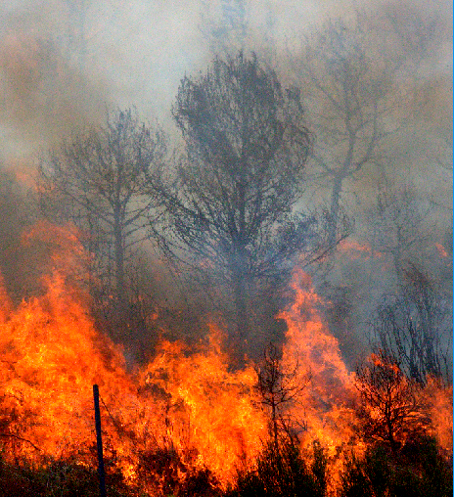
Wildfire Smoke Exposure
Wildfires are occurring more frequently in the United States, and present a health hazard especially for outdoor workers. In addition to emergency responders like wildland firefighters whose mission is to manage the fire, there are many other outdoor and indoor workers who may be exposed to smoke from wildfires. These could include, but are not limited to:
Workers engaged in supporting a fire response or working at the fire base camp or evacuation centers,
Drive-through food and/or beverage services that do not have mechanical ventilation,
Cleanup workers or demolition crews, and
Other groups who continue to do their usual non-fire-related outdoor job (e.g., agricultural workers, landscapers, utility workers, construction workers, park personnel).
While these workers are not often exposed to the physical hazards of the burning flames, these workers may be exposed to smoke from a wildfire near their work area.
Wildfire Smoke Training Requirements

Slide 5
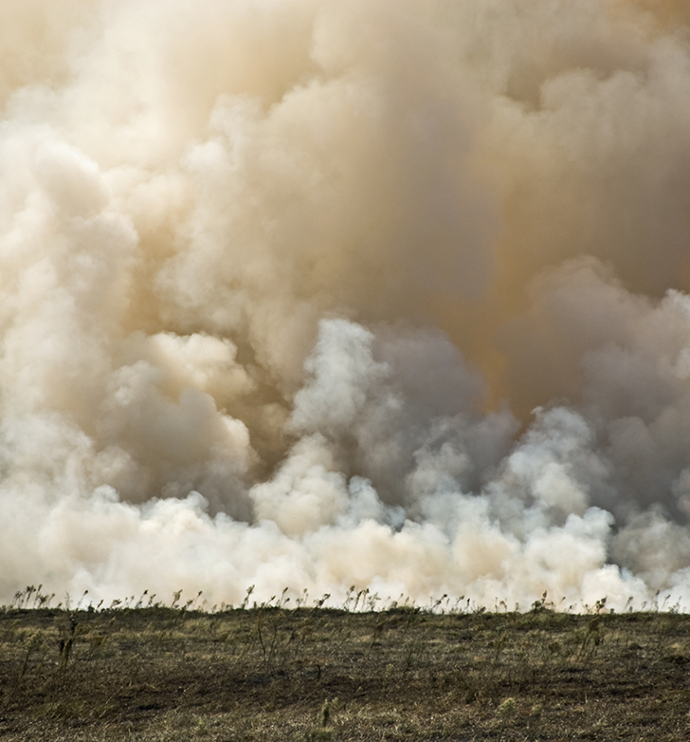
Oregon Wildfire Smoke Rule
To help protect workers from wildfire smoke, Oregon OSHA was asked to develop rules that address this hazard. The resulting rules are designed to protect employees from the potentially detrimental health effects of exposure to unhealthy and hazardous levels of wildfire smoke. These rules apply to all workers in Oregon and require an exposure assessment, information and training, documentation, employer two-way communication, and exposure controls. We won’t go into all of those aspects in this course, but will instead focus on the training requirements. Before we dive in, let’s talk about exemptions to the rules.
Wildfire Smoke Training Requirements

Slide 6
Exemptions
There are multiple exemptions from the rules for certain conditions. For example, employees working at home and in enclosed buildings with a mechanical ventilation system are exempt, as well as vehicles with an air filtration system. Wildland firefighting, emergency operations and intermittent exposures are partially exempt. For more information, please refer to Subsections (1)(a) and (1)(b) in the standard.
Next, let’s discuss the dangers of wildfire smoke.
Wildfire Smoke Training Requirements

Slide 7
Training Elements Satisfied
This course satisfies 5 of the 10 required training elements found in Subsections (4)(a) through (4)(e). Below is a basic summary of each element we’ll be discussing in this course:
(a) Symptoms of wildfire smoke exposure
(b) Potential health effects of wildfire smoke exposure
(c) Employee’s rights
(d) How to access air quality data
(e) The importance, limitations, and benefits of using a filtering facepiece respirator
Wildfire Smoke Training Requirements

Slide 8
Required Training Guidelines
The required training applies to all employees, including new employees, supervisory and non-supervisory employees, when they are expected to be exposed to wildfire smoke hazards with an Air Quality Index (AQI) at or above 101. The training must:
take place before employees are exposed to wildfire smoke hazards,
be provided in a language and vocabulary they readily understand, and
be in a manner that allows for employee feedback.
The remaining 5 elements are workplace-specific, based on each employer’s operational needs and practices. We’ll define and explain these elements and the AQI further along in the course.
Wildfire Smoke Training Requirements

Slide 9
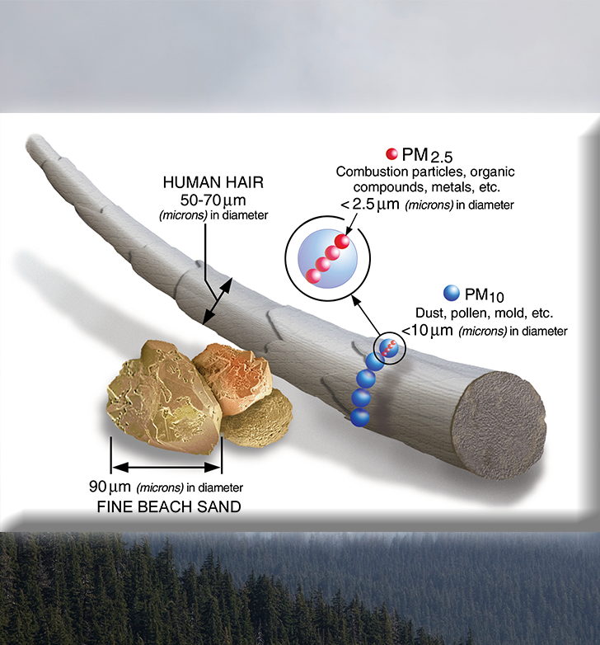
What is Wildfire Smoke?
Wildfire smoke is a complex mixture of gases and particles from burning vegetation and other materials. As a wildfire burns, different compounds are released in the smoke, such as carbon monoxide, carbon dioxide, hydrocarbons, particulate matter (PM), benzene, acrolein, and aldehydes. Wildfire smoke is made up of many different types and amounts of potentially toxic compounds and can change very quickly depending on factors in the wildfire environment, such as weather, fire behavior, the type of vegetation burning, and any man-made materials. Because of this, workers may be exposed to varying types and amounts of compounds in wildfire smoke throughout their work shift or during different fire events.
However, the rules specifically address the fine particulate matter contained in wildfire smoke, that has an aerodynamic diameter of 2.5 micrometers or smaller and measured in micrograms per cubic meter (µg/m3), known as PM2.5. To put this in perspective, a micron is one millionth of a meter and these particles have a diameter of 2.5 micrometers or less, which is about 3% the thickness of a strand of human hair. The small size of these particles allows them to reach deep into the lungs and even enter the bloodstream.
Wildfire Smoke Training Requirements

Slide 10
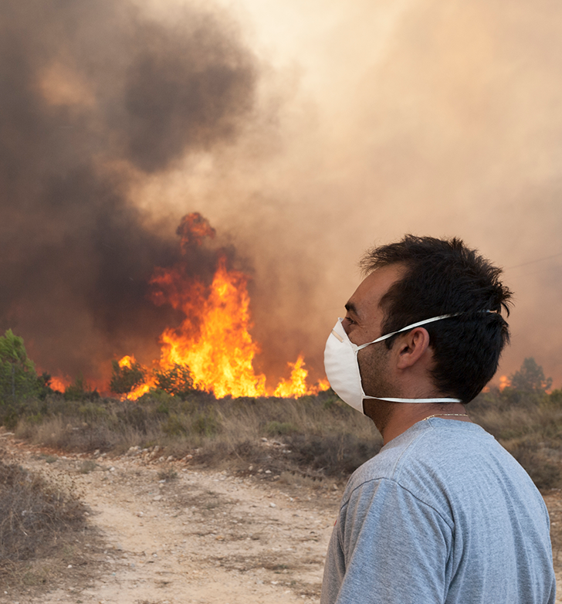
Air Quality Index (AQI)
Many governments use a system called the Air Quality Index (AQI) to measure the concentration of wildfire smoke. In the United States, the AQI has number values ranging from 0 to 301+ and has six different risk categories.
The AQI number can reflect any of five different contaminants. Each contaminant is measured separately and the highest of these is what’s reported on the Air Quality Index. This means that the AQI is reflecting what’s most harmful at the time; and with wildfire smoke it’s PM2.5.
Wildfire Smoke Training Requirements

Slide 11
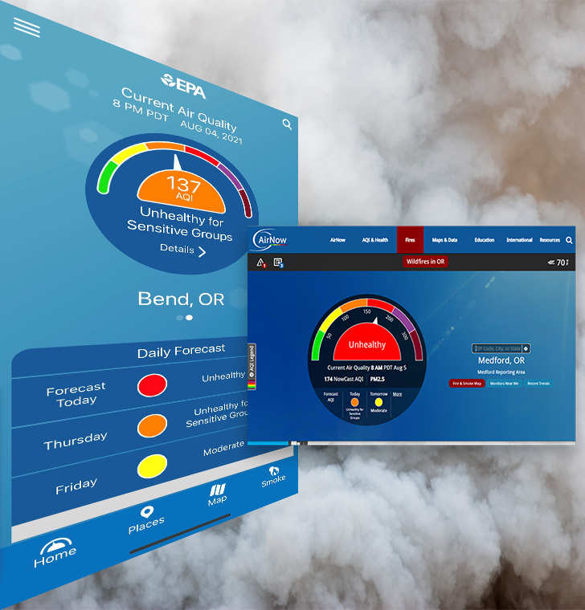
Measuring the PM2.5
Using the AQI
When the Air Quality Index (AQI) reaches 101, Oregon's wildfire smoke requirements take effect. There are several ways you can check to see what the AQI number is in your area. A popular option is the EPA’s AirNow website or app. Go to airnow.gov and enter your location to find out the current AQI. Another option is fire.airnow.gov. This features an interactive map. Simply click on a square in the map and it will display the AQI for that area. In Oregon, the Department of Environmental Quality also publishes air quality data at oraqi.deq.state.or.us. You can also measure your work location’s ambient air concentration for PM2.5 or particulate matter 2.5 microns in size to calculate the AQI. There are a variety of companies that manufacture air meters to help you accomplish this.
Wildfire Smoke Training Requirements

Slide 12
Symptoms
The risk of experiencing symptoms and adverse health effects due to smoke exposure varies from person to person. Workers can have different individual risk factors such as age and health conditions (e.g., pre-existing heart or lung disease) that make them more likely to be affected by wildfire smoke. Let’s review some of the common symptoms of smoke exposure:
Eyes may react to smoke exposure with a burning sensation, redness, and tearing caused by irritation and inflammation that can temporarily impair vision.
Respiratory symptoms include runny nose, sore throat, cough, difficulty breathing, sinus irritation, wheezing, and shortness of breath.
Other symptoms are fatigue, headaches, irregular heartbeat, and chest pain.
Wildfire Smoke Training Requirements

Slide 13
Potential Health Effects
While not every person has the same sensitivity to wildfire smoke, it’s still important to avoid or minimize breathing smoke if you can help it. And when smoke is heavy, such as what can occur from large scale wildfire events, it’s hazardous for everyone.
Wildfire smoke is a complex mixture that consists of other contaminants that have also been shown to lead to a variety of health effects. The health effects of particle exposure can range from relatively minor (e.g., eye and respiratory tract irritation) to more serious health effects (e.g., exacerbation of asthma and heart failure, and premature death). We’ll discuss respiratory and cardiovascular effects in the next few slides.
Wildfire Smoke Training Requirements

Slide 14
Respiratory Effects
The respiratory system is the network of organs and tissues that help you breathe. It includes your airways, lungs and blood vessels. Fine particles found in wildfire smoke are respiratory irritants, and exposures to high concentrations can cause persistent coughing, phlegm, wheezing, and difficulty breathing. Even in healthy people, exposures to fine particles can potentially lead to transient reductions in lung function, and pulmonary inflammation. Respiratory effects may include:
Bronchitis
Reduced lung function
Increased risk of asthma exacerbation and aggravation of other lung diseases
Increased risk of emergency room visits and hospital admissions
Wildfire Smoke Training Requirements

Slide 15
Cardiovascular Effects
Particle exposure may also affect the body’s ability to remove inhaled foreign materials, such as viruses and bacteria, from the lungs. Short-term exposures (i.e., days to weeks) to fine particles are associated with increased risk of pre-existing cardiovascular diseases becoming worse. The cardiovascular system consists of the heart, blood vessels, and blood. Cardiovascular effects from exposure to wildfire smoke may include:
Heart failure
Heart attack
Stroke
Increased risk of emergency room visits and hospital admissions
Certain populations may be at greater risk of experiencing a health effect due to wildfire smoke and may experience more severe effects. These groups are commonly referred to as “sensitive groups”; we will discuss this topic further on the next slide.
Wildfire Smoke Training Requirements

Slide 16
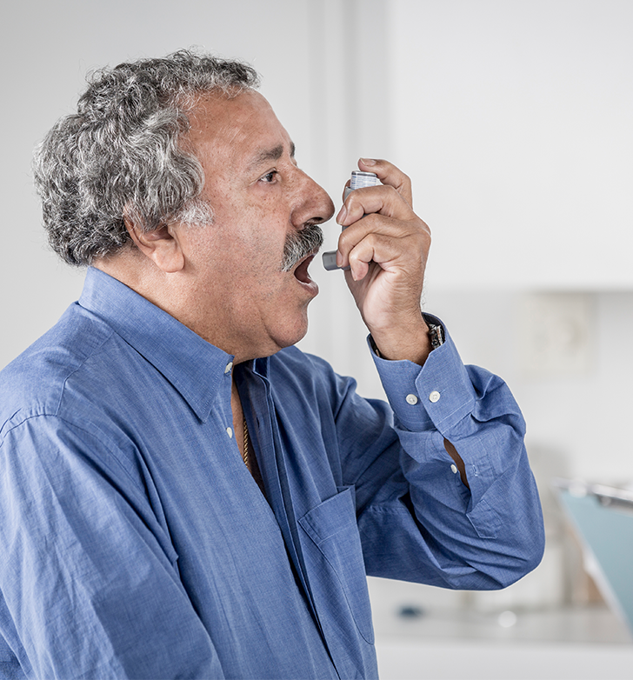
Sensitive Groups
Sensitive groups include people who may be more sensitive than others to the hazardous air contaminants in wildfire smoke and should especially take precautions to avoid or limit exposure. Workers who could have higher sensitivity include children under 18 years old, adults over age 65, pregnant women, and people with:
Lung disease such as asthma or chronic obstructive pulmonary disease (COPD), including bronchitis and emphysema, and those who smoke;
Respiratory infections, such as pneumonia or acute bronchitis, bronchiolitis, cold, flu, or those recovering from severe respiratory illness;
Existing heart or circulatory problems, such as irregular heartbeat, congestive heart failure, coronary artery disease, angina, and those who have had a heart attack or stroke;
Diabetes; and
Medical or health conditions that could be aggravated by exposure to wildfire smoke as determined by a physician or licensed healthcare provider.
Wildfire Smoke Training Requirements

Slide 17
Employee Rights
Employees have the right to report health issues, including those related to wildfire smoke exposure, and receive medical treatment if necessary. The employer’s procedures for complying with the requirements of this rule must include how employees can exercise their rights without fear of retaliation. Oregon law 654.062(5) protects employees who raise safety or health concerns and employees should report any safety or health violation to their employer and/or to their employer’s safety committee. Employees may also report safety and health violations to Oregon OSHA whether or not they have reported them to their employer.
For additional information about how to report a concern or violation, please visit osha.oregon.gov/workers or contact the nearest Oregon OSHA Enforcement field office.
Wildfire Smoke Training Requirements

Slide 18
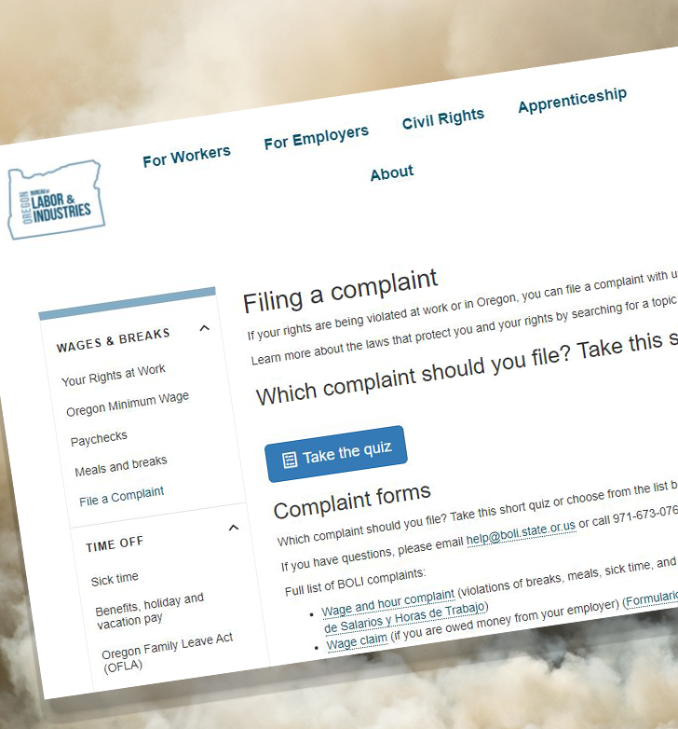
Workplace Retaliation
If you think your employer has punished you because of your concern about safety or health conditions where you work, that is considered retaliation and it is against the law. You can file a complaint with the Civil Rights Division of the Bureau of Labor and Industries (BOLI) if you think your employer is retaliating against you. You can file a complaint with BOLI within one year, or with federal OSHA within 30 days, of discrimination by your employer for making safety and health complaints or for exercising your rights under the Oregon Safe Employment Act. Filing a complaint begins by filling out an online questionnaire on their website. You may also call BOLI’s Civil Rights Division at 971-673-0764 (English) or 971-673-2818 (Español).
Please check out Oregon OSHA’s Whistleblower Rights online course for detailed information on this topic.
Wildfire Smoke Training Requirements

Slide 19
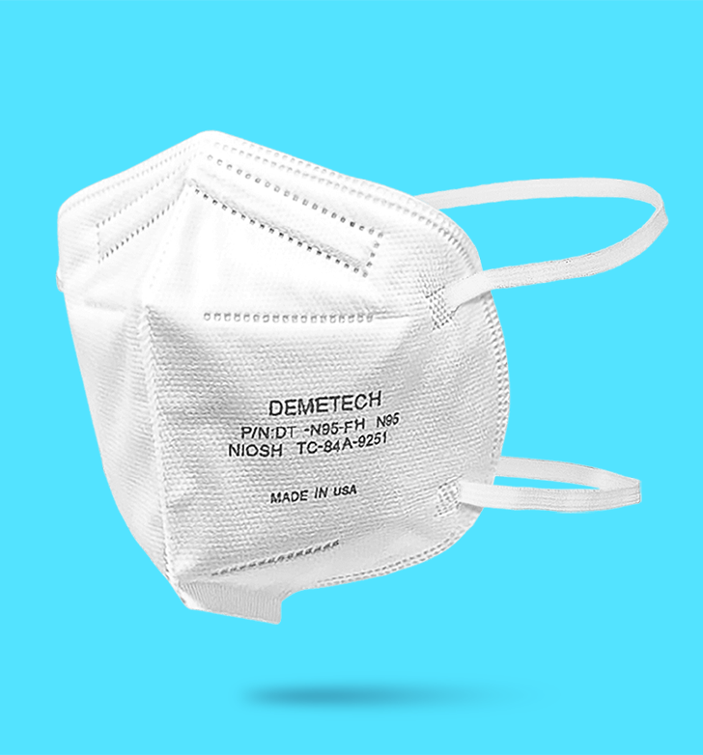
Filtering Facepiece Respirators
We’ve arrived at our last training topic for this course! Let’s talk about respirators. Respirator masks worn correctly may provide some protection by filtering out fine particles in the smoke. While there are many types of respirators available, you will want to use a “filtering” type, which will filter out the hazardous particulates in wildfire smoke.
You will need to ensure your filtering facepiece respirator is NIOSH-approved with one of these numbers on it: N95, P95, R95, N99, P99, N100, or P100. And in case you were wondering what the numbers mean, it’s all about filtration. For example, an N95 respirator should filter at least 95% of airborne particles. Regardless of which respirator you are using, if the smoke is still causing irritation, please consider using a better fitting respirator.
Go to the next slide to watch a tutorial on how to fit and wear an N95 respirator.
Wildfire Smoke Training Requirements

Slide 20
Video: How to Put On and Wear an N95 Respirator
Wildfire Smoke Training Requirements
Notes:
https://youtu.be/ucmx_hj1SW8

Slide 21
Limitations of Respirators
Although wearing a filtering facepiece respirator is a good way to protect yourself against the harmful health effects of wildfire smoke, there are some limitations to consider. Wearing a respirator, especially if it’s hot or you are physically active, can increase the risk of heat-related illness. Take breaks often and drink water. If you have difficulty breathing, get dizzy, or have other symptoms while wearing a respirator, notify your supervisor and go to a place with better air quality, if available, and remove it. People with heart or lung disease may be particularly sensitive to the added work of breathing when using a filtering facepiece respirator. If this is the case, it’s best to consult with your doctor.
Wildfire Smoke Training Requirements

Slide 22
Facial Hair Styles
Another limitation to consider is that facial hair styles may prevent the filtering facepiece respirator from creating a tight seal. Without a tight seal, it cannot filter out all the hazardous particulates in wildfire smoke. However, while using a filtering facepiece respirator with facial hair is normally noncompliant for all other work-related hazards that necessitates required use, Oregon OSHA strictly allows this exception only for wildfire smoke due to the effects of the exposure for the typical worker and the limited duration of filtering facepiece respirator use. While the hazard is serious enough to warrant efforts to reduce the risk, due to the known effects of PM2.5 contained in wildfire smoke on the human body, it is not significant enough to represent a respiratory hazard that triggers the full requirements of the respiratory protection standard when the AQI is below 849. Workers must conduct a seal check when donning the filtering facepiece respirator and make the necessary adjustments to minimize leakage.
Wildfire Smoke Training Requirements

Slide 23
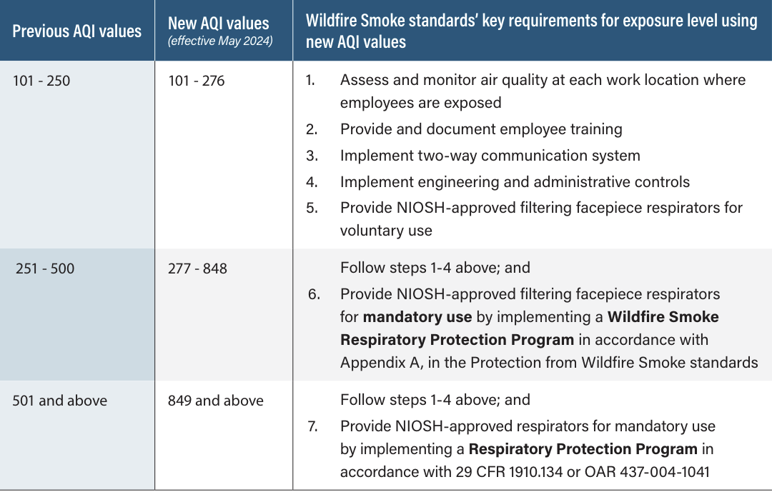
Employer Respirator Requirements
Whenever exposure to PM2.5 is at or above AQI 101, employers are required to ensure that appropriate NIOSH-approved filtering facepiece respirators are provided to employees at no cost, strictly for protection against wildfire smoke. The respirators must be stored and maintained so that they do not present a health hazard to the user.
There are additional aspects to consider in the rule with regards to respirators at different AQI levels, please reference our Wildfire Smoke topic page for more information.
Wildfire Smoke Training Requirements

Slide 24
Remaining Employer Training Requirements
So far you’ve completed 5 required training elements! As discussed earlier, there are 5 additional training elements that your employer is responsible for providing, found in Subsection (4)(f) through (4)(j). The remaining training elements are:
(f) Employer control methods,
(g) Review of any hazardous job tasks where filtering facepiece respirators can’t be used to protect employees from wildfire smoke,
(h) Procedures to follow when an employee is sick from exposure to wildfire smoke,
(i) How to operate and interpret direct testing devices for PM2.5 if used, and
(j) An explanation of the two-way communication system used for wildfire smoke exposure control information.
We’ll briefly discuss these topics over the next few slides.
Wildfire Smoke Training Requirements

Slide 25
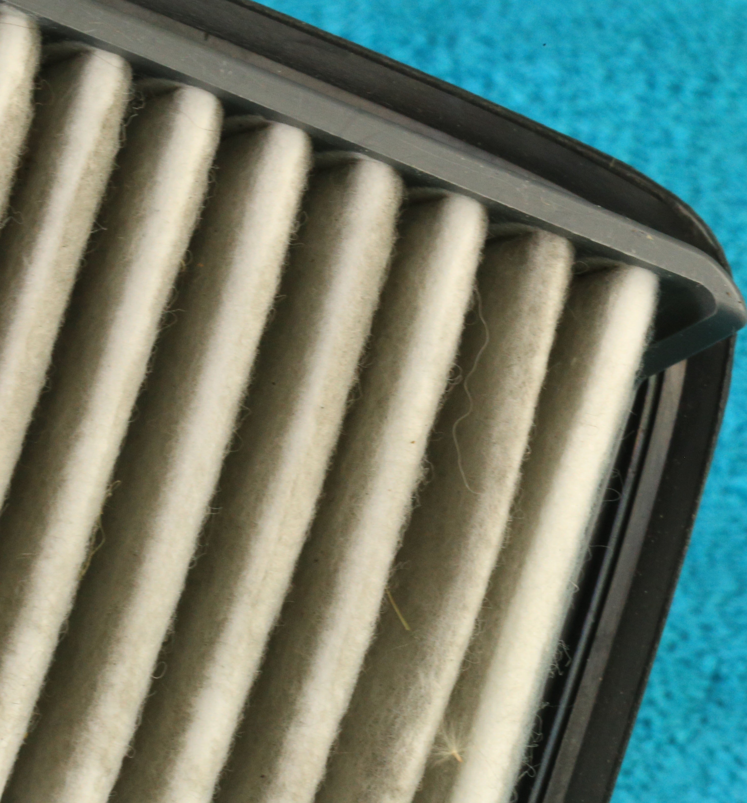
Employer Control Methods
Whenever exposure to PM2.5 is at or above AQI 101, employers are required to implement methods such as engineering controls, administrative controls, and respirators to protect employees from the dangers of exposure to wildfire smoke. Your employer is required to share their control methods and procedures with you as part of your training. Examples of these protection methods are:
Engineering controls include temporarily relocating outdoor workers to available indoor areas or vehicles where the air is adequately filtered, or using portable air purifiers equipped with HEPA filters.
Administrative controls including temporarily relocating outdoor work operations to another outdoor location with better air quality when work permits, and changing employee work schedules to when better air quality is forecasted.
The implementation of filtering facepiece respirators are required under certain circumstances. Please refer to Section (7) of the rule.
Wildfire Smoke Training Requirements

Slide 26
Reviewing Job Tasks
Your employer is required to review any job tasks performed by employees where the use of a filtering facepiece respirator would expose the wearer to a hazard associated with a substantially more serious injury or illness than the potential acute health effects of wildfire smoke exposure and must not be used when performing such tasks.
Examples of such job tasks may include: electrical work that requires fire resistant clothing to be worn and firefighting as well.
Wildfire Smoke Training Requirements

Slide 27
Health Symptoms
There are procedures your employer/supervisor must follow when an employee reports or exhibits health symptoms from wildfire smoke exposure that necessitate immediate medical attention such as, but not limited to, asthma attacks, difficulty breathing, and chest pain. This plan must be shared with employees as part of their training program.
Please note that the employer’s emergency medical plan or medical services provisions must address the types of medical situations that employees could encounter, including those conditions relating to wildfire smoke exposure to comply with:
Division 2, Subdivision K, OAR 437-002-0161(4)
Division 3, Subdivision D, 29 CFR 1926.50
Division 7, Subdivision C, OAR 437-007-0220
Wildfire Smoke Training Requirements

Slide 28
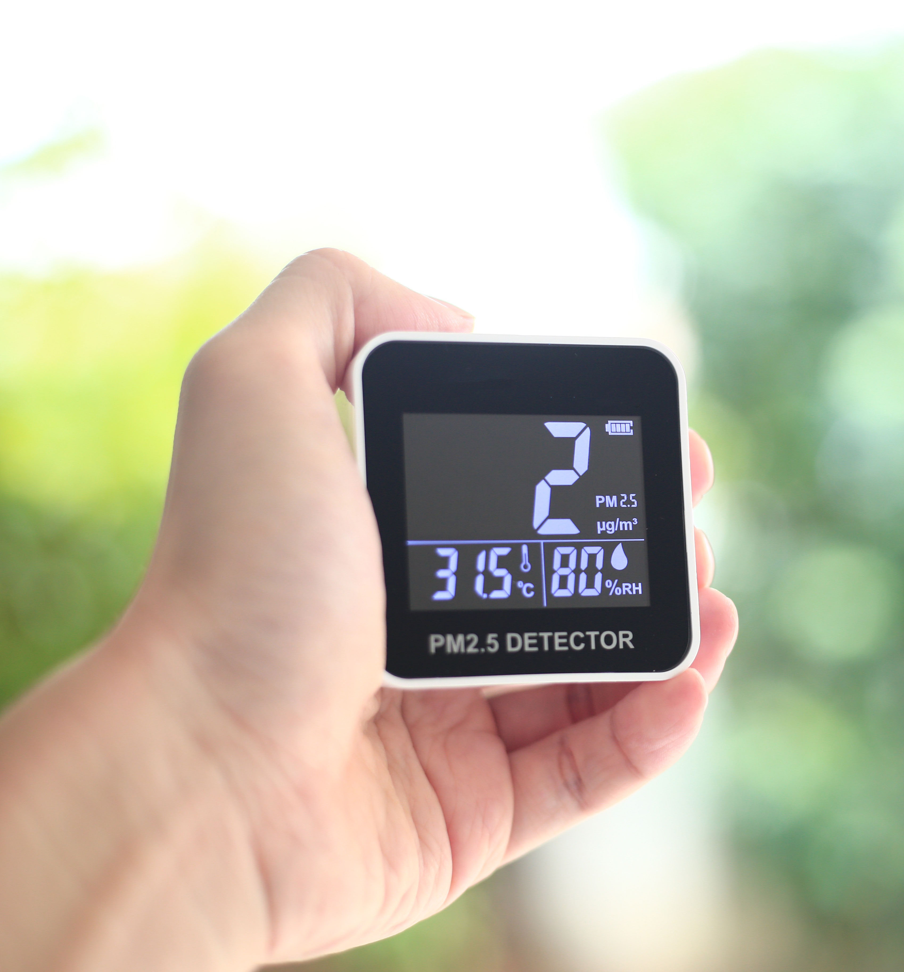
Exposure Results
Portable air quality monitors are devices that measure contaminant levels in the air. They are often electronic devices with sensors that collect data about the levels of different contaminants in the air. You can use air quality monitors specified for PM2.5 to determine the concentration in your immediate surroundings.
If your employer plans for you to use a device to directly measure PM2.5, they must provide you training on how to operate and interpret data.
Wildfire Smoke Training Requirements

Slide 29
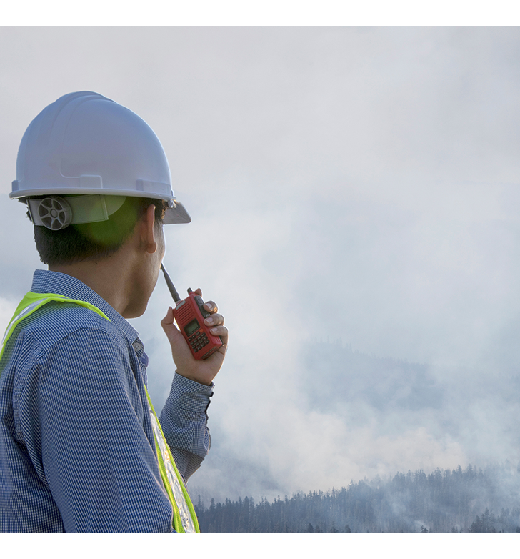
Two-way Communication Systems
Before employees are exposed to AQI 101, employers must develop and implement a two-way system to communicate wildfire smoke information between supervisors and employees. The system will notify exposed employees of any changes in the air quality at their work location that would require an increase or decrease in the level of exposure controls required in Section (7) of the rule.
The two-way communication system must also provide a means for employees to notify their supervisor or employer when air quality drops below these levels, and allow them to inform their employer if they experience health symptoms such as an asthma attack, difficulty breathing, and chest pain.
For more information, please review Section (6) of the rule.
Wildfire Smoke Training Requirements

Slide 30
Wildfire Smoke Training - Quiz
Question 1: Health effects attributed to wildfire smoke exposure include respiratory symptoms, respiratory effects, cardiovascular effects and increased risk of premature death.
True
False
Question 2: Symptoms of wildfire smoke exposure can include: (select all that apply)
Redness in the eyes
Burning sensation in the eyes
Fatigue
Headache
Quiz

Slide 31
Wildfire Smoke Training - Quiz
Question 3: The Air Quality Index (AQI) measures small particulates in the air and has a value ranging from 300-501.
True
False
Question 4: The Oregon OSHA Wildfire Smoke rule’s requirements take effect when the Air Quality index is at or above ___________.
21
50
75
101
Quiz

Slide 32
Wildfire Smoke Training - Quiz
Question 5: There are many resources available to help you determine the air quality in your location, including websites, such as AirNow.gov, and apps for your phone.
True
False
Question 6: Hazardous particulates in wildfire smoke can cause damage to cells and irritate the lungs.
True
False
Quiz

Slide 33
Wildfire Smoke Training - Quiz
Question 7: Some people can be more sensitive than others to the health impacts of wildfire smoke. This can include: (select all that apply)
People with lung disease
People with respiratory infection
People with heart or circulatory conditions
Children under 18 years of age
Question 8: Particulate-filtering respirators, such as N95’s or P-100’s, can help to reduce your exposure to the hazards of inhaling wildfire smoke.
True
False
Quiz

Slide 34
Wildfire Smoke Training - Quiz
Question 9: This training covered 5 of the 10 training requirements; your employer is not required to provide any further training.
True
False
Question 10: Workers should always conduct a seal check when donning a filtering facepiece respirator.
A. True
B. False
Quiz

Slide 35
Wildfire Smoke Training – Quiz Answers
A, True
A, B, C, D
B, False
D, 101
A, True
A, True
A, B, C, D
A, True
B, False
A, True
Quiz Answers
Notes:
Answers

Slide 36
Where To Go From Here
An excellent resource to utilize is the A-Z Topic Index on the Oregon OSHA website. It has a list of relevant publications, training materials, rules, interpretations, videos, and other miscellaneous materials.
If you want guidance in developing a safer work environment, you may consider our free and confidential consultation services. Our consultants in workplace safety and health can help you reduce accidents, related costs, and help you develop a comprehensive program to manage safety and health. For more information, please visit the consultation page.
File a Complaint
A-Z Topic Index
Consultation Services
Wildfire Smoke Resources
Wildfire Smoke Training Requirements

Slide 37
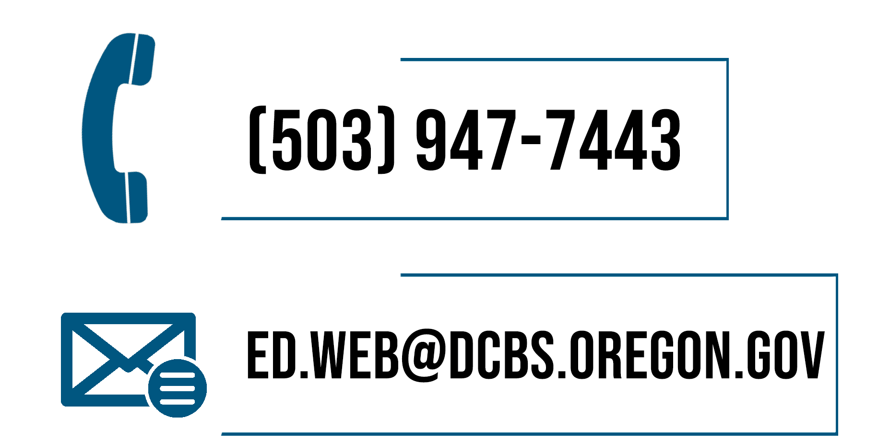
Wildfire Smoke Training Requirements

Slide 38
Congratulations
You’ve completed the Wildfire Smoke Training Requirements online course, which is intended to meet 5 of the 10 training requirements as outlined in the rules to address employee exposure to wildfire smoke.
Produced by the Public Education Team of Oregon OSHA:
Phillip Wade, Ricardo Vazquez Rodriguez, Tammi Stevens, Angelina Cox, Tim Wade, Anthony Dey
Images provided by: Getty Images Inc.
Wildfire Smoke Training Requirements

